Slide 1
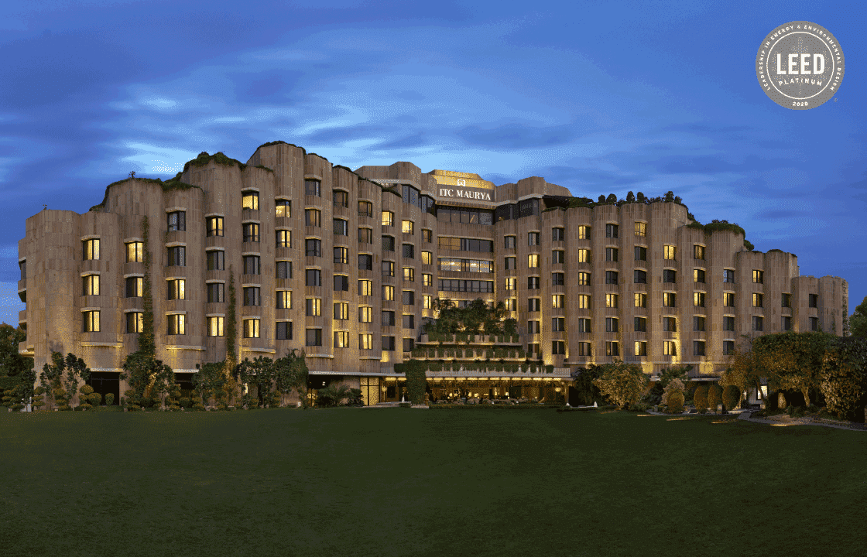
Project: ITC Hotels

Slide 2
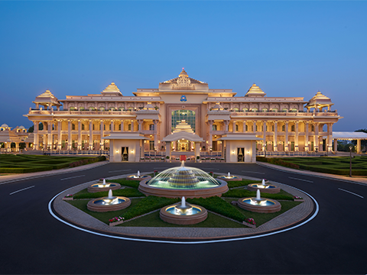
Introduction
ITC Hotels is an Indian hospitality company that
operates and manages hotels. It has over 100 hotels
and is India's third largest hotel chain. It has a
franchise agreement to operate most of its hotels as
part of The Luxury Collection of Marriott International.
It is a subsidiary of ITC Limited.
ITC Hotels has four brands, each with a different class of hotel:
ITC Hotels: Luxury hotels
Welcome Hotel: Five-star hotels
Fortune: Mid-market to upscale hotels
Welcome Heritage: Heritage leisure hotel

Slide 3

Business Challenge
ITC Hotels is a luxury hotel chain that operates multiple properties with diverse room categories and varying occupancy rates. The company wants to gain deeper insights into its overall financial performance, customer booking behavior, occupancy trends, and room category performance to optimize revenue generation, minimize cancellations, and enhance customer satisfaction. The goal of this project is to create an interactive, multi-page Power BI dashboard to provide stakeholders with real-time insights for decision-making.

Slide 4
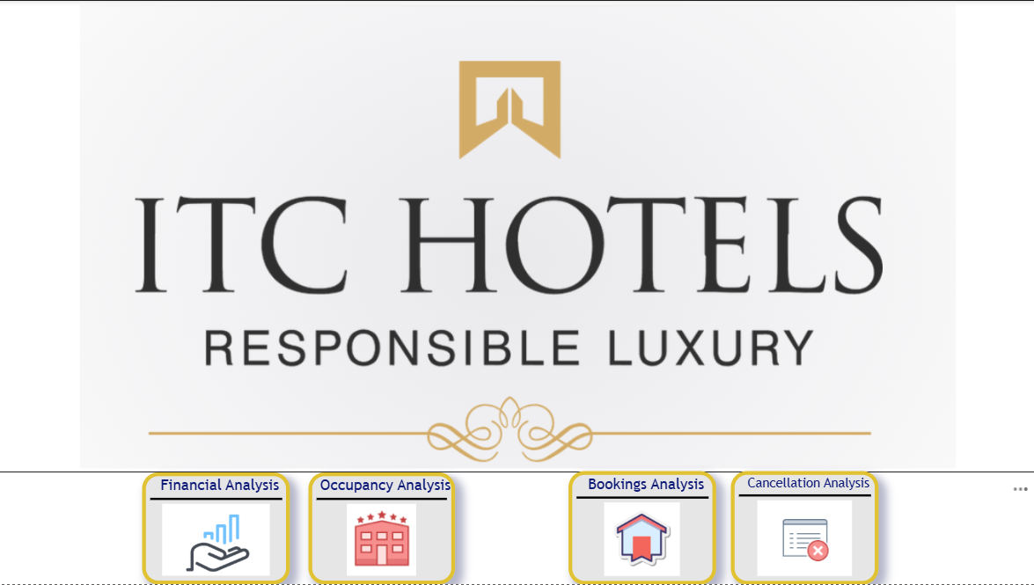
Home Page

Slide 5
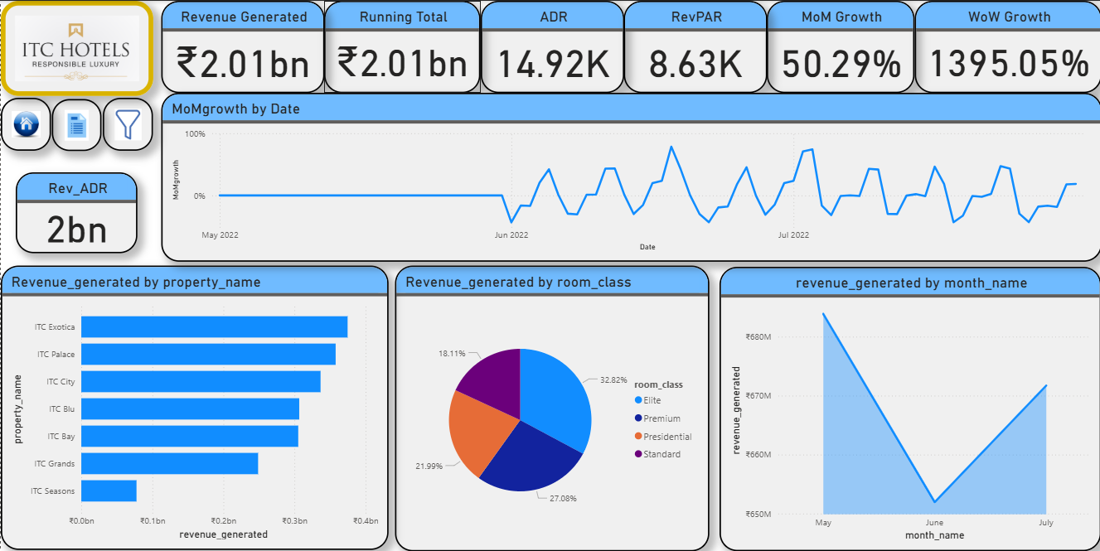
Financial Overview & Revenue Analysis

Slide 6
1. Financial Overview & Revenue Performance
🔑 Key Financial Metrics:
  Total Revenue Generated: ₹2.01B
  ADR (Average Daily Rate): ₹14.92K
  RevPAR (Revenue per Available Room): ₹8.63K
  Growth Performance:
    MoM Growth: 50.29% (strong month-over-month improvement)
    WoW Growth: 1395% (driven by sharp weekly uptick in demand/revenue realization)
📊 Revenue Breakdown & Trends:
  By Property
    Top performers: ITC Exotica and ITC Palace
    Lowest contribution: ITC Seasons, signaling underperformance and requiring focused revenue strategy.

Slide 7
1. Financial Overview & Revenue Performance(Contd.)
2. By Room Class
  Elite rooms dominate with 32.82% of revenue, followed by Standard (27.08%) and Premium (21.99%).
  Presidential rooms contribute the least (18.11%) but provide high-margin opportunities despite lower volume.
3. By Month
  Revenue peaked in May (~₹680M), declined sharply in June (~₹650M), and rebounded in July (~₹670M).
  This indicates a seasonal dip in June, followed by recovery — potential link to demand cycles, events, or pricing shifts.
4. Growth Over Time
  Revenue growth is volatile but upward trending, suggesting demand opportunities but requiring better stabilization strategies to maintain momentum.

Slide 8
1. Financial Overview & Revenue Performance(Contd.)
📈 Actionable Opportunities:
1. Property-Level Optimization
  Strengthen marketing and promotions for ITC Seasons to uplift its performance.
  Replicate successful revenue strategies from Exotica & Palace across weaker properties
2. Room Class Strategy
  Elite & Standard rooms are steady revenue drivers — maintain competitive pricing and loyalty incentives here.
  Presidential rooms: Explore bundled luxury experiences (chauffeur, curated dining) to increase utilization without price dilution.
3. Revenue Growth Management
  Introduce dynamic pricing or event-linked packages to stabilize month-over-month performance.

Slide 9
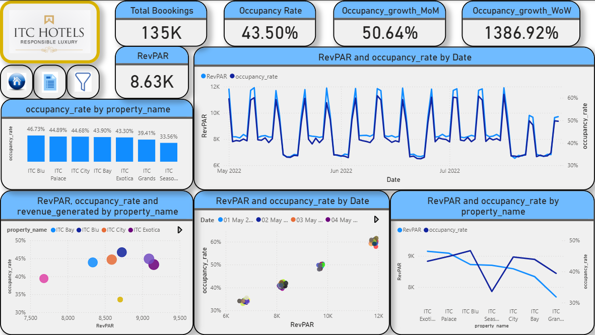
Occupancy & Capacity Analysis

Slide 10
2: Occupancy & Capacity Analysis
📊 Key Findings:
1. Hotel & Room Class Occupancy Performance:
  Overall Bookings & Occupancy:
    ITC Hotels recorded 135K total bookings with an average occupancy rate of 43.5%.
  Top Performers:
    ITC Blu leads with the highest occupancy (46.73%), followed by ITC Palace (44.89%).
  Lowest Performer:
    ITC Seasons reports the lowest occupancy (33.56%), indicating potential issues in market fit or pricing.
  By Room Class:
    Presidential class exhibits the highest occupancy (44.75%), while the Elite class trails at 43.23%.
2. Occupancy vs. Revenue Correlation:
  A strong positive correlation exists between Occupancy and RevPAR.
  Hotels segment into three performance clusters, reflecting variations in demand, market positioning, and strategic effectiveness.

Slide 11
2: Occupancy & Capacity Analysis (Cntd.)
3. Revenue Per Available Room (RevPAR) Highlights:
  Higher RevPAR generally aligns with higher occupancy, reinforcing the positive relationship.
  Top RevPAR Performers:
    ITC Exotica: ₹9.2K
    ITC Palace: ₹9.1K
  Top Tier Properties:
    ITC Exotica, Blu, Palace, and City lead on both RevPAR and occupancy, indicating high operational and pricing efficiency.
  Underperformer:
    ITC Seasons maintains a reasonable RevPAR but suffers from low occupancy, limiting revenue scalability.

Slide 12
2: Occupancy & Capacity Analysis (Cntd.)
💡 Business Insights:
1. Revenue & Operational Leadership:
  ITC Exotica & ITC Palace demonstrate superior revenue generation per room.
  ITC Blu achieves the best balance of occupancy and revenue—indicative of high efficiency.
Mid-Tier Properties:
  ITC City, ITC Bay & ITC Grands are mid-tier performers with growth potential.
  ITC Seasons is the weakest link, underperforming across both key metrics.
📈 Actionable Opportunities:
1. Top Performers (Blu, Palace, City):
  Maintain premium pricing and invest in yield management and upselling strategies to maximize profit per guest.
2. Mid-Tier Properties (Bay, Grands):
  Target market repositioning through promotional campaigns during low-demand periods, leveraging loyalty programs
Underperforming Asset (Seasons):
  Requires urgent strategic review. Explore dynamic pricing models.

Slide 13
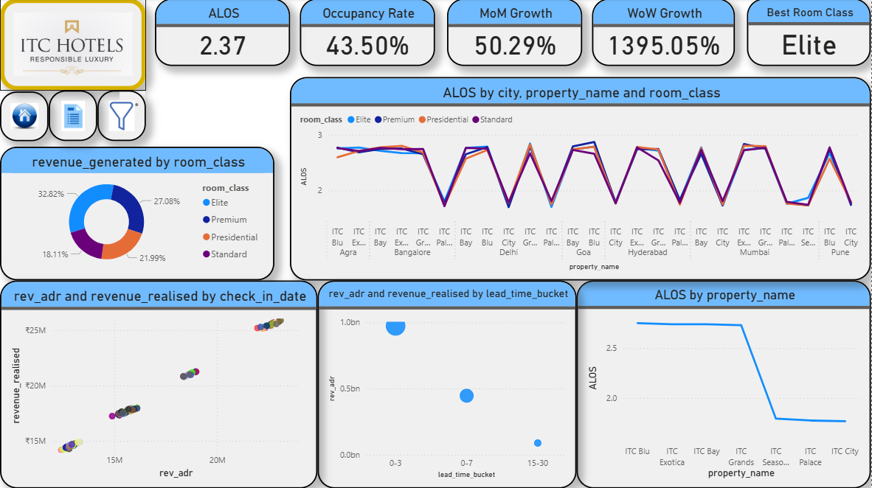
Room Category Performance & Booking Analysis

Slide 14
3. Room Category Performance & Booking Insights
📊 Key Findings:
1. Occupancy & Stay Duration
  Current occupancy rate is 43.5%, with an Average Length of Stay (ALOS) of 2.37 nights.
  Properties such as ITC Blu and ITC Exotica record the longest stays, while ITC Palace and ITC City show shorter stays.
2. Revenue Contribution by Room Category
  Elite rooms generate the highest share of revenue (32.82%), followed by Premium (27.08%), Presidential (21.99%), and Standard (18.11%).
  High-value categories (Elite, Premium, Presidential) collectively contribute over 80% of revenue.
3. Stay Duration by Room Class:
  ALOS patterns are highly consistent across all room classes, suggesting that room type has minimal influence on length of stay.

Slide 15
3. Room Category Performance & Booking Insights(Contd.)
4. Booking Lead-Time Insights
  Short lead-time bookings (0–3 days) drive most of both revenue and ADR.
  Advance bookings (15–30 days) contribute very little, highlighting a dependency on last-minute demand.
5. Revenue vs. ADR Relationship
  A strong positive correlation exists between ADR and realized revenue.
  This validates ITC’s premium pricing strategy, as higher ADR does not significantly reduce demand.
🎯 Business Insights:
1. Revenue Dependence: Hotels are heavily reliant on last-minute bookings, exposing them to demand volatility.
2. Pricing Confidence: Dynamic pricing strategies (higher ADR during peak periods) are working effectively, driving revenue growth.

Slide 16
3. Room Category Performance & Booking Insights(Contd.)
📈 Actionable Opportunities:
1. Early-Booking Incentives:
  Introduce targeted promotions for 15–30-day advance bookings to smoothen occupancy and reduce reliance on last-minute demand.
2. Segmented Pricing Strategy:
  Refine ADR strategies across different customer segments (business vs. leisure) and time periods (weekday vs. weekend) to capture untapped revenue potential.

Slide 17
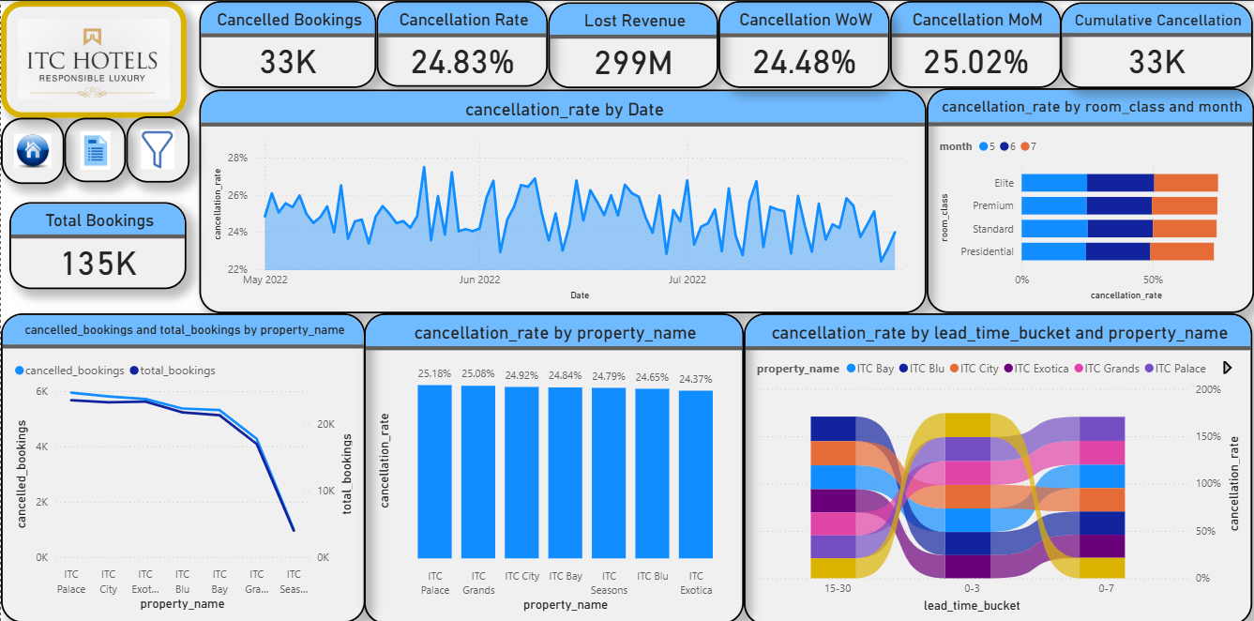
Cancellations & Lost Revenue Analysis

Slide 18
4. Cancellations & Lost Revenue Analysis
📊 Key Findings:
1. Overall Impact
  ITC Hotels faces a cancellation rate of 24.83% across categories.
  This translates to 33K cancelled bookings and an estimated ₹299M revenue loss.
2. Cancellation Trends (by Date & Month)
  Cancellation rates fluctuate between 22%–28%, indicating a persistent issue rather than isolated spikes.
  Monthly analysis confirms that cancellation pressure remains steady across periods, suggesting systemic rather than seasonal behavior.
3. Property & Room Class Analysis
By Property:
  Highest at ITC Palace (25.18%)
  Lowest at ITC Exotica (24.37%)
By Room Class:
  Presidential rooms show the lowest cancellations.
  Elite & Premium categories experience slightly higher-than-average cancellations (~25%), highlighting sensitivity in mid-luxury segments.

Slide 19
4. Cancellations & Lost Revenue Analysis(Contd.)
4. Lead-Time Behavior:
  Highest risk: Bookings made 15–30 days in advance, particularly at ITC Palace and ITC Grands.
  More stable: ITC Exotica shows consistent booking retention across lead times.
  Lowest cancellations: 0–7-day bookings, suggesting last-minute stays are more reliable.
📈 Actionable Opportunities:
1. Tailored Policies:
  Hotel managers should segment cancellation policies by lead time.
2. Revenue Protection Measures
  Introduce non-refundable / partially refundable early bird offers to reduce risk of advance cancellations.

Slide 20
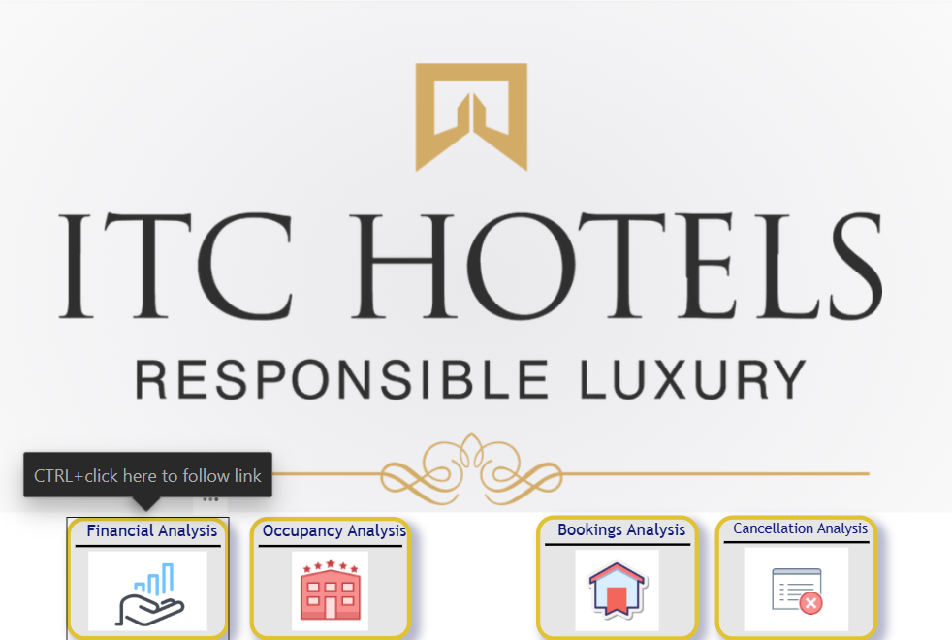
Dashboard Feature : Page Navigation From Home Page

Slide 21
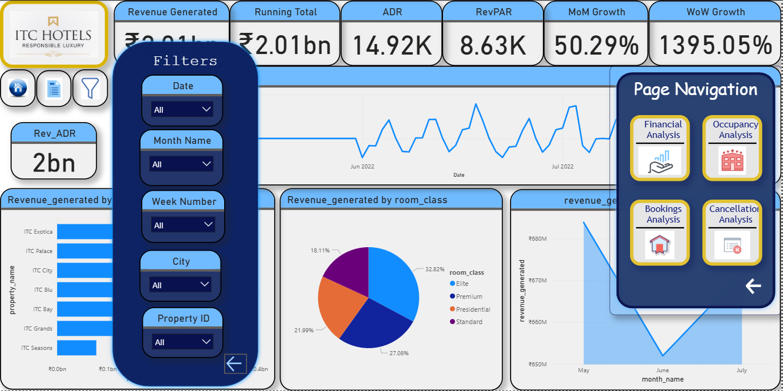
Dashboard Feature : Dynamic filters

Slide 22
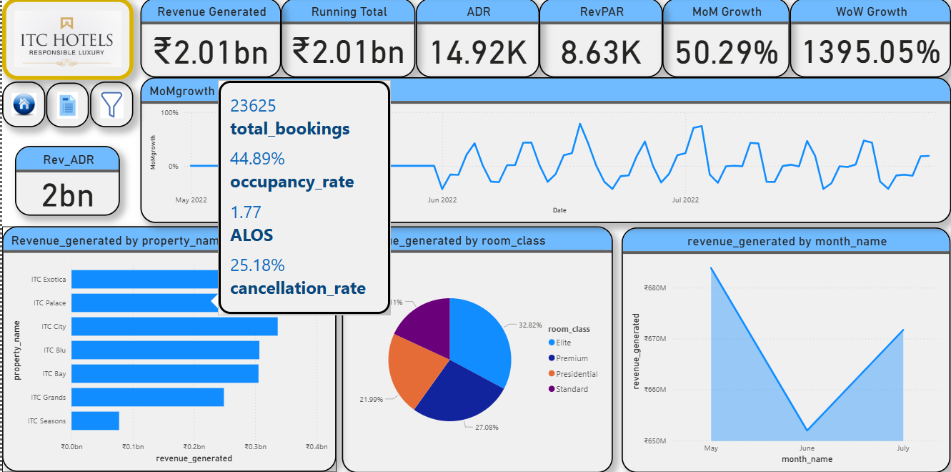
Dashboard Feature : Tool Tip (Finance Page)

Slide 23
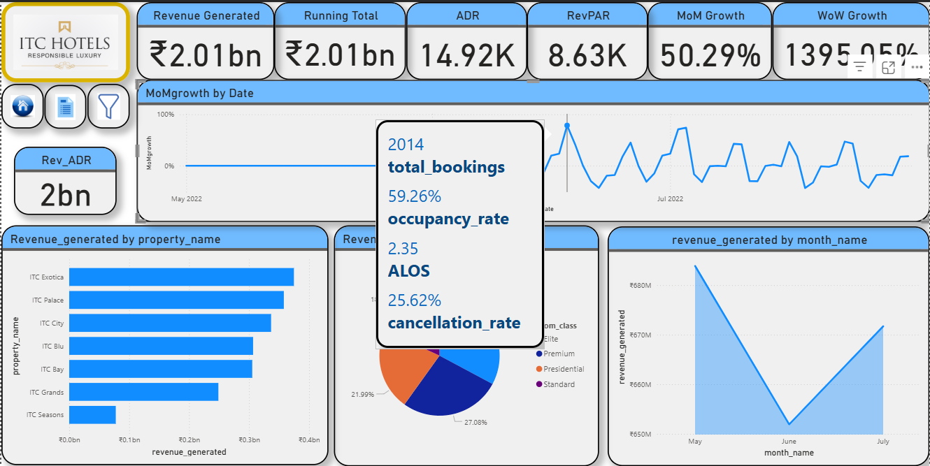
Dashboard Feature : Tool Tip 2 (Finance Page)

Slide 24
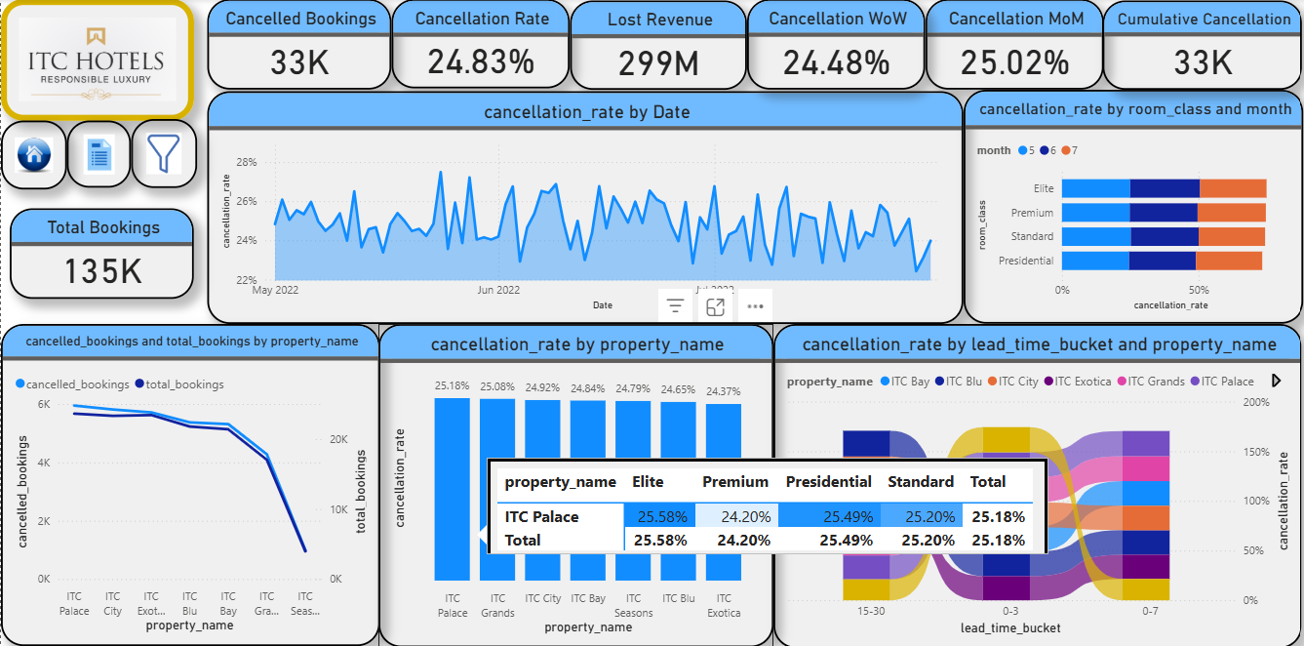
Dashboard Feature : Tool Tip (Cancellations Page)

Slide 25
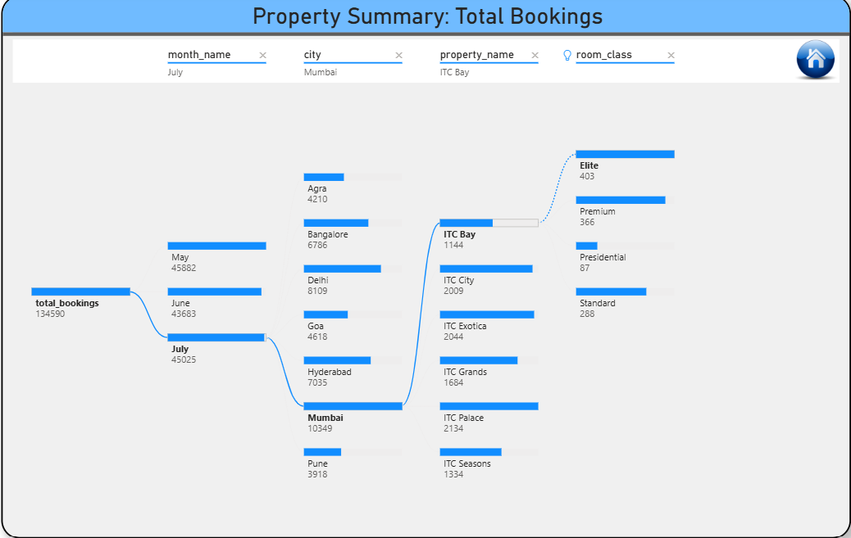
Dashboard Feature : AI Chart 1

Slide 26
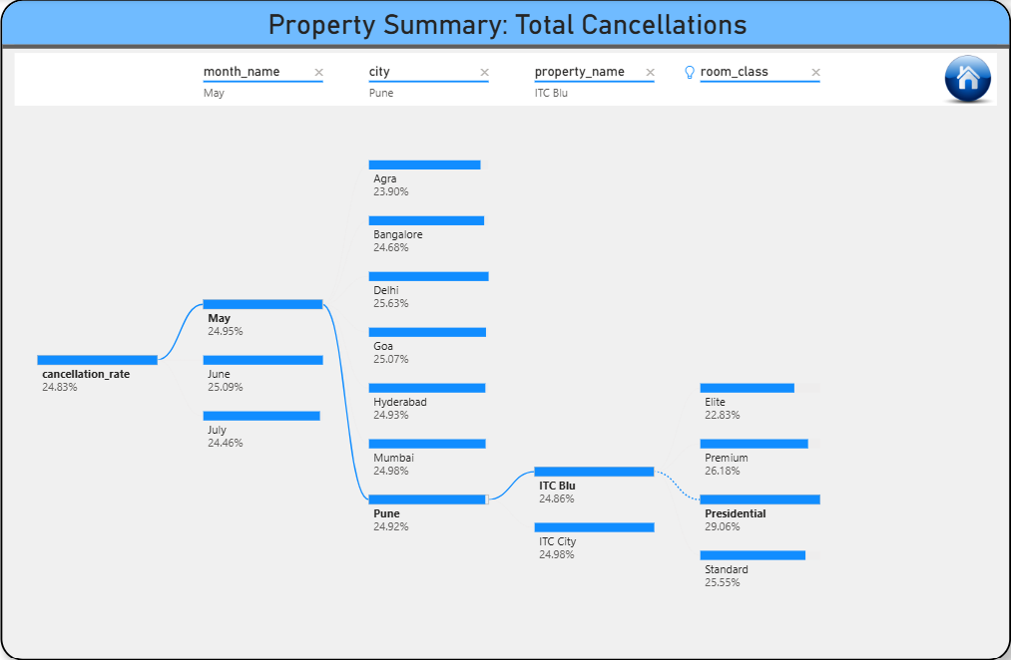
Dashboard Feature : AI Chart 2

Slide 27


