Slide 1
Human-in-the-Loop Data Management
CMPT 884, Fall 2016
Jiannan Wang

Slide 2
Introduce Yourself
What’s your name?
Where are you from?
M.Sc. or Ph.D.? Which year?
What do you want to get out of the course?

Slide 3


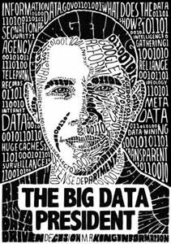

A Problem That Everybody Cares About!
How to manage data
and extract value from it?

Slide 4
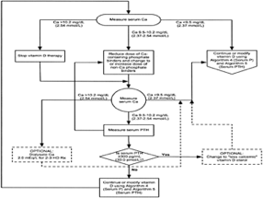


Key Resources
Algorithms
Machine Learning, Statistical Methods
Prediction, Business Intelligence
Machines
Clusters and Clouds
Warehouse Scale Computing
People
Crowdsourcing, Human Computation
Data Scientists, Analysts
From Prof. Michael Franklin’s talk

Slide 5
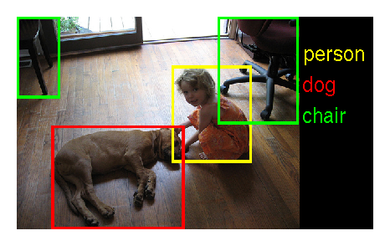
An Example of Using Three Resources
What are in the image?
How to solve the problem?
Deep Learning (Algorithms)
GPU Cluster (Machines)
ImageNet (People)

Slide 6












Human-in-the-loop Data Management
Data Producer
Data Processor
Data
Annotate&
Compute
Data Consumer
Data Scientist
Interactive
Analytics
Serve
Icons created by Clara Joy from Noun Project

Slide 7


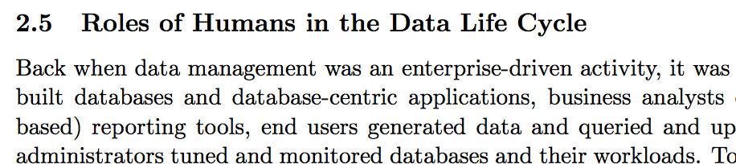

A very hot topic

Slide 8
Course Objectives
Introducing students the cutting-edge research on Human-in-the-loop Data Management

Slide 9
30 papers
Part 1: Crowdsouced Data Management (Human as Data Processor, 13 papers)
Part 2: Interactive Analytics (Human as Data Scientist, 17 papers)

Slide 10





Part 1: Crowdsouced Data Management (Human as Data Processor, 13 papers)
Hybrid
Human and Machine
Machine-based
Human-based
Quality
Time
Money
Quality
Time
Money
Quality
Time
Money

Slide 11
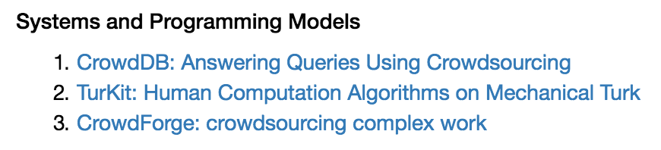
Part 1: Crowdsouced Data Management (Human as Data Processor, 13 papers)

Slide 12
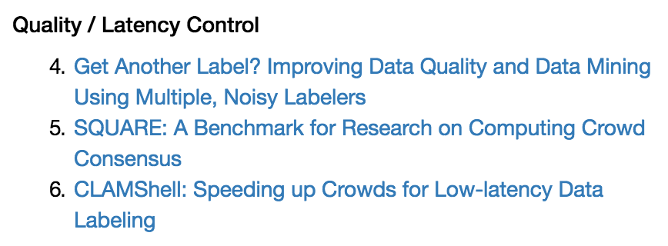
Part 1: Crowdsouced Data Management (Human as Data Processor, 13 papers)

Slide 13
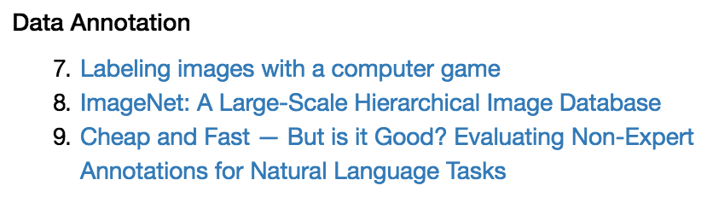
Part 1: Crowdsouced Data Management (Human as Data Processor, 13 papers)

Slide 14
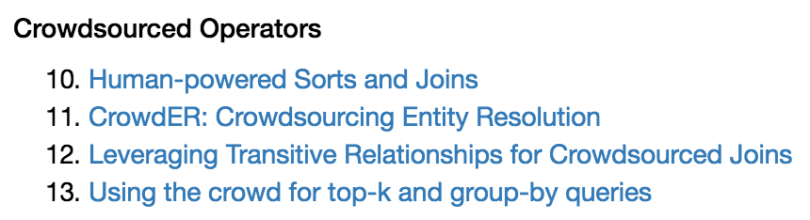
Part 1: Crowdsouced Data Management (Human as Data Processor, 13 papers)

Slide 15

Part 2: Interactive Analytics (Human as Data Scientist, 17 papers)
Command
Interactive Data Cleaning
Interactive Visualization
Interactive Machine Learning
Interactive SQL Analytics
Response

Slide 16
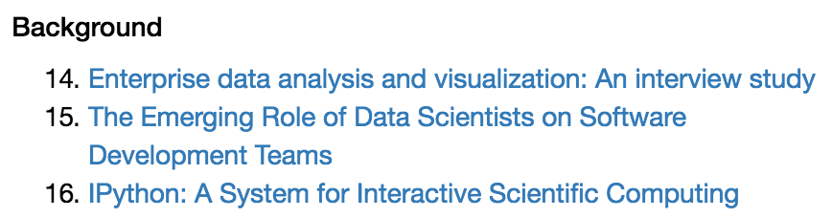
Part 2: Interactive Analytics (Human as Data Scientist, 17 papers)

Slide 17
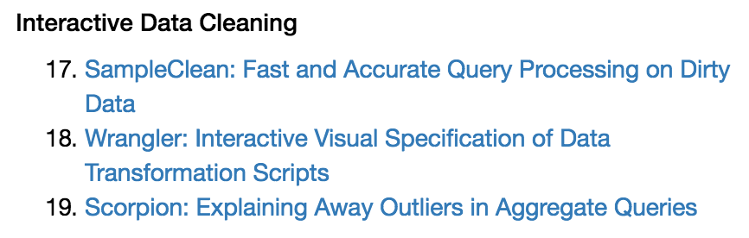
Part 2: Interactive Analytics (Human as Data Scientist, 17 papers)

Slide 18
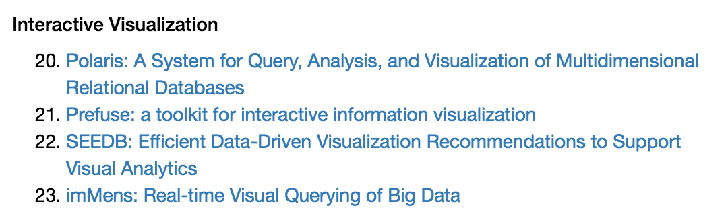
Part 2: Interactive Analytics (Human as Data Scientist, 17 papers)

Slide 19
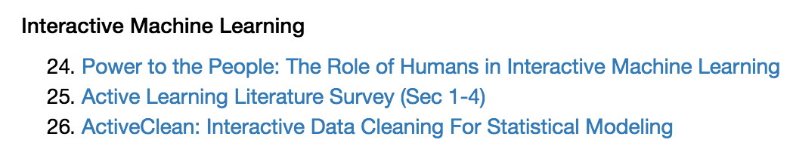
Part 2: Interactive Analytics (Human as Data Scientist, 17 papers)

Slide 20
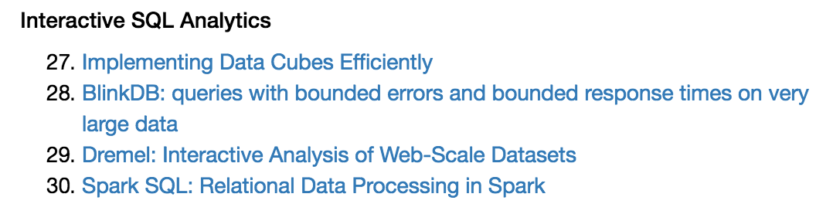
Part 2: Interactive Analytics (Human as Data Scientist, 17 papers)

Slide 21
Course Objectives
1. Introducing students the cutting-edge research on Human-in-the-loop Data Management
2. Training students to master basic skills for being a researcher

Slide 22
Skills
Reading Papers
Giving Talks
Reviewing Papers
Asking Questions

Slide 23
How you will be trained
Reading 27+3 Papers
A quick scan of 27 papers
A virtual reimplementation of 3 papers
Giving 1 Talk
Choosing 1 paper to present (35min+15 min Q&A)
Writing 2 reviews
One from Part 1 and the other from Part 2
Asking 10 Questions
Asking at least 10 questions in the Q&A sessions

Slide 24
Grading
Paper Presentation: 25%
Questions: 10%
Paper Review: 15%
Assignments: 15%
Final Project: 35% (5% proposal + 10% presentation + 20% report)

Slide 25
What’s next
Fill in the form by the end of Sunday 9/11
https://goo.gl/forms/FPEXVnosd00CCpDj1

