Slide 1
MCA FINAL YEAR PROJECT
Job Portal with AI-based
Resume Screening System
How it works, end to end — from candidate signup to AI-ranked shortlist
Presented by [Your Name] | Guide [Guide Name]

Slide 2
OVERVIEW
What We'll Cover
1
The problem with manual resume screening
2
What the system does — solution overview
3
Candidate workflow, step by step
4
Employer workflow, step by step
5
What happens behind the scenes when you apply
6
How the AI matching engine scores a resume
7
Architecture, tech stack, and testing results
2

Slide 3
THE PROBLEM
Manual Resume Screening Doesn't Scale
1
Recruiters receive hundreds of applications per posting
The Result
Longer time-to-hire
2
Every resume is reviewed manually, one at a time
Inconsistent, fatigue-driven decisions
3
Screening criteria are applied inconsistently
Candidates get no visibility into fit
4
Strong candidates get missed due to reviewer fatigue
Effort wasted on both sides
3

Slide 4
THE SOLUTION
What This System Does
One platform, two roles, one AI engine connecting them
Job Portal
Resume Intelligence
Candidates and employers register, build profiles, and manage the entire hiring process in one place.
Every uploaded resume is parsed automatically and converted into a structured, searchable text profile.
AI Matching Engine
Ranked Shortlists
Each application is scored for relevance against the job description — instantly, consistently, and explainably.
Employers see applicants ordered by relevance, not by the order they happened to apply.
4

Slide 5
CANDIDATE WORKFLOW
Getting Started
From zero to a fully searchable profile
1
2
3
Register
Build Profile
Upload Resume
Create an account as a Candidate using name, email, and password.
Add skills, years of experience, and education history.
Upload a PDF resume (max 5MB) — this becomes the input to the AI engine.
Why it matters: the resume uploaded here is the exact document the AI engine reads later — a complete, accurate profile directly improves match accuracy.
5

Slide 6
CANDIDATE WORKFLOW
Searching & Applying
From browsing jobs to tracking every application
1
2
3
4
Search Jobs
Apply
See Match Score
Track Status
Filter open postings by keyword, location, or salary range.
One click submits the application and triggers AI scoring automatically.
The candidate immediately sees how well their profile fits the role.
“My Applications” shows real-time status: Applied, Shortlisted, Rejected, or Hired.
6

Slide 7
EMPLOYER WORKFLOW
Posting a Job
From company signup to a live posting
1
2
3
Register Company
Post a Job
Job Goes Live
Create an Employer account with company name and a short description.
Enter title, description, required skills, location, and salary range.
The posting appears instantly in candidate search results.
Why it matters: the required-skills field entered here becomes the job-description input the AI engine compares every resume against.
7

Slide 8
EMPLOYER WORKFLOW
Reviewing & Hiring
From ranked applicants to a final decision
1
2
3
4
View Ranked List
Review Profiles
Shortlist or Reject
Hire & Close
Applicants for the job appear sorted by AI match score, highest first.
Open any candidate's resume, skills, and experience directly from the list.
One click updates status — the candidate is notified immediately.
Mark the candidate as hired and close the posting.
8

Slide 9
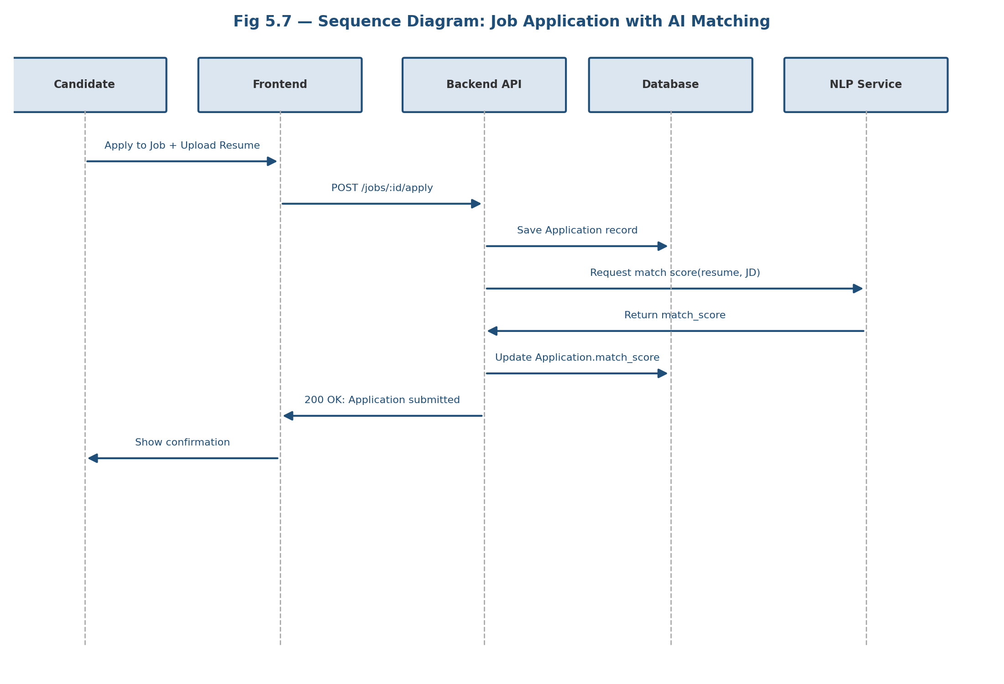
UNDER THE HOOD
What Happens When You Click “Apply”
A single click triggers five coordinated steps
1
Frontend sends the application request to the backend API
2
Backend saves the application record in the database
3
Backend asks the NLP microservice to score the resume against the JD
4
NLP service returns a match score within seconds
5
Candidate sees instant confirmation with their match score
9

Slide 10
THE CORE ENGINE
How the AI Matching Score Is Calculated
1
Extract text from the uploaded PDF resume
similarity(A, B) =
(A · B) / (||A|| × ||B||)
2
Clean both resume & job text (lowercase, remove stopwords)
3
Convert both into TF-IDF vectors
Higher cosine similarity = more shared, weighted terms between resume and job description
4
Compute Cosine Similarity between the two vectors
5
Scale the result to a 0-100% match score
Why TF-IDF? It's fast, needs no training data or GPU, and — unlike a black-box model — every score can be explained to the candidate and employer.
10

Slide 11
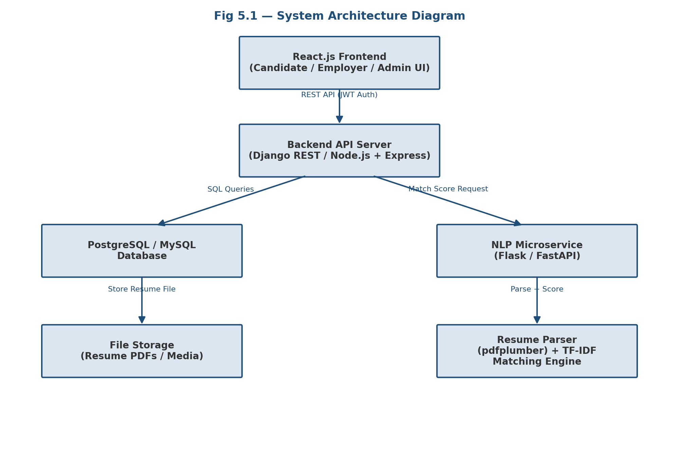
SYSTEM DESIGN
Architecture at a Glance
11

Slide 12
IMPLEMENTATION
Technology Stack
Frontend
Backend
Database
React.js
Django REST / Node.js
PostgreSQL / MySQL
AI Engine
Auth
DevOps
Python, scikit-learn
JWT
Docker, GitHub Actions
12

Slide 13
QUALITY ASSURANCE
Testing Summary
30
100%
4
3
Test Cases
Pass Rate
Testing Levels
Defects Resolved
13

Slide 14
RESULTS
Sample AI Match Scores
Job posting: Python Backend Developer
14

Slide 15
WHAT'S NEXT
Future Scope
1
Semantic matching via Sentence-BERT embeddings
2
DOCX resume support & LinkedIn import
3
Interview scheduling with calendar sync
4
Job recommendation engine for candidates
5
Admin analytics dashboard
6
Cloud deployment with CI/CD pipeline
15

Slide 16
CONCLUSION
A working prototype that takes a
candidate from signup to AI-ranked
shortlist — end to end
100% test pass rate • Full-stack implementation • Clear roadmap ahead
Thank You
Questions & Discussion

