Slide 1
Analysing and Boosting of ML models for Diabetes prediction
CS 725 : Foundations of machine learning

Slide 2
Team members & Work Done
ROLL NUMBER | NAME | WORK DONE IN PROJECT
22M0750 | ABHINAV GARG | Trained & tuned Neural network classifier, Implemented Boosting.
22M0761 | ABHISHEK DIXIT | Trained & tuned Logistic regression classifier, Studied and Tested scaling methods.
22M0770 | NIKHIL SHARMA | Trained & tuned Decision tree, Implemented Bagging (Random forest classifier), Studied and Tested under-sampling methods.
22M0780 | SHUBH MALHOTRA | Trained & tuned Naive bayes classifier, Implemented Boosting.
22M0747 | BALBIR SINGH | Trained & tuned Support Vector Machine classifier, Studied and Tested over-sampling methods.

Slide 3
Introduction & Problem Statement
One in every eleven people in India suffers from diabetes. In 2020, around 700,000 Indians died of diabetes or other complications caused by diabetes.
10.5 % of the world’s population suffers from some form of diabetes.
Early detection of Diabetes is necessary to counter it.
It is very hard to find the actual cause of diabetes and hence prediction based on multiple factors is a good approach.
We have taken a dataset [1] with 21 input features including BP, Cholesterol, BMI, Smoking, Physical activity, Mental health etc. and 1 output value which tells if the person is suffering from Diabetes or not.
We have implemented a Hybrid Ensemble using multiple classifiers trained by us to obtain a combined accuracy more than the individual models, to predict the target variable of Diabetes positive or negative in a person.

Slide 4
Summary of the Tasks performed
Exploratory Data Analysis to understand the composition and behaviour of the input and output variables.
Performed Data preprocessing to make the data suitable for training and prediction.
Performed further Data preprocessing to make the data optimal for individual models.
Trained Neural network, Logistic regression, Decision tree, Random forest, Naive bayes and SVM classifiers.
Implemented grid search for hyperparameter tuning of all the classifiers.
Implemented hybrid ensemble method i.e. Boosting to increase the collaborative accuracy of the models as compared to the individual models.

Slide 5
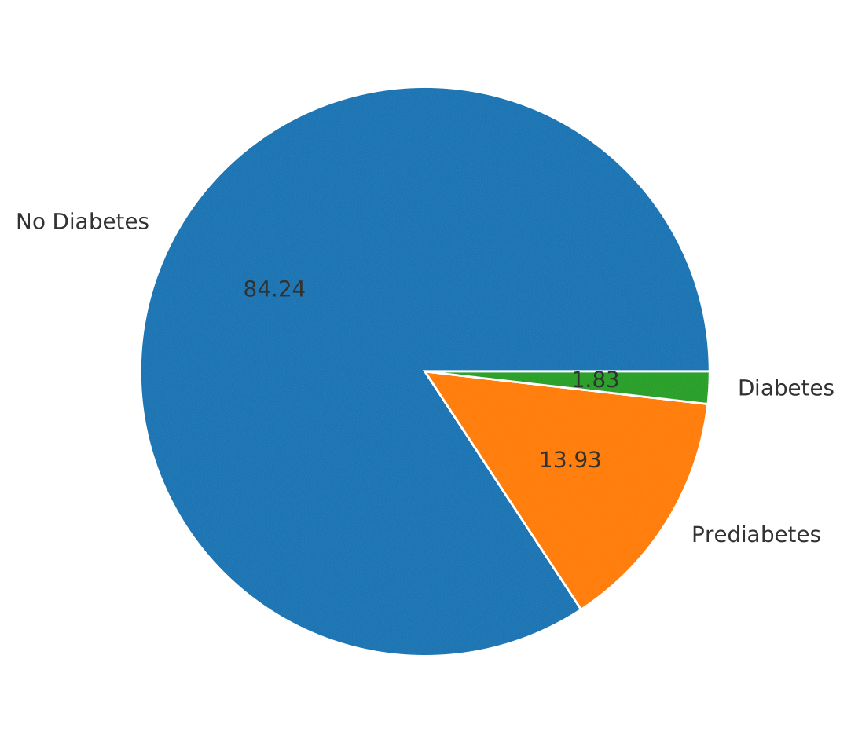
Description of the Dataset
The dataset is in .csv format and was acquired from Kaggle [2]. The Centers for Disease Control and Prevention (CDS) in America conducts a telephony survey every year and the Dataset used by us was collected in 2015 under the The Behavioral Risk Factor Surveillance System survey.
The dataset originally has 253680 rows containing the survey data collected from individuals.
We have chosen this dataset as it contains information from people of different age, education, income and other social determinants of health.
The dataset contains 21 input features which include various details about the individuals.
The dataset has 1 target variable Diabetes_012 which has 3 classes. 0 is for no diabetes, 1 is for prediabetes, and 2 is for diabetes.
By doing Exploratory Data Analysis, we found out that the dataset is highly skewed with respect to the output variables. The distribution is shown here -

Slide 6
Main techniques used

Slide 7
Sources of code used & Functionalities implemented
Implemented the following functionalities -
Transforming multi class target variable to binary variable.
Implemented functionality to identify and convert categorical input variables to multiple columns using one hot encoding.
Implemented Random forest classifier.
Implemented grid search using for loops for finding the most optimal hyperparameters.
Implemented Boosting for Hybrid Ensemble of all the models.
Libraries were used for the following functionalities -
“numpy, pandas, matplotlib, seaborn, train_test_split” for their respective basic functionalities.
“imblearn.under_sampling” for undersampling and “imblearn.over_sampling” for oversampling the data.
“sklearn.preprocessing” for various scaling methods.
“sklearn” for Logistic regression, Naive Bayes, Decision Tree, SVM.
“keras” for Neural Network model.

Slide 8
General data preprocessing
First of all, we dropped the duplicate rows as they increase the training time of the model and also do not significantly contribute to the accuracy of the model.
Number of rows changed 253680 - - > 229781
As the data has a highly skewed distribution between the classes of the target variable, we decided to combine the 2 classes of Prediabetes (1) and Diabetes (2), as doing undersampling on 3 classes would have reduced the total number of rows to a very small number.
Distribution of the output variable changed like -
Initial => 0 = 190055, 1 = 4629, 2 = 35097
Final => 0 = 190055, 1 = 39726 (The multi-class classification problem now got converted to a binary classification problem)
Plotted a correlation plot (next slide) between the input variables and target variables and dropped the variables with near 0 correlation with the target variable. This decreased the dimensionality of data while not having a significant impact on the accuracy of the models.
Dropped variables - Fruits, Veggies, AnyHealthcare, NoDocbcCost, Sex.

Slide 9
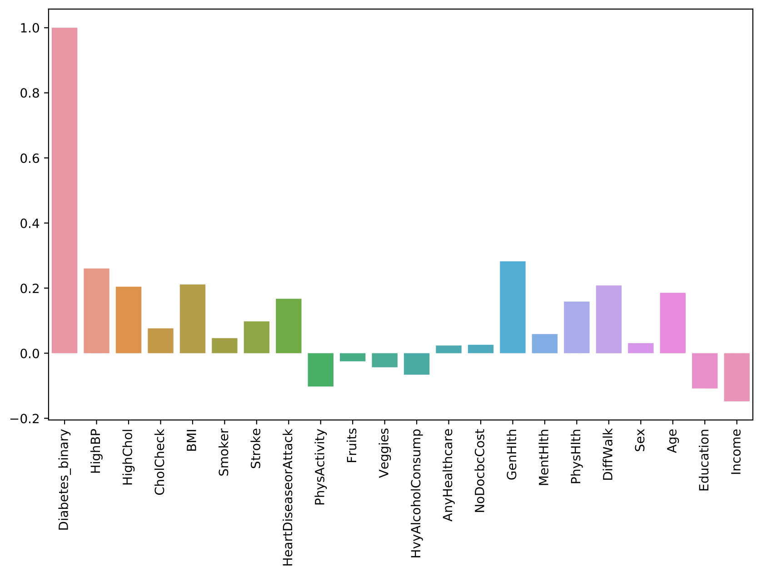
Correlation Plot

Slide 10
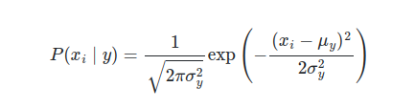
Naive Bayes Classifier
Implemented Gaussian Naive Bayes where likelihood of features is assumed to be Gaussian
Plotted correlation between all the features.
Dropped the features with very high correlation as Naive Bayes has an assumption of conditional independence between input features as they are likely to be dependent on each other.
Features Dropped - ('PhysHlth', 'Income', 'DiffWalk', 'MentHlth')
Tuned the hyperparameter for smoothing factor and found the optimal value to be 2e-9.
ACCURACY ACHIEVED = Train: 0.783755, Test: 0.782114

Slide 11
Logistic Regression
Converted categorical & continuous input variables into multiple columns using One Hot encoding.
Tested various undersampling and oversampling techniques and finally settled with SMOTE
Tested various scaling methods and found MinMaxScaler to be optimal
Implemented grid search to find optimum values of the following hyperparameters -
penalty = {‘l1’, ‘l2’, ‘elasticnet’, ‘none’}, default=’l2’
tol = float, default=1e-4
C = float, default=1.0
solver = {‘newton-cg’, ‘lbfgs’, ‘liblinear’, ‘sag’, ‘saga’}, default=’lbfgs’
max_iter = int, default=100
l1_ratio = float, default=None
Found the following optimal values of hyperparameters -
penalty = elasticnet
tol = 1e-3
C = 0.9
solver = saga
max_iter = 300
l1_ratio = 0.9
ACCURACY ACHIEVED = Train: 0.871671, Test: 0.872690

Slide 12
Decision Tree Classifier
Decision Trees is a very simple supervised machine learning algorithm. It works similarly to how we humans make decisions in daily life.
On every split or decision we want to choose the best feature using a splitting criterion. I have used Gini index for that.
Why gini?
Gave same accuracy as that of entropy.
Is faster than the entropy
Optimal depth found: 13 out of the 51 features
Resampling techniques like undersampling and oversampling was used to balance out the data. Decided to use undersampling. Why?
Was getting same accuracy as that of over sampling
Smaller size of dataset, hence less time taken to train the model.
ACCURACY ACHIEVED = Train: 0.843849, Test: 0.828996

Slide 13
Random Forest Classifier
RandomForest is an ensemble of decision trees.
Why random forest?
Decision trees have high variance
It reduces overfitting of decision trees using a technique known as bagging
Bagging
Bootstrapping:
Dataset for each tree is created by randomly selecting the data from the original dataset with replacement.
Each tree uses only a random subset of features.
This reduces correlation between the trees.
Aggregation: Class with the majority of the votes from all the models will be chosen as the final prediction.
Random forest has been implemented using the Decision tree library from the sklearn as a subroutine.
Each tree has been trained till the 0.2 of the max depth.
ACCURACY ACHIEVED = Train: 0.840585, Test: 0.836927

Slide 14
Support Vector Machine (SVM)
Preprocessing Steps:
Different Feature scaling method applied i.e. MaxAbsScaler, MinMaxScaler, StandardScaler. Out of which MaxAbsScaler was found optimal.
Undersampling - Tried different Undersampling Method, Best one is NearMiss.
Converting categorical features into multiple features using One-hot encoding. (except for features : ‘BMI’ , ‘MentHlth’, ’PhysHlth’, ‘Age’ )
Linear Kernel, Polynomial Kernel, Radial Basis Function (RBF) Kernel, these three kernel tricks when used with optimal value of Hyperparameter, RBF gives better performance.

Slide 15
Grid search is implemented to tune the following Hyperparameters:
C: C is the tuning parameter that decides how much importance is given to error or slack variables. A large C gives you low bias and high variance.
gamma: gamma is the parameter of RBF to handle non-linear classification.
degree: degree of the polynomial kernel functions, It is only applicable to the polynomial kernel and not applicable to other kernels.
tol: error tolerance, default values is 0.001
Following are the best values of hyperparameter for our dataset:
Optimal kernel - RBF
Optimal C = 20
Optimal gamma = 1
Optimal tol : 0.001
ACCURACY ACHIEVED = Train: 0.913909, Test: 0.897175

Slide 16
Neural Network
Tested various undersampling and oversampling techniques and finally settled with NearMiss(n_neighbors = 20)
Scaled the data using RobustScaler
Implemented grid search for tuning the following hyperparameters -
Batch Size
Learning Rate
Trained neural network with 2 hidden layers using relu as activation function.
The architecture for the NN is - “ X_train.shape[1], 32, 64, 1 “
Used Sigmoid as activation function at output layer
Used binary cross entropy loss as the loss function.
ACCURACY ACHIEVED = Train: 0.877330, Test: 0.870367

Slide 17
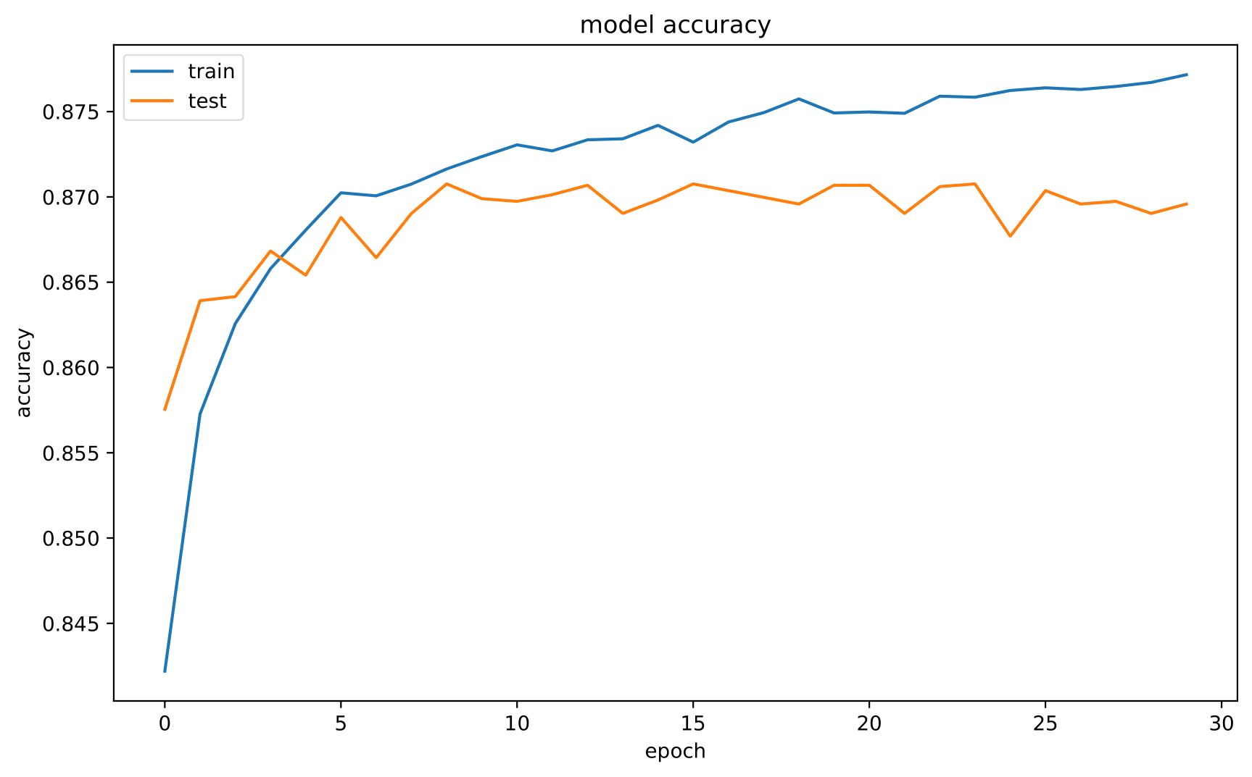
Neural Network model Accuracy graph

Slide 18
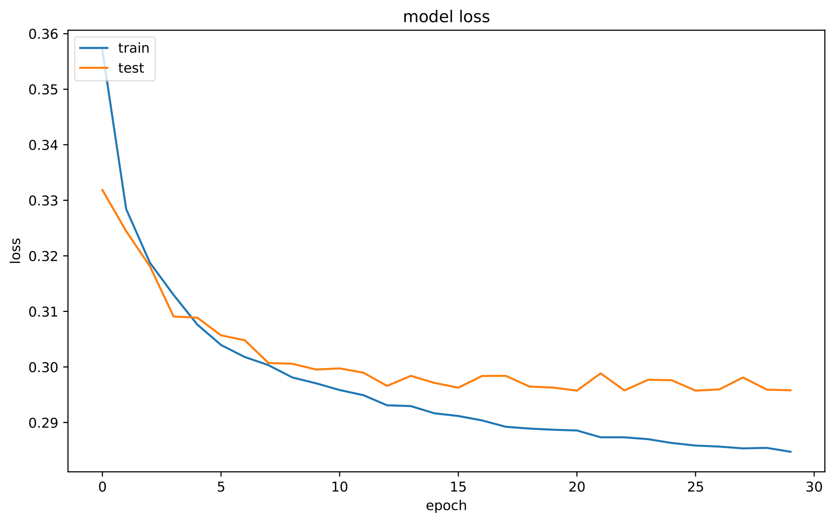
Neural Network model Loss graph

Slide 19
Boosting
Boosting methods build ensemble model in an incremental way.
The main principle is to build the model incrementally by training each base model estimator sequentially.
The idea of boosting is to basically combine several weak classifiers which are sequentially trained over multiple iterations of training data.
For each weak classifier, repeat the following :
Calculate the error as sum of weight of all misclassified points.
Calculate alpha that determines the importance given to that classifier while testing.
Update weights of all training points to give more importance to currently misclassified points.
The final accuracy obtained is generally better than the accuracy of the individual constituent models.
ACCURACY ACHIEVED = Train: 0.862324, Test: 0.851947

Slide 20
Results obtained (Using accuracy as a metric)
Model Name | Initial test accuracy (without preprocessing and hyperparameter tuning) | Final Accuracy (after preprocessing, grid search and hyperparameter tuning)
Naive Bayes | 0.753587 | Train: 0.783755, Test: 0.782114
Logistic Regression | 0.833040 | Train: 0.871671, Test: 0.872690
Support Vector Machine | 0.827803 | Train: 0.913909, Test: 0.897175
Decision Tree | 0.779932 | Train: 0.843849, Test: 0.828996
Random Forest | 0.842925 | Train: 0.840585, Test: 0.836927
Neural Network | 0.830689 | Train: 0.877330, Test: 0.870367
Final Model (Hybrid Ensemble) | - | Train: 0.862324, Test: 0.851947

Slide 21
Result of Boosting (Hybrid Ensemble)
SVM Training Accuracy: 0.8554193037974683
Neural Network Accuracy : 0.739661248561565
Logistic Regression Training Accuracy: 0.804067174913694
Decision Tree Training Accuracy: 0.5716160817031071
Naive Bayes Training Accuracy: 0.8117628020713463
Training accuracy obtained after Hybrid Ensemble - 0.862324
Why individual models accuracy less than before?
We are giving higher weight to misclassified points, hence models are struggling to fit them.
We used common data preprocessing for all the models unlike specific for each one.

Slide 22
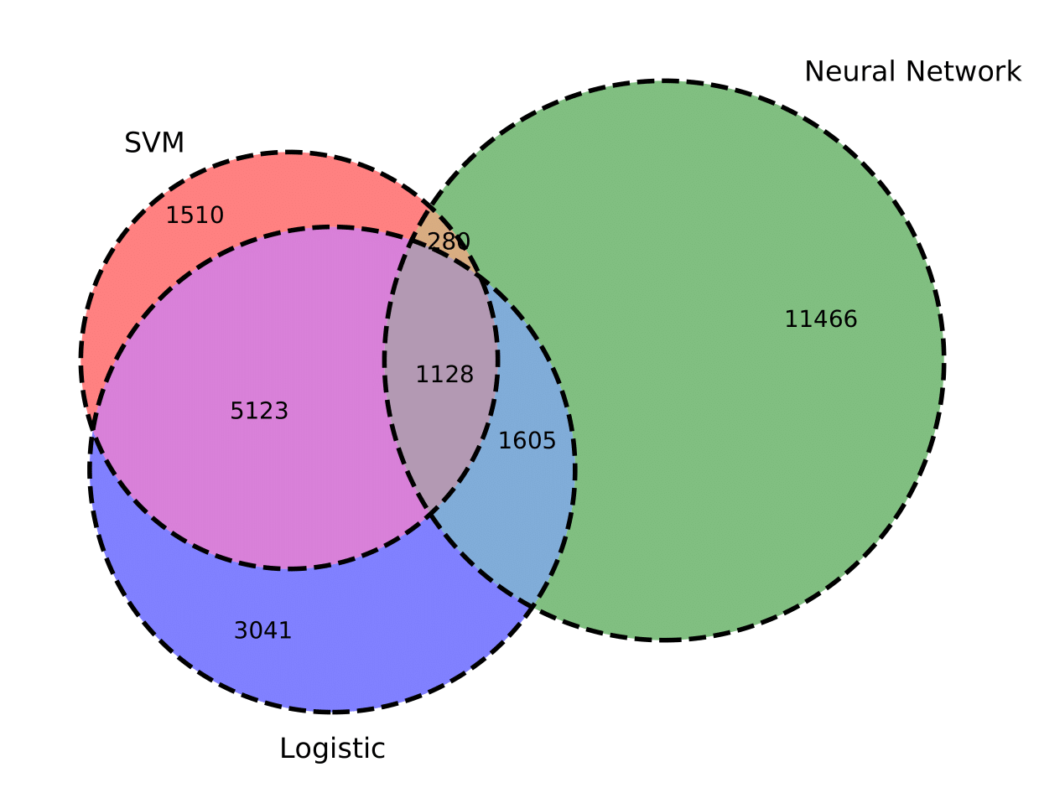
Why not drastic improvement between individual models and final hybrid ensemble classifier?
Models were already strong classifiers, hence not possible to increase accuracy and reduce errors above a certain limit.
Large overlap is present in the misclassified data points, hence many data points are misclassified by every classifiers, as indicated by the venn diagram for 3 of the classifiers. (no library support for more than 3 element venn diagram)

Slide 23
Links for the project code -
GitHub - https://github.com/Abhishek-Cypher/FML_22M0747_22M0750_22M0761_22M0770_22M0780
Google Colaboratory - https://colab.research.google.com/drive/18n_X3YoaYcKPqyiBE4NyoctUHl3IxopG?usp=sharing

