Slide 1

PrepPilot
AI-Driven Adaptive Exam Preparation System
"From knowing what to study to knowing what to study NEXT."

Slide 2

Students don't lack content. They lack direction.
01
Information Overload
No Personalized Strategy
Syllabus
02
Huge Notes
Manual Revision
Difficult Weakness Identification
03
Search
Inefficient Exam Preparation
04
Manual Revision
05
Practice
06
Discover Weaknesses Too Late

Slide 3
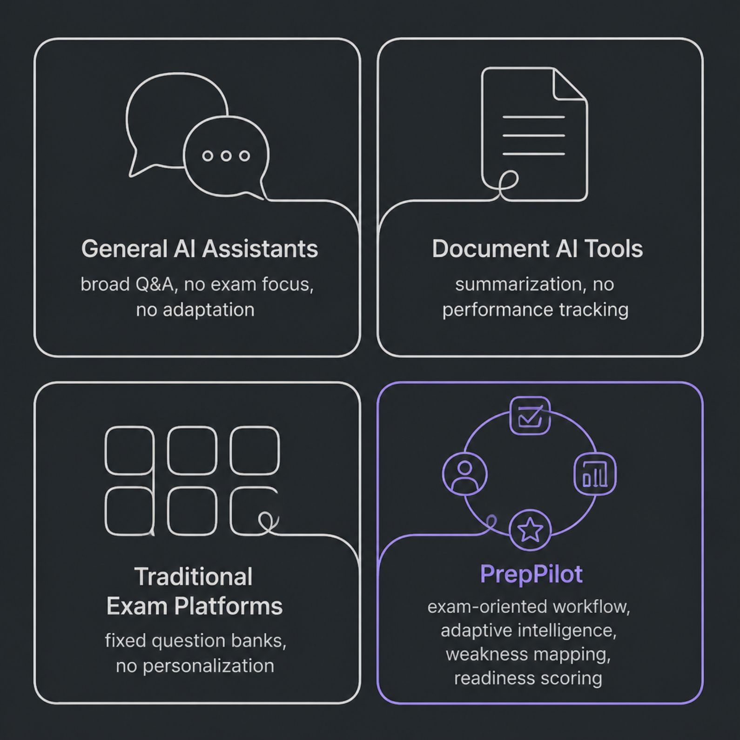
Existing Solutions & The Gap
Existing tools provide powerful individual capabilities. PrepPilot integrates them into an exam-oriented adaptive preparation workflow.
General AI Assistants
Document AI Tools
Broad Q&A — no exam focus
Summarization — no performance tracking
Traditional Exam Platforms
PrepPilot
Fixed banks — no personalization
Adaptive, exam-oriented, integrated

Slide 4










Our Solution
Inputs
Syllabus · Study Material · Questions · Student Performance
Chat
Summaries
PrepPilot AI
Adaptive intelligence engine
Personalized Preparation
MCQs
Flashcards
Tailored to every student
Revision
Weakness Analysis
Adaptive Practice

Slide 5

Current Technology — Working Prototype
React
Frontend
FastAPI + Python
Upload
Chunking
Backend
Submit study documents
Split into meaningful segments
Gemini
LLM
Sentence Transformers
Process
Embeddings
Embeddings
Normalize and parse content
Create semantic vectors
A fully functional RAG pipeline powering real study features today.
ChromaDB
Vector Store
SQLite + Docker
Data & Deployment

Slide 6













From AI Content Generation → Adaptive Exam Intelligence
Study
Practice
Exam Readiness
Performance
Prioritize & Adapt
Weakness
PrepPilot doesn't just generate content. It uses learning performance to decide what comes next.

Slide 7





Core Innovations — Proposed Adaptive Intelligence Layer
Exam Intelligence
Understand syllabus structure and topic importance
Personal Weakness Map
Identify weak concepts from performance data
Adaptive Practice
Direct questions toward weak areas automatically
Smart Revision
Recommend what to revise and when
Exam Readiness Score
Topic-by-topic and overall preparation measurement

Slide 8
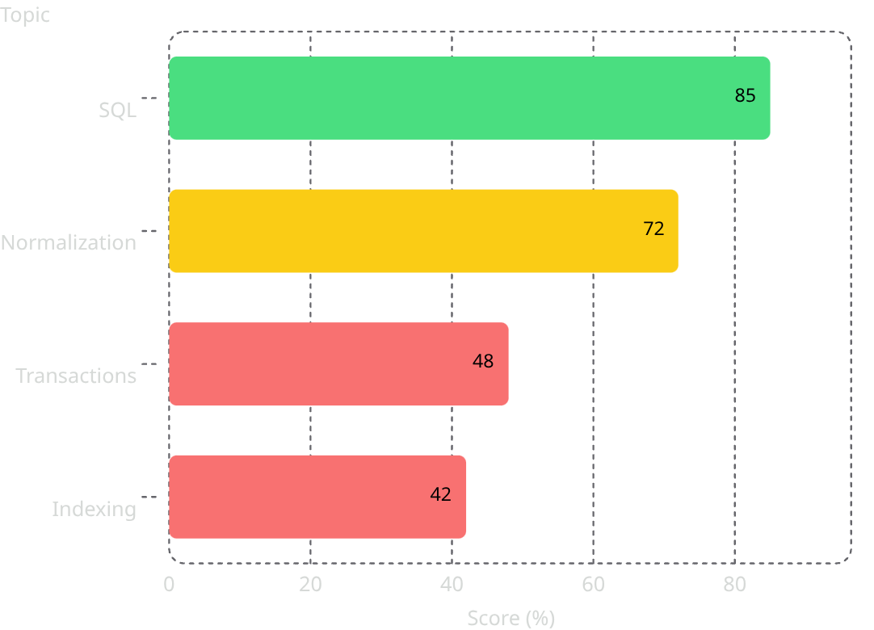
DBMS: From Weakness Detection to Targeted Practice
PRIORITY TARGETS
Transactions + Indexing flagged as critical weak areas
PrepPilot identifies the priority areas, then generates targeted practice automatically.
42%
78%
Indexing — Baseline
After adaptive revision
1
2
3
61%
After targeted practice

Slide 9

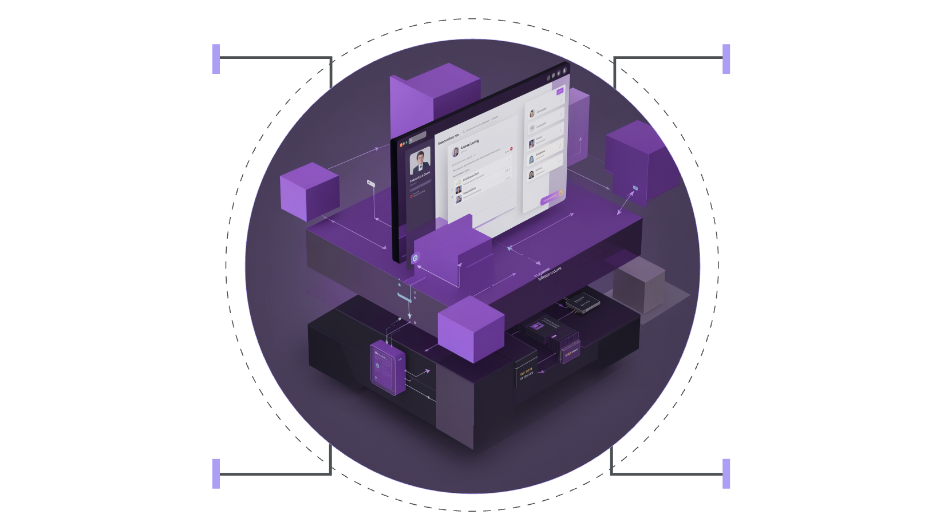

System Architecture
EXISTING
React Frontend
FastAPI Backend
RAG Foundation
Knowledge Store
Document Processing
Embeddings + ChromaDB
React → FastAPI → Document pipeline
Embeddings with ChromaDB
RAG + Gemini → AI Study Services
PROPOSED
Performance Engine
Topic / Weakness Analysis
Personalized Practice
Adaptive Engine
Performance & topic analysis
Tailored revision and readiness
Adaptive Learning Engine
Personalized Practice + Revision
Exam Readiness Score

Slide 10

Smarter Preparation, Not More Content
Future Roadmap
Students
Educators
Spaced Repetition
Personalized and efficient preparation
Better performance insights
Advanced Analytics
Institutions
Scalable personalized learning
Voice-Based Learning
Teacher / Institution Dashboard
Competitive Examination Support
Cloud Scalability
"PrepPilot doesn't just answer what you ask. It helps you decide what you should learn next."
Thank You.

