Slide 1
Module 3 Cloud Architecture

Slide 2
Content
Cloud Architecture- Layers and Models :Architecture for Cloud Application
Cloud Application requirements
SOA for Cloud applications
Parallelization within Cloud Applications
Multi-ties Application Architecture
Study of Cloud Tools and Platforms

Slide 3
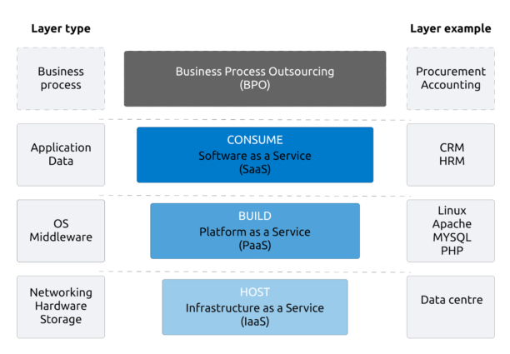
Cloud Architecture- Layers and Models

Slide 4
Cloud Architecture- Layers and Models
Infrastructure as a Service (IaaS)
The basic layer of cloud is the infrastructure –IaaS (Infrastructure as a service). This layer is basically hardware and network.
What distinguishes this from a regular server or hosting company are mainly two things: scalability and virtualisation.
IaaS service providers scale this layer in such a manner that the additional cost of adding more storage or bandwidth is minimal.
Owing to virtualisation, these providers are able to use up to 90% of their computing resources in contrast to traditional hosting services where servers may lay idle at times.
One of the first services where this was seen was in Gmail, the Google email service where each user gets around 8 GB of free storage. In order to do this, Google built gigantic data centres consisting of (probably) millions of servers.

Slide 5
Cloud Architecture- Layers and Models
Key Features of IaaS
Highly scalable resources
Enterprise-grade infrastructure
Cost depends on consumption
Multitenant architecture, i.e. a single piece of hardware serves many users
The client gets complete control over the infrastructure
IaaS Advantages
The most flexible and dynamic model
Cost-effective due to pay-as-you-go pricing
Easy to use due to the automated deployment of hardware
Management tasks are virtualized, so employees have more free time for other tasks
IaaS Disadvantages
Data security issues due to multitenant architecture
Vendor outages make customers unable to access their data for a while
The need for team training to learn how to manage new infrastructure

Slide 6
Cloud Architecture- Layers and Models
Platform as a Service (PaaS)
The second layer of the cloud is the platform – the PaaS (Platform as a service). The platform layer provides resources to actually build applications.
In combination with IaaS, PaaS provides the ability to develop, test, run, and host applications.
This layer of the cloud caters to the requirements of software developers as it is the place where new applications are developed.
You can use PaaS services to build and test your applications on the cloud before deploying them.
In fact, it is designed in such a manner that it supports the entire lifecycle of an application, right from building, testing and deployment to maintenance and updating. Like IaaS, PaaS includes infrastructure, but also includes development tools, database management systems and much more.
An example of a well-known PaaS is Microsoft Azure. This platform provides developers with swift access to a full development and deployment environment and even let you host the application you are building.

Slide 7
Cloud Architecture- Layers and Models
Key Features of PaaS
Allows for developing, testing and hosting apps in the same environment
Resources can be scaled up and down depending on business needs
Multiple users can access the same app in development
The user doesn’t have complete control over the infrastructure
Web services and databases are integrated
Remote teams can collaborate easily
PaaS Advantages
PaaS-built software is highly scalable, available and multi-tenant, as it is cloud-based
The development process is quickened and simplified
Reduced expenses for creating, testing and launching apps
Automated company policy
Reduced amount of coding required
Allows for easy migrating to the hybrid cloud
PaaS Disadvantages
Data security issues
Compatibility of existing infrastructure (not every element can be cloud-enabled)
Dependency on vendor’s speed, reliability and support

Slide 8
Cloud Architecture- Layers and Models
Software as a Service (SaaS)
The third cloud layer is the actual Software – the SaaS (Software as a service). SaaS has been used for many years, but in a Cloud setting, it is the layer in which the user consumes the offering from the service provider.
Here, organizations rent the usage of a SaaS application, and users connect to it by means of the internet.
The application, therefore, needs to be web-based server so that it can be accessed from anywhere.
In this case, the service provider offers both the software and the hardware.
The SaaS layer must be web-based and hence accessible from everywhere and preferably on any device. The key is to understand that it makes no sense to ask whether a service is cloud or SaaS, as SaaS is a layer in the cloud stack.

Slide 9
Cloud Architecture- Layers and Models
Key Features
The subscription model of utilizing
No need to download, install or upgrade software
Resources can be scaled depending on requirements
Apps are accessible from any connected device
The provider is responsible for everything
SaaS Advantages
No hardware costs
No initial setup costs
Automated upgrades
Cross-device compatibility
Accessible from any location
Pay-as-you-go model
Scalability
Easy customization
SaaS Disadvantages
Loss of control
Limited range of solutions
Connectivity is a must

Slide 10
Cloud Architecture- Layers and Models
Service Provider
A cloud service provider is a third-party company offering a cloud-based platform, infrastructure, application or storage services. Much like a homeowner would pay for a utility such as electricity or gas, companies typically have to pay only for the amount of cloud services they use, as business demands require.
Besides the pay-per-use model, cloud service providers also give companies a wide range of benefits. Businesses can take advantage of scalability and flexibility by not being limited to physical constraints of on-premises servers, the reliability of multiple data centers with multiple redundancies, customisation by configuring servers to your preferences and responsive load balancing which can easily respond to changing demands.
Though businesses should also evaluate security considerations of storing information in the cloud to ensure industry-recommended access and compliance management configurations and practices are enacted and met.

Slide 11
Cloud Application Requirements
Step 1: Requirement Analysis
Identify the business problem and objectives.
Determine user requirements and expected services.
Analyze workload characteristics and usage patterns.
Example: An online learning platform needs video streaming, user authentication, and assessment modules.
Step 2: Scalability Requirement
The application should support increasing or decreasing workloads.
Resources must be allocated dynamically based on demand.
Example: During online examinations, the system should automatically add servers to handle more users.
Step 3: Availability Requirement
The application should remain accessible with minimal downtime.
Redundant resources and failover mechanisms should be implemented.
Example: E-commerce websites must remain available during festive sales.
Step 4: Reliability Requirement
The system should perform consistently without failures.
Data integrity and fault tolerance mechanisms should be incorporated.
Example: Banking applications must ensure every transaction is completed accurately.

Slide 12
Cloud Application Requirements
Step 5: Performance Requirement
Applications should provide fast response times and efficient processing.
Load balancing and resource optimization should be used.
Example: Search results on a shopping website should appear within seconds.
Step 6: Security Requirement
Protect data, applications, and infrastructure from unauthorized access.
Implement authentication, authorization, encryption, and auditing.
Example: Cloud-based healthcare systems must secure patient records.
Step 7: Data Management Requirement
Efficient storage, retrieval, backup, and recovery of data.
Support for distributed databases and big data processing.
Example: Social media platforms store and manage billions of user posts and images.
Step 8: Interoperability Requirement
The application should work across different cloud platforms and services.
Standard APIs and protocols should be used.
Example: An application deployed on AWS should be able to interact with services hosted on Azure.

Slide 13
Cloud Application Requirements
Step 9: Elasticity Requirement
Resources should be automatically provisioned and released based on demand.
Pay only for resources actually used.
Example: Video streaming services allocate additional resources during live events.
Step 10: Cost Efficiency Requirement
Optimize resource utilization to reduce operational costs.
Select appropriate cloud service models (IaaS, PaaS, SaaS).
Example: Startups often use SaaS solutions to avoid infrastructure costs.
Step 11: Compliance and Governance Requirement
Ensure adherence to legal, regulatory, and organizational policies.
Maintain audit trails and data privacy standards.
Example: Financial institutions must comply with RBI and data protection regulations.
Step 12: Monitoring and Maintenance Requirement
Continuously monitor application performance and resource usage.
Implement logging, alerting, and automated maintenance.
Example: Cloud monitoring tools detect server failures and notify administrators immediately.

Slide 14
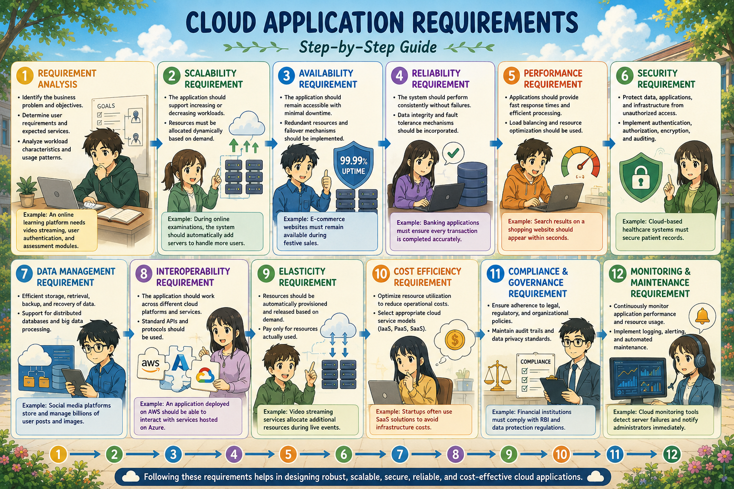

Slide 15
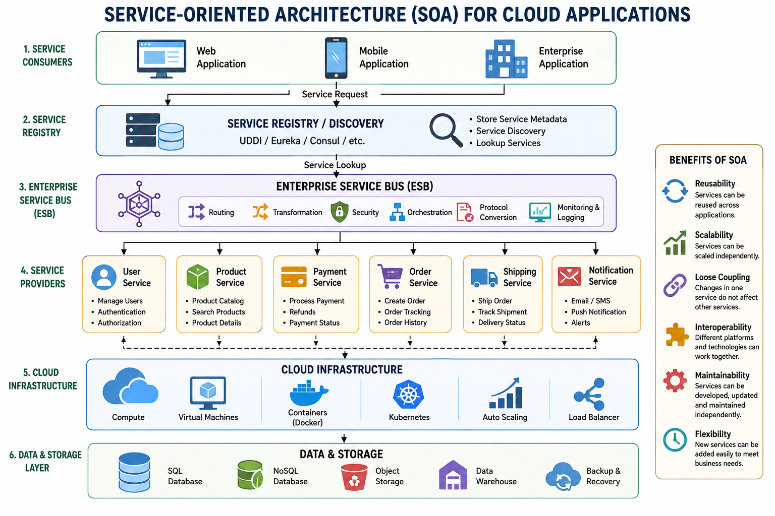
Service Oriented Architecture (SOA) for Cloud Application

Slide 16
Service Oriented Architecture (SOA) for Cloud Application
Service Consumer: The client or application that requests a service. It can be a web application, mobile app, or another service. Example: Customer placing an order through an e-commerce website.
Service Provider: Creates and provides the service. Publishes service details for users. Example: Payment Service providing online payment functionality.
Service Registry: Directory where available services are registered. Helps consumers discover services dynamically. Example: UDDI, Eureka Server, Consul.
Enterprise Service Bus (ESB): Middleware that enables communication among services. Handles routing, transformation, security, and protocol conversion. Functions: Message routing Data transformation Load balancing Security enforcement
Cloud Services: Each business functionality is implemented as an independent service. Examples: Authentication Service Inventory Service Payment Service Shipping Service Notification Service
Cloud Infrastructure Provides: Compute resources Storage Networking Virtualization Examples: AWS EC2Microsoft, Azure, Google Cloud Platform

Slide 17
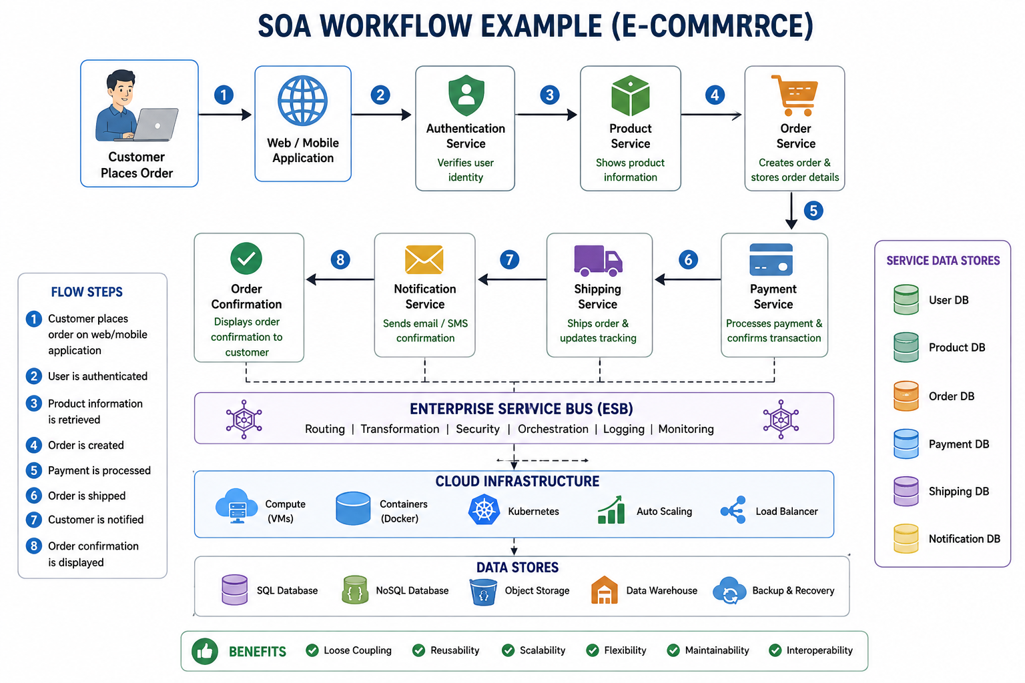

Slide 18
Role of Service-Oriented Architecture in Cloud Computing
Service-Oriented Architecture is a service-oriented approach that allows multiple service entities to communicate and share information through a single system. SOA does this by implementing a method called “loose coupling.”
Loose coupling makes the services and users to be less dependent on each other. In this way, the client applications remain uninterrupted even if the service functionality changes at any stage.
An SOA is a set of multiple services. Applications can be formed by making use of those facilities available across different platforms regardless of the languages or vendors.
The main focus of SOA in the cloud is to align users’ business with information technology and other resources better. It improves business workflows while providing-
Access management services
Ease of monitoring and management
Easy data exchange
Interoperability
Platform-neutral approach
Reliability
Reusable codes and services
Service change impact
Straightforward system integrations

Slide 19
Importance of Service Oriented Architecture in Cloud Computing
Migrating to the cloud is a significant and practical step for any enterprise to do. With SOA integration in the cloud environment, businesses reap many benefits like enhanced performance, security, faster deployments, and better monitoring.
With the SOA, the client does not need to be familiar with any of its underlying programming languages used by the service. Its characteristics are independent of products, technologies, or vendors.
While the SOA and cloud computing does exist separately and concurrently, the two technology complement each other well.
For a seamless business transition, it’s beneficial to integrate SOA into your workloads first. This will eliminate any complexities of cloud computing integration into your business model.

Slide 20
Service-Oriented Architecture makes it easier to deploy SaaS (software-as-a-service) in a cloud platform, while the cloud supplies the processing power and other resources required for the process.
SOA and cloud integration makes it easier for your organization to collaborate within, and with IT as well.
Cloud technology lays out a strong foundation for SOA through its storage and other platform services.
With SOA in their cloud computing, businesses can reuse the already designed services, making it cost beneficial and increased usability of software inventory.

Slide 21
The reusability of existing services automatically skips the extensive and detailed testing process.
Each element in SOA is a relatively autonomous unit. So, when you extend the cloud resources to it, SOA provides strong and direct interfaces and architectures for a robust cloud computing platform.
Developers can find the required services to assemble any new application quickly. That gives the company the ability to respond to any business or technological shifts promptly.
The SOA interface successfully processes the transmission of data and information while coordinating perfectly between various applications and service activities. Enterprises gain agility in run-time response to any changes, with lesser complexity and disbursement.

Slide 22
Parallelization within Cloud Application
Parallelization is the process of dividing a large computational task into multiple smaller tasks that can be executed simultaneously on multiple processors, virtual machines, containers, or cloud resources. Cloud computing provides virtually unlimited resources, making parallel execution efficient and scalable.
Need for Parallelization in Cloud Applications
Reduce execution time
Improve application performance
Handle large-scale data processing
Support real-time analytics
Utilize distributed cloud resources effectively
Example: Processing millions of customer transactions on an e-commerce platform.

Slide 23
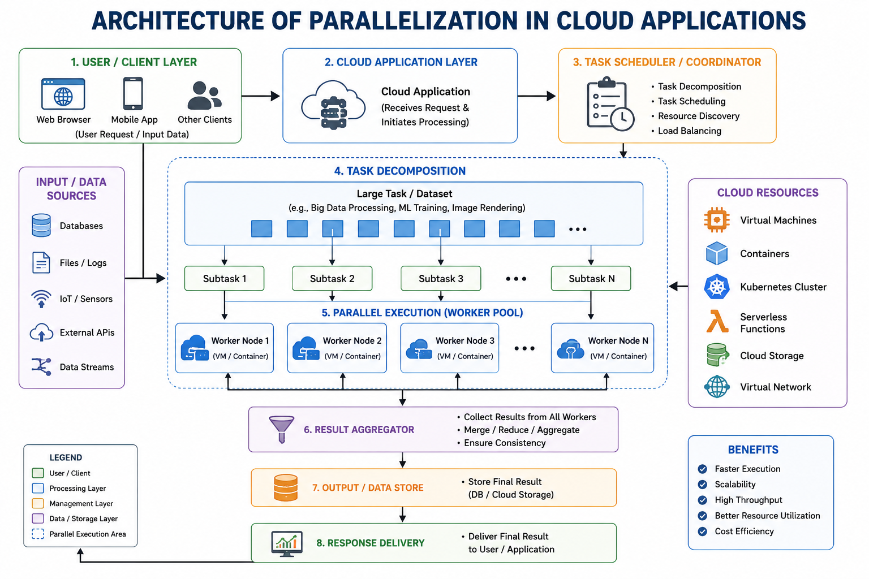

Slide 24
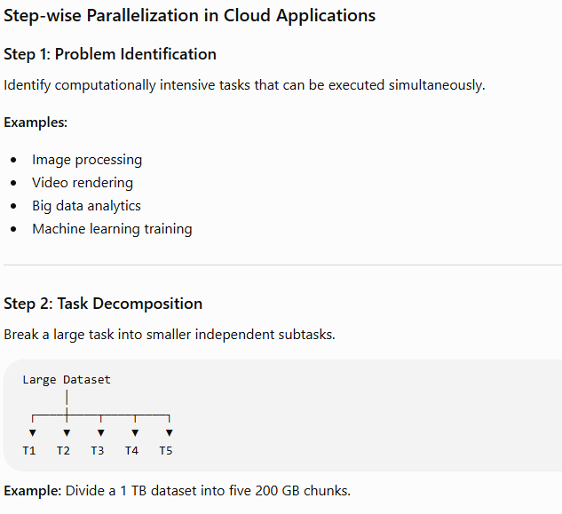

Slide 25
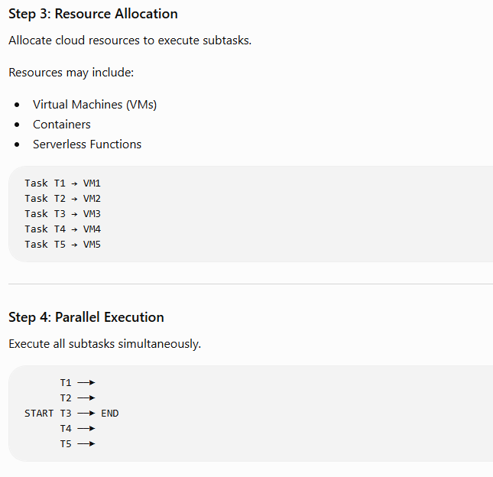

Slide 26
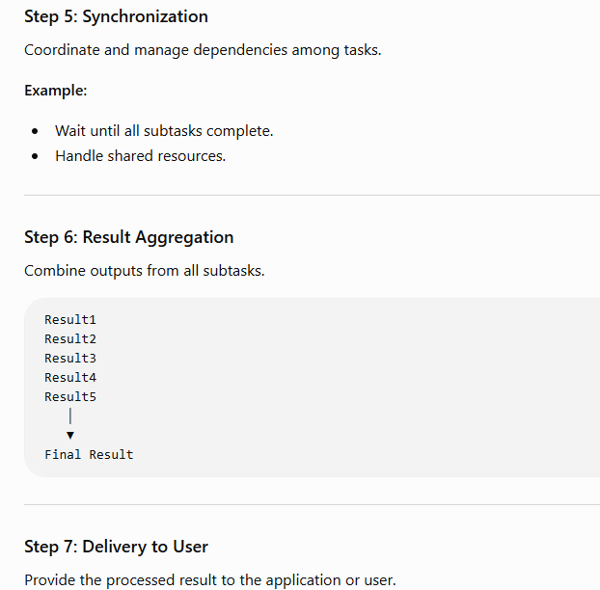

Slide 27
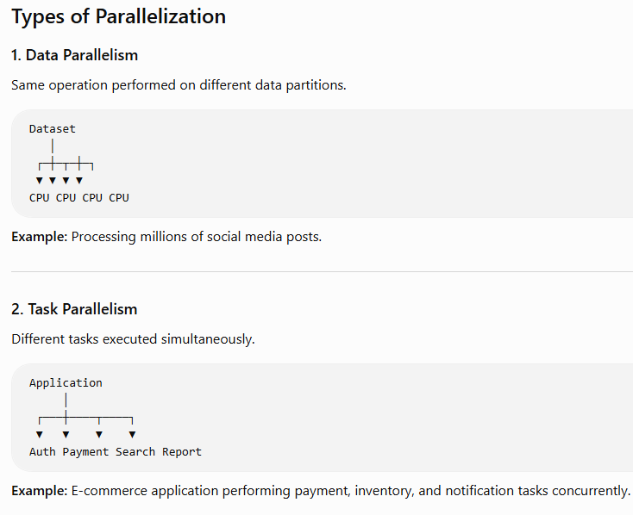

Slide 28
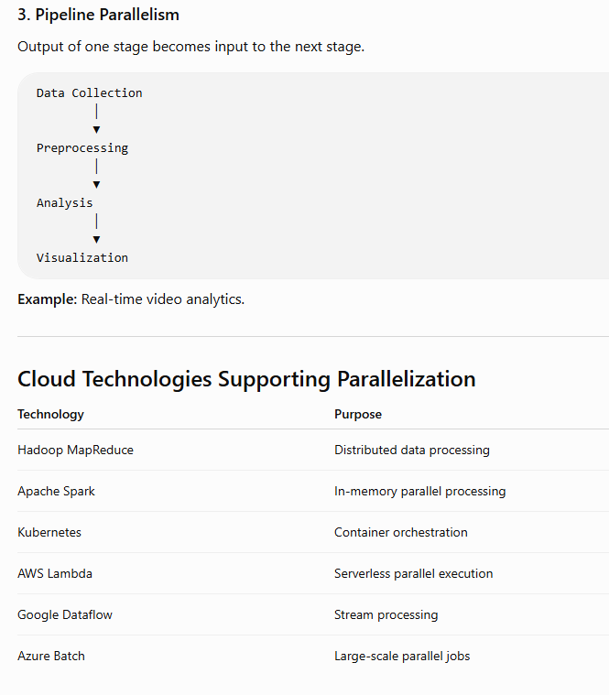

Slide 29
Advantages of Parallelization
Faster execution
Improved scalability
Better resource utilization
Reduced response time
Supports big data processing
Disadvantages of Parallelization
Synchronization overhead
Communication delay
Load balancing issues
Fault tolerance management
Data consistency

Slide 30
Parallelization within Cloud Applications
Cloud Computing: The system components are located at multiple locations, uses multiple computers, has only distributed memory, communicates through memory parsing.
Parallel Computing: Many operations are performed simultaneously, requires a single computer, can be both distributed or shared memory, processors communicate through a bus
The delivery of scalable services, such as databases, data storage, networking, servers, and software, over the Internet on an as-needed, pay-as-you-go basis is referred to as “cloud computing” in general.
Cloud computing services are fully managed by the provider, allow for remote access to data, work, and applications from any device in any location with an Internet connection, and can be either public or private. Platform as a Service (PaaS), Infrastructure as a Service (IaaS), and Software as a Service are the three most popular service categories (SaaS).
Cloud computing services are fully managed by the provider, allow for remote access to data, work, and applications from any device in any location with an Internet connection, and can be either public or private. Platform as a Service (PaaS), Infrastructure as a Service (IaaS), and Software as a Service are the three most popular service categories (SaaS).

Slide 31
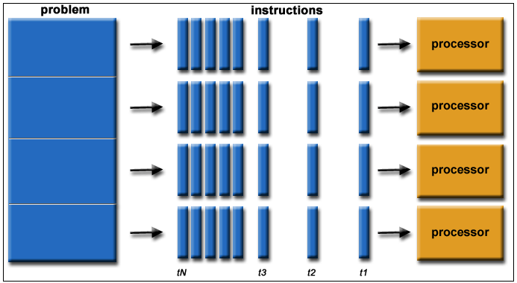
Parallel Computing
Parallel Computing basically breaks down a large problem into several small problems depending on the type of parallelism and processes them separately and glues them back together.
The figure shown above basically sums up the theory behind parallel computing. The primary goal for parallel computing is to increase the available computational power for faster application processing and problem-solving.
When a larger problem is divided into smaller, independent, frequently similar components that can be worked on concurrently by several processors connected by shared memory, the process is known as parallel computing. The completed results are combined as a component of a larger algorithm. Increasing the amount of computation power available for quicker application processing and problem-solving is the main objective of parallel computing.
The majority of parallel computing infrastructure is kept in a single data center, where several processors are installed in a server rack. The application server distributes computation requests in small chunks, which are then executed concurrently on each server.

Slide 32
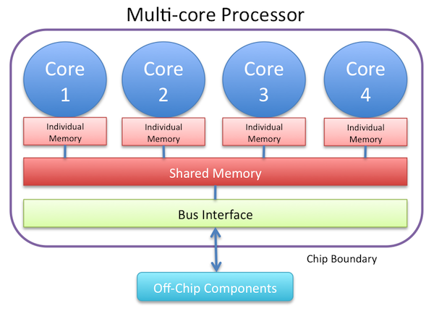
Parallel Computing Architecture
Parallel computing has two different types of architecture:
Multi-core computing: is a computer processor integrated circuit with two or more separate processing cores. Each execute program instructions in parallel. A multi-core processor has one shared memory and uses a message bus to communicate.

Slide 33
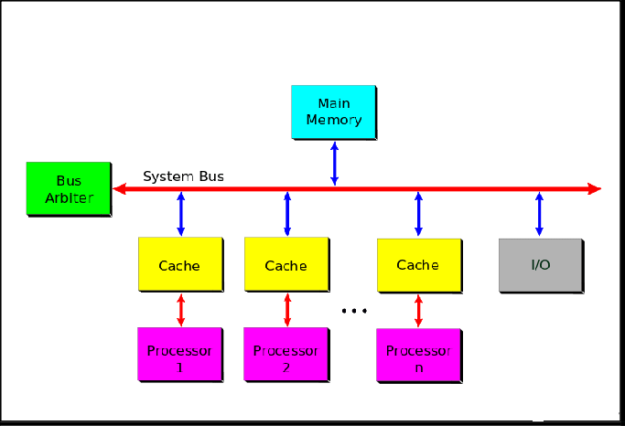
Symmetric Processing: a multiprocessor computer hardware and software architecture that has one OS that treats all processors equally, and is connected to a single, shared memory.
Technique and Solutions in Parallel Computing
Application checkpointing: Records the current state of all components in the system so that it can restore in case of failure
Automatic Parallelization: Automatic Conversion of serial code to multi-threaded code that can be used on an SMP machine
Parallel Programming Languages: Classified as either using Distributed Memory( use message parsing to communicate)or using shared Memory(manipulating shared memory variables)
Ref: https://manasreddy11.medium.com/cloud-computing-a-series-parallel-computing-99c60388e64e

Slide 34
There are 4 types of Parallel Computing which are:
Bit-Level Parallelism: Which is based on increasing the processing power of word size. This reduces the number of instructions the processor must execute. For example, if adding two 16bit integers on an 8-bit processor, first the lower-order buts must be added then the higher-order bits then two processes to add them both must be done. Whereas a single 16-bit processor can process them in one instruction.
Instruction-level Parallelism: Which is based on the multiple execution of instructions of a program. For example, A code containing a for loop to read a list, each “i ” iteration can be done on different processors. Making the program “i” times faster.
Data- Level Parallelism: Which is based on concurrent execution of the same task on multiple computing systems. Ex. Input data is split into batches the exact same algorithm is applied to all batches of code.
Task- Level Parallelism: Which is based on the concurrent execution of different tasks on multiple computing systems.

Slide 35
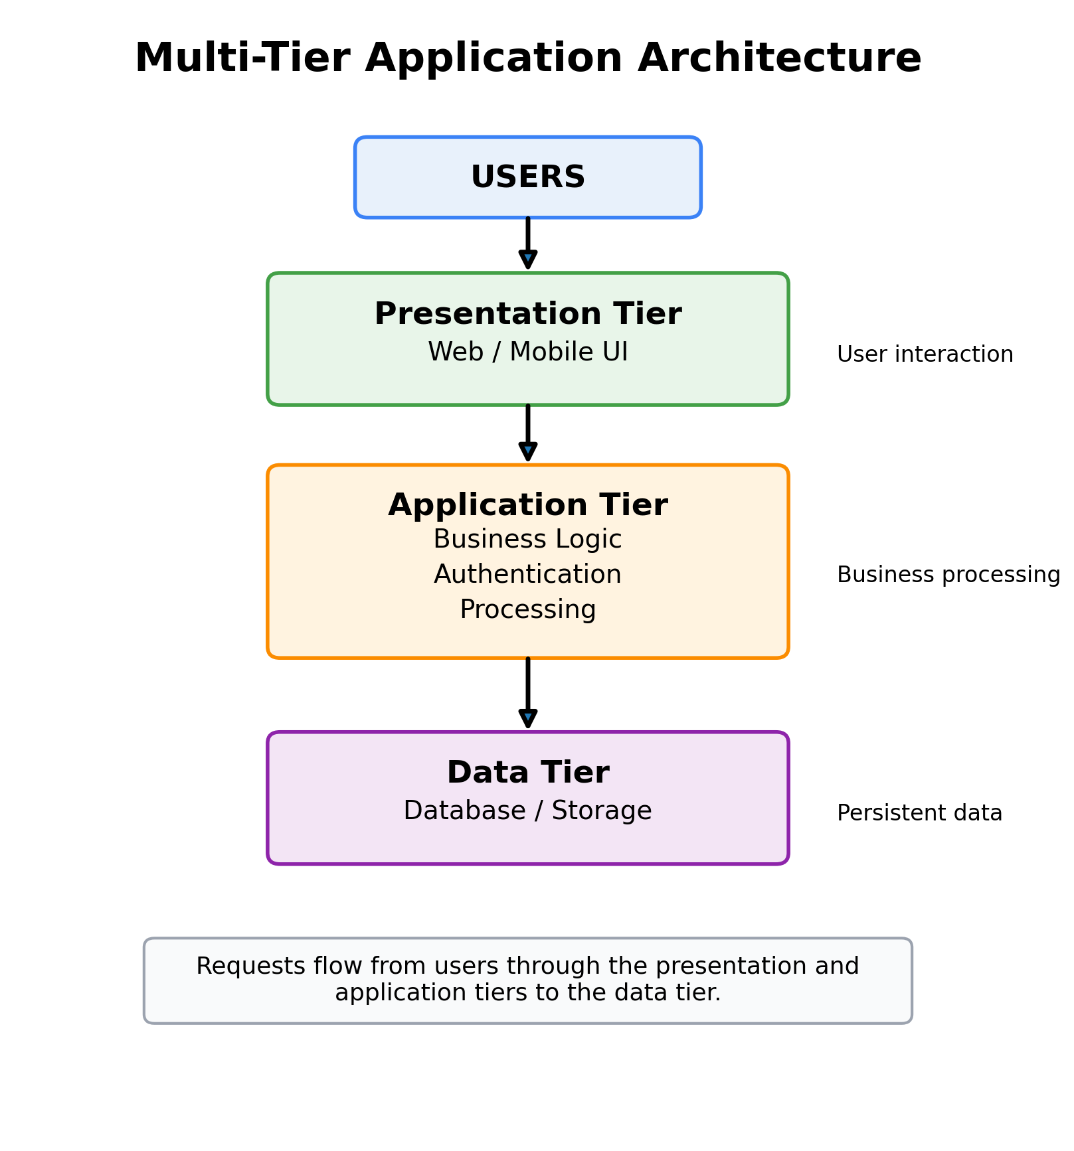
Multi Tier Application Architecture
A tier is a logical part of an application responsible for a particular type of processing.
Instead of developing the entire application as one large program, we divide it into separate tiers.
The major advantage is separation of concerns.
Multi-tier architecture is a software architecture in which an application is divided into multiple independent logical tiers, with each tier performing a specific function and communicating with other tiers through well-defined interfaces.

Slide 36
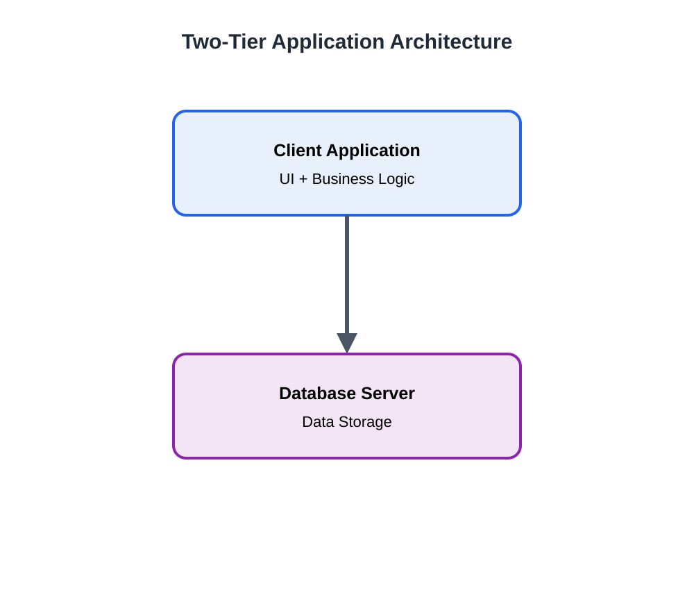
Two Tier Architecture
Example Desktop banking application directly communicates with a database server.
Advantages
Simple to develop
Easy to understand
Suitable for small applications
Less communication overhead
Limitations
Difficult to scale
Business logic may be tightly coupled with client
Security can be weaker
Maintenance becomes difficult for large applications

Slide 37
Three Tier Architecture
Tier 1 – Presentation Tier: Responsible for the user interface.
Examples: HTML, CSS, JavaScript, Mobile application, Web interface
Tier 2 – Application / Business Tier: Responsible for processing requests.
Examples: Authentication, Order processing, Payment calculation, Business rules, Validation.
Tier 3 – Data Tier: Responsible for data storage.
Examples: MySQL, PostgreSQL, MongoDB, Cloud databases, Object storage.

Slide 38
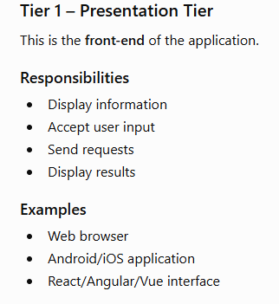
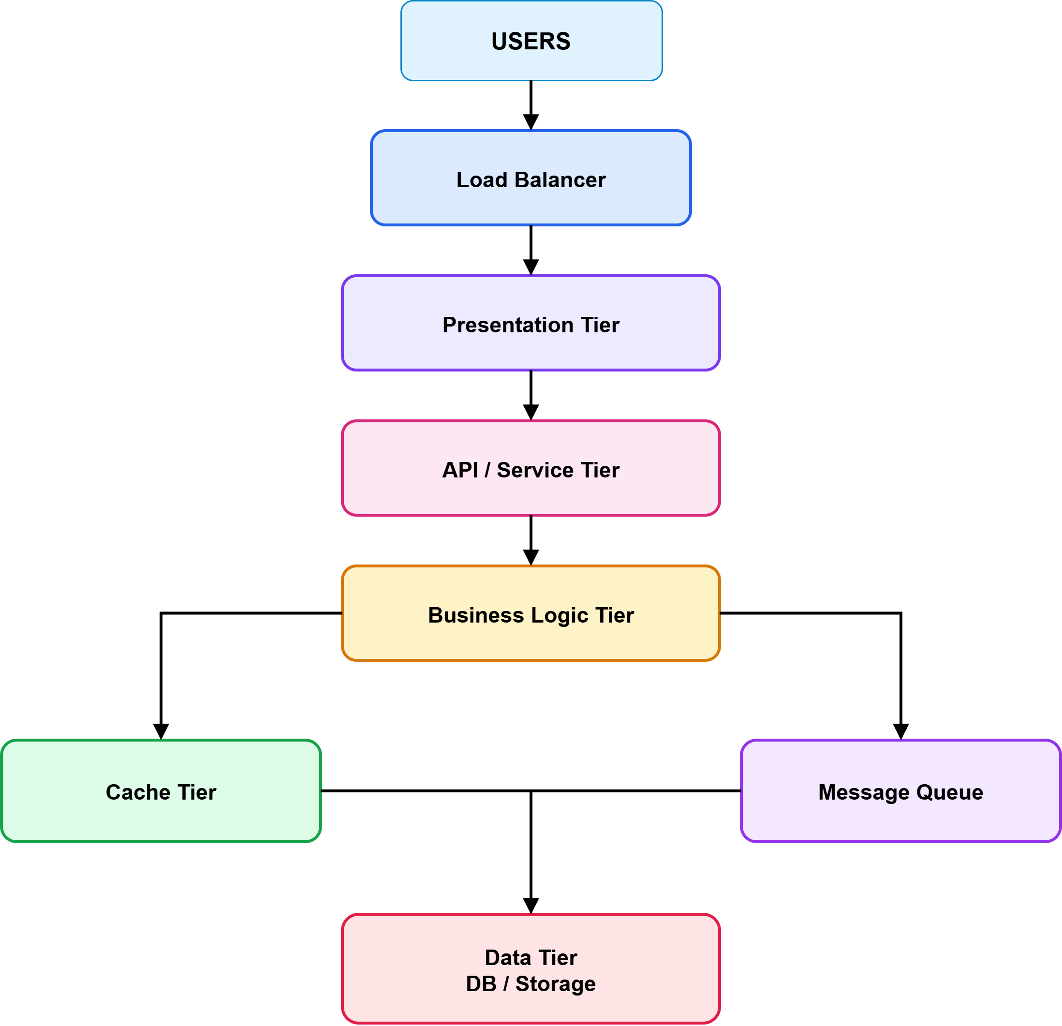
Multi Tier/ N-Tier Architecture

Slide 39
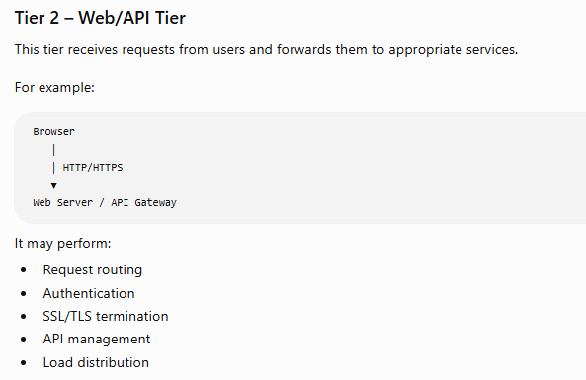
Multi Tier/ N-Tier Architecture

Slide 40
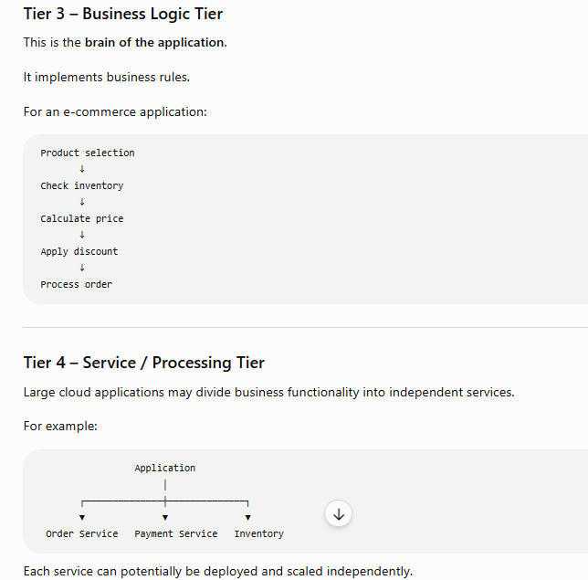
Multi Tier/ N-Tier Architecture

Slide 41
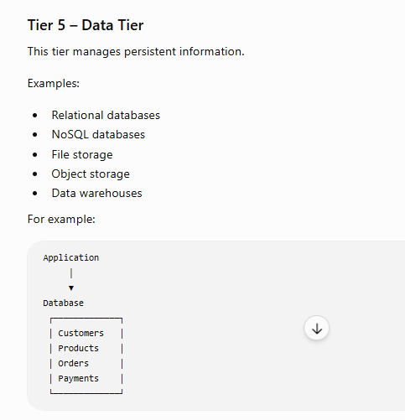
Multi Tier/ N-Tier Architecture

Slide 42
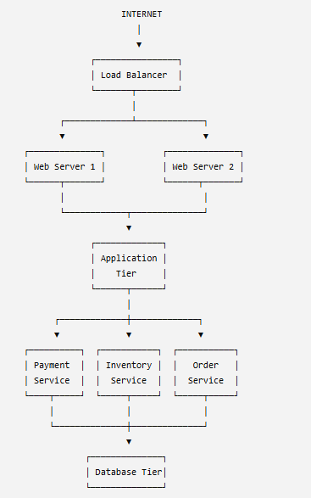
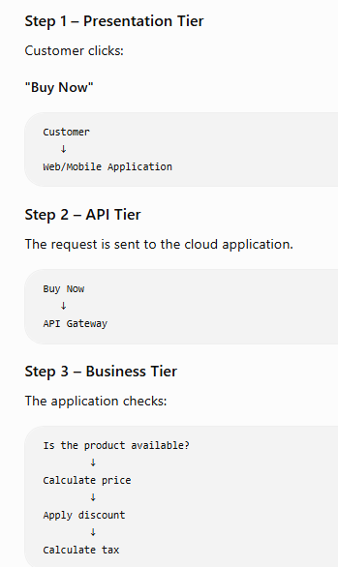
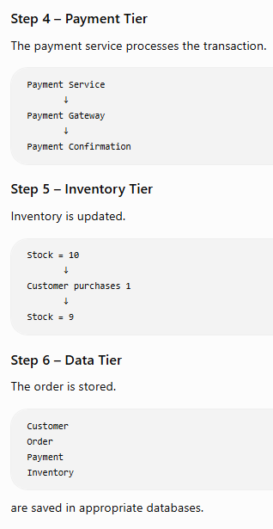
Multi Tier/ N-Tier Architecture in Cloud Computing

Slide 43
Multi-tier Architecture
The multi-tier application (three-tier, n-tier, and so forth.) has been a cornerstone architecture pattern for decades, and remains a popular pattern for user-facing applications. Although the language used to describe a multi-tier architecture varies, a multi-tier application generally consists of the following components:
Presentation tier: Component that the user directly interacts with (for example, webpages and mobile app UIs).
Logic tier: Code required to translate user actions to application functionality (for example, CRUD database operations and data processing).
Data tier: Storage media (for example, databases, object stores, caches and file systems) that hold the data relevant to the application.
The multi-tier architecture pattern provides a general framework to ensure decoupled and independently scalable application components can be separately developed, managed, and maintained (often by distinct teams).
As a consequence of this pattern in which the network (a tier must make a network call to interact with another tier) acts as the boundary between tiers, developing a multi-tier application often requires creating many undifferentiated application components. Some of these components include:
Code that defines a message queue for communication between tiers
Code that defines an application programming interface (API) and a data model
Security-related code that ensures appropriate access to the application

Slide 44
Types of Multi-tier Architecture
1-Tier Architecture: Imagine you have a toy robot that can do everything independently. It has buttons for you to press, it processes the commands, and it stores any information it needs. All the robot’s functions are built into the same robot itself.
2-Tier Architecture: Now, let’s say you have a robot toy that you control using a remote control. The remote control sends commands to the robot, and the robot follows those commands. The remote control is responsible for telling the robot what to do, and it handles all the actions.
3-Tier Architecture: Now, let’s make it more interesting. Imagine you have a robot toy that you control using a smartphone app. When you tap buttons on the app, the app sends the commands to a separate device, like a hub or a server. This device receives the commands and then sends them to the robot toy. The robot toy performs the actions and sends any results or information back to the device, which then sends it back to the app on your smartphone.
N-Tier Architecture: Let’s take our robot toy example even further. Imagine a whole team of robots working together to perform different tasks. In N-tier architecture, the system is divided into multiple layers, each with a specific role.

Slide 45
Example of Multi-tier Architecture
AWS offers a number of services that enable the creation of serverless multi-tier applications – greatly simplifying the process of deploying such applications to production and removing the overhead associated with traditional server management. Amazon API Gateway, a service for creating and managing APIs, and AWS Lambda, a service for running arbitrary code functions, can be used together to simplify the creation of robust multi-tier applications.
Amazon API Gateway’s integration with AWS Lambda enables user-defined code functions to be initiated directly through HTTPS requests. Regardless of the request volume, both API Gateway and Lambda scale automatically to support exactly the needs of your application (refer to API Gateway Amazon API Gateway quotas and important notes for scalability information). By combining these two services, you can create a tier that enables you to write only the code that matters to your application and not focus on various other undifferentiating aspects of implementing a multi-tiered architecture such as architecting for high availability, writing client SDKs, server and operating system (OS) management, scaling, and implementing a client authorization mechanism.
API Gateway and Lambda enable the creation of a serverless logic tier. Depending on your application requirements, AWS also provides options to create a serverless presentation tier (for example, with Amazon CloudFront and Amazon Simple Storage Service) and data tier (for example, Amazon Aurora, Amazon DynamoDB).
Ref: https://docs.aws.amazon.com/whitepapers/latest/serverless-multi-tier-architectures-api-gateway-lambda/introduction.html

Slide 46
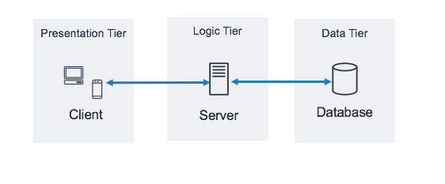
Three-tier architecture overview
The three-tier architecture is the most popular implementation of a multi-tier architecture and consists of a single presentation tier, logic tier, and data tier. The following illustration shows an example of a simple, generic three-tier application.
Architectural pattern for a three-tier application
There are many great online resources where you can learn more about the general three-tier architecture pattern. This whitepaper focuses on a specific implementation pattern for this architecture using Amazon API Gateway and AWS Lambda.

Slide 47
Serverless logic tier
The logic tier of the three-tier architecture represents the brains of the application. This is where using Amazon API Gateway and AWS Lambda can have the most impact compared to a traditional, server-based implementation. The features of these two services enable you to build a serverless application that is highly available, scalable, and secure. In a traditional model, your application could require thousands of servers; however, by using Amazon API Gateway and AWS Lambda you are not responsible for server management in any capacity. In addition, by using these managed services together, you gain the following benefits:
AWS Lambda:
No OS to choose, secure, patch, or manage
No servers to right size, monitor, or scale
Reduced risk to your cost from over-provisioning
Reduced risk to your performance from under-provisioning
Amazon API Gateway:
Simplified mechanisms to deploy, monitor, and secure APIs
Improved API performance through caching and content delivery

Slide 48
Data tier
Using AWS Lambda as your logic tier does not limit the data storage options available in your data tier. Lambda functions connect to any data storage option by including the appropriate database driver in the Lambda deployment package, and use IAM role-based access or encrypted credentials (through AWS KMS or AWS Secrets Manager).
Choosing a data store for your application is highly dependent on your application requirements. AWS offers a number of serverless and non-serverless data stores that you can use to compose the data tier of your application.

Slide 49
Presentation tier
The presentation tier is responsible for interacting with the logic tier through the API Gateway REST endpoints exposed over the internet. Any HTTPS capable client or device can communicate with these endpoints, giving your presentation tier the flexibility to take many forms (desktop applications, mobile apps, webpages, IoT devices, and so forth). Depending on your requirements, your presentation tier can use the following AWS serverless offerings:
Amazon Cognito - A serverless user identity and data synchronization service that enables you to add user sign-up, sign-in, and access control to your web and mobile apps quickly and efficiently. Amazon Cognito scales to millions of users and supports sign-in with social identity providers, such as Facebook, Google, and Amazon, and enterprise identity providers through SAML 2.0.
Amazon S3 with CloudFront - Enables you to serve static websites, such as single-page applications, directly from an S3 bucket without requiring provision of a web server. You can use CloudFront as a managed content delivery network (CDN) to improve performance and enable SSL/TL using managed or custom certificates.
AWS Amplify is a set of tools and services that can be used together or on their own, to help front-end web and mobile developers build scalable full stack applications, powered by AWS. Amplify offers a fully managed service for deploying and hosting static web applications globally, served by Amazon's reliable CDN with hundreds of points of presence globally and with built-in CI/CD workflows that accelerate your application release cycle. Amplify supports popular web frameworks including JavaScript, React, Angular, Vue, Next.js, and mobile platforms including Android, iOS, React Native, Ionic, and Flutter. Depending on your networking configurations and application requirements, you might need to enable your API Gateway APIs to be cross-origin resource sharing (CORS) – compliant. CORS compliance allows web browsers to directly invoke your APIs from within static webpages.
When you deploy a website with CloudFront, you are provided a CloudFront domain name to reach your application (for example, d2d47p2vcczkh2.cloudfront.net). You can use Amazon Route 53 to register domain names and direct them to your CloudFront distribution, or direct already-owned domain names to your CloudFront distribution. This enables users to access your site using a familiar domain name. Note that you can also assign a custom domain name using Route 53 to your API Gateway distribution, which enables users to invoke APIs using familiar domain names.

Slide 50
Programming Support for Google Apps engine
http://stmarysguntur.com/wp-content/uploads/2018/02/UNIT-IV-Programming-Support-of-Google-App-Engine-AWS.pdf

Slide 51
Programming Support for AWS
Features:
Relational Database Service (RDS) with a messaging interface
Elastic MapReduce capability
NOSQL support in SimpleDB

Slide 52
Programming Support for AWS
Features:
Relational Database Service (RDS) with a messaging interface
Elastic MapReduce capability
NOSQL support in SimpleDB
Amazon Simple Storage Service (S3)
https://youtu.be/77lMCiiMilo?si=iNskG7xz5p434u7R

Slide 53
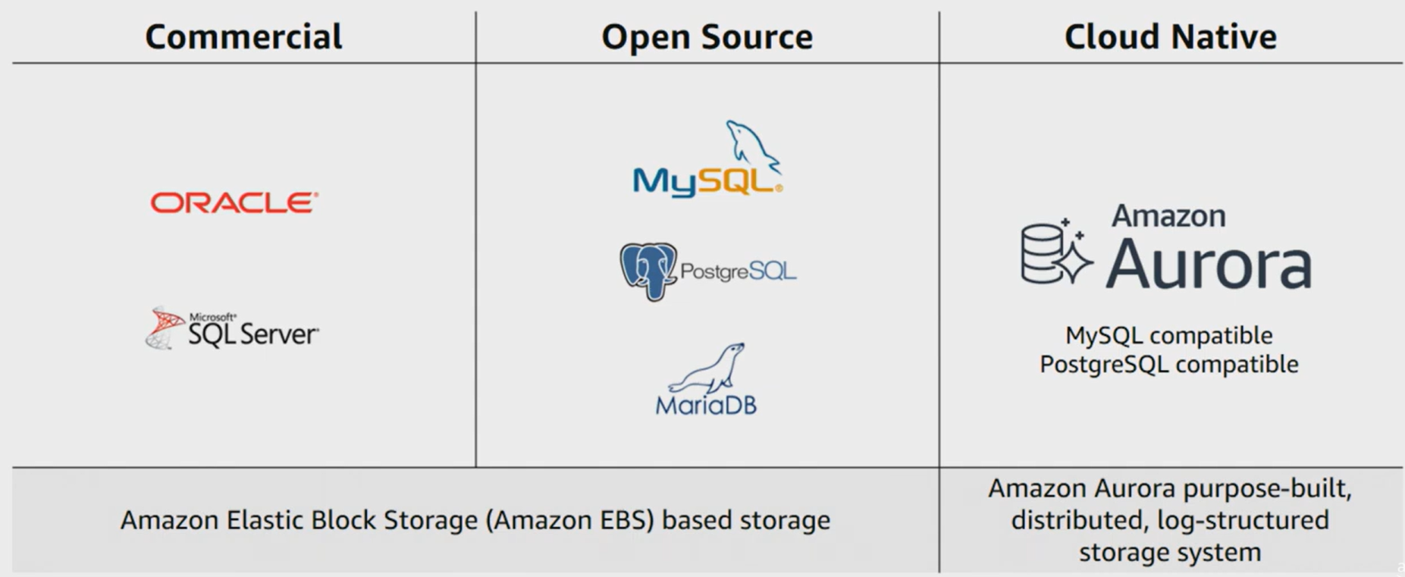
Programming Support for AWS
Features:
Relational Database Service (RDS) with a messaging interface
Elastic MapReduce capability
NOSQL support in SimpleDB

Slide 54
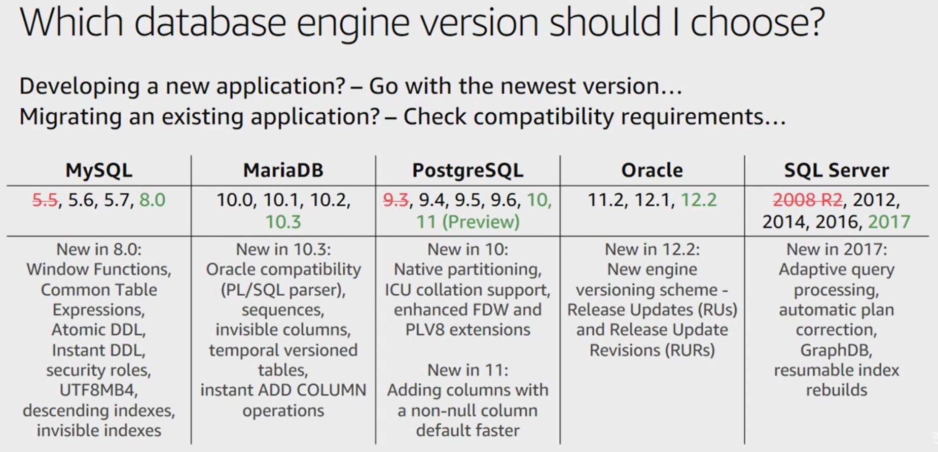
Programming Support for AWS
Features:
Relational Database Service (RDS) with a messaging interface
Elastic MapReduce capability
NOSQL support in SimpleDB

Slide 55
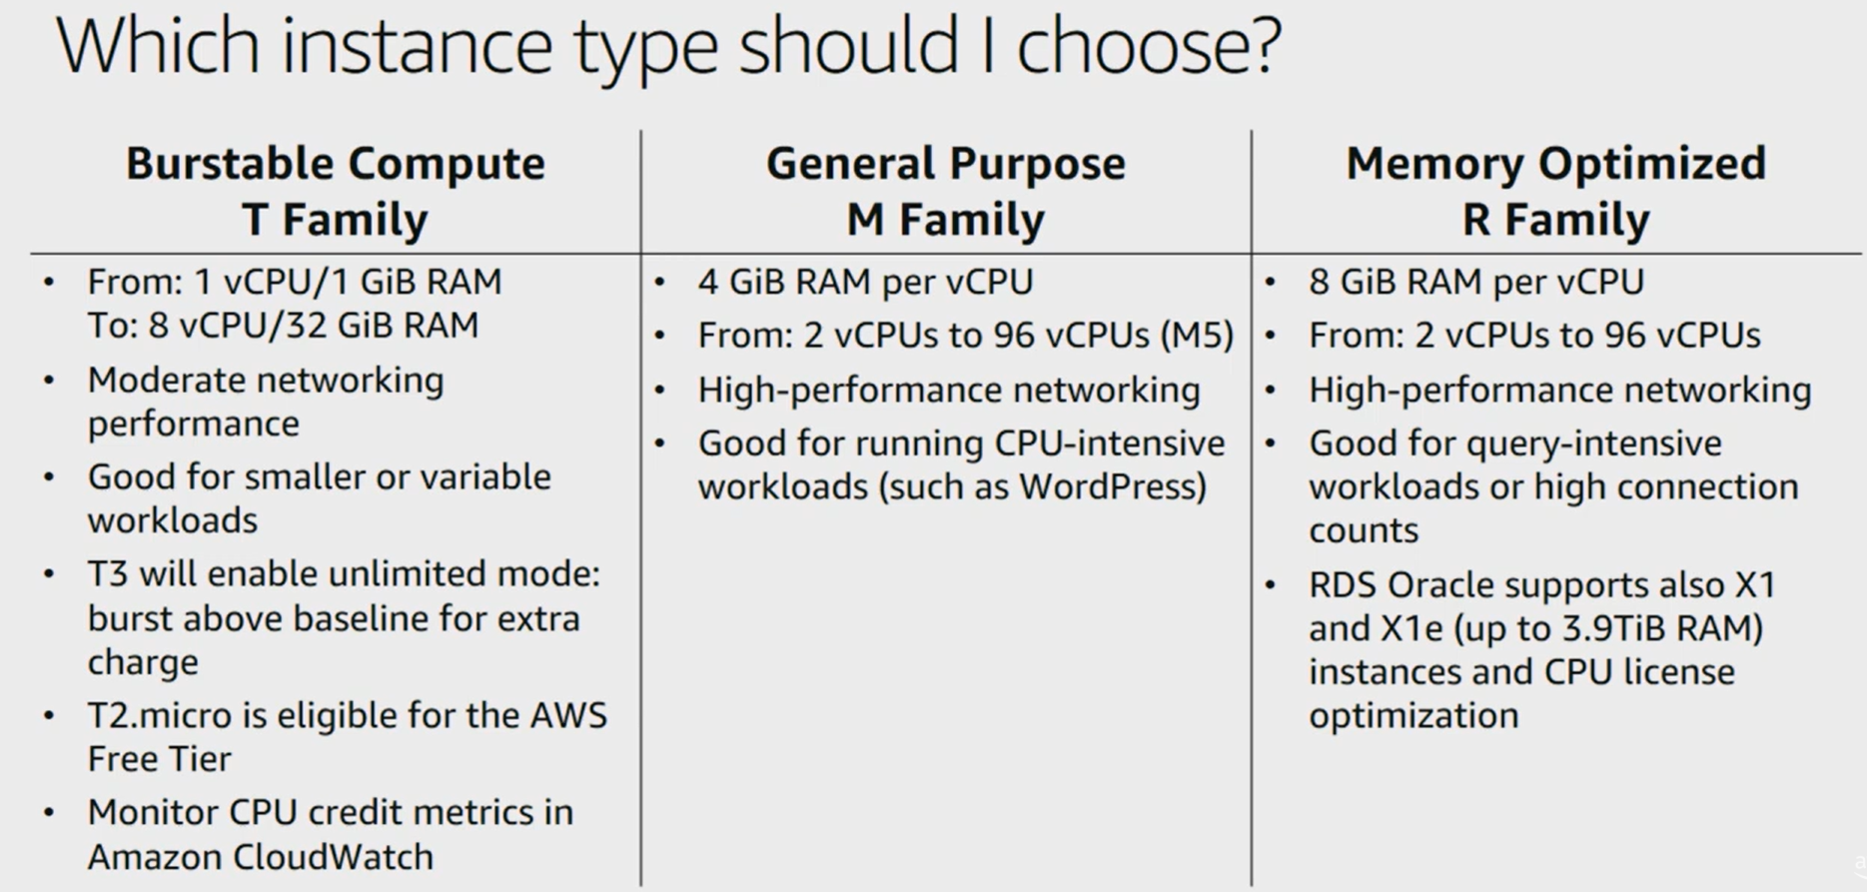
Programming Support for AWS
Features:
Relational Database Service (RDS) with a messaging interface
Elastic MapReduce capability
NOSQL support in SimpleDB

Slide 56
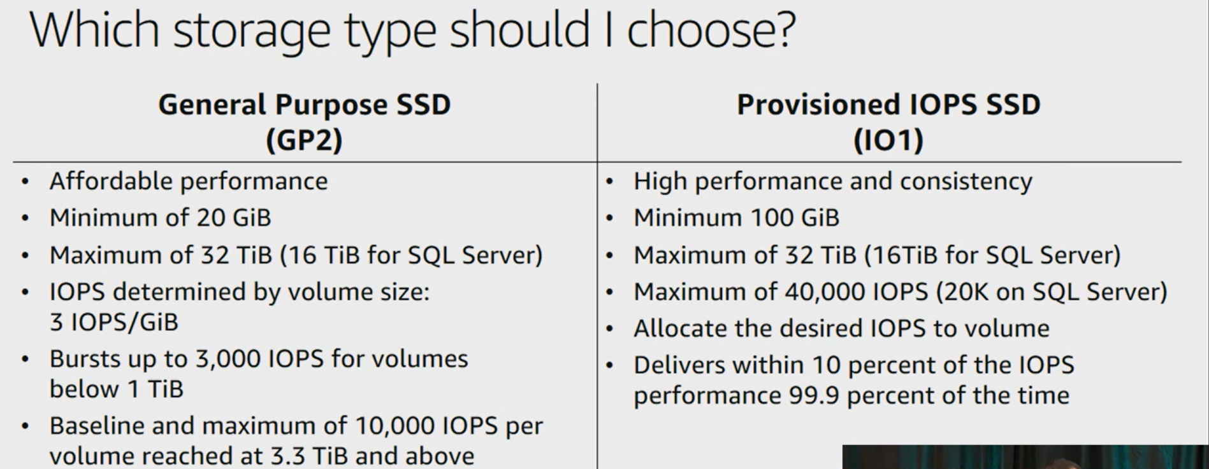
Programming Support for AWS
Features:
Relational Database Service (RDS) with a messaging interface
Elastic MapReduce capability
NOSQL support in SimpleDB

Slide 57
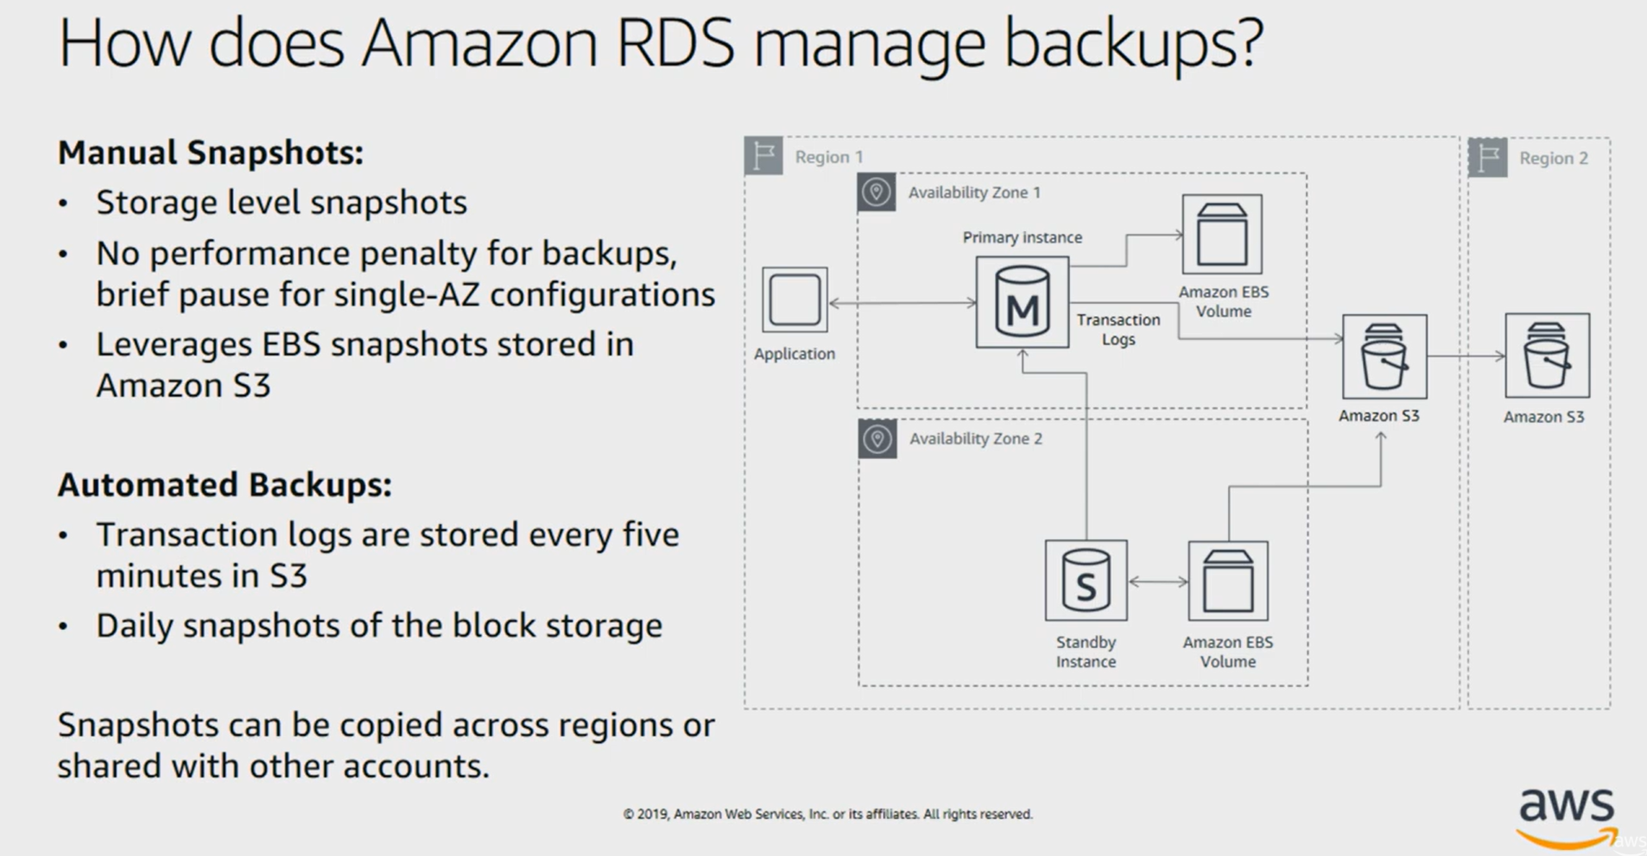
Programming Support for AWS
Features:
Relational Database Service (RDS) with a messaging interface
Elastic MapReduce capability
NOSQL support in SimpleDB

Slide 58
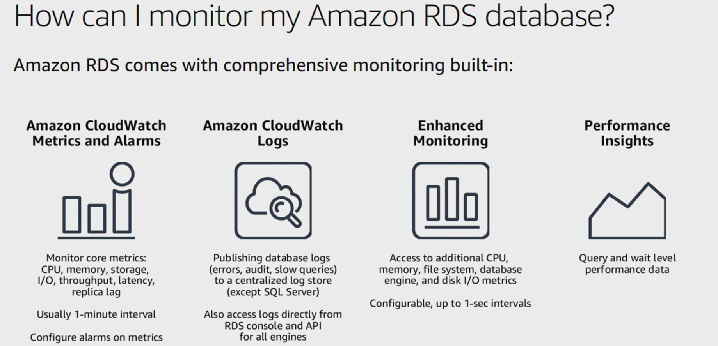
Programming Support for AWS
Features:
Relational Database Service (RDS) with a messaging interface
Elastic MapReduce capability
NOSQL support in SimpleDB

Slide 59
Programming Support for AWS
Features:
Relational Database Service (RDS) with a messaging interface
Elastic MapReduce capability
NOSQL support in SimpleDB
Amazon Simple Storage Service (S3)
https://youtu.be/S6Ja55n-o0M?si=Pu8nB12h7FmLTcU6

Slide 60
Programming Support for AWS
Features:
Relational Database Service (RDS) with a messaging interface
Elastic MapReduce capability
NOSQL support in SimpleDB
Amazon Simple Storage Service (S3)

Slide 61
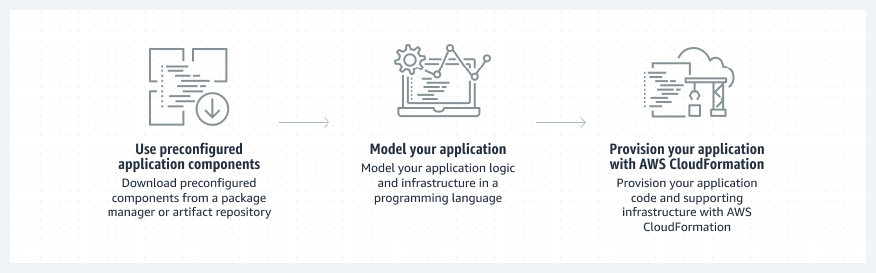
AWS Cloud Development Kit (AWS CDK) accelerates cloud development using common programming languages to model your applications.

Slide 62
Programming Support for Amazon EC2
Amazon Web Service(AWS) supports multiple popular programming languages like Java, Python, Ruby, PHP, and Node.js, etc.
All the programming languages have different characteristics, communities, support, and ecosystems to consider when making choice.
Lets, discuss some of the popular programming languages supported by AWS

Slide 63
https://docs.aws.amazon.com/cdk/v2/guide/languages.html#:~:text=The%20AWS%20CDK%20is%20developed,natural%20and%20intuitive%20as%20possible.
The AWS Cloud Development Kit (AWS CDK) has first-class support for the following general-purpose programming languages:
TypeScript
JavaScript
Python
Java
C#
Go
Other JVM and .NET CLR languages may also be used in theory
https://docs.aws.amazon.com/cdk/v2/guide/hello_world.html

Slide 64
1. Java
Java is an object-oriented language with fewer dependencies. It is a secure and dynamic language designed to have high performance. Java is one of the earliest languages used in business-critical ideas. It has a wide range of libraries and frameworks supported.
Java Applications in AWS Have the Following Merits:
Reliable and well-tested libraries: All of the libraries of Java are reliable and are well tested to create a supportive and reliable environment for the users.
Platform Independent: Java works with various tools like Eclipse, IntelliJ IDEA, Maven, and Gradle.
High Performance: With the use of Just-In-Time compilers, Java enables high performance. It is easy to determine the amount of memory needed by the program which makes its performance predictable.
These merits of Java help it in running a Java-based web application on various AWS services like Amazon Simple Storage Service (S3), Amazon Elastic Compute Cloud (EC2).

Slide 65
2. Python
Python is a dynamic, high level, open-source programming language. It is relatively a newer language in the world of programming languages and in AWS environment as well. This is the simplest language and beginners friendly.
The benefits of Python in the AWS environment:
Fast Spin up Time: Python has a great spinning up time for containers. It’s about 100 times faster than Java or C#.
Easy to Code: Python is highly readable and a supportive community. Python has more than 145,000 support package
Simplicity: With python, one can avoid the over-complicated architecture
Using the SDK for Python, you can build applications on top of Amazon S3, Amazon EC2, Amazon DynamoDB, and more.

Slide 66
3. Ruby
Ruby is also a popular object-oriented programming language having training available online, both for beginners, with no coding experience, and experts in the field. Ruby has a repository of reusable libraries easily maintained and deployed in the form of RubyGems.
Benefits of Ruby:
Highly Scalable: Ruby is very much scalable and big programs written in Ruby are easily maintainable.
Easy to understand: Ruby has a clean and easy syntax that allows a new developer to learn very quickly and easily.
Suitable for automation purposes: Ruby is suitable for automation with Puppet. Ruby support various web services including Airbnb, GitHub, and Groupon.
With Ruby, developers can easily deploy their applications on various AWS services like Amazon S3, Amazon EC2, DynamoDB, and more. Ruby is really a programmer’s best friend.

Slide 67
4. PHP
PHP is an open-source server-side scripting language. PHP code is executed on the server so you need a web browser to execute PHP code. Major companies including Facebook, WordPress, Twitpic, Flickr, and Imgur are part of the PHP alumni.
Features of PHP:
Simple and Easy: PHP is simple and easy to understand language as compared to other scripting languages.
Does not have any rules: PHP doesn’t have rules like compiled languages or strict standards as seen with Python, but rather guidelines available from the developer community.
Host’s webpages through AWS: Elastic Beanstalk for PHP is available for developing or hosting a web application using PHP.
The PHP SDK is a modern, open-source PHP library that makes it easy to integrate your PHP application with AWS services like Amazon S3, Amazon Glacier, and Amazon DynamoDB.

Slide 68
5. Node.js
Node.js is the newest entry to the list of languages supported by AWS. Node.js applications are written in JavaScript and can be run within the Node.js runtime on OS X, Microsoft Windows, and Linux. Leaders such as Yahoo and LinkedIn have implemented portions of their applications on Node.js.
Why Node.js?
Modules: There are various modules to help developers with their applications in a lot of different ways.
Better spinup time: Node.js has better spin-up time than C# or Java which makes it a better option for client-facing applications.
No Buffer: Node.js never buffer any data of its applications
The Node.js SDK helps take the complexity out of coding by providing JavaScript objects for AWS services including Amazon S3, Amazon EC2, DynamoDB, and Amazon SWF.

Slide 69
Study of Cloud Tools and Platforms

Slide 70
Insights about Cloud Computing Architecture
Cloud Architecture refers to the various components in terms of databases, software capabilities, applications, etc. which is used by companies of all sizes for leveraging the power of cloud resources to solve all kinds of business problems.
Even at home, we use cloud technologies for various daily activities. From Microsoft Office 365, Google Docs, and Spotify, these services are provided to us through cloud infrastructure.
The entire cloud architecture is aimed at providing the users with high bandwidth, allowing users to have uninterrupted access to data and applications, on-demand agile network with possibility to move quickly and efficiently between servers or even between clouds and most importantly network security

Slide 71
Principles of Cloud Computing Architecture Design
A complete cloud computing architecture design is also a step-by-step process that begins with collecting requirements and analysis, designing the architecture based on the requirements analysis, evaluating improvements and delivering implementation, and then achieving continuous operations.
To proceed with architecture design based on Cloud Computing, all technical solutions should follow certain principles, which is the target to be hit in architecture design.
There are 6 principles of cloud computing architecture design, including reasonable deployment, business continuity, elastic expansion, performance efficiency, security compliance, and continuous operation.

Slide 72

Principle 1: Reasonable Deployment
The deployment of business systems on the public cloud includes the cloud hosts in the form of virtual machines and physical cloud hosts with higher performance. Hosting services include hosted applications and hosted physical servers.
The cloud computing operating system is extracted and packaged as independent software and services to be deployed in the user's private environment. Unlike public clouds, which are available to "any" user, private deployments are only available to a select few users.
Hybrid architecture enables unified management and scheduling of resources for public cloud and privatized deployed platforms, traditional VMware, OpenStack virtualization platforms or physical servers.

Slide 73

Principle 2: Business Continuity
Business continuity mainly refers to the 3 aspects of high availability, continuous operations, and disaster recovery and the design pattern is developed according to this logic.
High Availability refers to avoiding business interruption by redundancy and other designs when the resources running the business fail.
Continuous Operations mean that the resources for business operation are fault-free and the business can continuously provide services.
Disaster Recovery refers to the ability to restore applications and data in different environments when the business operating environment is damaged.

Slide 74
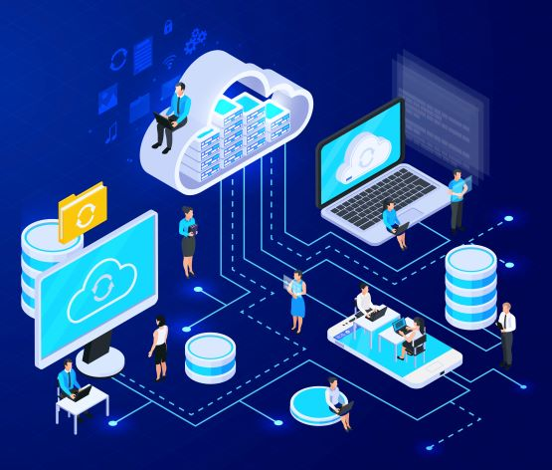
Principle 3: Elastic Expansion
Tightly coupled systems are not easy to expand, and it is difficult to troubleshoot problems when software bugs and system failures occur.
To maintain the elastic expansion of the system, the first step is to decouple the system components, including the decoupling of dynamic data and static data.
Component decoupling is a prerequisite for achieving expandability and can be done in the following ways.
Remain stateless and store state data in Redis.
Put in load balancing, as expansion and scaling had no effect on the overall business.
Decoupled by message queues or API Gateway. Producers and consumers can be expanded without affecting each other.
Achieve global load balancing of business. Back-end business can be expanded in a hybrid architecture and multi-cloud environment.

Slide 75
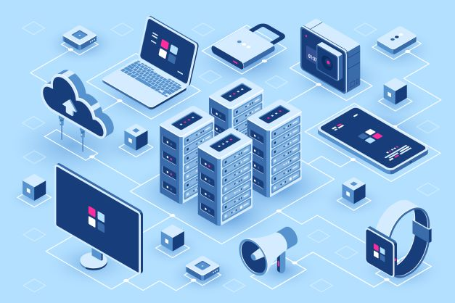
Principle 4: Performance Efficiency
The primary goal in performance efficiency is to discover and enhance the performance of the application and improve the efficiency of resources and components.
The first is computing performance. The single-machine performance is improved by using high-configuration cloud hosts or physical cloud hosts, and the overall service performance is expanded through clusters.
The second is storage and caching. Cache hot data and store temporary state data by Redis, and performing in-memory calculations can improve business performance.
The third is the optimization of network. Select the optimal data center when the business is deployed globally, and improve the network performance based on global infrastructure network.

Slide 76
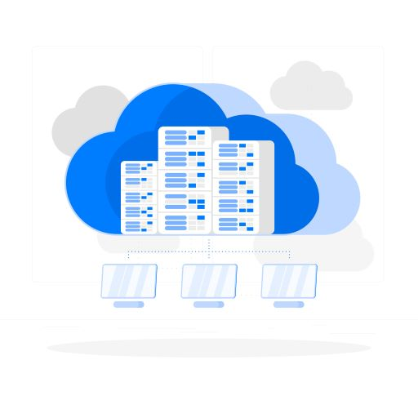
Principle 5: Security Compliance
On the one hand, security compliance is to meet the business security protection of their own needs, on the other hand, it is to meet the security supervision requirements.In the specific implementation, these two aspects will be crossed together.
Set up master accounts and sub-accounts in the account system, and manage public keys and private keys separately; Set appropriate roles and assign the minimum permissions required to accounts and roles.
Controlling network access through ACLs; Restrict open ports on cloud hosts through security groups; Control communication across subnets through subnetting and routing. Configure the database and the cloud hosts that only need internal access to the intranet VPCs, set the VPCs that are allowed to access, and set them to not connect to the extranet.
Prevent DDoS, cc, SQL injection, XSS and other attacks.
Security audit; Keep access logs and operation logs; Gradually realize low-frequency storage and archive storage, etc.

Slide 77
Principle 6: Continuous Operation
Cloud resources, cloud services, events and users' applications will be monitored in continuous operation, and alarms will be set.
When alarm conditions are reached, relevant personnel will be notified by phone, SMS, email, WeChat, etc.
Alarms will be handed over to callback functions, which can realize automated fault handling or corresponding contingency plans and reduce manual intervention.
In addition, it needs to have automatic response and processing functions. Automatic scaling can automatically expand or shrink the number of cloud hosts by monitoring indicators such as CPU.
Detect changes in consumption and business costs in a timely manner and optimize costs. Set alarm values for account balances to avoid rapid spending and achieve cost control.

