Slide 1
Vedic Maths Tricks
Division
Square Root
Multiplication
Square of a number
Subtraction

Slide 2
Divide a number by 5
Multiply number by 2
Move decimal point to the left one space

Slide 3
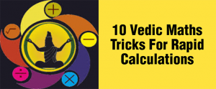
Name of app- Sutras of Vedic Mathematics
Description of creator(achievements) and app (Catch phrase)
Adhyay- 9 lessons http://blog.pcmbtoday.com/10-vedic-maths-tricks-rapid-calculations/
Test your knowledge

