Slide 1

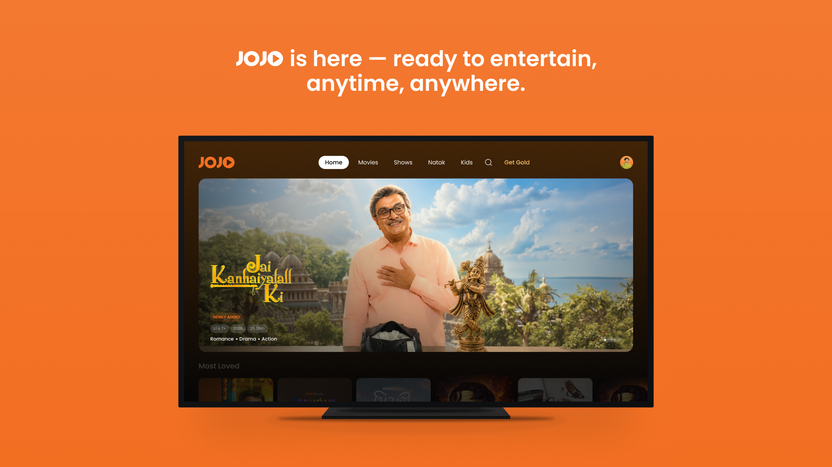
SELLER LOUNGE SUBMISSION
UX Scenario
Document
LG webOS TV application
App ID
JOJO
in.jojoapp.jojo
Gujarati movies, shows, natak, kids content and premium entertainment — designed for TV remote navigation.
Version 1.0.0 • 29 September 2026
Prepared for LG Seller Lounge review
JOJO Limited • support@appjojo.in

Slide 2
DOCUMENT MAP
02
Table of Contents
01
Basic Information
05
Sub Page Description
Identity, platform and service scope
Detail, episodes and search
02
Document History
06
Paid Content
Version and submission record
Gold and one-time purchase flow
03
Remote & Login
07
In-App Ad
Required controls and authentication
Video advertisement behavior
04
Main Page Description
08
Reviewer Test Information
Home hero and content browsing
Pre-submission handoff fields
JOJO | LG webOS TV UX Scenario | v1.0.0
29 SEP 2026 • 02

Slide 3
1. BASIC INFORMATION
03
Application Overview
APP TITLE
APP ID
JOJO
in.jojoapp.jojo
APP VERSION
CATEGORY
1.0.0
Entertainment › Movie
APPLICATION TYPE
SERVICE PLATFORM
Web app for LG webOS TV
2022 and later / per uploaded device group
DISPLAY
REMOTE
1920 × 1080 UHD application UI
Magic and general remote supported
PRIMARY LANGUAGE
SUPPORT
English UI; Gujarati content catalogue
support@appjojo.in
Submission note
Country availability and exact model rows follow the selections made in Seller Lounge.
JOJO | LG webOS TV UX Scenario | v1.0.0
29 SEP 2026 • 03

Slide 4
2. DOCUMENT HISTORY
04
Submission Record
Sent
Version
File name
Contents
29.09.2026
1.0.0
JOJO_LG_UX_Scenario_v1.0.0
Initial LG Seller Lounge submission
SCOPE OF THIS REVISION
• Documents the LG TV launch, authentication and remote-navigation paths.
• Covers Home, card focus, asset detail, episodic content and Search.
• Records paid-content and video-ad behavior for certification review.
• Uses production-style screenshots supplied by the submission owner.
Owner action: update this row whenever the app binary, reviewer flow or screenshots change.
JOJO | LG webOS TV UX Scenario | v1.0.0
29 SEP 2026 • 04

Slide 5
3. PAGE DESCRIPTION
05
Device Requirements & Remote Controls
SELLER LOUNGE SELECTIONS
NAVIGATION MAP
DEVICE REQUIREMENTS
D-pad
Moves the visible focus between navigation items, cards and controls.
None
REMOTE CONTROLLER
OK / Wheel click
Activates the focused item and starts the selected action.
Both Magic and general remote
DIAL APP NAME
Back
Returns one level; at the app root it follows the webOS close/back flow.
Leave blank — DIAL is not required
Magic pointer
Pointer selection is supported where available; D-pad remains primary.
FOCUS RULE
The screenshots show the white focus border / expanded card used throughout browsing. Focus returns to a predictable item after Back navigation.
Every actionable TV element presents a visible focus state before activation.
JOJO | LG webOS TV UX Scenario | v1.0.0
29 SEP 2026 • 05

Slide 6
3. DETAILED LOGIN INFORMATION
06
Sign-in & TV Pairing
1
2
3
4
5
Launch
›
Choose login
›
Verify
›
Select profile
›
Enter Home
Open JOJO from the LG launcher.
Use Phone/QR or enter mobile number / email.
Pair from JOJO mobile app or enter the received OTP.
Choose or create the viewing profile.
Authenticated session opens the Home page.
PHONE / QR PATH
REVIEWER CREDENTIALS
• Open the JOJO mobile app.
• Go to Profile › TV Login.
• Scan the TV QR code or enter its unique pairing code.
• The TV detects the verified session and continues automatically.
Provide the test account and OTP / pairing method in Seller Lounge → Test Info.
Do not use a live customer account. If OTP is dynamic, provide a stable reviewer route or assisted test instructions.
JOJO | LG webOS TV UX Scenario | v1.0.0
29 SEP 2026 • 06

Slide 7
4. MAIN PAGE DESCRIPTION
07
Home — Hero & Global Navigation
REVIEWER FLOW
1
Open Home
Launch the app after a valid sign-in.
1
2
2
Move in header
Use Left/Right across Home, Movies, Shows, Natak, Kids and Search.
3
3
Browse hero
Move focus to the featured carousel and review its metadata.
4
4
Continue below
Press Down to enter content rails.
EXPECTED RESULT
Home loads the current featured title, its rating/year/runtime and the first content rail. The focused navigation item remains visibly highlighted and all controls respond to the remote.
JOJO | LG webOS TV UX Scenario | v1.0.0
29 SEP 2026 • 07

Slide 8
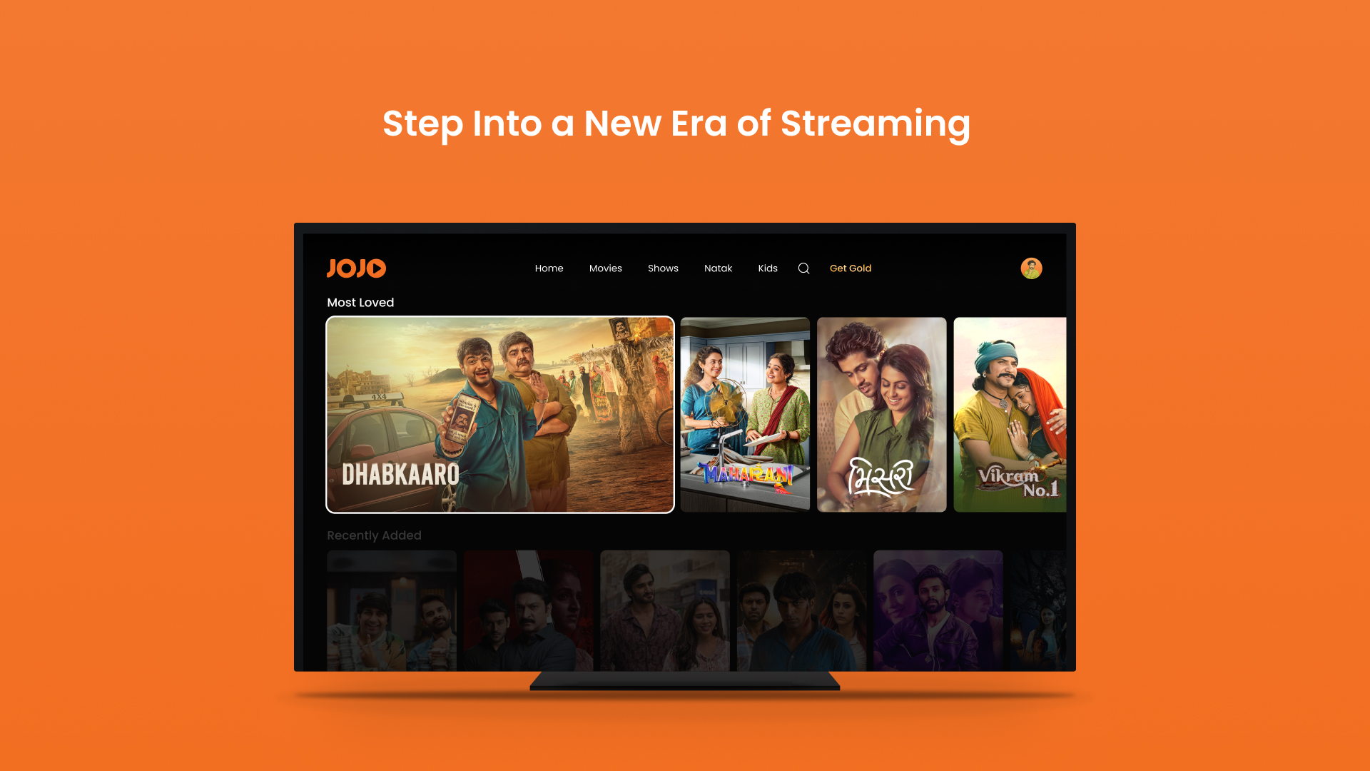
4. MAIN PAGE DESCRIPTION
08
Content Rails — Focus & Selection
REVIEWER FLOW
1
Enter a rail
Press Down from the header / hero.
1
2
Move focus
2
Use Left/Right to browse the row.
3
4
3
Confirm state
Focused card expands and receives a white border.
4
Open title
Press OK to open the selected asset.
EXPECTED RESULT
Focus never disappears while navigating. The selected landscape card is visually distinct, adjacent cards remain available, and OK opens the matching detail page. Back returns to the previous rail position.
JOJO | LG webOS TV UX Scenario | v1.0.0
29 SEP 2026 • 08

Slide 9
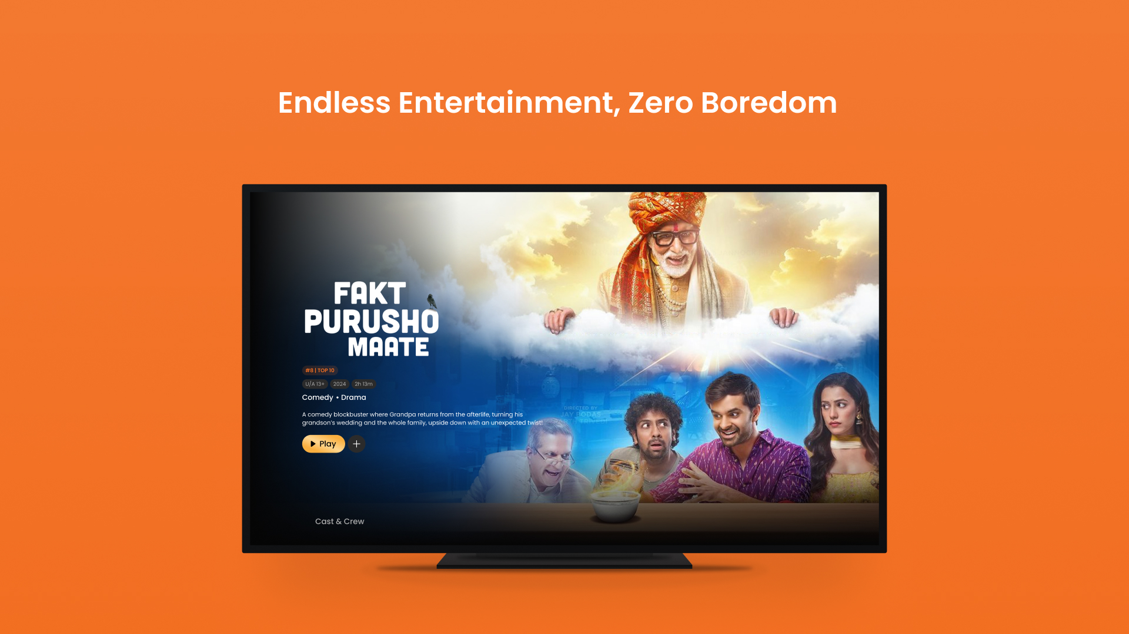
5. SUB PAGE DESCRIPTION
09
Asset Detail — Play & Watchlist
REVIEWER FLOW
4
1
Review metadata
Title, rating, year, duration, genre and synopsis are displayed.
2
Select Play
Move to Play and press OK.
1
2
3
3
Optional save
Select + to add or remove the title from Watchlist.
4
Return
Back closes the page and restores the prior browse context.
EXPECTED RESULT
Play starts the selected asset (or the access / purchase flow when entitlement is required). Watchlist updates give visible confirmation and the detail page remains fully remote-operable.
JOJO | LG webOS TV UX Scenario | v1.0.0
29 SEP 2026 • 09

Slide 10
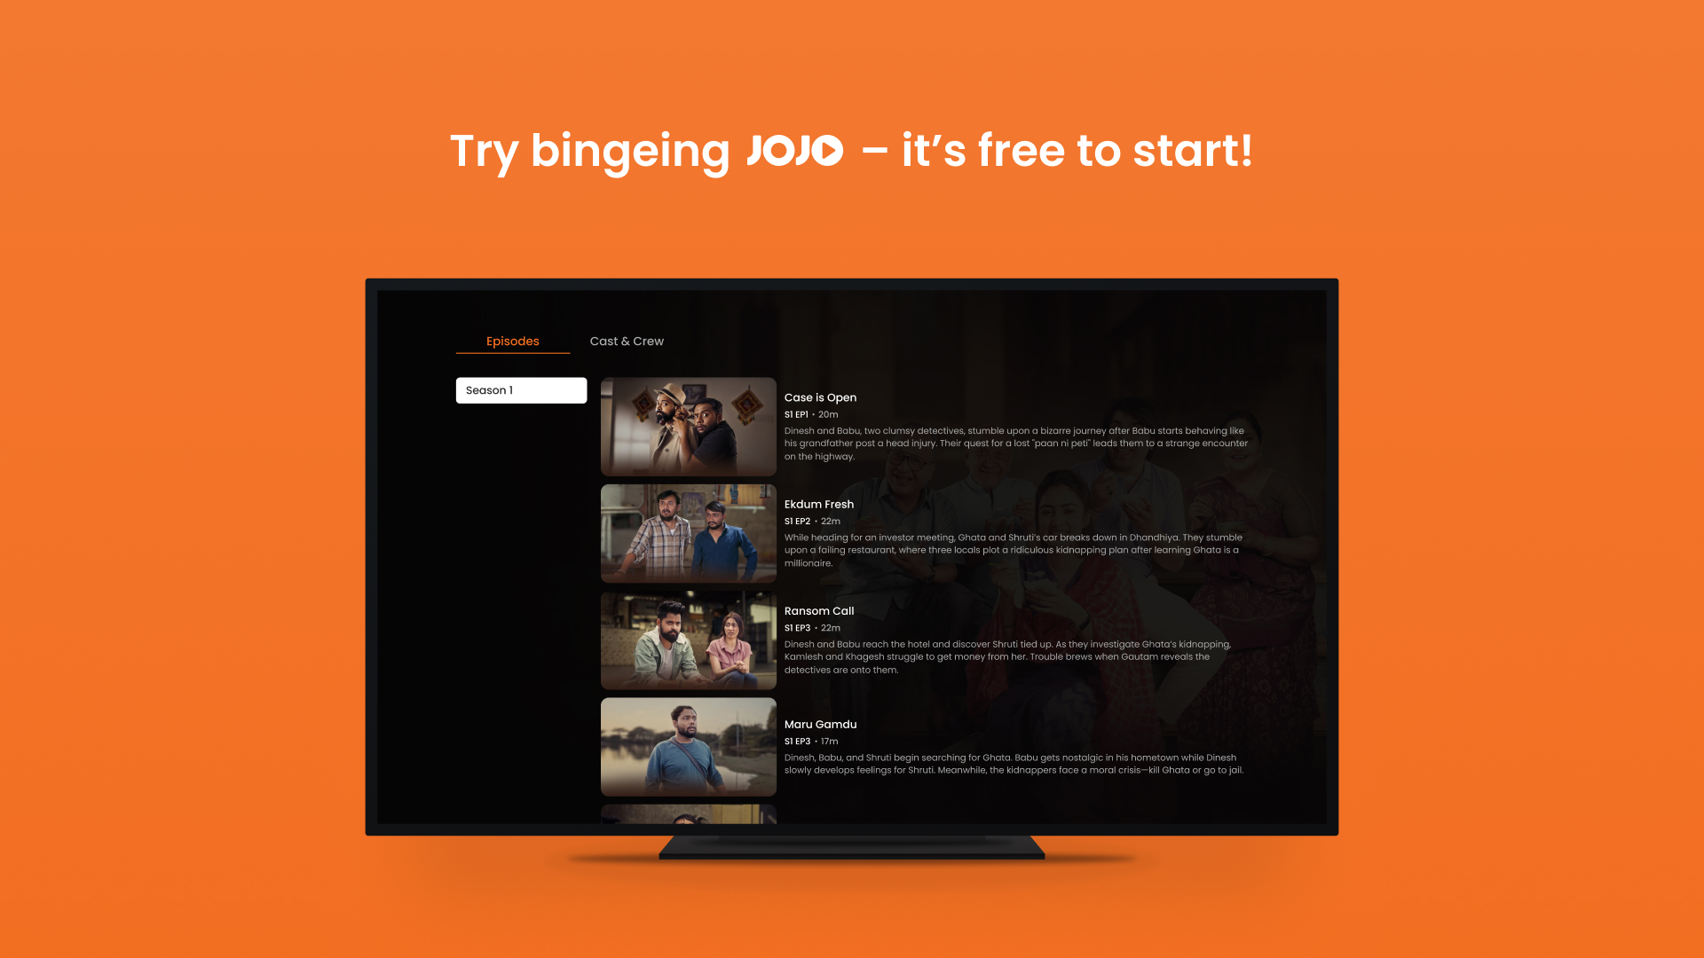
5. SUB PAGE DESCRIPTION
10
Series Detail — Seasons & Episodes
REVIEWER FLOW
1
Open Episodes
Select an episodic title and move to Episodes.
1
2
2
Choose season
Use the season selector when multiple seasons exist.
3
4
3
Browse episode
Move Up/Down through image, title, number, runtime and synopsis.
4
Start playback
Press OK on an episode.
EXPECTED RESULT
The selected season refreshes its episode list. Each episode exposes sufficient metadata, focus remains visible while scrolling, and OK launches exactly the highlighted episode.
JOJO | LG webOS TV UX Scenario | v1.0.0
29 SEP 2026 • 10

Slide 11
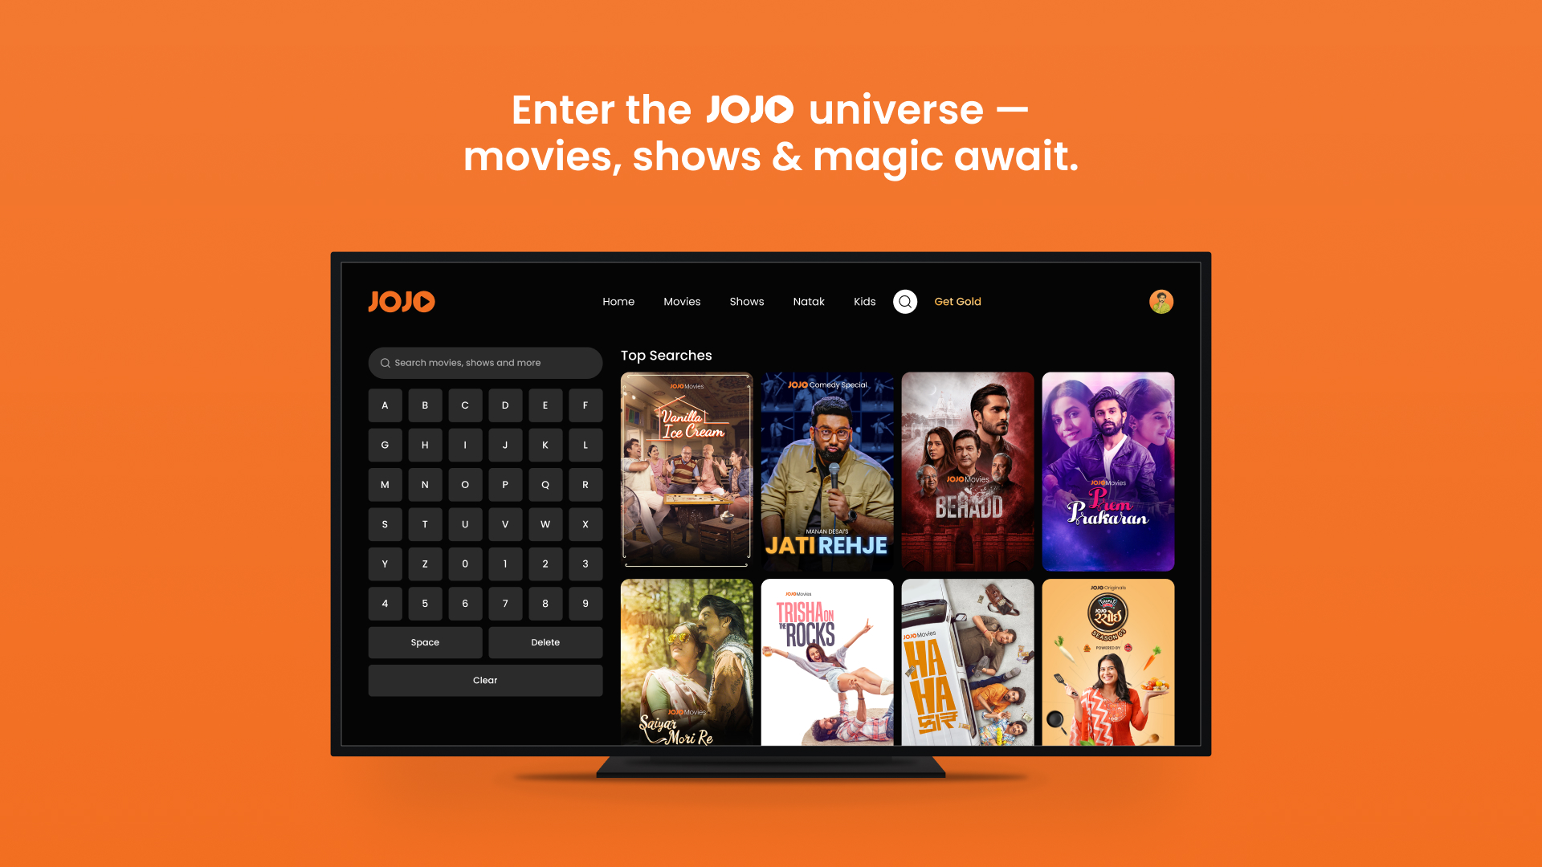
5. SUB PAGE DESCRIPTION
11
Search — Keyboard & Results
REVIEWER FLOW
1
Open Search
Select the search icon in the global header.
1
2
Enter query
3
Use D-pad + OK on the on-screen keyboard.
2
4
3
Review results
Results / top searches appear as portrait cards.
4
Open result
Move into the grid and press OK on a title.
EXPECTED RESULT
Search accepts letters, numbers, Space, Delete and Clear. The portrait results retain title artwork, focused cards are visible, and a chosen result opens its matching detail page.
JOJO | LG webOS TV UX Scenario | v1.0.0
29 SEP 2026 • 11

Slide 12

6. PAID CONTENT
12
JOJO Gold & Transactional Access
1
Open Get Gold
2
Select offer
3
Complete payment
4
Refresh access
Choose Get Gold in the global navigation.
Review the plan / price available for the service country.
Follow the configured Razorpay or Stripe/Card route.
Success updates entitlement; failure offers retry/back.
CERTIFICATION TEST
Payment test data must be supplied separately in Seller Lounge → Test Info.
Access rules
• Free / AVOD titles play when no premium entitlement is required.
• Gold unlocks eligible premium viewing and removes in-video ads.
• TVOD titles can request a one-time transaction before playback.
Include the reviewer account, selected country, plan/asset to test and provider-approved test instrument. Never upload a real customer's card or OTP.
JOJO | LG webOS TV UX Scenario | v1.0.0
29 SEP 2026 • 12

Slide 13
7. IN-APP AD
13
In-Video Advertisement Behavior
FORMAT
PLACEMENT
ELIGIBILITY
VAST / VMAP in-video advertisements
Pre-, mid- or post-roll per server schedule
Ad-enabled Free / AVOD playback
1
Start eligible content
Select Play on a free/ad-enabled asset.
EXPECTED BEHAVIOR
• Gold / ad-free entitlement suppresses configured video ads.
• Back does not accidentally abandon playback without the intended navigation response.
• After an ad error or no-fill, playback continues according to the configured fail-safe.
• No banner overlay is documented on the Home navigation pages in this revision.
2
Ad break begins
The ad overlay shows progress; main content is paused.
3
Use allowed controls
Play/Pause and Mute are available; Skip appears only when permitted.
4
Resume programme
Content continues automatically when the break completes.
Ad inventory is network-dependent; reviewers should use an enabled test account/asset supplied in Test Info.
JOJO | LG webOS TV UX Scenario | v1.0.0
29 SEP 2026 • 13

Slide 14
8. REVIEWER TEST INFORMATION
14
Pre-Submission Handoff
Complete these four items in Seller Lounge before submitting the application.
1
Reviewer account
A non-customer test login or QR pairing route
REQUIRED
2
OTP method
Stable OTP, assisted flow or precise retrieval instructions
REQUIRED
3
Paid-content test
Plan/asset, country and approved test payment method
IF ENABLED
4
Ad test
An ad-enabled free asset and expected break position
IF ENABLED
Support contact
JOJO Limited • support@appjojo.in • App ID in.jojoapp.jojo • Version 1.0.0
JOJO | LG webOS TV UX Scenario | v1.0.0
29 SEP 2026 • 14

