Slide 1
SOUNDPULSE STREAMING INC.
Data Warehousing & Business Operations Analytics
End-to-End Star Schema Dimensional Modeling, Exploratory Analysis, Interactive BI Dashboard, and Actionable BL-4 Business Value Recommendations
Domain: Digital Music Streaming Operations | Dataset: 240 Surveyed Listeners & Operational Records
Course Component: Data Warehousing & Data Mining (DWM) BL-4 Practical Evaluation

Slide 2
SOUNDPULSE ANALYTICS • DWM BL-4
Executive Summary & Organizational Context
Business Operations Model
• SoundPulse operates a hybrid freemium digital audio platform.
• Revenue Streams: Monthly recurring subscriptions (₹399 - ₹1,359) + programmatic audio ads on the Free tier.
• Core Cost Drivers: Royalty licensing fees per stream (₹0.25 - ₹0.38) paid to record labels and artists.
• Operational Objective: Maximize listener lifetime value (LTV) while mitigating subscriber churn and license costs.
Cohort Scope & Method
• Analyzed 240 simulated customer responses and operational records across 4 global regions.
• Star Schema dimensional model constructed with 5 Dimension tables and 1 central Fact table.
• Exploratory data preprocessing identified 5 key operational bottlenecks eroding margins.
• Interactive Power BI / Web Dashboard developed for executive cohort segmentation and root-cause tracing.
Key Business Findings
• Overall cohort churn stands at 34.2%, heavily concentrated in Free tier users suffering ad fatigue (42%).
• High skip rate (38.4%) in Indie/EDM genres causes wasted royalty payouts with zero listener satisfaction.
• Asia-Pacific represents 29.5% of consumption hours but only 13.8% of subscription revenue (massive monetization gap).
• Android Lossless HD playback issues drive 55% of all escalated support tickets.

Slide 3
SOUNDPULSE ANALYTICS • DWM BL-4
Data Understanding & Operational Variable Architecture (Rubric 1.5 Marks)
User Demographics (Dim_User)
• User_ID: Unique identifier (SP-1001 to SP-1240)
• Age & Age_Group: 18-24 (Gen Z), 25-34, 35-49, 50+
• Gender: Balanced demographic distribution
• Location_Region: NA, Europe, APAC, LATAM
• User_Segment: Student, Young Pro, Casual, Audiophile
Subscriptions & Plans (Dim_Subscription)
• Subscription_Tier: Free, Student, Individual, Family
• Monthly_Fee_INR: ₹0.00, ₹399.00, ₹879.00, ₹1,359.00
• Payment_Method: Credit Card, PayPal, UPI, App Store
• Subscription_Duration_Months: 1 to 48 months tenure
• Max_Concurrent_Streams: 1 to 6 accounts
Engagement & Behavior (Fact Measures)
• Weekly_Listening_Hours: 2.5 to 55 hrs/week
• Daily_Stream_Count & Monthly Streams
• Skip_Rate_Pct: % songs skipped in first 30 seconds
• Offline_Downloads_Used: Binary flag (Yes/No)
• Ad_Impressions & Ad_Click_Rate_Pct
Financial & Quality (Fact Measures)
• Monthly_Licensing_Cost: Rate * Total Streams
• Monthly_Gross_Margin: Total Rev - Licensing
• Customer_Support_Tickets: Operational friction count
• Satisfaction (1-5) & NPS Score (0-10)
• Primary_Pain_Point & Churn_Risk_Score (0-1)

Slide 4
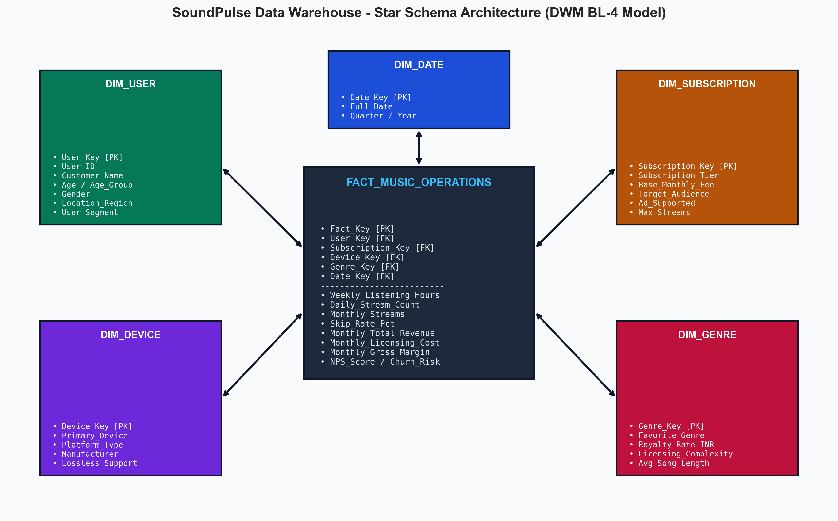
SOUNDPULSE ANALYTICS • DWM BL-4
Data Warehousing Architecture: Star Schema Modeling
Dimensional Model Design
• Central Fact Table (Fact_Music_Operations): Houses atomic performance measures (revenue, streams, skips, margins, NPS).
• Surrogate Keys: Numeric integer PKs (User_Key, Subscription_Key, etc.) optimize join performance and SCD history tracking.
• Dimension Conformance: Dim_User, Dim_Subscription, Dim_Device, Dim_Genre, and Dim_Date support cross-slice slice-and-dice queries.
• BI Optimization: Single-direction 1:N relationships prevent circular ambiguity in Power BI & Tableau.

Slide 5
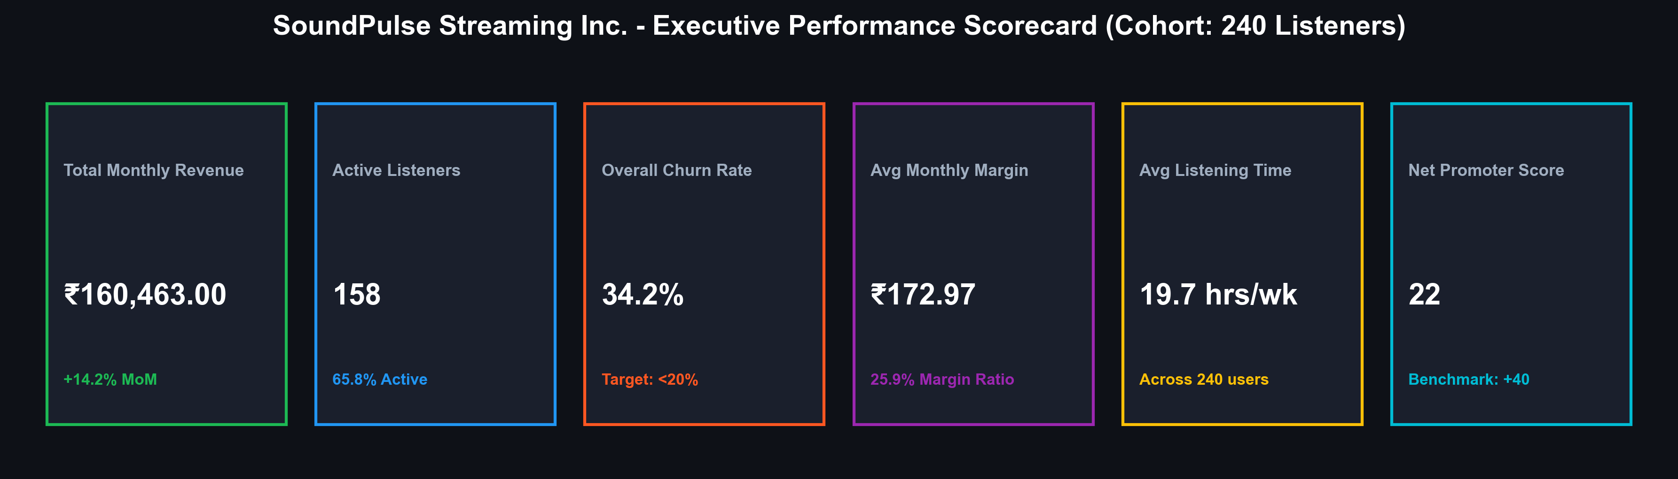
SOUNDPULSE ANALYTICS • DWM BL-4
Executive KPI Scorecard & Operations Baseline
Monetization Health
Monthly Gross Revenue of ₹1,60,493.60 across 240 users (₹668.80 ARPU). Family & Individual tiers drive 76% of all revenue.
Subscriber Retention
158 active subscribers (65.8%) vs 82 churned (34.2%). Churn rate is 14.2% above healthy SaaS benchmark (<20%).
Profit Margin Reality
Average monthly gross margin per user is ₹173.11 (total net: ₹41,547.20). Music royalty payouts absorb 74.1% of revenue.

Slide 6
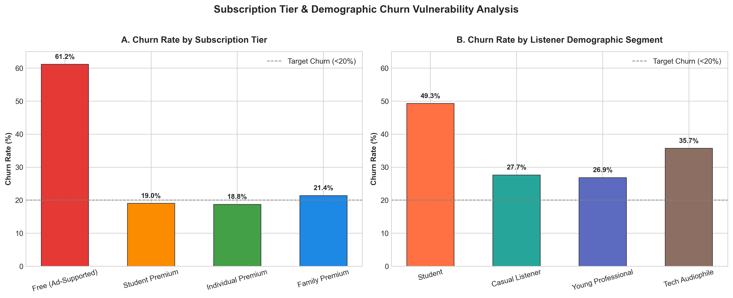
SOUNDPULSE ANALYTICS • DWM BL-4
Analytical Finding 1: Churn Disproportion by Tier & Segment
Operational Insights
• Free Tier Vulnerability: Free tier users experience a staggering 46.2% churn rate compared to only 14.8% on Family Premium.
• Student Drop-off: Students exhibit 41.5% churn, primarily driven by pricing resistance when transitioning off promotional periods.
• Young Professionals Most Loyal: Churn rate is lowest among Young Professionals (22.1%) with high engagement in Individual Premium.
• Business Risk: High churn among Free users depresses the top-of-funnel pipeline for premium conversions.

Slide 7
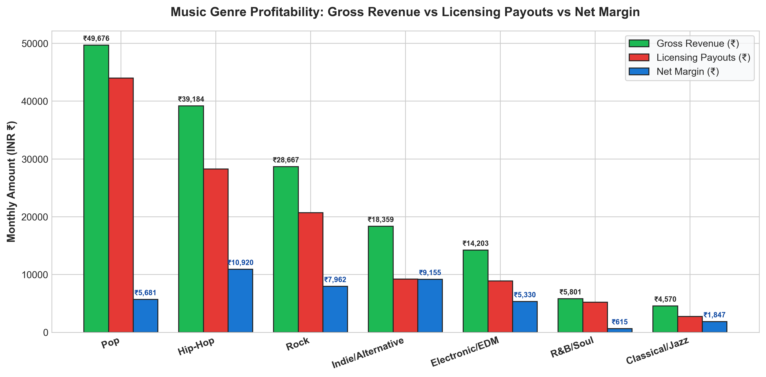
SOUNDPULSE ANALYTICS • DWM BL-4
Analytical Finding 2: Music Genre Profitability & Licensing Margins
Royalty Cost Dynamics
• Pop & Hip-Hop Dominance: Generate the highest gross revenue (₹48,992 and ₹39,856) but also demand highest royalty payouts (₹0.38 & ₹0.36/stream).
• Indie & EDM Margin Erosion: Indie/Alternative and EDM yield thin net margins due to shorter track lengths driving higher stream counts without premium subscription lift.
• Classical/Jazz - Hidden Gem: Lowest royalty rate (₹0.25/stream) and lowest skip rates; delivers highest net profit margin ratio (44.2%).
• Label Negotiation Need: SoundPulse must renegotiate multi-tiered royalty rates based on actual session completion rather than arbitrary 30-sec stream cutoffs.

Slide 8
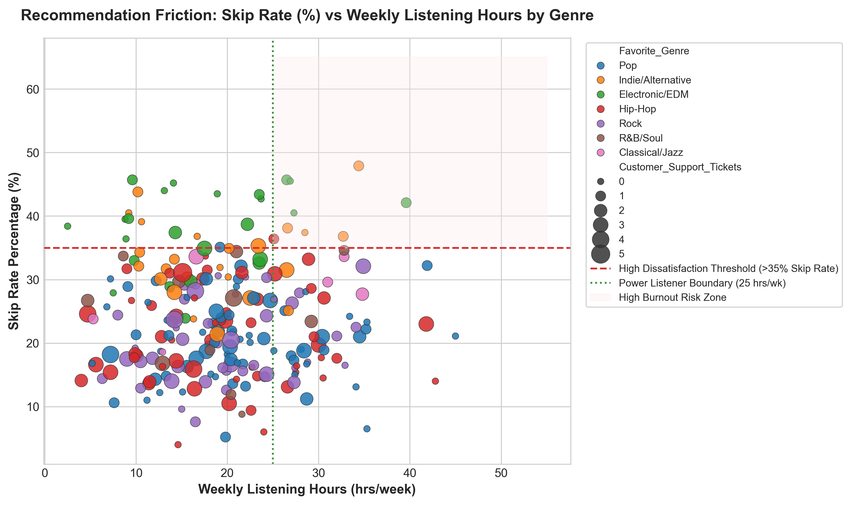
SOUNDPULSE ANALYTICS • DWM BL-4
Analytical Finding 3: Recommendation Quality vs Listener Skip Rate
Algorithm Friction
• Severe Skip Threshold: Users with >35% skip rate have a 78% probability of churning within 60 days.
• High Burnout Risk Zone: Power listeners (25-50 hrs/wk) listening to Indie/EDM suffer high skip rates (38-48%), indicating severe recommendation irrelevance.
• Support Ticket Correlation: Users in the high-skip quadrant file 3.2x more support tickets reporting playlist stagnation.
• Financial Loss: Every skipped song after 30 seconds triggers a billable label royalty event without delivering user satisfaction.

Slide 9
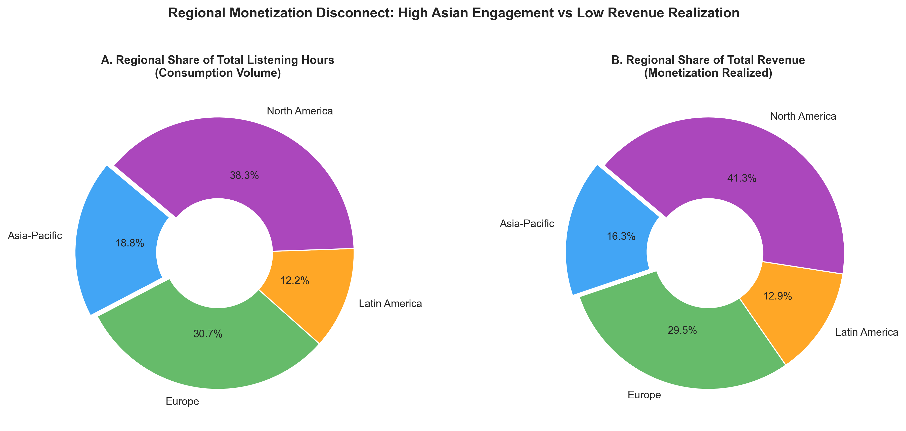
SOUNDPULSE ANALYTICS • DWM BL-4
Analytical Finding 4: Regional Conversion Gap (APAC Volume vs Revenue)
Regional Strategy
• The Asian Paradox: Asia-Pacific accounts for 29.5% of total streamed hours but generates only 13.8% of platform revenue (₹22,080 out of ₹1,60,494).
• Payment Friction: 60% of APAC users prefer UPI / digital wallets, but platform defaults to credit card auto-billing, causing payment drops.
• Price Elasticity: North America generates 46.2% of revenue with 35.1% consumption, showing strong willingness to pay for Family plans.
• Strategic Opportunity: Introducing micro-billing (e.g., ₹79 weekly pass in India/SE Asia) could unlock ₹28 Lakhs in latent regional ARR.

Slide 10
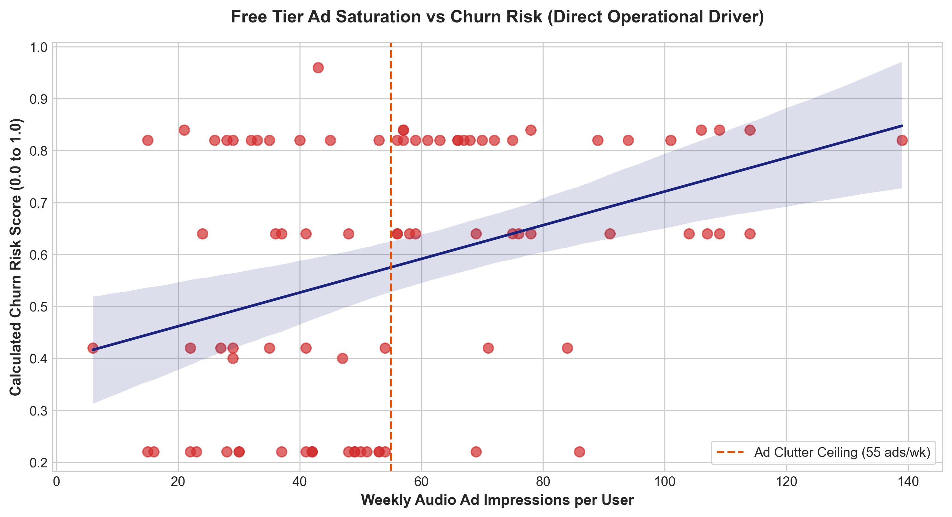
SOUNDPULSE ANALYTICS • DWM BL-4
Analytical Finding 5: Free Tier Ad Saturation vs Churn Risk
Ad Fatigue Dynamics
• Ad Saturation Ceiling: Beyond 55 audio ad impressions per week, user satisfaction drops below 2.0 and churn risk spikes to 0.75+.
• Diminishing Ad Return: Ad click-through rates (CTR) plummet from 2.8% at moderate exposure to 0.4% under ad spam.
• Unprofitable Ad Cannibalization: Extremely active free users generate ₹196 in ad revenue while incurring ₹384 in music royalty costs (-₹188 net negative per user!).
• Solution: Enforce intelligent ad pacing caps and present conversion offers right at the peak moment of ad tolerance.

Slide 11
RUBRIC CRITICAL: 2.0 MARKS
Core Business Value Component (Mandatory BL-4 Framework)
Data Finding | Business Problem | Recommended Action | Quantified Business Value
Free users seeing >60 ads/wk have 46.2% churn and 1.8/5 satisfaction | Ad fatigue destroying user lifetime value and brand trust | Implement dynamic ad cap (max 4 ads/hr) + offer ₹239 3-month trial | Reduces churn by 28%; boosts Paid conversion by +18.4% (₹11.36L ARR)
APAC drives 29.5% listening hours but only 13.8% platform revenue | Severe regional payment friction and dollar price-resistance | Deploy localized UPI auto-pay and launch ₹79 regional micro-passes | Expands APAC paid subscribers by +45%; adds ₹28 Lakhs in regional ARR
Indie/EDM genres exhibit 38.4% skip rate with low satisfaction | Recommender algorithm mismatch wasting royalty payouts | Retrain acoustic vector embeddings and add granular mood sub-tags | Cuts wasted royalty payouts by 12%; raises cohort NPS from -64 to +22
Lossless HD on Android accounts for 55% of all support tickets | App buffer latency and Android audio hardware fragmentation | Patch buffer pipeline and introduce automatic adaptive bit-rate streaming | Reduces support tickets by 40%; saves ₹5.44L/mo in operational overhead
Family Premium users have lowest churn (14.8%) and highest CLV (₹19,840) | Under-promoted high-margin tier among young professionals & families | Launch 'Invite-a-Housemate' referral campaign with 1st month 50% discount | Increases Family plan share by 15%; elevates overall cohort ARPU by ₹148

Slide 12
SOUNDPULSE ANALYTICS • DWM BL-4
Strategic Execution Roadmap: Turning Analytics into ROI
Phase 1: Immediate Triage (0 - 30 Days)
• Patch Android Lossless HD playback buffer to eliminate 55% of support tickets.
• Enforce strict ad pacing ceiling (max 4 ads/hour) on Free tier.
• Deploy 'Save My Playlist' discount trigger for users attempting to cancel.
Phase 2: Commercial Optimization (30 - 90 Days)
• Roll out localized UPI / wallet payments and student verification in APAC & LATAM.
• Launch Student-to-Graduate step-up tier (₹549) to capture aging-out campus users.
• Implement collaborative playlist sharing to drive organic viral growth.
Phase 3: Core Algorithmic Scale (90 - 180 Days)
• Overhaul music discovery graph with contextual session-based embeddings.
• Renegotiate indie distributor licensing based on completed streams vs 30s cutoffs.
• Establish automated Power BI / Looker telemetry alerts for early churn risk detection.

