Slide 1


Introduction to Linux Operating System Presented By: Priyanka Gupta(18MCMC06) Abhishek Kumar(18MCMC10) Lokesh Kirad(18MCMC22) Pallavi Kumari(18MCMC33)

Slide 2

Content
What is Linux?
Why Linux?
The Linux System
Security
OS Comparison

Slide 3
What is Linux?
Linux is a Unix-like, community-developed operating system developed originally for home PCs.
Linux was created by Linus Torvalds in 1991.
Now it has evolved into a very functional, powerful and usable clone of Unix which has at least 10 million users worldwide.
Now-a-days, It runs on a variety of platforms including PowerPC, Macintosh, Amiga, DEC Alpha and many others.

Slide 4
Why Linux?
Open Source
High Stability
Free distribution
Support multiple processors
Secure
Platform Independent
Ease of Use
Flexible
Ideal environment to run servers
Ease of maintenance

Slide 5
The Linux System
The Linux system excel in many area, ranging from end user concerns such as stability, speed, ease of use, to serious concerns such as development and networking.
Linux kernel
Linux networking
Linux file system

Slide 6
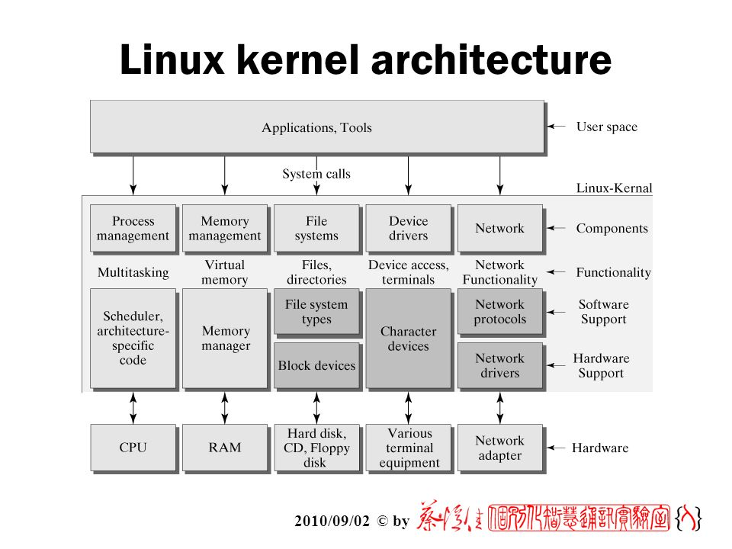
Linux Kernel
The kernel is the central nervous system of Linux.
It manages and provides resources to all other programs.
It includes the code that performs certain specialized tasks, including TCP/IP networking.
The kernel design is modular
Small, fast and highly extensible

Slide 7
Linux Networking
Linux is a product of the Internet or World Wide Web (www).
Probably all networking protocols in use are native to Unix and/or Linux
The Linux kernel supports several networking protocols:
TCP/IP : Transport Control Protocol/Internet Protocol
IP : primary network protocol supported by Linux
IPX : Internetwork Packet Exchange
AppleTalk DDP
Amateur Radio AX.25 Level 2

Slide 8
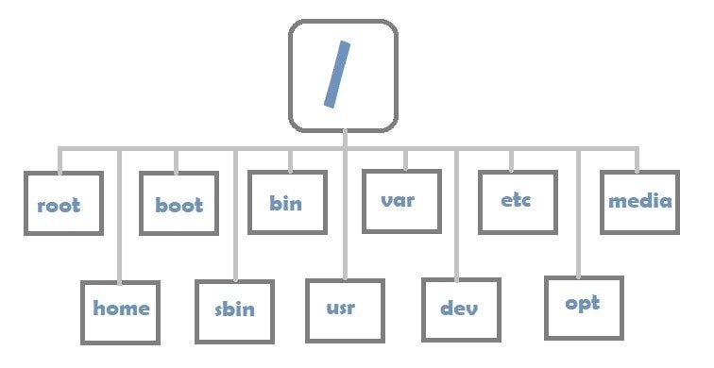
Linux File System
Linux has an hierarchical, unified file system
Supports 256-character filenames.
All command line entries are case sensitive.
Use the slash(/) rather than the backslash(\) you have been using in DOS.
Types of File
Ordinary files
directories
links
special device files

Slide 9
Security
Encryption
Encryption commonly used to secure data. It is the ancient technique of hiding information in plain sight. It include:
strong encryption - stronger than the 40-bit encryption maximum that can be exported from the United States under U.S. law.
Public-key Encryption -type of asymmetric encryption, which is a system that you encrypt your message with one key, and the recipient decrypts it with a mathematically related, but different key.

Slide 10
The Secure shell(ssh)
The ssh and its tools use strong encryption to allow remotely
located systems to exchange data securely.
By using strong encryption, ssh significantly enhances the
security of both the authentication process and the session itself.

Slide 11
Principle of Security
Two broad categories of attack exist:
unauthorized access
denial of service
Defense against the attacks:
enforce the use of password
use TCP wrappers to limit which resources are made available to which categories of users.
monitor internal users, protect your organization against unauthorized or inappropriate use of the computer facilities to harass personnel.

Slide 12
Linux
Unix
Open source Operating system which is freely available.
Freely available and distributed with no associated cost
Portable
Faster
Linux Variants as Ubuntu, RedHat, Opensuse etc.
Operating system can only be used by the copywriters.
come as customized cost
Not Portable
Comparatively slower on the same hardware configuration
Unix Variants as AIS,HP-UX,BSD etc.

Slide 13
Linux
MS Windows
Open source
Graphics capabilities and include excellent networking capabilities
Support multi-user, multi-tasking
Low Hardware Cost
Closed Source
Graphics Capabilities and include network capabilities
Doesn’t support
High Hardware Cost

Slide 14
Linux
Windows NT
2MB RAM and at least 15MB disk space
multitasking, multiprocessing and multi- user support
Support Dynamic Cache
Designed initially in context of size efficiency
Network Support
Flexible
12MB RAM and at least 70MB disk space
multitasking, multiprocessing and multi- user support
Also support Dynamic cache
Designed for portability
Less Network Support
Less Flexible

Slide 15
References
http://www.Linux.org
http://www.croftj.net/~jam
http://metalab.unc.edu/LDP/HOWTO/NET-3-HOWTO-4.html#ss4.1

Slide 16


