Slide 1
Multithreading in Java
Abhishek Kuvalekar
25/02/2024

Slide 2
Agenda
What is a thread in programming?
What is multithreading?
Multithreading in Java
Lifecyle of a thread in Java
Naming a thread
Thread priority
Thread Group
Thread Scheduler
Thread Pool
Interthread Communication
Daemon Thread

Slide 3
What is a thread?
A lightweight process which OS can schedule and run concurrently
A smallest unit of a process
Difference between process and thread
  Processes are independent while threads are not
  Threads are bound to a process
  Have their own state and shares state with the parent process and other threads of the same process

Slide 4
What is multithreading?
A programming concept in which a process can create small units of tasks and execute them concurrently
Are threads run in parallel?
Difference between parallel programming and multithreading
How OS runs individual threads? (Refer image)

Slide 5
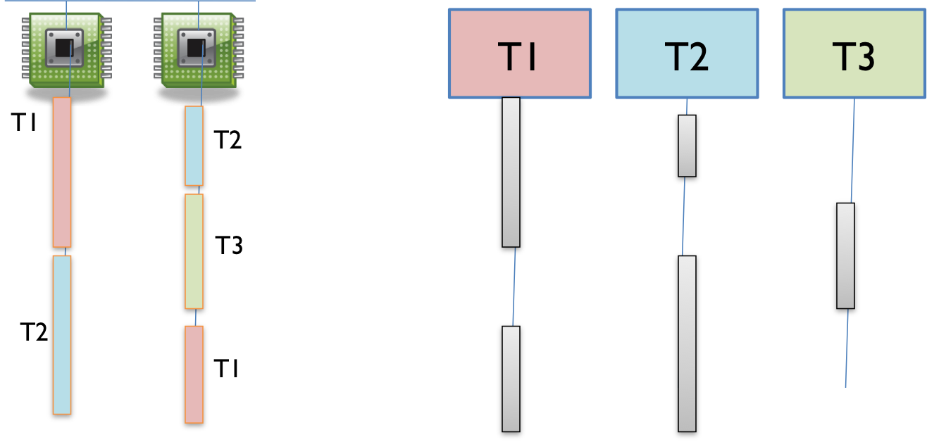
What is multithreading? (cont)

Slide 6
Multithreading in Java
Two ways to create a thread
  Extending the Thread class
  Implementing the Runnable interfacer
Demo
  Threads run concurrently
Thread functions:
  start()
  run()
  sleep(int milliseconds)
  join()

Slide 7
Lifecycle of a thread in Java
Lifecyle stages of a thread:
  New
  Active
    Runnable
    Running
  Blocked/Waiting
  TimedWaiting
  Terminated

Slide 8
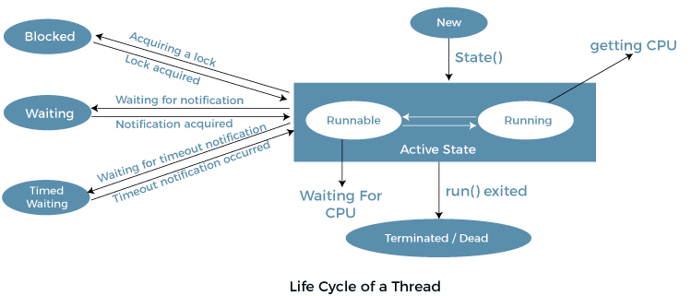
Lifecycle of a thread in Java (cont)

Slide 9
Naming a thread
Can assign names to threads for identification
Default names are thread-0, thread-1...
Can be done using two functions:
  getName()
  setName(String name)

Slide 10
Thread priority
Each thread has a priority given by JVM
Application programmer can set priority
Can be done using two functions:
  getPriority()
  setPriority(int priority)
Values:
  MIN_PRIORITY
  NORM_PRIORITY
  MAX_PRIORITY
Does not guarantee the thread execution order
Demo

Slide 11
Thread Group
A provision to group multiple threads together
Represents a set of threads
Can have nested thread groups
Access control:
  A thread can access information of its own threadgroup
  Can’t access information of own thread group’s parent or other thread groups
Implemented using java.lang.ThreadGroup class
Demo

Slide 12
Thread Scheduler
Decides which thread to run and which thread to be made waiting
Considers two factors:
  Thread Priority
  Arrival Time (i.e. time at which a thread became runnable)
Algorithms:
  FCFS (First Come First Serve) Scheduling
  Time Slicing Scheduling
  Preemptive-Priority Scheduling

Slide 13
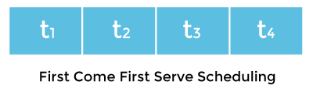
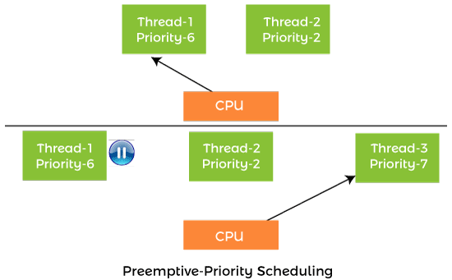
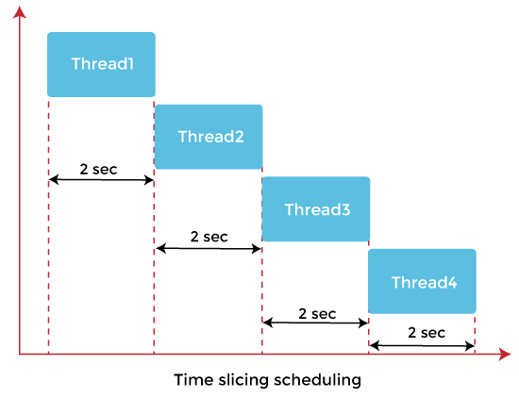
Thread Scheduler (cont

Slide 14
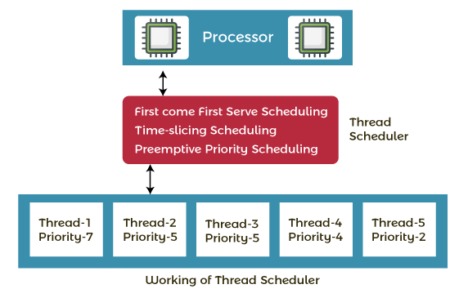
Thread Scheduler (cont)
Working of thread scheduler in Java:

Slide 15
Thread Pool
Creation of a thread is expensive
Thread pool is a group of worker threads which contains a number of threads to run tasks
A thread from a thread pool is pulled to execute a task and returned back to the pool once the task is completed
Thread Pools in Java:
  Single Thread Pool
  Fixed Thread Pool
  Cached Thread Pool
Demo

Slide 16
Inter thread communication
Concept of a lock:
  Used for thread synchronization
  synchronized methods and blocks
  Locked section of a code can be executed by only one thread at a time
  Demo
Inter thread communication methods:
  wait() - Releases lock and waits till another thread calls notify()
  notify() - Wakes up a single thread waiting on the object’s monitor
  notifyAll() - Wakes up all the threads waiting on the object’s monitor
Demo

Slide 17
Daemon Thread
Service provider thread
Works as a helper to the worker threads
Automatically terminated when all the worker threads are terminated
Methods:
  setDaemon(boolean status)
  IsDaemon()
Example:
  GC thread

Slide 18
Thank you!

