Slide 1
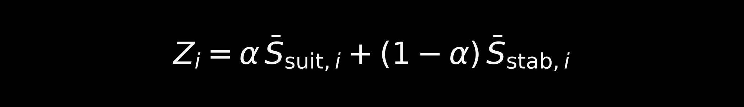
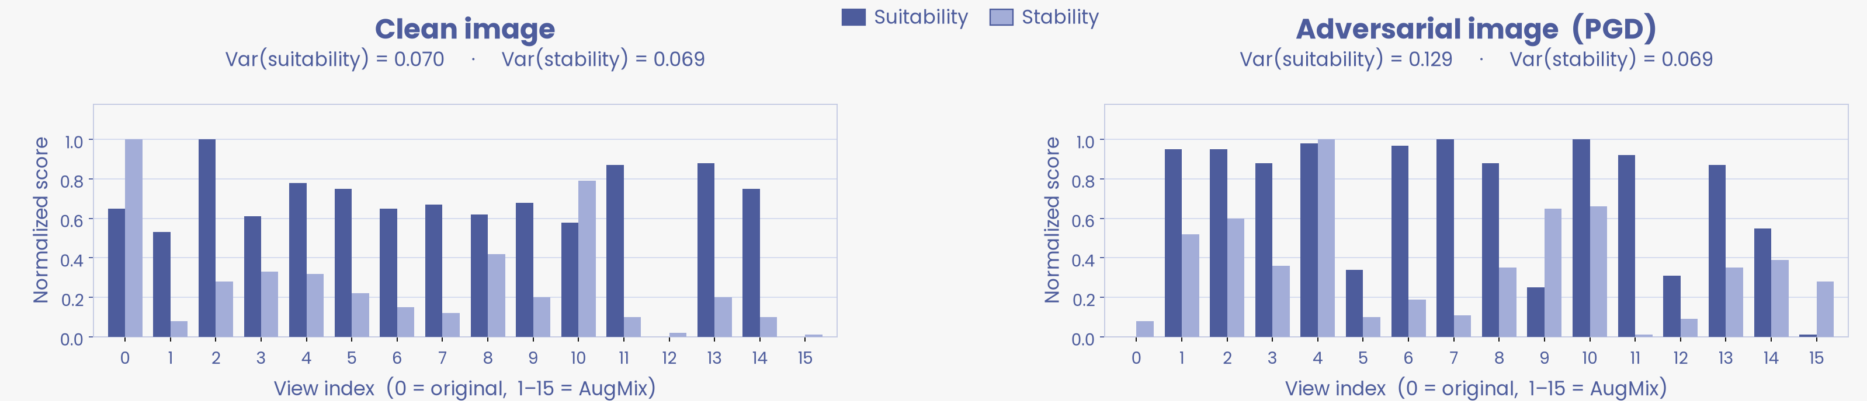
/
Task 2
Instance-Adaptive Stability–Suitability Balancing
1. The fixed trade-off
SS-TPT mixes suitability and stability with one global α = 0.4 for every image.
2. Reliability varies by image
We inspect the 16-view score distributions and estimate which score is more informative.
3. What Task 2 changes
Replace α with instance-dependent α(x). The rest of SS-TPT is unchanged.
Original SS-TPT
One coefficient for every image
α is frozen at 0.4
If the wrong score dominates, corrupted views keep high weight.
Step 1 — Analyze the 16-view suitability and stability distributions (no α yet)

Slide 2
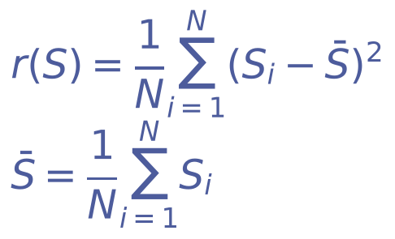

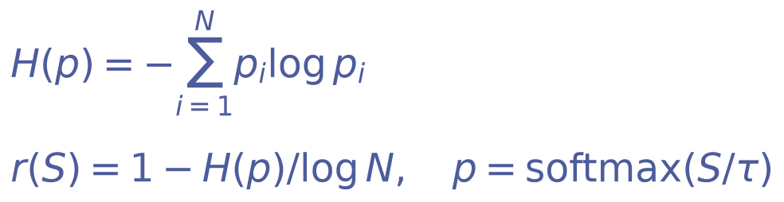
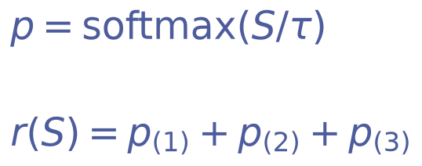
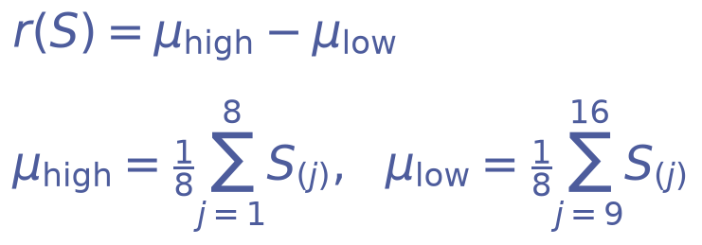

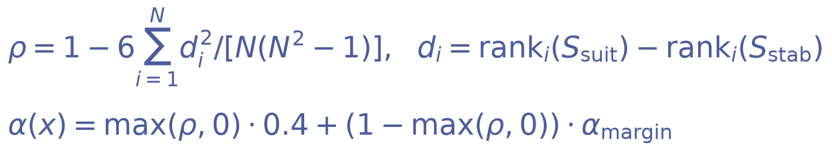
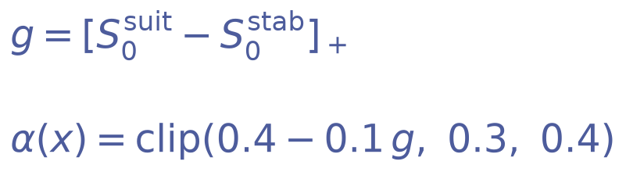
/
Method
Reliability r(S) → mix weight α(x) → blended view scores
r_suit(x) = r(S_suit(x)), r_stab(x) = r(S_stab(x)). S_suit, S_stab are the 16-view scores. If both r = 0, α(x) = 0.4.
Mode
Formula
What each symbol is
1. These five define reliability r(S). Then α(x) uses the mix above.
Variance (ours)
S : one 16-view score (suitability or stability).
S-bar : mean of S. i = 1, …, N. N = 16.
Compute r once on S_suit and once on S_stab.
Margin
S_(1) ≥ S_(2) ≥ ⋯ ≥ S_(N) : scores sorted descending.
S_(1) : best view. S_(2) : second-best. N = 16.
Entropy
p_i = exp(S_i / τ) / Σ_j exp(S_j / τ). H(p) : Shannon entropy.
H = 0 if one view has all mass; H = log N if p is uniform.
τ = 0.25 (temperature). N = 16.
Top-k
p_i = exp(S_i / τ) / Σ_j exp(S_j / τ).
p_(j) : j-th largest probability. k = 3. τ = 0.25. N = 16.
Separation
S_(j) : j-th largest view score.
N = 16, so each half has 8 views.
μ_high, μ_low : means of the strong and weak halves.
2. These three set α(x) directly — they do not use the shared r(S) mix.
Fixed
Original SS-TPT. No reliability r(S). Same mix on every image.
Agreement
ρ : Spearman rank correlation of the two 16-view scores, in [−1, 1].
rank_i : average rank of view i. N = 16.
α_margin : the Margin mix from block 1. If ρ ≤ 0, use Margin fully.
View0
[z]_+ = max(z, 0). Index 0 : unaugmented original view.
clip(z, a, b) = min(b, max(a, z)).
Nudges α toward stability by at most 0.1.

Slide 3
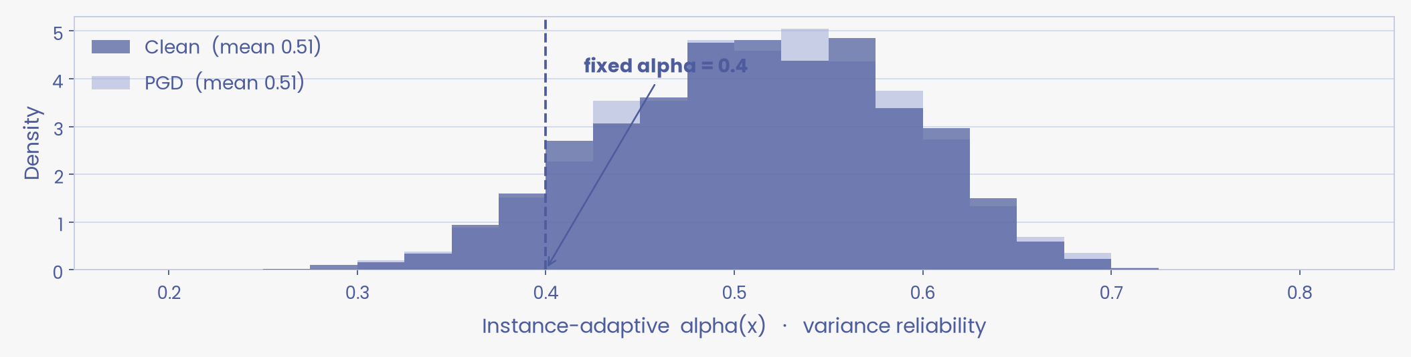
/
Results
Caltech-101 test set · 2,465 images · CLIP RN50 · PGD ε = 1/255, 7 steps
Mode | What it measures | Clean % | Adv % | Mean α(x)
Fixed α = 0.4 | Global constant (original SS-TPT) | 85.40 | 80.41 | 0.40 always
Variance (ours) | Spread of the 16 view scores | 85.11 | 80.37 | 0.51 → 0.51
View0 | Unaugmented original view only | 85.40 | 80.37 | 0.38 → 0.40
Entropy | Peakiness of softmaxed scores | 85.48 | 79.88 | 0.27 → 0.25
Top-k | Mass in the top-3 views | 85.44 | 79.96 | 0.39 → 0.38
Agreement | Do suit / stab rank views the same? | 85.23 | 79.84 | 0.29 → 0.29
Margin | Best minus second-best view | 85.23 | 79.55 | 0.24 → 0.22
Separation | Top-half mean − bottom-half mean | 84.67 | 79.72 | 0.57 → 0.57
Variance α(x) on the same 2,465 images — not a fixed 0.4
01 Entropy wins clean
Highest clean accuracy: 85.48%.
02 Variance is the method
Best adaptive PGD score. Mean α(x) = 0.51.
03 View0 is almost fixed-α
Ties variance on PGD, but most images stay at 0.4.

