Slide 1
CROWDFUNDING PROJECT

Slide 2
index
INTRODUCTION 3
KEY OBJECTIVE 4
DATA PREPARATION 5
DATA MODEL 6
DASHBOARD 7 CHALLENGES FACED 14

Slide 3

What is Crowdfunding
Crowdfunding is a method of raising money by collecting small contributions from a large number of people, typically via the Internet.
It is commonly used to fund creative projects, business ventures, charitable causes, or personal needs.
Crowdfunding platforms like Kickstarter, Indiegogo, GoFundMe, and others act as intermediaries, allowing project creators to present their ideas and solicit funds directly from the public.

Slide 4




Key Objective
Convert Epoch Time to Natural Time.
Build a Calendar Table and add custom columns.
Create a data model using provided Excel files.
Perform data transformations like currency conversion.
Generate dashboards in Excel, Power BI, and Tableau.
Solve analytical queries using SQL.
We have completed a crowdfunding project and developed the project solution using various tools, including Power BI, SQL, Excel, and Tableau. The details and outcomes of this solution are presented in the subsequent slides.

Slide 5

Data Preparation Steps
Step 1: Convert Epoch Time to Natural Time.
Used the reference article and Epoch Converter tool.
Applied formulas in Excel to transform timestamps.
Step 2: Build a Calendar Table.
Used the Created Date column.
Calculated custom fields like Year, Month Name, Financial Month, etc., using formulas.
Step 3: Currency Conversion.
Converted Goal Amount to USD using a static exchange rate
Applied transformations in Power Query .

Slide 6
Data Model Creation
Approach:
Imported Excel files into Power BI, Tableau, and Excel.
Established relationships between tables (e.g., Projects, Calendar).
Ensured a star schema for optimal performance.

Slide 7
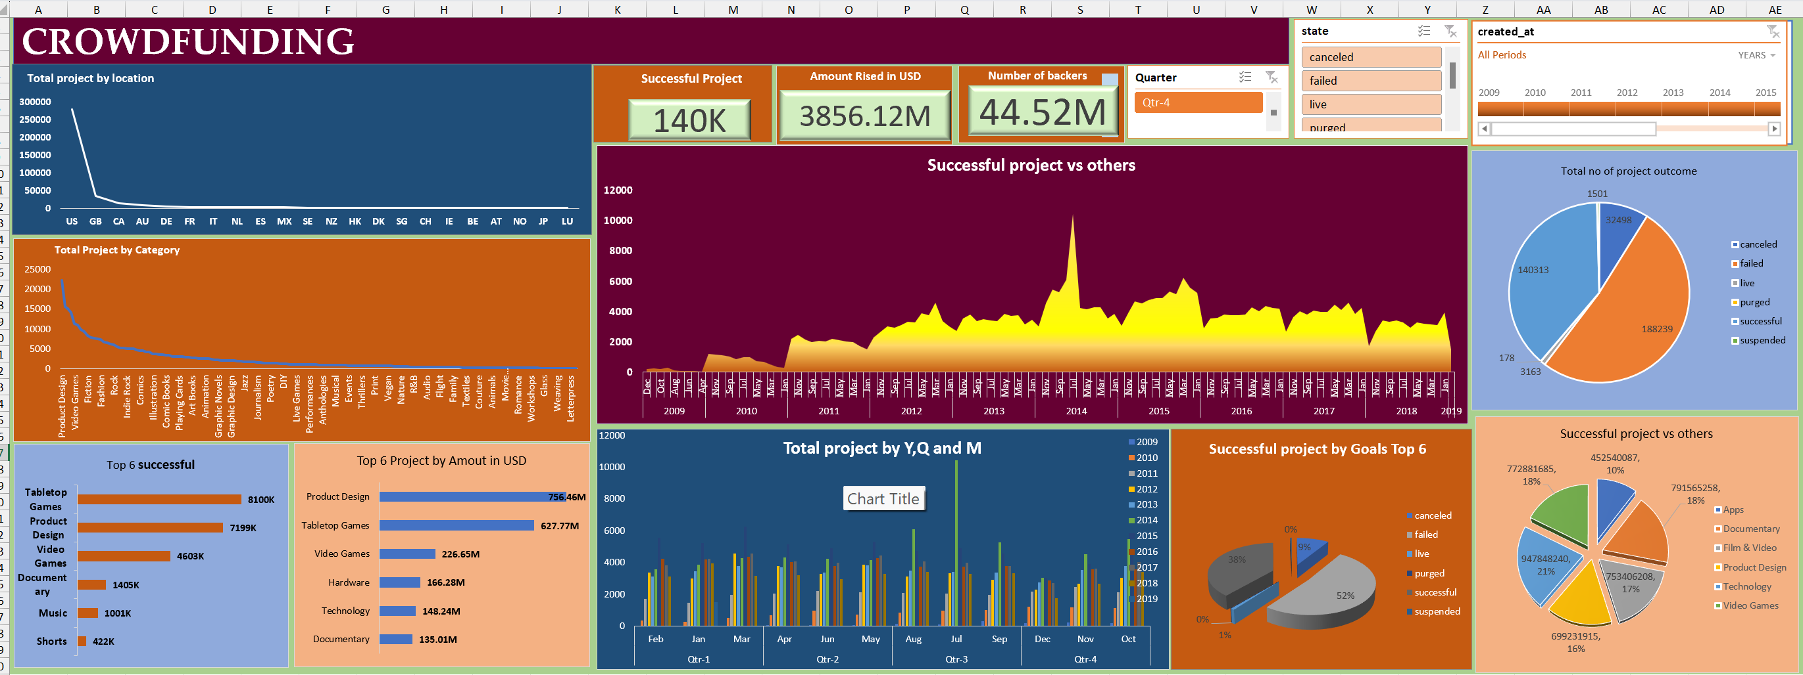
EXCEL DASHBOARD

Slide 8
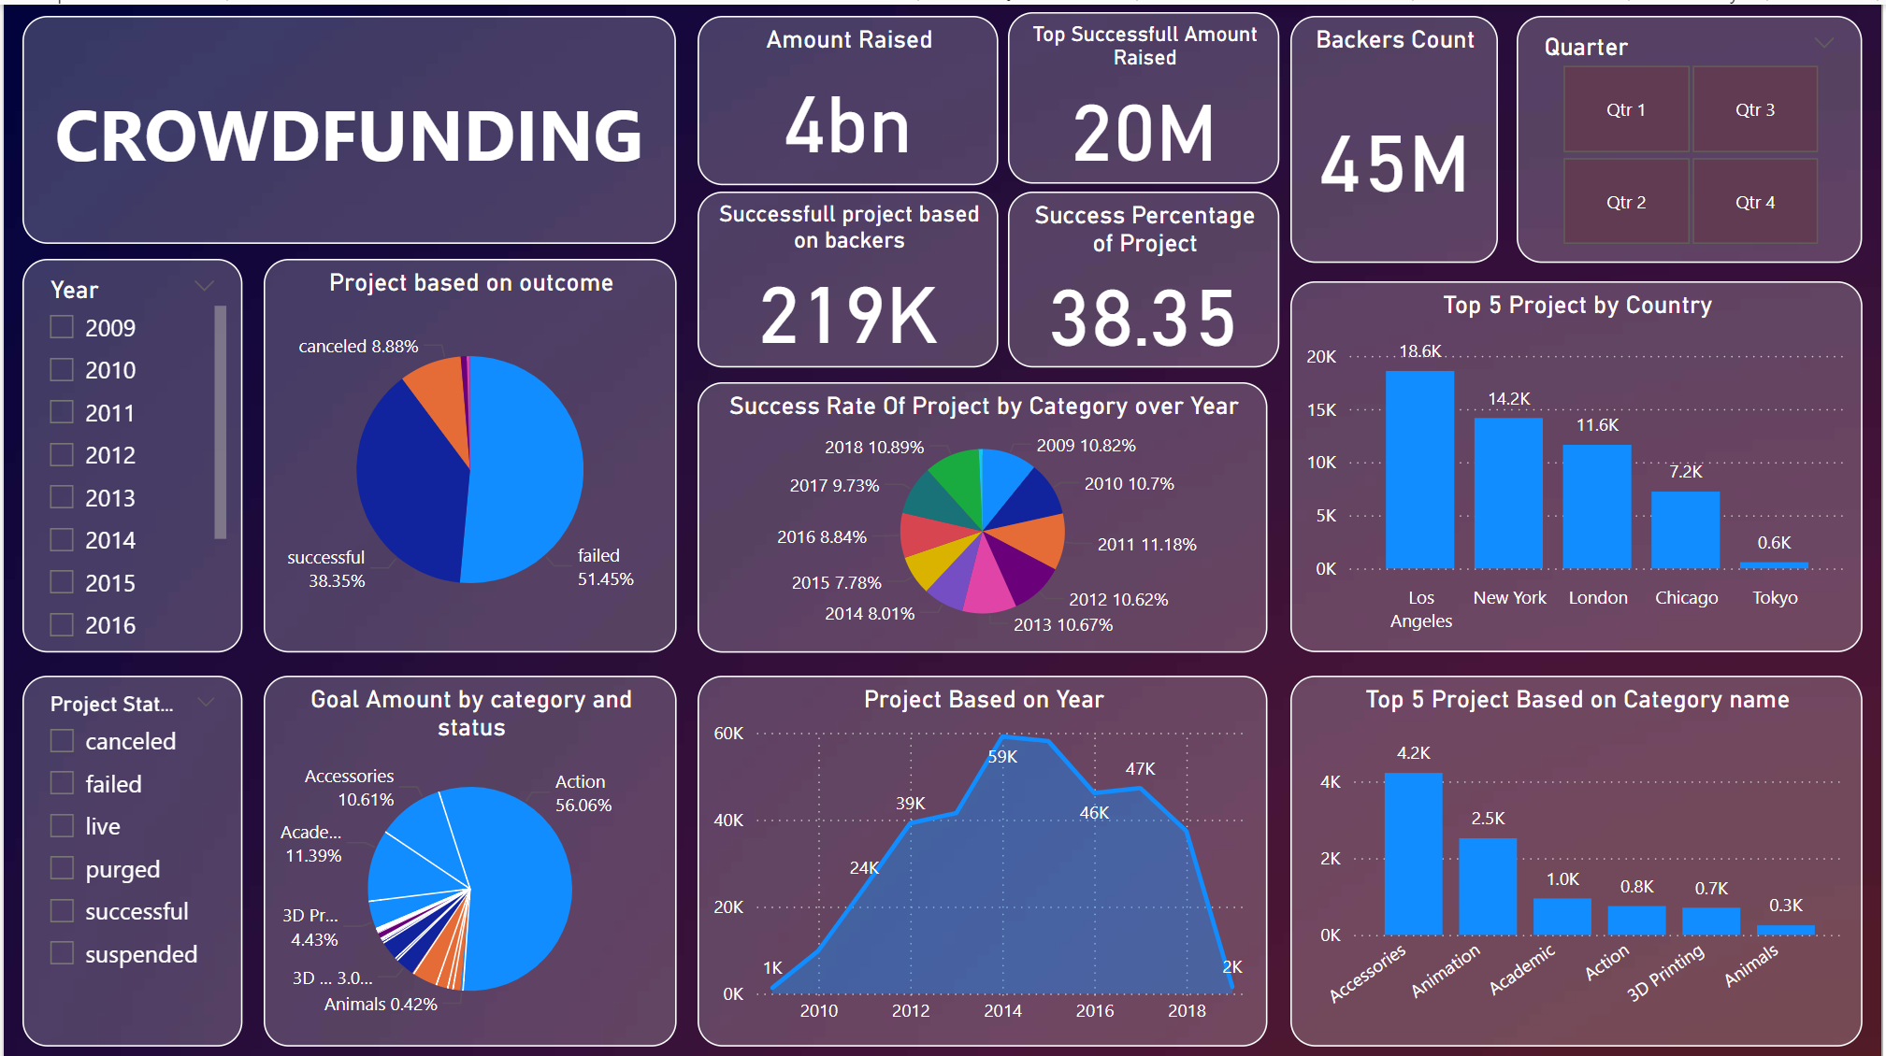
POWERBI DASHBOARD

Slide 9
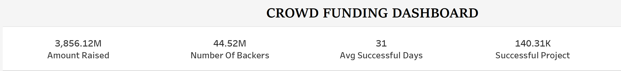

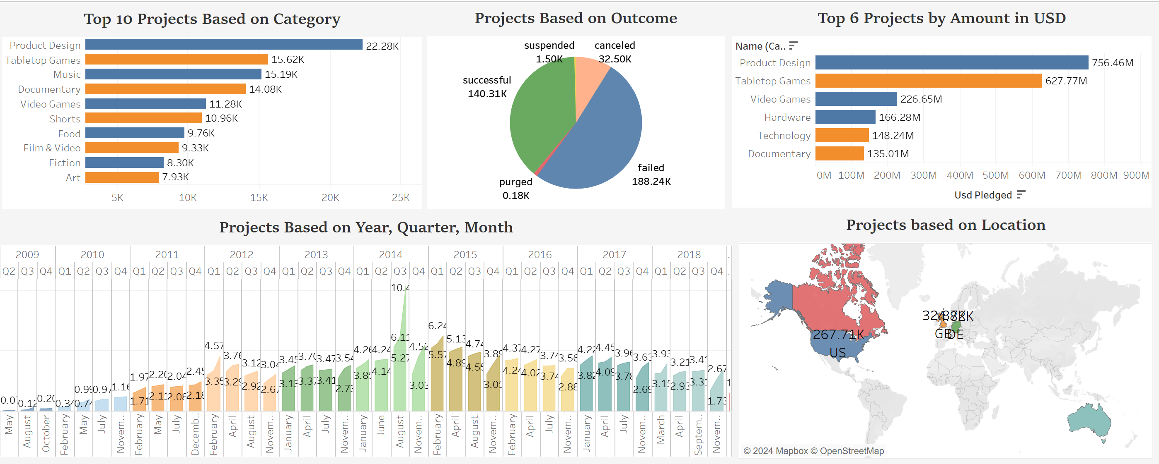
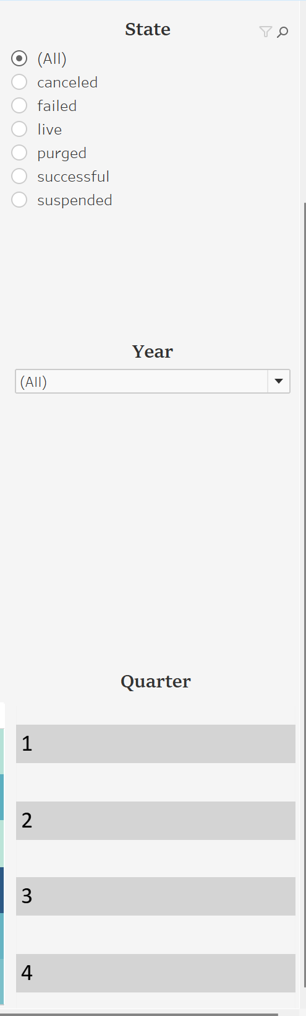
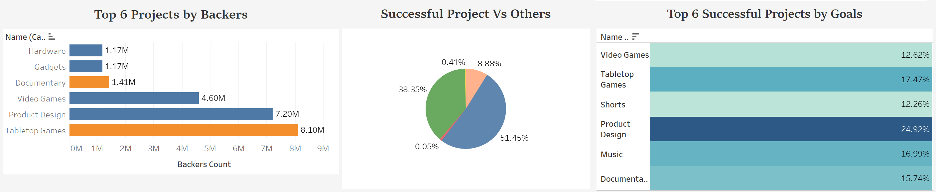

Slide 10
The dashboard provides a comprehensive view of crowdfunding performance,
helping us understand the following key insights:
Project Success and Performance:
140K projects have been successful, raising $85.55M with support from 44.52M backers.
However, 188K projects failed, indicating a higher failure rate compared to successes. This suggests room for improvement in strategy or execution.
Top Performing Categories:
Tabletop Games, Product Design, and Video Games stand out as the most successful in terms of both the number of projects and the amount raised.
These categories are the most attractive for potential creators and investors.
Geographic Insights:
The majority of crowdfunding activity originates from the United States, with the UK, Canada, and Australia also contributing significantly.
This highlights the US as the dominant market for crowdfunding.
Trends Over Time:
There was a significant peak in project successes between 2013 and 2015, followed by a gradual decline.
Seasonal patterns show fluctuations in project launches and outcomes, with some months and quarters performing better than others.
Project Outcomes:
The pie chart shows a significant portion of projects failed, while others were canceled, suspended, or remained live. Understanding the reasons behind failed projects can help improve future outcomes.
Goals and Funding Success:
52% of successful projects met their goals, particularly in high-performing categories like Apps, Product Design, and Technology.

Slide 11

What It Tells Us
Opportunities: Focus on high-performing categories (e.g., Product Design and Video Games) and regions like the US to maximize success.
Challenges: The high failure rate emphasizes the need for better planning, market research, and goal setting.
Timing: Leveraging historical trends can help identify the best times to launch projects.
Growth Potential: Expanding into underutilized markets and optimizing project strategies can boost success rates and funding totals.

Slide 12
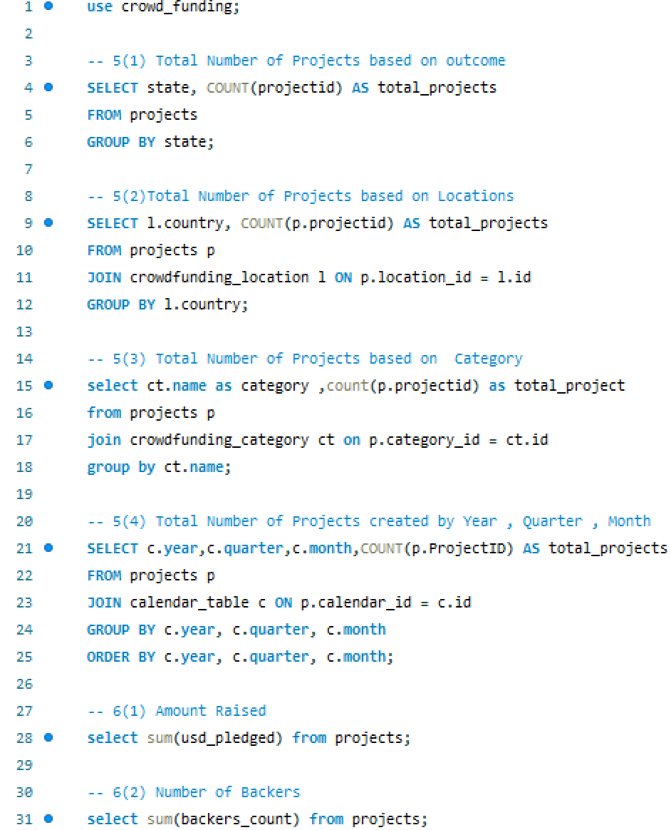
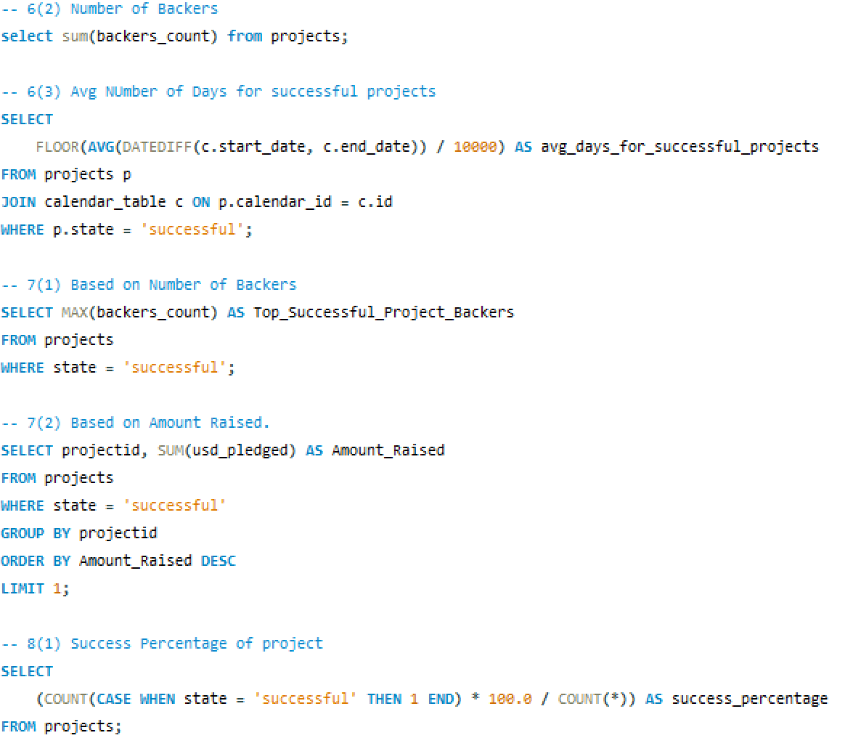
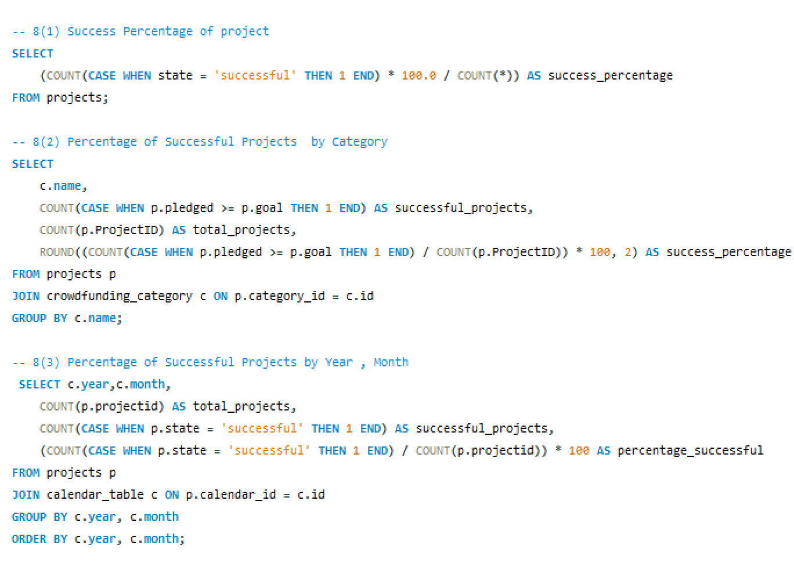
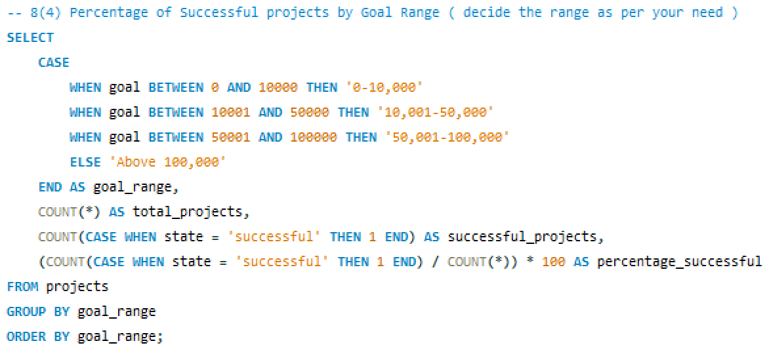

Slide 13
Analytical Queries (SQL Implementation)
Key Metrics Derived:
Total Projects by Outcome, Location, and Category.
Successful Project KPIs:
Amount Raised.
Number of Backers.
Average Days for Success.
Percentage of Successful Projects by various dimensions.
Challenges Faced:
Complex joins and grouping in large datasets.
Optimizing query performance.
Solutions:
Indexed critical columns.
Used subqueries and CTEs for better readability.

Slide 14

CHALLENGES FACED
Challenges Faced:
Handling missing or inconsistent data.
Resolving circular dependencies in the data model.
Solutions:
Cleaned and standardized data.
Reconfigured relationships to avoid ambiguity.
Challenge:
Epoch to Natural Time Conversion.
Building Calendar Table.
Currency Conversion.
Dashboard Visualizations.
Solution: :
Automated using formulas and Python scripts.
Used SQL/Power Query to dynamically generate columns.
Applied static rates globally across tools.
Focused on user experience, interactivity, and performance.

Slide 15
THANK YOU

