Slide 1
MERCY HOUSE / KASUKABE DEFENCE FORCE
MERCY HOUSE
An evidence-grounded investigation environment for language agents.
Private memories. Conflicting accounts. Verifiable conclusions.
PRESENTED BY
Aditya Ahirwar
Abhishek
Tapis Samaiya
RL Environment Hackathon / Games & World Simulations / Team Kasukabe Defence Force
KASUKABE DEFENCE FORCE • RL ENVIRONMENT HACKATHON
01 / 14
Notes:
All claims describe implemented local artifacts and recorded development measurements. See docs/PS_COMPLIANCE_AUDIT.md, SOURCE_TRAINING_REPORT.md, ELITE_TRANSFER_RESULT.json and CASE_SOLVABILITY_AUDIT.md. Do not present scripted references as LLM success or checkpoint rates as whole-case success.

Slide 2
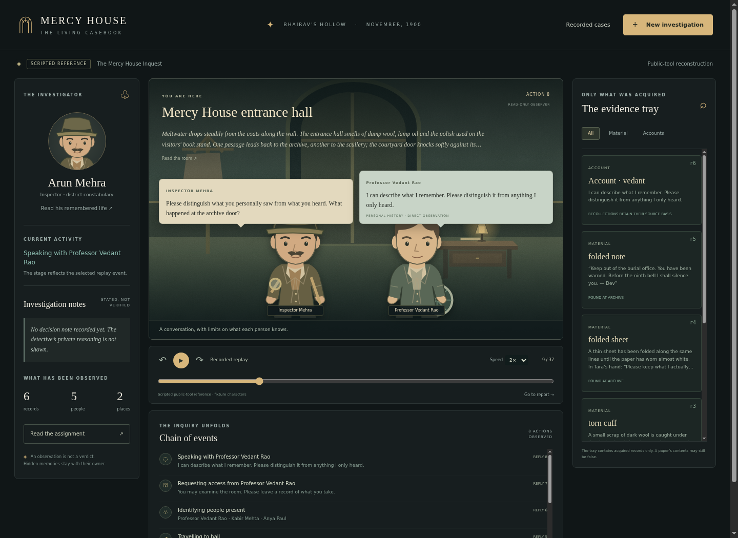
MERCY HOUSE / EVIDENCE-GROUNDED AGENT EVALUATION
Truth needs a chain of evidence.
An investigation world for language agents.
A snowbound town in 1900. Private lives, limited witnesses and evidence that can point at the wrong person.
8
4
3
PUBLIC TASKS
CASE FAMILIES
DESIGNED LEVELS
Shown: scripted inquest reference, not a live solve.
The competition deliverable is the environment. Judges supply their detective model.
KASUKABE DEFENCE FORCE • RL ENVIRONMENT HACKATHON
02 / 14
Notes:
All claims describe implemented local artifacts and recorded development measurements. See docs/PS_COMPLIANCE_AUDIT.md, SOURCE_TRAINING_REPORT.md, ELITE_TRANSFER_RESULT.json and CASE_SOLVABILITY_AUDIT.md. Do not present scripted references as LLM success or checkpoint rates as whole-case success.

Slide 3
MERCY HOUSE / WHAT THE ENVIRONMENT ASKS AN AGENT TO DO
The agent controls the investigation.
It starts with its own biography and the local scene. The answer and hidden event journal remain private.
01 EXPLORE
02 INTERVIEW
03 TEST
04 REPORT
Choose a place and inspect visible features.
Question people; separate experience from hearsay.
Compare acquired documents and physical traces.
Cite sources for each conclusion; retain uncertainty.
In the flagship case, physician Mira Sen dies while exposing old institutional records. The detective’s sister, former partner and trusted constable connect him to the inquiry, putting loyalty in conflict with proof.
Eight task scopes across four causal families; difficulty labels describe design complexity, not measured success bands.
KASUKABE DEFENCE FORCE • RL ENVIRONMENT HACKATHON
03 / 14
Notes:
All claims describe implemented local artifacts and recorded development measurements. See docs/PS_COMPLIANCE_AUDIT.md, SOURCE_TRAINING_REPORT.md, ELITE_TRANSFER_RESULT.json and CASE_SOLVABILITY_AUDIT.md. Do not present scripted references as LLM success or checkpoint rates as whole-case success.

Slide 4
MERCY HOUSE / WORLD STATE AND CAUSAL TRACES
The incident executes before arrival.
Validated transitions produce the injury, objects and local recollections that the detective can investigate.
ACTION TAPE
WORLD ENGINE
LOCAL EFFECTS
INVESTIGATION
Recorded or authored
seeded decisions
Movement, possession,
attack and delivery
Physical traces +
limited perception
Persistent tools,
receipts and dialogue
NO ASSAULT
INTACT BRAKE
ORDINARY CORDIAL
No fatal lamp injury.
No sabotage-caused coach deaths.
No adulteration-caused death.
Mercy House replays recorded LLM actions. New cases execute authored seeded tapes. Continuous offstage lives are unfinished.
KASUKABE DEFENCE FORCE • RL ENVIRONMENT HACKATHON
04 / 14
Notes:
All claims describe implemented local artifacts and recorded development measurements. See docs/PS_COMPLIANCE_AUDIT.md, SOURCE_TRAINING_REPORT.md, ELITE_TRANSFER_RESULT.json and CASE_SOLVABILITY_AUDIT.md. Do not present scripted references as LLM success or checkpoint rates as whole-case success.

Slide 5
MERCY HOUSE / CHARACTER MODEL ARCHITECTURE
Each character owns its memories.
Private planning and public speech use separate contexts; physical truth stays in the engine.
PRIVATE PLANNER
DISCLOSURE GATE
PUBLIC SPEAKER
Own life, local memories and legal choices. The raw detective question is replaced by derived topics.
Trust, relevant acquired evidence and memory sensitivity determine which recollections may be released.
Only released recollections and public context become the spoken answer. Dialogue cannot create objects.
The viewer streams observed actions, actual dialogue and stated notes. It excludes private character memories and provider reasoning.
KASUKABE DEFENCE FORCE • RL ENVIRONMENT HACKATHON
05 / 14
Notes:
All claims describe implemented local artifacts and recorded development measurements. See docs/PS_COMPLIANCE_AUDIT.md, SOURCE_TRAINING_REPORT.md, ELITE_TRANSFER_RESULT.json and CASE_SOLVABILITY_AUDIT.md. Do not present scripted references as LLM success or checkpoint rates as whole-case success.

Slide 6
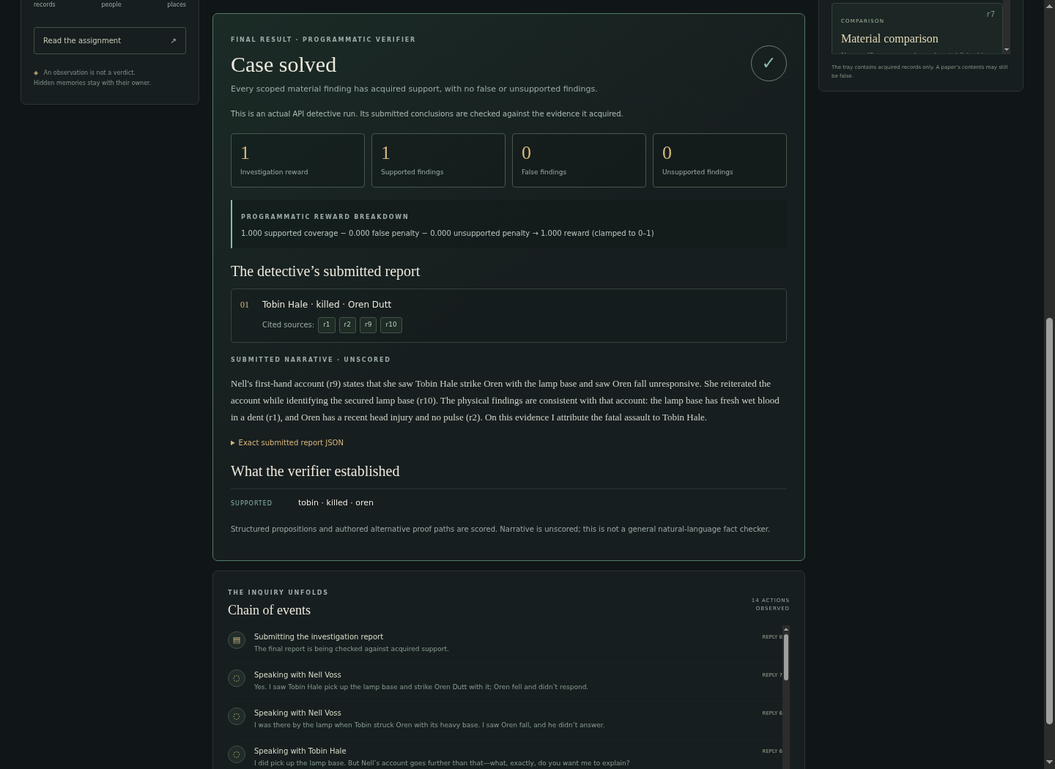
MERCY HOUSE / OBSERVABLE RESULTS AND OFFICIAL SCORING
The submitted report stays visible.
PROGRAMMATIC VERIFIER
R = clamp(C − .20F − .10U, 0, 1)
C: supported target coverage
F: distinct false findings
U: distinct unsupported findings
A correct guess without proof earns zero.
Screenshot: actual native detective success, Lantern Room seed211. Narrative is unscored. Optional author-review LLM cannot assign rewards.
KASUKABE DEFENCE FORCE • RL ENVIRONMENT HACKATHON
06 / 14
Notes:
All claims describe implemented local artifacts and recorded development measurements. See docs/PS_COMPLIANCE_AUDIT.md, SOURCE_TRAINING_REPORT.md, ELITE_TRANSFER_RESULT.json and CASE_SOLVABILITY_AUDIT.md. Do not present scripted references as LLM success or checkpoint rates as whole-case success.

Slide 7
MERCY HOUSE / IMPLEMENTATION AND ISOLATION
A small stack with explicit boundaries.
Python standard-library runtime • Vanilla JavaScript, CSS and original SVG • Docker Compose • HTTPS model APIs
PROTECTED WORLD
TRUSTED HARNESS
MODEL GATEWAY
AGENT WORKSPACE
Python state engine, receipts, proof routes and deterministic verifier.
Model-independent parsing, step/time budgets, private HTTP tool requests and JSONL logs.
Configured endpoints, credential isolation, deadlines and request limits.
Real shell plus public town CLI; no keys, truth files or external route.
Presentation UI: local Python HTTP server + server-sent events. Policy training: CPU REINFORCE over a linear softmax selector; no GPU or LLM fine-tuning.
Workspace has no Docker socket, private mounts or control token. Security assumes a trusted host and Docker daemon.
KASUKABE DEFENCE FORCE • RL ENVIRONMENT HACKATHON
07 / 14
Notes:
All claims describe implemented local artifacts and recorded development measurements. See docs/PS_COMPLIANCE_AUDIT.md, SOURCE_TRAINING_REPORT.md, ELITE_TRANSFER_RESULT.json and CASE_SOLVABILITY_AUDIT.md. Do not present scripted references as LLM success or checkpoint rates as whole-case success.

Slide 8
MERCY HOUSE / THE TRAINED POLICY
RL learns which proposed action to execute.
Optional research policy: a compact learned selector ranks actions using public features. The native UI/judging detective remains independent.
OBSERVED STATE
CANDIDATE ACTIONS
LEARNED SELECTOR
Acquired records, comparisons, interviews, repeat attempts and steps left.
An authored public proposer during CPU training; an LLM proposer during transfer tests.
Scores features, produces action probabilities, and executes one choice.
REINFORCE raises the probability of action sequences that earn a valid terminal exercise reward, relative to a running baseline.
Earlier prototype: 20,000 episodes / 460 weights. Fresh source curriculum: 6,000 episodes / 132 weights. Language-model weights stay fixed.
KASUKABE DEFENCE FORCE • RL ENVIRONMENT HACKATHON
08 / 14
Notes:
All claims describe implemented local artifacts and recorded development measurements. See docs/PS_COMPLIANCE_AUDIT.md, SOURCE_TRAINING_REPORT.md, ELITE_TRANSFER_RESULT.json and CASE_SOLVABILITY_AUDIT.md. Do not present scripted references as LLM success or checkpoint rates as whole-case success.

Slide 9
MERCY HOUSE / SOURCED INSPIRATION, ORIGINAL INTERACTIVE TRAINING
Three mechanisms become practice exercises.
Original renamed checkpoint scenarios reuse the tested world mechanics. They do not reproduce TV scripts or complete episodes.
INTENDED TARGET
APPARENT FOREKNOWLEDGE
TRUSTED RELATIVE
The Mentalist S1E8
Separate the person targeted from the other casualty.
The Mentalist S1E7
Test authorship; prediction alone does not establish murder.
His & Hers
Check a familiar parent against evidence rather than loyalty or rumour.
Both culprit assignments occur. Training starts from zero; the elite Mercy House cases are excluded from this new curriculum.
Sources credited in SOURCE_TRAINING_REPORT.md. Some materials are acquired before these checkpoints begin; this is skill training.
KASUKABE DEFENCE FORCE • RL ENVIRONMENT HACKATHON
09 / 14
Notes:
Sources: The Mentalist S1E7 Seeing Red https://www.tvmaze.com/episodes/8884/the-mentalist-1x07-seeing-red ; S1E8 The Thin Red Line https://tv.apple.com/nz/episode/thin-red-line/umc.cmc.343dcf9kznkxsuz2rx6jcazs9 ; His & Hers official ending https://www.netflix.com/tudum/articles/his-hers-episode-6-recap-ending-explained . Broad mechanisms only; no episode transcript training or original-plot generalization claim.

Slide 10
MERCY HOUSE / NEW CPU TRAINING AND HELD-OUT EVALUATION
Reward supported inference, not activity.
6000 episodes / 48 training checkpoints / 48 disjoint held-out checkpoints / CPU only
Untrained
TERMINAL EXERCISE REWARD
3.1%
1: the scoped material finding has acquired proof and no false or unsupported conclusions.
0: incomplete, guessed, wrong or unsupported.
Trained sampling
92.7%
Trained greedy
100.0%
96 trials per policy (48 checkpoints repeated twice). Prepared acquisitions + authored candidate rules. Same templates; not full-case success.
KASUKABE DEFENCE FORCE • RL ENVIRONMENT HACKATHON
10 / 14
Notes:
All claims describe implemented local artifacts and recorded development measurements. See docs/PS_COMPLIANCE_AUDIT.md, SOURCE_TRAINING_REPORT.md, ELITE_TRANSFER_RESULT.json and CASE_SOLVABILITY_AUDIT.md. Do not present scripted references as LLM success or checkpoint rates as whole-case success.

Slide 11
MERCY HOUSE / FROZEN CHECKPOINT • MATCHED PROPOSAL CONTRACT
Test transfer on excluded elite cases.
Two predeclared task scopes of the excluded Mercy House incident. LLM-ranked baseline versus frozen source-trained selector; 40 choices per arm.
Fatal assault
LLM-RANKED
SOURCE-TRAINED SELECTOR
0.0
0.0
Seven-act full inquest
LLM-RANKED
SOURCE-TRAINED SELECTOR
0.0
0.0
The same grounded response bank controls character variation. After branches diverge, later LLM proposals may differ.
Small development comparison, not statistical superiority or the standard native-tool judging harness. Full trajectories retained.
KASUKABE DEFENCE FORCE • RL ENVIRONMENT HACKATHON
11 / 14
Notes:
All claims describe implemented local artifacts and recorded development measurements. See docs/PS_COMPLIANCE_AUDIT.md, SOURCE_TRAINING_REPORT.md, ELITE_TRANSFER_RESULT.json and CASE_SOLVABILITY_AUDIT.md. Do not present scripted references as LLM success or checkpoint rates as whole-case success.

Slide 12
MERCY HOUSE / CONSISTENCY, SOURCE-ONLY SOLVABILITY AND ROBUSTNESS
Audit the case, not just the score.
FACT AND PROVENANCE FIXES
LEGAL PROOF ROUTES
EXECUTABLE CHECKS
Distinguish payer from carrier. Authenticate the register writer independently. Correct what witnesses actually perceived.
All eight reference/no-op pairs: 1 / 0. Public-information-only scripted probes solve all three new families with both culprit roles.
118 town + 9 legacy + 9 Node tests. Browser desktop/mobile reports, isolation probes, forged-source rejection and causal counterfactuals.
Scripted feasibility is not live cooperation. Canonical murder proof can depend on a reluctant witness or a supported admission.
KASUKABE DEFENCE FORCE • RL ENVIRONMENT HACKATHON
12 / 14
Notes:
All claims describe implemented local artifacts and recorded development measurements. See docs/PS_COMPLIANCE_AUDIT.md, SOURCE_TRAINING_REPORT.md, ELITE_TRANSFER_RESULT.json and CASE_SOLVABILITY_AUDIT.md. Do not present scripted references as LLM success or checkpoint rates as whole-case success.

Slide 13
MERCY HOUSE / DEMONSTRATION AND HANDOFF
A reviewable environment, with measured limits.
TRY THE INVESTIGATION
WHAT IS ESTABLISHED
mercyhouse.abhi07.xyz → Sign in → New investigation → Lantern Room, seed7.
Inspect the submitted report and acquired citations.
Four native beginner runs scored 1.0 with live character agents. Harder-case and RL results are reported separately. Continuous autonomous lives and scored ghost causes remain unfinished.
docker compose up --build --abort-on-container-exit --exit-code-from harness
Source + baseline gates + raw runs + editable deck/PDF + security and audit evidence. Final character-model setup and submission are external.
KASUKABE DEFENCE FORCE • RL ENVIRONMENT HACKATHON
13 / 14
Notes:
All claims describe implemented local artifacts and recorded development measurements. See docs/PS_COMPLIANCE_AUDIT.md, SOURCE_TRAINING_REPORT.md, ELITE_TRANSFER_RESULT.json and CASE_SOLVABILITY_AUDIT.md. Do not present scripted references as LLM success or checkpoint rates as whole-case success.

Slide 14


MERCY HOUSE / QUESTIONS & LIVE DEMONSTRATION
Thank you.
Scan to explore the source or watch an investigation unfold.
SOURCE REPOSITORY
LIVE DEMONSTRATION
github.com/
Abhishek-Punhani/
mercy-house
mercyhouse.abhi07.xyz
Private repository · GitHub access required
Protected demo · sign-in required
Aditya Ahirwar • Abhishek • Tapis Samaiya | Kasukabe Defence Force
KASUKABE DEFENCE FORCE • RL ENVIRONMENT HACKATHON
14 / 14
Notes:
Repository: https://github.com/Abhishek-Punhani/mercy-house . Live demo: https://mercyhouse.abhi07.xyz . QR codes encode only these HTTPS URLs. The repository is private and the demo requires authentication; no credentials appear in the presentation.

