Slide 1

Notes:
Smart Campus Analytics

Slide 2

Notes:
Fragmented data makes intervention arrive too late

Slide 3
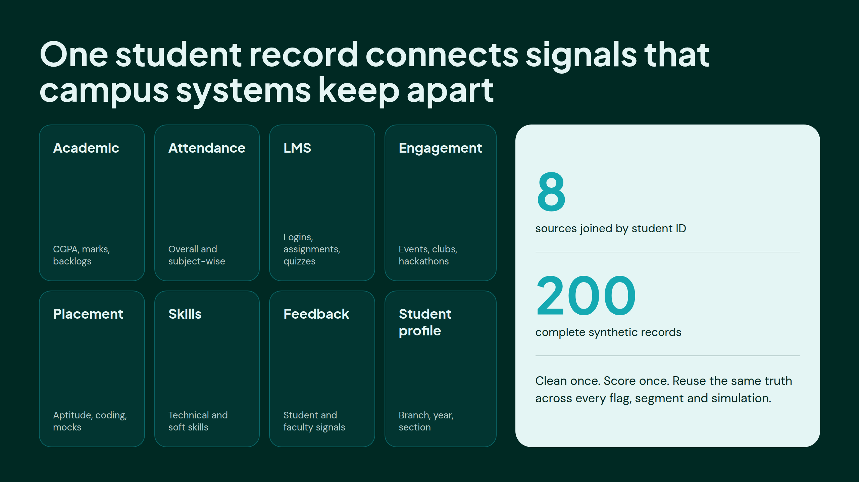
Notes:
One student record connects signals that campus systems keep apart

Slide 4
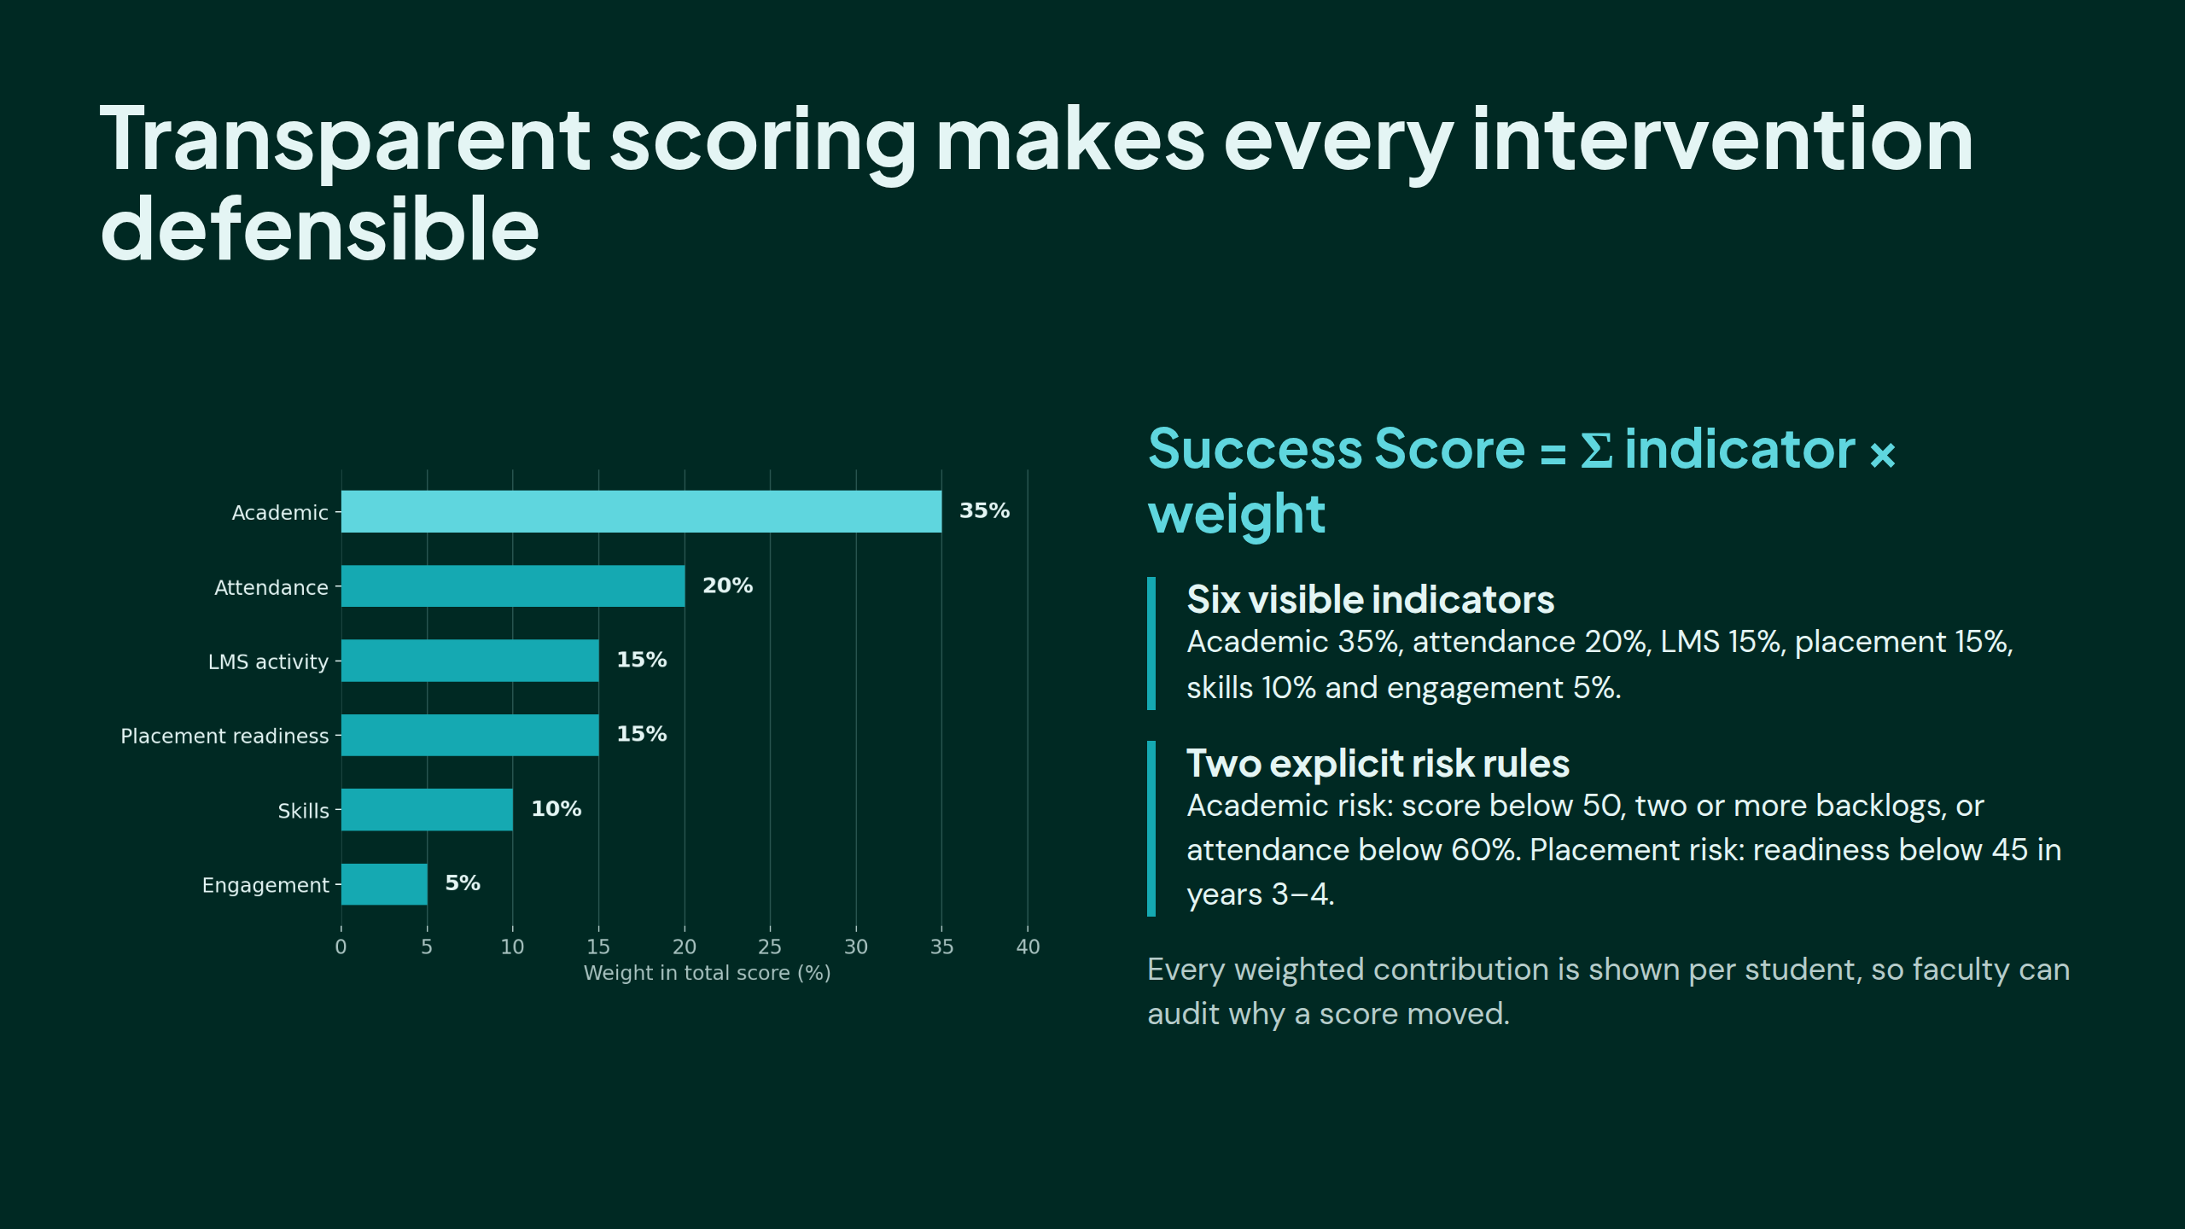
Notes:
Transparent scoring makes every intervention defensible

Slide 5
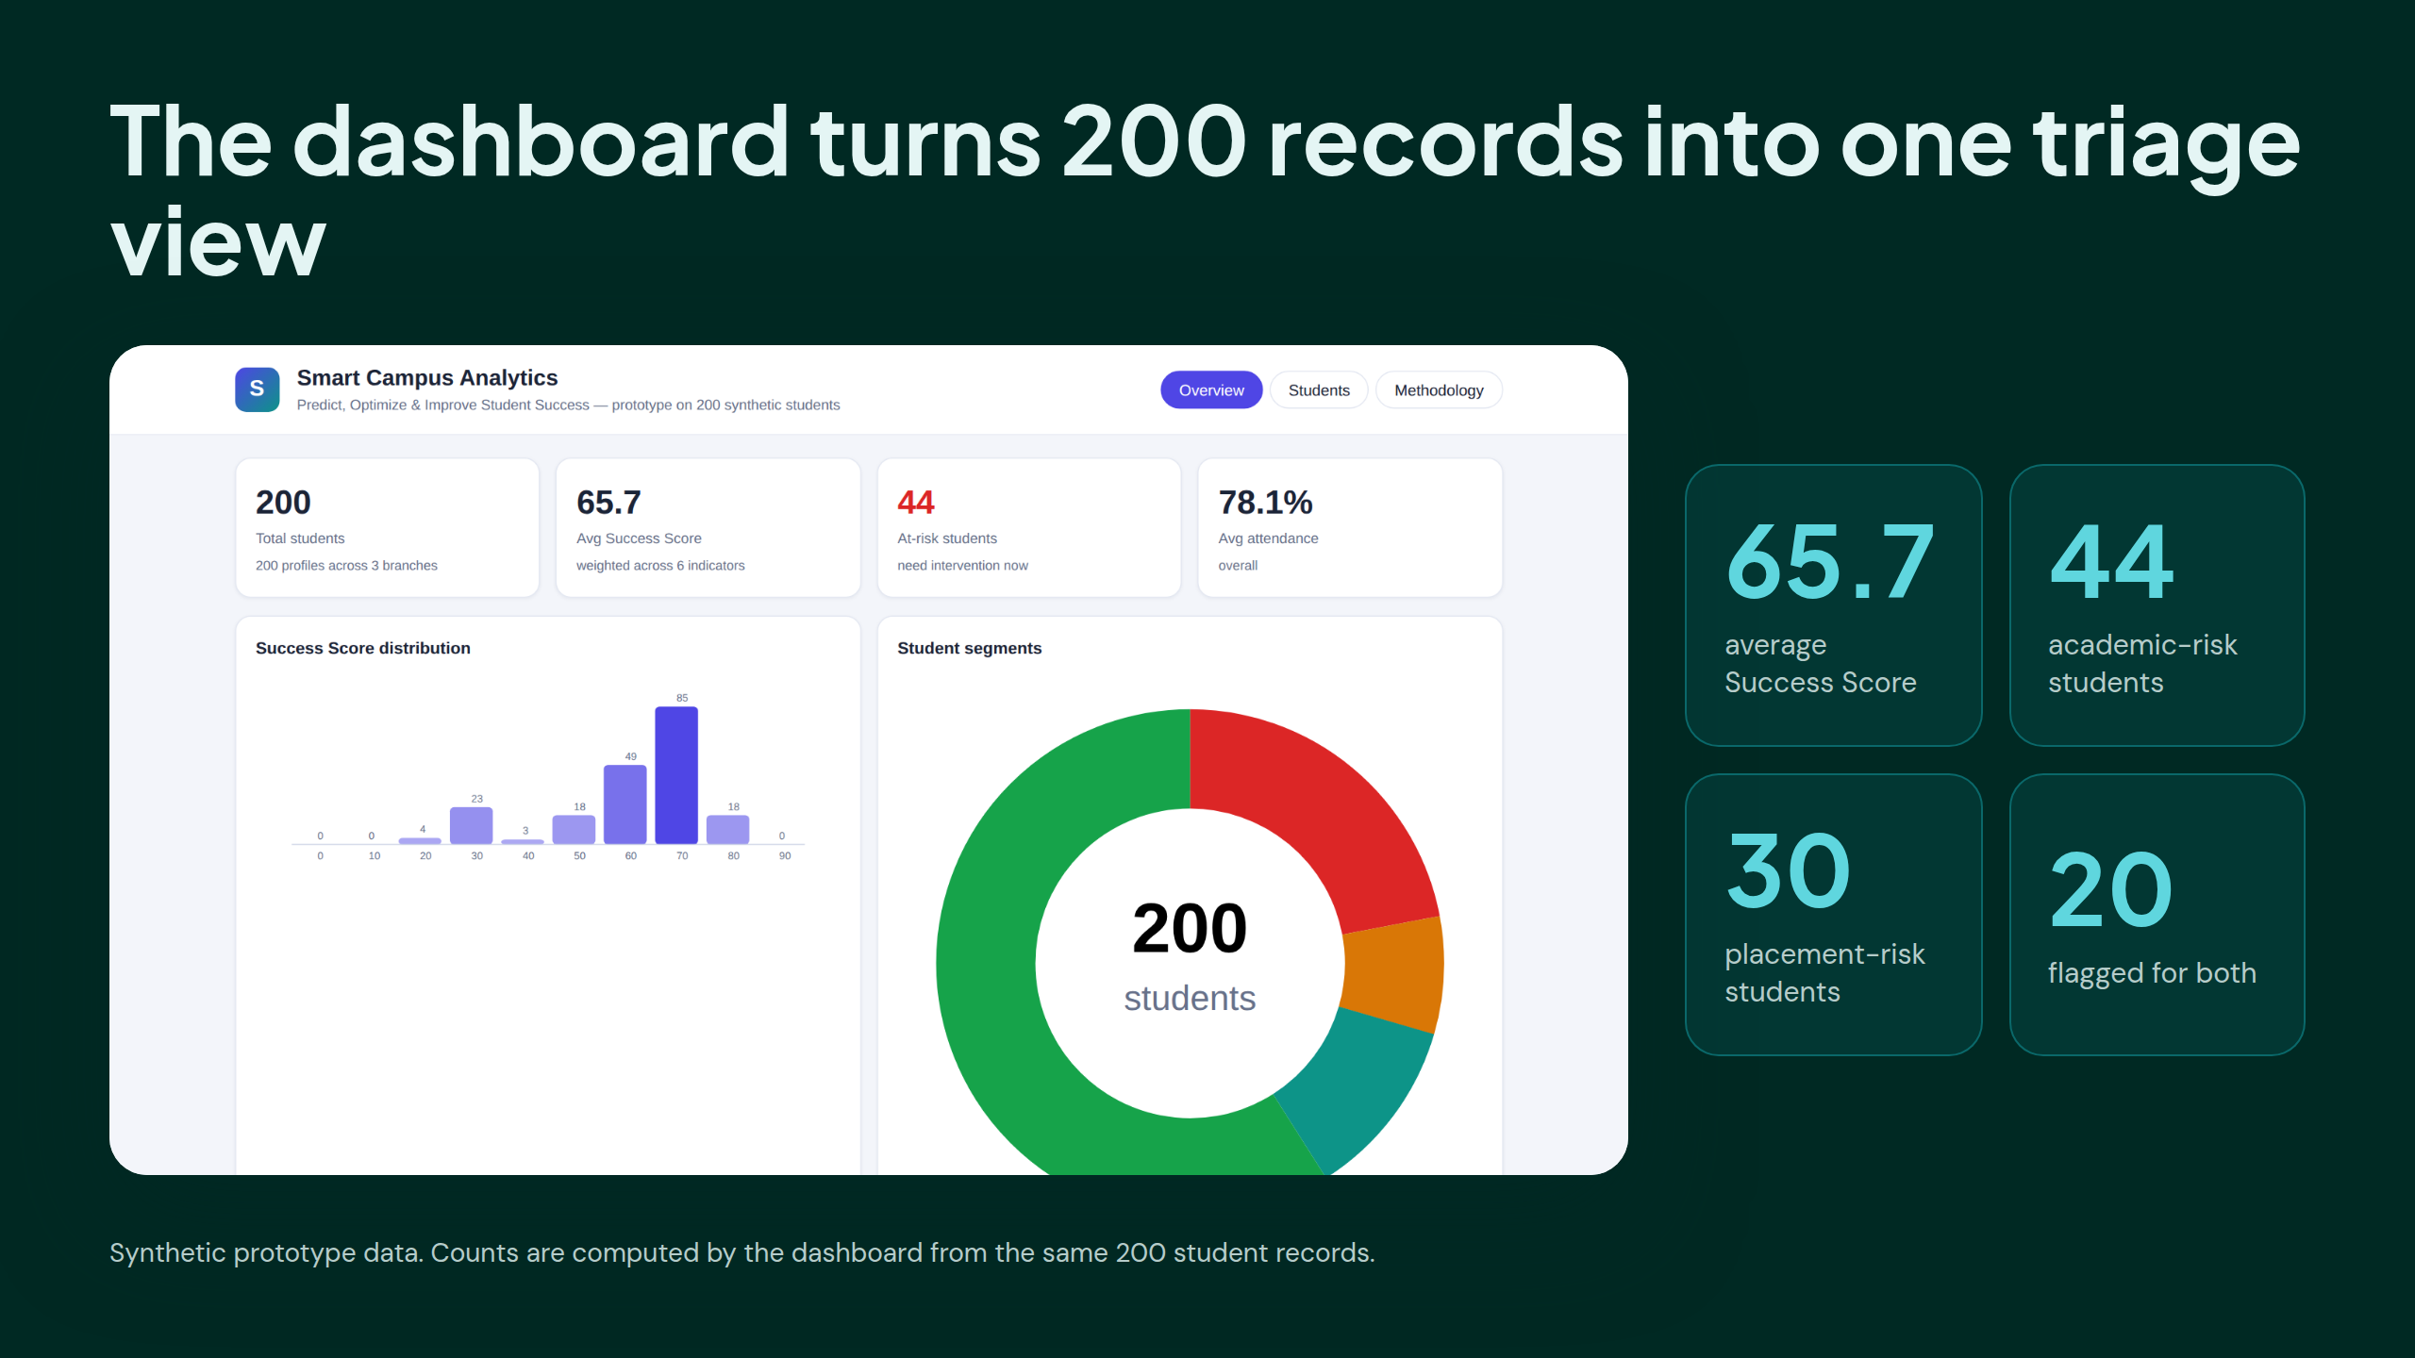
Notes:
The dashboard turns 200 records into one triage view

Slide 6
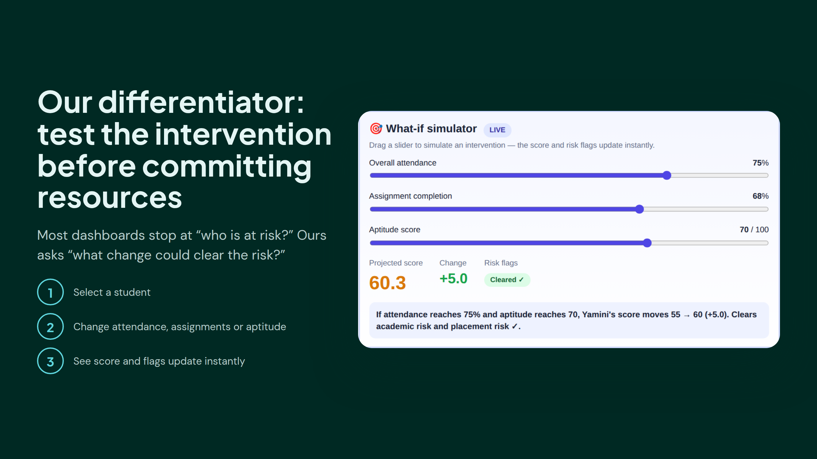
Notes:
Our differentiator: test the intervention before committing resources

Slide 7
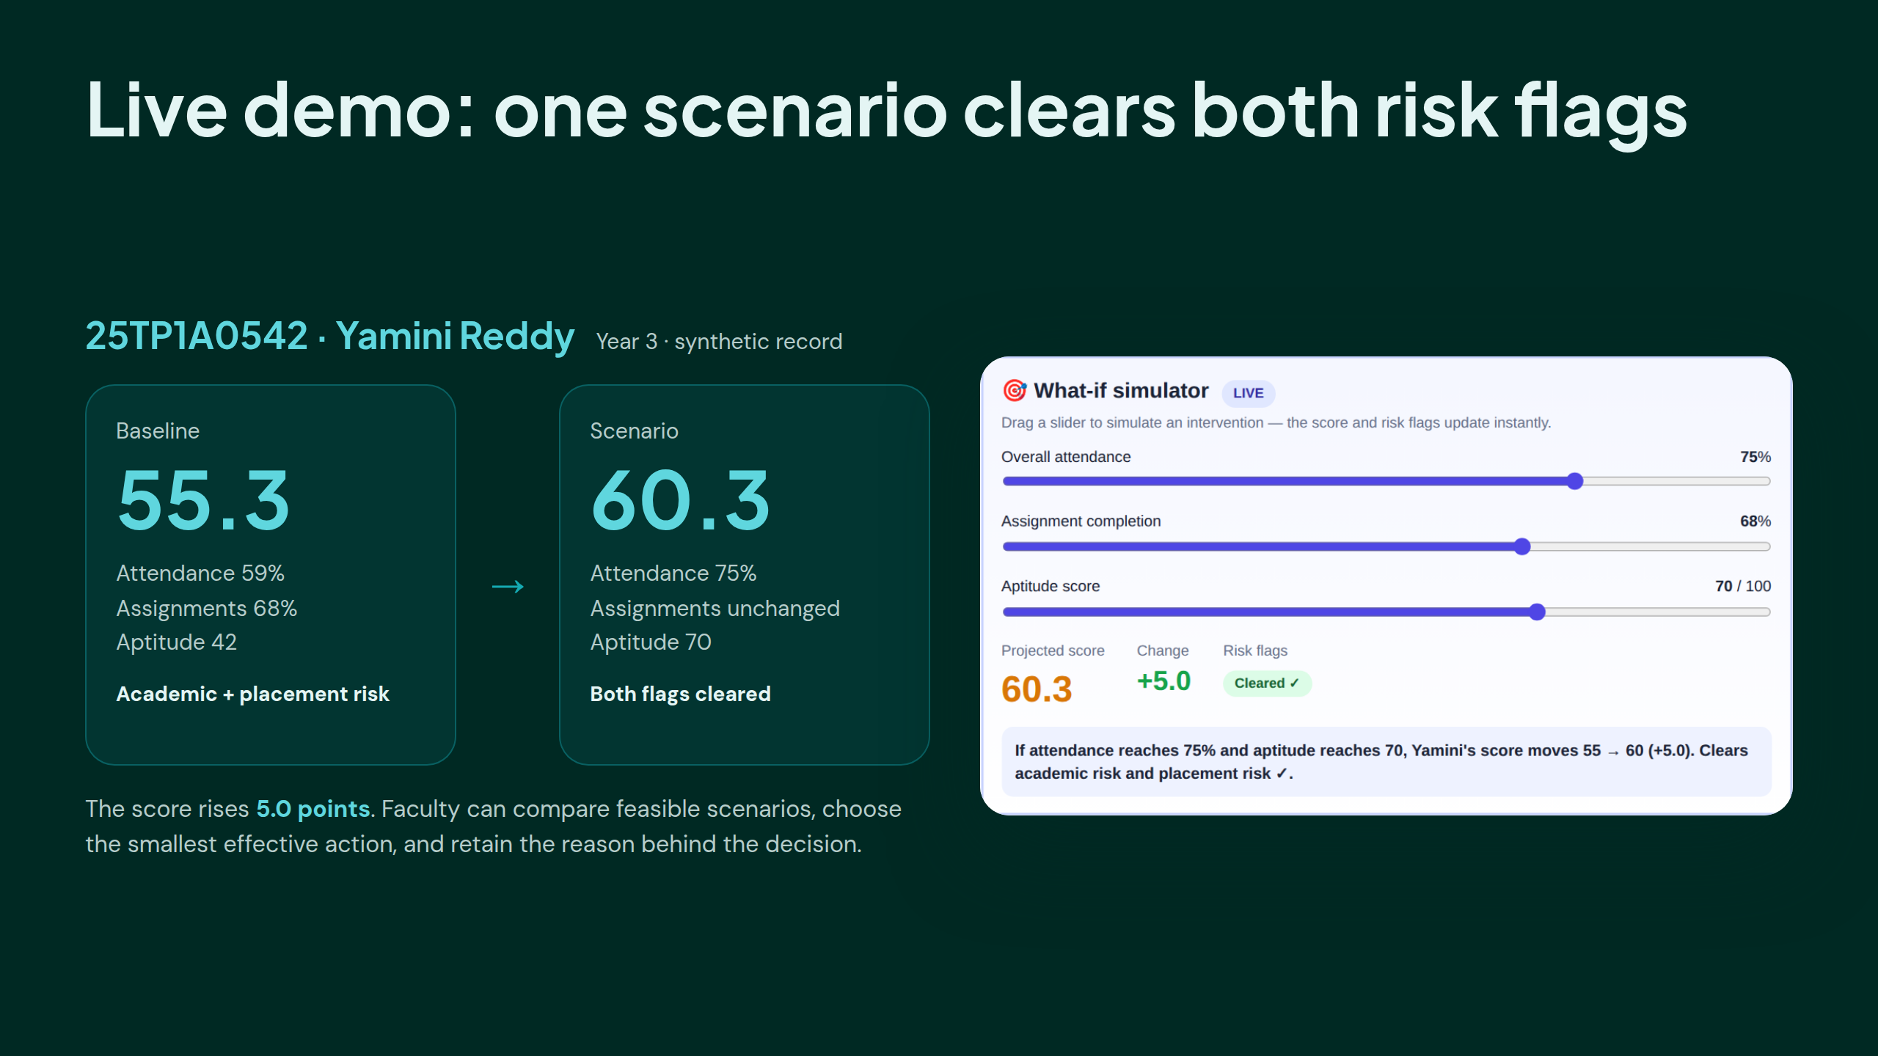
Notes:
Live demo: one scenario clears both risk flags

Slide 8
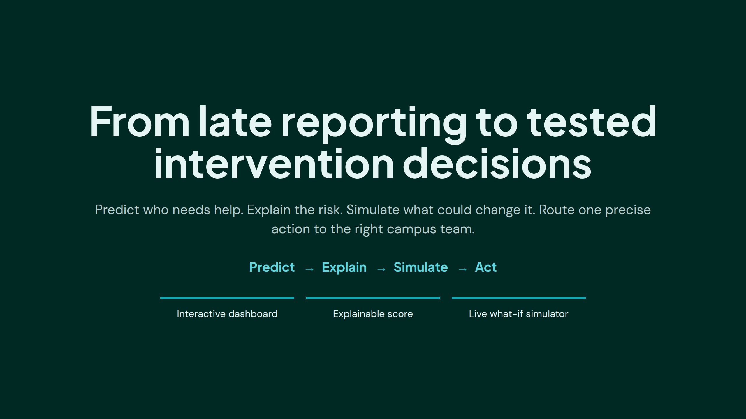
Notes:
From late reporting to tested intervention decisions

