Slide 1

Data Analysis Portfolio Project – Credit Risk Dataset Analysis
Using MySQL for Data Analytics
By Abhishek Roy

Slide 2
AGENDA :
Background and Purpose
Exploratory Data Analysis
Variable analysis and selection
Finding Segments
Conclusion/Key Insights
Appendix

Slide 3
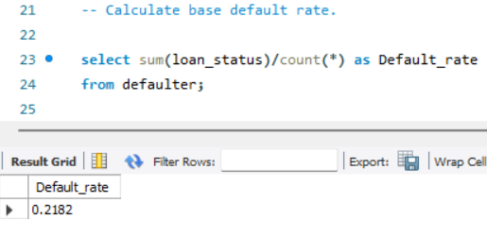
Background and Purpose :
The dataset has performance tags in the form of whether a person defaulted the loan or not.
We are using other attributes available to find the segment of customers who have higher probability of defaulting on their loan.
There are 10 such variables available in the given dataset out of which 3 variables are of string datatype and 7 are of integer datatype.
The base default rate of the entire population is 21% →

Slide 4
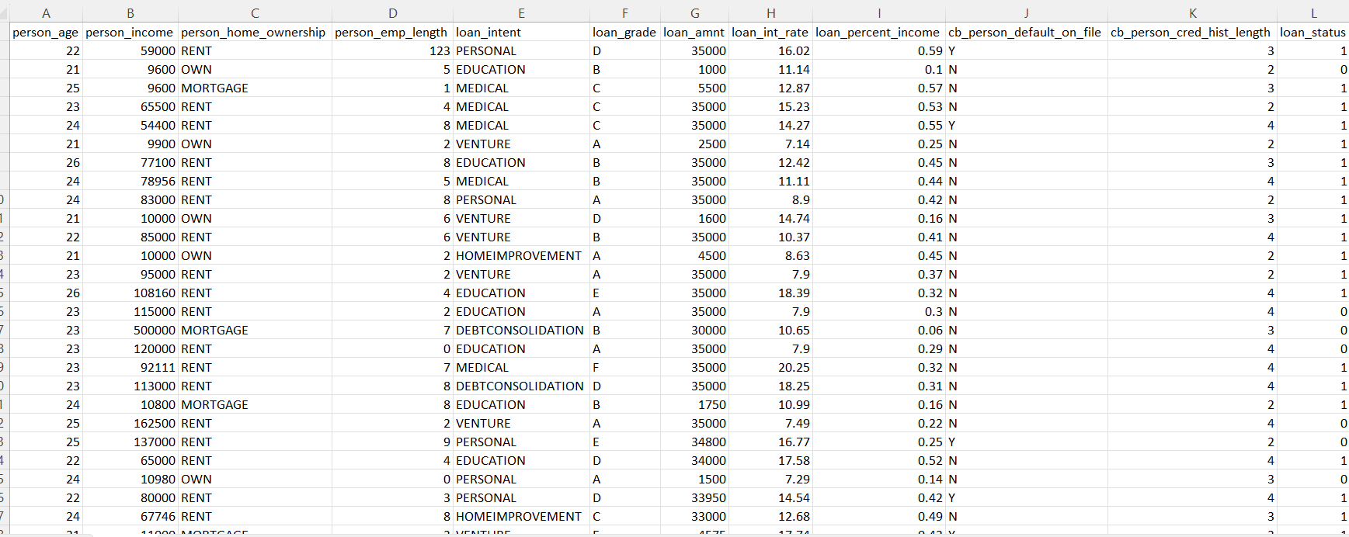
Exploratory Data Analysis :
As per the dataset, we had information's like the person age, income, home ownership, employment length, loan intent, loan grade, loan amount, loan interest rate, loan percent income, if the person is default on file or not, credit history length and lastly the loan status. All these were valuable inputs which in turn helped us to generate key insights.
--→ Our target variable being loan status.

Slide 5
Approach :
Objective → Using historical data, identify segments of population that are risky than the average
default rate. In other words, to find the subset of the population whose default rate is
significantly higher than the base default rate.
Variables analysis and selection :
For continuous variables, using percentile distribution (ntile function) to differentiate between default and non-default from population (default-1, non-default-0). This will help us to find trends in the data.
We want to find a threshold value to identify the part of the population where risk is significantly elevated.
For categorical variables, finding out default rate in each categories to see whether any particular category has more risk.
After analysing each variable, shortlisting some of the variables for final analysis.
Using combination of thresholds/categories and business sense to identify a population that has higher chance to default.

Slide 6
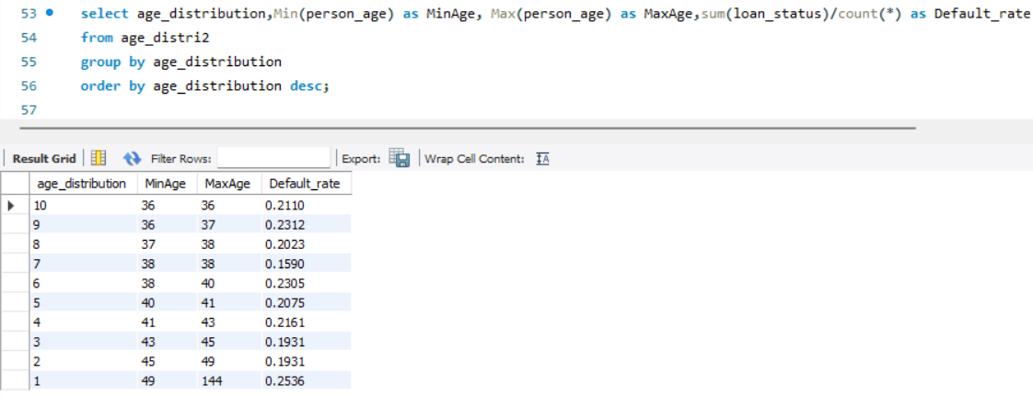
Person Age:
1. Analysing the data using person_age
There is no monotonicity in the default rate across the deciles. Hence, we are not considering this variable for further analysis.

Slide 7
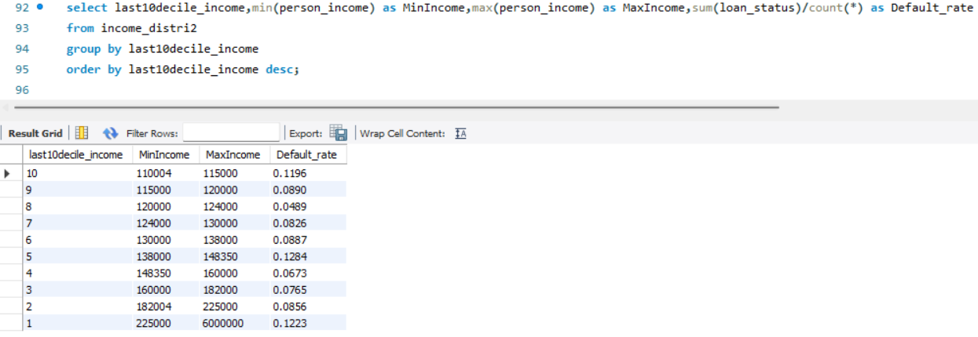
Person Income :
2. Analysing the data using person_income
There is no monotonicity in the output across the deciles. The default rates are well and truly below our base default rate (21%) for each decile. Hence, we are not considering this variable for further analysis.

Slide 8
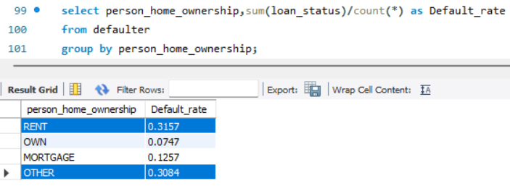
Person Home Ownership :
3. Analysing the data using person_home_ownership
We can clearly see from the output that people who live in ‘rent’ or falls in ‘other’ categories, have their default rate above (31% and 30% respectively) our defined based default rate (21%). Hence, we are categorizing ‘rent’ and ‘other’ as riskier.

Slide 9
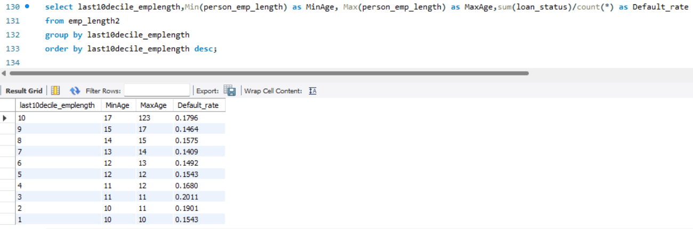
Person Employment Length :
4. Analysing the data using person_emp_length
There is no monotonicity in the output across the deciles. Hence, we are not considering this variable for further analysis.

Slide 10
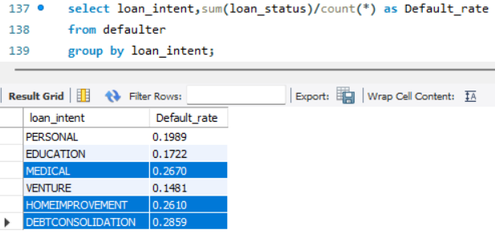
Loan intent :
5. Analysing the data using loan_intent
We can clearly see that people who took loans for medical reasons (26%), home-improvement (26%) and debt consolidation (28%) have their default rate above our defined based default rate (21%). Hence, we are categorizing ‘medical’ , ‘home improvement’ and ‘debt consolidation’ as riskier.

Slide 11
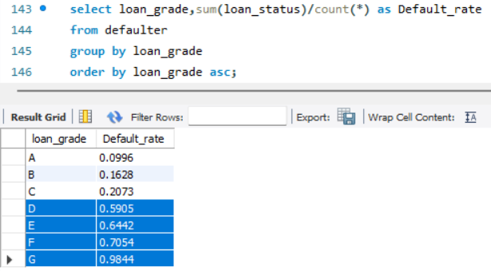
Loan Grade :
6. Analysing the data using loan_grade
We can clearly see from the output that Loan Grades D,E,F and G have significantly higher default rate (59%,64%,70%,98% respectively) than the base default rate of 21%. Hence, we are categorizing grades ‘D’,’E’,’F’, and ‘G’ as riskier.

Slide 12
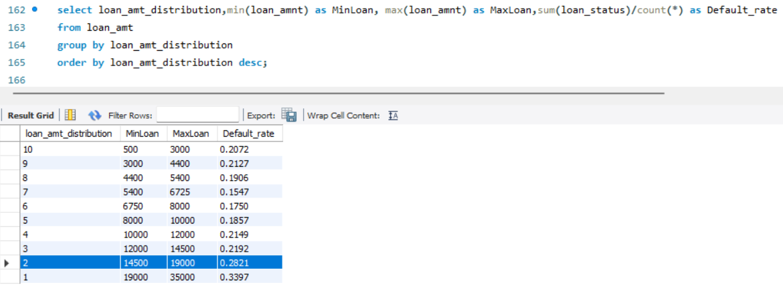
Loan Amount :
7. Analysing the data using loan_amnt
We can clearly see that starting from Rs 14500/- the default rate (28%) is much higher than the base default rate of 21%. Hence, we can consider loan amount starting from Rs 14500/- to be more risky.

Slide 13
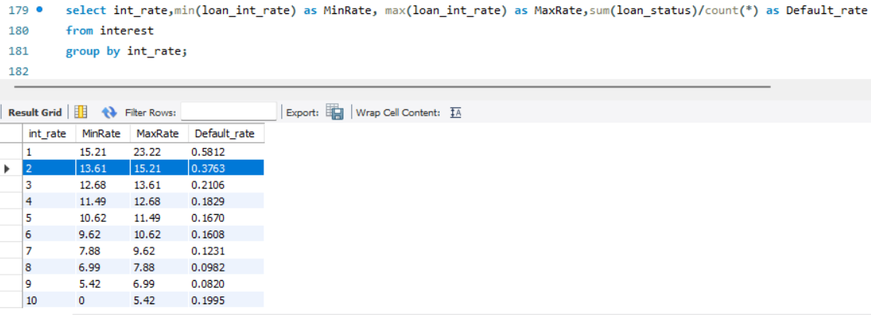
Loan Interest Rate :
8. Analysing the data using loan_int_rate
We can clearly see that when the minimum loan interest rate is 13.61, the default rate jumps up to 37% which is much higher than our base default rate of 21%. Hence, we can consider that 13.61 is the threshold for loan interest rate and anything above that is considered to be risky.

Slide 14
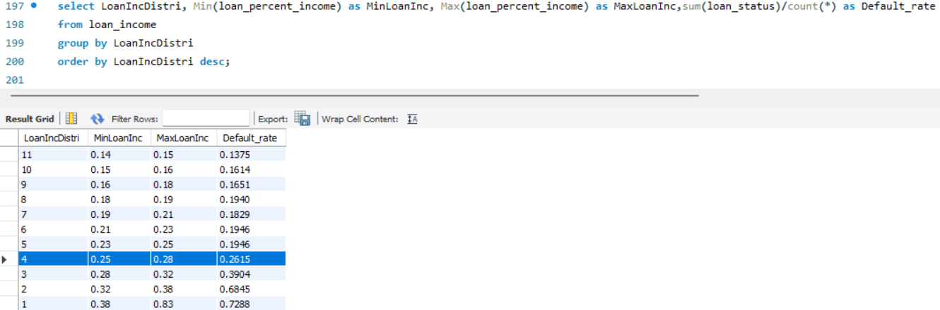
Loan Percent Income :
9. Analysing the data using loan_percent_income
We can clearly see that when the minimum loan percent income is 0.25, the default rate rises up to 26 % and peaks as we progress. Thus, we can consider 0.25 to be the threshold value for loan percent income and anything above that is risky.

Slide 15
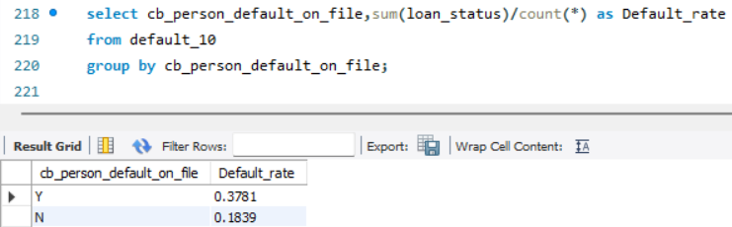
Person Default on File :
10. Analysing the data using cb_person_default_on_file
It is already evident that when the person is default on file (Y), the default rate hovers around 37%, much higher than our base default rate of 21%. However, if the person is not default on file (N), the default rate drops down to 18%, lower than our base default rate of 21%.

Slide 16
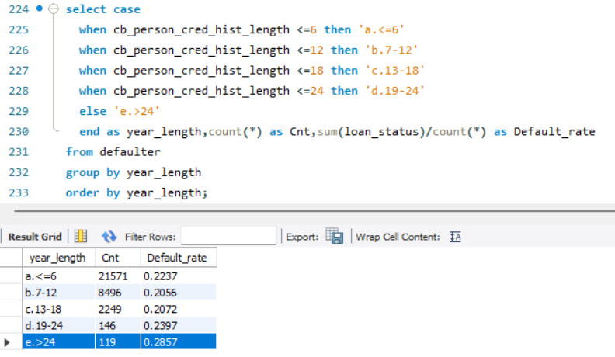
Person Credit History Length :
11. Analysing the data using cb_person_cred_hist_length
It can be seen that when the credit history length is greater than 24 months, the chances of default rises up to 28% which is higher than our base default rate of 21%. Thus, the threshold value can be considered to be 24 months for credit history length and anything beyond that is risky.

Slide 17
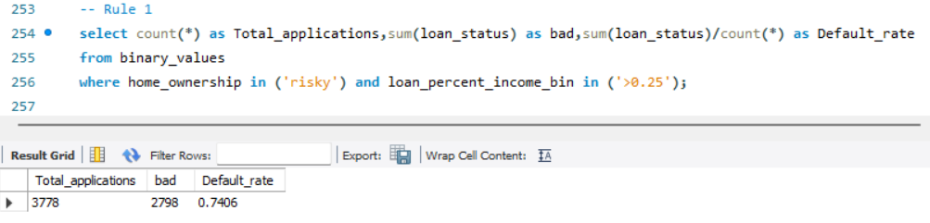
Analysis : combining the various variables
Rule 1 : People who have their home ownership type as ‘risky’ and loan percent income greater than 0.25 has significant chances of default with the default rate being 74%. Out of the total 3778 applications, 2798 applications are considered to be ‘bad’ and risky and has a higher chances of default.

Slide 18
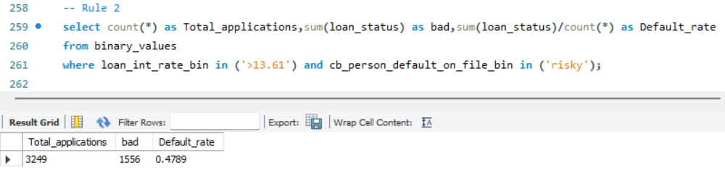
Analysis : combining the various variables
Rule 2 : People who have their loan interest rate greater than 13.61 and is already defaulted on file has 47% chances of default. Out of the total 3249 applications, 1556 applications are considered to be ‘bad’ and risky and has a higher chances of default.

Slide 19
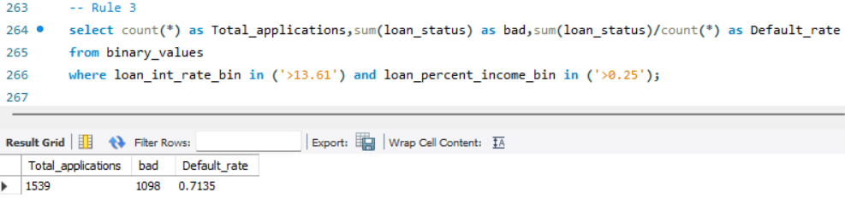
Analysis : combining the various variables
Rule 3 : People who have their loan interest rate greater than 13.61 and loan percent income greater than 0.25 has a significant 71% chances of default. Out of the total 1539 applications, 1098 applications are considered to be ‘bad’ and risky and has a higher chances of default.

Slide 20
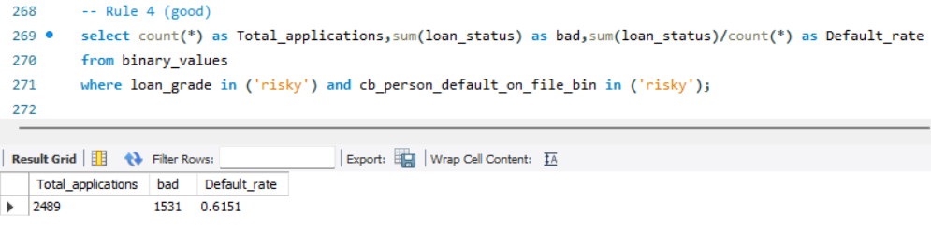
Analysis : combining the various variables
Rule 4 : People who have their loan grade in ("D","E","F","G") and is already default on file has a significant 61% chances of default. Out of the total 2489 applications, 1531 applications are considered to be ‘bad’ and risky and has a higher chances of default.

Slide 21
CONCLUSION/ KEY INSIGHTS :
Thus, after analysing the data, we can conclude that :
If any of the applicants falls within any of the set of 4 defined rules, then giving them loans is considerably risky.
Note : The set of 4 rules are not mutually exclusive that is there can be some degree of overlap between them.

Slide 22
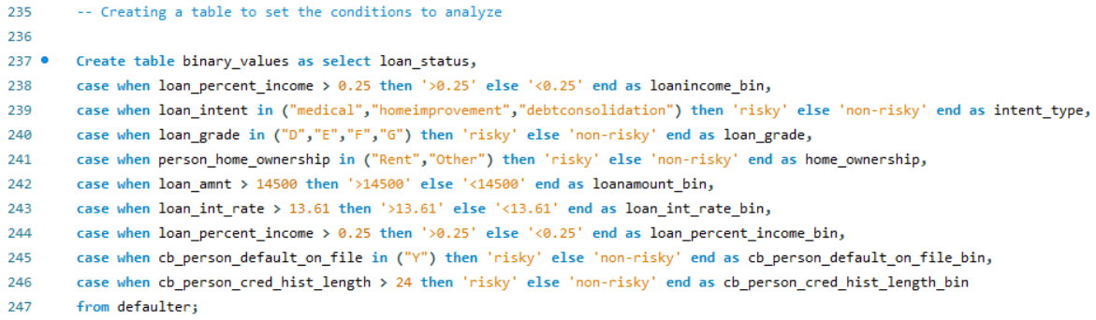
Appendix :
Grouping variables into risky and non risky categories based on Exploratory Data Analysis

Slide 23
THANK YOU

