Slide 1
Outreach STT and Question Generation
By Abhishek Sinha, Kali Nangia and M. Akshay Kumar
Reporting Manager: Karan Choudhary

Slide 2
Projects Worked on
Benchmarking USLMs on the basis of their decisions of tool calling
YADEP (Youtube Audio Dataset Extraction Pipeline)
Speech To Text and Question Generation

Slide 3
1. Benchmarking USLMs on their decisions of tool calling
By
Abhishek Sinha
Scoring Criteria
Action Score: (Correct Tool Calls for Actionable Prompts) / 21.
Restraint Score: (Correct No Tool Calls for Restraint Prompts) / 9.
Wrong-Tool-Avoidance: (30 - Total Wrong Tool Events) / 30.
Agent Score: (Action Score * 0.4) + (Restraint Score * 0.3) + (Wrong-Tool-Avoidance * 0.3).
We tested and benchmarked the decision making capacity of 5 USLMs towards tool use and calls.
Steps:
We provide a set of tools to the models.
Then we fed tricky prompts to the models.
A total of 30 prompts were provided to the following models:
qwen2.5:0.5b
qwen3: 0.6b
Qwen3:4b
Ministral-3:3b
lfm2.5-thinking:1.2b
Link to Project

Slide 4
Final SLMs scores
By
Abhishek Sinha
Model | Action Score | Restraint Score | Wrong Tool Avoidance | Agent Score
qwen2.5:0.5b | 0.71 | 0.78 | 0.77 | 0.749
qwen3:0.6b | 0.81 | 0.78 | 0.80 | 0.798
qwen3:4b | 1.0 | 0.78 | 0.93 | 0.913
ministral-3:3b | 0.29 | 1.0 | 0.50 | 0.566
lfm2.5-thinking:1.2b | 0.81 | 0.78 | 0.80 | 0.798

Slide 5
Sample Prompts
Tools Provided
I do not want to schedule a meeting of 2 persons at 6pm.
My Machine state is Active, what's yours?
The population of India is 150000000000. Whats the weather like in Delhi?
How could he have set up a meeting for 6 people at 4pm without notifying me?
If I ask you to schedule a meeting for 8 people at 3pm, which tool would u use?
Get_machine_state
Get_weather
Validate_switch
Setup_meeting
get_population
By
Abhishek Sinha

Slide 6
2. YADEP (Youtube Audio Dataset Extraction Pipeline)
Actual Task here was to Extract Krishi Darshan Episodes from Youtube for their audio and transcripts).
We made it as a generic pipeline for any future use case that may arise.
The pipeline is divided into three phases:-
Phase 1: Extract YT metadata..
Phase 2: Extract all audio files
Phase 3: Extract Transcripts.
Link to Project

Slide 7
Phase 1: Metadata Extraction
By
Abhishek Sinha
Install all relevant modules.
All videos which one want to extract data from, need to be first compiled into a playlist, and then the playlist link can be passed as input.
The .csv file will contain
VIDEO_ID
VIDEO_TITLE
VIDEO_URL
CHANNEL
DURATION_SECS
UPLOAD_DATE
LANGUAGE
VIEW_COUNT
EXTRACTION_TIMESTAMP
AUDIO_PATH
TRANSCRIPT_PATH
TRANSCRIPT_STATUS

Slide 8
Phase 2: Audio Extraction
By
Abhishek Sinha
Load the .csv files from drive and start downloading the audio files.
Download speed depends on the no. of CPU cores.
Use multithreading to bypass this to some degree
All audio files will be saved with the way:
Audio Dataset -> Video_ID1 -> audio.mp3
-> Video_ID2 -> audio.mp3
-> Video_ID3 -> audio.mp3

Slide 9
Phase 3: Audio Transcription
By
Kali Nangia &
M. Akshay Kumar
The Program will first attempt to fetch transcripts, either auto generated or human made, using the youtube_transcript_api.
If unavailable, they would switch to using whisper large v3 for AI based transcription.
For the transcription task we have arrived at whisper-large-v3 after testing the following models:
Indic whisper
Whisper turbo
All other whisper models
Faster_whisper
Gemma E2B,E4B, 12B
Sarvam 30B
Caution: Phase 3 requires high GPU compute to function and generate transcripts accurately, make sure to have access to them.

Slide 10
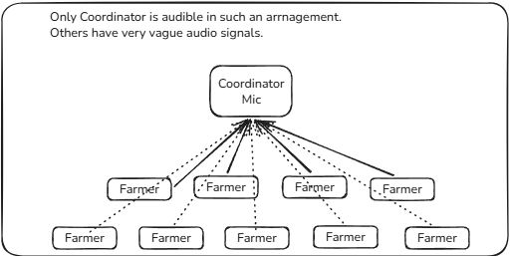
3. Speech to Text and Question Generation
Problem Statement
By
Abhishek Sinha
Develop a software that integrates multiple microphones during agricultural outreach sessions to capture clear speech from all participants.
The system should overcome the limitations of single-microphone recordings, enabling accurate transcription, speaker separation, and extraction of actionable insights such as
farmer queries,
concerns, and
recommendations for targeted agricultural interventions.

Slide 11
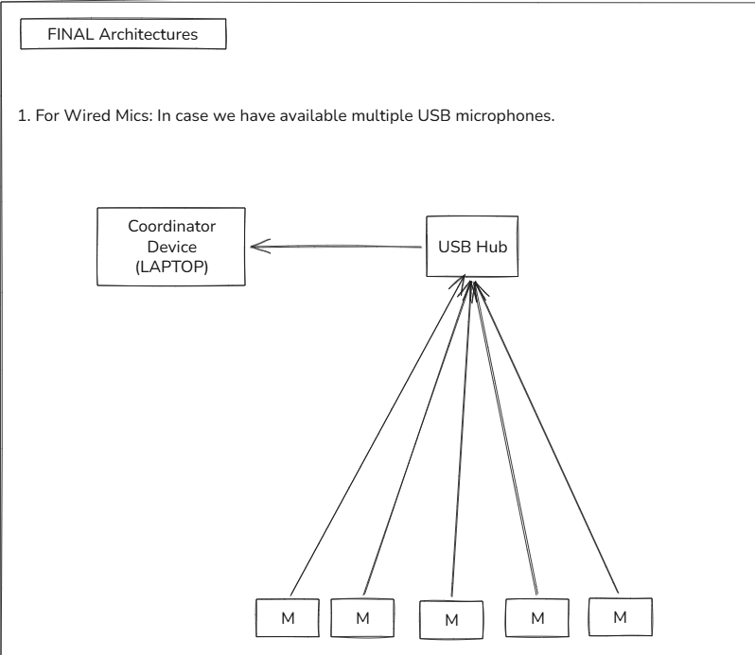
Approach
By
Kali Nangia and Abhishek Sinha
An application that can be used by the coordinator, to connect to the set of microphones present across the venue.
All microphones (including coordinator) will record audio independently, which will be finally combined at the end of discussion.
The wired Setup requires the minimal hardware of
Powered USB Hub
Multiple USB microphones

Slide 12
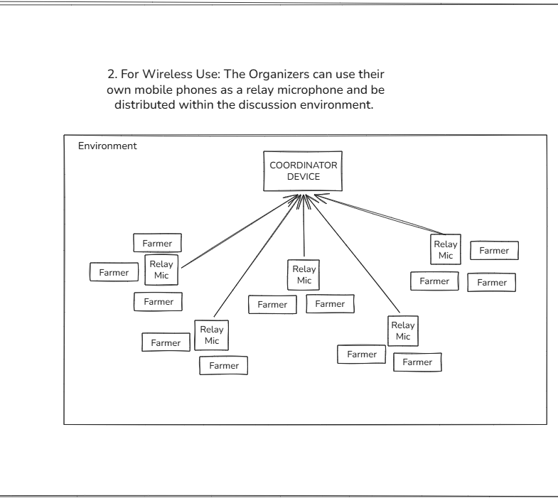
By
Kali Nangia and Abhishek Sinha
The wireless approach will utilize mobile phones connected to the coordinator's device as a relay microphone.
The relay microphones will act as the microphone array and stream their individual audio live recordings to the coordinator.

Slide 13
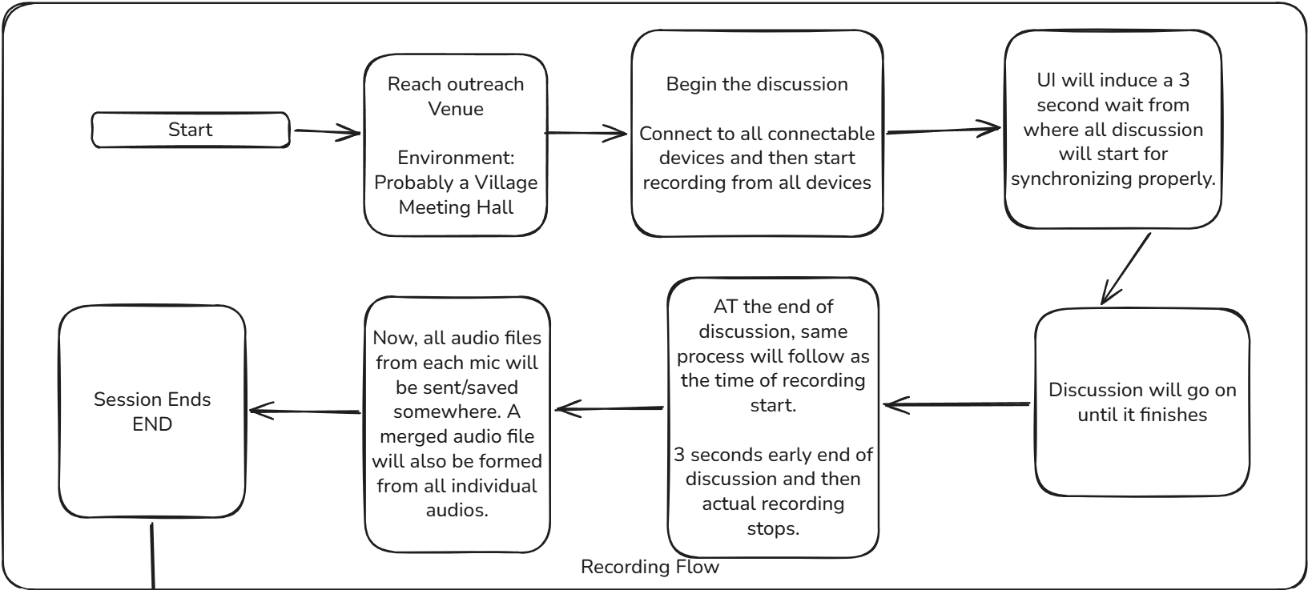
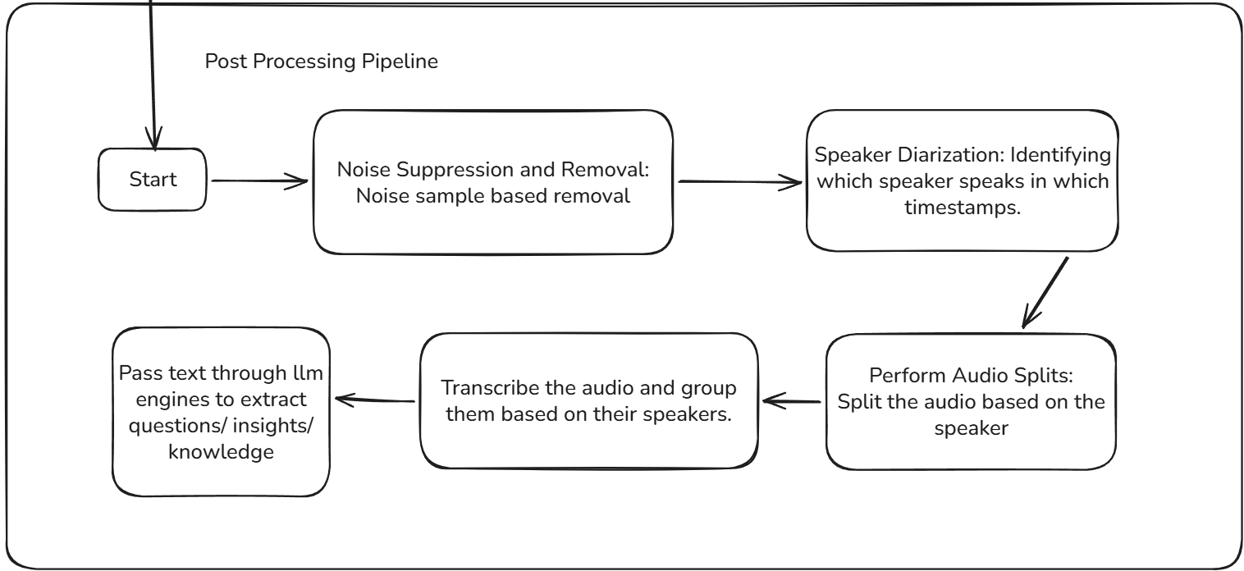
The app will output
The coordinator's audio recording (combined from all)
Each individual's microphone audio recording
These audio data will be then put through a pipeline for:
Noise Suppression
Speaker Diarization
Timestamps based Speaker Audio Splitter
Per speaker audio transcription
By
Abhishek Sinha

Slide 16
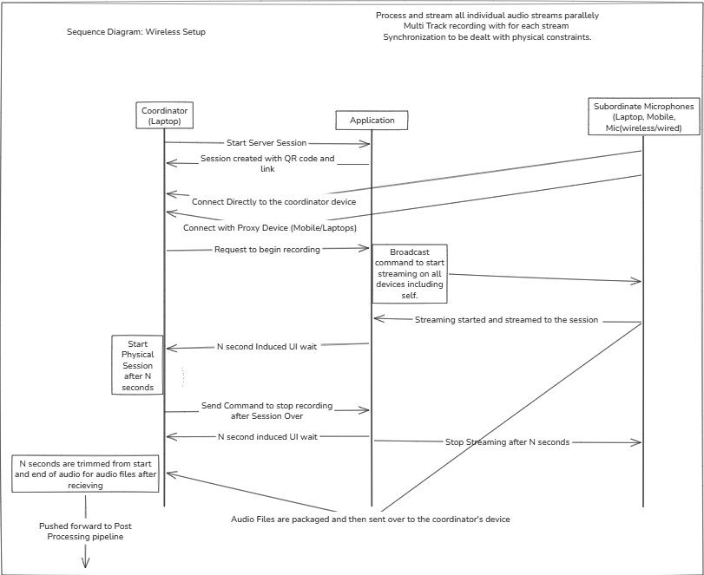
Sequence
Diagram for
Wireless Setup

Slide 17
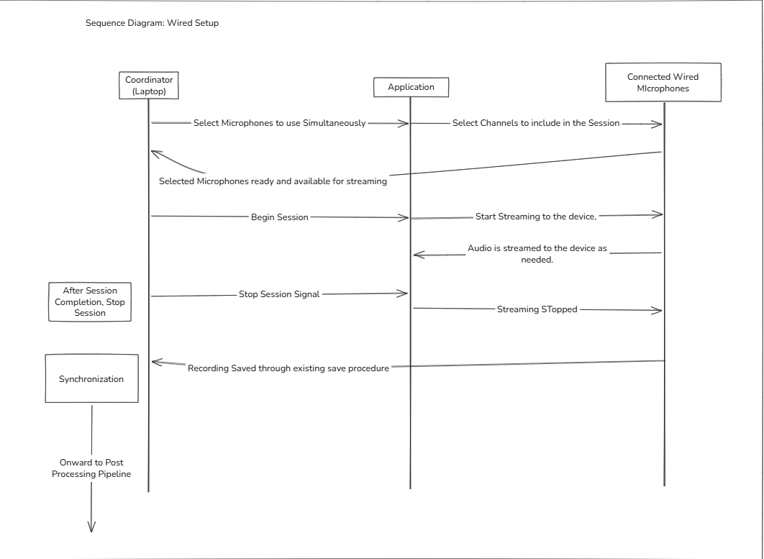
Sequence Diagram for Wired Setup

Slide 18
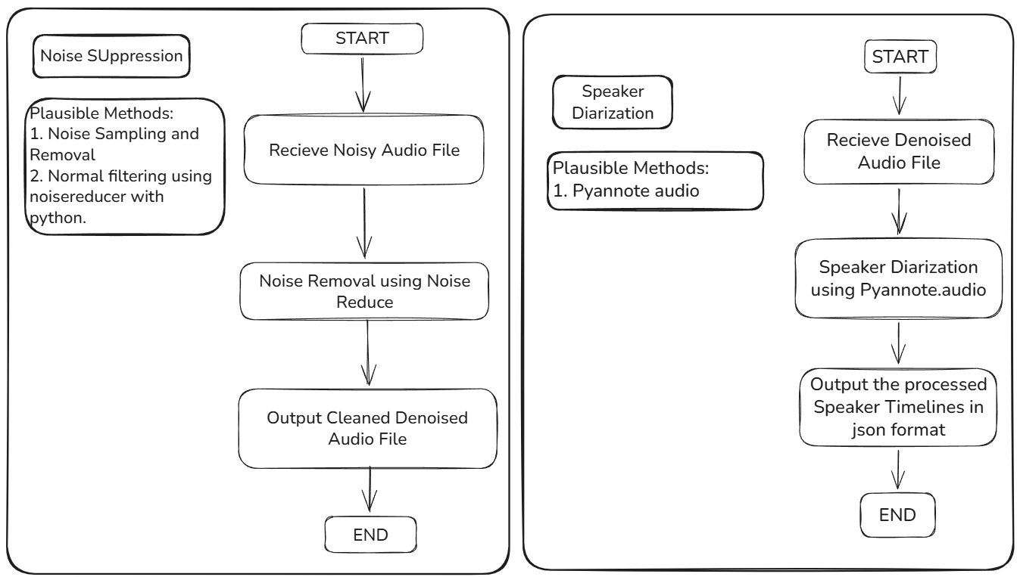
By
Abhishek Sinha
Noise Suppresion
Speaker Diarization

Slide 19
Limitations
Currently, the transcription stage can only accomodate punjabi i.e. Gurmukhi language.
Mics must be connected to the coordinator device to join the session.
Currently There is no fallback in case transcription fails due to unforeseen circumstances.
Transcription time is longer due to no presence of VAD based splitting in the audio.
By
Abhishek Sinha
Kali Nangia
M. Akshay Kumar

Slide 20
Fine Tuning Details
Our Current best model uses 8-bit quantised LORA on whisper turbo
Tuning Layers:
Q_proj (What to look for)
V_proj (What info to carry forward)
Dataset: 8 hours of Gurmukhi Audio with transcript.
Link to Model
Going forward, We will increase the data and layers for better results:
20H dataset
K_proj (What information exists)
Out_proj (How to combine the attended data)
By
Abhishek Sinha & M. Akshay Kumar

Slide 21
By
M. Akshay Kumar
Team Fine-Tuned Models Evaluation Report
Models | WER | STATUS
Garden2006/whisper-large-v3-turbo-gurmukhi-lora | 0.7246 | Completed
abhi8799/whisper-large-v3-turbo-gurmukhi-lora | 0.811 | Completed
abhi8799/whisper-small-gurmukhi-lora | 0.9064 | Completed
KaliNangia/whisper-large-v3-turbo-gurmukhi-lora | 0.802 | Completed
KaliNangia/whisper-medium-gurmukhi-lora | 0.8272 | Completed

Slide 22
Finetuned Whisper Turbo Samples
Sample output from current best finetuned model: Link to Model
Currently vital knowledge about questions has been preserved:
Agri Questions
Awareness of ajrasakha
Total farmers present and names
Crop Dieseases
ਸਾਸਿਕਾਲ ਜੀ ਮੀਟਿਂ ਸ਼ਜਿੂਲ ਬਿਲਜ ਮਡੋਲੀ ਖੁਰਦ ਡੇਟ ਦੋ ਅਪਰਾਈਲ ਦੋਹਿਆਰ ਛੱਬੀ ਬਿਲਜ ਮਡੋਲੀ ਖੁਰਦ ਪੰਚੈਥ ਮਡੋਲੀ ਖੁਰਦ ਬੁਲੋਕ ਮਰੰਡਾ ਡੇਸਟਿਕ ਰੂਪਨਗਰ ਨੇ ਮਉਫਦਾ ਕੋਡੀਨੇਟਰ ਅਮਰਿਤ ਪ੍ਰਿਤ ਸਿੰਗ ਨੇ ਮਉਫਦਾ ਪੋਟਿਂਗ ਮੈਨੇਜਰ ਸੀਰੀ ਮਤੀ ਨਮੀਸ਼ਾ ਮਹਾਜ਼ਨ ਜੀ ਇਵਿਂਟ ਸਟਾਟ ਟਾਇਮੈਜਿਜਰ ਸ਼ੀਰੀ ਮਤੀ ਨਿਮੀਸ਼ਾ ਮਹਾਜਨ ਜੀ ਇਵੇਂਟ ਸਟਾਟ ਟਾਇਮ 11 ਬਜੇ ਦਿਨ ਬੀਰਬਾਰ ਨੇ ਮੌਫਦਾ ਸਰਪੰਚ ਬਲਜੀਤ ਕੋਰ ਸਰਪੰਚ ਫੋਨ ਨੰਬਰ ਨਾਈਨ ਫੋਰ ਸਿਕਸ ਥਰੀ ਨਾਈਨ ਸਿਕਸ ਐਟ ਡਾਬਲ ਸਿਕਸ ਫਾਈਬ ਇਵੇਂਟ ਲਕੇਸ਼ਨ
By
M. Akshay Kumar

Slide 23
Models Tested Upon
Gemma 4 12b
Gemma 4 e4b
Sarvam 30 b
Sarvam 2b
Whisper large v3
Gemini 3.5 flash APIs
Gemini 2.5 flash APIs
Gemini 2.5 Flash Lite APIs
Gemini 3.1 flash lite APIs
Sarvam API.
By
Kali Nangia & M. Akshay Kumar

Slide 24
STT Audio Transcript using Whisper
Used model 'whisper large v3'.
The output was not as expected.
The text does not provide a proper, coherent recognition of words.
The current process failed to accurately detect many words.
The audio source is likely suffering from the environmental noise (wind, tractor rumbles, and crowded farmer cross-talk) has blended into a "messy, un-transcribable audio matrix."
The engine is struggling to interpret multi-lingual regional Punjabi dialects and the specialized agricultural vocabulary required for your outreach project.
By
M. Akshay Kumar

Slide 25
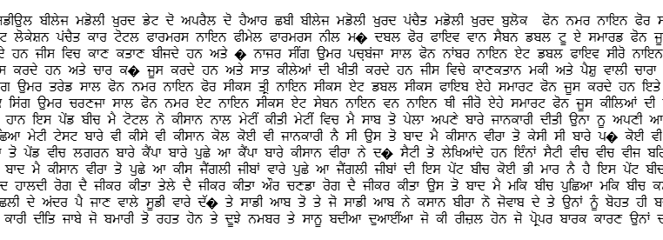
Sample Transcript
This is a transcript of audio Full Narration_MarauliKhurad in punjabi language.
By
M. Akshay Kumar

Slide 26
Using Sarvam
Used Sarvam 2B and 30B models.
2B model is done in colab and 30B is done in kaggle.
Both the outputs were not as expected.
There were repetition of words and hallucination in the transcript.
The transcript was not accurate and couldn't recognize the words of the audio.
By
M. Akshay Kumar

Slide 27
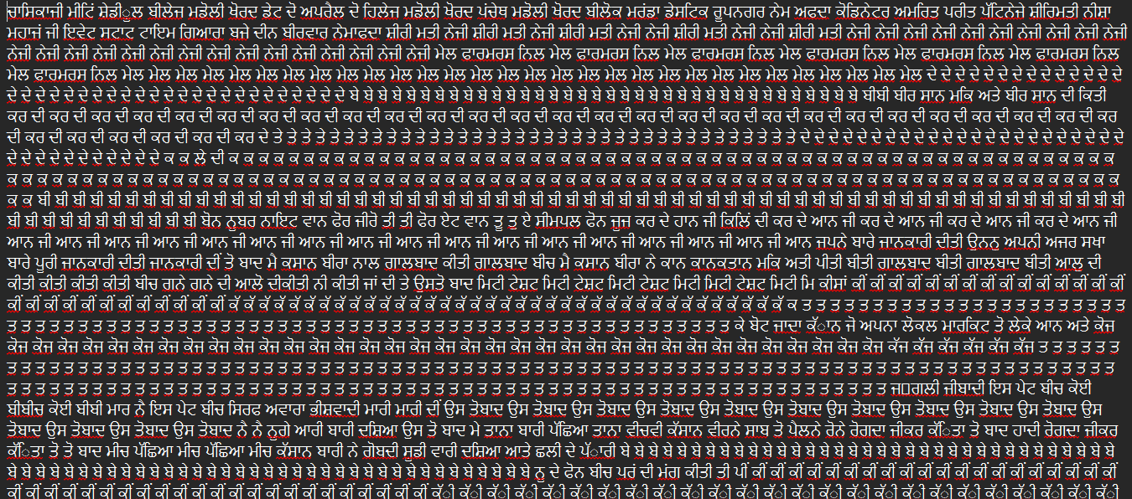
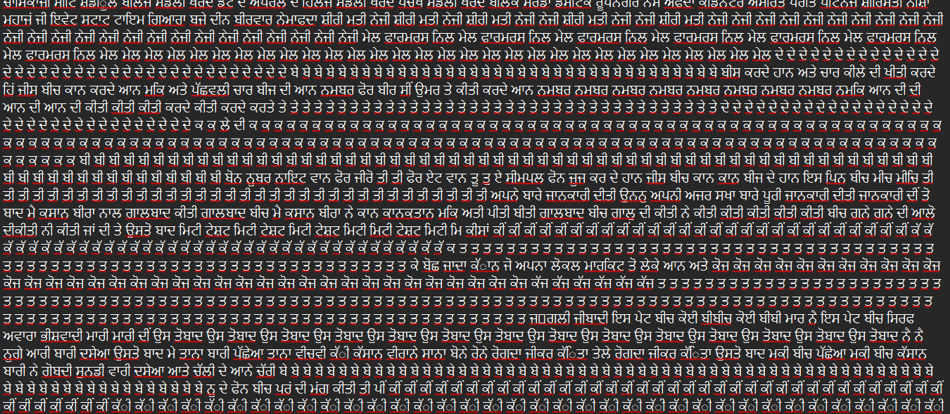
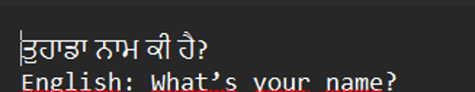
30B 2B
By
M. Akshay Kumar
Punjabi Transcript
Punjabi Transcript
Hindi Transcript
Hindi Transcript
The audio file used for this transcript is Full Narration_MarauliKhurad.

Slide 28
Using GEMINI APIs
Leveraged the Gemini 3.5 Flash API to perform direct, end-to-end processing of the full Punjabi audio narration file.
Generated a clean and highly accurate transcript fully rendered in the native Gurmukhi script.
Extracted complete organizational metadata, successfully capturing the event date (April 2, 2026), coordinator names, management roles, and precise location details (Village Madoli Khurd, District Rupnagar).
Captured structured quantitative metrics, documenting exact event timings, total farmer attendance, and gender distribution.
Logged precise individual farmer profiles, accurately capturing names, exact ages, contact numbers, phone types (smartphone vs. simple phone), land acreage in killas, and specific crop varieties including wheat, paddy, maize, mustard, and fodder.
By
Kali Nangia

Slide 29
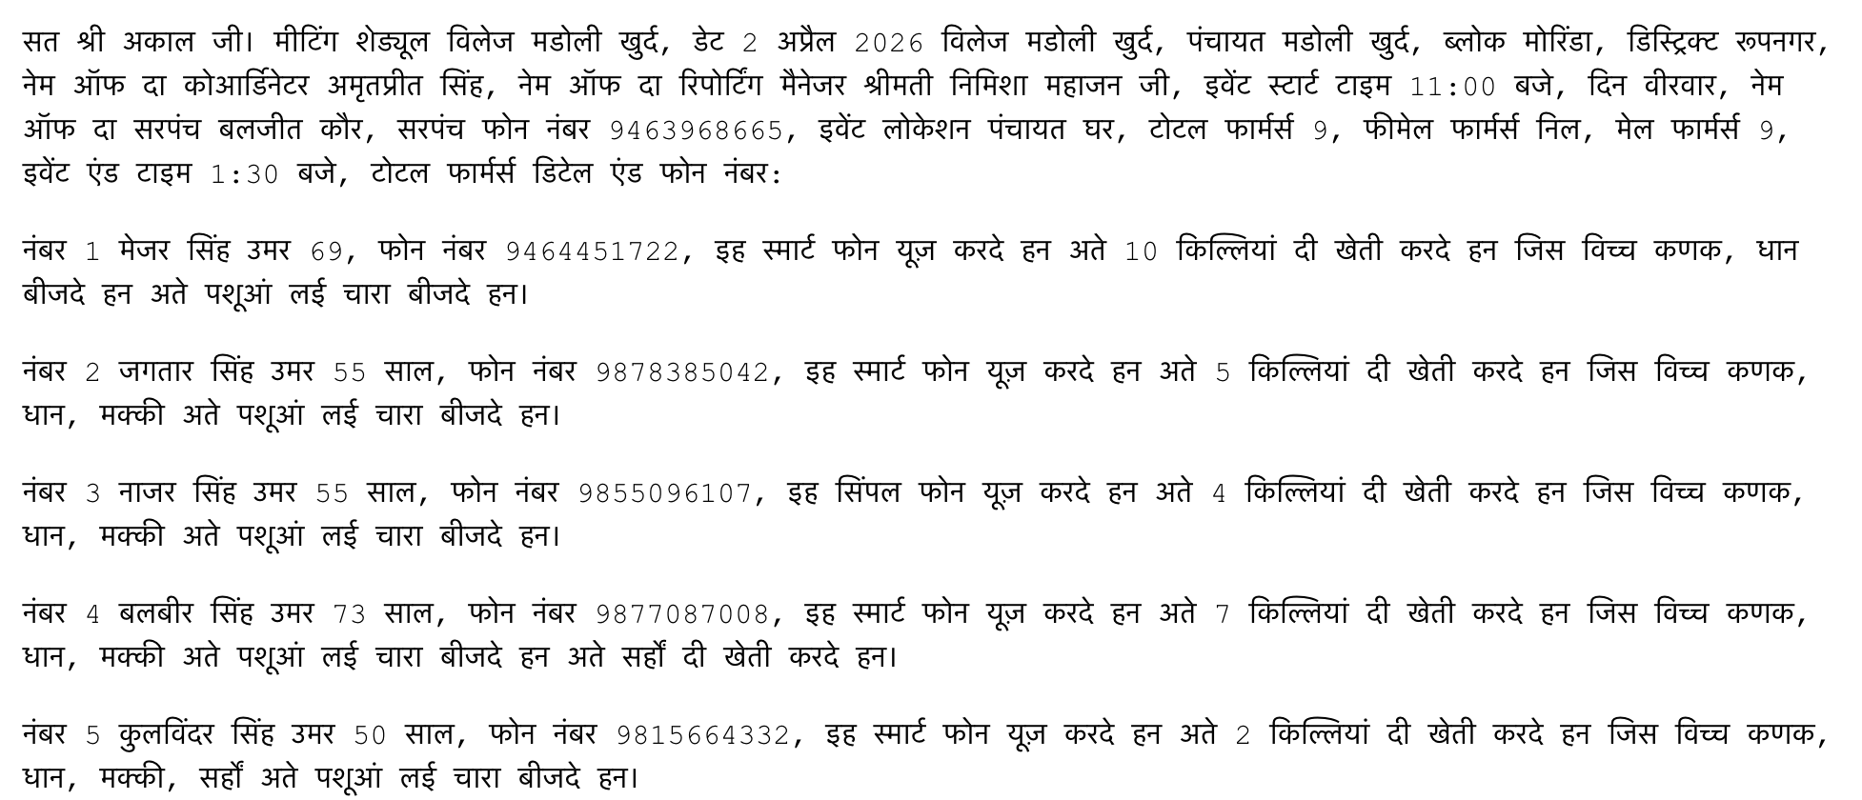
Using GEMINI APIs
By
Kali Nangia

