Slide 1
INDUSTRIES
Presented By :- Abhishek Sharma

Slide 2
INDUSTRIES
Industries are the place where the products are manufactures and supplied in the market.

Slide 3

TYPES OF INDUSTRIES
Primary Industry
Secondary Industry
Tertiary Industry

Slide 4
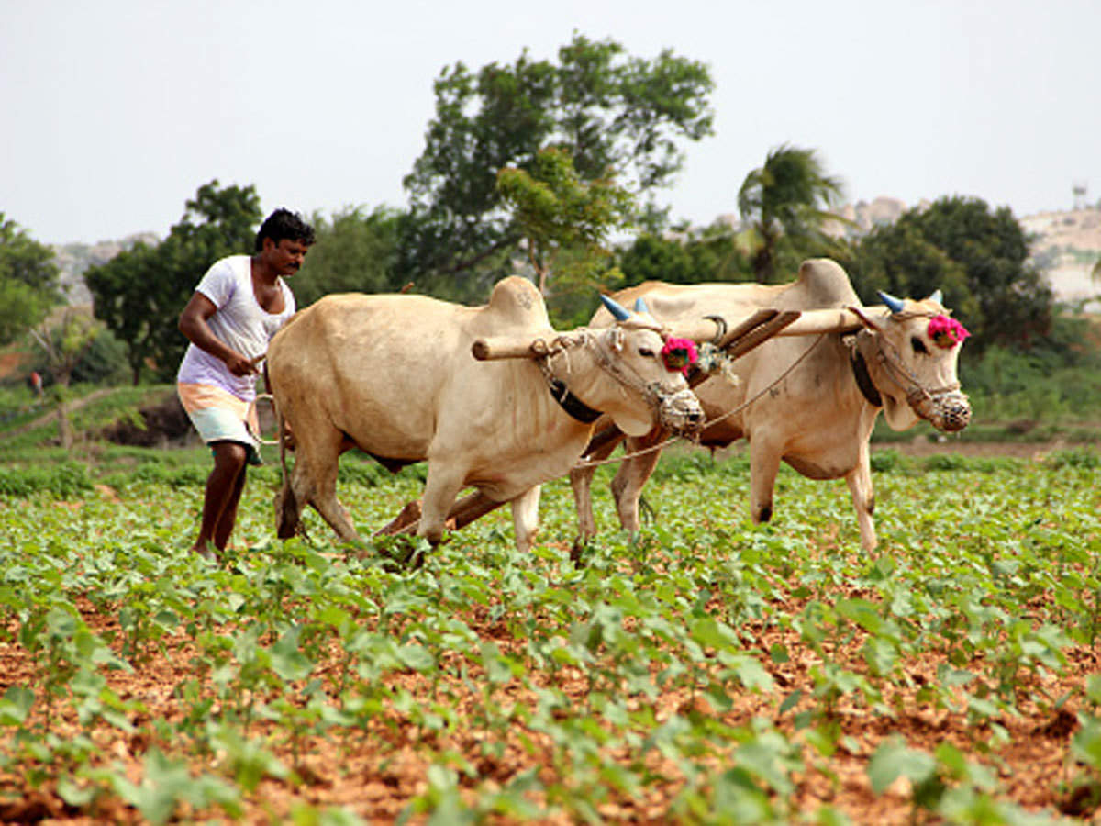
PRIMARY INDUSTRY
Primary industries are those industries where the raw material are produced.
For example:-pollutary farming

Slide 5
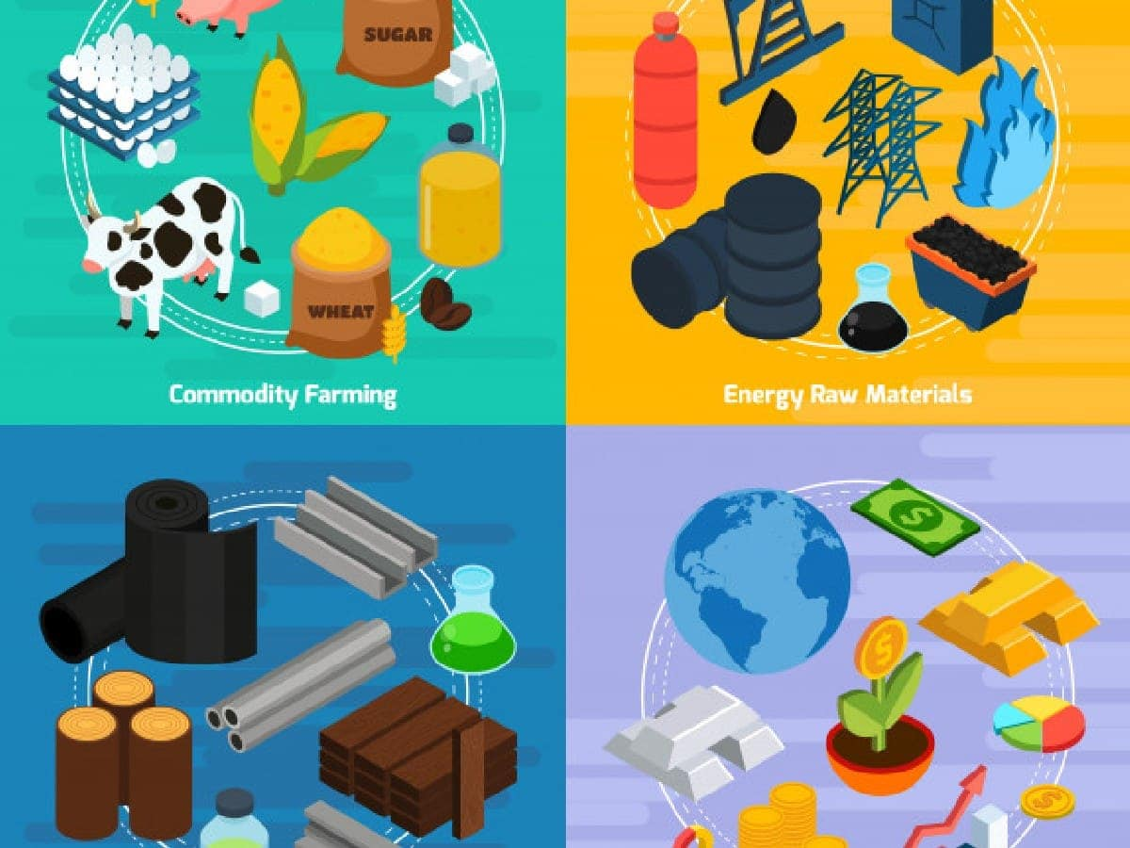
Secondary Industry
Secondary industries are those industries where raw materials are converted inti finished goods.
For example :- making sugar from sugarcane.

Slide 6

Tertiary Industry
Tertiary industry are those industry where banking , transportation , communication , takes place.
For example :- marketing

Slide 7
Notes
Secondary Industry are also known as manufacturing Industries.
Tertiary Industry is the main part because both primary and secondary industry are depends on tertiary industry.
The primary sector feeds into the secondary factors.
Each sector relies on the others to function properly.

Slide 8

Importance of Industries
Economic growth
Development
Job Creation
Increase Productivity
Increase Exports
Improve resource Utilization.

