Slide 1
React JS Calculator App

Slide 2
Motivation:
The ReactJS Calculator Web App is a modern and user-friendly application designed to empower users with the ability to perform basic arithmetic calculations through an intuitive and responsive interface. Leveraging the power of the React JavaScript library, this web app offers a versatile and seamless experience for individuals seeking a reliable tool for everyday calculations.

Slide 3
Objective:
Build a simple calculator app which performs simple arithmetic operations such as addition, subtraction, multiplication and division
Create a visually appealing and intuitive user interface using React components, HTML, and CSS.
Display buttons for numbers (0-9) and common arithmetic operations (addition, subtraction, multiplication, division).
Allow users to input numerical values by clicking on number buttons
Benefits:
Gives Results of Arithmectic Operation in just few milliseconds.
Able to perform Operations such as i.e. Addition , Subtraction,Multiplication,Division.
Able to perform Operations on decimal digits.

Slide 4
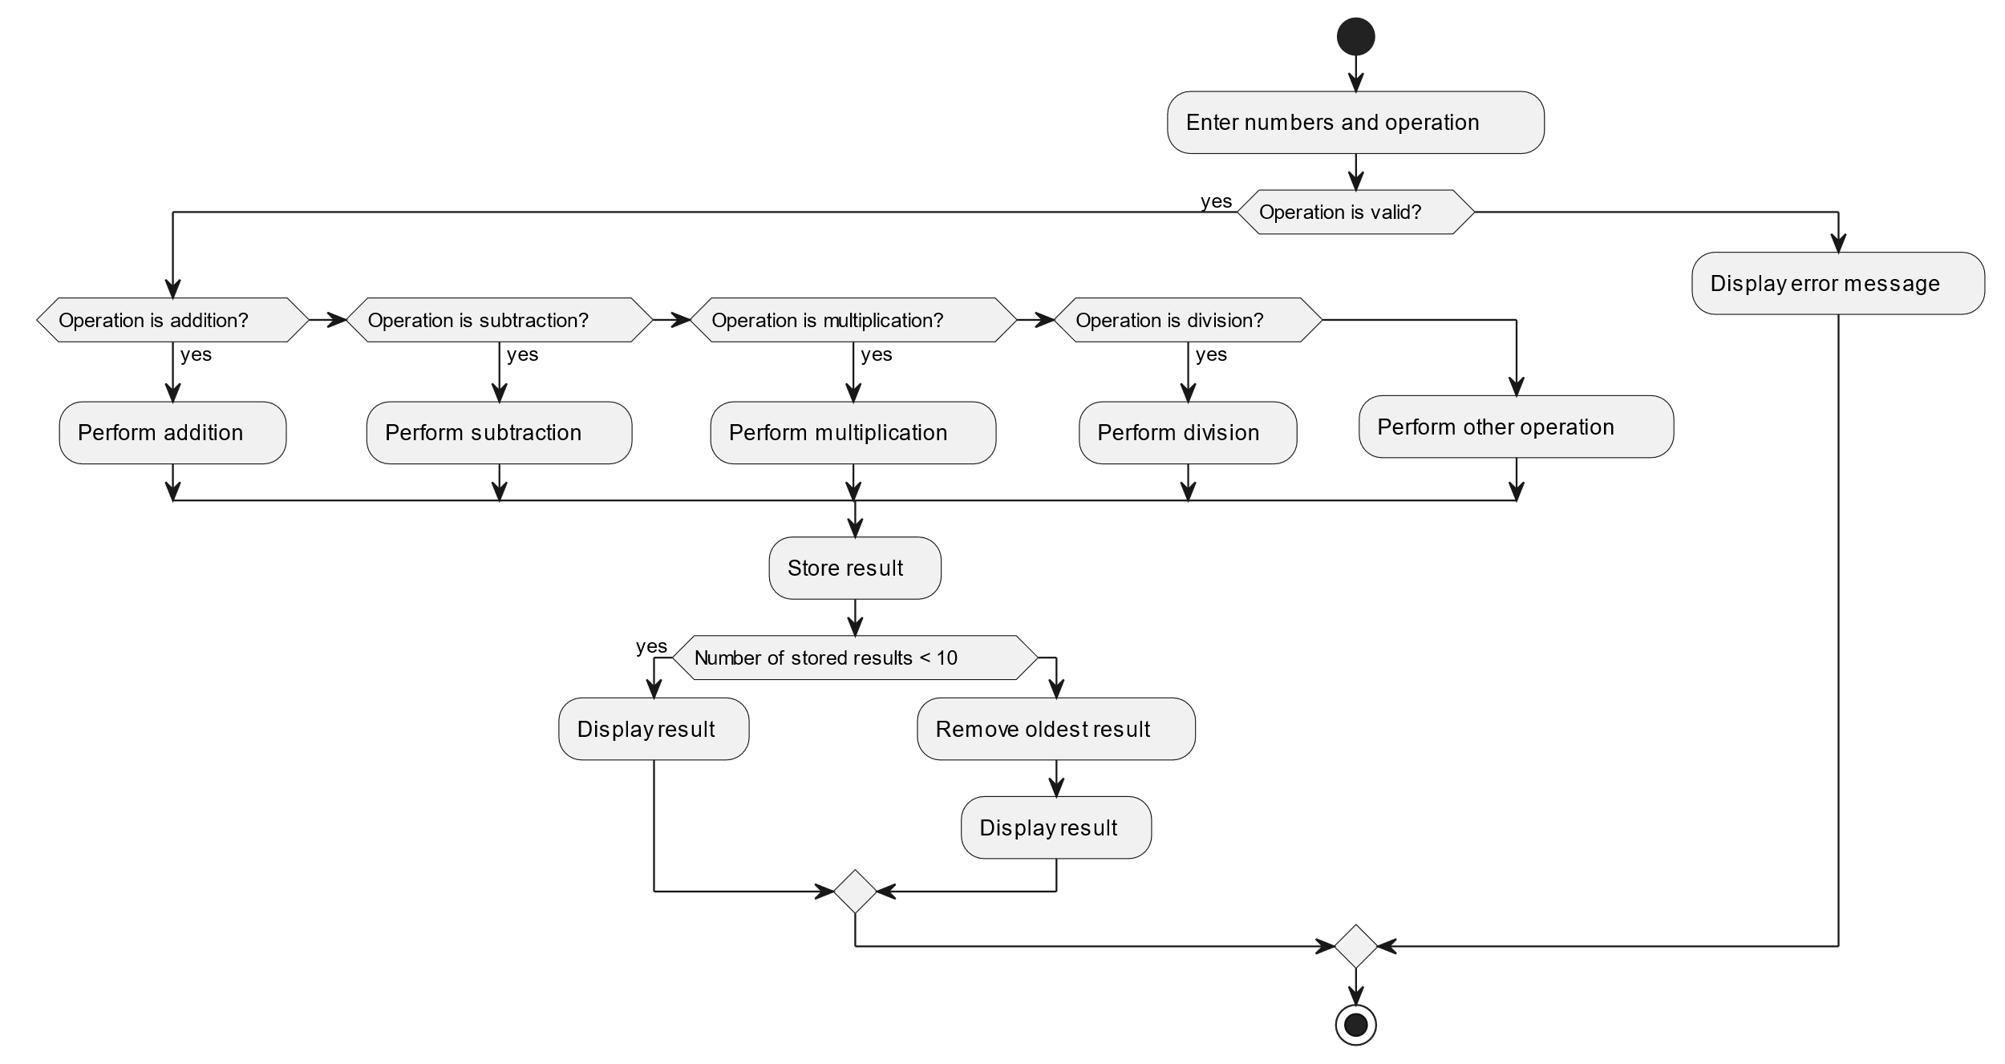
Workflow of Calculator

Slide 5
Input:
User will enter the first number .
In this second step, user will enter the operation which they want to perform.(+,-,*,/)
User will enter the second number.
Output:
User will get the Result of the Operation that was given at the input section .

Slide 6
Remarks:
Calculator App is able to perform all arithmetic operation.
Can Perform operation on any data type(int,decimal)
Results in error when performed invalid expression.(‘*3*2*’==Invalid expression)
Shows result as ‘Infinity’ when any number divided by 0.(3/0==Infinity)

Slide 7
Q & A:
Q1) Is able to perform all arithmetic Operation?
Yes , this app is able to perform Arithmetic operation such as addition,subtraction,multiplication,division.
Q 2) What is the type of data for performing operation?
It can perform Operations for both integer and decimal data type.
Q 3) What will happen if any number is divided by 0(5%0)?
It will show result as ‘Infinity’.
Q 4) Is there any special feature in this app?
Yes, this calculator can be switched between Light and Dark mode.

