Slide 1

Customer Relationship Management (CRM)
Atharv Sathe (20104054)
Harsh Yadavade (20104077)
Jayesh Singh (20104101)
Project Guide
Prof. Sonal Balpande
01

Slide 2
Contents
Introduction
Objectives
Scope
Literature Survey
Proposed System
Project Outcomes
Block Diagram
Use Case/DFD
Technology Stack
Suggestions in Review-1
Result and Discussion
Conclusion and Future Scope
References
02

Slide 3
Introduction
CRM is the development and maintenance of mutually beneficial long-term relationships with strategically significant customers.
CRM is a shift from traditional marketing as it focuses on the retention of customers in addition to the acquisition of new customers.
CRM enables organizations to gain ‘competitive advantage’ over competitors that supply similar products or services.
CRM is a business philosophy based on upon individual customers and customised products and services supports by open lines of communication and feedback from the participating firms that mutually benefit both buying and selling organisations.
CRM is ultimately what the company defines it to be depending on their business objectives.
03

Slide 4
Problem Identified :
1. Not very much Centralized
2. Irregular workflow.
3. Low user adoption.
4. Perspective.
Solution Proposed:
A CRM solution will centralize all your data and make it easier for you to find what you need, exactly when you need it.
CRM will help the seller to run their business efficiently with using our technology and also help them to improve good business sense.
04

Slide 5
Objectives
To Improve the customer’s journey.
To Improve operational efficiency.
To Generate more opportunities for the Companies.
To provide analysis through web application
To Expand the customer base.
To improve customer Profitability.
05

Slide 6
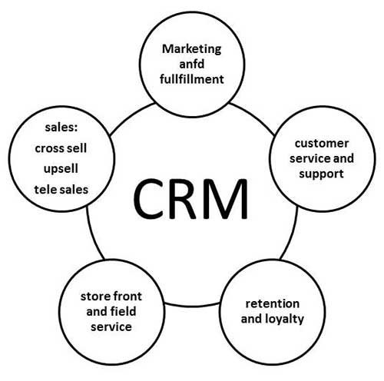
Scope
A CRM system is huge and important, which can be used by small and large companies as the main aim is to provide effective customer service..
The ideal CRM system is a single repository for all data sources within a company that gives an atomistic real-time view of client data.
CRM is a sound idea or approach for strengthening or retaining customer relationships while lower costs and increasing productivity and profitability in the workplace.
A CRM system is important not just for dealing with existing clients, but also for obtaining new ones.
06

Slide 7
Literature Survey
Sr.no | Title | Author(s) | Year | Outcomes | Methodology | Result
1 | Machine learning-based customer relationship management with chatbot automation and time series forecasting using ARIMA model. | P.S. Gopalakrishnan, G. Raghavendra Rao, K. Prasad | 2020 | The proposed system improved customer satisfaction and sales revenue by providing personalized recommendations and accurate sales forecasting. | The system used a combination of machine learning algorithms, including natural language processing, sentiment analysis, and ARIMA model for time series forecasting. | A case study showed that the system increased sales revenue by 30%.
2 | Intelligent Chatbot-Based CRM System using Machine Learning and Time-Series Analysis | D. Sumathi, K. Saravanan | 2021 | The proposed system improved customer engagement and satisfaction by providing 24/7 support and accurate sales forecasting. | The system used a combination of machine learning algorithms, including natural language processing, sentiment analysis, and time-series analysis using ARIMA model. | A survey showed that 75% of the participants found the system helpful in addressing their queries.
3 | Chatbot-Based CRM System with Time Series Analysis for Sales Forecasting | Chia-Wei Hsu, Chun-Hao Liao, Chia-Chen Chen | 2021 | The chatbot-based CRM system improved customer experience and sales forecasting accuracy by providing personalized recommendations and real-time insights. | The system used a combination of machine learning algorithms, including natural language processing, sentiment analysis, and time-series analysis using ARIMA model. | A case study showed that the system increased sales forecasting accuracy by 35%.
07

Slide 8
Proposed System
Features and Functionality
Feature 1: Providing Dashboard
Feature 2: Option for Creating A new Ticket
Feature 3: Creating a Quote Request
08

Slide 9
Algorithm Used
Customer Relationship Management:
1] Auto Regressive Integrated Moving Average (ARIMA) :
ARIMA, short for ‘Auto Regressive Integrated Moving Average’ is actually a class of models that ‘explains’ a given time series based on its own past values, that is, its own lags and the lagged forecast errors, so that equation can be used to forecast future values.
An ARIMA model is characterized by 3 terms: p, d, q
where,
p is the order of the AR term.
q is the order of the MA term.
d is the number of differencing required to make the time series stationary.
09

Slide 10
Outcomes of Project
Customer Relationship Management enables a company to align its strategy with the needs of the customer in order to best meet those needs and thus ensure long-term customer loyalty.
However, in order to be successful in these aims, the different company departments have to work together and use measures in a coordinated fashion.
This purpose is achieved via a customer database which is analysed and updated using CRM software.
This approach will be of particular interest to companies operating in highly competitive markets with less small company where it is difficult to attract new customers.
10

Slide 11
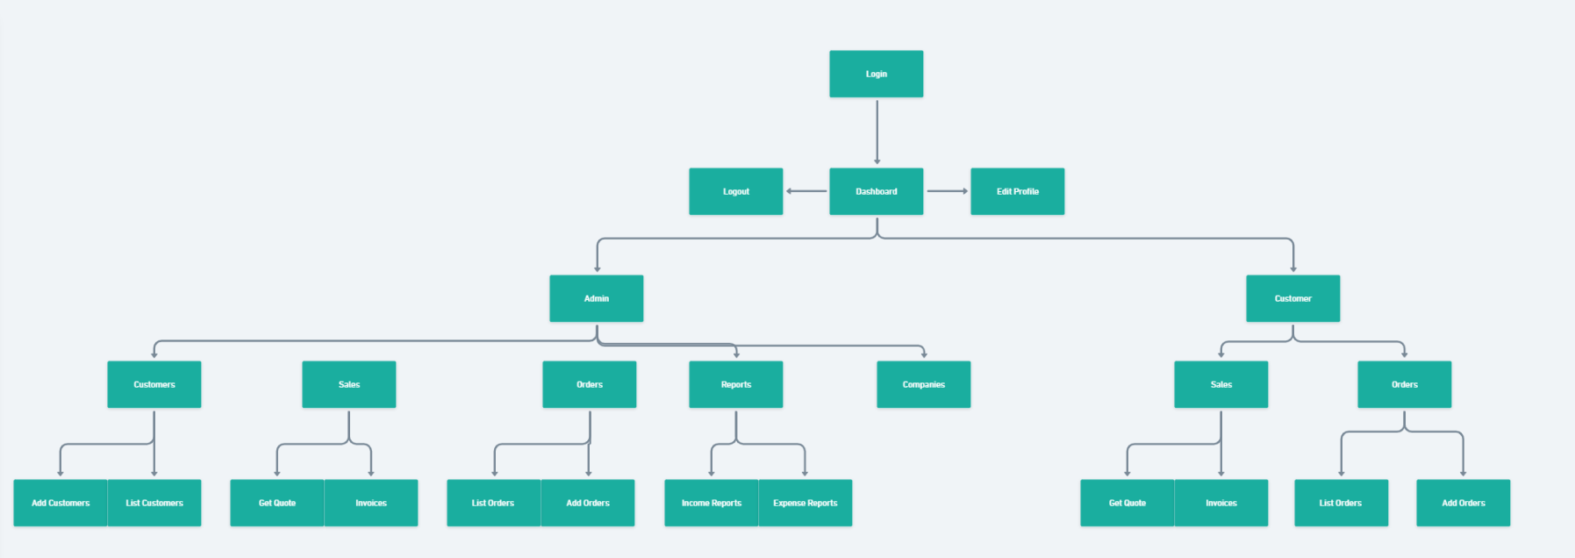
Block Diagram
11

Slide 12
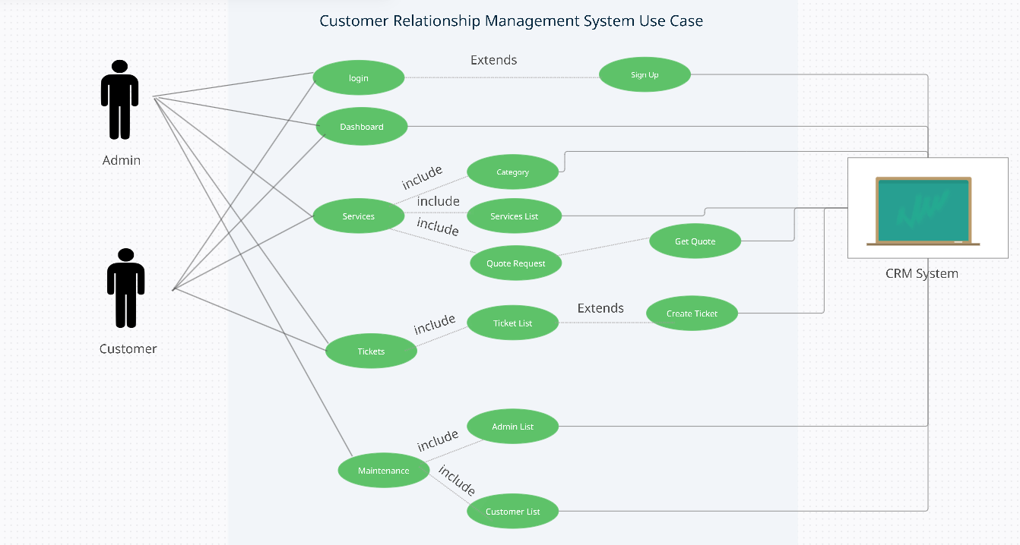
Use Case Diagram
12

Slide 13
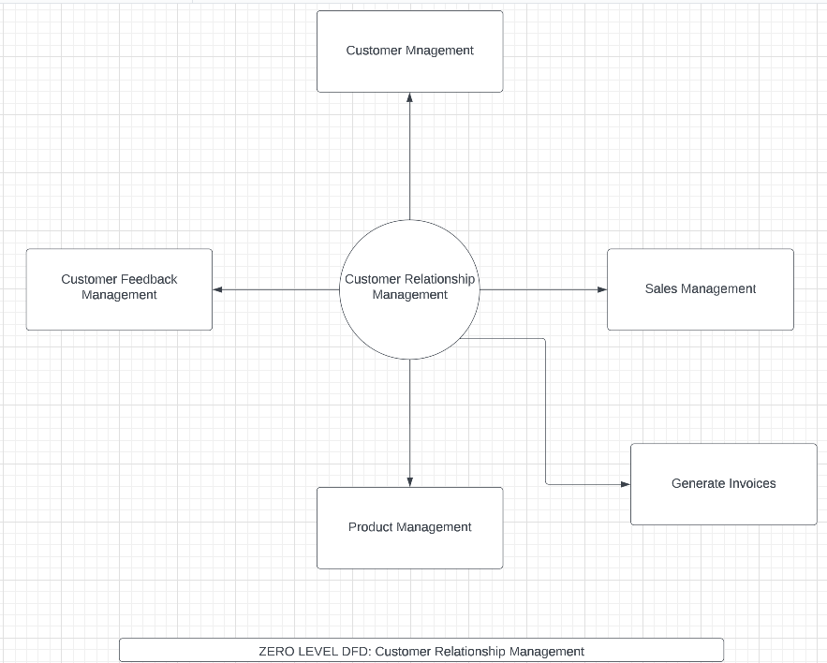
DFD Diagram
(Level 0)
13

Slide 14
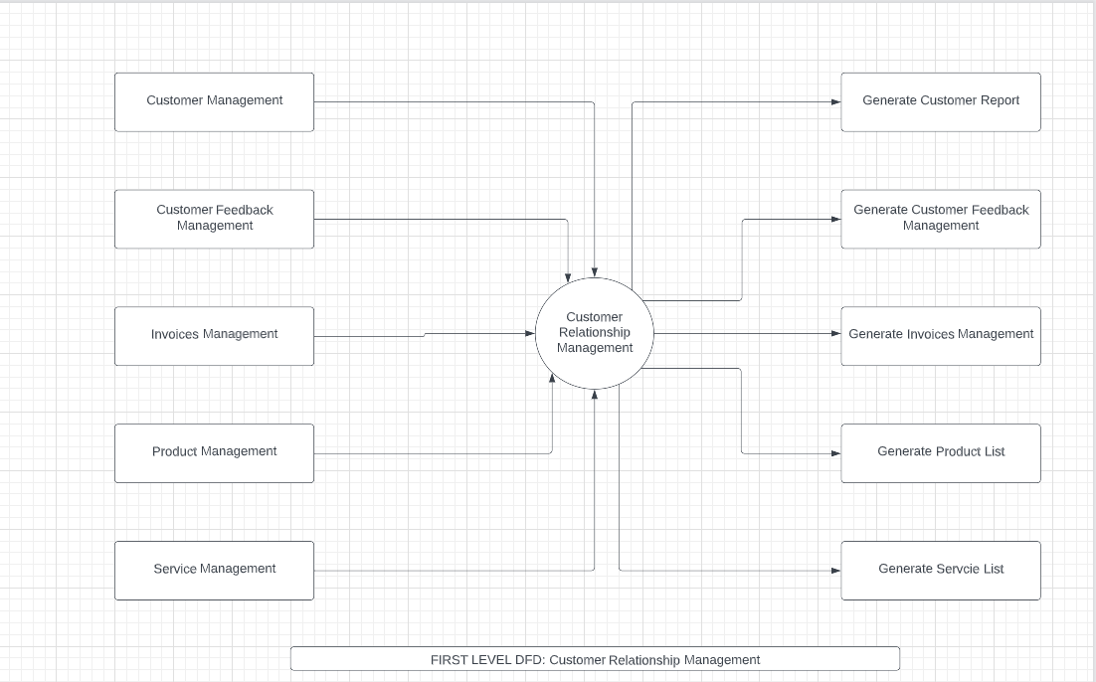
DFD Diagram
(Level 1)
14

Slide 15
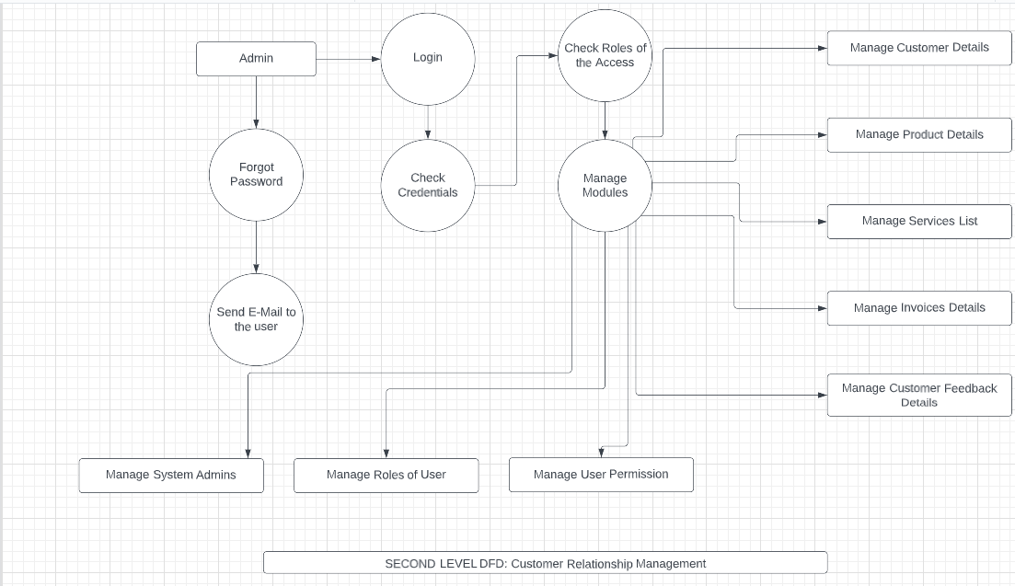
DFD Diagram
(Level 2)
15

Slide 16
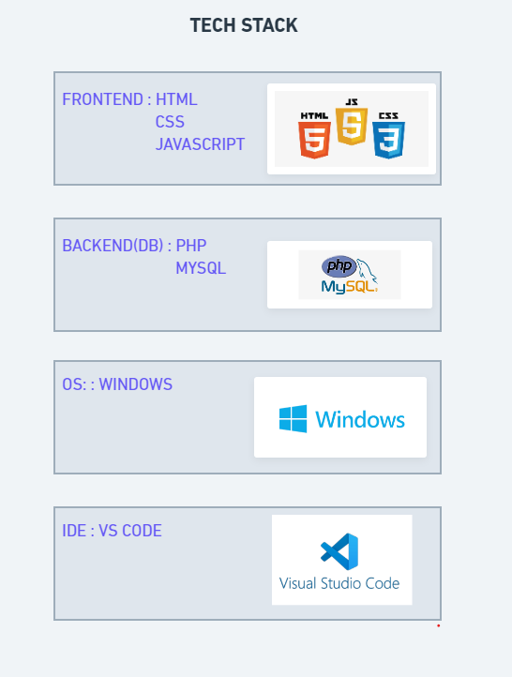
Technology Stack
16

Slide 17
Suggestion in Review - 1
Proper Categorization
Proper ML Explanation of Project
Changes in PPT
17

Slide 18
Result & Discussion
CRM benefits a company in a variety of ways. While the benefits vary by department or industry, six benefits of CRM platforms that affect every user include:
Trustworthy reporting.
Dashboards that visually showcase data.
Proactive service.
Efficiency enhanced by automation.
Simplified collaboration.
18

Slide 19
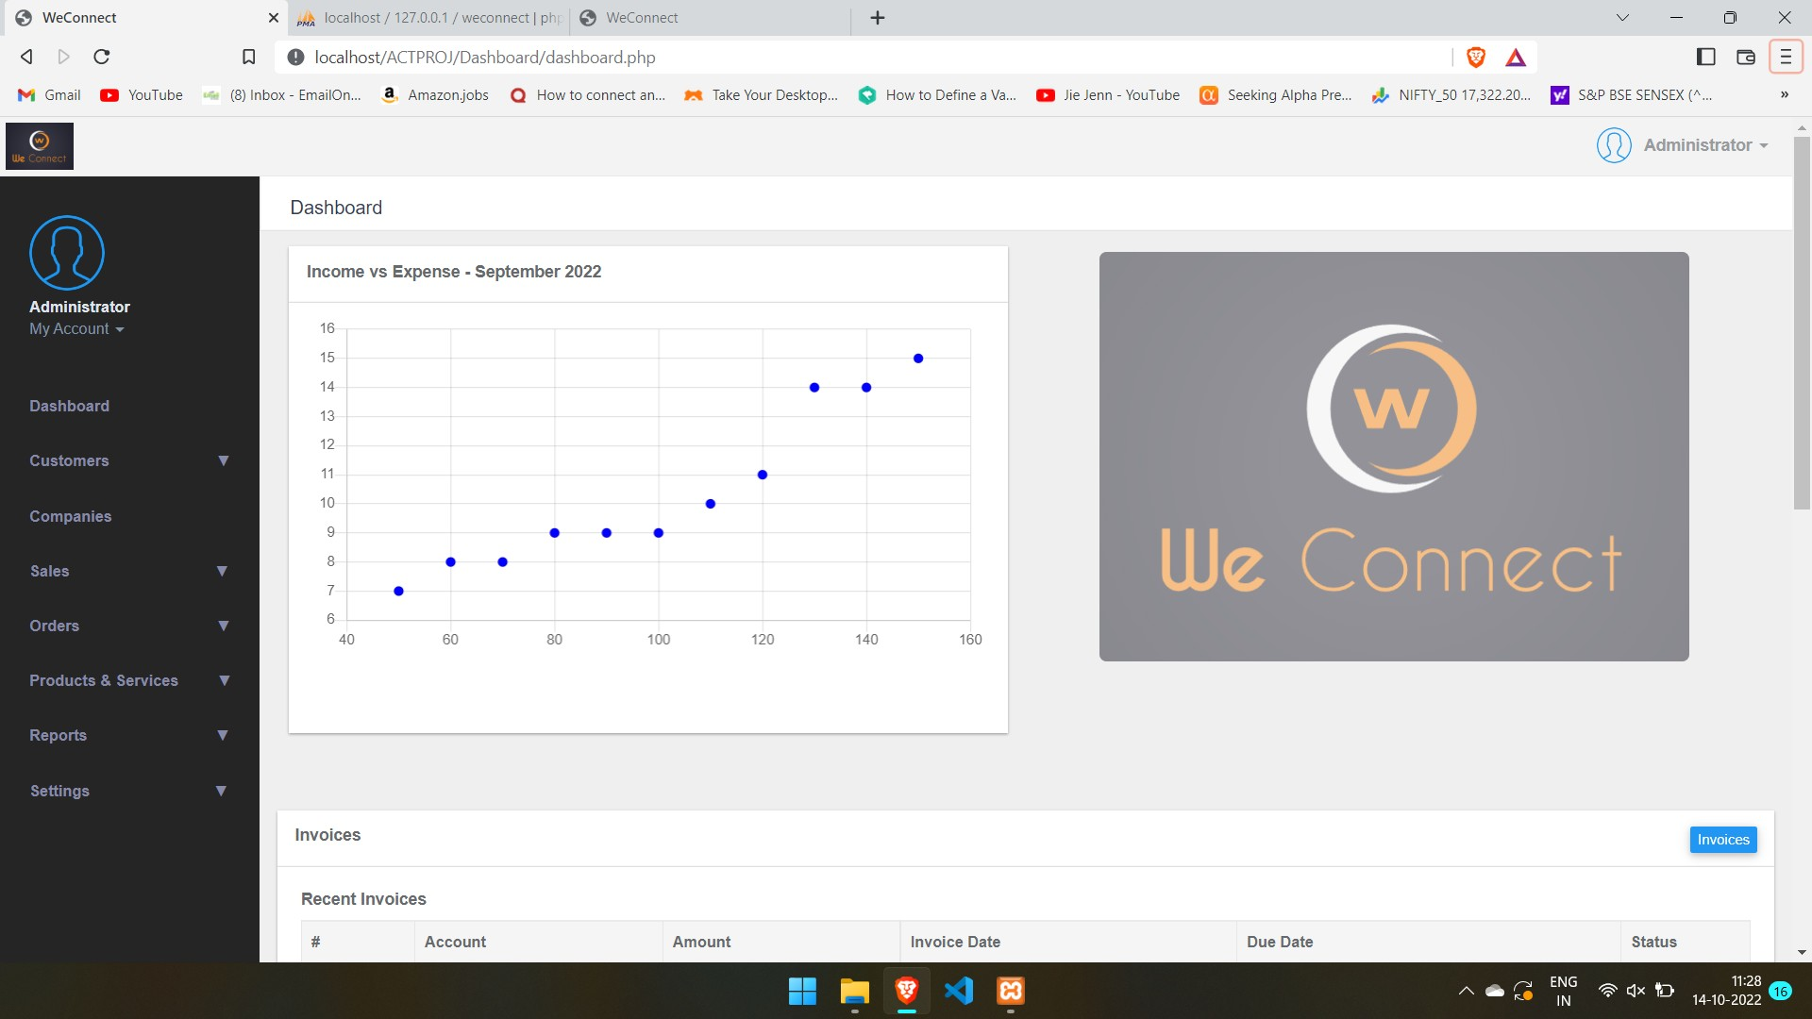
Discussion
19

Slide 20
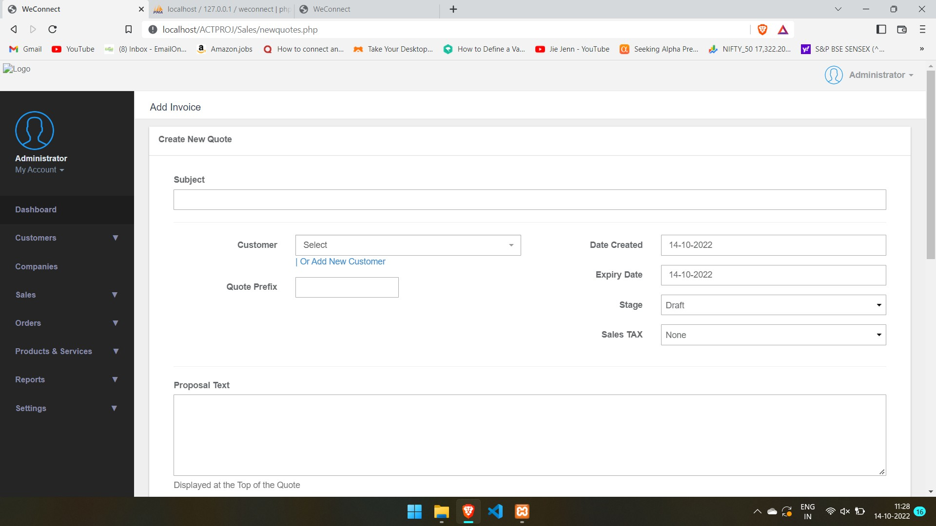
Discussion
20

Slide 21
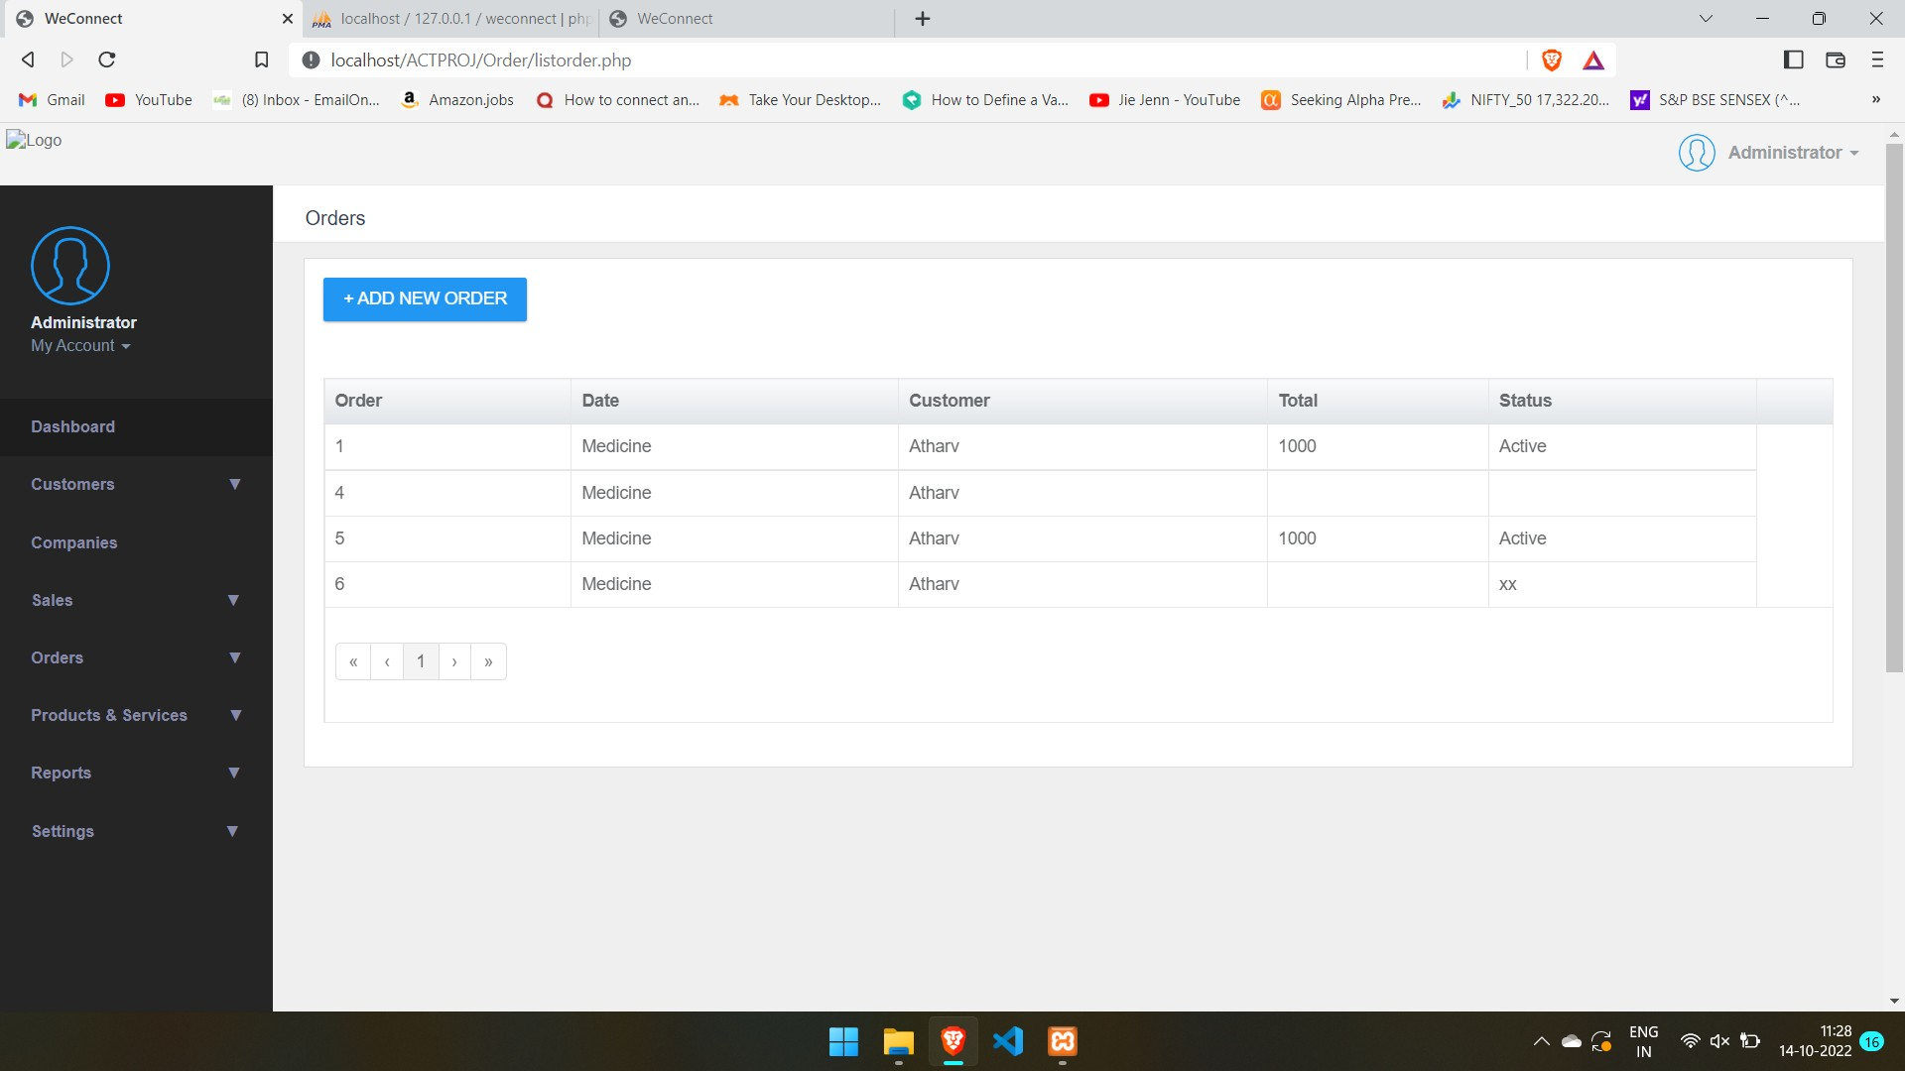
Discussion
21

Slide 22
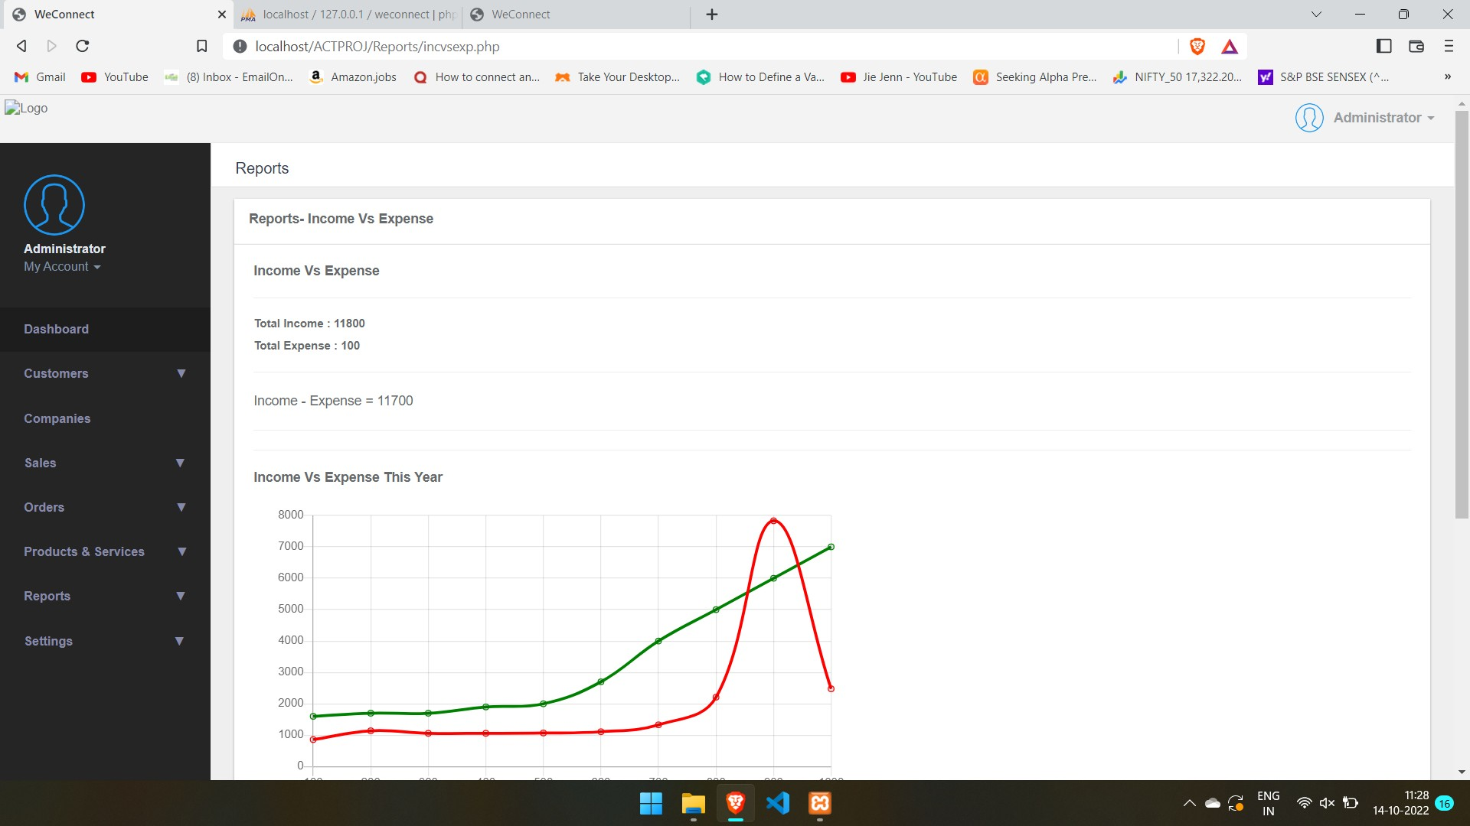
Discussion
22

Slide 23
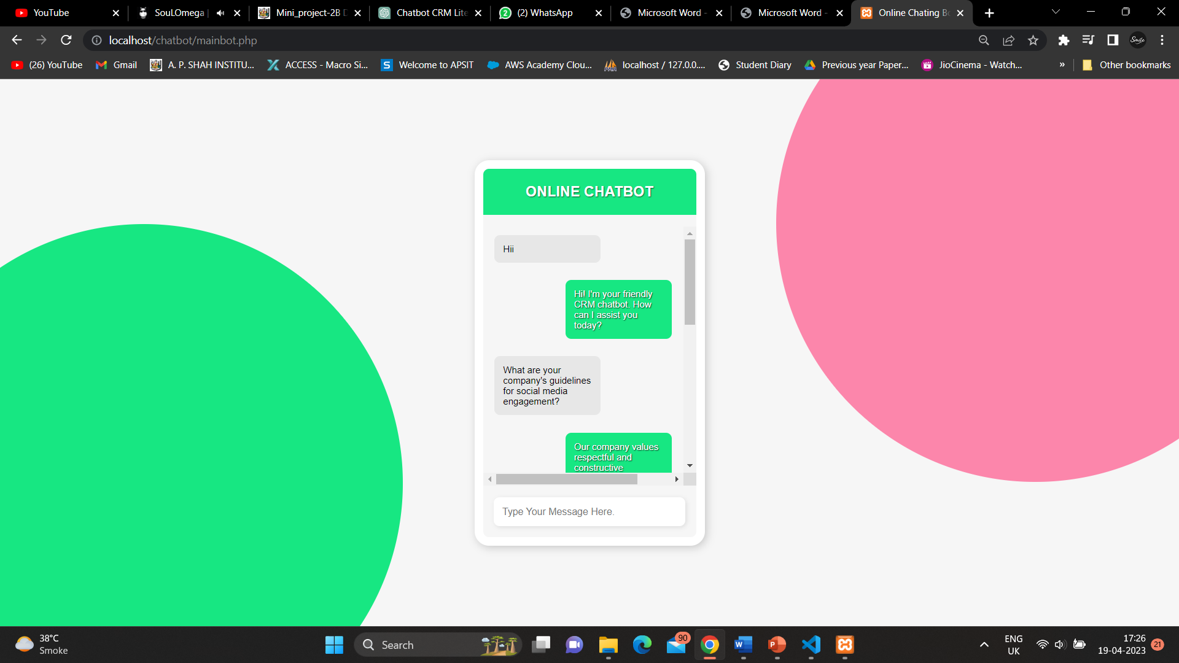
Discussion
23

Slide 24
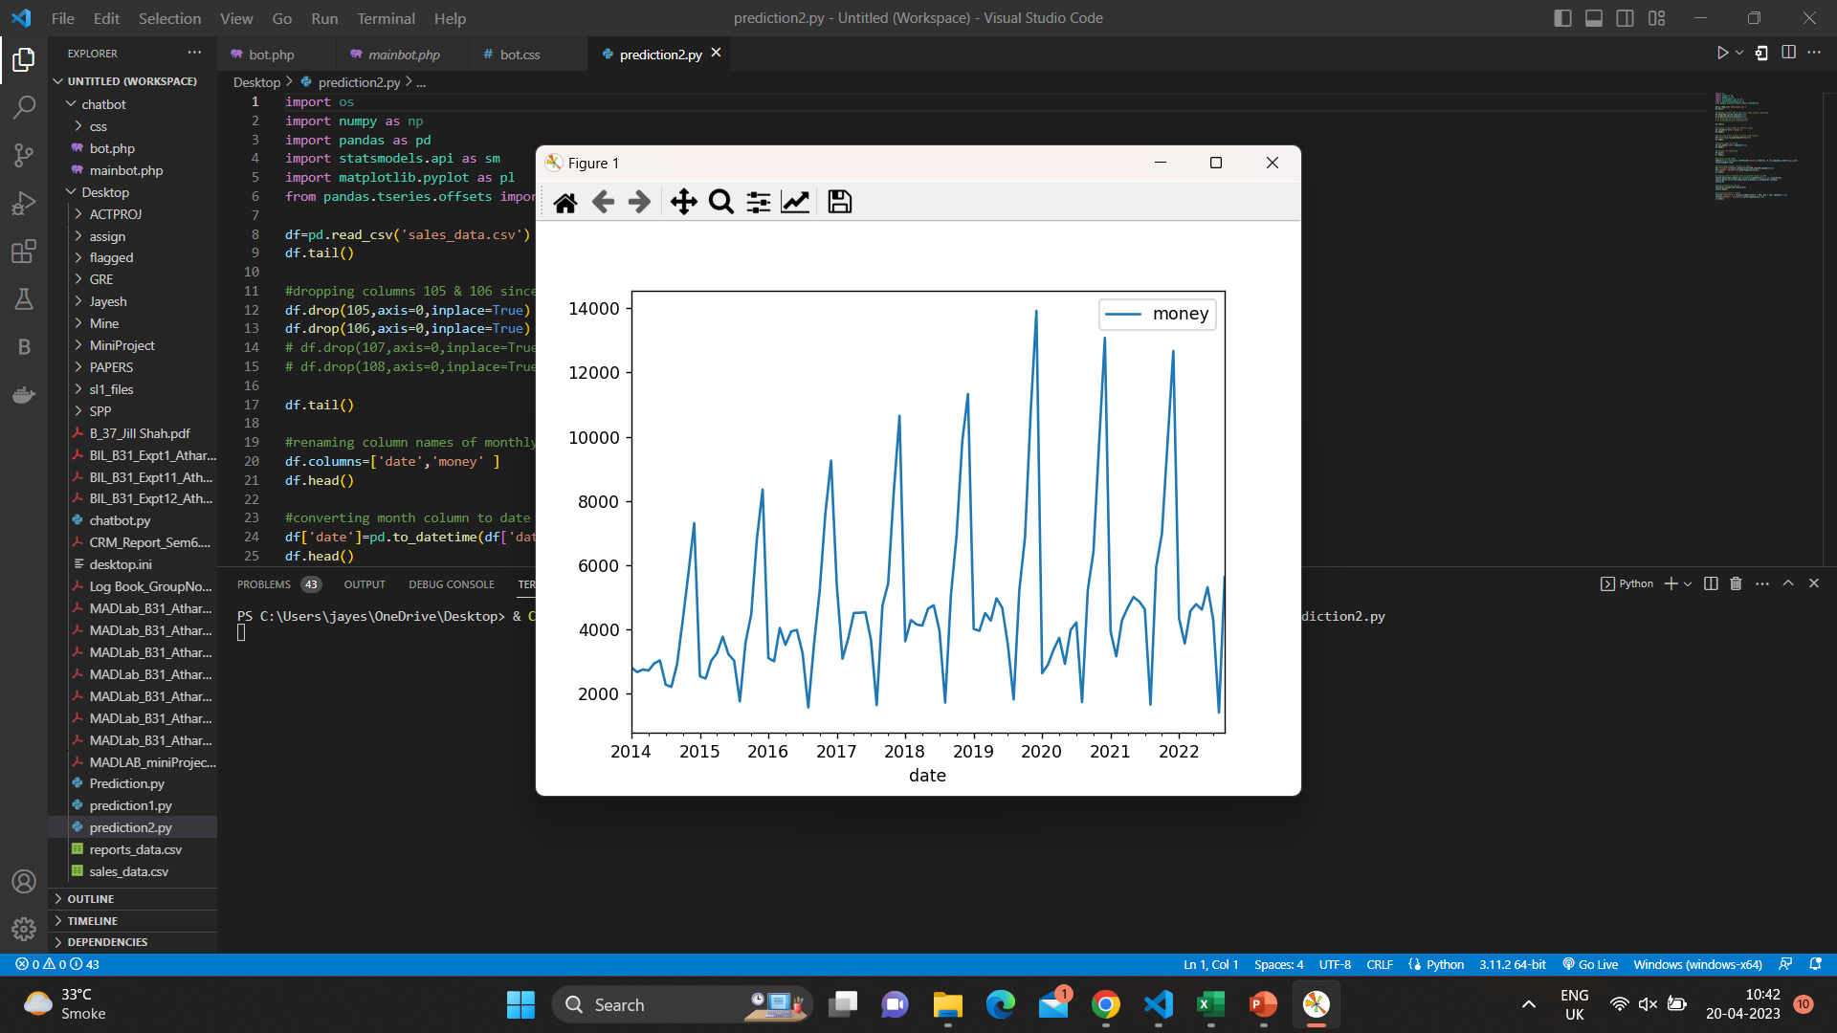
Discussion
24

Slide 25
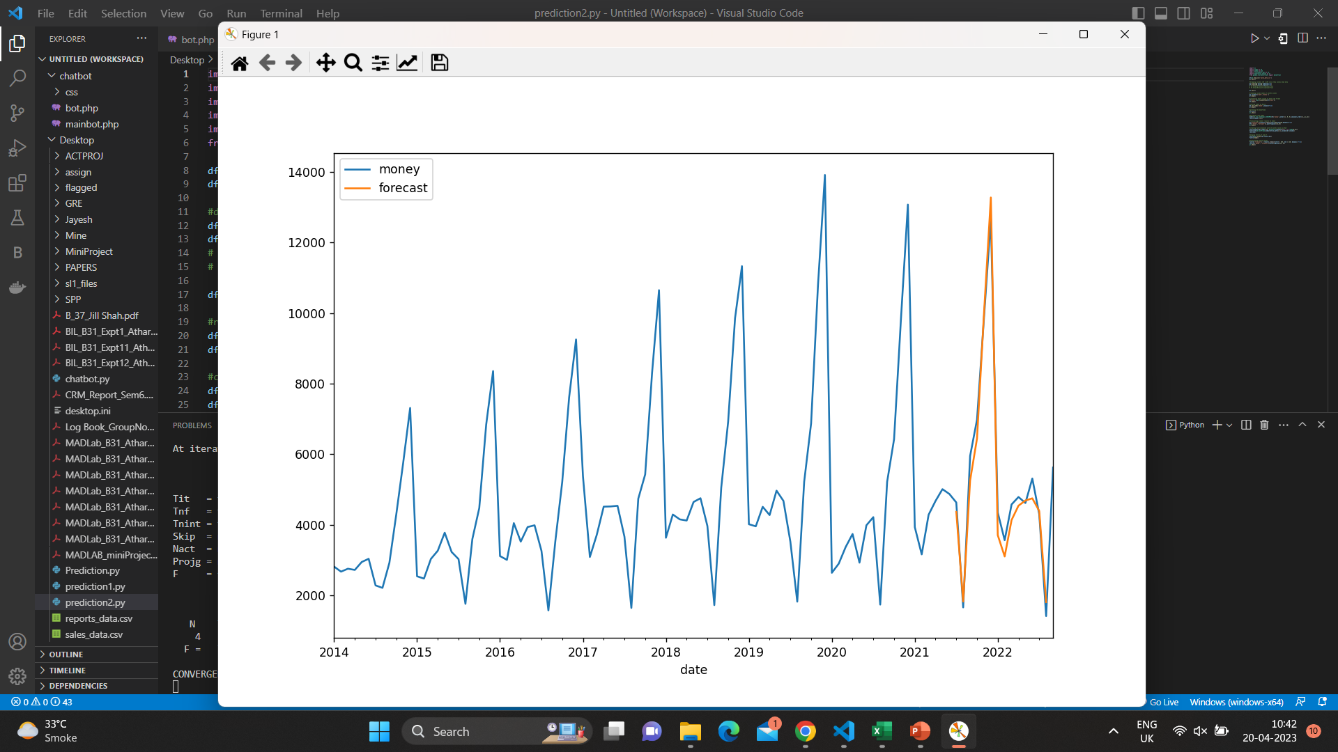
Discussion
25

Slide 26
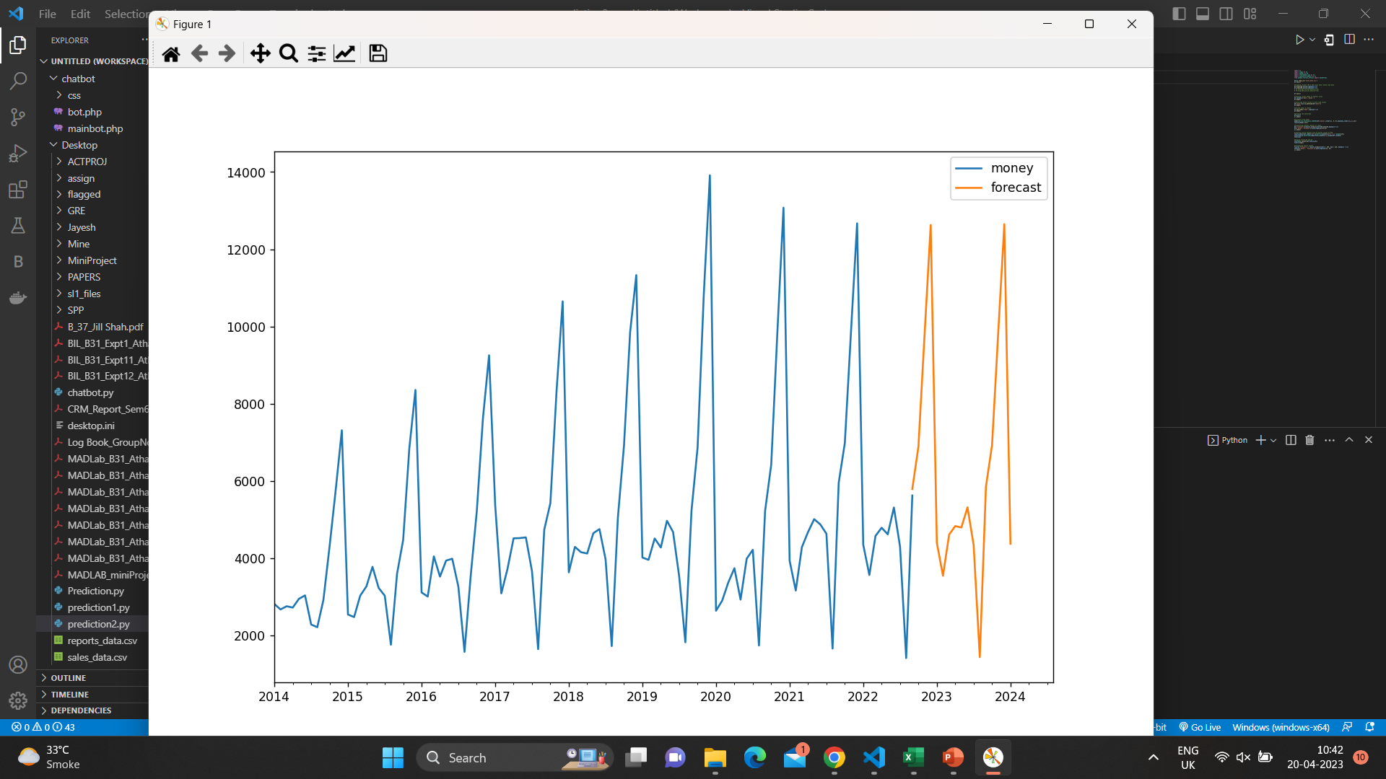
Discussion
26

Slide 27
Conclusion & Future Scope
Customer Relationship management is a business strategy that enables a business organization to maximize revenue, customer satisfaction, profitability through strategic mobilization, organization, and management of customer’s interests and desires.
CRM in the automotive industry is strategically used a model mechanism for brand promotion and customer attraction.
The technology comes with imperative customer analysis measures using technological systems for business organization, automation, and synchronization of the business sales, customer services, marketing, and technical support.
Key CRM Challenges to Overcome
Being used to the new system leaving the old one behind
Ability to analyze the CRM data correctly
Picking the right CRM that blends in precisely
Non-expert CRM solution provider
Not retrieving enough actionable business insight
Integration in competencies
27

Slide 28
References
[1] Bhatia, S.C. (2008) “Retail Management” John Wiley & Sons
[2] Brink, A. & Berndt, A. (2009) “Relationship Marketing and Customer Relationship Management” Juta Publications
[3] Goldenberg, B.J. (2008) “CRM in Real Time: Empowering Customer Relationships” Information Today, Inc.
[4] Cox, E. (2011) “Retail Analytics: The Secret Weapon” John Wiley & Sons
[5] Khurana, M. (2010) “Information Technology for Retailing” Tata McGraw-Hill Education
[6] Lamb, C.W., Hair, J.F. & McDaniel, C. (2011) “Marketing: Student Edition” Cengage Learning
[7] Mathur, U.C. (2010) “Retail Management: Text and Cases” I.K. International Pvt Ltd
[8] Mueller, B. (2010) “Dynamics of International Advertising: Theoretical and Practical Perspectives” Peter Lang
[9] Peppers, D. & Rogers, M. (2011) “Managing Customer Relationships: A Strategic Framework” John Miley & Sons
[10] Pradhan, S. (2009) “Retailing Management: Text & Cases”, 3rd edition, Tata McGraw-Hill Education
[11] Raab, G., Ajami, R.A., Gargeya V. & Goddard, G.J. (2008) “Customer relationship management: a global perspective” Gower Publishing
[12] Sinkovics, R.R & Ghauri, P.N. (2009) “New Challenges to International Marketing” Emerald Group Publishing.
28

Slide 29
THANK YOU!!!!

