Slide 1

Microservices
Notes:
Warm Welcome to this Session on MicroServices
My name is Puneet Vashisht and I'm going to be your instructor for this training. I'm a full-stack developer with keen interest in anything around application development. I'm also certified on Spring with a bunch of other Java certfications and recently got certified on Google Cloud Architect.
This is a 5 half day training session where we focus on practical approach of writing code on microservices.
The session is broadly divided into 4 sections where
1. I explain concepts using code
2. Small tea break in b/w aroud 11-11:30 (20 mins)
3. Practice on remote labs
4. Doubts and queries
I will be sharing you PPT and code using Github. I will appreciate interaction during training and just to maintain decorum would request you to first raise hand or put a message on chat window before asking question.
I would love to hear your feedbacks and suggestions during the course of the training and you can slow me down, ask me for repetetions without hesitation.

Slide 2
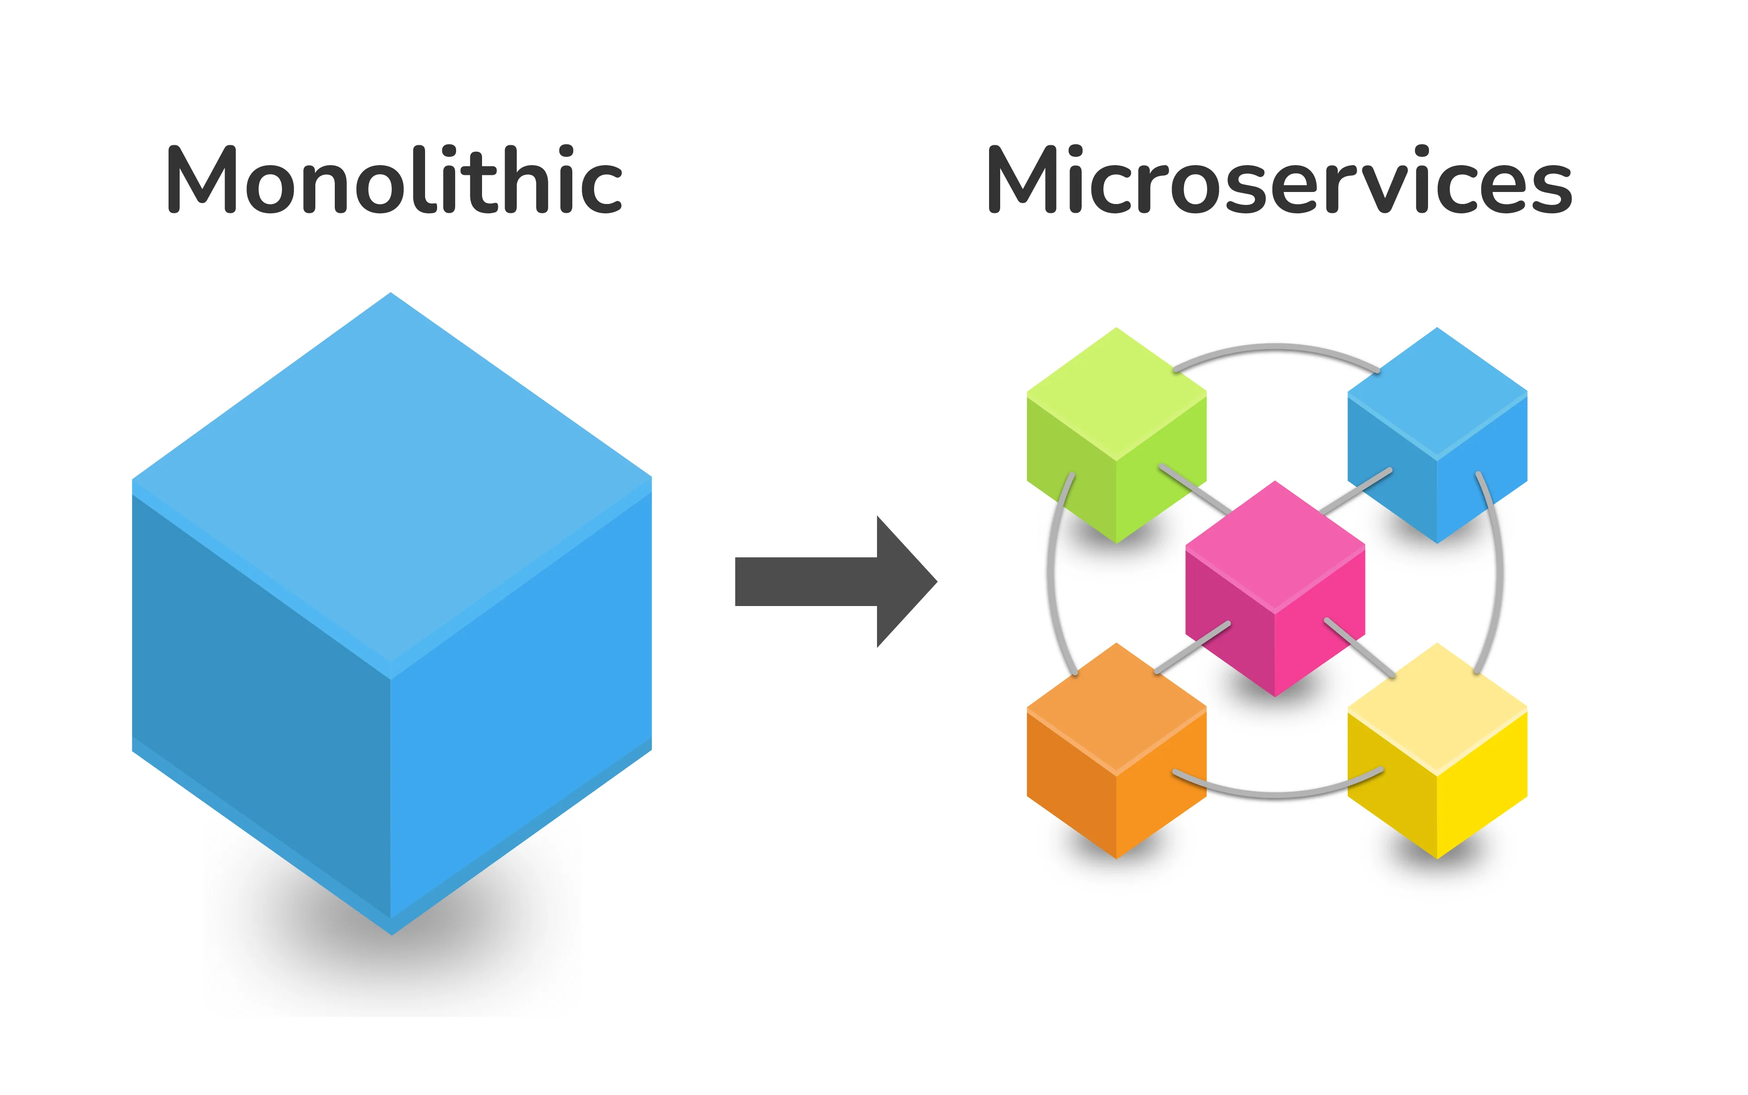
Why MICROSERVICES
Notes:
With microservices.. we are looking at a very different way of building applications.
To me, one prime differenciating factor is deploying application as a single entity and scaling it as a single entity. This completely affects the way you build, organize code and deploy your application.
Microservices is all about dividing your big monolith into small narrow focused chunks of pieces with reuseablity on top of your mind.

Slide 3
AgenDA
DAY | Topics
1 | Developing REST based services Testing using POSTMAN
2 | REST Clients Spring Cloud Communication in Microservices
3 | Feign Client Configuration for MS Profiles
4 | API Gateway Circuit Breakers
5 | Distributed Log Tracing Spring Cloud Stream

Slide 4
Definition
Small autonomous services that work together
REST
& Small Well Chosen Deployable Units
& Cloud Enabled

Slide 5
Key characteristics
Service autonomy
Single responsibility
Decentralized data management
Inter-service communication
Polyglot technology stack

Slide 6
Advantages/DISADVANTAGES
Scalability
Flexibility
Modularity
Fault isolation
Team autonomy
RELEASE PROCESS
Distributed data management
Monitoring and debugging
Service orchestration
Infrastructure complexity

Slide 7
SPRING CLOUD
Specific TECHNOLOGIES/MODULES
LOAD BALANCING
SERVICE DISCOVERY
FAULT TOLERANCE
LOG TRACING
Configuration

Slide 8
Application

Slide 9
Service Registration and Discovery
Dynamic registration of services
Automatic discovery of services
Service metadata management
Load balancing of requests across service instances

Slide 10
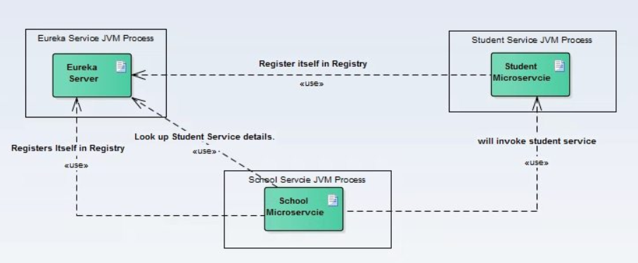
Service Registration and Discovery

Slide 11
Spring cloud config
GOALS
Externalized (args)
Environment Specific (profiles)
Consistent
Version HISTORY
REAL TIME MANAGEMENT

Slide 12
API Gateway
Request routing
Load balancing
Authentication and authorization
Request transformation
Caching
Rate limiting
Logging and monitoring

Slide 13
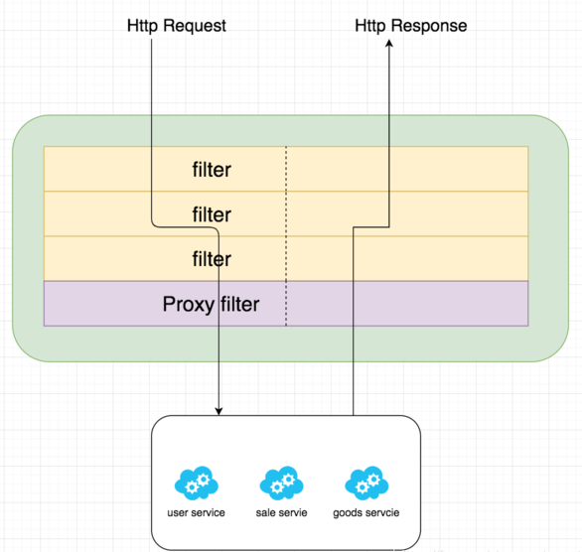
API Gateway

Slide 14
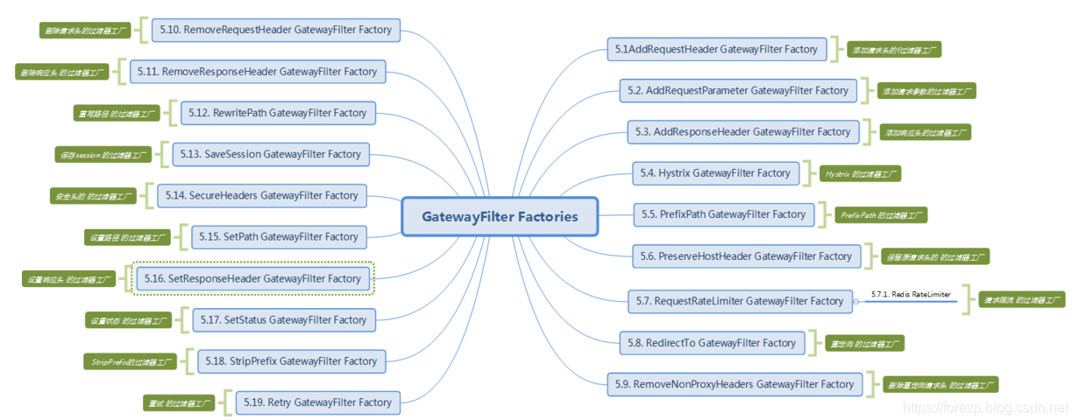
API Gateway fILTERS

Slide 15
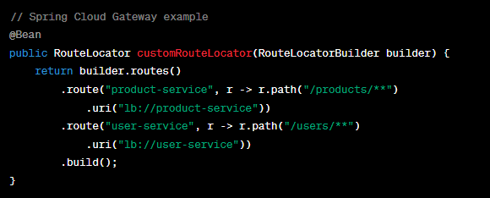
API Gateway

Slide 16
FAULT TOLERANCE and Resilience
Fault tolerance through circuit breakers
Automatic recovery from service failures
Resilient communication between services
Distribution of incoming requests across multiple service instances

Slide 17
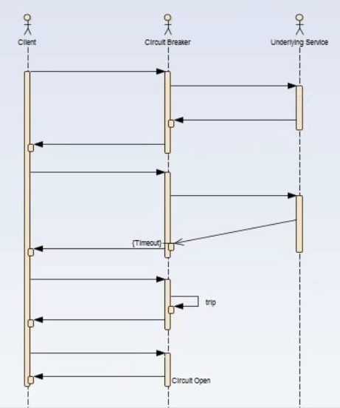
CIRCUIT bREAKER

Slide 18
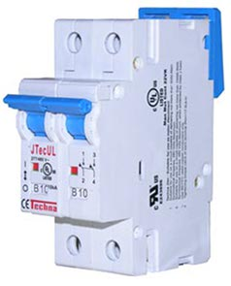
CIRCUIT bREAKER
A circuit breaker is an electrical safety device designed to protect an electrical circuit from damage caused by overcurrent.
Its basic function is to interrupt current flow to protect equipment
and to prevent the risk of fire.

Slide 19
CIRCUIT bREAKER PARAMETERS
WHEN Does the circuit trip?
Last N Request to consider?
How many of those fail?
timeout duration?
WHEN DOES THE circuit un-trip?
how long after to try again?
Notes:
Requests to consider for the decision? : 5
Should fail? : 3
Duration? 2 secs
Wait/sleep: 10 s

Slide 20
FALLBACK
THROW AN ERROR
RETURN A FALLBACK DEFAULT RESPONSE
SAVE PREVIOUS RESPONSE (CACHE)
Notes:
Requests to consider for the decision? : 5
Should fail? : 3
Duration? 2 secs
Wait/sleep: 10 s

Slide 21
HYSTRIX
implements circuit breaker pattern
just configuration
Notes:
Requests to consider for the decision? : 5
Should fail? : 3
Duration? 2 secs
Wait/sleep: 10 s

Slide 22
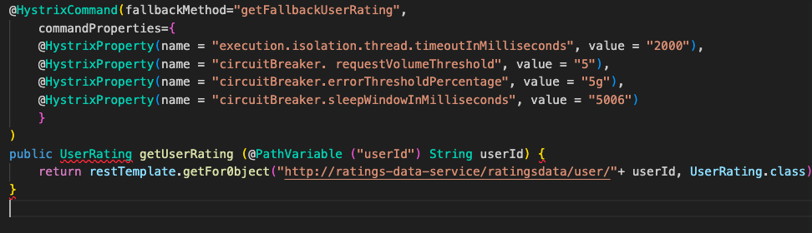
HYSTRIX
Notes:
Requests to consider for the decision? : 5
Should fail? : 3
Duration? 2 secs
Wait/sleep: 10 s

Slide 23
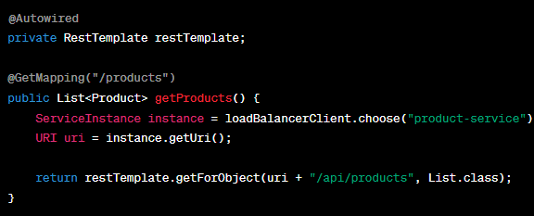
load balancing with Spring Cloud Ribbon

Slide 24
Service-to-Service Communication
RESTful APIs for communication between services
Declarative HTTP clients (e.g., Feign)
Messaging systems (e.g., RabbitMQ, Kafka)
Asynchronous communication patterns

Slide 25
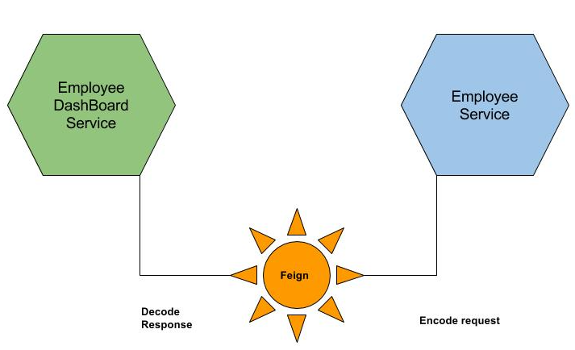
FEign

Slide 26
Distributed Tracing and Monitoring
Tracking and monitoring of requests across services
Collection and visualization of traces
Performance monitoring and troubleshooting
Insights into request latency and dependencies

Slide 27
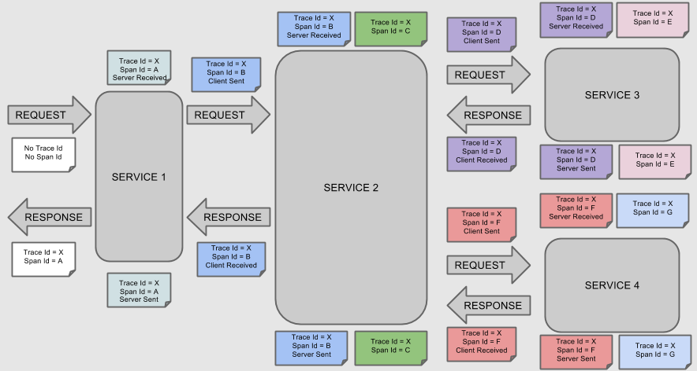
Distributed Tracing and Monitoring

Slide 28
Security and Authorization
Secure communication between services
Authentication and authorization mechanisms
OAuth2 integration for token-based authentication
Role-based access control
Secure transmission of sensitive data

Slide 29
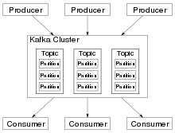
KAFKA

