Slide 1
Welcome
Book Recommender System

Slide 2
Introduction
A book recommender system using machine learning (ML) would involve using data about a user's past reading behavior, such as books they have read or rated, to predict which books they may be interested in reading in the future. This could be done using techniques such as collaborative filtering or content-based filtering. Collaborative filtering would involve analyzing the reading behavior of a group of users and identifying patterns and similarities, while content-based filtering would involve analyzing the features of the books themselves, such as their genre or author. These techniques could be combined and fine-tuned using techniques such as matrix factorization, deep learning, and reinforcement learning to improve the recommendations.

Slide 3
Road Map
Creating a book recommendation system using machine learning would involve several steps, including data collection, preprocessing, model training, and evaluation.
Steps:
Data collection: Collect data on books and user interactions with them, such as book ratings or purchase history.
Data preprocessing: Clean and format the data, such as filling in missing values and converting categorical variables to numerical ones.
Model training: Use a machine learning technique, such as collaborative filtering or content-based filtering, to train a model on the preprocessed data.
Evaluation: Use metrics such as precision, recall, and mean average precision to evaluate the performance of the model.
Model Deployment: Use the trained model to make personalized book recommendations for users.

Slide 4
Basic steps
# import necessary libraries
import pandas as pd
from sklearn.feature_extraction.text import TfidfVectorizer
from sklearn.linear_model import LogisticRegression
from sklearn.model_selection import train_test_split
# load and preprocess data
data = pd.read_csv('books.csv')
vectorizer = TfidfVectorizer()
X = vectorizer.fit_transform(data['summary'])
y = data['genre']
# split data into training and test sets
X_train, X_test, y_train, y_test = train_test_split(X, y, test_size=0.2)
# make predictions
y_pred = clf.predict(X_test)
# evaluate performance
from sklearn.metrics import accuracy_score
accuracy = accuracy_score(y_test, y_pred)
print("Accuracy:", accuracy)

Slide 5
Algorithms
The way to do this would be to treat each book as a separate class and use a classification algorithm to predict which class a user is most likely to be interested in based on their past reading behavior. This approach is known as content-based filtering.
We are using Classification Algorithms on bases of some criteria:
Book Ratting
User age
Book Author
Subject of Book

Slide 6
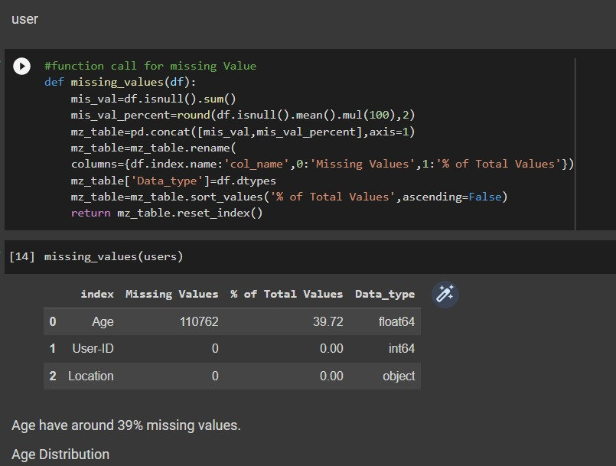
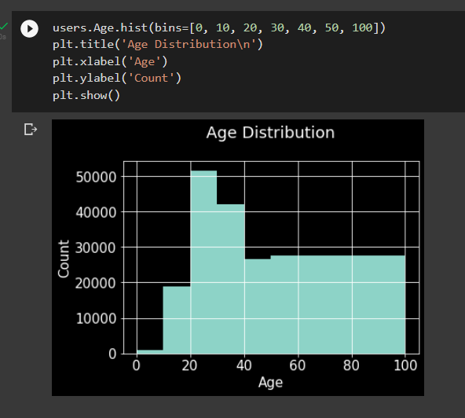
EDA (Exploratory Data Analysis)
user
The most active users are among those in their 30 – 30s.
Let’s check for outliers in age columns

Slide 7
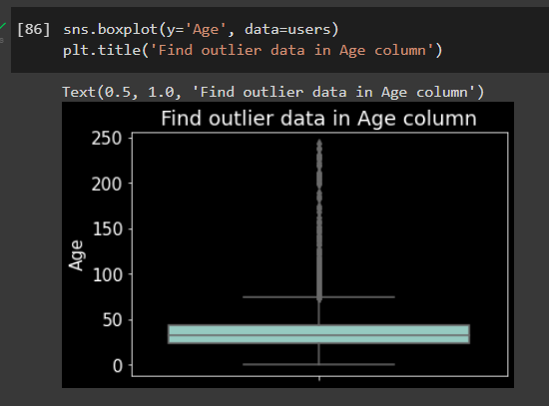

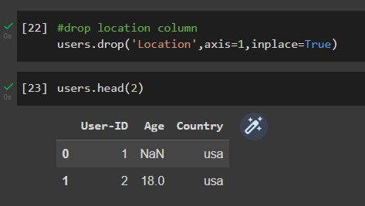
57339 unique Value it’s really hard to understand So lets create column Country .
Age : 244, we have Outlier data in Age
Let’s find our unique value in Location column
Drop location column we not required

Slide 8
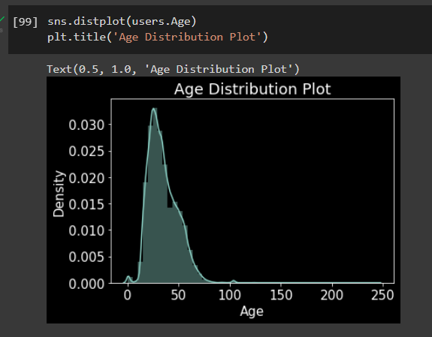
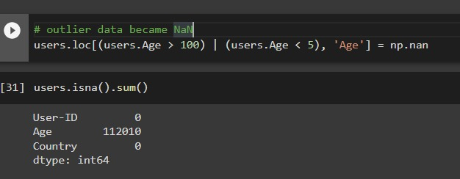
Age value's below 5 and above 100 do not make much sense for our book rating case. hence replacing these by Null.
Age has positive Skewness (right tail) so we can use median to fill Nan values, but for this we don't like to fill Nan value just for one range of age. To handle this we'll use country column to fill Null.

Slide 9
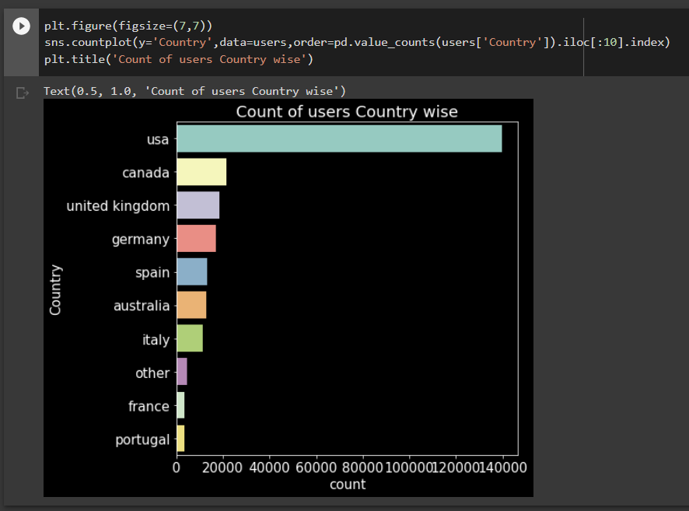
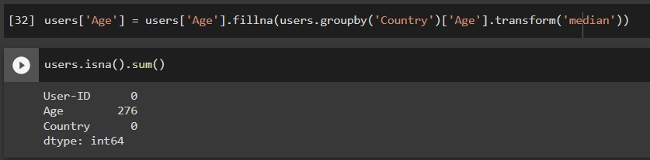
fillna fuction used to replace the nall value to specific value. then we add
now we have 276 Nall values let's fill them with mean
Most number of users are from USA

Slide 10
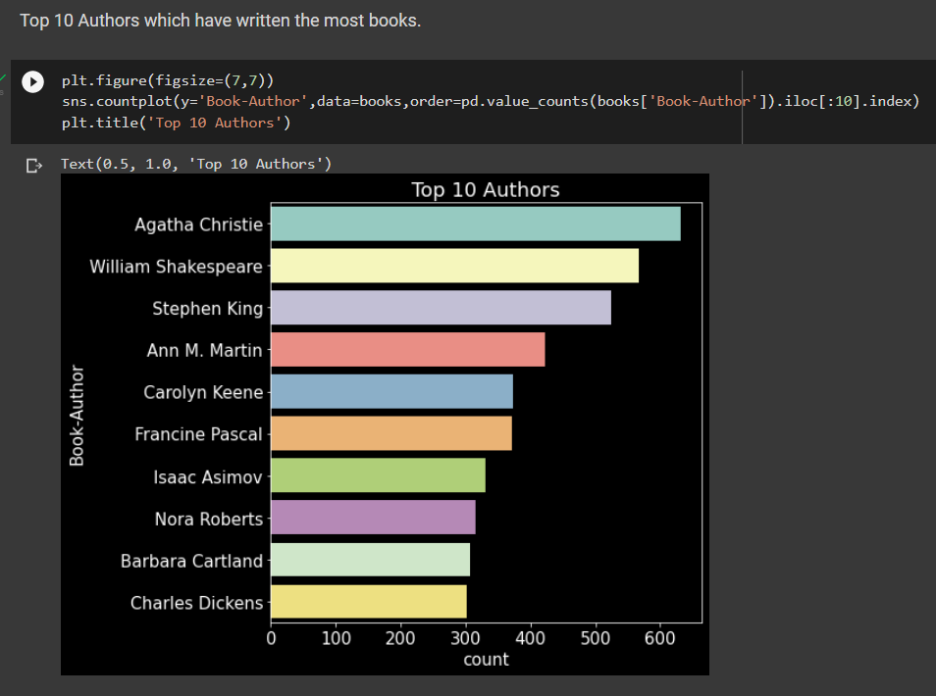
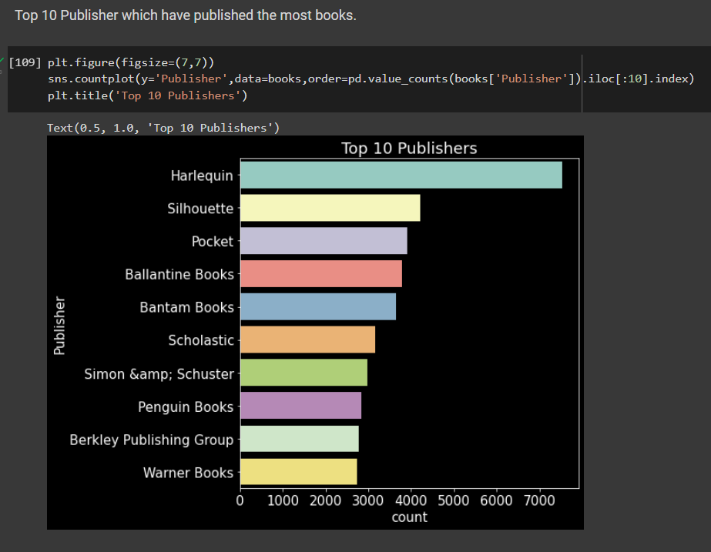
Book
Top 10 Publisher which have published the most books.
Top 10 Authors which have written the most books.

Slide 11
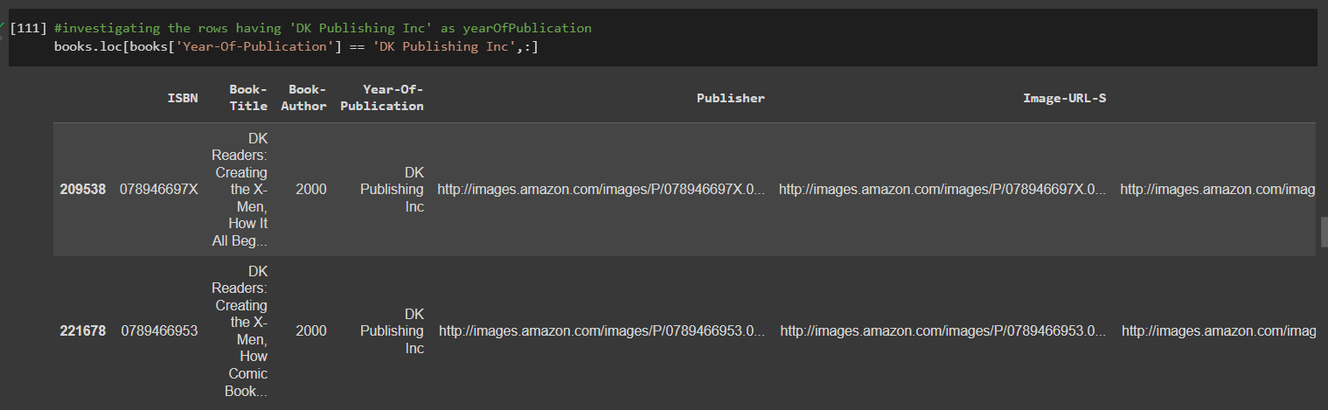
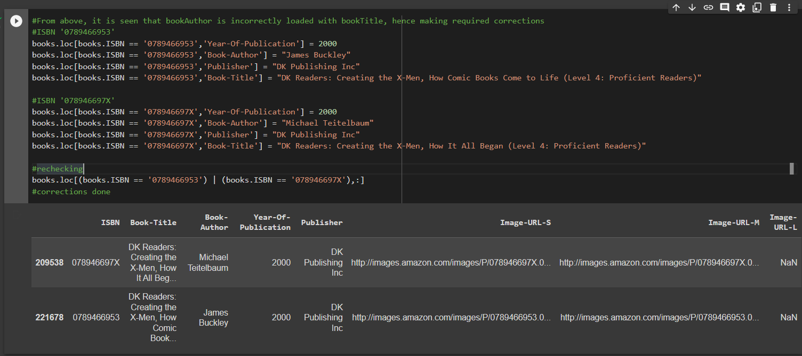
As it can be seen from above that there are some incorrect entries in Year-Of-Publication field.
It looks like Publisher names 'DK Publishing Inc' and 'Gallimard' have been incorrectly loaded as Year-Of-Publication in dataset due to some errors in csv file

Slide 12
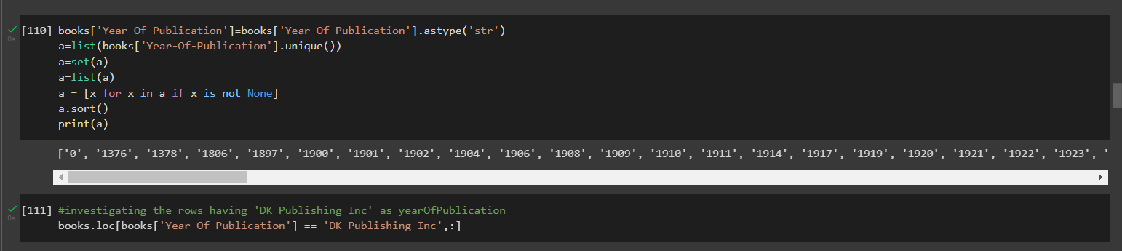
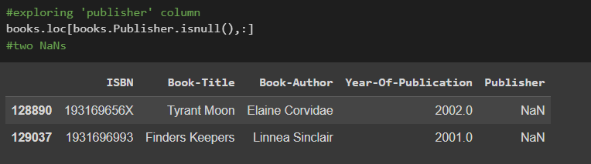
here astype() function we used to function also provides the capability to convert any suitable existing column to categorical type. then we move year into veriable then we sort tham.
The value 0 for Year-Of_Publication is invalid and as this dataset was published in 2004, We have assumed that the years after 2006 to be invalid and setting invalid years as Null

Slide 13
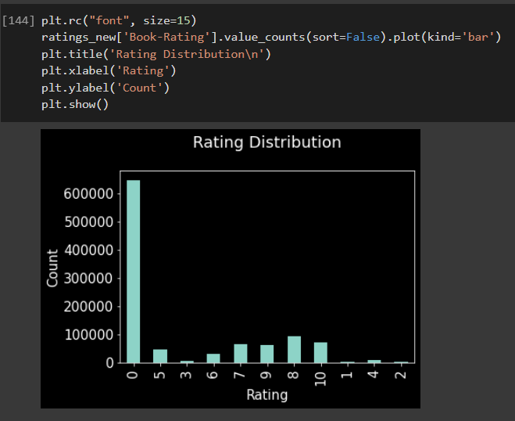
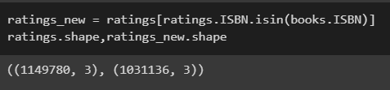
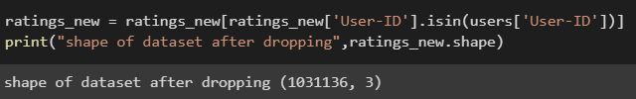
Ratings Dataset
It can be seen that many rows having book ISBN not part of books dataset got dropped off
The ratings are very unevenly distributed, and the vast majority of ratings are 0 .As quoted in the description of the dataset - BX-Book-Ratings contains the book rating information.
Ratings are either explicit, expressed on a scale from 1-10 higher values denoting higher appreciation, or implicit, expressed by 0.Hence segragating implicit and explict ratings datasets
Ratings dataset should have ratings from users which exist in users dataset.

Slide 14
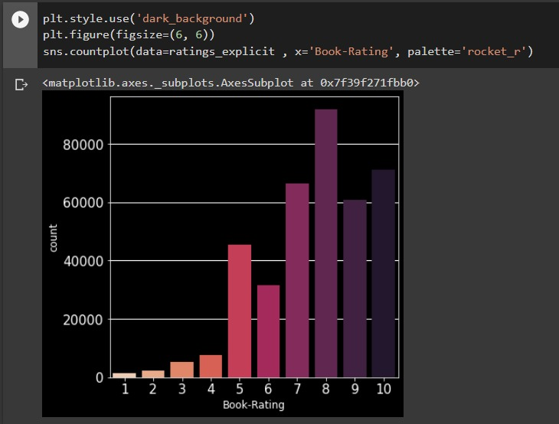
It can be observe that higher ratings are more common amongst users and rating 8 has been rated highest number of times
Let's find the top 5 books which are rated by most number of users.

Slide 15
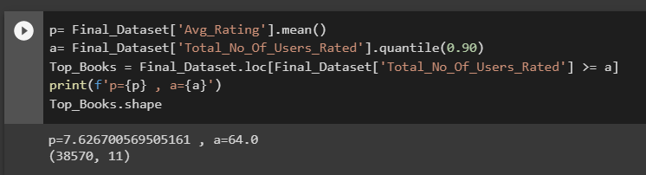
Popularity Based Filtering
As the name suggests Popularity based recommendation system works with the trend.
It basically uses the items which are in trend right now.
For example,
if any book which is usually bought by every new user then there are chances that it may suggest that book
to the user who just signed up.
Book weighted avg formula:
Weighted Rating(WR)=[pR/(v+a)]+[aC/(v+a)]
where,
p is the number of votes for the books;
a is the minimum votes required to be listed in the chart;
R is the average rating of the book; and
v is the mean vote across the whole report.
Now we find the values of p,a,R,v.

Slide 16
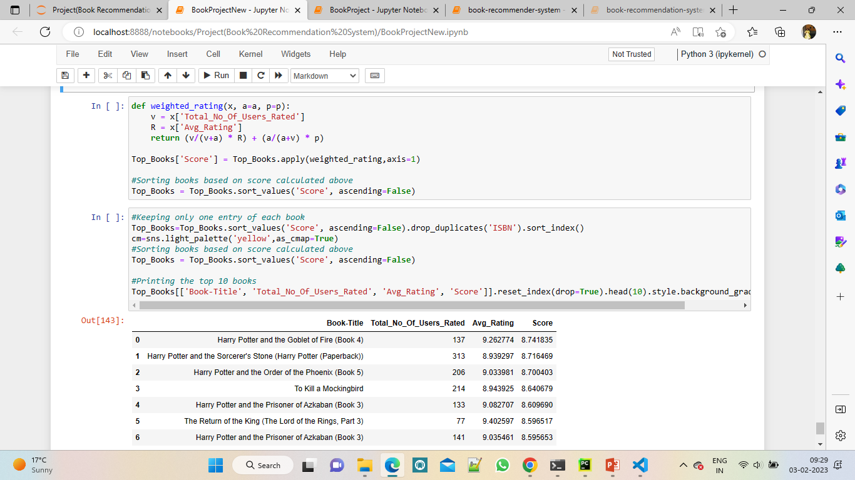
Here we used 90th percentile as our cutoff. In other words, for a book to feature in the charts, it must have more votes than at least 90% of the books in the list. We see that there are 38570 books which qualify to be in this list
Now, we need to calculate our metric for each qualified book. To do this, we will define a function, weighted_rating() and define a new feature score, of which we’ll calculate the value by applying this function to our DataFrame of qualified books:

Slide 17
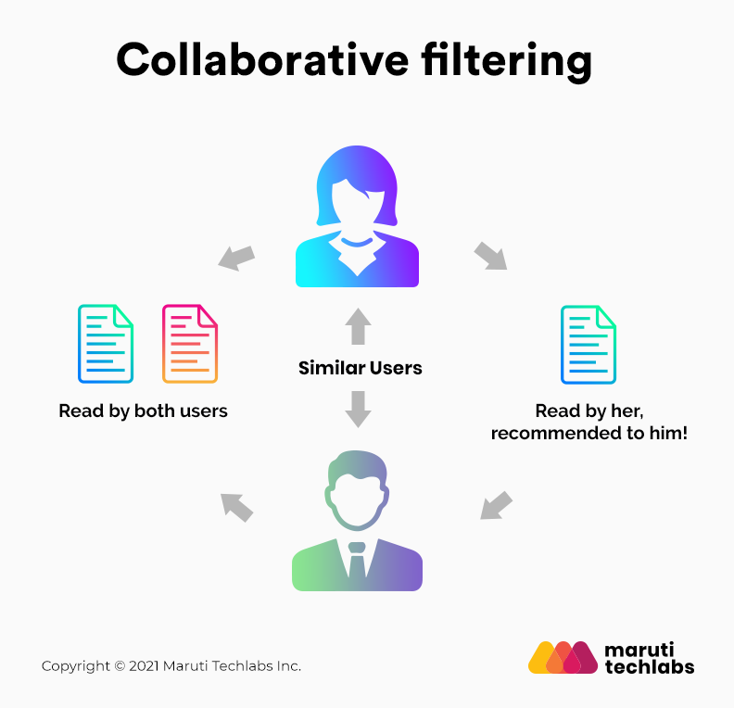
Collaborative Filtering Based Recommender System
Collaborative filtering filters information by using the interactions and data collected by the system from other users. It's based on the idea that people who agreed in their evaluation of certain items are likely to agree again in the future.
In this project the collaborative filtering approach focuses on finding users who have given similar ratings to the same books, thus creating a link between users, to whom will be suggested books that were reviewed in a positive way. In this way, we look for associations between users, not between books.

Slide 18
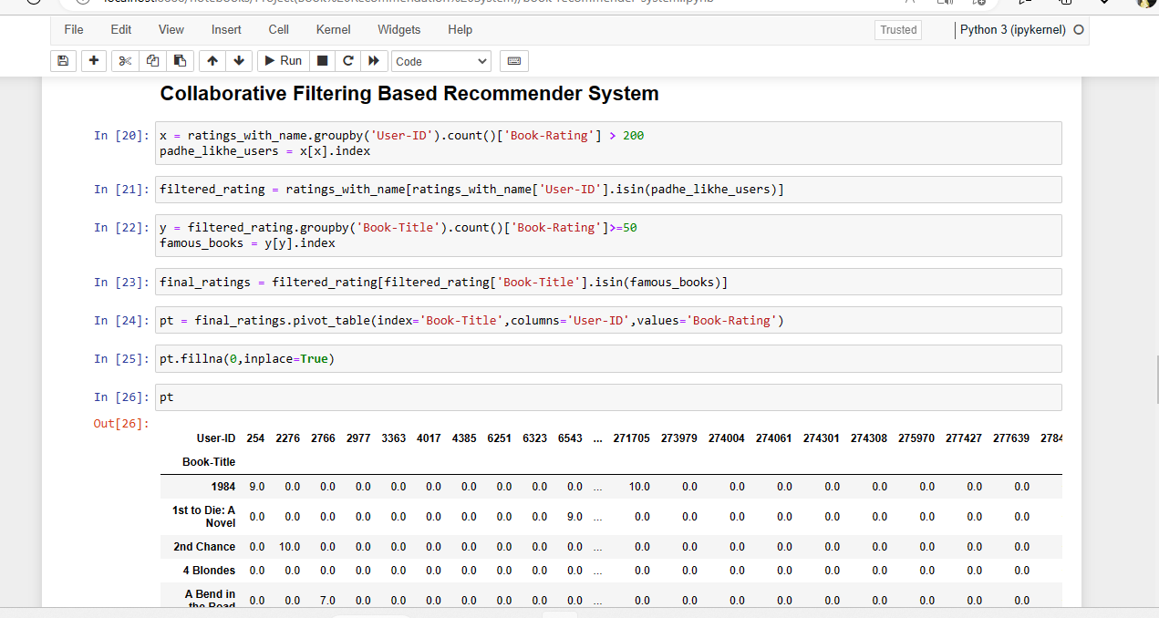

Slide 19
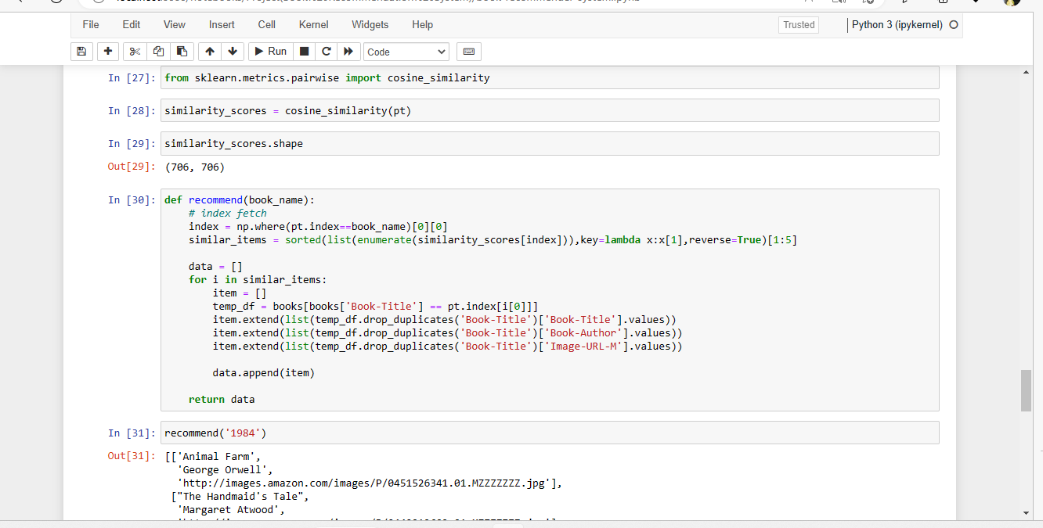

Slide 20
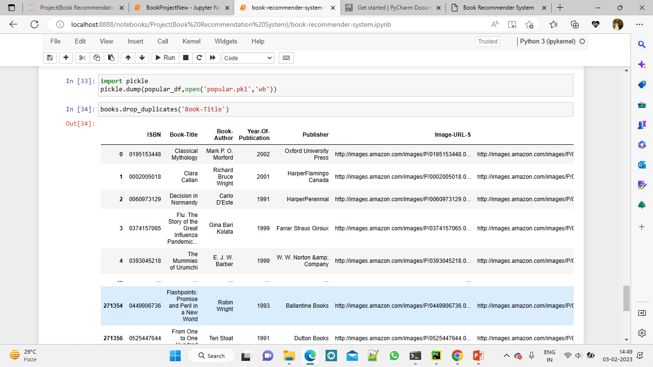

Slide 21
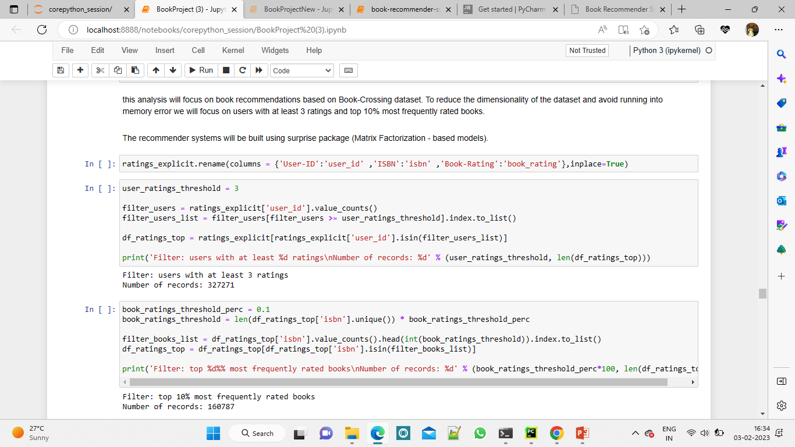
this analysis will focus on book recommendations based on Book-Crossing dataset. To reduce the dimensionality of the dataset and avoid running into memory error we will focus on users with at least 3 ratings and top 10% most frequently rated books.
The recommender systems will be built using surprise package (Matrix Factorization - based models).

Slide 22
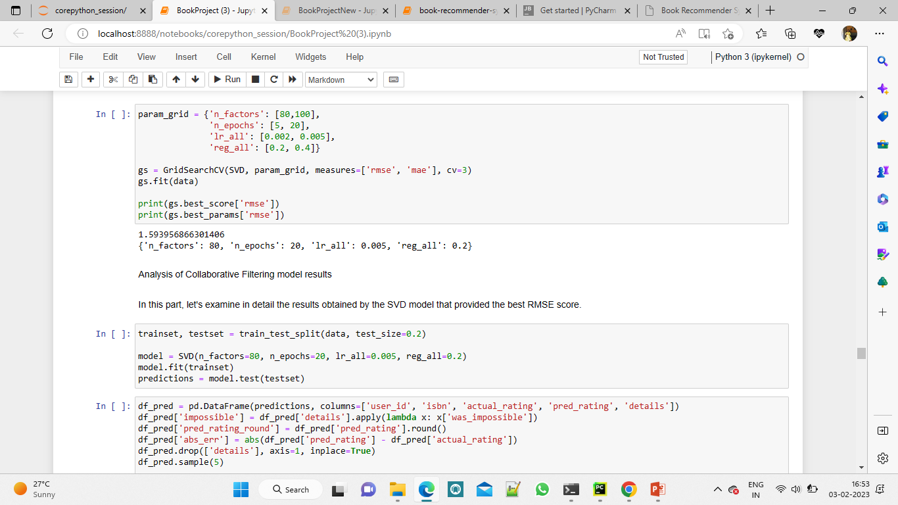
Optimisation of SVD algorithm
Grid Search Cross Validation computes accuracy metrics for an algorithm on various combinations of parameters, over a cross-validation procedure. It's useful for finding the best configuration of parameters.
It is used to find the best setting of parameters: n_factors - the number of factors n_epochs - the number of iteration of the SGD procedure lr_all - the learning rate for all parameters reg_all - the regularization term for all parameters As a result, regarding the majority of parameters, the default setting is the most optimal one. The improvement obtained with Grid Search is very small.

Slide 23
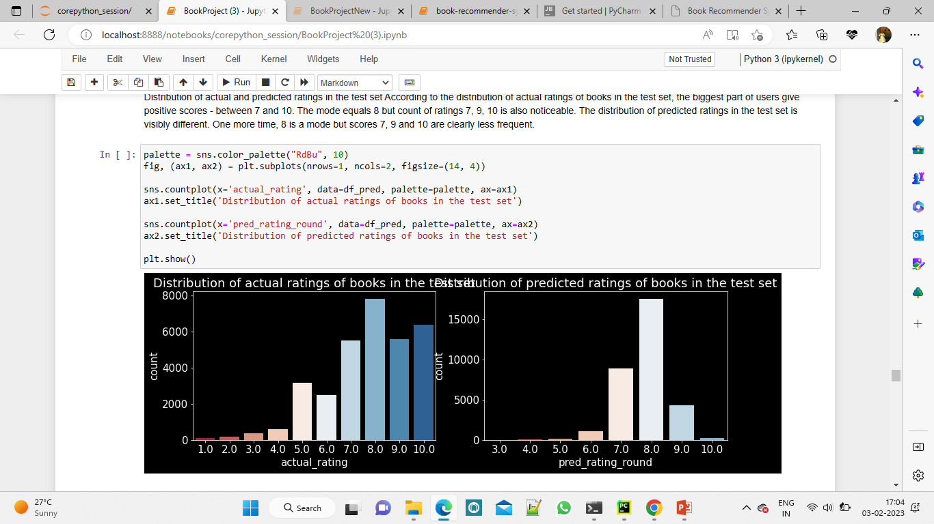
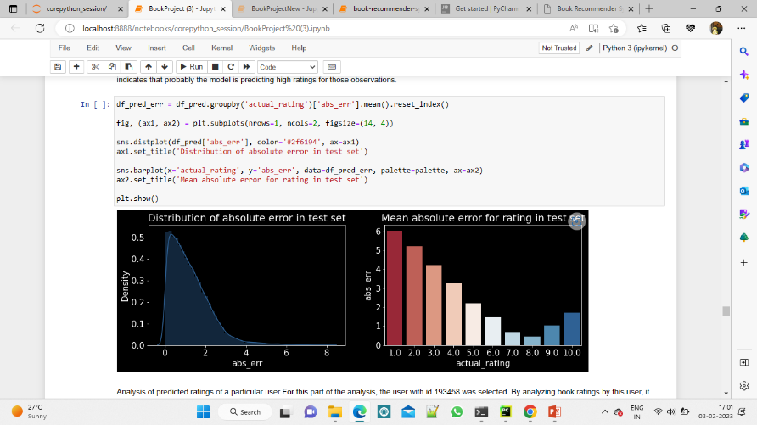
Analysis of predicted ratings of a particular user For this part of the analysis, the user with id 193458 was selected. By analyzing book ratings by this user, it can be noted that he/she likes diverse types of readings: English romantic novels (Pride and Prejudice, Sense and Sensibility), fantasy (Narnia) as well as historical novels (Schindler's List). Among the recommended books there are other works from Narnia's series, two historical novels and one romance which correlates with user's previous preferences.
Absolute error of predicted ratings The distribution of absolute errors is right-skewed, showing that the majority of errors is small: between 0 and 1. There is a long tail that indicates that there are several observations for which the absolute error was close to 10.
How good/bad the model is with predicting certain scores? As expected from the above charts, the model deals very well with predicting score = 8 (the most frequent value). The further the rating from score = 8, the higher the absolute error. The biggest errors happen to observations with scores 1 or 2 which indicates that probably the model is predicting high ratings for those observations.

Slide 24
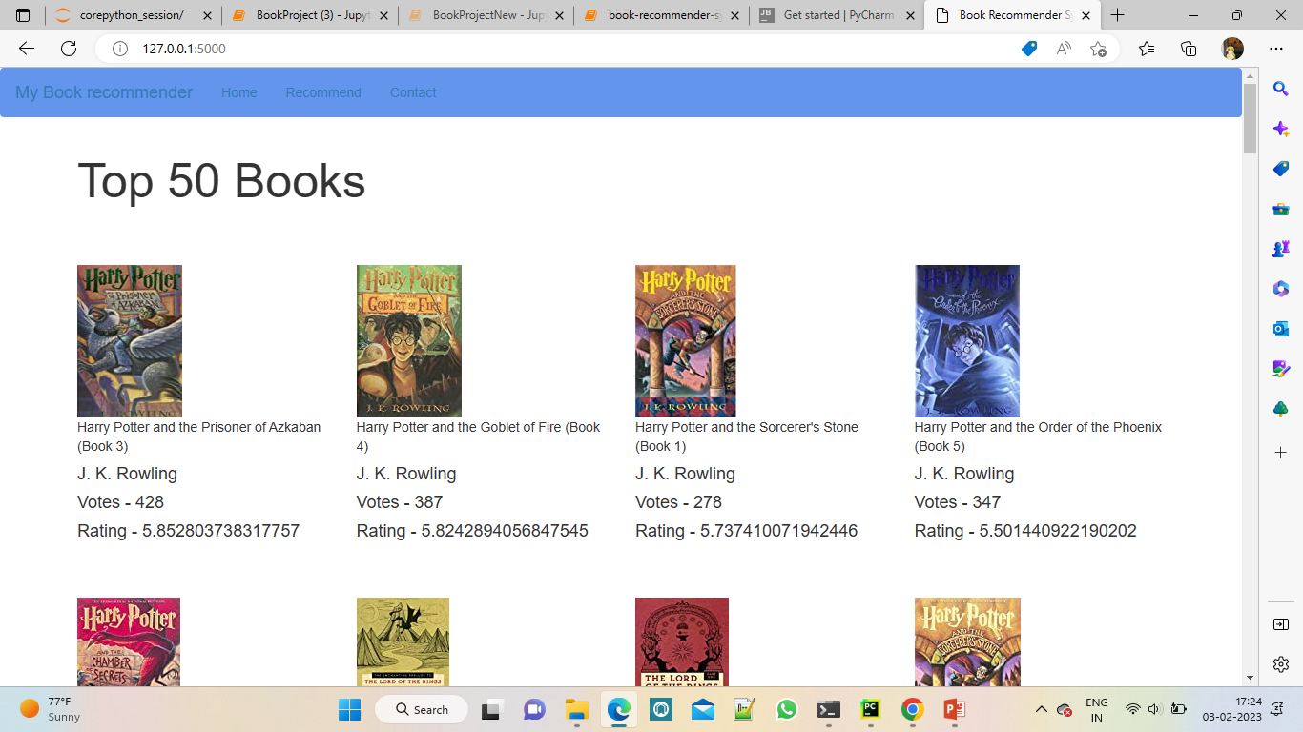

Slide 25
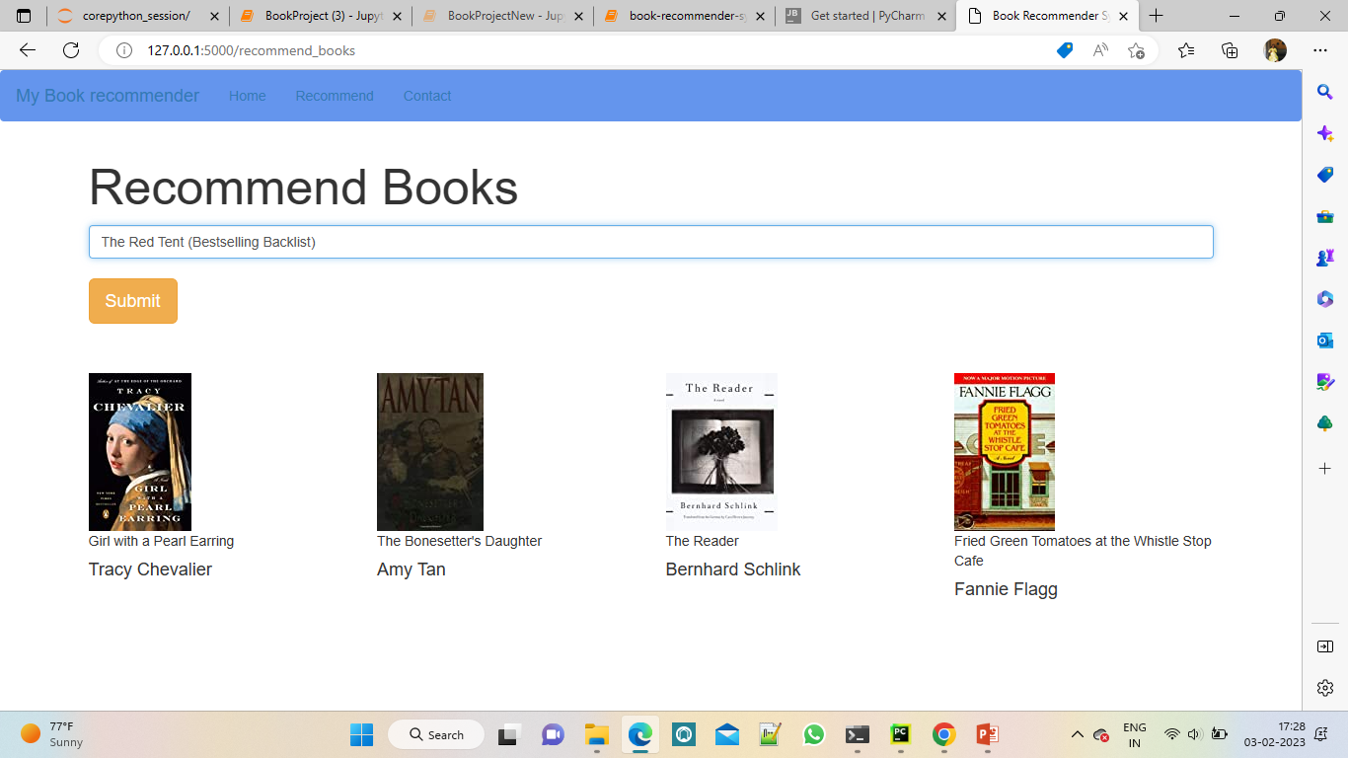

Slide 26
Conclusion
The Lovely Bones: A Novel and Wild Animus are the two most read books.
Stephen King is the most popular book author based on the number of ratings.
Ballantine Books and Pocket are the top publishers based on the number of ratings that their books have received.
The majority of readers are between the ages of 25 and 40.
The majority of readers who have given the books ratings are from the United States and Canada.
Regardless of the age group, The Lovely Bones and Wild Animus appear on lists of the top-rated books.
We have built five types of recommendation systems and did evaluation for one of them.
In the case of Memory-based approach, the Cosine similarity-based KNN performs better at recommending books that are similar than the Euclidean distance-based KNN.

Slide 27
Work Together
Rajeshwari Pilankar
Abhishek Tawale
Payal Aher
Ankita Tarkase
Rohit Shelke
Prasad Nimse

