Slide 1
Abhishek Jain
Performance Comparison: Python vs Rust in Data Preprocessing

Slide 2

To evaluate and compare the performance of Python and Rust implementations across key data preprocessing stages, focusing on:
Objective
1.Execution Time
2.Memory Usage
3.Scalability

Slide 3
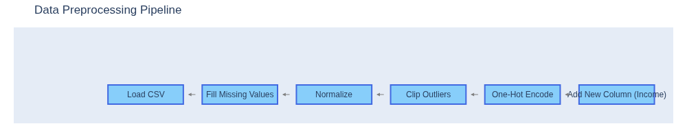
Pipeline Overview: Data Preprocessing Stages
Notes:
[Option 1]: All attendees, Zelis + Client, on one slide. Appropriate for smaller groups. If extra lines are needed, simply add a row to the table
Guidance: Add client name and logo. Introduce attendees (or have them introduce themselves, time permitting) and their role in the meeting. Thank client for their business and the time for this meeting.

Slide 4
Execution Time Comaparison
Stage | Python | Rust
Load | 4.04 | 0.31
Fill Missing | 0.35 | 0.36
Normalize | 0.06 | 0.34
Clip Outliers | 0.10 | 0.34
One-Hot Encode | 0.19 | 0.35
New-Col Income | 0.27 | 0.36

Slide 5
Memory Usage Comparison (1 Million datasets) (in Mb)
Stage | Python | Rust
Load | 166 | 11
Fill Missing | 226 | 15
Normalize | 166 | 18
Clip Outliers | 165 | 16
One-Hot Encode | 252 | 9
New-Col Income | 169 | 14
Notes:
[Option 2]: For larger groups, split attendees on to 2 slides. This slide is for client attendee names and titles. If extra lines are needed, simply add a row to the table.
Guidance: Add client name and logo. Introduce client attendees and their role in the meeting (or have them intro themselves, time permitting). Thank client for their business and the time for this meeting.

Slide 6
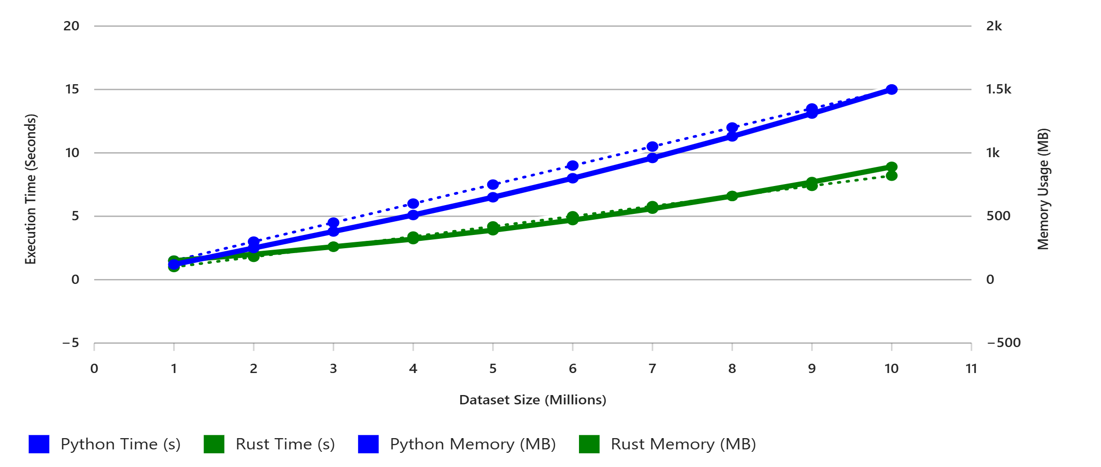
Scaling from 1M to 10M dataset
Python shows steep increases in both execution time and memory usage, making it less suitable for large-scale data processing.
Rust maintains linear scalability and low memory overhead, demonstrating its strength in handling high-volume datasets efficiently.
This comparison reinforces the recommendation to use Rust for backend-heavy workloads and Python for lightweight, rapid development tasks.
Notes:
[Option 2]: For larger groups, split attendees on to 2 slides. This slide is for Zelis attendee names and titles. If extra lines are needed, simply add a row to the table.
Guidance: Introduce Zelis attendees and their role in the meeting.

Slide 7

Why Python Appears Faster (Sometimes)
• Optimized C-based NumPy functions minimize overhead.
• Vectorized operations reduce per-element cost.
• Better for small datasets where interpreter overhead dominates.
• Rust’s startup cost is higher, but its compiled code scales linearly.
• For larger datasets, Rust’s raw execution and memory control win.
Notes:
Guidance: Share what we know about client strategic goals and objectives through our research and relationship (pulling from your Know Your Client research). Start the meeting by demonstrating our stakeholder alignment/preparedness and validate our understanding of client priorities. Basically, we should be walking into the meeting with a POV on what their goals and priorities are – whether from research, client conversation in prep, or a combination of both.
This is a good opportunity to allow the client to talk about themselves and provide updates vs us talking about them. Leverage your active listening and discovery skills. Uncover new areas of focus for the team or potential new opportunities for growth that we may not be aware of. Learn how client is measuring success/attainment of those goals.
Business Goals = “what” the client is working to achieve. These are their high-level strategic imperatives as a business. Things like:
Increase revenue growth
Improve member experience
Expand market penetration
Reduce operating expenses
Priority Initiatives (aka business objectives) = “how” the client will achieve their business goals. These are their strategic projects. Things like:
Expand cost management product offering by 10%
Proactively manage changes to benefits/policies and improve effective member communication
Expand into XYZ new groups
Leverage technology and automation to drive efficiency.
​
Think about it in relation to how Zelis sets goals at the company level. ​
Vital Few Objectives = Business Goals​
Most Important Tasks = Priority Initiatives​
Success Measures = KPIs​
​
phxonline.sharepoint.com/sites/Zelis3/SiteAssets/Forms/Regulatory.aspx?id=%2Fsites%2FZelis3%2FSiteAssets%2FSitePages%2FThe-Zelis-Vital-Few-Objectives%2FMITs%2FEnterprise MITs-2024%2Epdf&parent=%2Fsites%2FZelis3%2FSiteAssets%2FSitePages%2FThe-Zelis-Vital-Few-Objectives%2FMITs

Slide 8
Analysis & Observations
-> Rust uses ~20× less memory than Python across all algorithms.
-> Rust’s execution time scales linearly, while Python slows exponentially with data growth.
-> Interpolation and Exponential searches perform best overall for sorted data.
-> Rust’s predictability makes it ideal for large-scale production workloads.
-> Python is better for experimentation and small, in-memory analytics.
Notes:
Guidance: Share what we know about client strategic goals and objectives through our research and relationship (pulling from your Know Your Client research). Start the meeting by demonstrating our stakeholder alignment/preparedness and validate our understanding of client priorities. Basically, we should be walking into the meeting with a POV on what their goals and priorities are – whether from research, client conversation in prep, or a combination of both.
This is a good opportunity to allow the client to talk about themselves and provide updates vs us talking about them. Leverage your active listening and discovery skills. Uncover new areas of focus for the team or potential new opportunities for growth that we may not be aware of. Learn how client is measuring success/attainment of those goals.
Business Goals = “what” the client is working to achieve. These are their high-level strategic imperatives as a business. Things like:
Increase revenue growth
Improve member experience
Expand market penetration
Reduce operating expenses
Priority Initiatives (aka business objectives) = “how” the client will achieve their business goals. These are their strategic projects. Things like:
Expand cost management product offering by 10%
Proactively manage changes to benefits/policies and improve effective member communication
Expand into XYZ new groups
Leverage technology and automation to drive efficiency.
​
Think about it in relation to how Zelis sets goals at the company level. ​
Vital Few Objectives = Business Goals​
Most Important Tasks = Priority Initiatives​
Success Measures = KPIs​
​
phxonline.sharepoint.com/sites/Zelis3/SiteAssets/Forms/Regulatory.aspx?id=%2Fsites%2FZelis3%2FSiteAssets%2FSitePages%2FThe-Zelis-Vital-Few-Objectives%2FMITs%2FEnterprise MITs-2024%2Epdf&parent=%2Fsites%2FZelis3%2FSiteAssets%2FSitePages%2FThe-Zelis-Vital-Few-Objectives%2FMITs

Slide 9
Conclusion
-> Use Rust for performance-critical components like file loading and memory-sensitive operations.
-> Use Python for rapid development and transformation-heavy tasks.
-> Hybrid Approach Recommended: Combine Rust for backend processing and Python for orchestration and analytics.
Notes:
Guidance: Share what we know about client strategic goals and objectives through our research and relationship (pulling from your Know Your Client research). Start the meeting by demonstrating our stakeholder alignment/preparedness and validate our understanding of client priorities. Basically, we should be walking into the meeting with a POV on what their goals and priorities are – whether from research, client conversation in prep, or a combination of both.
This is a good opportunity to allow the client to talk about themselves and provide updates vs us talking about them. Leverage your active listening and discovery skills. Uncover new areas of focus for the team or potential new opportunities for growth that we may not be aware of. Learn how client is measuring success/attainment of those goals.
Business Goals = “what” the client is working to achieve. These are their high-level strategic imperatives as a business. Things like:
Increase revenue growth
Improve member experience
Expand market penetration
Reduce operating expenses
Priority Initiatives (aka business objectives) = “how” the client will achieve their business goals. These are their strategic projects. Things like:
Expand cost management product offering by 10%
Proactively manage changes to benefits/policies and improve effective member communication
Expand into XYZ new groups
Leverage technology and automation to drive efficiency.
​
Think about it in relation to how Zelis sets goals at the company level. ​
Vital Few Objectives = Business Goals​
Most Important Tasks = Priority Initiatives​
Success Measures = KPIs​
​
phxonline.sharepoint.com/sites/Zelis3/SiteAssets/Forms/Regulatory.aspx?id=%2Fsites%2FZelis3%2FSiteAssets%2FSitePages%2FThe-Zelis-Vital-Few-Objectives%2FMITs%2FEnterprise MITs-2024%2Epdf&parent=%2Fsites%2FZelis3%2FSiteAssets%2FSitePages%2FThe-Zelis-Vital-Few-Objectives%2FMITs

