Slide 1

NATURAL LANGUAGE PROCESSING PROJECT
VeriFact AI
Explainable news analysis
A trained article classifier with
transparent explanations and linguistic insights
TF-IDF and a calibrated linear SVM
University project presentation
01 / 08
Notes:
PRESENTATION SCRIPT
Good morning, sir. My project is VeriFact AI, an application for fake-news screening and misinformation analysis using Natural Language Processing. It helps a reader understand an English article, inspect the language features influencing a prediction, and identify statements that need verification. The active model combines TF-IDF with a calibrated linear Support Vector Machine. I will explain the problem, the architecture, the training process, and a working example. Model classification and factual verification have separate statuses throughout the application.
DEMO / FILES TO SHOW
Open the application in the same browser session used for the saved report. The project starts with ./scripts/dev.sh from /Users/admin36/Desktop/NLP.
SOURCES
/Users/admin36/Desktop/NLP/docs/ARCHITECTURE.md
/Users/admin36/Desktop/NLP/docs/ARTICLE-MODEL.md
Cover illustration: built-in Image Generation tool. Project copy: /Users/admin36/Desktop/NLP/.presentation-build/verifact/assets/news-analysis-cover.png. Prompt: minimal editorial still life of an ivory newspaper and clear glass magnifying lens, pale lavender background, restrained navy/violet palette, no text or logos.

Slide 2
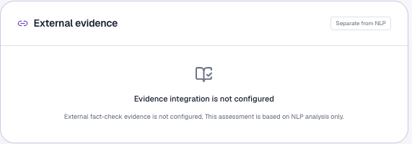
The problem and the implemented solution
A reader receives a forwarded article. What should they check?
Long articles
Select original sentences and surface names
and recurring subjects.
Opaque predictions
Show signed word and phrase contributions
with their article context.
Actual product disclosure
The interface tells the reader
when external evidence is unavailable.
Unclear evidence status
Keep candidate claims and factual-verification
status visible in the report.
Purpose: support a careful review before sharing.
VeriFact AI
02 / 08
Notes:
PRESENTATION SCRIPT
The problem is that a reader may receive a long article and a confident-looking headline but have little time to inspect its claims. A bare fake-or-real label provides limited help. I addressed this by combining article screening with extractive summaries, entity and topic inspection, feature-level explanations, and candidate claims. The evidence panel shown here is an actual screenshot. It clearly says that integration is not configured. This makes the current scope visible instead of presenting a model estimate as an independently verified verdict. The project supports review rather than establishing the truth of the allegations in the submitted article.
DEMO / FILES TO SHOW
Point to the evidence panel. Explain that no independent fact-check has occurred for this report.
SOURCES
/Users/admin36/Desktop/NLP/docs/ARTICLE-MODEL.md
/Users/admin36/Desktop/NLP/backend/app/services/evidence.py
/var/folders/k7/7fjk7gdn7qqfrqljvm3v_jc40000gn/T/codex-clipboard-086d08d6-7f35-4b7b-9484-3d137639893b.png

Slide 3
Learning patterns: the spam-filter analogy
A simplified example of supervised classification
Email filtering
News screening
“Claim your free prize now”
Labeled English news articles
Example training label: spam
Training labels: real or fake
Labeled examples
Learned model
New article
Text paired with an existing class
TF-IDF features and fitted weights
Apply the saved model to new text
Training learns the weights. Inference reuses them.
VeriFact AI
03 / 08
Notes:
PRESENTATION SCRIPT
Sir, a familiar analogy is the Spam folder in an email application. Imagine a simplified classifier trained on emails already labeled spam or legitimate. TF-IDF converts their words and phrases into numerical features, and a classifier learns weights from those labeled examples. When a new message arrives, it applies the saved representation and weights. My article classifier follows that supervised-learning idea using WELFake article labels. This is a conceptual analogy rather than a claim about Gmail’s internal implementation. A legitimate cybersecurity email might quote the phrase claim your free prize. That shows why a phrase alone cannot establish the category or factual meaning of the entire message. Likewise, a red word contribution in my report describes a model association, not a verified factual error.
DEMO / FILES TO SHOW
Explain training versus inference. If asked whether each submission trains the model, answer no. It performs inference and stores a report.
SOURCES
/Users/admin36/Desktop/NLP/backend/training/articles.py
/Users/admin36/Desktop/NLP/backend/app/ml/article_classifier.py
The email sentence is a hypothetical teaching example.

Slide 4
System architecture
The classifier and linguistic observations remain separate logical branches.
Article input
Next.js frontend
FastAPI backend
Optional evidence
Text, public URL, TXT or PDF
Collects input and displays reports
Validates and coordinates
Related fact-check search with consent
Article classifier
spaCy and summary
Language rules
TF-IDF: text to numbers
SVM: learned decision score
Calibration: class estimates
Entities and grammar
Original-sentence summary
Recurring noun topics
Wording-pattern matches
Lexical sentiment and counts
Candidate claim excerpts
Report, storage and history
Structured JSON report with SQLAlchemy and SQLite
VeriFact AI
04 / 08
Notes:
PRESENTATION SCRIPT
The frontend uses Next.js, React, and TypeScript. Requests pass through a same-origin proxy to FastAPI. The backend validates the request and coordinates three logical branches. The article classifier transforms cleaned text using the saved TF-IDF vocabulary, calculates the SVM decision score, applies sigmoid calibration, and returns signed feature contributions. The spaCy branch produces linguistic annotations, and a separate sentence-level TF-IDF calculation selects summary sentences. Explicit rules calculate wording cues, lexical sentiment, and candidate claims. The displayed outputs of the spaCy and rule branches do not feed the SVM. The diagram shows logical responsibilities, not necessarily simultaneous execution. Optional related fact-check search requires configuration, credentials, and consent. SQLAlchemy stores the combined report in SQLite locally. The API returns JSON to the frontend for results, history, and dashboard views.
DEMO / FILES TO SHOW
Files: backend/app/api/routes.py; backend/app/services/analysis.py; backend/app/ml/article_classifier.py; backend/app/services/nlp.py; backend/app/services/linguistics.py. Setup: scripts/dev.sh starts both services and applies Alembic migrations. The backend loads the saved model at startup.
SOURCES
/Users/admin36/Desktop/NLP/docs/ARCHITECTURE.md
/Users/admin36/Desktop/NLP/backend/app/ml/article_classifier.py
/Users/admin36/Desktop/NLP/backend/app/services/nlp.py
/Users/admin36/Desktop/NLP/backend/app/services/linguistics.py
/Users/admin36/Desktop/NLP/backend/app/services/analysis.py

Slide 5
Training and reproducibility
72,134 original rows
60,544 retained articles
WELFake historical English-news corpus
Shared cleaning and duplicate handling
Partition | Articles | Role
Training | 36,325 | Fit features and SVM
Validation | 6,054 | Select settings
Calibration | 6,055 | Map scores to estimates
Test | 12,110 | Measure performance
140,000
Word and two-word phrase features
Linear SVM, selected C = 2
Separate sigmoid calibration
Duplicate groups stay in one split
Training: backend/training/articles.py
Saved artifact: model.joblib
VeriFact AI
05 / 08
Notes:
PRESENTATION SCRIPT
The active training pipeline is backend/training/articles.py. The downloader verifies the WELFake checksum. Preparation applies shared article cleaning, filters unsuitable bodies, removes exact/conflicting duplicates, and groups approximate duplicates using matching titles/leads and MinHash LSH. Groups stay within one partition to reduce leakage. Training fits the vocabulary and SVM; validation selects C among 0.5, 1, and 2 using macro-F1; calibration fits a separate sigmoid mapping; the test set evaluates the selected model. The saved artifact contains 140,000 unigram and bigram features and a LinearSVC with C=2. LogisticRegression acts as the one-dimensional calibrator, not the main classifier. The source description has a numeric-label discrepancy, documented in the model card; the project audits and uses CSV 0=real and 1=fake. The saved model bundle contains the vectorizer, classifier, calibrator, metadata, and metrics. The pipeline also runs a separate LIAR diagnostic after fitting. Source/time overlap can remain despite group separation.
DEMO / FILES TO SHOW
Show backend/training/articles.py at lines 149, 166, 183, and 288. Then show backend/artifacts/articles/metrics.json. The reproduction command is ../.venv/bin/python -m training.articles from backend/. scripts/train.sh runs an older experiment. To run the prepared product, use ./scripts/dev.sh without retraining.
SOURCES
/Users/admin36/Desktop/NLP/backend/training/articles.py
/Users/admin36/Desktop/NLP/backend/artifacts/articles/metrics.json
/Users/admin36/Desktop/NLP/docs/ARTICLE-MODEL.md
/Users/admin36/Desktop/NLP/backend/training/download_articles.py

Slide 6
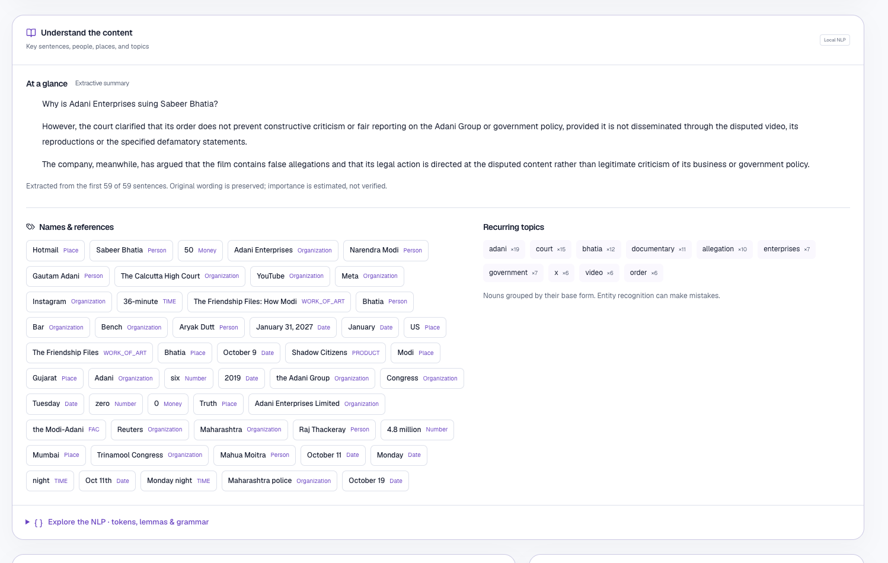
Working demo: understanding an article
Input
Paste text, extract a public
URL, or upload TXT/PDF.
Understand
Read selected sentences.
Inspect people, dates,
and recurring subjects.
1,049 words
59 sentences
17.8 words per sentence
VeriFact AI
06 / 08
Notes:
PRESENTATION SCRIPT
For the working demonstration, use the complete article shown in the user-supplied screenshots. The screenshot here is actual application output. It reports 1,049 words, 59 sentences, and average sentence length 17.8. The summary selects up to three original sentences from candidates in the first 200 sentences; this article has 59. It preserves wording and estimates importance rather than verifying statements. Named-entity recognition uses the pretrained spaCy en_core_web_sm model. It can misclassify entities, as Hotmail labeled Place demonstrates. Recurring topics count nouns/proper nouns grouped by lemma. Expand tokens, lemmas, and grammar to explain tokenization, base forms, parts of speech, morphology, and dependency relationships. The snapshot sentiment of 1.00 results from good and gain matching the positive list once each and no negative-list matches. This small lexicon does not understand the whole situation or quotation context.
DEMO / FILES TO SHOW
Demo sequence: Analyze; submit the full article; open Understand the content; point to summary, entity labels, and topics; expand grammar. If URL extraction fails, paste the article text. Source file: backend/app/services/nlp.py. Interface: frontend/src/components/nlp-inspector.tsx.
SOURCES
/var/folders/k7/7fjk7gdn7qqfrqljvm3v_jc40000gn/T/codex-clipboard-b4950b00-3791-4098-860c-725fe0a8434b.png
/Users/admin36/Desktop/NLP/backend/app/services/nlp.py
/Users/admin36/Desktop/NLP/backend/app/services/linguistics.py
/Users/admin36/Desktop/NLP/backend/verifact.db, matching saved report: Hotmail co-founder Sabeer Bhatia faces Rs 50 crore Adani defamation suit over Modi documentary

Slide 7
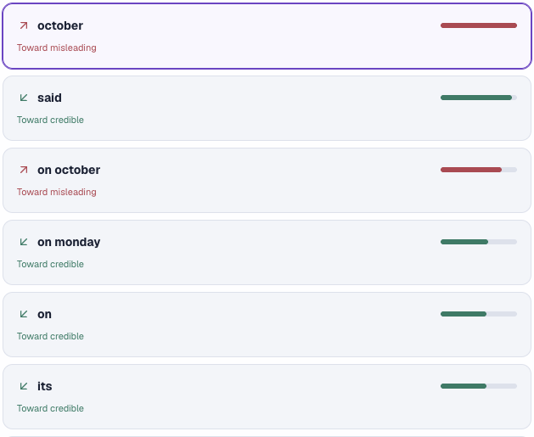
Working demo: explaining the prediction
Likely Credible
95.61% model confidence
“October” +0.647
Moves the score toward misleading.
“said” −0.603
Moves the score toward credible.
All active features and the intercept
determine the complete prediction.
Factual status: Not independently verified
VeriFact AI
07 / 08
Notes:
PRESENTATION SCRIPT
The saved report matching the screenshots predicts Likely Credible with credible-class estimate 0.9560909576 and misleading estimate 0.0439090424. This is benchmark class confidence, not the probability that every statement is factually true. The selected features come directly from the fitted model. A positive signed contribution points toward misleading and a negative contribution toward credible. October contributes about +0.647, said about -0.603, and on Monday about -0.402. The strongest individual displayed feature can be red while the complete sum favors credible. All feature contributions sum to about -4.645, and the combined calibrated intercept is +1.565, giving calibrated log-odds about -3.081. The sigmoid gives 4.39% misleading and 95.61% credible. Each contribution is TF-IDF times SVM coefficient times calibration slope. The report displays up to 14 strong features; bars are relative magnitudes, not probabilities. October is an ordinary date word. Its weight can reflect dataset associations and does not establish a false date. No SHAP or LIME is used.
DEMO / FILES TO SHOW
Click October, read its context, then select said or on Monday. Explain why no specific wording problem is detected for October. Open the technical contribution if asked. Keep the factual-verification status visible.
SOURCES
/var/folders/k7/7fjk7gdn7qqfrqljvm3v_jc40000gn/T/codex-clipboard-da809fa7-4985-489a-9e42-1c2ea4f6a002.png
/Users/admin36/Desktop/NLP/backend/app/ml/article_classifier.py
/Users/admin36/Desktop/NLP/frontend/src/components/prediction-explainer.tsx
/Users/admin36/Desktop/NLP/backend/verifact.db, matching saved report

Slide 8
Results, limitations and next steps
Held-out WELFake article benchmark
Current boundaries
Historical English news
Current Indian-news accuracy unmeasured
External evidence unconfigured in this demo
47.24% on short claims
Separate cross-domain diagnostic
on 798 LIAR examples
12,110 test articles
Next: domain evaluation and
evidence-based claim review
Precision, recall and F1 refer to the misleading class.
VeriFact AI
08 / 08
Notes:
PRESENTATION SCRIPT
On the full 12,110-article held-out WELFake test set, accuracy is 96.31%, misleading-class precision 96.51%, recall 94.99%, and F1 95.74%. Accuracy means overall agreement with the dataset labels. Precision asks how often misleading predictions match that label; recall asks how many misleading-labeled examples the model identifies. F1 balances precision and recall. Full-test results include low-confidence inputs before confidence-only filtering. This evaluation separates approximate-duplicate groups, but it does not hold out publishers or time periods. Labels come from merged datasets and may reflect publisher categories. A separate diagnostic on 798 short LIAR claims reached 47.24% accuracy, showing task/domain dependence. Current Indian-news accuracy remains unmeasured. Future work includes domain-specific evaluation, stronger entity handling, contextual language analysis, multilingual support, and evidence-grounded review of individual claims. My contribution is the integrated reproducible workflow with transparent explanations and clear evidence status. Thank you, sir. I am ready for questions.
DEMO / FILES TO SHOW
Open Model performance if asked. Show backend/artifacts/articles/metrics.json. For persistence, reload the report and open History. Export and print options are available in the report.
SOURCES
/Users/admin36/Desktop/NLP/backend/artifacts/articles/metrics.json
/Users/admin36/Desktop/NLP/docs/ARTICLE-MODEL.md

