Slide 1
Java ME for Education
Course Introduction
Notes:
This document is licensed under the Creative Commons Attribution-Share Alike 3.0 License.
For more information, see http://creativecommons.org/licenses/by-sa/3.0/ for the full terms of the license.

Slide 2
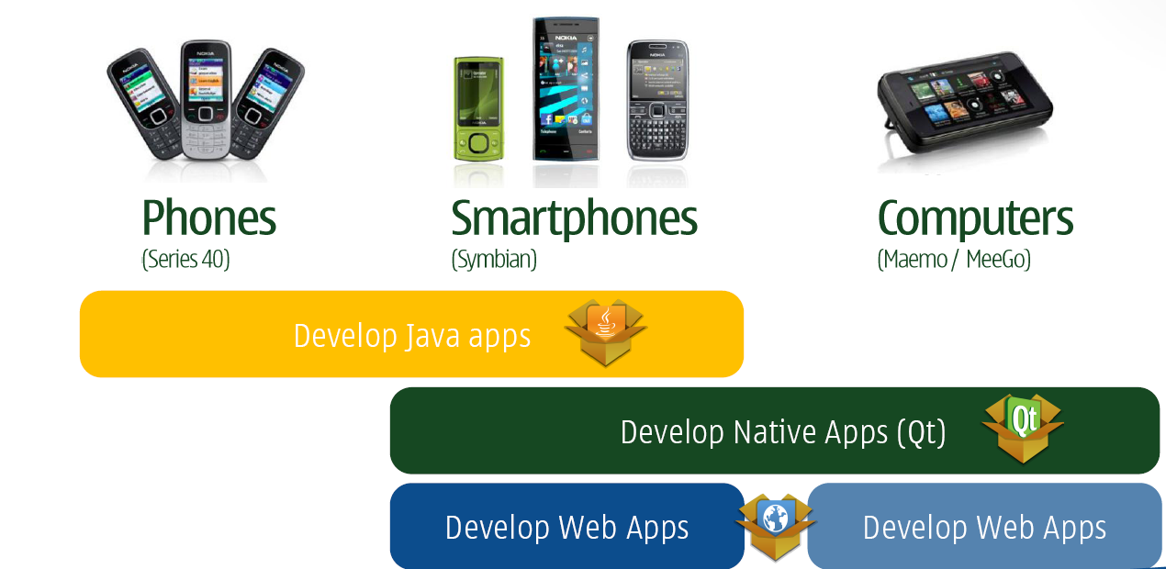
Java ME and Nokia Platforms

Slide 3
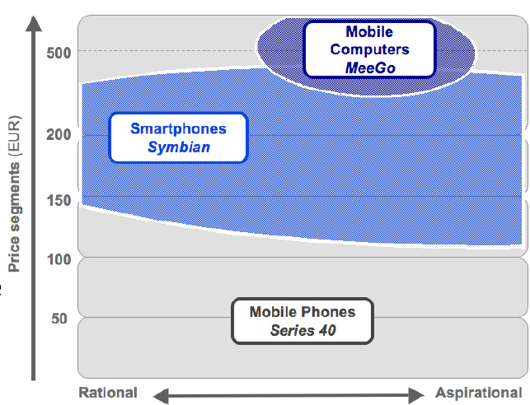
Nokia Platform Segmentation

Slide 4
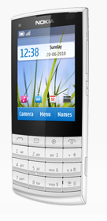
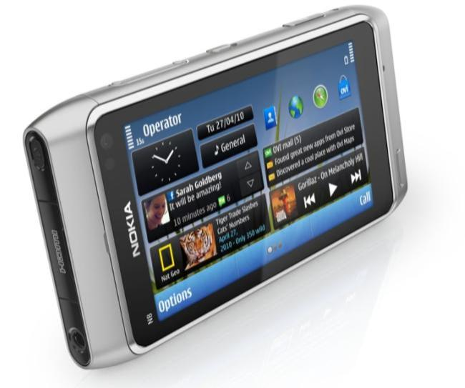
Java ME in Mobile Platforms
Java ME is an app development framework on Series 40 and Symbian platforms. For detailed list of devices, visit www.nokia.com/phones
Example devices of the platforms
Series 40: Nokia X3 Touch and Type
Symbian: Nokia N8

Slide 5
Course Contents by Modules
Java ME Development Overview
High Level UI API
Low Level UI API
Game API and Graphics
Persistent Storage
Networking
Mobile Media API
Location API
Security
Development for Touch and Type UI Devices
Wireless Messaging API (optional)
Bluetooth API (optional)

Slide 6
Main Targets of the Course
Knowledge: To learn the fundamentals of mobile application development by using Java ME application framework
Exercises: To incrementally develop a complete Java ME game application utilizing the technologies covered by the modules the course.
Project: To innovate and implement a Java ME application based on your own idea and optionally, publish your application in the Ovi Store (www.ovi.com) .

Slide 7
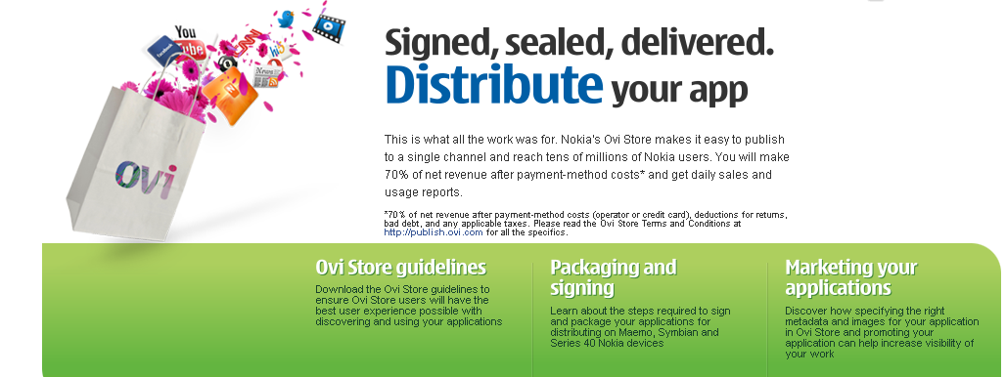
Distributing Apps via Nokia Ovi Store
Channel for marketing and distributing mobile content
More info from
www.ovi.com
www.forum.nokia.com

