Slide 1
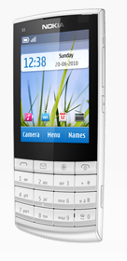
Module 10 Touch UI
Development for Touch and Type enabled Devices
Series 40: Nokia X3 Touch and Type
Notes:
This document is licensed under the Creative Commons Attribution-Share Alike 3.0 License.
For more information, see http://creativecommons.org/licenses/by-sa/3.0/ for the full terms of the license.

Slide 2
Lecture Overview
Introduction to Touch and Type UI
Using Gesture API
Using Frame Animator API
Touch UI Usability

Slide 3
Introduction to Touch and Type UI

Slide 4
Touch and Type UI
A new user interface concept which brings touch screen on Series 40 platform
Combines touch with the traditional keypad as user input methods
For App developers, this brings two new Java APIs for creating enhanced user experiences
Gesture API
Frame Animator API are introduced. These APIs enable creation of touch UI applications with enhanced user experiences
Introduced in Series 40 6th Edition, FP1
Series 40: Nokia X3 Touch and Type

Slide 5
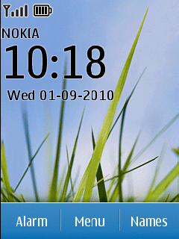
Touch and Type UI Principles
The Touch and Type UI is based on Compact UI, meaning that the general UI look and feel, and UI flows are similar.
Additionally, it follows a set of key principles:
Objects are manipulated directly with a single tap.
Double tap is generally not recommended.
The UI navigation is done by touch strokes, for example, dragging and flicking to scroll menus. The content always follows the direction of finger movement.
Moving focus to an object to manipulate it is not used, because objects are manipulated by tapping them directly.
Each finger touch-down event is indicated visually.
Actions are usually performed on a touch release event.

Slide 6
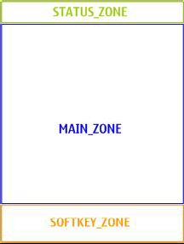
Touch and Type Display
240 x 320 resolution divided in 3 zones
Status zone
Header text
Status indicators
Main zone
Application content
The content can be touch enabled
Softkey zone
Touch enabled softkey buttons
1, 2 or 3 softkeys

Slide 7
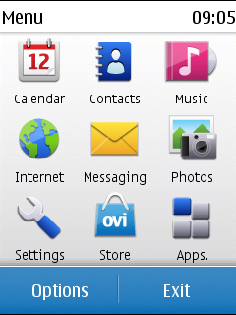
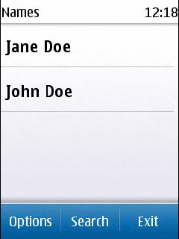
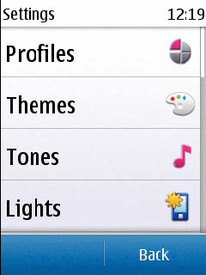
Softkey Guidelines
Left softkey (LSK) stands for positive effect
Right softkey (RSK) stands for negative effect
If three softkeys: Middle softkey (MSK) for primary positive
Two softkeys;
LSK for Options,
RSK for negative
Three softkeys;
LSK for Options,
MSK for primary positive,
RSK for negative
One softkey;
RSK for negative

Slide 8
APIs for Touch UI
There are two new APIs for utilizing Touch features in Touch and Type devices
Gesture API
Animator Framework API

Slide 9
Using Gesture API

Slide 10
Gestures
The Single tap is recognized by a quick touch down and release.
The Long press is a touch, hold and release.
The Long press repeated is a generated when a long press is held down.
Drag and drop are defined as touch down, move the finger whilst keeping contact with the touch screen, stop and then release.
The Flick gesture is defined as a touch down, move and release before stopping the finger movement.

Slide 11
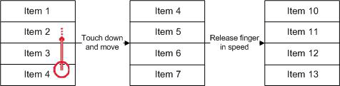
Flick

Slide 12
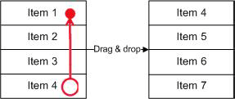
Drag and Drop

Slide 13
Using Gesture API
Gesture framework is utilized by the native high-level UI components of Java ME MIDP framework by default in Series 40 Touch UI Devices
You can utilize the Gesture API in your canvas by the following
Create GestureInteractiveZone for the canvas or a specified rectangle area on canvas to receive gesture events
Register the zone to GestureRegistrationManager passing in
The container (canvas or customitem)
GestureInteractiveZone created in the container
Implement GestureListener interface and set the listener (observer pattern)
Handle the gesture events you want

Slide 14
Gesture Event Types
EVENT | TYPE
GESTURE_ALL | All gesture events
GESTURE_TAP | Simple press and release
GESTURE_LONG_PRESS | Press and hold for long press interval followed by release
GESTURE_LONG_PRESS_REPEATED | Repeated long presses
GESTURE_DRAG | Press and move
GESTURE_DROP | Press and move followed by release. It is possible that a Flick gesture maybe recognized instead of the drop gesture.
GESTURE_FLICK | Press and move followed by release. It is possible that a Drop gesture maybe returned if Flick gesture cannot be recognized.

Slide 15
Using Gesture API (1/3)
Import the corresponding modules
import com.nokia.mid.ui.gestures.GestureEvent;
import com.nokia.mid.ui.gestures.GestureInteractiveZone;
import com.nokia.mid.ui.gestures.GestureListener;
import com.nokia.mid.ui.gestures.GestureRegistrationManager;

Slide 16
Using Gesture API (2/3)
Implement your gesture listener class
public class MyCanvas extends GameCanvas implements GestureListener {
…
public void MyCanvas()
{
…
// Create the GestureInteractiveZone
GestureInteractiveZone giz =
new GestureInteractiveZone(GestureInteractiveZone.GESTURE_ALL);
// Register it
GestureRegistrationManager.register(this, giz);
// Set the listener
GestureRegistrationManager.setListener(this, this);
}
}

Slide 17
Using Gesture API (3/3)
Handle the Gesture Events
public void gestureAction(Object container, GestureInteractiveZone giz, GestureEvent event) {
switch(event.getType()) {
case GestureInteractiveZone.GESTURE_DRAG:
// event.getDragDistanceX()
// event.getDragDistanceY()
break;
case GestureInteractiveZone.GESTURE_FLICK:
// event.getFlickSpeed()
// event.getFlickDirection()
break;
// etc.
}
}

Slide 18
GestureEvent
EVENT | TYPE
int getDragDistanceX() | Query for the Drag & Drop gesture events movement in horizontal direction since last drag gesture.
int getDragDistanceY() | Query for the Drag & Drop gesture events movement in vertical direction since last drag gesture.
float getFlickDirection() | Query for the Flick gesture events direction.
int getFlickSpeed() | Query for the Flick gesture events speed in actual flick direction.
int getFlickSpeedX() | Query for the Flick gesture events speed in horizontal direction.
int getFlickSpeedY() | Query for the Flick gesture events speed in vertical direction.
int getStartX() | Query for the gestures horizontal start location.
int getStartX() | Query for the gestures vertical start location.
int getType() | Query for the actual gesture event that has occurred.

Slide 19
Using FrameAnimator API

Slide 20
FrameAnimator API
The FrameAnimator API supports two types of animations
Drag
Kinetic scroll
These map to the drag and flick Gesture Events respectively
FrameAnimator API is independent of the Gesture API
To trigger the animations from the Touch Gestures the MIDlet needs to also register for Gesture Events using the Gesture API as seen before.

Slide 21
Using FrameAnimation API
The FrameAnimator API consists of
class FrameAnimator
interface FrameAnimatorListener with method animate(), which will be called repeatedly during the animation
public void animate(FrameAnimator animator, int x, int y, short delta, short deltaX,
short deltaY, boolean lastFrame) {
this.y = y;
this.x = x;
// Render…
flushGraphics();
}

Slide 22
Frame Animator Demo / Example
Frame Animator demo application demonstrates the usage Frame Animator API together with Gesture API
Download and build the example application from
http://www.forum.nokia.com/Develop/Java/Code_examples/

Slide 23
Imports
import com.nokia.mid.ui.frameanimator.FrameAnimator;
import com.nokia.mid.ui.frameanimator.FrameAnimatorListener;
import com.nokia.mid.ui.gestures.GestureEvent;
import com.nokia.mid.ui.gestures.GestureInteractiveZone;
import com.nokia.mid.ui.gestures.GestureListener;
import com.nokia.mid.ui.gestures.GestureRegistrationManager;

Slide 24
Initializations
public class MyView extends GameCanvas implements GestureListener, FrameAnimatorListener{
private FrameAnimator animator;
private int x = 0;
private int y = 0;
…
public MyView() {
animator = new FrameAnimator();
short fps = 0;
short pps = 0;
//when fps and or pps is zero, will use platform default values
animator.register(x, y, fps, pps, this);
// Register to get all gesture events GESTURE_ALL
GestureInteractiveZone giz =
new GestureInteractiveZone(GestureInteractiveZone.GESTURE_ALL);
GestureRegistrationManager.register(this, giz);
GestureRegistrationManager.setListener(this, this);
}

Slide 25
Handling the gesture events
public void gestureAction(Object container, GestureInteractiveZone giz, GestureEvent event) {
switch(event.getType()) {
case GestureInteractiveZone.GESTURE_DRAG:
animator.drag( this.x + event.getDragDistanceX(), this.y + event.getDragDistanceY() );
break;
case GestureInteractiveZone.GESTURE_FLICK:
animator.kineticScroll(event.getFlickSpeed(),
FrameAnimator.FRAME_ANIMATOR_FREE_ANGLE,
FrameAnimator.FRAME_ANIMATOR_FRICTION_MEDIUM,
event.getFlickDirection() );
break;
}
}

Slide 26
Animating
public void animate(FrameAnimator animator, int x, int y,
short delta, short deltaX, short deltaY, boolean lastFrame) {
this.y = y;
render(g);
flushGraphics();
}
public void render(Graphics g) {
g.setColor(0xFFFFFF);
g.fillRect(0, 0, getWidth(), getHeight());
if(this.y > 0) {
this.y = 0;
} else if(this.y < lowerLimit) {
this.y = lowerLimit;
}
g.drawImage(buffer, x, y, g.TOP | g.LEFT);
}

Slide 27
Touch UI Usability

Slide 28
Touch UI Guidelines / Documents
The touch UI brings new usability aspects of applications to be considered. Examples:
The sizes of the thumb-touchable objects (one-hand apps)
The sizes of finger-touchable objects (games)
The softkey guidelines
Etc..
Documents
User Experience Checklist for Touch
Series 40 Touch andType UI Style Guide
Download from: http://www.forum.nokia.com/Develop/Java/Documentation/

