Slide 1
Module 1 – Java ME Development Overview
Introduction to Development tools and the first Java ME Applications
Notes:
This document is licensed under the Creative Commons Attribution-Share Alike 3.0 License.
For more information, see http://creativecommons.org/licenses/by-sa/3.0/ for the full terms of the license.

Slide 2
Lecture Overview
Java ME Overview
CLDC and MIDP Overview
MIDlet overview
User Interface overview
Networking overview
Persistent storage overview
Game API overview
Notes:
In this Lecture, you will get an overview of the often used features during MIDlet development. You will see some code examples but don’t worry about understanding them all at the moment, they are handled more precisely later.

Slide 3
Java ME Overview
Java Micro Edition (ME) is Java for small devices
Java ME provides a common platform for devices such as
Mobile phones
Pagers
PDAs
Set-top boxes
Defines a standard set of configuration, profiles and optional APIs
This enables developers to write applications for a broad range of devices

Slide 4
Java ME Architecture
Java ME platform consists of separate layers which provide a modular approach to functionality
Configuration/profile/optional APIs combination is called a stack
Optional APIs
Other CDC
Profiles
Personal
Profile
Personal
Basis Profile
Profiles
Other CLDC
Profiles
Mobile Information
Device Profile
Foundation
Profile
Configurations classes
CDC Core classes
CLDC Core classes
Virtual Machines
CVM
CLDC-HI or KVM
Notes:
The Java ME architecture defines configurations, profiles and optional packages as elements for building complete Java runtime environments that meet the requirements for a broad range of devices and target markets. Each combination is optimized for the memory, processing power, and I/O capabilities of a related category of devices.

Slide 5
Configurations
Defines a Java Virtual Machine (JVM) and the minimum set of class libraries available for a range of devices
Defined through the Java Community Process
Other CDC
Profiles
Personal
Profile
Personal
Basis Profile
Other CLDC
Profiles
Mobile Information
Device Profile
Foundation
Profile
Configurations classes
CDC Core classes
CLDC Core classes
Virtual Machines
CVM
CLDC-HI or KVM
Notes:
Configurations define the minimum Java libraries and virtual machine capabilities expected to be available on devices that share similar characteristics such as memory size and processing resources. They provide the base functionality that a device manufacturer or a content provider can safely assume to be present on a range of devices. Configurations are defined through the Java Community Process, which is Sun's attempt to involve the international Java community in developing Java specifications.
More specifically, a configuration specifies:
The Java programming language features supported,
The Java virtual machine features supported,
The Java libraries and APIs supported.
Application developers and content providers must design their code to stay within the bounds of the Java virtual machine features and APIs specified by that configuration.
Java ME currently defines two configurations, the Connected Device Configuration (CDC), and the more restrained Connected Limited Device Configuration (CDLC).

Slide 6
Profiles
A profile is based on a configuration
Adds the APIs necessary to develop applications for a specific family of devices
Other CDC
Profiles
Personal
Profile
Personal
Basis Profile
Profiles
Other CLDC
Profiles
Mobile Information
Device Profile
Foundation
Profile
CDC Core Classes
CLDC Core Classes
CVM
CLDC-HI or KVM
Notes:
A profile is a collection of Java based APIs that supplement a Configuration to provide capabilities for a specific vertical market or device type (for example, wireless: pagers, mobile devices, etc.).
The main goal for a profile is to provide flexibility to the Java Community while still maintaining portability across device types.
Profiles are defined by open industry working groups utilizing the Java Community Process Program. In this way industries can decide for themselves what elements are necessary to provide a complete solution targeted at their industry.
Profiles are implemented on top of a configuration to further define the application life cycle model, the user interface, and access to device specific properties.
Examples of profiles are the Mobile Information Device Profile (MIDP), Foundation Profile (FP), Personal Profile (PP) and Personal Basic Profile (PBP).
The practical definition for developers is that a configuration specifies everything that is necessary to provide basic Java Technology support in a compliant device, while profiles provide industry-specific or specialized APIs on top of the underlying configuration. The CLDC and MIDP described below together specify both the core VM and Java language features plus the wireless- and mobile-specific APIs needed for mobile devices and pagers with small memory, power constraints, small screens, and limited user interfaces.

Slide 7
Optional APIs
Define specific additional functionality that may be included in a particular configuration
This functionality is separated into an optional API because it is too specific to include a profile or configuration
Optional Packages
Other CDC
Profiles
Personal
Profile
Personal
Basis Profile
Other CLDC
Profiles
Mobile Information
Device Profile
Foundation
Profile
CDC Core classes
CLDC Core classes
CVM
CLDC-HI or KVM

Slide 8
Overview of CLDC and MIDP
The focus of this course is
Connected, Limited Device Configuration (CLDC)
Mobile Information Device Profile (MIDP)
Optional APIs compatible with CLDC
This is aimed at devices such as
Series 40: Nokia 6500 slide, Nokia 6700 classic…
Symbian S60: Nokia E75, Nokia 5800 XpressMusic…
Mobile Information
Device Profile
CLDC Core classes
CLDC-HI or KVM

Slide 9
CLDC
CLDC stands for Connected, Limited Device Configuration
It is a configuration targeted at devices with
Limited power (often battery)
Connectivity to network
CLDC covers the following areas:
Java language and virtual machine features
Input/output and Networking
Security
Internationalization
Borrows some classes from Java SE and introduces Java ME specific classes
Currently two versions available
CLDC 1.0 and CLDC 1.1
Mobile Information
Device Profile
CLDC Core classes
CLDC-HI or KVM
Notes:
Connected Limited Device Configuration (CLDC) specifies the core libraries and virtual machine features for Java ME implementation on small, resource-constrained devices, such as mobile devices, mainstream personal digital assistants, and small retail payment terminals.
CLDC enables dynamic, secure delivery of interactive Java based content to small devices. It also incorporates 3rd-party application development for these devices.
This configuration includes some new classes, not drawn from the Java Standard Edition (SE) APIs, designed specifically to fit the needs of small-footprint devices.

Slide 10


CLDC 1.0 and 1.1
Two versions of CLDC aimed at devices with different memory requirements
Newer versions of CLDC include more features
 | CLDC 1.0 | CLDC 1.1
Memory Requirement | At least 160KB | At least 192KB
Processor Speed | 16-32 MHZ | 16-32 MHZ
Floating point support
Weak References
Reflection
JNI
Thread groups
Finalization
Mobile Information
Device Profile
CLDC Core classes
CLDC-HI or KVM
Notes:
The general goal for a Java VM supporting CLDC is to be as compliant with the Java. Language Specification as is feasible within the strict memory limits of the target devices. A number of features have been eliminated from a JVM supporting CLDC because of lack of hardware support, the Java libraries included in CLDC are substantially more limited than regular J2SE libraries, and/or the presence of the feature would have posed security problems in the absence of the full Java security model. The limitations include:
No support for floating point data types (float and double). This was removed because the majority of CLDC target devices do not have hardware floating point support, and since the cost of supporting floating point in software was considered too high.
No support for finalization of class instances. The method Object.finalize() does not exist.
No support for the Java Native Interface (JNI). The limited security model provided by CLDC assumes that the set of native functions must be closed. Also the full implementation of JNI was considered too expensive given the strict memory constraints of CLDC target devices.
No user-defined, Java-level class loaders. The elimination of user-defined class loaders is part of the security restrictions.
No reflection features. I.e., features that allow a Java program to inspect the number and the contents of classes, objects, methods, fields, threads, execution stacks and other runtime structures inside the virtual machine. Consequently, does not support RMI, object serialization, JVMDI (Debugging Interface), JVMPI (Profiler Interface) or any other advanced features of J2SE that depend on the presence of reflective capabilities.
No supports for thread groups or daemon threads. Implements multithreading, but does not have support for thread groups or daemon threads. Thread operations such as starting and stopping of threads can be applied only to individual thread objects.
No weak references, i.e. a reference that does not prevent the referenced object from being garbage collected.
Error Handling Limitations
The set of error classes included in CLDC libraries is limited, and consequently the error handling capabilities of CLDC are restricted. This is because of two reasons:
In embedded systems, recovery from error conditions is usually highly device specific. While some embedded devices may try to recover from serious error conditions, many embedded devices simply soft-reset themselves upon encountering an error. Application programmers cannot be expected to worry about device-specific error handling mechanisms and conventions.
The class java.lang.Error and its subclasses are exceptions from which ordinary programs are not ordinarily expected to recover. Implementing the error handling capabilities fully according to the Java. Language Specification is rather expensive, and mandating the presence and handling of all the error classes would impose a significant overhead on the implementation given the strict memory constraints in CLDC target devices.

Slide 11
CLDC Virtual Machine
The virtual machine that operates in CLDC is called CLDC-HI or KVM
Minimal, highly optimised virtual machine with the constraints of inexpensive resource-constrained mobile devices in mind
CLDC runs on top of KVM
Various compile-time options for tuning the VM and for debugging
Easily portable onto various platforms for which a C compiler is available
Mobile Information
Device Profile
CLDC Core classes
CLDC-HI or KVM
Notes:
The Java virtual machine is an abstract computing machine. Like a real computing machine, it has an instruction set and manipulates various memory areas at run time.
Sun offers two virtual machines to support the CLDC: The K virtual machine (KVM) and CLDC-HI (HotSpot) virtual machine.
KVM is the minimal VM for the Java ME platform and is the virtual machine of choice for the CLDC configuration. It is a highly optimized virtual machine designed from the ground up with the limitations of inexpensive resource-constrained mobile devices in mind. It is named to reflect that its size is measured in the tens of kilobytes.
More specifically, KVM was designed to be:
Small, with a static memory footprint of the core of the virtual machine in the range 40 kilobytes to 80 kilobytes (depending on compilation options and the target platform,)
Clean and highly portable,
Modular and customisable,
As "complete" and "fast" as possible without sacrificing the other design goals.
The K virtual machine is extremely small -- starting from approximately 50K in size -- and efficient. CLDC with KVM is suitable for devices with 16/32-bit RISC/CISC microprocessors/controllers, and with as little as 160 KB of total memory available for the Java technology stack. 128 KB of this is for the storage of the actual virtual machine and libraries, and the remainder is for Java applications.
The KVM is implemented in the C programming language, so it can easily be ported onto various platforms for which a C compiler is available. Since the KVM was written from scratch in C, it permitted the engineers to incorporate optimizations that would not have been possible if it was a modification of an existing VM. The virtual machine has been built around a straightforward bytecode interpreter with various compile-time flags and options to aid porting efforts and improve space optimization. This was to address the fact that KVM-based devices would have cramped memory spaces and limited processor power.
Sun provides reference implementations of KVM for Win32 and Solaris. Additional ports for Linux and PalmOS are also provided. Third party vendors have released Java ME CLDC implementations for various hardware and OS platforms.
Like all Java virtual machines, the KVM provides the foundation for the downloading and execution of dynamic content and services. However, it does differ from other virtual machines in that, for example, the virtual machine is highly customizable. It is modular and is built so device manufacturers can easily remove features not needed for a particular target implementation. Such optional features include: large data types (long, float, and double), multidimensional arrays, classfile verification, and others. It has various compile- time options for tuning the VM (size vs. speed) and for debugging.
The actual role of KVM in the target devices can vary significantly. In some implementations, KVM is used on top of an existing software stack to give the device the ability to download and run dynamic, interactive, secure Java content on the device. In other implementations, KVM is used at a lower level to implement the system software and applications of the device in the Java programming language.

Slide 12
CLDC Core classes
Classes inherited from Java Standard Edition (SE) are in packages
java.lang.*
java.io.*
java.util.*
New classes introduced by CLDC are in package:
javax.microedition.io.*
Mobile Information
Device Profile
CLDC Core classes
CLDC-HI or KVM
Notes:
In order to ensure upward compatibility and portability of applications, the majority of the class libraries included in CLDC are a subset of those specified for the larger Java editions (SE and EE). Only those classes that are appropriate for mobile devices are specified by CLDC.

Slide 13
MIDP
MIDP stands for Mobile Information Device Profile
It is a profile targeted at devices with:
At least 96x54 screen size, 1-bit depth
One or two handed keyboard
Two-way wireless networking capability
MIDP covers the following areas:
User Interfaces
Application life-cycle management
Device data persistence
Networking
Currently three versions available
MIDP 1.0, MIDP 2.0 and MIDP 2.1
Mobile Information
Device Profile
CLDC Core classes
CLDC-HI or KVM
Notes:
The Mobile Information Device Profile (MIDP) is a profile designed for mobile devices, two-way pages and entry-level PDAs. It offers the core application functionality required by mobile applications, including the user interface, network connectivity, local data storage, and application management. Combined with CLDC, MIDP provides a complete Java runtime environment that leverages the capabilities of handheld devices and minimizes both memory and power consumption.

Slide 14
MIDP 1.0, 2.0 and 2.1
Two versions of MIDP aimed at devices with different memory requirements
MIDP 2.1 is updated MIDP 2.0
Newer versions of MIDP include more features
 | MIDP 1.0 | MIDP 2.0
Memory Requirement | At least 200KB | At least 256KB
High/Low-Level UI
Network API
Persistent Storage API
Game API
Secure networking
Push Registry
Signed MIDlets
Mobile Information
Device Profile
CLDC Core classes
CLDC-HI or KVM
Notes:
MIDP 2.1 specification key features:
Device fragmentation reduction:
Defines consistent set of Java technologies that must present in MIDP 2.1 capable phone
LCDUI
Layout directive is mandatory
Communication protocols
SocketConnection, HttpConnection, HttpsConnection(SSL V3) and SecureConnection(SSL V3) must be supported
Portability
Virtual Machine must comply with CLDC 1.1 or optionally with CDC
Nokia S40 5th edition phone models were the first in-line to feature MIDP 2.1
Note: MIDP 3 specification is ongoing

Slide 15
MIDP Functionality
MIDP defines the architecture and the associated APIs to enable an open application development environment for Mobile Information Devices(MID)
MIDP defines the following set of classes:
Application Lifecycle Package
User Interface Package
Persistence Package
Networking Package
Language and Utility Packages
MIDlet
APIs
User
Interface
Persistent
Storage
Networking
Mobile Information
Device Profile
CLDC Core classes
CLDC-HI or KVM

Slide 16
MIDlets (1)
Java apps that run on MIDP devices are known as MIDlets
Defined in javax.microedition.midlet package
Derived from the MIDP-defined abstract class javax.microedition.midlet.MIDlet
Well-defined lifecycle controlled via implemented methods of the MIDlet class
A group of related MIDlets may be collected into a MIDlet suite
MIDlet
APIs
User
Interface
Persistent
Storage
Networking
Mobile Information
Device Profile
CLDC Core classes
CLDC-HI or KVM
Notes:
Java applications that run on MIDP devices are known as MIDlets. A MIDlet consists of at least one Java class that must be derived from the MIDP-defined abstract class javax.microedition.midlet.MIDlet. MIDlets run in an execution environment within the Java VM that provides a well-defined lifecycle controlled via methods of the MIDlet class that each MIDlet must implement. A MIDlet can also use methods in the MIDlet class to obtain services from its environment, and it must use only the APIs defined in the MIDP specification if it is to be device-portable.

Slide 17
MIDlets (2)
An application manager controls the execution of MIDlets
The behaviour of the MIDlet is controlled by a life-cycle, which is reflected in the methods a MIDlet must implement
default constructor()
startApp()
Paused
Active
pauseApp()
destroyApp()
destroyApp()
Destroyed
Notes:
At any given time, a MIDlet is in one of three states: Paused, Active, or Destroyed. A state diagram that shows how these states are related and the legal state transitions is shown in this slide.
When a MIDlet is loaded, it is initially in the Paused state. The usual class and instance initialization is then performed - that is, static initializers are called the first time the MIDlet class is loaded, all instance initializers are invoked when the MIDlet instance is created, and its public, no-argument constructor is then invoked. If the MIDlet throws an exception during the execution of its constructor, the MIDlet is destroyed. If the MIDlet does not throw an exception, it is scheduled for execution at some later time. Its state is changed from Paused to Active, and its startApp( ) method is called. The MIDlet class declares this method as follows:
protected void startApp( ) throws MIDletStateChangeException;
That this method is abstract means that you must implement it in your MIDlet, and that it is protected implies that it will be called either from the MIDlet class itself or from another class in the javax.microedition.midlet package.
The startApp( ) method may complete normally, in which case the MIDlet is allowed to run, or it may inform the MIDP platform that the MIDlet does not want to run at this point. There are several ways to achieve the latter:
If the startApp( ) method detects an error condition that stops it from completing, but which might not exist later (i.e., a transient error condition), it should throw a MIDletStateChangeException. This moves the MIDlet back to the Paused state, so that another attempt to start it can be made later.
If the startApp( ) method detects an error condition from which recovery is likely never to be possible (a nontransient error condition), it should call its notifyDestroyed( ) method, which is described a little later.
Finally, the MIDlet may throw an exception other than MIDletStateChangeException, either deliberately or because a method that it invokes throws the exception, and the startApp( ) method does not catch it. In this case, it is assumed that a fatal error has occurred, and the MIDlet is destroyed by calling its destroyApp( ) method (described later).
If the MIDlet does none of these things, it is in the Active state and will be allowed to run until it is either paused or destroyed.

Slide 18
MIDlets (3)
Platform can put a MIDlet from the Active state to Paused state at any time
startApp()
Paused
Active
pauseApp()
destroyApp()
destroyApp()
Destroyed
Notes:
At any time, the MIDP platform can put a MIDlet into the Paused state. On a cell phone, for example, this might happen when the host software detects an incoming call and needs to release the device's display so the user can answer the call. When a MIDlet is paused, its pauseApp( ) method is called:
protected abstract void pauseApp( );
As with startApp( ), a MIDlet is required to provide an implementation for this method. The appropriate response to this state change depends on the MIDlet itself, but, in general, it should release any resources it is holding and save the current state so it can restore itself when it is reactivated later.
If the host platform decides to resume a paused MIDlet, because the incoming call has terminated, for example, the MIDlet's startApp( ) method is invoked again to notify the MIDlet that it has access to the screen. As a consequence, a MIDlet's startApp( ) method should be written carefully to distinguish, if necessary, between the first time that it is called, which signifies that the MIDlet is being started for the first time, and subsequent calls notifying resumption from the Paused state, to prevent resources from being allocated multiple times.

Slide 19
MIDlets (4)
MIDlet’s destroyApp() is called when the platform needs to terminate a MIDlet
startApp()
Paused
Active
pauseApp()
destroyApp()
destroyApp()
Destroyed
Notes:
When the host platform needs to terminate a MIDlet, it calls the MIDlet's destroyApp( ) method:
public abstract void destroyApp(boolean unconditional) throws MIDletStateChangeException;
In the destroyApp( ) method, the MIDlet should release all the resources that it has allocated, terminate any background threads, and stop any active timers.
There are two other methods that a MIDlet may invoke to influence its own lifecycle:
public final void notifyPaused( );
public final void resumeRequest( );
The notifyPaused( ) method informs the platform that the MIDlet wishes to be moved to the Paused state; this has the same effect as if the platform had invoked the MIDlet's pauseApp( ) method. When the MIDlet calls notifyPaused( ), the platform does not invoke its pauseApp( ) method, in the same way that it does not call destroyApp( ) in response to notifyDestroyed( ), because it assumes that the MIDlet has prepared itself to be paused. A MIDlet often, therefore, precedes an invocation of notifyPaused( ) with a call to pauseApp( ) so that the appropriate steps are taken before the MIDlet is suspended.
The resumeRequest( ) method is the reverse of notifyPaused( ); it tells the platform that a MIDlet in the Paused state wishes to return to the Active state. At some future time, the platform may resume the MIDlet by calling its startApp( ) method. The resumeRequest( ) method typically is called by a background thread or from a timer that the MIDlet left active while it was paused.

Slide 20
MIDlets (5)
Basic MIDlet example: Overrides the startApp(), destroyApp() and pauseApp()
public class MyMIDlet extends MIDlet {
private MyForm myForm;
private Display display;
public MyMIDlet() {
this.display = Display.getDisplay(this);
this.myForm = new MyForm(“Please Log in”);
}
Notes:
All MIDlets are derived from the abstract base class javax.microedition.midlet.MIDlet, which contains methods that the MIDP platform calls to control the MIDlet's lifecycle, as well as methods that the MIDlet itself can use to request a change in its state. A MIDlet must have a public default constructor (that is, a constructor that requires no arguments), which may be one supplied by the developer if there is any initialization to perform or, when there are no explicit constructors, the empty default constructor inserted by the Java compiler.

Slide 21
MIDlets (5)
public void startApp() throws MIDletStateChangeException {
this.display.setCurrent(myForm);
}
public void destroyApp(boolean arg) throws MIDletStateChangeException {
this.myForm = null;
this.display = null;
}
public void pauseApp() {
}
}
Notes:
All MIDlets are derived from the abstract base class javax.microedition.midlet.MIDlet, which contains methods that the MIDP platform calls to control the MIDlet's lifecycle, as well as methods that the MIDlet itself can use to request a change in its state. A MIDlet must have a public default constructor (that is, a constructor that requires no arguments), which may be one supplied by the developer if there is any initialization to perform or, when there are no explicit constructors, the empty default constructor inserted by the Java compiler.

Slide 22
User Interface (1)
MIDP has it own UI architecture
Defined in javax.microedition.lcdui package
High-level, portable API
An abstract and portable interface
Applications using this API should work on all devices
Low-level API
Graphic elements
Key events
Developers may compromise portability for better user experience
MIDlet
APIs
User
Interface
Persistent
Storage
Networking
Mobile Information
Device Profile
CLDC Core classes
CLDC-HI or KVM
Notes:
The user interface requirements for handheld devices are different from those for desktop computers. For example, the display size of handheld devices is smaller, and the input devices do not always include pointing devices, for example, a mouse or pen input. For these reasons, you cannot follow the same user interface programming guidelines for applications running on desktop computers and hand-held devices.
The CLDC provides foundation classes for all resource-constrained Java-enabled handheld devices and needs to be complemented by profiles. For example, the CLDC itself does not define any Graphical User Interface (GUI) functionality. Official GUI classes are included in profiles such as the MIDP. The GUI classes included in the MIDP are defined in the javax.microedition.lcdui package. These are not based on the Abstract Window Toolkit (AWT).
The MIDP UI classes were designed with the consumer devices in mind. They consist of high-level and low-level APIs.
High-Level API
The high-level API is designed for applications whose client parts run on mobile information devices where portability is important. Applications that use this API should work on all devices. To achieve portability, the API employs a high-level abstraction and gives little control over its look and feel. For example, there is no direct access to device features (colors, sizes, input). Interaction with components is encapsulated by the implementation and the application is not aware of such interactions.
When the high-level API is used, the underlying implementation does the necessary adaptation to the device's hardware and native user interface style. The high-level API is implemented by classes that inherit from the Screen class. It is much simpler and less powerful than AWT.
Low-Level API
The low-level API provides little abstraction. It is designed for applications that need precise placement and control of graphic elements and access to low-level key events. This API gives the application full control over what is being drawn on the display. The Canvas and Graphics classes implement the low-level API.
It is important to note that MIDlets that access the low-level API are not guaranteed to be portable because this API provides mechanisms to access details that are specific to a particular device. This compromise on portability however may result in a better user experience.

Slide 23
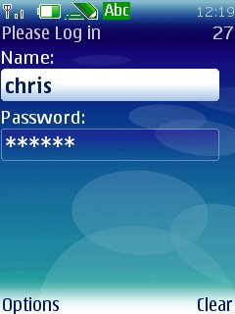
User Interface (2)
High-Level API example
Extends the Form class
Creates instances of TextField
Uses the append() method to add the TextFields
public class MyForm extends Form {
private TextField name;
private TextField password;
public MyForm(String title) {
super(title);
name = new TextField("Name:", "", 20, TextField.ANY);
password = new TextField("Password:", "", 20,
TextField.PASSWORD);
append(name);
append(password);
}
}

Slide 24

User Interface (3)
Low-Level API example
Extends the Canvas class, overrides the paint() method
Uses the methods in Graphics to draw to the screen
public class MyCanvas extends Canvas {
public MyCanvas() {
setFullScreenMode(true);
}
public void paint(Graphics g) {
g.setColor(255, 255, 0);
int width = this.getWidth();

Slide 25
User Interface (3)
int height = this.getHeight();
g.fillRect(0, 0, width, height);
g.setColor(0, 0, 0);
Font f = Font.getFont(Font.FACE_SYSTEM,
Font.STYLE_BOLD, Font.SIZE_LARGE);
g.setFont(f);
g.drawRect(10, 10, width - 25, height - 25);
g.drawString(“Hello There!", width/2, height/2,
Graphics.BASELINE|Graphics.HCENTER);
}
}

Slide 26
Networking (1)
Network classes are part of the Generic Connection framework (GCF)
Defined in javax.microedition.io package
GCF designed for devices with limited resources
More coherent than Java SE in supporting different types of networking protocols
Classes included to create HTTP and HTTPS connections
MIDlet
APIs
User
Interface
Persistent
Storage
Networking
Mobile Information
Device Profile
CLDC Core classes
CLDC-HI or KVM

Slide 27
Networking (2)
Example: uses Connector.open() to open a HttpsConnection
public boolean checkLoginDetails(String user, String password) {
String url = “https://www.website.com/login?user=” + user +
”&password=“ + password;
HttpsConnection con;
try {
con = (HttpsConnection)Connector.open(url);
InputStream is = con.openInputStream();
char ch;
StringBuffer buff = new StringBuffer();
while ((ch = is.read()) != -1) {

Slide 28
Networking (2)
buff.append((char)ch);
}
if (buff.toString().startsWith(“PASSWORD=OK”)) {
return true;
} else return false;
} catch (Exception e) {
//log error
return false;
} finally {
con.close();
}
}

Slide 29
Persistent Storage (1)
Handled using a Record Management System (RMS)
Defined in javax.microedition.rms package
Device-independent API
Records are arrays of bytes
Records live in record stores
Record stores are shared within MIDlet suite
Support for enumeration, sorting and filtering
MIDlet
APIs
User
Interface
Persistent
Storage
Networking
Mobile Information
Device Profile
CLDC Core classes
CLDC-HI or KVM
Notes:
Persistent storage is a non-volatile place for storing the state of objects. The MIDP provides a Device- independent API for MIDlets to persistently store data and retrieve it later. This mechanism is a simple record- oriented database called the Record Management System (RMS). A MIDP database (or a record store) consists of a collection of records that remain persistent after the MIDlet exits. When you invoke the MIDlet again, it can retrieve data from the persistent record store.
To use the RMS, import the javax.microedition.rms package.
A record store is a collection of records, and a record is basically a byte array of arbitrary data. Record stores (binary files) are platform-dependent because they are created in platform-dependent locations. MIDlets within a single application (a MIDlet suite) can create multiple record stores (database files) with different names. The RMS APIs provide the following functionality:
Allow MIDlets to manipulate (add and remove) records within a record store.;
Allow MIDlets in the same application to share records (access one another's record store directly).
Does not provide a mechanism for sharing records between MIDlets in different applications.
Different MIDlets in the same MIDlet suite can also use the RMS to share data. (A MIDlet suite is a set of MIDlets packaged together into a single JAR file.)
There is no way to change just part of a record: the entire record must be read, the change made to the data in memory, and then the entire record is written back to the record store.

Slide 30
Persistent Storage (2)
Example code:
Opens a new RecordStore
Converts a String to bytes
Calls RecordStore.addRecord() with the bytes to add
public boolean storeUsername(String username) {
RecordStore rs;
try {
rs = RecordStore.openRecordStore(“loginInfo”, false);
byte[] user = username.getBytes();
rs.addRecord(bytes,0,bytes.length);
return true;
} catch (Exception e) {
return false;
} finally {
if (rs != null)
rs.closeRecordStore();
}
}

Slide 31
Game API Overview
Package included with MIDP 2.0 to deal with game related procedures
Defined in javax.microedition.lcdui.game package
Helps develop faster UI and reduce size of the jar
Don’t have to code own routines for good performance as in MIDP 1.0
Introduces the idea of layers which are the objects in the game
Game
MIDlet
APIs
User
Interface
Persistent
Storage
Networking
Mobile Information
Device Profile
CLDC Core classes
CLDC-HI or KVM

Slide 32

Example Game created with Game API
GameCanvas
Sprite
Sprite
TiledLayer
Notes:
The GameCanvas class is a subclass of javax.microedition.lcdui.Canvas.
It has a few advantages when compared to Canvas:
Graphics buffering
Smoother animation
Update and repaint the screen with paint(getGraphics()) and flushGraphics()
Ability to query key states
In Canvas, Canvas.keyPressed() method is called whenever the user presses a button
Might lead to errors when multiple threads are running simultaneously, key press event can be missed
Tells information about only a single key
In GameCanvas, keystroke information can be get whenever needed from the getKeyStates() method
GameCanvas.getKeyStates() tells also when multiple keys are being pressed simultaneously
In the Game API the graphical versions characters that move around and interact with each other are called sprites.
Represents a graphical image at a point in time
Has Cartesian coordinates
x-coordinate indicates how far across the screen they should be placed
y-coordinate indicates how far down
Supports animation
Sequence of frames can be defined with setFrameSequence(int sequence[])
Advance the animation from one frame to the next using nextFrame()
TiledLayer is a grid of cells, each painted with one frame selected from an Image
Similar to Sprite but has no transformations, frame sequence, or reference pixel

Slide 33
Java ME/MIDP Basics Summary
Java ME is made up of Configuration, Profiles and Optional Packages
MIDP applications are called MIDlets
MIDlets have a lifecycle
The UI in MIDlets can be created using High-Level or Low-Level components
Networking uses Generic Connection framework (GCF)
Persistent storage can be done using Record Management System (RMS)
Game API helps to develop faster UI and reduce size of the jar

Slide 34


MIDP Development Process
Development Station
MyMIDlet.jad
MyMIDlet.java
Download
/deploy
javac
Target Devices
Download
/deploy
MyMIDlet.class
preverify
MyMIDlet.jar
jar
MyMIDlet.class

Slide 35
Development Tools
MIDlets can be developed on regular desktop computers
There are a number of developments tools available to assist creating the various elements of a MIDP application
An IDE – To code and compile the source code
NetBeans, Eclipse
An SDK - to compile your MIDlets against
A build tool - to pre-verify and package your MIDlets (included in IDE)
An emulator - to test your MIDlets (included in SDK)
We will now cover the tools to be used in this course

Slide 36
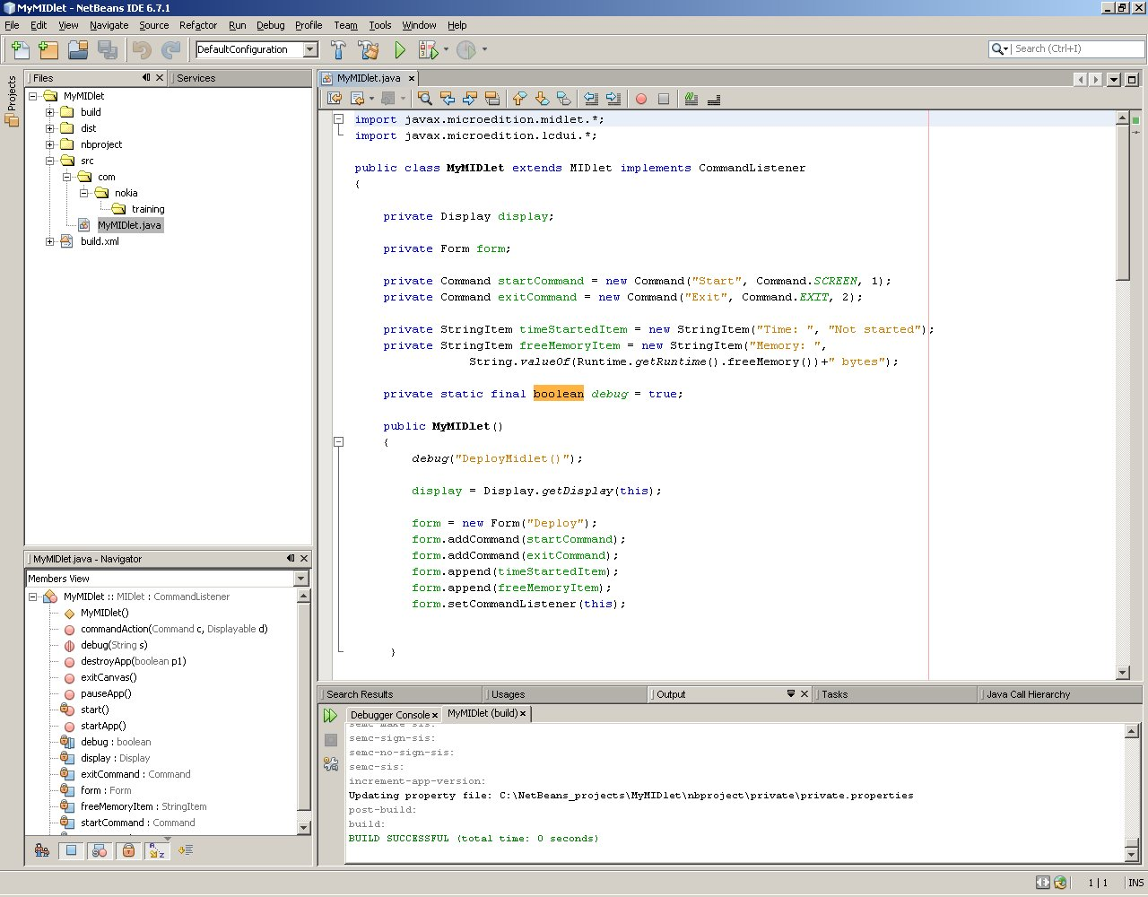
IDE - NetBeans
General purpose IDE that supports several types of projects (C++, Java ME, Java SE…)
Used to edit, compile, debug, pre-verify, package, and deploy MIDlets
Project / File
explorer
Editor
Navigator
Output

Slide 37
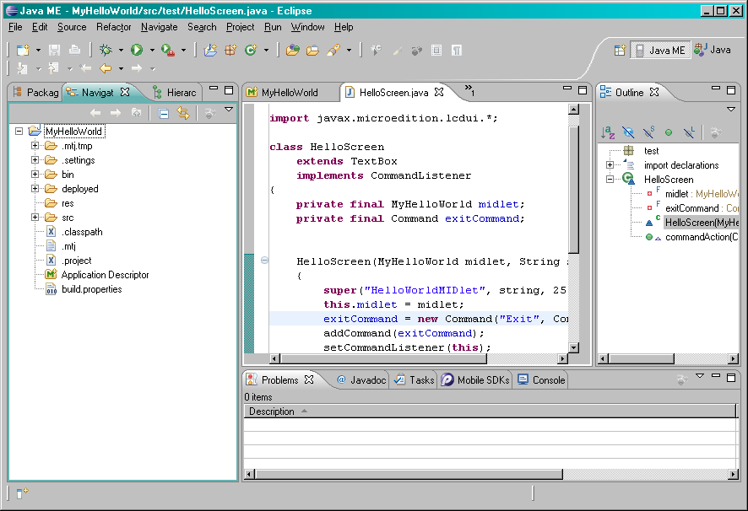
IDE - Eclipse
Another popular IDE that supports several types of projects (C++, Java ME, Java SE…)
Used to edit, compile, debug, pre-verify, package, and deploy MIDlets
Editor
Project
Navigator
Outline
Problems

Slide 38
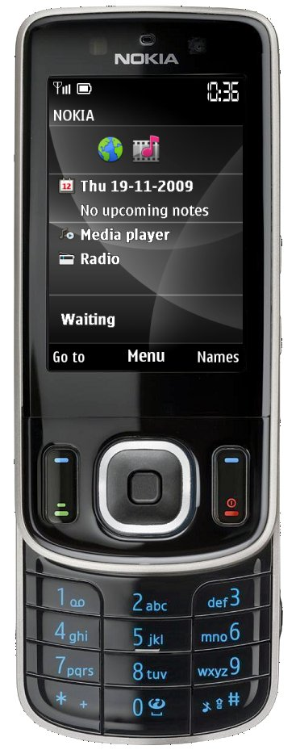


SDK – S40 SDK for Java ME
Provides development kit and emulators
Download from http://www.forum.nokia.com/tools
Contains several Developer Platform emulators
S40 3rd Ed.
S40 5th Ed.
S40 6th Ed.

Slide 39
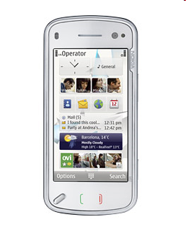
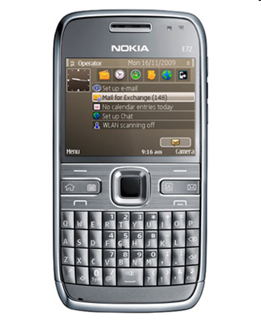
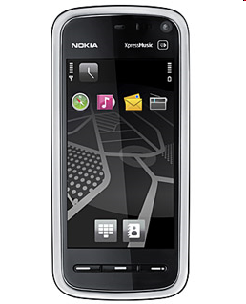
SDK – S60 SDK for Java ME
Provides development kit and emulators
Download from http://www.forum.nokia.com/tools
Contains several Developer Platform emulators
All-in-one S60 SDKs for
Nokia N97 mobile computer.
S60 5th Edition.
S60 3rd Edition, Feature Pack 2.
S60 5th Ed.
S60 3rd Ed. FP2
N97 - S60 5th Ed.

Slide 40
Compiling
For MIDP applications, compiling the .java files is done in exactly same way a compiling for a Java SE application
Javac is used, with the MIDP classes included in the classpath
The MIDP classes are obtained from the Nokia SDK

Slide 41
Pre-Verifying
Once the code is created and compiled, it needs to be pre-verified
The CLDC dictates a two-pass bytecode verification
Before deployment bytecode of the class files is checked to make sure they behave well, and use the configuration classes correctly
Once these pre-verified class files are deployed on the target device, further device-specific verification is applied
CLDC introduced this new two-pass class file verifier due to standard Java class file verifier is too large for a typical CLDC target device
Each Nokia SDK contains a tool called preverify.exe that performs the first step
Pre-verification is done automatically when packaging applications using NetBeans

Slide 42
Packaging application
After pre-verifying, application must be packaged in a Java Archive (JAR)
Each MIDlet JAR file must contain:
Pre-verified classes for the application
Resources used by the application (images, sounds, videos etc)
A Manifest file to describe the contents of the archive
The creation of the manifest.mf file and sub-sequent JAR file are, again, automated by using NetBeans

Slide 43
Manifest file
A manifest.mf file is simply a text file used to give the MIDP runtime environment information about the contents of the JAR file
Information such as MIDlet class name, MIDP version, CLDC version are included in the format:
MIDlet-1: SpaceMission, , com.nokia.example2dgame.GameMIDlet
MIDlet-Name: SpaceMission
MIDlet-Vendor: Nokia
MIDlet-Version: 1.0
MicroEdition-Configuration: CLDC-1.1
MicroEdition-Profile: MIDP-2.0

Slide 44
MIDlet descriptor
Finally, a Java Application Descriptor (JAD) file is required to that the installing device can learn about the MIDlet JAR without installing it
Information such as JAR size, JAR location, and MIDlet name is included in the format:
Again, the creation of this file can be automated by using NetBeans
MIDlet-1: SpaceMission, , com.nokia.example2dgame.GameMIDlet
MIDlet-Jar-Size: 71684
MIDlet-Jar-URL: SpaceMission.jar
MIDlet-Name: SpaceMission
MIDlet-Vendor: Nokia
MIDlet-Version: 1.0

Slide 45
NetBeans Basics
NetBeans Concepts
Layout of IDE
Creating a MIDP Project
Configuring Emulator Platform
Editing Files
Compiling a Project
Pre-verifying and Packaging a MIDP Application
Running in the emulator
Debugging with NetBeans

Slide 46
NetBeans Concepts (1)
Projects
Contains all open NetBeans projects (by default NetBeans uses folder C:\NetBeans_projects for new projects)
Files
Contains files of the projects
Navigator
Contains file navigation of the current file (for example methods of the code)
Notes:
The common concepts associated with NetBeans are discussed below.
In the NetBeans open projects can be explored from the “Project Explorer” and from the “Files explorer”. Default folder for new projects is C:\NetBeans_projects.
The folders and files that you create to a project are stored under a project directory.
Navigator helps you to navigate in current file. If you are editing a source code file, navigator displays the methods of the class.
You can select what views are displayed from ”Window” menu.

Slide 47
NetBeans Concepts (2)
Windows and views
Provide ways to navigate the information in your Projects (e.g. “Projects” view)
Each view contains information from a specific topic (for example properties)
Can be modified from ”Window” menu
Editor
Used to edit files in your Project
Help
NetBeans provides both online and offline help. You can access help from “Help” menu. If you press F1 offline help is opened.
Notes:
Views are UI components that provide ways to navigate the information in your project. For example, the “Project Explorer” view displays the projects that are open using a tree structure. Top level nodes are ‘project’ nodes that can contain child ‘folder’ nodes. These nodes themselves can contain child ‘file’ nodes.
Editors are used to edit files in your projects. They are another UI component, but unlike Views are associated with a particular file and are confined to the editor area of the project. Editors identify the file they are modifying by a tab containing the name of the file.
See the NetBeans Help documentation for more information on any of these topics including specific information about each of the views. Select the “Help -> Help Contents” menu item to open the help window. Once this window is open, type a search string in the top left search field and click the Go button.

Slide 48
Layout of IDE
Project and file navigator
Editor
Method navigator
Output area
Notes:
The above slide illustrates the default layout of the NetBeans IDE (for the Java perspective).
In the top right corner of the IDE a control exists to display the current perspective and allow the selection of other perspectives.
The editor area appears in the centre of the IDE and is surrounded by view windows (although in the slide it is only surrounded on three sides).
The default view layout is shown in the above slide with three view areas. However, in practise you can have any number of view areas. View windows may be moved from one view area to another or even into a completely new view area by dragging it’s title bar with the mouse into another area of the IDE. Views may also be detached rather than appearing in a specific view area. In such cases the view has its own window which is independent from the main Eclipse IDE window.
To reset the initial layout of your current perspective select the “Window -> Reset Perspective” menu item.

Slide 49
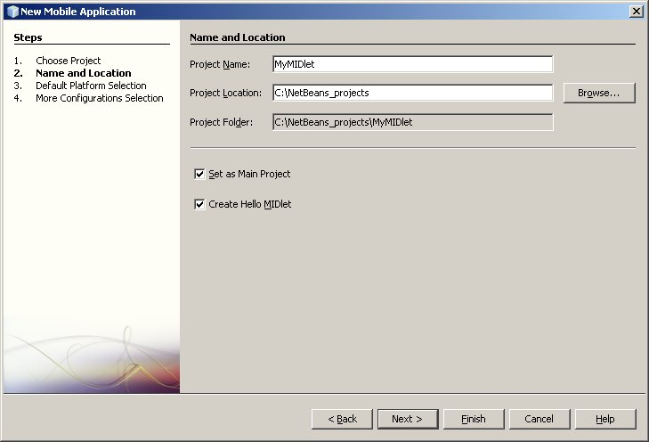
Creating a MIDP Project (1)
Use built in wizard to create new MIDP Application
Select “File-> New Project” menu item
Select “Java ME” from Categories and “Mobile Application” from Projects
Click Next
“Name and Location” dialog appears
Enter Project Name and change location if you want
Unmark “Create Hello MIDlet” if you want to create the MIDlet by yourself
“Set as Main Project” will set created project as Main Project
Click Next
Notes:
To create a new NetBeans MIDP project, one of the application creation wizards should be used. These wizards generate the code and settings, for a simple application, that can be used as a starting point for writing your own application.
This slide, and the following ones, illustrate how to create a new NetBeans project using the “Java ME Mobile Application” wizard.
First select the “File -> New Project” menu item. Under the categories, select “Java ME” and under projects select “Mobile Application” to display the wizard dialog. The first screen of this wizard allows you to select a name and location for your project. Type a name in the “Project name” field and change the default location if needed.
If you keep option “Set as Main Project” selected, NetBeans will automatically set this project as Main project after creation. You can however change the Main project at any time from “Project Explorer”.
Unmark "Create Hello MIDlet" if you want to create the MIDlet by yourself. Keeping this selected will create MIDlet according to NetBeans built-in template.

Slide 50
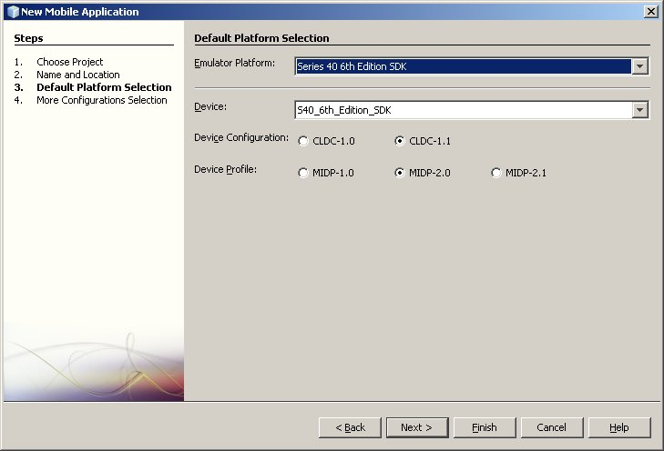
Creating a MIDP Project (2)
Select a SDK
Change CLDC and MIDP versions if needed
Click Next if you need additional configurations
Click Finish to complete the “New Mobile Application” creation
Notes:
This screen of the wizard allows you to choose an SDK for your application. A simple explanation is given in the description pane (see slide) for the template currently selected in the list.
To create a project for the S40 Platform, select the “Series 40 xx Edition SDK”. Device will be updated automatically according to the emulator platform. If you used for example Wireless toolkit for the Emulator platform, you can also select device (grey/color phone etc.).
You can also select what device configuration and profile are used. They can be changed at anytime from project properties.
Click ”Next” if you need to add additional configurations (usually you don’t).
Click ”Finish” to complete the new Mobile Application creation.

Slide 51
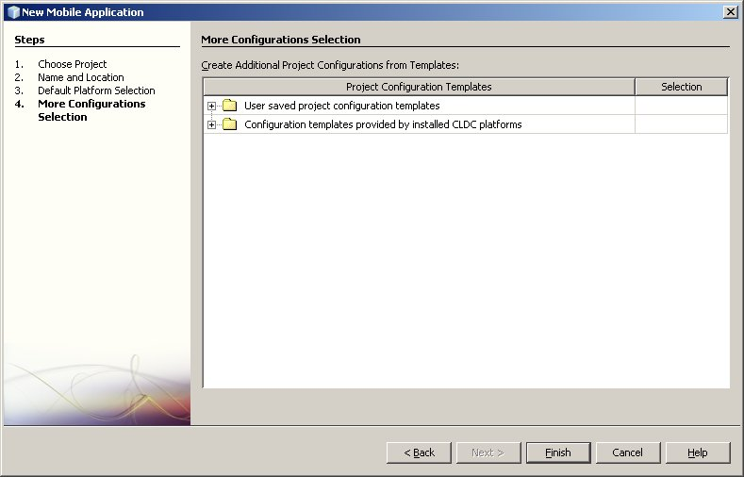
Creating a MIDP Project (3)
In case you need additional configuration, select one from the list
Click Finish to complete the “New Mobile Application” creation
Notes:
This screen allows you to add some additional configurations from the templates to your project.
To add configurations, expand the tree. This lists the configurations that are available.
Expand the configuration that you need. Configuration is added with marking it from ”Selection” column.

Slide 52
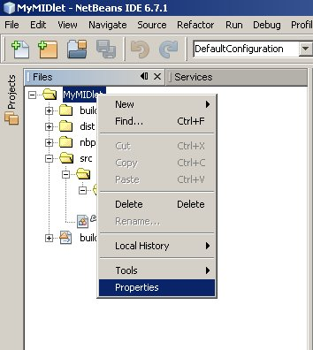
Configuring the emulator platform (1)
A “Configuration” needs to be defined to run the application in the emulator (usually this is done during project creation)
Select the project name in the “File Explorer” or select “File” → “Project Properties”
Right-click and select “Properties”
Notes:
Before you can test your MIDlet in the emulator, you must have valid emulator platform selected for your project (this is done already when you create a new project). You will need to change the emulator platform when for example you just tested that S40 works fine and want to be sure that S60 does that too. Let’s go through how to handle several platforms.
Right click on your MIDlet name and select “Properties”. Or from menu, choose “File” → “Project Properties”.

Slide 53
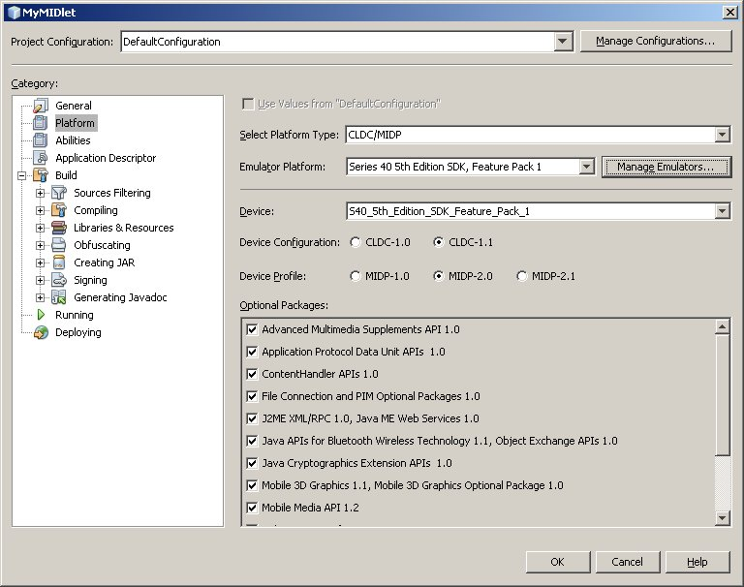
Configuring the emulator platform (2)
Select the emulator platform from list
Device field will be updated automatically according to emulator
Press the “Manage Emulators…” to install new emulator platforms
Ensure the correct emulator is selected
Press “OK”
Select emulator platform
Manage emulators
Notes:
This screen displays the settings for your project. You can see that there is quite a lot of settings that you can configure. Information, like MIDlet name and version can be found from ”Application Description” and they are easy to modify.
In this case, select ”Platform” from Category.
Select emulator platform from Emulator Platform (see image above). This will update the device field below the emulator platform. Usually when you are using manufacturer SDKs, there is one device available. However, if you are using generic emulator like Wireless Toolkit provides, you can select what kind of emulator you want to use (color/grey display etc.).
If you need to change used Device Configuration or Profile, all you have to do is to change the selections (see image)
If you can’t see the needed SDK in the Emulator Platform list, click ”Manage Emulators” button on the right side. This will open ”Java Platform Manager” screen
Click ”Add Platform” from the bottom-left corner to start ”Add Java Platform” wizard
Select ”Java ME MIDP Platform Emulator” and click ”Next” to start SDK scanning
Select the SDK that you want install and click ”Next”
You will see ”Detected platforms” screen. Make sure the SDK is selected and click ”Finish”
Click ”OK” and NetBeans will change the platform

Slide 54
Editing Files
Double click source file node in “Project Explorer” view
A new editor window opens in the editor area containing file contents
Edit file “as usual”
Note: NetBeans checks code during editing: If You write code that wouldn’t compile, you will see instant error indicator (lines are underlined with red colour). Also, light bulb may appear to the left side of the line. It has a suggestion how to fix the line.
Notes:
Editing of files in NetBeans is very straightforward. In the “Files” view, double click on a source file node that you want to edit. A new editor window opens in the editor area containing the file contents. Edit the file as “usual”; i.e. as you would using any other standard text editor.
During editing, NetBeans checks the code that you are writing. For example, if you write code that can throw an exception without handling the exception, you will see error indicators immediately. Often you will also see a light bulb appearing to the left side of the line. It contains suggestions how to fix the line. You can see suggestions by left-clicking the bulb. In this case, it would suggest to ”Add throws clause for java.io.IOException”, or to surround statement/block with try-catch. Select one of the suggestions and NetBeans will do it automatically.

Slide 55
Compiling a Project
In NetBeans, code is checked for common mistakes during editing
To compile all the classes in the project, select “Run” -> “Build Main Project”, or click “Build Main Project” icon, or press F11
This will then create the .class files for your project. You can find these files under “build” folder

Slide 56
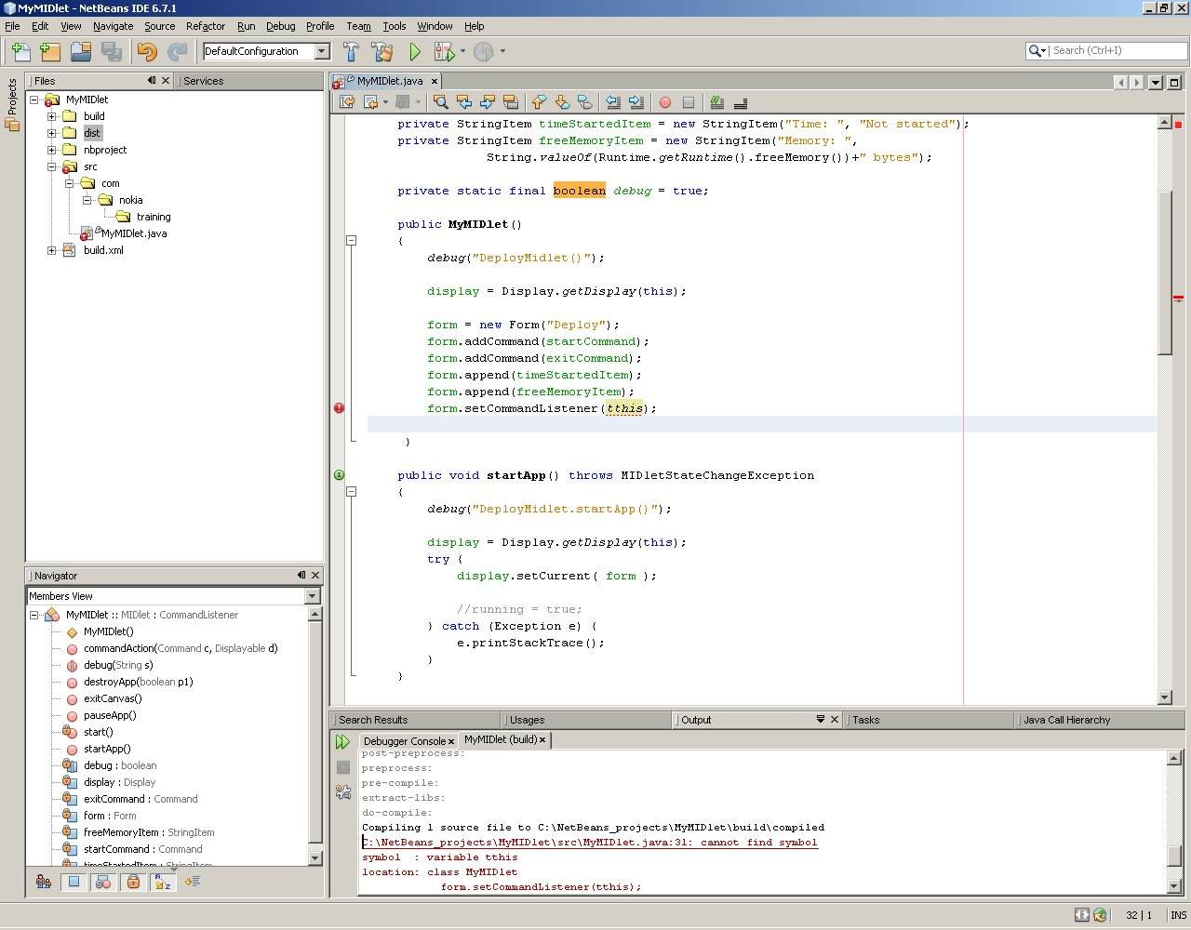
Compilation Errors
Error icon indicating specific error
Error icons indicating error(s) in a resource
Error bar
Click on rectangle to ‘jump’ to error
Errors also shown graphically in “Files” view and editor windows by error icons
Build failures described in “Output” view
Notes:
If you have compilation failures in your project then you must fix them. The errors will all be described in the log that was output to the Problems view during the compilation. This will tell you the file and line number the error occurred on along with a reason for the error.
Errors are also indicated, and can be located, using the graphical error icons. These are used to indicate whether an error is present in a particular resource.
To show how to track an error, using this graphical approach, let us look at the example on the slide. First look at the “MyMIDlet” project node in the “Files Explorer” view. This has an error icon associated with it so there are error(s) in the project.
Expand the “MyMIDlet” project node to view its child nodes. At least one of these nodes will have an associated error icon indicating there are error(s) associated with that resource. The “src” folder node is the resource with the associated error icon and so contains the error(s).
Expand the “src” folder node to view its child nodes. Like before at least one of these nodes will have an associated error icon indicating there are error(s) associated with that resource. In this case, it is the MyMIDlet.java source-file node that contains the error(s).
You can repeat this procedure and expand the MyMIDlet.java source-file node to find which method(s) the error(s) occurred in. In any event, the next stage is to open the source file MyMIDlet.java by double clicking on the source-file node or a method node with an associated error icon. This will open an editor window containing the contents of the file.
The error bar is the area immediately to the right of an editor window’s vertical scroll bar. It works in conjunction with the scroll bar to show the location of all the errors in the file. Each error is represented by a red rectangle. Clicking on a rectangle causes the editor window to jump to the part of the file where the error is located.
The editor window also displays an error icon in the marker bar for each line of the file on which an error occurs. The marker bar is located to the left hand side of the editor window. In addition the line itself on which the error occurs is underlined in red.
If you move the mouse pointer over an error icon in the marker bar or an error rectangle in the error bar, the reason for the error (as described in the build log) will be shown as a tooltip.
Note: Error indicators described at the right side of image would have indicated this error immediately after incorrect line was written (except build failure indicator that displays errors during compilations).

Slide 57
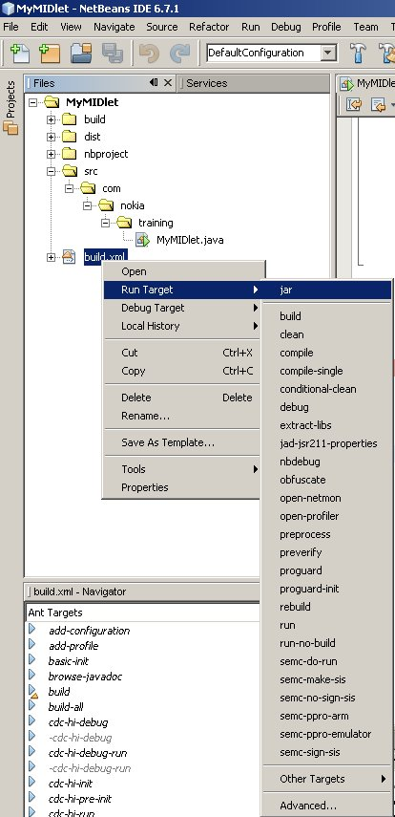
Pre-verifying and Packaging a MIDP Application
MIDP Projects can be pre-verified and packed into a JAD and JAR file by using NetBeans
Do this by right-clicking the build.xml file from the “File Explorer” and selecting “Run Target” → “jar”
Under “dist” folder you can now found the JAD and JAR files
Note: NetBeans creates folders compiled, preprocessed, preverified and preverifysrc under ”build” folder. These contains compiled class files

Slide 58

Running in the emulator
Run Project: Select Run Main Project, or press F6
Debug: Select Debug Main Project, or press Ctrl+F5
The emulator will launch
If you selected Debug then debugger will start
Build
Clean&Build
Run
Debug
Profiler
Notes:
Once you have fixed all your errors and built your project successfully you can now test your application out. The simplest way to test your application is to use the emulator that comes with an SDK. There are two choices available:
Run the application in the emulator. Select the “Run -> Run Main Project” menu item. You can also run the application by clicking run icon or just press F6. This is to select the configuration to start the emulator without the debugger.
Debug the application in the emulator. select the “Debug -> Debug Main Project” menu item. You can also debug the application by clicking debug icon or just press Ctrl+F5. This is to select the configuration to start the emulator and the debugger.

Slide 59
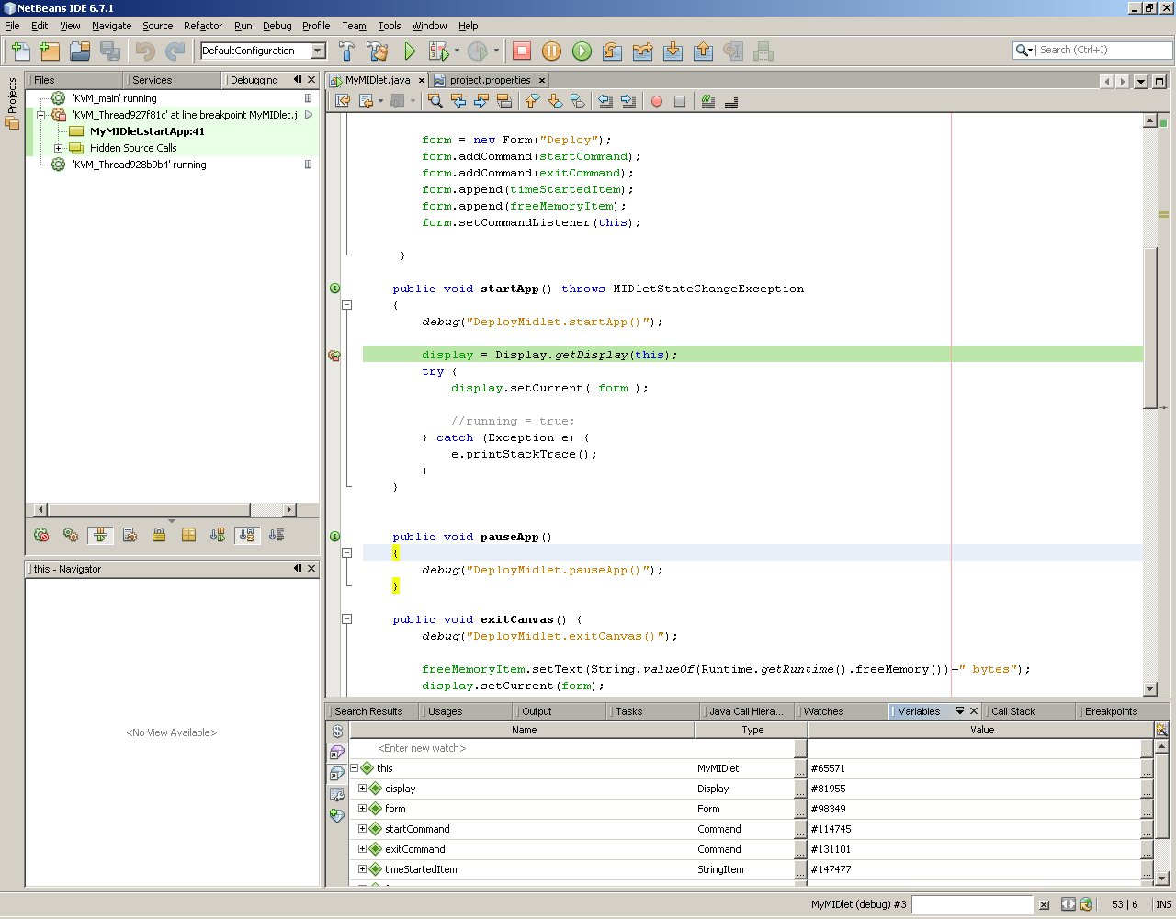
Debugging with NetBeans
Use “Debug” view toolbar to step through code
Suspended application thread
“Variables” view displays descriptor contents
Click in margin to set/remove breakpoints
You can select displayed windows from “Window” → “Debugging”
Editor file highlights location of next line of code to execute
Notes:
Once the debugger has started, NetBeans automatically switches to the Debug perspective. This perspective displays views that are useful when debugging an application.
In order to debug code you must place a breakpoint somewhere in your code. This is done by clicking in the marker bar (to the immediate left of the editor window) alongside the line of code where you want to place the breakpoint. A red square appears to indicate that a breakpoint has been set. To remove a breakpoint click on the breakpoint icon in the marker bar.
When the breakpoint you set has been reached by the execution flow, the debugger will halt execution of your application and focus will switch from the emulator to the NetBeans IDE. The line of code that is next in line to be executed is highlighted in green in the editor window.
When the debugger halted execution of your application, it suspended your application’s thread of execution. This is shown in the Debug view which contains a list of all the Java threads running under the emulator. One of the thread nodes in the list is marked “Suspended”; this is your application’s thread.
Under your application’s thread node there are a number of child nodes which form the call stack for the thread. Each child node represents a stack frame in the call stack.
The Debug view also has a debugging toolbar that provides a number of useful functions including:
Resuming thread execution.
Stepping through the code.
Terminating the debug session.
You can select what views are available from “Window”→ “Debugging”.
Note that when you finally terminate your debug session, the NetBeans IDE automatically switch back to the Java perspective.

Slide 60
Deployment Process
Build and Test your MIDlet with emulators supplied with the Nokia SDK
Create code using IDE, e.g. NetBeans
Test using Nokia SDK emulator
Package and deploy using NetBeans
Deploy to the target device via:
Bluetooth
IrDA
Serial Cable
OTA
Test and Profile on the target device

Slide 61
Deploying to a Physical Device
You must test your MIDlet on all the target devices that you wish to support
Many ways to get the MIDlet to the target:
Use deploy configurations of the NetBeans:
Nokia PC Suite
FTP
Device Anywhere Remote Device Deployment etc.
Use FTP and OTA
Use Bluetooth
Use Nokia PC Suite
Use system tools like Windows IrDA or Linux tools:
IrDA tray icon on Windows
OpenOBEX tools on Linux
Notes:
Deploying to a physical device can be done with a several ways:
Use Deploy configuration of the NetBeans.
Select “File” → “Project Properties”. Configure “Deploy“ settings to suit your needs.
Right click your project’s build.xml. Select “Run Target” → “Deploy”. Deploy option might be under “Run Target” → “Other Targets” depending on your configurations
Build JAD and JAR files and manually transfer them to a physical device
Use FTP for uploading the files to a server and OTA (Over-The-Air) for the installation
Use Bluetooth or IrDA to send the files to a device
Use Nokia PC Suite to installation. You can use Bluetooth, IrDA and Serial Cable connections
Note: OTA installation can be done by entering the URL address of the JAD file to a web-browser of the device. Make sure that the JAR file described in JAD file can be found.

Slide 62
Nokia PC Suite (1)
You can use Nokia PC Suite to create connection to device:
IrDA connection
Bluetooth connection
Serial cable connection
Once the connection is made, you can install applications to device via PC Suite “Application Installer”
You can also configure NetBeans to use PC Suite for deploy
Notes:
Nokia PC Suite allows you to create connection in a various ways. With Nokia PC Suite you can for example write and read text messages, synchronize calendar, share files etc.
In this course, we will only look at how to configure NetBeans to use the Nokia PC Suite to deploy applications directly.

Slide 63
Nokia PC Suite (2)
Use Nokia PC Suite to deploy the MIDlet:
First create connection to device via Nokia PC Suite
Then select “File” → “Project Properties” → “Deploying” from NetBeans
From “Select Deployment Method” select “Nokia Terminal connected via PC Suite”
Press “Manage Deployment”
Select “Nokia Terminal connected via PC Suite” and press “Add instance”
From the right side, select “Deploy to the selected devices” and left click your device from a list. This adds your device to selected list.
Press “Close”
Check that your deployment is selected in “Deployment Instance” and press “OK”. Now you can use “Run target” → “Deploy” to instant installation

Slide 64
OTA
If you want your users to be able to install your MIDlet from a network you need to test OTA
Configure your server MIME types:
application/java-archive
text/vnd.sun.Java ME.app-descriptor
Make sure your JAD file contains these attributes:
MIDlet-Name: Example
MIDlet-Vendor: Forum Nokia
MIDlet-Version: 1.0
MIDlet-Jar-Size: 25798
MIDlet-Jar-URL: http://myserver/MyMIDlet.jar
MIDlet-1: Example, , Example
Notes:
Remember that each Java ME enabled device has a Java Application Manager (JAM) that will handle the installation and the JAM uses the information in the JAD file to control its operations.
To ensure that an application can be installed via OTA, it must include specific attributes in its JAD and manifest file:
MIDlet-Name: The name of the MIDlet suite. The value of this attribute must match the value of the same attribute contained within the manifest file of the downloaded JAR.
MIDlet-Vendor: The vendor of the MIDlet suite. The value of this attribute must match the value of the same attribute contained within the manifest file of the downloaded JAR.
MIDlet-Version: This attribute is used to check if there is a newer version of the application available. If an older version of the MIDlet is already installed, notification about updating can then be provided. The value of the attribute must match the value of the same attribute contained within the manifest file of the downloaded JAR.
MIDlet-Jar-Size: Since the JAM has to check the amount of free space and memory available on a device to ensure an application can be installed, the attribute MIDlet-Jar-Size must be included in the JAD file. However, the actual memory required may be larger or smaller depending on the device, and so this value is only actually used as a hint to the JAM. This value is also used to check that the received JAR file size matches the size specified in the JAD.
MIDlet-Jar-URL: To be able to locate the JAR file for the MIDlet suite, the JAM uses the MIDlet-Jar-URL attribute.
MIDlet-1: Name, icon and main class of MIDlet
Note. A simple way to set up the MIDlet-JAR-URL attribute is to keep the JAR file and the JAD file in the same directory, that way you only need the name of the JAR file for the MIDlet-JAR-URL entry like:
MIDlet-Jar-URL: mymidlet.jar
Finally, the default install folder is the Applications folder. If, for example, if you are deploying a game you can control where to install the MIDlet by adding an entry like this to your JAD:
Nokia-MIDlet-Category: Game
This will install the MIDlet in the Game folder on the target.
Now, in order to successfully test out OTA provisioning -- which will most likely be the method your end-users use to install MIDlets -- you'll need to set the web server MIME types correctly for your web server. The following MIME types should be set:
.jad text/vnd.sun.Java ME.app-descriptor
.jar application/java-archive

Slide 65
OTA
Tip: If you can’t deploy from the Internet then your gateway provider may have set an arbitrarily small MIDlet download size on their gateway.
Tip2: Upload the JAD and JAR to same folder in the server. This way you don’t have to keep http address in the JAD file. In this case, it would be just MIDlet-Jar-URL: MyMIDlet.jar

Slide 66
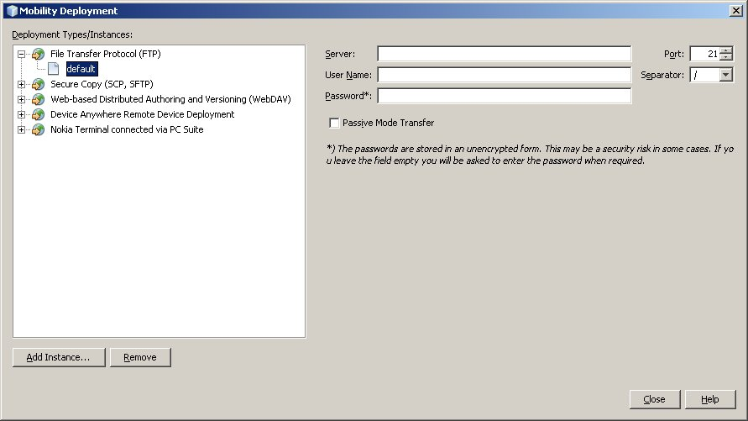
OTA with NetBeans
NetBeans can automate deploying MIDlets to the web server via FTP

Slide 67
Using OTA
Point your target device to the URL to install
http://your company/yourmidlet.jad
Point to the JAD file not the JAR
Some network operators have small JAR file limitations on the gateway so if your MIDlet won't install that could be the problem
Default installation folder is Applications
You can control location by using Nokia-MIDlet-Category directive in the JAD file
To install a MIDlet in the Game folder configure the JAD file like this:
Nokia-MIDlet-Category: Game

Slide 68
Debugging on the Target
Write methods to trace execution on the target
Have a method that deals with a debug messages:
public static void debug(String string) {
if (debug) {
//output string
…
}
}
Call the debug method throughout the code
public void myMethod() {
debug(“calling myMethod()”);
...
}
Notes:
Now, debugging with the emulator can help with logic and design errors, but what happens if you have problems with the MIDlet once it's on the device? One method of doing this is to write test cases and insert code into the MIDlet itself.
Simply add code like:
public void myFunc() {
debug(“calling myFunc”);
// some useful stuff
}
throughout your code and you've got and an easy way to trace the execution on the target to determine where the trouble spots are occurring.
The debug flag can be controlled either as a resource property or even more simply as a static flag that can be turned on or off. Also, you can write a test harness that validates all your assumptions and run these test cases to find out if they pass on the target. Typically called unit testing, you can either role your own test harness or use the Java MEUnit which does the same thing as JUnit which most java programmers are already familiar with.

Slide 69
Developing and Deploying MIDP Applications Summary
The MIDP Development Process consists of the following steps:
Development the code using the MIDP SDK
Compile the .java files into .class files
Run the Pre-verifying tool on the .class files
Package the application by creating a JAR and JAD tool
Most of the build phases are automated in NetBeans
MIDP applications can be deployed to physical devices using
OTA
Bluetooth
Infrared
Serial Cable

