Slide 1
Module 2 High Level UI API
Standard Java ME UI components: Screen, Form, TextBox, Alerts
Notes:
This document is licensed under the Creative Commons Attribution-Share Alike 3.0 License.
For more information, see http://creativecommons.org/licenses/by-sa/3.0/ for the full terms of the license.

Slide 2
High-Level UI API
GUI Components for creating user interfaces
Portable across MIDP compatible devices
Same look and feel
Very little control over look and feel
All high-level controls are Displayables and they are subclasses of the Screen class
Your application should create new instances of or extend the provided Screen classes like Form and Alert
This ensures you application has a consistent user interface throughout
Displayable
Screen
Canvas
Alert
Form
List
TextBox
GameCanvas
Notes:
MIDP defines two different ways to interact with the user: the screen and the canvas. Whereas screens implement high-level APIs that define how the user interface components look on the device and thus are portable, the canvas is a low-level API, is non-portable and provides the developer with almost complete control over how the user Interface appears. The canvas is particularly geared towards rich applications such as mobile games.
Screen is a common superclass of all high-level user interface classes. Subclassess defines the contents
that are displayed and their interaction with the user.
The application may change the contents of a Screen object while it is shown to the user by using
subclass-defined methods, like List.append(string,image).
If this occurs when the Screen object is visible, the display will be updated automatically.
Example: List object is currently displayed, and every element of the List is visible.
Application inserts a new element at the beginning of the List
It is displayed immediately, and the other elements will be rearranged appropriately
There is no need for the application to call another method to refresh the display.
UI5 - The application’s user interface should be consistent throughout, e.g. common series of
actions, action sequences, terms, layouts, soft button definitions and sounds.
To make sure your application screens, error messages etc have a consistent UI, you should
create new class by extending Form/Alerts with the chosen layout for your application. You can
then use/extend these new classes to create the elements in your application. Use static final
constants for terms, soft button definition and sounds. This way, you can use these throughout
your application consistently.

Slide 3
Displaying Controls and appending items to controls
Get the current display and set the current display to your control
Display display = Display.getDisplay(midlet);
Form form = new Form(“MyForm”);
display.setCurrent(form);
Create list control and add items to it
List list = new List(“My List”, Choice.IMPLCIT);
list.append(“first”, null);
list.append(“second”, null);
list.append(“third”, null);
display.setCurrent(list);
Notes:
Constructing a component using the high-level API is straightforward. The important thing to remember that there can only be one current component per screen unless you are using a Form and form items to show multiple components. Also, all high-level components are located on the javax.microedition.lcdui package so you need to import that package to use the controls.
Here's an example of how to grab the current display and set it to your component:
class MyMIDlet extends MIDlet {
Display display;
void init() {display = Display.getDisplay(this); }
Once you have the display, you can use the object to set the current display to a control that you want to display. For example:
void showAlert() {
Alert alert = new Alert(“Alert”);
alert.setType(AlertType.ERROR);
alert.setString(“*****ERROR*****”);
display.setCurrent(alert); } // set the current display
And that's it! Once you do that your control will be displayed as the current screen.
Appending Items to a control
Certain controls – namely list boxes and choice controls – allow the programmer to attach items for the control to manage. Here's a code snippet that shows how to attach items to a list control:
void shotList() {
list = new List(“My List”, Choice.IMPLCIT);
list.append(“first”, null);
list.append(“second”, null);
list.append(“third”, null);
display.setCurrent(list); }
Now, the user has 3 options to choose from.

Slide 4
Setting CommandListener to a control
Define the MIDlet to implement the CommandListener
class MyMIDlet extends MIDlet implements CommandListener
Create a control and set the CommandListener
class MyMIDlet extends MIDlet implements CommandListener {
…
List myList = new List("MyList", List.EXCLUSIVE );
myList.setCommandListener( this );
…
}
Notes:
Setting a command listener to a control
In the previous example, we demonstrated how to append items to a list. How do you determine which item was selected by the user? As with menu event handlers for screens, this is accomplished through the implementation of the CommandListener interface. The following example shows how easy it is for the list control to dispatch selection events:
class MyMIDlet extends MIDlet implements CommandListener {
List list;
Display display;
// code ommitted for setting the display object
public void commandAction(Command c, Displayable d) {
List l = display.getCurrent();
switch(l.getSelectedIndex()) {
case 0: break; // first
case 1: break; // second
}
}
The only thing that you need to be aware of with the above example is that you make sure you process any menu commands attached to the screen as well. For example:
Command backCommand = new Command(“Back”, Command.BACK,0);
public void commandAction(Command c, Displayable d) {
if (c == backCommand)
// go back to last screen
else
List l = display.getCurrent();
switch(l.getSelectedIndex()) {
case 0: break; // first
case 1: break; // second
}
}

Slide 5
Screen Types
Two types of screens for the high-level API
Simple screens that show one control at a time
Complex screens called Forms that can group controls together
Only one type of screen can be shown at a time on the display
This screen should only be displayed for the time necessary to read its information
You should try to limit the number of screens that the user has to browse through
Try to combine information on screens with limited content
Notes:
UI2 - Each screen must appear for the time necessary to read all its information
The developer, depending on the nature of the usage, should decide how long a screen should be displayed for.
UI12 - The number of screens a user has to browse through must be minimal
Minimizing the number of screens means the user is less likely to get lost within the application. There are a number of ways in which you can keep the number of screen the user has to page through to a minimum. On way is to try to combine the information on multiple screens with limited content. Another idea is to implement shortcuts in your application, which take the user directly to the main areas of the application, without having to trawl through menus and other screens.

Slide 6
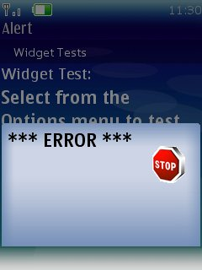
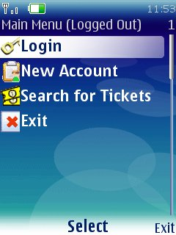
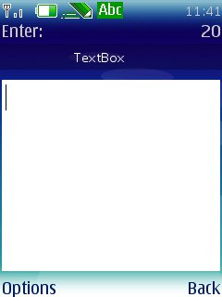
Simple Screens
Use them for simple user input
Alert
List
Textbox

Slide 7
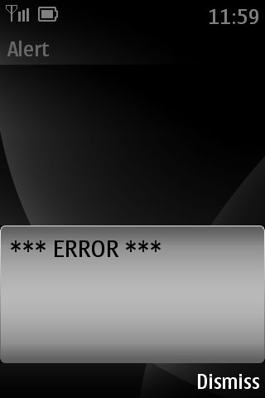
Alert
Use the Alert control for notifications
Alerts are like modal dialogs and can close themselves with a timeout
They are particularly useful for displaying error messages
Alert alert = new Alert(“Alert”);
alert.setType(AlertType.ERROR);
alert.setString(“*** ERROR ****”);
display.setCurrent(alert);
Ensure the error message is clearly understandable
Use human-readable language
Use precise descriptions and constructive advice
Notes:
Alert
Alerts now have the ability to attach custom commands and progress/activity indicators. The following code illustrates how to attach a custom command and an activity gauge:
Alert alert = new Alert("Title","Message",null, null);
alert.setTimeout(5000);
Gauge indicator = new Gauge(null, false, Gauge.INDEFINITE, Gauge.CONTINUOUS_RUNNING);
alert.setIndicator(indicator);
alert.addCommand(okCommand);
alert.addCommand(backCommand);
alert.setCommandListener(this);
display.setCurrent(alert);
In the above example, note the use of the , Gauge.INDEFINITE, Gauge.CONTINUOUS_RUNNING flags which are new to MIDP 2.0 as well. This flags indicate that the gauge does not have an endpoint to the activity and are typically used in conjunction with user determined activities such as the Alert above.
UI9 - Any error messages in the application must be clearly understandable. Error messages must clearly explain to the user the nature of the problem, and indicate what action needs to be taken (where appropriate).
As the slide explains, you can use an Alert to display an error message. To make the error message clearly understandable set the Alert type to be AlertType.ERROR. This way, the implementation will know to display a box that represents an error. Set the title of the alert to be something relating directly to the problem and ensure the text of the error provides constructive advice using a human-readable language (not obscure codes) and precise description of the problem.

Slide 8
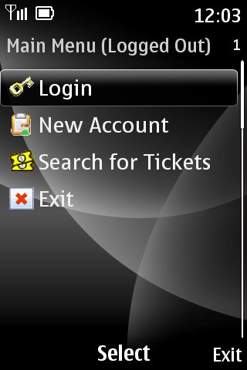
List (1)
Use List controls to display choices to the user
List list = new List(“Main Menu”,
Choice.IMPLICIT);
list.append(“Login”, image1);
list.append(“New Account”, image2);
list.append(“Search for Tickets”, image3);
list.append(“Exit”, image4);
display.setCurrent(list);
Notes:
List
A List control now has the ability to set the selected command which will be the default when the List is first instantiated. This allows for flexible command handling than using List.SELECT_COMMAND and now MIDlets can define command dispatchers more cleanly. This is valid for implicit lists and the code could like this:
List list = new List("Title", Choice.IMPLICIT);
list.setCommandListener(this);
Command defCommand = new Command("Default", Command.ITEM, 1);
list.addCommand(defCommand);
list.setSelectCommand(defCommand);
// now can define event dispatch
public void commandAction(Command cmd, Displayable d) {
int selIdx = ((List) d).getSelectedIndex();
if (cmd == defCommand) { // do something with selIdx
}
}
If a text item in a List is too long to fit on a single line, we now have policies that we can use that indicate how we wish to manage the items thereof. We can either choose to wrap the text or use the default mechanism:
list.setFitPolicy(List.TEXT_WRAP_ON);// wraps text
Next, we can now set different fonts for elements within a list. The code to do this looks like this:
// Get a new font with only the style differing from default font
Font newFont = Font.getFont(list.getFont(0).getFace(), Font.STYLE_BOLD | Font.STYLE_ITALIC, list.getFont(0).getSize());
for (int i = 0 ; i < list.size() ; i++) {
// some boolean array that determines if we use the new font
if (!fontStyle[i]) {
list.setFont(i, newFont);
}
}

Slide 9
List (2)
Implement CommandListener interface to dispatch list events
public void commandAction(Command c, Displayable d) {
List list = (List)display.getCurrent();
switch(list.getSelectedIndex()) {
case 0: break;
case 1: break;
}
}

Slide 10
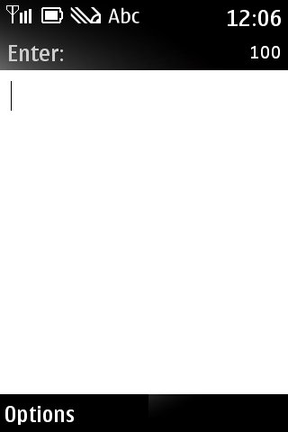
TextBox
Use the TextBox control to accept user input
TextBox textBox = new
TextBox(“Enter:”,””,100,TextField.ANY);
display.setCurrent(textBox);

Slide 11
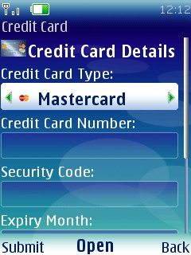
Complex Screens - Forms
Form class acts as a container for form items.
Form Items:
TextField
StringItem
DateField
ImageItem
Gauge
CustomItem
ChoiceGroup

Slide 12
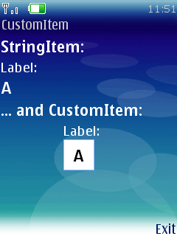
CustomItem
Customizable by subclassing to introduce new visual and interactive elements into Forms
Subclasses are responsible for
Visual appearance (sizing, rendering, colors etc.)
User interaction mode by responding to events generated by keys, pointer actions, and traversal actions
Calling Item.notifyStateChanged() to trigger notification of listeners that the CustomItem's value has changed.
Notes:
Custom Items
Finally, if you are completely dissatisfied with the widget elements provided with MIDP 2.0, you are free to implement your own owner-drawn items which sublass CustomItem. The complete visual appearance and user interaction is completely implemented and defined by the programmer so now there is virtually limitless design freedom when it comes to designing MIDP user interfaces. The programmer must override the getMinContentHeight(), getMinContentWidth(), getPrefContentHeight(), and getPrefContentWidth() methods to tell the MIDlet how to respond to size changes. In addition, sizeChanged() and paint() must also be implemented and when the MIDlet needs to redraw the CustomItem, it needs to call invalidate() method to force a repaint. If the CustomItem wishes to dispatch events then it can also implement the ItemListener interface and the implement the notitfyStateChanged() method
class MyCustomItem extends CustomItem
public CustomItem (String string) {
this.super(string);
}
ing getMinConentHeight() {
// return min height
return HEIGHT/2 – 138;
}
int getMinContentWidth() {
// return min width
return WIDTH/2 – 150;
}
int getPrefConetntHeight(itnt width) {
return WIDTH/2;
}
int getPrefContentWidth(int height) {
return HEIGHT/2;
}
void paint(Graphics g, int width, int height) {
int x = (WIDTH - 150) / 2;
int y = (HEIGHT - 138) / 2;
g.setClip(x, y, 150, 138);
drawMenuTitleBackground(x, y, 150, 138);
g.setFont(canvasFont);
g.setColor(LIGHTGREEN);
g.drawChars(TEXT, 24, 6, x + 10, y + 5, 20);
g.setColor(RED);
g.fillRect(x + 2, y + 22 + 20 * menuEntry, 146, 15);
g.setColor(WHITE);
g.drawChars(TEXT, 11, 6, x + 30, y + 25, 20);
g.drawChars(TEXT, 17, 7, x + 30, y + 45, 20);
}

Slide 13
Form Layout
Forms have layout control
In MIDP 1.0 only horizontal layout
In MIDP 2.0
LAYOUT_BOTTOM
LAYOUT_CENTER
LAYOUT_RIGHT
LAYOUT_LEFT
And so forth

Slide 14
Displaying Form Items
Displaying items on a form is easy
Form form = new Form(“form);
StringItem item = new StringItem(“text”,”text”);
form.append(item); // display it
Removing items on a form is easy
form.delete(0); // delete first item
form.deleteAll(); // delete them

Slide 15
Form Items - TextField
Use TextFields to accept user input as text
TextField textField = new TextField(“TextField Label”,”some text”,20,0);
form.append(textField);
Accepts characters depending on default device language
Input constraints can be applied when constructing a TextField by selecting on of the following:
TextField.ANY - The user is allowed to enter any text.
TextField.EMAILADDR - The user is allowed to enter an e-mail address.
TextField.NUMERIC - The user is allowed to enter only an integer value.
TextField.PHONENUMBER - The user is allowed to enter a phone number.
TextField.URL - The user is allowed to enter a URL.
TextField.DECIMAL - The user is allowed to enter only a decimal value.
Notes:
SE3 - The application must not echo the input of sensitive data, e.g., pins and passwords
Your application should use the TextField class for password input box. To ensure the TextField does not echo the input of sensitive data, you should set the value of the input constraints parameter to TextField.PASSWORD
LO2 - Data entry fields must accept and properly display International characters.
TextField supports all input modes available in native text editing. The default input mode is set dependent on the user interface language of the device. In MIDP 2.0, you can use the setInitialInputMode method to define the active input mode, however, this is only a hint to the implementation.

Slide 16
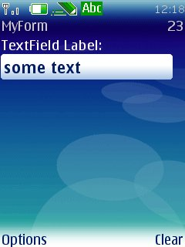
Form Items - TextField
You can also set following additional constraints:
TextField.PASSWORD - The text entered must be masked
TextField.UNEDITABLE
TextField.SENSITIVE
TextField.NON_PREDICTIVE
TextField.INITAL_CAPS_WORD
TextField.CAPS_SENTENCE
To set constraints after constructing, use setConstraints method
Notes:
SE3 - The application must not echo the input of sensitive data, e.g., pins and passwords
Your application should use the TextField class for password input box. To ensure the TextField does not echo the input of sensitive data, you should set the value of the input constraints parameter to TextField.PASSWORD
LO2 - Data entry fields must accept and properly display International characters.
TextField supports all input modes available in native text editing. The default input mode is set dependent on the user interface language of the device. In MIDP 2.0, you can use the setInitialInputMode method to define the active input mode, however, this is only a hint to the implementation.

Slide 17
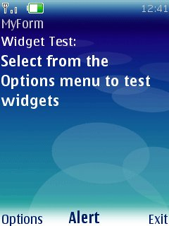
Form Items - StringItem
Use StringItem to display static text
String str = “Select from the Options menu to test widgets”;
StringItem stringItem
= new StringItem(“Widget Test:”, str);
form.append(stringItem);
Notes:
Items
All items now allow individial event listeners to be attached directly to the form item. Items can now also modify the labels in addition to the textual content after the Item is created. The following code shows how to attach a listener to a StringItem, which new Item in MIDP 2.0 that allows for non-textual descriptors to be placed on a Form:
StringItem stringItem = new StringItem(“Here”, “There”, Item.BUTTON);
stringItem.setDefaultCommand(new Command(“There”, Command.ITEM, 1));
stringItem.setItemCommandListener(myItemCmdListener);
StringItems and ImageItems now also have new appearance modes: PLAIN, BUTTON and HYPERLINK. The above example constructs a SringItem to appear as a button and attach a command to that button that is activated when the button is pressed.

Slide 18
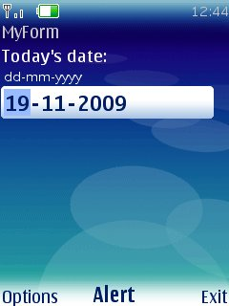
Form Items - DateField
Use DateField to display dates
DateField dateField = new DateField(“Date:”, DateField.DATE);
java.util.Date date = new java.util.Date();
dateField.setDate(date);
form.append(dateField);
Displays the date in the correct format for default device time zone
Notes:
LO1 - Data format must be handled appropriately for the targeted country
Always use the DateField class for displaying/entering dates and times. This is especially useful when thinking about localisation, as when using the DateField class, the date is displayed correctly for the default time zone of the device the application is running on.

Slide 19
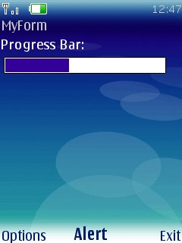
Form Items - Gauge
Use Gauge to display values in a range as a bar graph if non-interactive or ascending arc if interactive
Use setValue() to change the position of the current level in the bar graph
Useful for displaying progress screens
// 2nd parameter determines if
// interactive or not
Gauge gauge = new Gauge(“Progress Bar”,
false, 25, 10);
form.append(gauge);
Notes:
UI13 - Any selection of a different function in the application should be performed within 5 seconds. Within 1 second, there must be some visual indication that the function will be performed
A Gauge can be used to show progress. Your application should update the Gauge as parts of the task are completed, using the setValue method
UI13 - Any selection of a different function in the application should be performed within 5 seconds. Within 1 second, there must be some visual indication that the function will be performed
A Gauge can be used to show progress. Your application should update the Gauge as parts of the task are completed, using the setValue method

Slide 20
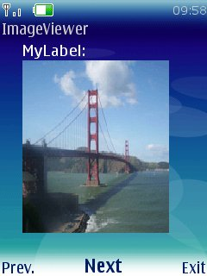
Form Items - ImageItem
Use ImageItem to display images on the Form
If you don't care about layout then you can append an Image directly
Image image = Image.createImage(“/sf.png”);
int pos = ImageItem.LAYOUT_CENTER;
ImageItem imageItem
= new ImageItem(“MyLabel”, image, pos, “alt”);
form.append(imageItem);
Notes:
Slide shows an example how to append ImageItem to a form.
To append the image directly to a form: form.append(image);

Slide 21
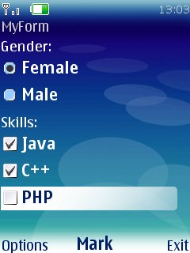
Form Items - ChoiceGroup
Use ChoiceGroup to present a selection of choices to the user
ChoiceGroup cg = new ChoiceGroup(“Gender”, ChoiceGroup.EXCLUSIVE);
gender.append("Female", null);
gender.append("Male", null);
form.append(cg);
Useful when displaying application settings
Provides a clear way to present the status of a setting
Two possible types:
ChoiceGroup.EXCLUSIVE – one selected at a time
i.e. radio buttons
ChoiceGroup.MULTIPLE - multiple number selected at a time
i.e. check boxes
Notes:
UI17 - The current status of each setting is clear: the application should make use of check boxes or by changing text.
As the slide shows, a ChoiceGroup can be used to display setting within your application. Check boxes can be implemented by, setting the type to Choice.MULTIPLE

Slide 22
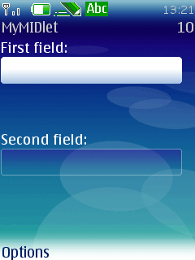
Form Items - Spacer
Use Spacers for non-interactive spaces to help position controls
Spacer space = new Spacer(10,20);
form.append(space);
Notes:
Spacers and Layout
One of the problems with MIDP 1.0 (especially dealing with Forms) was how to place Items on the screen in aesthetic manner. What was sorely needed was a way to space items and to lay items out according to different affinities. Both of these actions are now supported in MIDP 2.0. Spacers are non-interactive items that specify a minimum size in width and height. The new layout affinities such as LAYOUT_BOTTOM, LAYOUT_CENTER, LAYOUT_NEWLINE_AFTER aid in the positioning of form items in the most aesthetic manner. Here’s an example of how to use the new layout directives (see the image from slide to see how it looks in display):
Form form = new Form( "MyMIDlet" );
TextField textField = new TextField( "First field", "", 10, TextField.ANY );
textField.setLayout( Item.LAYOUT_2 | Item.LAYOUT_SHRINK | Item.LAYOUT_VSHRINK | Item.LAYOUT_RIGHT | Item.LAYOUT_TOP );
form.append( textField );
Spacer space = new Spacer( form.getWidth(), 50 );
form.append( space );
TextField textField2 = new TextField( "Second field", "", 10, TextField.ANY );
textField2.setLayout( Item.LAYOUT_2 | Item.LAYOUT_SHRINK | Item.LAYOUT_VSHRINK | Item.LAYOUT_RIGHT | Item.LAYOUT_TOP );
form.append( textField2 );
getDisplay().setCurrent( form );
Note that the MIDP 2.0 algorithm for item layout is done each row at a time and if an Item cannot fit on a row then a new row is created, so the directive Item.LAYOUT_2 instructs the layout manager to use this algorithm. For backwards compatibility, the flag directive Item.LAYOUT_1 could also be used.

Slide 23
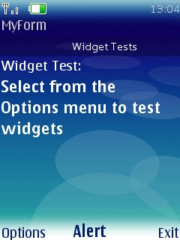
Form Items - Tickers
Tickers are scrolling text information that appears on the screen
You can attach a Ticker to any Displayable except Canvas
Form form = new Form(“MyForm”);
form.setTicker(new Ticker(“Widget Tests”));
Ticker
Notes:
Tickers are scrolling display items that you can attach to a screen item. Typically they are used to display some form of current information such as stock market price information. Tickers can be attached to screen item like this:
// using the same list examples
void setListTicker() {
list.setTicker(new Ticker(“a ticker tape));
}

Slide 24
Menus (1)
Menus can attach to screens.
Menu options created using Command object with the parameters:
Command label, e.g. “Exit”
Command Type, e.g. Command.EXIT
Command Priority, e.g. 0 (which means the command should be positioned to the top of the menu)
To implement a menu, implement the CommandListener interface
The CommandListener interface dispatches Command objects
Override the commandAction method and listen for Command events
Notes:
UI6 - Where the application uses menu or selection items, the function of the selection and menu items must be clearly understandable to the user. Further, each menu or selection item must perform a valid action (i.e. no menu orphans.)
When adding the command label, you should ensure it appropriate for the target audience. Ideally, the label of the selected command should be reflected in the title of the resultant screen. The order of commands must be considered in your application also. For example, the most relevant command for currenct application state should be at the top, while something such as an ”Exit” command should be at the bottom.

Slide 25
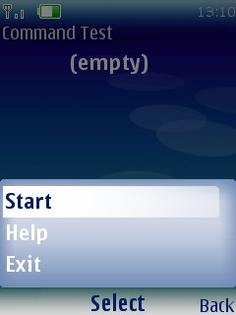
Menus (2)
Some uses of menus: Option to Display the Help or Exit the application
class MyForm extends Form
implements CommandListener {
Command exitCmd =
new Command(“Exit”, Command.EXIT, 2);
public MyForm() {
super(“Command Test”);
super.addCommand(exitCmd);
super.setCommandListener(this);
}
public void commandAction(Command c,
Displayable d) {
if (c == exitCmd)
exit();
}
}
Notes:
FN1 - An exit functionality is explicitly present in the application (e.g. in a Main Menu)
For every screen in your application, you should have a way to exit the whole application. This can be done by adding a Command with type Command.EXIT to each Form, Alert, Canvas etc. You must ensure that the ”Exit” functionality in your application calls destroyApp then notifyDestroyed. The destroyApp method must release all resources that your application has been using
UI4 - If applicable, the main functionalities of Exit, About and Help must be accessed easily through a Main Menu.
You can create a main menu using Commands

Slide 26
MIDP 2.0 additions to high-level UI
The high-level has added some new classes as well as improving on existing ones.
New classes Spacer, StringItem and ItemListener
New layout flags for better Form item placement
Appearance flags for StringItem and ImageItem
Items can now attach CommandListener
CustomItem allows the programmer complete control over how a Form item looks and acts
Lists can now set default actions
Set Fonts for elements in a ChoiceGroup and List
Notes:
Some new classes and improved functionality of the MIDP 1.0 classes have been added that dramatically improve programmer control over the high-level UI. Notably the following improvements have been made:
Ability to control backlight and vibrator
New methods for managing styles and colours including alpha values for colours
Methods to query preferred image dimensions for use in lists
Commands can implement short and long labels which are more aesthetic depending on the context of the where the command is used
Affinity identifiers that allow for more flexible layout of Form items
New classes StringItem, Spacer and CustomItem
New input constraints for TextBox class such as TextBox.PHONENUMBER and TextBox.DECIMAL and input modes for different character sets.

