Slide 1
Multi-Model Optimization for Multiplex Screen Scheduling and Revenue Management
Operations Research · Final Review
Group 14
Abhishek Karthik · CB.SC.U4AIE23010
Abhishek R · CB.SC.U4AIE23011
M P Mothiswaran · CB.SC.U4AIE23041
M S Bavesh Reddy · CB.SC.U4AIE23044
The final plan: 5 screens × 6 slots, colour = genre
Notes:
Welcome. We built a four-model Operations Research pipeline that plans a multiplex's week: which films to license, how to split screens by genre, which film plays where and when, and how to balance revenue against other goals. The tile pattern on the right is our actual final schedule for the week of 16 July 2014, coloured by genre.

Slide 2
The problem: four connected weekly decisions
1
Which films to license?
5
6
Weekly budget, 8–12 films, a content mix
How much capacity per genre?
screens (120–250 seats)
daily slots, 180 min each
2
Big screens should carry high-demand genres
3
Which film on which screen, when?
₹20 L
13
Runtime plus cleanup, no simultaneous duplicates
weekly licensing budget
schedulable films of 15 candidates
4
How to balance revenue with other goals?
Occupancy, prime-time variety, idle time, capacity plan
Project question Can we build a feasible one-day schedule that beats a popularity-based one, and what does each trade-off cost?
Why OR: picking only popular films ignores budget, capacity and variety, and the decisions interact, so no single model answers it.
Notes:
A multiplex manager faces four decisions every week and they are linked. Licensing decides what can be shown; screen capacity decides where blockbusters go; the timetable turns that into shows; and the manager also cares about occupancy, variety and idle screens, not just revenue. Our question is whether a chain of OR models gives a feasible plan better than the naive 'show the most popular films' plan, and what each trade-off costs. Setup: 5 screens of 250/180/180/120/120 seats, six fixed slots, a 20-lakh weekly budget.

Slide 3
Dataset: TMDB 5000, real metadata without sales
What the data has
4,803 films, 20 columns: popularity, vote counts and averages, runtime, release date, genres, languages, budget and revenue. After cleaning, 2,571 films from 1927 to 2016 remain.
What it lacks, so we declare it
No ticket sales, prices or weekly demand history. Theatre layout, prices, fees, slot factors, genre–slot affinity and the demand scale are declared synthetic assumptions, kept in one configuration. Revenue and occupancy are model estimates, not observations.
Cleaning steps released films only, at least 200 votes (drops low-information records), valid runtime and release date; popularity log-transformed and min–max scaled because raw values are heavily skewed. Zero budget or revenue means “not reported” and is not used.
Notes:
The dataset is the public TMDB 5000 movie dataset from Kaggle. It has real popularity, runtime, release date and genres, which is what we need to rank films and place them in time. It does not have ticket sales, so everything about the theatre and demand has to be an explicit assumption. We keep all of them in one config and test the important ones by sensitivity analysis. Cleaning takes 4,803 rows down to 2,571 usable films.

Slide 4
From metadata to tickets: the demand model
1 · Weekly effective demand
e = popularity × exp(−λ · weeks since release), λ = 0.55
about 42% of demand is lost each week
2 · Demand per show (persons)
D = scale × e × slot factor × genre–slot affinity
prime time and the right genre at the right hour sell more
3 · Capped by the screen
sold = min(D, seats); revenue = price × sold
spill = max(D − seats, 0) people are turned away
Worked example Lucy, 9 pm, 250-seat screen: demand 363 → 250 sold → 113 turned away → ₹70,000.
Calibration, fixed before any comparison: demand scale 650 gives average occupancy 36.6% (target band 35–45%) with spill present. It is never re-tuned, and later swept ±30%.
Notes:
This bridges real metadata to ticket demand. Effective demand is normalised popularity times an exponential decay in weeks since release, lambda 0.55. Demand per show multiplies in a slot factor and a genre-by-slot affinity, in persons. Crucially, seats sold are capped by the screen's capacity, so screen size matters, and the excess is spill. Example: Lucy at 9 pm has 363 demand, the 250-seat screen sells 250 and turns 113 away. The demand scale was calibrated once so average occupancy of the optimal schedule falls in a realistic 35 to 45 percent band, then frozen; we never tuned it to improve a result.

Slide 5
Methodology: a chain of four OR models
AHP weights
Demand model
weekly market, D, spill
Model 1
Knapsack (ILP)
Model 2
Transportation (LP)
Model 3
Assignment (ILP)
Model 4
Goal programming (MILP)
demand, fees, spill
licensed films
quota + preferred genre
timetable, R*
final schedule
Model | Question | OR technique | Course topic
1 | Which films to license? | 0/1 knapsack, binary ILP, LP relaxation | Integer programming, knapsack, capital budgeting
2 | Which screens for which genres? | Balanced transportation LP, duals (MODI) | Transportation, sensitivity analysis
3 | Which film, screen and slot? | Binary assignment ILP with side constraints | Assignment models
4 | How to balance the goals? | Weighted goal programming (MILP) with AHP weights | Goal programming, AHP with consistency check
Notes:
The whole problem is decomposed into four connected models, each answering one question and handing its output to the next. Model 1 chooses films with a knapsack integer program. Model 2 turns the licensed films into a genre quota per screen with a transportation LP. Model 3 builds the revenue-maximising timetable with an assignment-type integer program, using Model 2's preferred genre as a constraint. Model 4 is goal programming: it reconciles revenue with five other goals, and the goal weights come from AHP. Each hand-off is checked in code. The right-hand column maps each model to a topic from the course.

Slide 6
Model 1 · Knapsack: which films to license?
Decision yᵢ ∈ {0,1}: license film i
Maximise Σ vᵢ yᵢ, the daily revenue potential of one show per slot on an average screen
Licensed film | Genre | Fee (₹ k) | Value (₹ k/day)
Lucy | Action | 798.5 | 193.4
Dawn of the Planet of the Apes | Sci-Fi | 303.0 | 88.6
Deliver Us from Evil | Thriller | 263.0 | 67.7
How to Train Your Dragon 2 | Fantasy | 154.5 | 23.5
Earth to Echo | Family | 134.0 | 12.5
Maleficent | Fantasy | 117.0 | 7.4
Jersey Boys | Music | 115.0 | 5.8
Edge of Tomorrow | Action | 114.5 | 6.3
 | Constraint | Meaning
K1 | Σ fᵢ yᵢ ≤ ₹20 L | weekly budget
K2 | 8 ≤ Σ yᵢ ≤ 12 | variety policy
K3-4 | ≥ 1 action-like, ≥ 1 family | content mix
K6 | yᵢ = 0 if runtime + 20 > 180 | must fit a slot
Fee fᵢ = ₹1 L + ₹12.5 L × eᵢ: fresh, popular films cost more, as with real minimum-guarantee terms.
8 of 15 candidates licensed; spend ₹19,99,500 of ₹20,00,000. Transformers (165 min) and Boyhood (164 min) cannot fit a slot, so they are never licensed.
Notes:
Model 1 is a 0/1 knapsack: one binary variable per film. The objective maximises a value score, which is the daily revenue a film could earn with one show per slot on an average screen. Constraints: budget, a film-count range of 8 to 12 which is our variety policy, at least one action-type and one family film, and films longer than 160 minutes are forced to zero because they can't fit a 180-minute slot with 20 minutes of cleanup. Fees rise with current demand. The solver licenses 8 films and uses almost exactly the whole 20-lakh budget.

Slide 7
Model 1: why an exact ILP, and what the duals say
Greedy fails
The classic value-per-rupee greedy rule picks only 6 films and breaks the 8-film minimum. Side constraints are exactly why an exact ILP is needed.
LP relaxation
Relaxing y to [0,1] gives a bound 4.77% above the ILP, but only by licensing fractions of films (Lucy 0.73, Maleficent 0.27). Whole films cost 4.77% of value.
Shadow prices
Budget: +0.273 value per extra rupee, valid for budgets ₹15.0–21.9 L.
Film-count rule: −₹24,486 of daily value per extra film required.
Runtime rule: allowing Transformers would add ₹22,993.
Reading the budget and the 8-film rule both bind, so the knapsack is a real trade-off. Without the 8-film rule it picks the same films as a simple demand ranking, so its value is meeting budget, count and content rules together and exactly.
Notes:
Three things show the knapsack is doing real work. First, the greedy heuristic is not just worse, it is infeasible: it stops at 6 films and violates the minimum. Second, the LP relaxation, where films may be fractional, is 4.77% higher, which is the integrality gap. Third, the sensitivity report from the LP gives shadow prices: each extra rupee of budget is worth 0.273 value units within a range, and each extra film the variety policy requires costs about 24 thousand of value. We say honestly that without the film-count rule, the knapsack and a simple demand ranking agree; the contribution is satisfying all the rules exactly.

Slide 8
Model 2 · Transportation: capacity per genre
Supply: each screen offers 6 show-slots
Demand: genre g needs b_g shows (30 in total)
Cost: c_sg = lost tickets + empty seats on screen s for genre g (₹20 per empty seat)
Quota: each film gets shows ∝ its demand, clipped to 1–5; summed per genre
Integral: the matrix is totally unimodular, so the LP optimum needs no integer constraints
Screen | Action | Sci-Fi | Thriller | Fantasy | Family | Music | Preferred
0 (250) | 6 | · | · | · | · | · | Action
1 (180) | 1 | · | 5 | · | · | · | Thriller
2 (180) | · | · | · | 1 | 3 | 2 | Family
3 (120) | · | · | · | 6 | · | · | Fantasy
4 (120) | · | 5 | · | · | 1 | · | Sci-Fi
Quota b_g | 7 | 5 | 5 | 7 | 4 | 2 | → M3
Result: optimal show allocation x[s,g]. The large screen carries Action; the 120-seat screens carry lower-demand genres, where empty seats cost least. The preferred genre of each screen becomes a hard constraint in Model 3; the whole matrix is a goal in Model 4.
min Σ c_sg x_sg s.t. Σ_g x_sg = 6, Σ_s x_sg = b_g, x ≥ 0
Notes:
Model 2 is a balanced transportation problem. The unit is a show-slot: each screen supplies six, each genre demands a quota. The cost of putting genre g on screen s is the expected lost ticket revenue when demand exceeds the screen plus the cost of empty seats when it doesn't, which is exactly the capacity-demand mismatch from the first review, in rupees. The quota is computed per film then summed per genre. Because transportation matrices are totally unimodular with integer supplies and demands, the simplex solution is integral with no integer constraints. The yellow cells show the optimal plan.

Slide 9
Model 2: value, optimality test and alternatives
Value of optimising
An even genre mix costs ₹1,43,767/day of mismatch; the optimum costs ₹1,09,548. It saves ₹34,219 a day (23.8%).
Duals and the MODI test
Every reduced cost c − u − v is ≥ 0 and 0 on used cells, so the plan is optimal. The 250-seat screen has the lowest potential: its show-slots are the most valuable.
Alternative optima
The sensitivity report shows 14 unused cells with zero reduced cost: several equally cheap plans exist.
Saves ₹34,219 a day (23.8%) of lost tickets and empty seats by putting the right genres on the right screen sizes.
A correction we made
Quotas per genre gave Action 10 shows because Lucy is strong. Per film gives 7.
Notes:
Optimisation is worth ₹34 thousand a day of mismatch against giving every screen the same mix. The dual values, or MODI potentials, confirm optimality: reduced costs are nonnegative and zero on used cells. The sensitivity report also reveals something typical of transportation problems: there are alternative optima, equally cheap plans, so some preferred-genre assignments are ties. Finally, a correction after our audit: the original quota was set per genre, and a single blockbuster could give its whole genre the maximum number of shows, which then had to be filled by a weak film. Setting the quota per film fixes that.

Slide 10
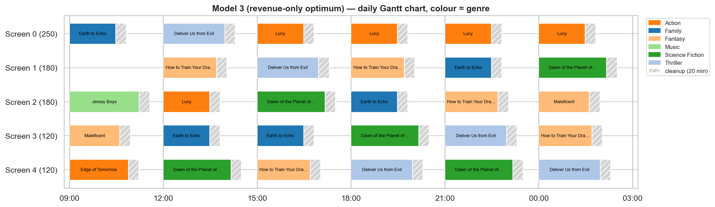
Model 3 · Assignment: the revenue-optimal timetable
Decision a[i,j,s] ∈ {0,1}: film i plays slot j on screen s. Maximise Σ revenue[i,j,s] · a[i,j,s]
 | Constraint | Meaning
C1 | ≤ 1 film per screen and slot | one show per cell
C2 | ≤ 1 screen per film and slot | no simultaneous duplicate
C3 | a = 0 if runtime + 20 > 180 | show must fit the slot
C4 | ≤ 5 shows per film | cap on repetition
C5 | ≥ 1 show per licensed film | we paid for it
C6 | ≥ 4 screens open per slot | minimum operation
C7 | each screen shows its preferred genre | from Model 2
₹4.20 L
240
0.1 s
optimal revenue R* per day
binary variables, 105 constraints
to proven optimality (CBC)
R* = ₹4,19,711. Average occupancy 36.6%, prime-time 54.6%, 208 people turned away; 29 of 30 cells used. R* becomes the revenue target of Model 4.
Notes:
Model 3 assigns licensed films to the 30 screen-slot cells. Seven families of constraints: one film per cell, no simultaneous duplicate shows of a film, the runtime plus cleanup must fit the slot, at most five shows of any film, every licensed film is shown at least once, at least four screens operate in each slot, and each screen must show its Model 2 preferred genre. Objective is pure revenue. It has 240 binaries and 105 constraints and the solver proves optimality in a tenth of a second. The result, R star, 4,19,711 rupees a day, is the best possible revenue and becomes Model 4's target.

Slide 11
Model 4 · Goal programming with AHP weights
Goal | Aspiration (target) | Penalise | AHP weight
G1 Revenue | ≥ R* from Model 3 | shortfall | 0.399
G2 Average occupancy | Model 3 + 3 points | shortfall | 0.095
G3 Prime-time genres | Model 3 + 1 genre | shortfall | 0.095
G4 Idle time | Model 3 − 5 min | excess | 0.051
G5 Prime-time occupancy | Model 3 + 3 points | shortfall | 0.170
G6 Follow Model 2 plan | shows = x[s,g] | deviation | 0.190
AHP: where the weights come from
Goals are compared in pairs on Saaty's 1–9 scale (revenue first, capacity plan second, idle time last). The weights are the principal eigenvector.
λmax = 6.024
CI = 0.0048, RI(6) = 1.24
CR = 0.004 < 0.10: consistent
Objective min Σ wₖ · (unwanted deviation of goal k), subject to the same hard rules C1–C7. Each goal is normalised, so ₹, %, genres and minutes are comparable. Ratio goals are linearised.
Targets are one step better than Model 3, so the goals genuinely conflict; otherwise goal programming would just return Model 3.
Judgments were declared before any Model 4 result was computed with them. Only the consistency ratio was checked.
Notes:
Model 4 reconciles six goals. Each goal has a target and deviation variables; we penalise only the unwanted deviation: shortfall for revenue, occupancy and variety, excess for idle time, and absolute deviation for following the Model 2 capacity plan. Targets are set one declared step better than what the revenue-only Model 3 achieves, which is why the goals really conflict. The weights come from AHP: pairwise comparisons on the Saaty scale, principal eigenvector, consistency ratio 0.004, far below the 0.10 limit. We wrote the judgments down before using them, and only checked their consistency.

Slide 12
Model 4: results and the price of balance
Goal | Target | Model 3 | Model 4 | Met
G1 Revenue | ₹4,19,711 | ₹4,19,711 | ₹4,16,230 | ✘
G2 Avg occupancy | 39.6% | 36.6% | 34.9% | ✘
G3 Prime-time genres | 6 | 5 | 6 | ✔
G4 Idle (min) | 53.0 | 58.0 | 52.0 | ✔
G5 Prime occupancy | 57.6% | 54.6% | 51.4% | ✘
G6 Off-plan shows | 0 | 35 | 0 | ✔
0.83%
of revenue given up (₹3,481 a day): the price of balance, (R* − R) / R*
Prime-time genres 5 → 6
Off-plan shows 35 → 0
Idle per cell 58.0 → 52.0 min
Occupancy 36.6% → 34.9%; prime 54.6% → 51.4%
Model 4 meets 3 of 6 goals and changes 18 of 30 cells. The remaining gaps are real conflicts: more prime-time variety means weaker films in prime-time cells, which lowers prime-time occupancy.
How to read it: the weighted deviation (0.018) is Model 4's own objective, so Model 4 always scores lowest on it. The evidence is the per-goal change and its price, not that number.
Notes:
Here is what goal programming buys. Revenue drops by 0.83 percent, 3,481 rupees a day, relative to the revenue-only optimum. In return prime time shows six genres instead of five, the schedule follows the Model 2 capacity plan exactly instead of being 35 shows off, and idle time falls six minutes. But average occupancy falls from 36.6 to 34.9 and prime-time occupancy from 54.6 to 51.4: we state that openly. Prime-time variety competes with prime-time occupancy. And note: Model 4 scoring best on its weighted deviation is circular, since it minimises exactly that, so we do not present it as proof.

Slide 13
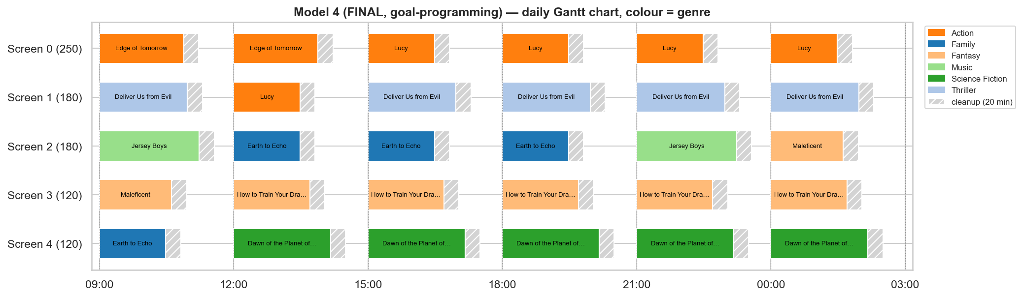
The final operating plan (week of 16 July 2014)
₹4.16 L
1,893
6
30 / 30
9 / 9
ticket revenue per day
seats sold per day
genres in prime time
screen-slots used
constraint checks pass
Licensed: Lucy, Dawn of the Planet of the Apes, Deliver Us from Evil, How to Train Your Dragon 2, Earth to Echo, Maleficent, Jersey Boys, Edge of Tomorrow, for ₹19,99,500.
Notes:
This is the deliverable promised in the first review: a one-day plan with film, screen, start time, cleanup, expected attendance and revenue. The Gantt bars show each show's runtime followed by the hatched cleanup block, coloured by genre. The blockbuster Lucy takes the large screen in prime time; the 120-seat screens carry lower-demand genres. The plan earns about 4.16 lakh a day and passes all nine hard-constraint checks.

Slide 14
Results: better than naive, honest against greedy
 | Revenue | Avg occ. | Prime occ. | Prime genres | Turned away
B1 naive | ₹2,57,294 | 25.9% | 38.1% | 4 | 468
B2 greedy | ₹4,19,711 | 39.1% | 54.6% | 5 | 208
M3 optimum | ₹4,19,711 | 36.6% | 54.6% | 5 | 208
M4 final | ₹4,16,230 | 34.9% | 51.4% | 6 | 208
B1 = top films by raw popularity, rotated across cells. B2 = a sensible greedy manager using Model 1's films. Both pass every physical constraint.
B1 naive
₹2,57,294
+ ₹1,01,166
smarter placement
+ ₹61,251
smarter licensing
− ₹3,481
price of balance
₹4,16,230
M4 final: +61.8%
Greedy matches the revenue optimum here (≤ 0.9% apart across 10 weeks): pure revenue is easy to approach. The exact models add proven optimality, rule satisfaction and priced trade-offs.
Notes:
Against the naive popularity schedule the final plan earns 61.8 percent more. The bridge splits that: about 1.0 lakh from better placement of the same films, 61 thousand from licensing the right films, minus 3.5 thousand which is the price of balance. A greedy manager given Model 1's films gets the same revenue, within 0.9 percent across ten test weeks. That is an honest finding: for pure revenue, heuristics are close. What the exact models add is a proof of optimality, exact satisfaction of the rules, and the ability to price the trade-offs.

Slide 15
Every rule has a price: trade-offs, quantified
Trade-off | What the manager gets | What it costs | OR tool
Balance (Model 4) | 6 prime-time genres, capacity plan followed, idle −6 min | 0.83% of revenue (₹3,481/day); prime occupancy −3.2 points | goal programming, AHP
Variety policy (≥ 8 films) | A wider catalogue of 8 films | ₹44,251/day (9.5% of revenue); free up to 6 films | constraint sweep, shadow price
Licensing budget | Access to the blockbuster | 0.273 value per ₹; returns shrink once Lucy is affordable | LP duals, budget sweep
Fixed 180-min slots | A simple, regular timetable | Films over 160 min excluded; worth ₹22,993 of value | shadow price of K6
OR inference a constraint is a decision. Dual values and parametric sweeps turn each rule into a price in rupees, so the manager can accept it, relax it, or change the weights, instead of discovering the cost afterwards. A sacrifice in revenue is a successful result when it is measured and bought on purpose.
Notes:
This is the main OR message. Revenue is not the only objective, and every rule we impose has a price. Balancing goals costs 0.83 percent of revenue. The variety policy of licensing at least eight films costs 44 thousand a day, about nine and a half percent, and is free up to six films. The budget has a shadow price. The fixed slot grid excludes long films, with a shadow price too. A revenue sacrifice is not a failure of the optimisation: Model 3 answers 'what is the most money possible', Model 4 answers 'what does it cost to care about the other goals'. Both are optimisations; the second prices the choice.

Slide 16
Pricing the variety policy (minimum films)
Free up to 6 films. Model 1 licenses 6 films anyway.
The policy of 8 costs ₹44,251 a day (9.5%). Relaxing to 7 recovers ₹41,433; tightening to 9 costs ₹44,786 more.
Why a show can have 2 viewers: old films have little demand left, and the policy plus “every licensed film is shown” forces them in.
Without the rule, Model 1 equals a demand ranking (₹4,63,961 both); its value is meeting budget, count and content rules exactly.
Notes:
This sweep re-solves the entire chain for each minimum number of films. Up to six films the rule is free because the optimal portfolio is six films anyway. At eight, our chosen policy, the revenue optimum drops from 4.64 lakh to 4.20 lakh, a price of about 44 thousand a day. The curve also explains why a few shows in the final plan have only a couple of viewers: weak, older films are forced in by the minimum and by the requirement that every licensed film is shown. We keep the policy from the first review, but now it is a priced choice the manager can revisit.

Slide 17
Sensitivity and robustness: end to end
Every point re-solves the whole chain (market, demand, Models 1–4, baselines, validation): 7 values of λ, 7 budgets, 5 demand scales, 7 policy levels, 10 weeks. All schedules valid.
Demand ±30%: lift over naive stays +62% to +65%; the ranking of methods does not change.
10 weeks chosen by a fixed rule, not by hand: M4 wins in 9, mean +44%. The one loss (2011-05) is a week where the naive plan costs more than the budget.
Notes:
This answers the first-review limitation that sensitivity was only planned at the demand and licensing layer. Every sweep point here re-optimises the whole chain. The left chart varies lambda: the final plan beats the naive plan from lambda 0.35 up, and below that the naive plan would cost more than the budget, so it isn't attainable. The right chart runs ten weeks picked by a fixed rule; the final plan wins in nine. Varying the demand scale by plus or minus 30 percent changes revenue levels but not the ranking.

Slide 18
What the results do not say: honest findings
Greedy ≈ ILP on pure revenue
A greedy manager is within 0.9% of the optimum in every tested week. The ILP's value is the proof of optimality, exact handling of the rules, and pricing the balance.
Naive wins in some settings
At λ = 0.25, budgets ≤ ₹17.5 L, 1 of 10 weeks and a 10-film minimum. Cause: Model 1 scores films one by one, but all films share 30 show-slots (sequential decomposition).
Synthetic demand and fees
TMDB has no ticket sales, so revenue is a model estimate. λ is assumed, not learned (swept 0.25–0.85). Fees were set so weekly revenue covers licensing (1.46×).
Model quirks
With fixed slot starts, idle time has little economic meaning (lowest AHP weight). Model 2 has alternative optima. Future work: feed Model 3's shadow prices back to Model 1.
Notes:
We want to be upfront about what the results do not claim. A greedy manager is nearly as good on pure revenue. The naive plan wins in a few settings, mostly where it would not be affordable, but also at tight budgets, because Model 1 values each film separately while all films compete for the same 30 show-slots; solving the chain sequentially has a cost. Demand and fees are synthetic. And two quirks: idle time is a weak goal under fixed slot starts, and Model 2 has ties. Naming these makes the conclusions more credible.

Slide 19
First review to final: what we closed
First review (promise or limitation) | Final review (done)
Implement the models and verify the chain | Four models implemented; 7 hand-offs verified in code; 26 automated tests
Check all hard constraints | 9-check validator on every schedule (M3, M4, B1, B2) and every sweep run
Compare with a popularity baseline | B1 naive plus B2 greedy manager; revenue bridge: selection vs placement
Sensitivity only at demand/licensing layer; end-to-end = future work | Every sweep re-optimises the whole chain: λ, budget, demand scale, 10 weeks, variety policy
Films over 160 min are infeasible | Excluded explicitly (K6, C3) and priced by a shadow price
Goal-attainment report | Goal report, price of balance; weights by AHP (CR 0.004)
Assumed six 180-min slots | Found the 9 pm slot was only 120 min; moved last slot to 00:00 so all are 180 min
Popularity static; cold start | Still a limitation: λ-decay gives a weekly signal and is swept
Notes:
This slide maps the first review's commitments and stated limitations to what we delivered. [Presenter: add any specific suggestions the faculty gave verbally in the first review and say how each was handled; this table is based on the commitments and limitations written in the first-review deck.] The biggest closures are end-to-end sensitivity, the constraint validator and the honest greedy baseline, and we also fixed a time-grid flaw we found ourselves: the 9 pm slot only had 120 minutes.

Slide 20
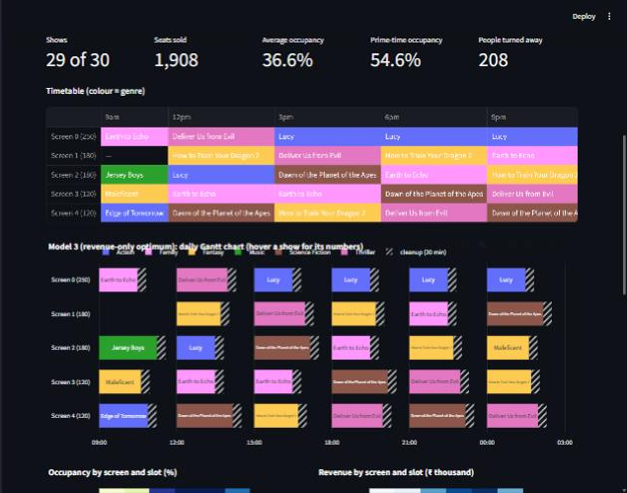
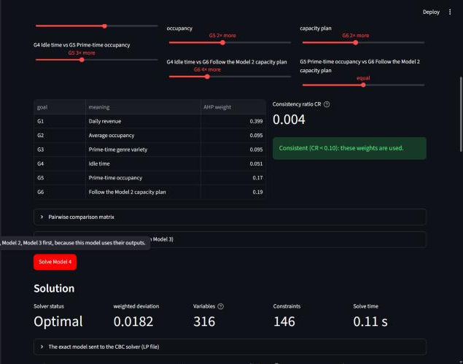
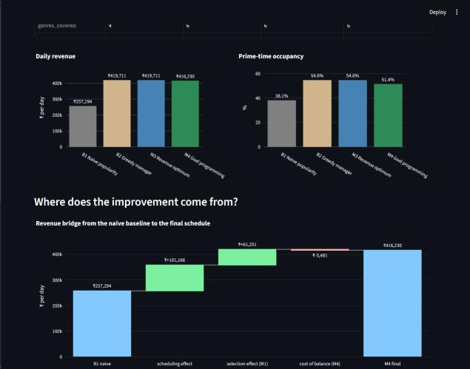
The interactive app (Streamlit)
Model page: timetable and Gantt chart
Model 4: AHP weights, consistency check
Compare: baselines and revenue bridge
Load data
bundled TMDB file or upload; schema check; cleaning funnel
Statistics on demand
9 analyses with filters, charts, CSV export
Run any optimisation
Models 1–4 on their own pages, or the full chain
See the model
formulation, input data, exact .lp file, duals
What-if and sweeps
pick your own films; re-solve the chain live
Compare and export
baselines, validator matrix, final plan files
Notes:
The professor asked for a user interface where data can be loaded, statistics generated on demand, and at least two optimisations chosen by the user. Our Streamlit app has twelve pages. The data page loads the bundled dataset or an uploaded CSV, shows the cleaning funnel, and lets the user build statistics on demand. Each model has its own page showing the formulation, the real input data, the exact model sent to the solver, the solution and the sensitivity information. There is a what-if page where you pick the films yourself, a compare page with the validator, a sensitivity lab, and export of the final plan. [Live demo suggested here: solve Model 1, then Model 4 with AHP, then run the S6 sweep.]

Slide 21
The code: one engine, two front ends
engine/
config.py every assumption
data · market · demand
models.py Models 1–4
baselines · metrics (validator)
pipeline.py chain, sweeps
analysis.py LP sensitivity
ahp.py
app/ Streamlit, 12 pages
tests/ 26 tests
report notebook
Model 1 in PuLP (simplified)
y = pulp.LpVariable.dicts('y', films, cat='Binary')
prob += lpSum(value[i] * y[i] for i in films)
prob += lpSum(fee[i] * y[i] for i in films) <= budget # K1
prob += lpSum(y[i] for i in films) >= n_min # K2
prob.solve(PULP_CBC_CMD(msg=False)) # branch and bound
Single source of truth: the notebook and the app import the same engine, so their numbers cannot drift apart.
Verified: 26 tests, including exact sensitivity ranges checked by brute-force re-solving, and the first version's numbers reproduced exactly.
Tools: Python, PuLP with the CBC solver, SciPy (HiGHS) for sensitivity reports, Pandas, Plotly, Streamlit. Every model solves in under a second.
Notes:
The notebook and the app both import one engine package, so there is a single implementation of every model. The snippet is Model 1 in PuLP: one binary variable per film, maximise value, budget and film-count constraints, solved by CBC with branch and bound. We have 26 automated tests: they check that the engine reproduces the first version's numbers, that the corrections change what we say they change, and that the sensitivity ranges are exact by re-solving the LP with perturbed costs.

Slide 22
Conclusion
Answer
Yes. A chain of four OR models gives a feasible plan that earns 61.8% more than the popularity-based schedule (₹4,16,230 vs ₹2,57,294 a day) and wins in 9 of 10 test weeks.
OR contribution
Knapsack, transportation, assignment and goal programming, linked in code, with duals, LP sensitivity reports and AHP, all checked by a validator.
Key inference
Trade-offs are priced: balance costs 0.83% of revenue, the 8-film policy ₹44,251 a day. Greedy matches pure revenue, so exactness pays in rules, proofs and prices.
Next
Feed Model 3's shadow prices back to Model 1, fit λ from weekly box-office data, and try lexicographic goal programming.
Thank you · Questions
Notes:
To close: yes, the OR chain beats the naive schedule by 61.8 percent in the main week and in nine of ten test weeks, and every schedule is feasible. The deeper point is that the models do more than produce a number: duals, sweeps and goal programming price each trade-off, and we are honest that a greedy heuristic is close on pure revenue. Possible questions to prepare for: why is the transportation solution integral (total unimodularity); why goal programming rather than a single objective (different units, conflicting goals, explicit targets); where do the weights come from (AHP, consistency 0.004); why does a show have two viewers (variety policy, priced in S6); is the demand realistic (declared assumptions, calibrated once, swept plus or minus 30 percent).

