Slide 1
OPERATIONS RESEARCH | FIRST REVIEW
Multi-Model Optimization Framework for Multiplex Screen Scheduling and Revenue Management
Group 14
Team Members:
ABHISHEK KARTHIK - CB.SC.U4AIE23010
ABHISHEK R-CB.SC.U4AIE23011
MP MOTHISWARAN-CB.SC.U4AIE23041
M.S. BAVESH REDDY -CB.SC.U4AIE23044

Slide 2
What Are We Actually Trying to Do?
2
The main goal is not simply to choose popular movies. It is to build a decision-support system that answers a complete scheduling problem.
INPUT
DECISION PROCESS
OUTPUT
• Movie metadata
• Release date / age
• Popularity and revenue
• Genres
• Runtime
• Screens and time slots
• Which films to license?
• How much screen capacity per genre?
• Which film goes to which screen?
• Which time slot should it occupy?
• Final one-day schedule
• Film–screen–slot assignments
• Revenue estimate
• Occupancy estimate
• Genre coverage
• Goal-attainment report
Key idea: each OR model solves one part of the decision; the models are then chained so the output of one becomes an input to the next.
2

Slide 3
Problem Statement
3
BUSINESS / OPERATIONAL PROBLEM
A multiplex has limited screens, fixed time slots, limited licensing budget and different audience demand for different films.
• Selecting only the most popular films can ignore budget and diversity requirements.
• Different screens have different capacities, so capacity must be allocated intelligently.
• Every film has a runtime, and a cleanup buffer must fit between consecutive shows.
• Demand is not constant: the project models demand decay as a film gets older.
• Revenue, occupancy, genre diversity and idle time can conflict with one another.
PROJECT QUESTION
How can we generate a feasible one-day multiplex schedule that gives a better operating plan than a simple popularity-based schedule?
This is the reason an OR pipeline is useful: the problem contains several connected decisions rather than one single decision.
3

Slide 4
Dataset — What Data Do We Actually Have?
4
PRIMARY DATASET
TMDB 5000 Movie Dataset (Kaggle)
Primary file: tmdb_5000_movies.csv
Dataset scale used in the project
• Budget and revenue
• Popularity and vote-related metrics
• Runtime
• Release date
• Genres
• Spoken languages
• Production companies
• Movie status
Original movies
4,803
Columns
20
After cleaning
2,571
Important limitation: the dataset does NOT contain actual daily ticket sales for the multiplex. Therefore, demand and occupancy must be constructed using explicit modelling assumptions.
4

Slide 5
Dataset Cleaning & Weekly Market Construction
5
WHY CLEAN THE DATA?
CLEANING FLOW
• Keep only released films.
• Remove very low-information records using the vote-count threshold.
• Require valid runtime and release-date information.
• Create a clean candidate pool for the scheduling model.
4,803
→
Released
→
≥ 200
Initial rows
Status filter
Vote-count filter
Valid
2,571
Runtime + date
Usable rows
WEEKLY MARKET SYNTHESIS
weeks_out
How old the film is at the selected schedule week
effective_demand
normalized popularity × weekly_decay
weekly_decay
exp(−λ × weeks_out) — models demand decay
market_status
new / running / catalogue / future
5

Slide 6
OR MODELS — DECISION CHAIN
6
One large scheduling problem is decomposed into connected decisions.
1
KNAPSACK
What films can we afford?
INPUT: Candidate films + cost + budget
→ Licensed film set
2
TRANSPORTATION
Where should capacity go?
INPUT: Screen capacities + genre demand
→ Preferred genre per screen
3
ASSIGNMENT
Where and when should each film play?
INPUT: Licensed films + preferred genres + slots
→ Film–screen–slot schedule
6

Slide 7
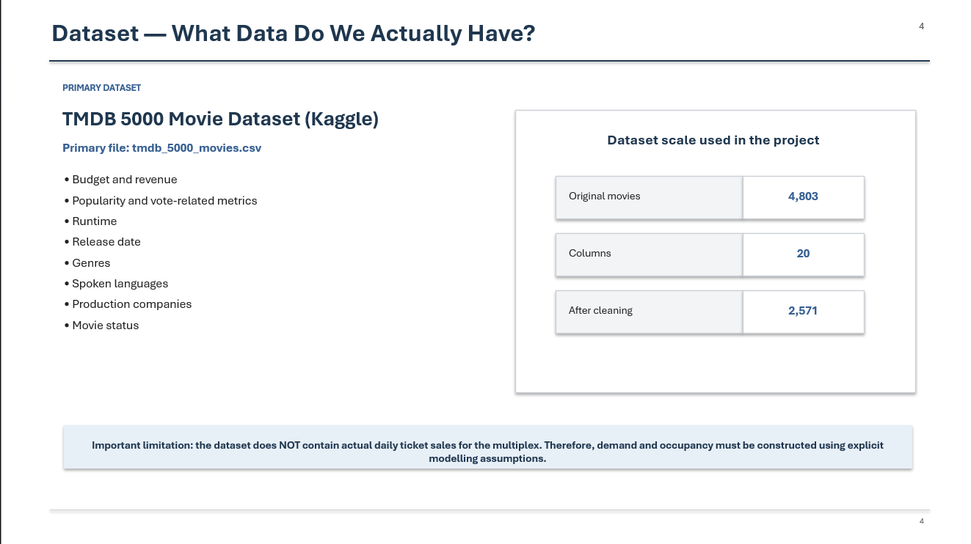
Optimization 1: Film Selection & Licensing
4
Q1. Film Selection
Given a limited licensing budget, which films should the multiplex select for the selected week?
Decision
Given candidate films and their modelled licensing fees: which films should be selected?
Objective
Maximize total revenue-potential score of selected films.
Output
Selected / licensed film set
8–12 films satisfying coverage requirements
Constraint
Budget: Σ Feeᵢ yᵢ ≤ ₹40L
Binary decision: yᵢ ∈ {0,1}
Film count: 8 ≤ Σyᵢ ≤ 12
Content coverage requirements
Non-selected films: yᵢ = 0
OR Technique
Binary Integer Programming / Knapsack
4

Slide 8
Optimization 2: Screen–Genre Capacity Planning
5
Q2. Screen Capacity
Given limited screen capacity and genre-level demand, how should screen capacity be aligned with the demand for genres?
Decision
How should available screen capacity be distributed across genres?
Objective
Minimize capacity–demand mismatch between screen supply and genre demand.
Output
Preferred genre for each screen
Capacity allocation / genre mapping
Input to Model 3
Constraint
Screen capacities: 250 / 180 / 180 / 120 / 120
Supply cannot exceed available capacity
Genre demand must be balanced
xₛg ≥ 0
All allocated capacity must remain feasible
OR Technique
Transportation / Linear Programming
5

Slide 9
Optimization 3: Movie–Screen–Slot Assignment
6
Q3. Daily Scheduling
Given selected films, screens and time slots, which film should be assigned to which screen and at what time?
Decision
How should films be assigned across 5 screens × 6 daily slots?
Objective
Maximize estimated ticket revenue from feasible film–screen–slot assignments.
Output
Final one-day film–screen–slot schedule
Expected occupancy and revenue
Constraint
At most one film per screen-slot
Runtime + 20 min cleanup ≤ 180 min
No simultaneous simulcast of same film
Maximum showings per film
Minimum operating screens per slot
Genre / preferred-screen feasibility
OR Technique
Binary Integer Programming / Assignment
6

Slide 10
How the Models Will Be Chained
12
DATASET
Cleaned movies + selected week
↓
DEMAND MODEL
effective_demand using popularity + decay
BASELINE
VALIDATION
↓
Naive top-5 popularity schedule
Compare + sensitivity tests
MODEL 1
licensed_films
↓
MODEL 2
screen_preferred_genre
↓
MODEL 3
schedule grid + occupancy + idle time
This is the central architecture of the project: every stage has a defined input and output, so the full system can be tested step-by-step.
12

Slide 11
FINAL OUTPUT & EVALUATION PLAN
13
WHAT THE FINAL SYSTEM PRODUCES
HOW WE WILL EVALUATE IT
• A one-day multiplex operating plan.
• Which films are licensed.
• Which film plays on each screen.
• Start time / slot for every show.
• Estimated occupancy and revenue.
• Genre coverage and idle time per screen.
• Goal-attainment summary.
• Compare against a simple popularity-based baseline.
• Check all hard constraints.
• Measure revenue, occupancy, diversity and idle time.
• Sensitivity analysis for demand-decay λ.
• Sensitivity analysis for licensing budget.
• Check whether the schedule remains feasible and interpretable.
These are planned evaluation steps for the first review; final experimental results are reported only after implementation.
13

Slide 12
TOOLS, ASSUMPTIONS & MODELLING BRIDGE
14
TOOLS
KEY ASSUMPTIONS
• Python — data processing, demand modelling and OR models.
• Pandas — load, clean, filter and transform TMDB data.
• NumPy — normalization, decay, demand and revenue calculations.
• PuLP + CBC — LP/ILP/MILP formulation and open-source solving.
• Matplotlib / Seaborn + Jupyter — EDA, visualization, debugging and scenario testing.
• 5 screens: 250 / 180 / 180 / 120 / 120 seats.
• Six fixed slots: 9am, 12pm, 3pm, 6pm, 9pm, 11pm.
• 180-minute slots with 20-minute cleanup buffer.
• Synthetic ticket prices: ₹120–₹280 by slot.
• ₹40L licensing budget; λ = 0.55 base assumption.
DEMAND / OCCUPANCY BRIDGE
synthetic_demand = effective_demand × slot_factor × genre_slot_affinity × demand_scale
Constructed from explicit assumptions because TMDB has no multiplex ticket transactions
14

Slide 13
LIMITATIONS & CURRENT SCOPE
15
DATA LIMITATION
TMDB provides movie-level metadata, not actual multiplex ticket transactions or weekly ticket-demand history.
POPULARITY
Popularity is a static dataset value here; the model does not observe weekly popularity updates.
COLD START
A genuinely new film with no usable historical metadata is not explicitly handled.
SYNTHETIC INPUTS
Capacities, prices, demand scale, slot factors, genre-slot affinity and licensing fees are assumptions.
LONG RUNTIMES
With fixed 180-minute slots and 20-minute cleanup, movies requiring more than 160 minutes are infeasible.
HISTORICAL REVENUE
TMDB revenue/budget are not directly used as the ticket-revenue objective; projected revenue uses modelled occupancy × capacity × price.
SENSITIVITY SCOPE
Parameter sweeps are planned at the demand/licensing layer; full end-to-end reoptimization for every sweep is future work.
These limitations define the prototype scope and keep synthetic assumptions distinct from real-world observations.
15

Slide 14
FIRST REVIEW TAKEAWAY & PROJECT SCOPE
16
From real movie metadata to an OR-based multiplex decision-support system.
1
Problem defined
Selection, allocation, assignment and multi-objective scheduling are connected decisions.
2
Dataset understood
TMDB provides movie-level metadata; explicit assumptions create the weekly demand bridge.
3
OR methodology defined
Knapsack → Transportation → Assignment .
4
Inputs / outputs defined
Every model has a clear purpose and a clear hand-off to the next model.
5
Evaluation planned
Baseline comparison, feasibility checks and sensitivity analysis follow implementation.
Next milestone: implement the four models, verify the model chain, and generate the first complete schedule.
16

Slide 15
Thank You

