Slide 1
Differentiating AI written text and Human written text using
Machine Learning
and
Deep Learning techniques

Slide 2
Introduction
In the era of ever-advancing artificial intelligence (AI), the ability to discern between machine-generated text and human-authored content has become a critical challenge.
As AI technologies, particularly machine learning and deep learning models, continue to evolve, their capacity to generate text that closely resembles human expression raises intriguing questions about the authenticity of digital communication.
The exponential growth in AI-driven language models, such as OpenAI's GPT (Generative Pre-trained Transformer) series, has ushered in an era where synthetic text can be eerily indistinguishable from human-generated content.

Slide 3
Research Objectives:
The aim of our study, we want to figure out how computers are at telling if something was written by a human, BARD and ChatGPT.
We aim to make these computer programs better at noticing the small differences in how humans and machines write.
We're also looking at the challenges when the programs need to understand the changing abilities of AI and how the context of what's written can affect their accuracy.
Another important part of our study is finding and dealing with any biases or ethical issues that might come up during this process.
Overall, our goal is to help computers get better at telling who wrote something—whether it's a person or one of these advanced AI programs.

Slide 4
Machine Learning Models
Here we use some machine learning and Deep Learning models to identifying human-Written, BARD and ChatGPT Generated Text are :-
Decision Trees (DT)
K-Nearest Neighbors Classifier (KNN)
Random Forest Classifier (RF)
Support Vector Machine (SVM)
Generalized Linear Model (GLM)
Bidirectional Encoder Representations from Transformers (BERT)

Slide 5
Our Results
We have taken almost 500 dataset each of human generated text, BARD and ChatGPT and from base paper, it had take only 250 dataset each of human generated text and ChatGPT generated text and comparing its accuracy:
Model | ( Base Paper) | ( Our paper)
DT | 87.00 % | 86.66 %
KNN | 65.50 % | 65.00 %
RF | 93.00 % | 98.33 %
SVM | 91.50 % | 95.00 %
GLM | 91.50 % | 92.50 %
BERT | 73.46 % | 55.00 %

Slide 6
Working
First we understand its working of these models:
Random Forest Model (RF Model) – Random Forest works by creating a bunch of decision trees, each trained on a different random subset of the data. For each tree, only a random set of features is considered when making decisions. When you want a prediction for a new data point, each tree gives its own prediction, and the final result is determined by a majority vote (for classification) or averaging (for regression) of all the individual tree predictions. This ensemble approach makes Random Forest more accurate and less prone to overfitting compared to a single decision tree.

Slide 7
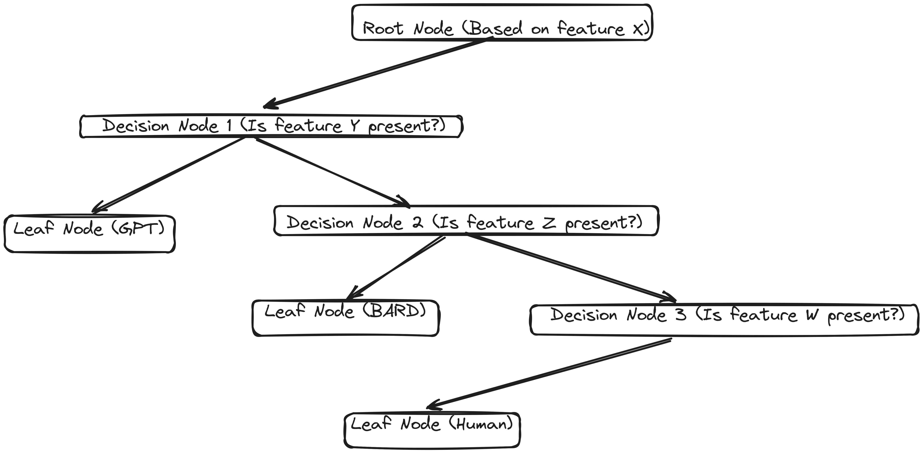

Slide 8
Bidirectional Encoder Representations from Transformers (BERT)- It is a NLP technique language model that excels in understanding context. It is deep learning model which recognize complex patterns in pictures, text, sounds, and other data to produce accurate insights and predictions. BERT is a neural-network-based technique for language processing pre-training. In neural-network - based technique that uses interconnected nodes or neurons in a layered structure like resembles the human brain.
Step 1: Preprocessing
The input text is preprocessed to ensure consistency and compatibility with the model's architecture. This may involve tasks like:
Tokenization: Breaking the text into individual words or subword units.
Normalization: Converting text to lowercase, removing punctuation, and handling special characters.
Embedding: Representing each token as a numerical vector to represent its meaning.

Slide 9
Step 2: Pre-training
The pre-training stage is BERT learns to capture contextual relationships between words in a massive dataset of unlabeled text. This involves two main tasks:
Masked Language Modeling (MLM): Randomly masking 15% of the words in the input and asking the model to predict the missing words. This helps BERT learn the context of surrounding words and understand their relationships.
Next Sentence Prediction (NSP): Given a pair of sentences, predicting whether the second sentence is the actual next sentence in the original document. This helps BERT learn how sentences are connected and how to capture long-range dependencies.
Step 3: Fine-tuning
Once pre-trained, BERT can be fine-tuned for specific NLP tasks by adding a task-specific output layer and training it on a labeled dataset. This involves adjusting the model's weights to optimize its performance for the specific task at hand.

Slide 10
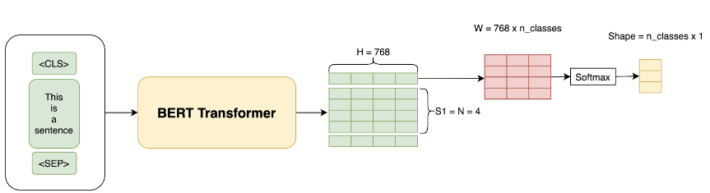
Step 4: Inference
After fine-tuning, BERT can be used for inference, which involves applying the trained model to new unseen data. The model takes an input text, processes it through its encoder layers, and produces an output based on the task at hand.

Slide 11
Our Model Working Method
We combine two model Random Forest ,Bert Model and the make them hybrid to improving its accuracy of model. We make mainly changes in code to improve its accuracy are following:
Preprocessing:
Manual Filtering (Duplicacy): This involves manually filtering out duplicate data points. Duplicate data can introduce biases and skew the learning process. By removing duplicates, you ensure that the model learns from a diverse and representative dataset.
Averaging: Averaging likely refers to incorporate averaged features into the model. For example, if BERT generates multiple contextualized embeddings for a sentence, averaging them can provide a more stable and representative input for the BERT model.

Slide 12
Matrix Input: Converting data into a matrix format suitable for both Random Forest and BERT. This could involve transforming textual data into numerical representations that Random Forest can handle, while also preparing the input in a format suitable for BERT embeddings.
Increasing the number of Nodes: This involves expanding the number of decision nodes in each tree of the BERT. More nodes can capture finer details in the data, potentially improving the model's ability to learn complex patterns.
Increasing its Layers: BERT typically doesn't have layers like neural networks, but increasing the depth of individual decision trees effectively adds layers to the overall ensemble. A deeper tree can capture more intricate relationships in the data.

Slide 13
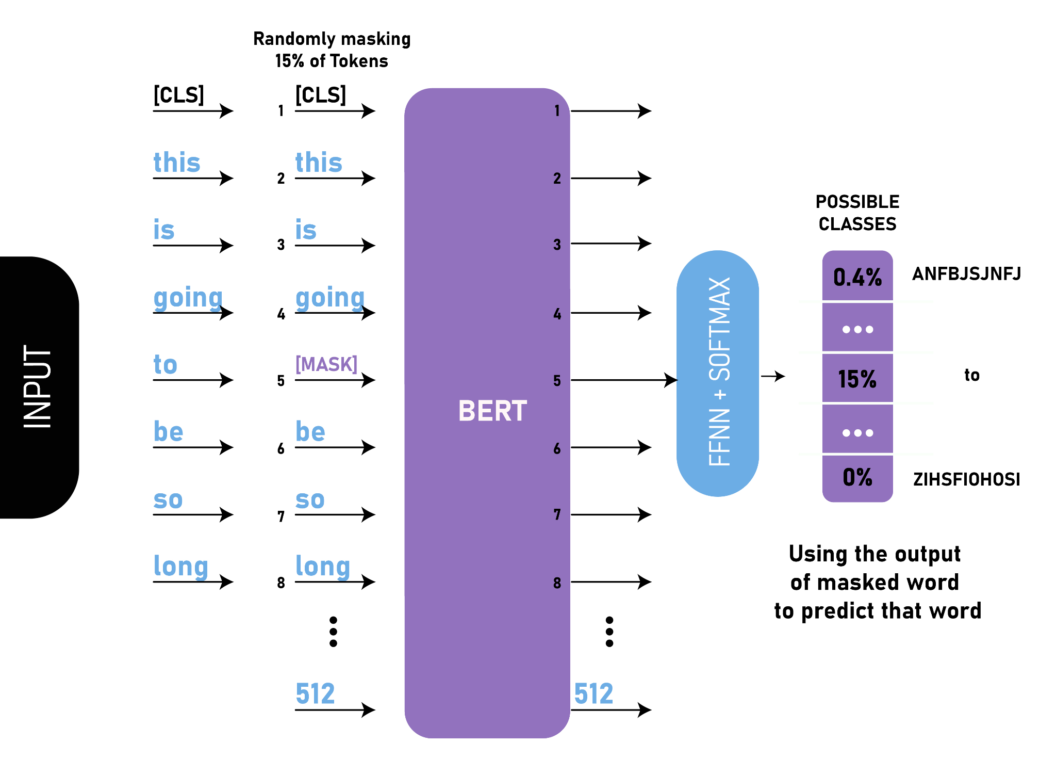
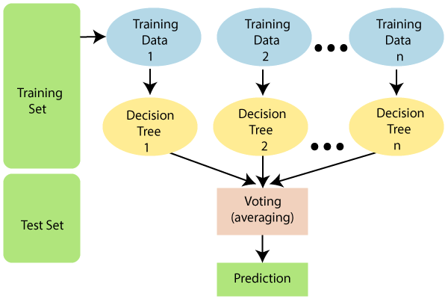
Working
+

Slide 14
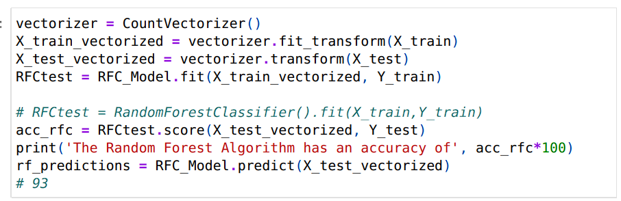

Slide 15
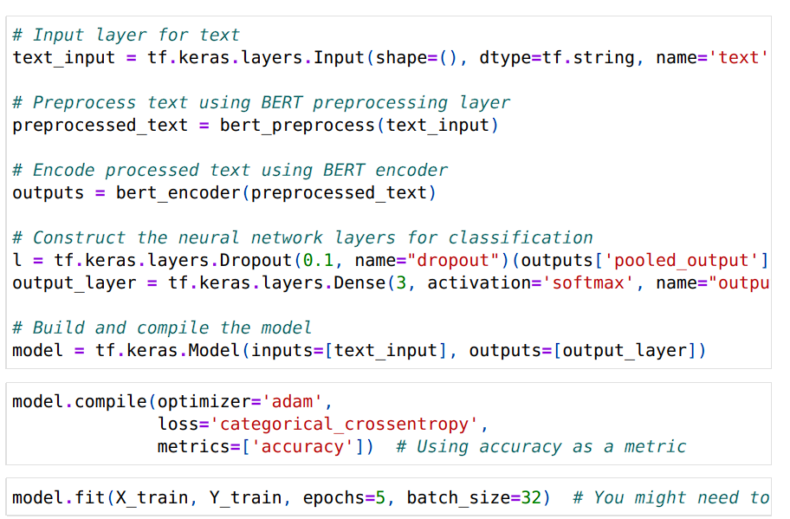

Slide 16
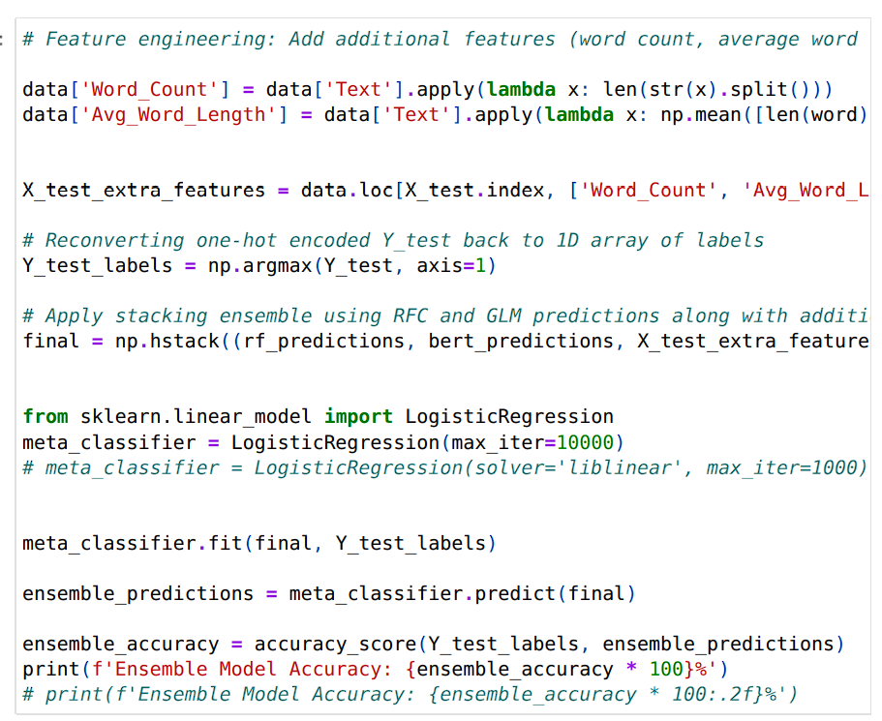

Slide 17
Our Hybrid Model results
Here, we have take different number of Datasets to see accuracy of hybrid Model by Preprocessing and increasing the number of Layers and Nodes might improve its accuracy
Human+GPT+BARD | RF Model | BERT Model | Hybrid (RF + BERT) Model
500+500+500 | 88.36 % | 86.04 % | 96.34 %
2500+540+745 | 92.72 % | 91.86 % | 98.43 %
15k+540+745 | 94.54 % | 95.52 % | 97.06 %

Slide 18
Conclusion
Traditional Models:
DT, KNN, and SVM: Demonstrated strong performances, with SVM leading the pack in both the baseline and our proposed model scenarios.
State-of-the-Art Models:
BERT: Emerged as a powerful contender, showcasing high accuracy and robustness in both baseline and our proposed model evaluations.
Hybrid (RF + BERT) Model: Surpassed individual models, indicating the synergistic benefits of combining traditional Random Forest (RF) with advanced BERT, achieving remarkable accuracy.
Our Proposed Model:
Performance Improvement: The hybrid model, combining the strengths of Random Forest and BERT, demonstrated significant performance improvement compared to individual models, achieving the highest accuracy across all scenarios.

Slide 19
Thank You

