Slide 1
EDA COURSE PROJECT
Effects of Climate change on Agriculture and adaption.

Slide 2
Climate change and agriculture
Climate change is an important and most significant influence on agriculture.
Factors that effect climate change:
Temperature
Precipitation
Humidity
Ocean currents and sea levels
winds

Slide 3
Factors that effect agriculture
Temperature
Soil
Rainfall
irrigation

Slide 4
Reason for climate change
Green house gasses.

Slide 5
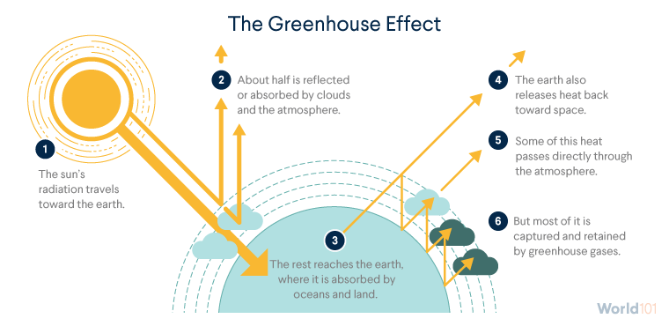

Slide 6
MAJOR AGRICULTURAL COUNTRIES:
USA : wheat
China : rice
Brazil : soybean
India : spice, wheat, rice
Russia : sugar cane, wheat, potatoes
France : flour, cereals
Mexico : wheat, sugarcane,pepper
Japan : rice
Germany : vegetables , fruits
Turkey : tobacco

Slide 7
DATASETS

Slide 8
Questions to answere:
What Ideal crops to grow in upcoming years?
how can agriculture of a country benefit from climate change?
how to Prevent exhaustion of resources?

