Slide 1
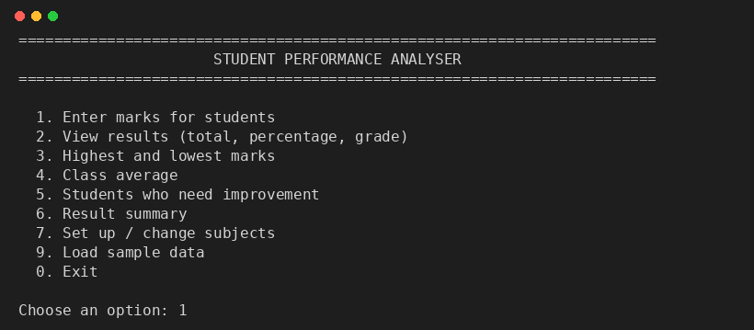
PYTHON FOR ENGINEERING ESSENTIALS LAB
Student Marks & Performance Analyser
Programme: BTech CSE CYS
Team No: 5
Team
Satyajit Pati (BWU/BCC/25/085) | Soyel Rana Halder (BWU/BCC/25/086) | Sk Sayan Hasan (BWU/BCC/25/087)
Rituraj Das (BWU/BCC/25/088) | Shrijeeta Paul (BWU/BCC/25/089) | Abhishek Kumar Mistry (BWU/BCC/25/090)

Slide 2
INITIAL GOALS
What we set out to build
8
features required by the brief
The problem
Adding up marks, working out percentages and grades, and spotting weak students by hand is slow and error-prone.
Our aim
Develop a system to enter marks and analyse student performance. Enter marks for different subjects
Calculate total marks
Calculate percentage
Assign grades
Find highest and lowest marks
Calculate class average
Identify students who need improvement
Display result summary.
0
external libraries needed
1
Python file, runs in any terminal

Slide 3
INITIAL GOALS
Eight required features
1
2
3
4
Enter marks
Total marks
Percentage
Assign grades
For each subject, validated 0-100
Sum of all subjects
Total out of maximum
A+ down to F
5
6
7
8
Highest & lowest
Class average
Needs improvement
Result summary
Per subject and overall
Per subject and overall
Flag weak students
One-screen overview
Every feature is reachable from a single numbered menu.

Slide 4
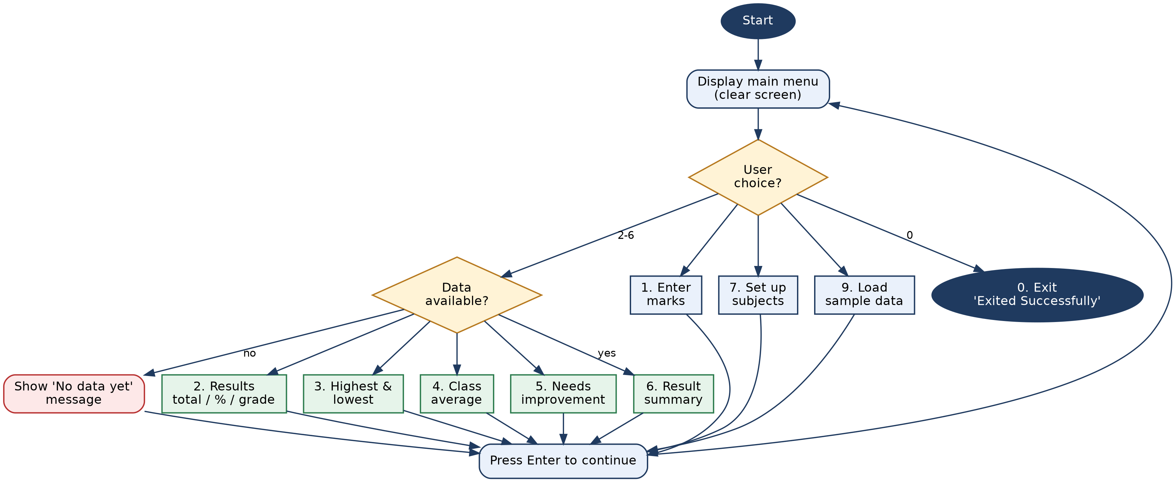
DESIGN DIAGRAM
Program flow

Slide 5
DESIGN DIAGRAM
Data, formulas and grade scale
Data structures
Calculations
subjects = ["Maths", "Science", ...]
students = {
"Asha": {"Maths": 92,
"Science": 88, ...},
"Ben": {...}
}
MAX_MARKS=100 PASS_MARK=40
IMPROVE_BELOW=50
Total = sum of all subject marks
Percentage = total / (100 x subjects) x 100
Class average = mean of all percentages
Needs improvement = below 50% overall, or any subject below 40
Grade scale (percentage)
A+
A
B
C
D
E
F
90+
80+
70+
60+
50+
40+
<40

Slide 6
FUNCTIONS RESPONSIBLE
Calculation functions
Function | What it does
total(name) | Adds up a student’s marks across all subjects
percentage(name) | Converts the total into a percentage
grade(pct) | Maps a percentage to A+, A, B, C, D, E or F
failed_subjects(name) | Lists subjects scored below the pass mark (40)
class_average() | Mean percentage of every student
needs_improvement(name) | True if under 50% overall or any subject failed
ask_number(prompt, low, high) | Reads a number and repeats until it is valid

Slide 7
FUNCTIONS RESPONSIBLE
Menu option to function
Option | Function | What it does
1 | enter_marks() | Reads student names and marks for every subject
2 | show_all_results() | Table of total, percentage and grade
3 | highest_lowest() | Best and weakest marks per subject and overall
4 | show_average() | Subject averages with bars, plus class average
5 | show_improvement() | Lists students who need improvement
6 | summary() | Pass rate, topper and grade distribution
7 | setup_subjects() | Defines subject names (clears old records)
9 | load_sample() | Loads five demo students
Helpers: main() runs the menu loop; title(), clear_screen() and line() draw each page; pause() and need_data() control flow.

Slide 8
HOW IT WORKS
Using the application
1
2
3
4
5
Run it
Get data in
Enter marks
Analyse
Exit
Type python, then the file name student_perf00ADormance.py
Press 9 for sample data, or 7 to set up subjects
Press 1, type a name and marks per subject; leave the name blank to stop
Press 2 to 6 for results, extremes, average, weak students and summary
Press 0 to quit; Enter returns to the menu after each page
Invalid input (letters, or marks above 100) is rejected and the question is asked again.

Slide 9
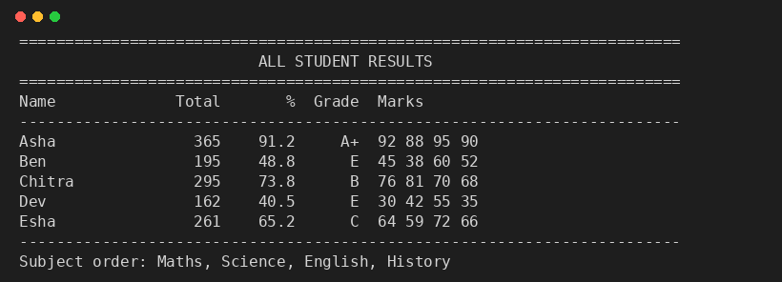
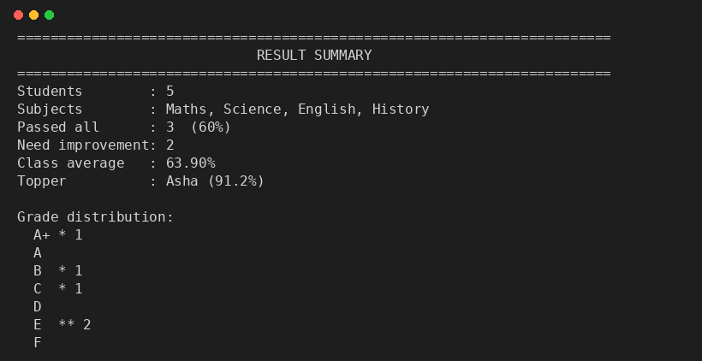
HOW IT WORKS
Sample output
Option 2: total, percentage and grade
Option 6: result summary

Slide 10
Acknowledgement
We sincerely thank our faculty, our department and our classmates for their guidance, feedback and support throughout this project.
Thank You

