Slide 1
Employe dashboard
- Created By IT Zoho Support - Wisethink

Slide 2
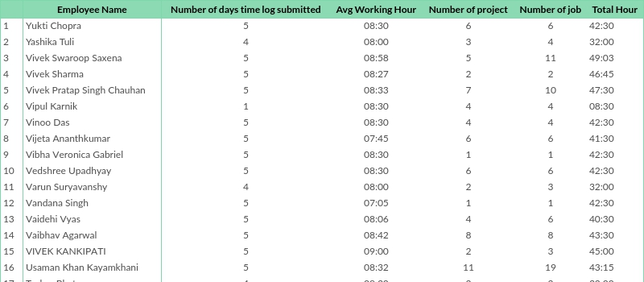
Employee summery report

Slide 3
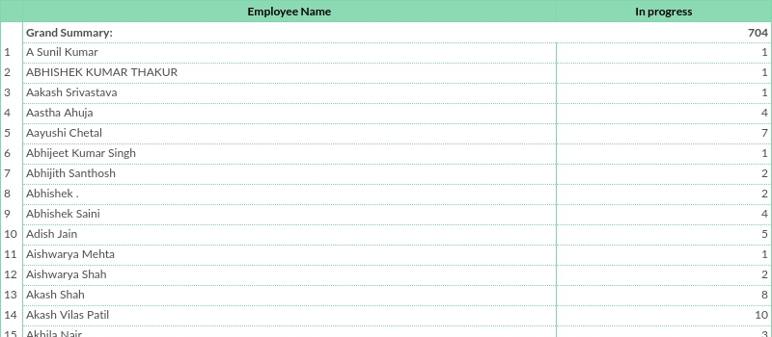
Employee Wise Project status

Slide 4
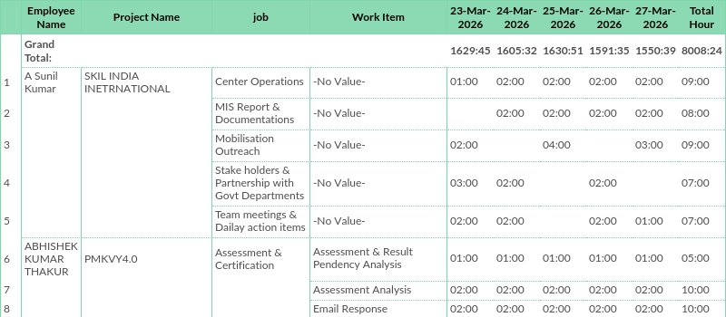
Project And Work Item Wise Time Logs

Slide 5
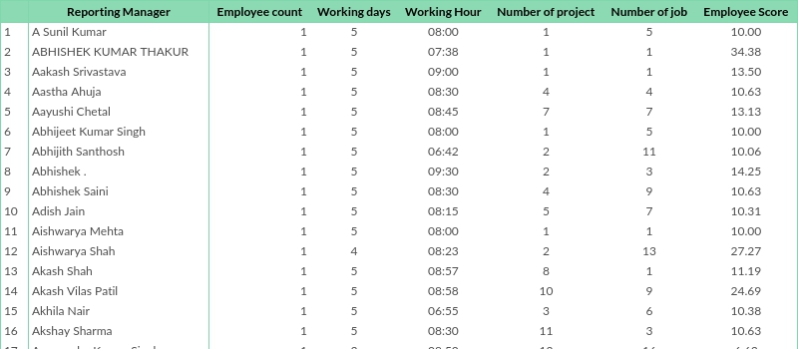
Reporting Manager Report

Slide 6
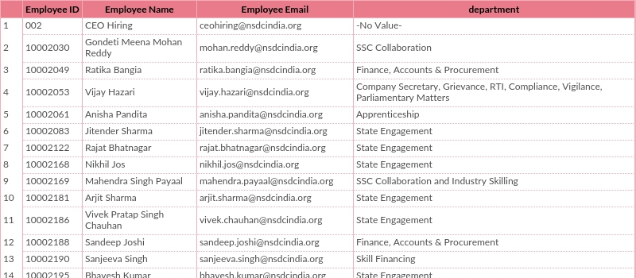
Time Log Not Submitted

Slide 7
Thank you

