Slide 1
Report View
- Created By IT Zoho Support - Wisethink

Slide 2
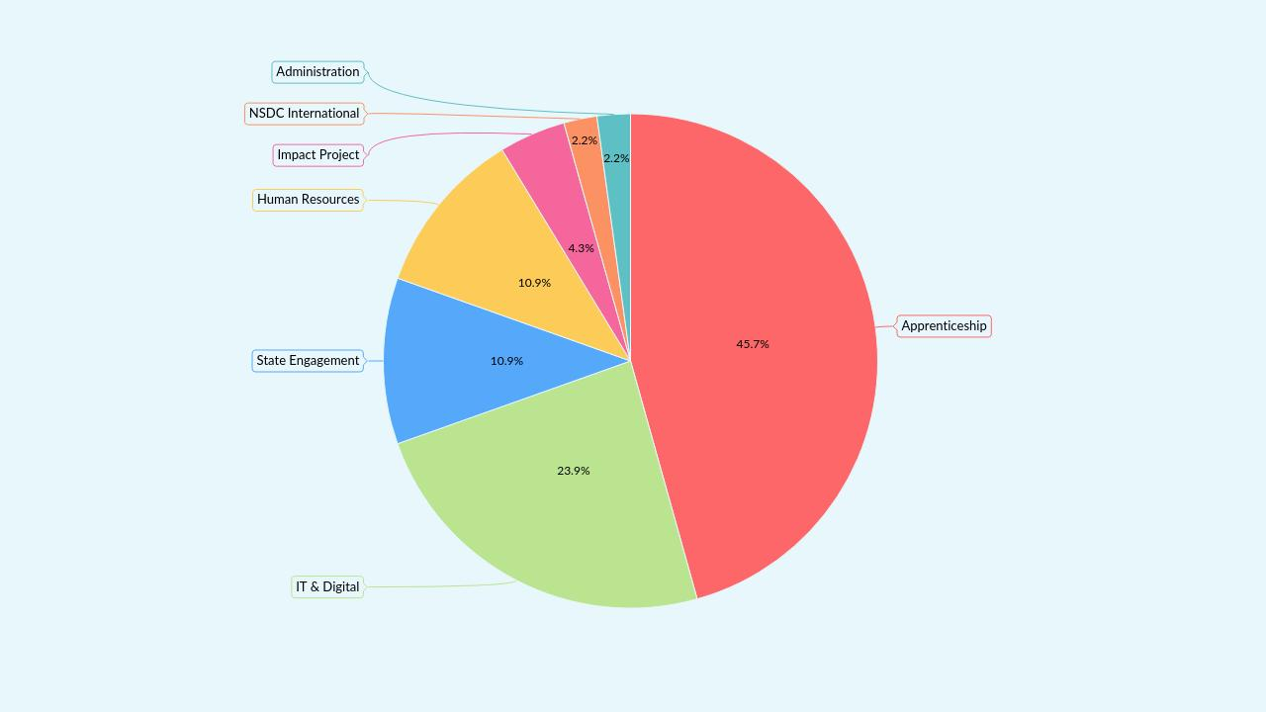
Department-wise Project Distribution

Slide 3
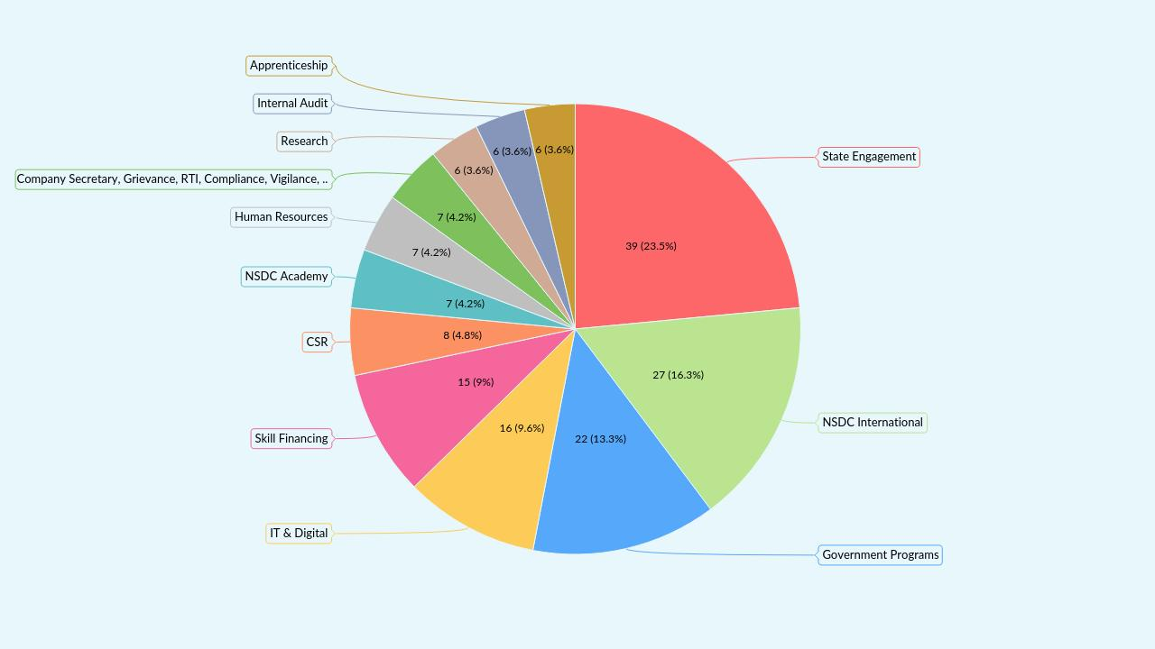
Department-wise Employee Distribution

Slide 4
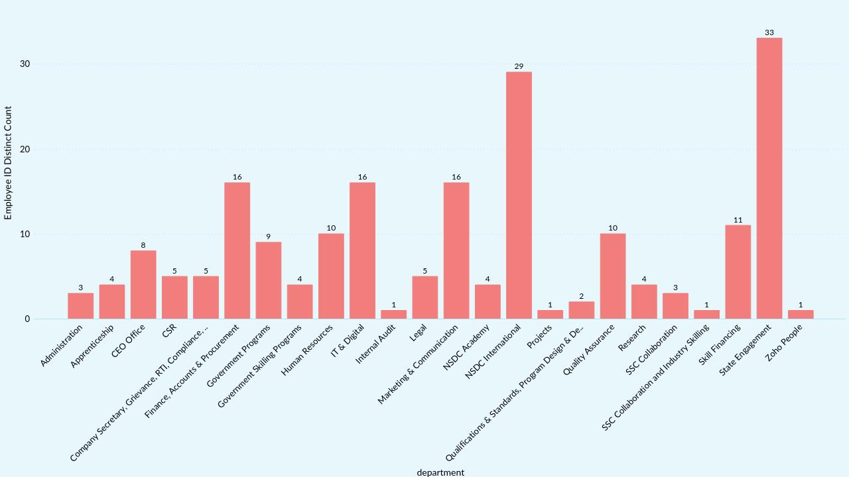
Department wise log not submitted

Slide 5
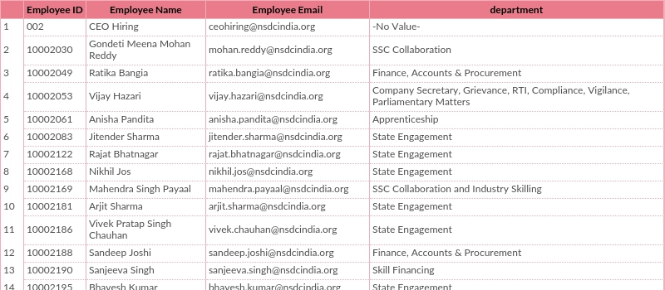
Time Log Not Submitted

Slide 6
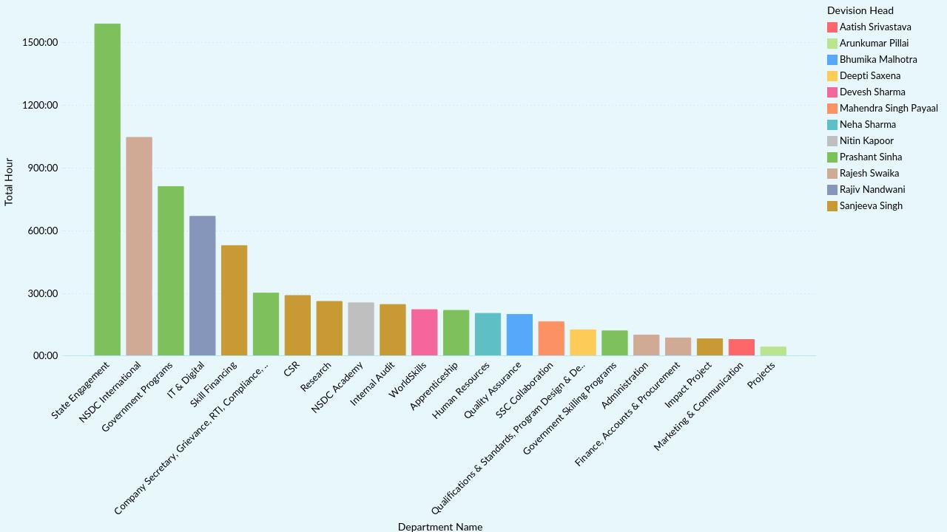
Department-wise Total Hours Count

Slide 7
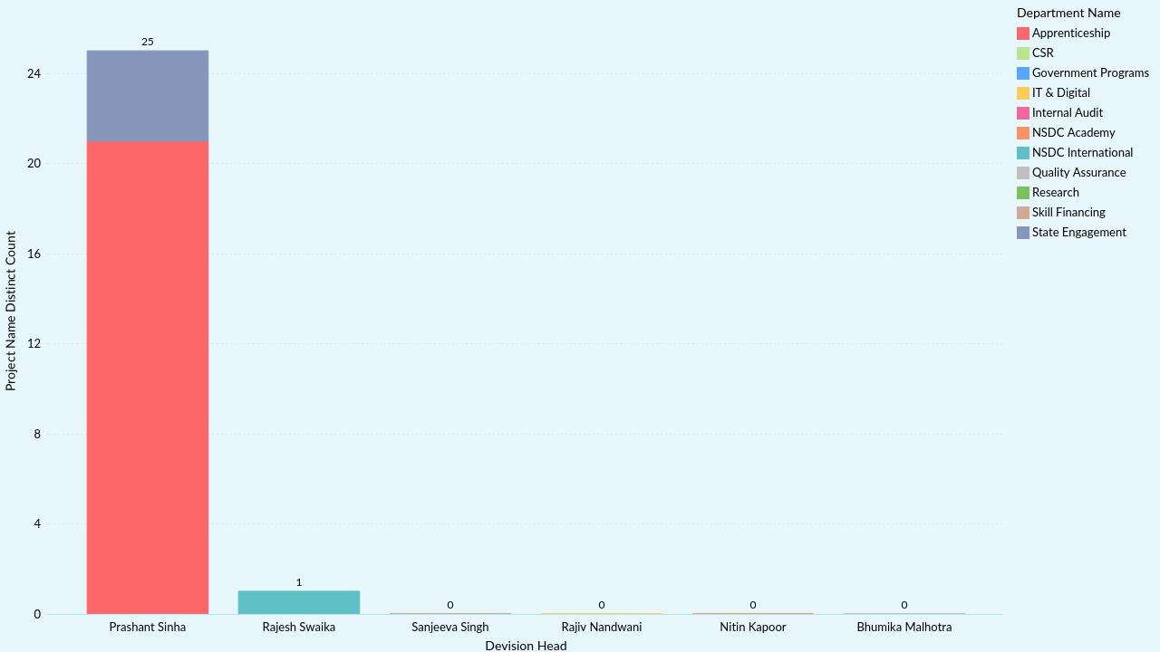
DH Wise Project Count

Slide 8
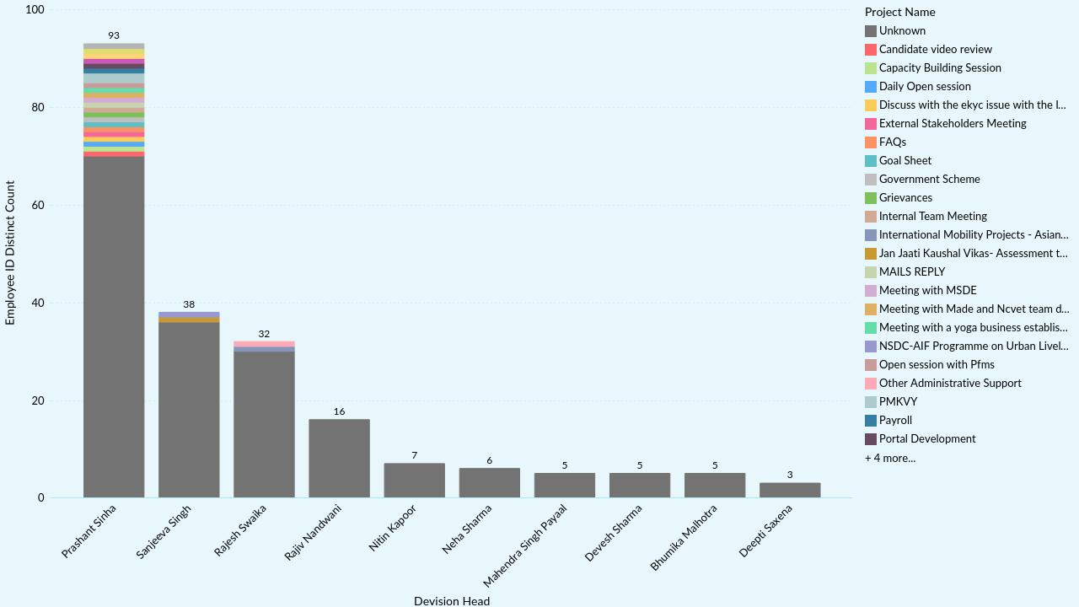
DH Wise Employee & Project

Slide 9
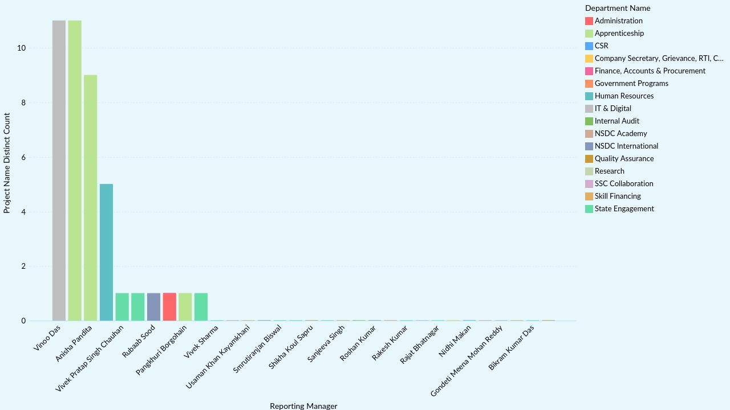
Reporting Manager Wise Project Count

Slide 10
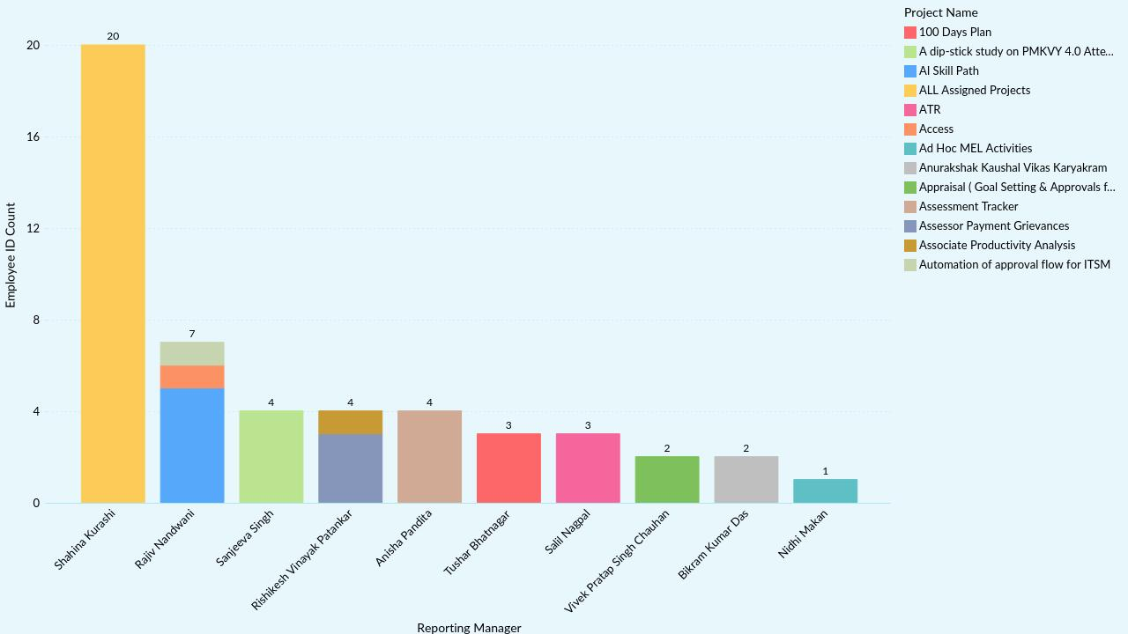
RM Wise Employee & Project

Slide 11
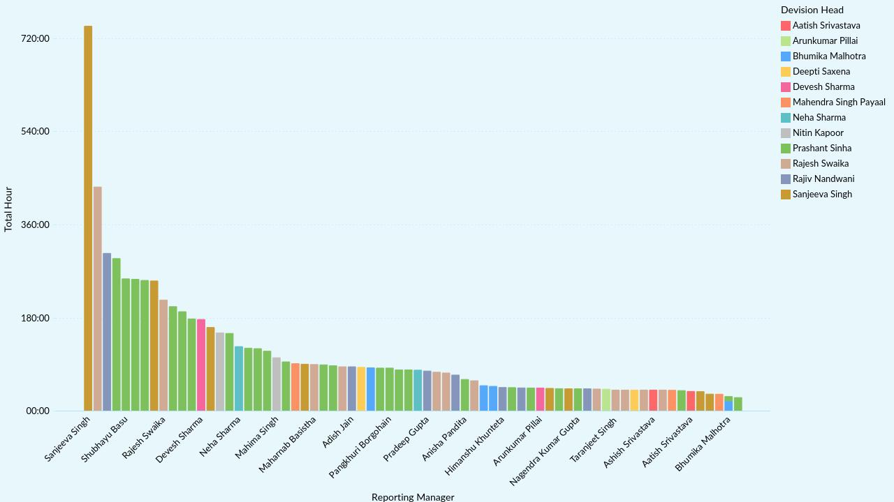
RM-wise Total Hours Count

Slide 12
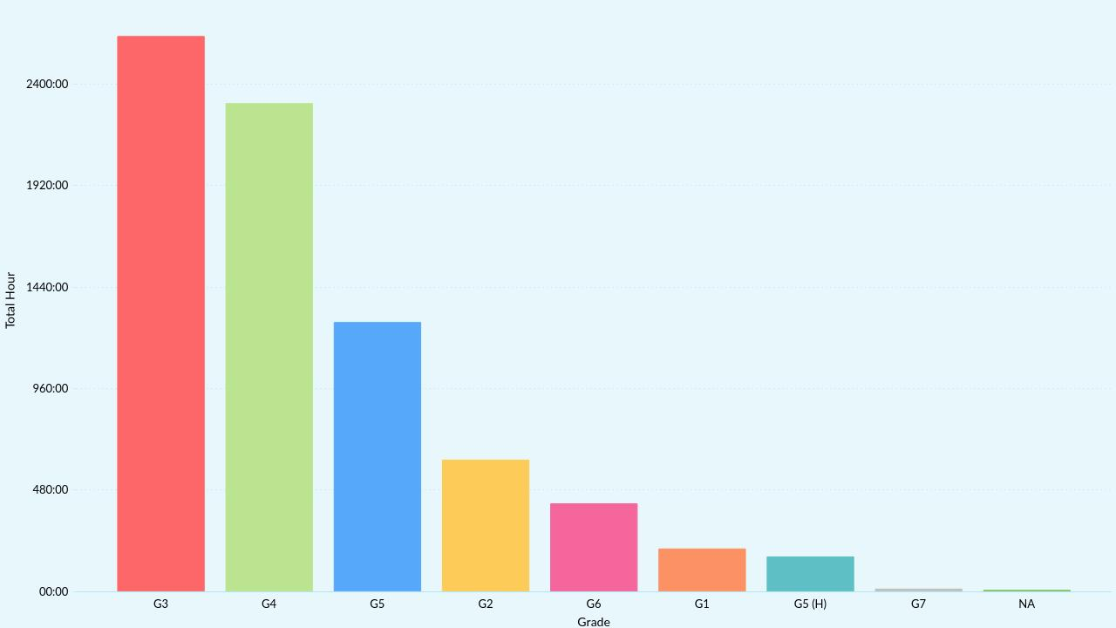
Grade-wise Total Hours

Slide 13
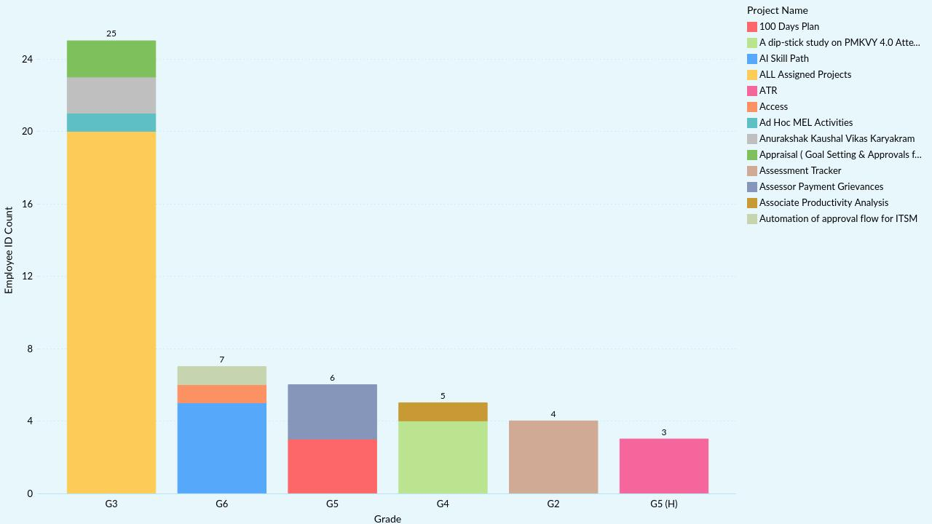
Grade Wise Employee & Project

Slide 14
Thank you

