Slide 1

MPMC COURSE PROJECT
PostureSense Chair— Real-time Sensor Feedback & Personalised Correction
PosturePilot
SREEVATHSAN V - EC24B1080
JULY - NOVEMBER
2025
ABHISHEK S - EC24B1085

Slide 2
Introduction
Poor sitting posture has become a major health concern in today’s digital age, especially among students and professionals who spend long hours at desks.
Prolonged slouching can lead to back pain, spinal deformities, and reduced productivity.
To address this, our system aims to monitor sitting posture in real time using low-cost sensors and provide instant feedback and alerts to help users maintain healthy posture habits.

Slide 3
ROADMAP - ENGINEERING ASPECT
Phase-1: Ideation and Research Phase-2: Prototype Making Phase-3: Testing and Iterations | ESP32: Processor/Brain IR Sensor - Measures distance to user’s back HC-SR04
Phases
Components Used
Working Logic
Evolution of the Product
Past → Passive braces & posture advice
Present → Sensorized wearables with haptic feedback
Future → ML-driven personalised coaching + clinical validation
Our Prototype → A smart chair add-on that senses your sitting posture and gently reminds you to sit upright.
Calibration: Record baseline distances.
Monitoring: If seat shifts forward distance increases, assume bad posture
After delay, triggers alert on app interface

Slide 4
IEEE RESEARCH PAPER-1
WORKING LOGIC:
Ultrasonic sensor detects posture by comparing measured distance with a preset threshold (6 cm).
IMU sensor identifies posture deviations via angle changes in the thoracic spine region.
ESP32 processes sensor data and sends it via Bluetooth to the mobile app.
The Android app displays real-time posture data and issues alerts when improper posture is detected.
ELECTRONICS INVOLVED:
Core Controller:
ESP32 microcontroller with built-in Wi-Fi/Bluetooth for wireless data transmission.
Sensors Used:
HC-SR04 Ultrasonic Sensor mounted on the chair backrest to measure distance between user’s back and chair.
MPU-6050 IMU Sensor embedded in a T-shirt to monitor angular variations (pitch, roll, yaw) of the upper back.
Power Source:
3.7 V Li-ion rechargeable battery supplies the ESP32 and sensors.
Software Tools:
Arduino IDE for programming ESP32; MIT App Inventor for developing the Android app.

Slide 5
IEEE RESEARCH PAPER-2
ELECTRONICS INVOLVED:
ESP32S Wi-Fi module which sends processed posture data to the Arduino IoT Cloud.
Accelerometer (ADXL335, 3-axis): Detects inclination of the user’s spine.
ADC0804 (8-bit): Converts analog accelerometer signals into digital data .
555 Timer (Astable mode): Generates clock frequency required by ADC for conversion.
AT89S52 Microcontroller: Processes digital data , Compares readings and displays the result.
WORKING LOGIC:
The AT89S52 microcontroller compares the reading with a preset threshold value (≈180).
If value < threshold → normal posture (no alert). If value ≥ threshold → bad posture.
For bad posture , Vibration motor is activated to alert the user.
LCD (16×2) displays the digital value.
Simultaneously, data is sent via ESP32 Wi-Fi module to the Arduino IoT Cloud.
Mobile app/IoT dashboard shows real-time readings and graphs posture history.
Cycle repeats continuously for real-time posture monitoring.

Slide 6
Current Scenario
Most available posture correction devices are either:
Too expensive and targeted toward medical use or
Too basic, offering only vibration/buzzer alerts without data tracking.
There’s a lack of affordable, real-time, and user-friendly posture monitoring systems for everyday users.
Hence, a simple, low-cost system integrating hardware feedback with a mobile app interface is highly relevant today.

Slide 7
The proposed system continuously monitors the user’s sitting distance using an ultrasonic sensor fixed to a chair and controlled by an ESP32 microcontroller.
Working Steps:
1) Distance Measurement: Ultrasonic sensor measures the user’s back distance in real time.
2)Feedback Display:
LCD shows posture status as “Good” or “Bad.”
Bluetooth sends posture data to the MIT App Inventor mobile app.
3)Timed Alerts:
If slouching continues for >10 seconds, a reminder is triggered.
If sitting continuously for >45 minutes, the system alerts the user to take a break.
Health Promotion: Regular reminders help maintain proper posture and reduce fatigue.
Methodology & Working Principle

Slide 8
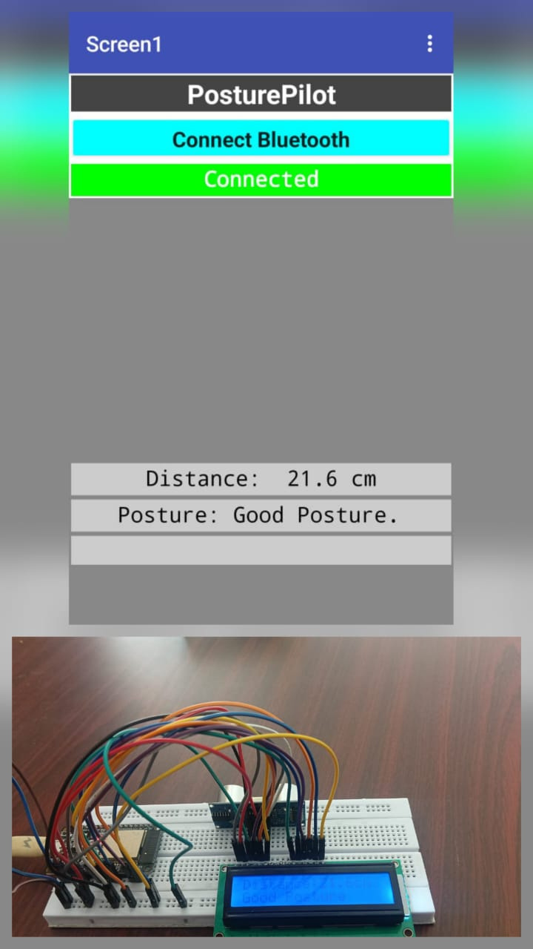
RESULTS OBTAINED
https://screenapp.io/app/v/xKcn4iP6iV

Slide 9
Future Enhancements
Cloud Integration: Store posture data for long-term tracking and analytics.
Machine Learning: Personalize feedback based on user behavior and seating patterns.
Multi-Sensor Setup: Use IMU/gyroscope sensors for full-body posture analysis.
Vibration Feedback: Add gentle haptic alerts instead of only visual/audio cues.
Compact Design: Miniaturize the system for easy integration into office chairs.

