Slide 1
Used car PRICE PREDICTION

Slide 2
The focus of this project is developing machine learning models that can accurately predict the price of a used car based on its features, in order to make informed purchases. We implement and evaluate various learning methods on a dataset consisting of the sale prices of different makes and models across cities in the India. Our results show that Random Forest model and K-Means clustering with linear regression yield the best results, but are compute heavy. Conventional linear regression also yielded satisfactory results, with the advantage of a significantly lower training time in comparison to the aforementioned methods.
Problem understanding?

Slide 3

Objective/motive of this project
To develop a efficient and effective model which predicts the price of a used car according to user’s inputs. To achieve good accuracy.

Slide 4

Technical requirements
Python 3.8 and higher
Jupyter notebook

Slide 5
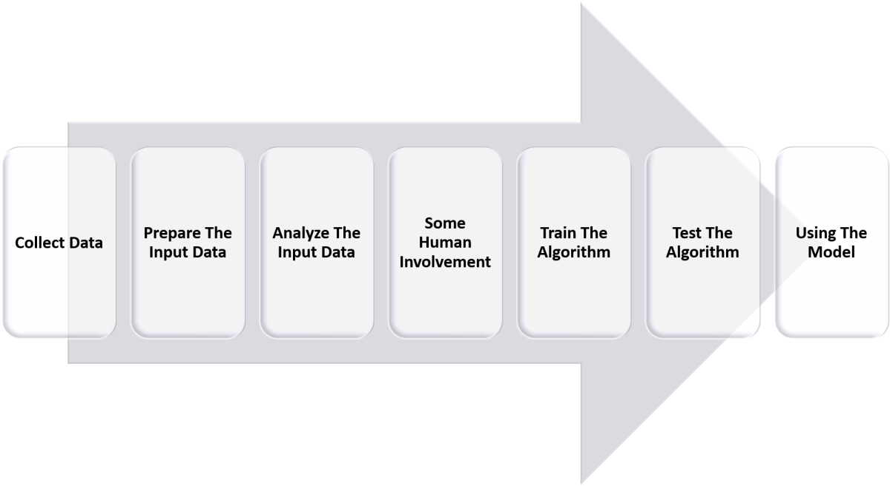
STEps involved

Slide 6
Step 1: Data Acquisition
The first step in the machine learning process is to get the data. This will depend on the type of data you are gathering and the source of data. This can be either static data from an existing database or real-time data from an IoT system or data from other repositories.
Step 2: Data Cleaning
All real-world data is often unorganized, redundant, or has missing elements. In order to feed data into the machine learning model, we need to first clean, prepare and manipulate the data. This is the most crucial step in the machine learning workflow and takes up the most time as well. Having clean data means that you can get a more accurate model down the road.
Step 3: Model Training
The next step in the machine learning workflow is to train the model. A machine learning algorithm is used on the training dataset to train the model. This algorithm leverages mathematical modeling to learn and predict behaviors. These algorithms can fall into three broad categories - binary, classification, and regression.

Slide 7
Step 4: Model Testing
After the model is trained, we need to test and validate it for further processing. By using the testing dataset obtained from Step 3, we can check the accuracy of the model. If the results are not satisfactory, the model should be further improved. The model is trained and improved over and over again until the results are satisfactory.
Step 5: Deployment
Once the model is trained, deploy and pipeline it to production for application consumption.

Slide 8
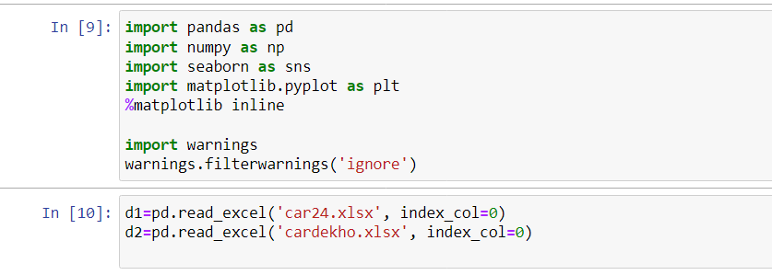
ImpORTING DATA

Slide 9
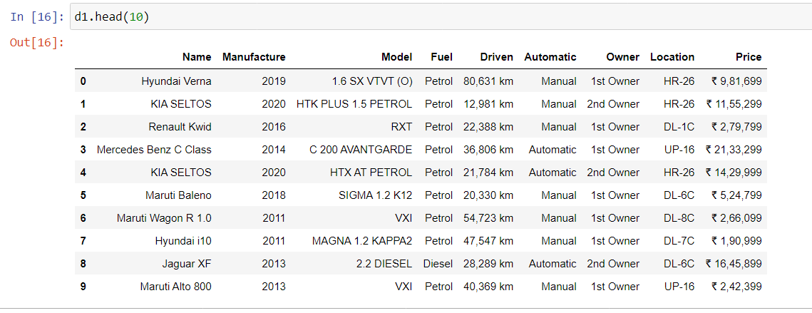
Viewing data

Slide 10
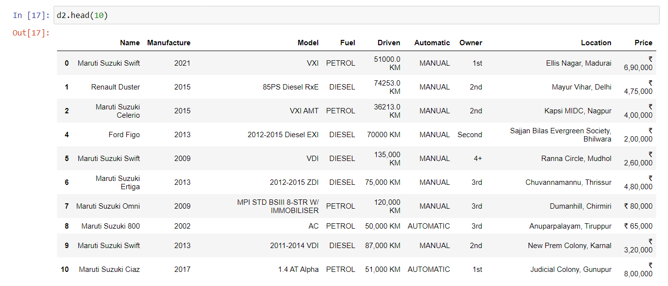

Slide 11
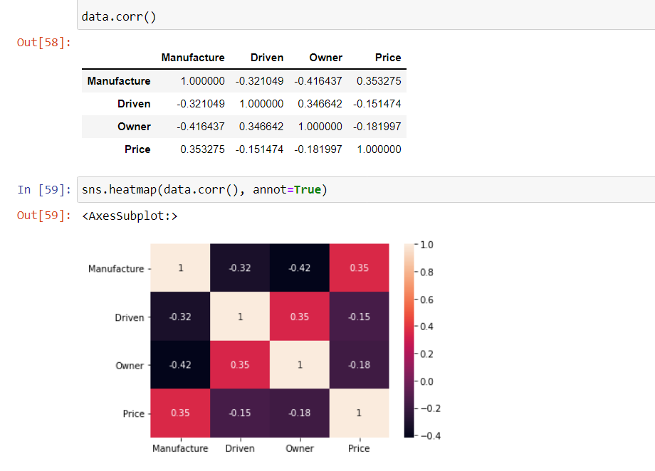
Data Correlation

Slide 12
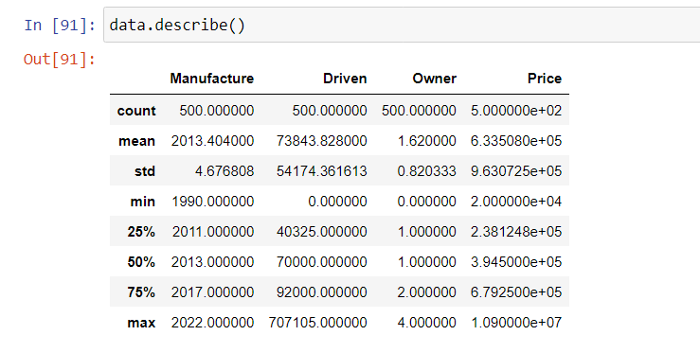
Show statistical summary

Slide 13
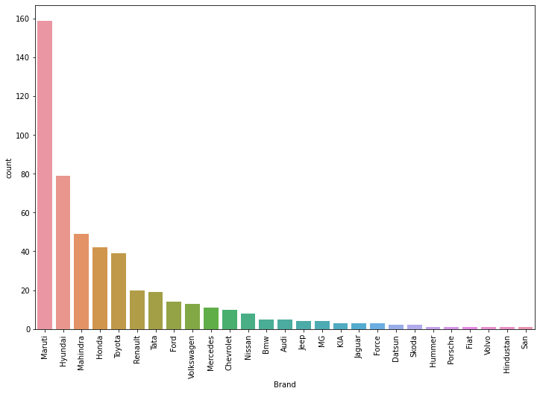
Visualization of data
Brand and Count

Slide 14
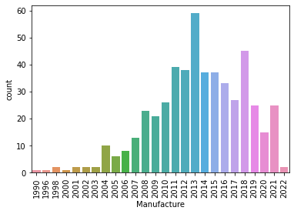
Visualization of data
Manufacture and Count

Slide 15
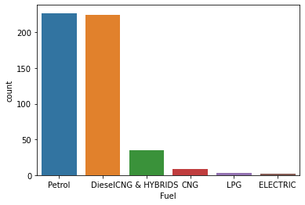
Visualization of data
Fuel and Count

Slide 16
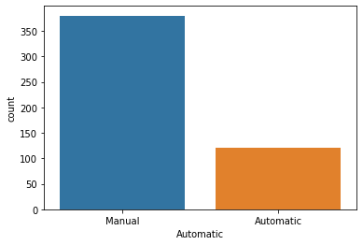
Visualization of data
Automatic and Count

Slide 17
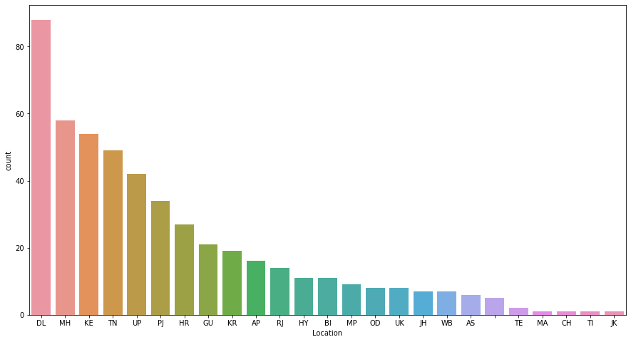
Visualization of data
Location and Count

Slide 18
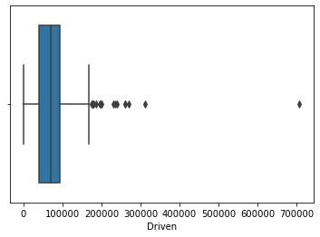
Outliers and its removal
Outliers are the values that look different from the other values in the data. Below is a plot highlighting the outliers in ‘red’ and outliers can be seen in both the extremes of data.
Problems caused by outliers
Outliers in the data may causes problems during model fitting (esp. linear models).
Outliers may inflate the error metrics which give higher weights to large errors (example, mean squared error, RMSE).

Slide 19
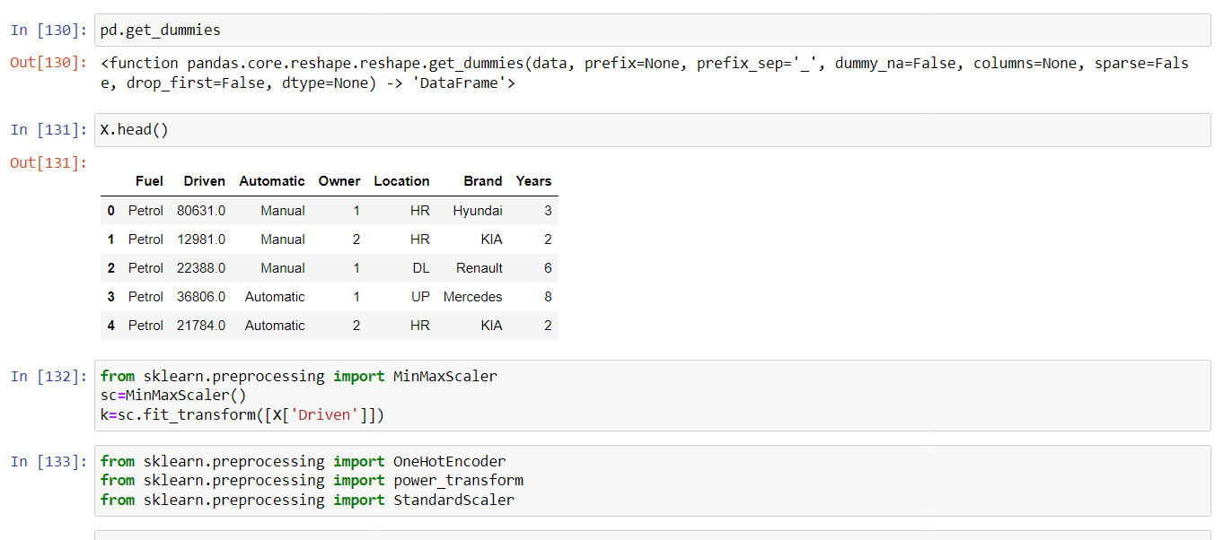
Encoding of data

Slide 20

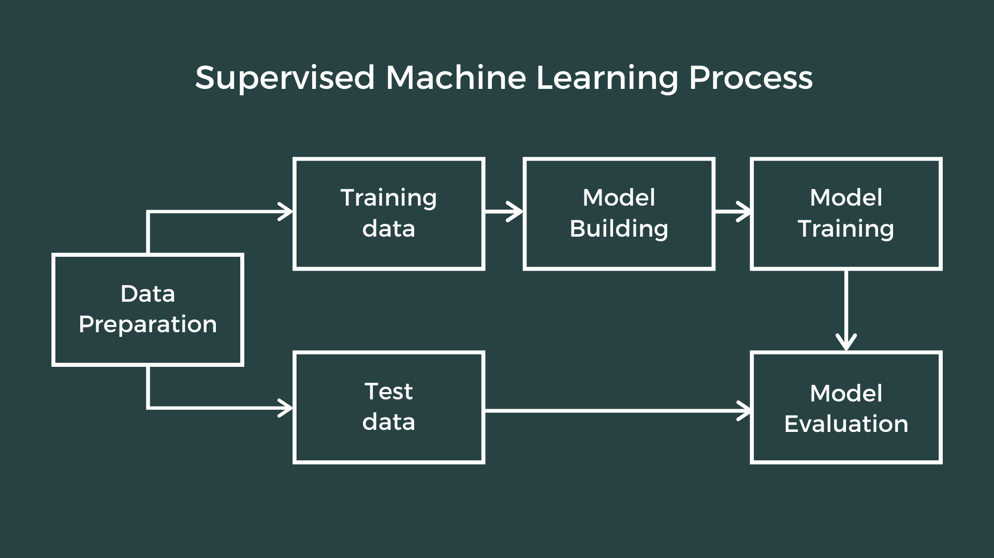
Machine learning

Slide 21
Models used in this project
Regression Model is used in this project. The different types of regression models used are –
Linear Regression
Lasso Regression
Ridge Regression
SVR Regressor
Kneighbor Regressor
AdaBoost Regressor

Slide 22
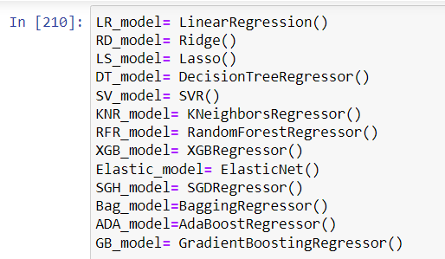
How I choose the best model?
Here are the list of all models I used for prediction. I calculated the –
Mean absolute error of each model
Mean squared error of each model
R2 score of each model
Cross validation score of each model
using a function and then interpreted the results.

Slide 23
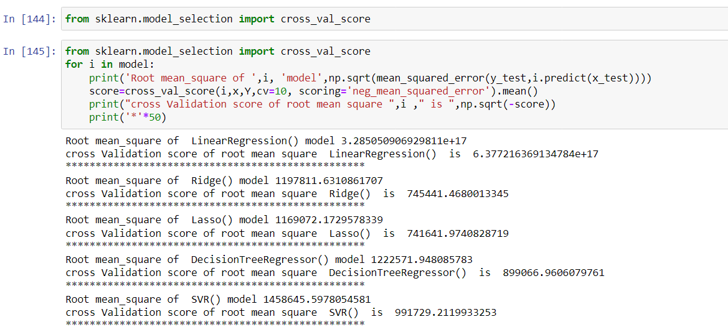
Cross Validation

Slide 24
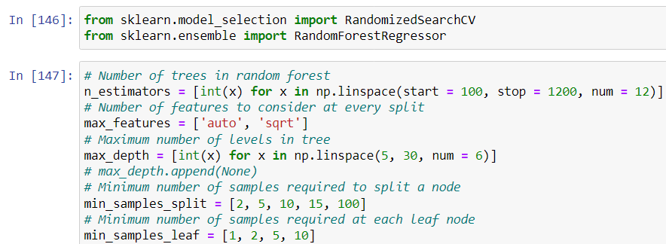
Used Random Forest Regressor Model

Slide 25
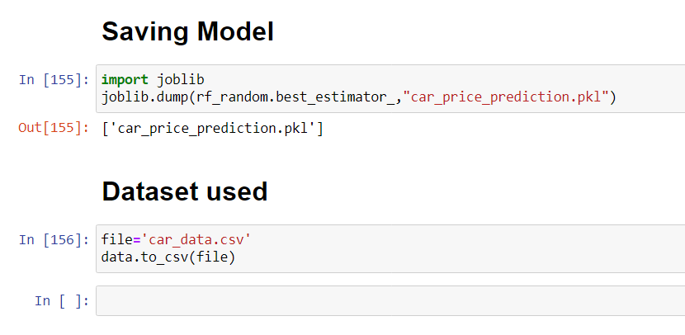
Saving of my model

Slide 26
Conclusion
Using data mining and machine learning approaches, this project proposed a scalable framework for India based used cars price prediction. Car24.com and CarDekho websites was scraped using the Selenium scraping tool to collect the benchmark data. An efficient machine learning model is built by training, testing, and evaluating three machine learning regressors named Random Forest Regressor, Linear Regression, and Bagging Regressor. As a result of pre-processing and transformation, Random Forest Regressor came out on top with 69% accuracy.
The intelligent model will then be included in online and mobile applications for general use. In addition, after the data gathering phase, the pandemic-related shortages of semiconductors caused a rise in automobile costs and had a significant impact on the used-car market. Therefore, it is necessary to periodically gather and analyse data; ideally, we would use a real-time processing tool

