Slide 1
HOUSE PRICE PREDICTION

Slide 2

Houses are one of the necessary need of each and every person around the globe and therefore housing and real estate market is one of the markets which is one of the major contributors in the world’s economy. It is a very large market and there are various companies working in the domain. Data science comes as a very important tool to solve problems in the domain to help the companies increase their overall revenue, profits, improving their marketing strategies and focusing on changing trends in house sales and purchases. Predictive modelling, Market mix modelling, recommendation systems are some of the machine learning techniques used for achieving the business goals for housing companies. Our problem is related to one such housing company.
What is problem?

Slide 3

Objective/motive of this project
House price prediction can help determine the selling price of a house and can help to arrange the right time to purchase a house. There are various factors that influence the price of a house which include physical conditions, concept and location

Slide 4

Technical requirements
Python 3.8 and higher
Jupyter notebook

Slide 5
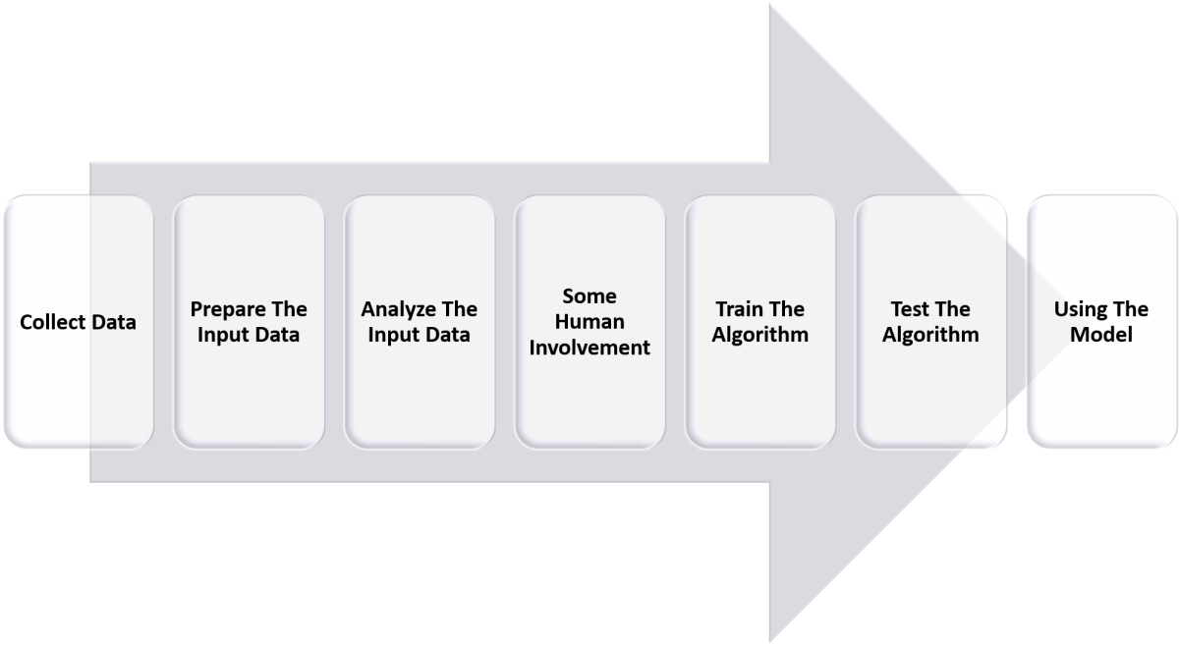
STEps involved

Slide 6
Step 1: Data Acquisition
The first step in the machine learning process is to get the data. This will depend on the type of data you are gathering and the source of data. This can be either static data from an existing database or real-time data from an IoT system or data from other repositories.
Step 2: Data Cleaning
All real-world data is often unorganized, redundant, or has missing elements. In order to feed data into the machine learning model, we need to first clean, prepare and manipulate the data. This is the most crucial step in the machine learning workflow and takes up the most time as well. Having clean data means that you can get a more accurate model down the road.
Step 3: Model Training
The next step in the machine learning workflow is to train the model. A machine learning algorithm is used on the training dataset to train the model. This algorithm leverages mathematical modeling to learn and predict behaviors. These algorithms can fall into three broad categories - binary, classification, and regression.

Slide 7
Step 4: Model Testing
After the model is trained, we need to test and validate it for further processing. By using the testing dataset obtained from Step 3, we can check the accuracy of the model. If the results are not satisfactory, the model should be further improved. The model is trained and improved over and over again until the results are satisfactory.
Step 5: Deployment
Once the model is trained, deploy and pipeline it to production for application consumption.

Slide 8
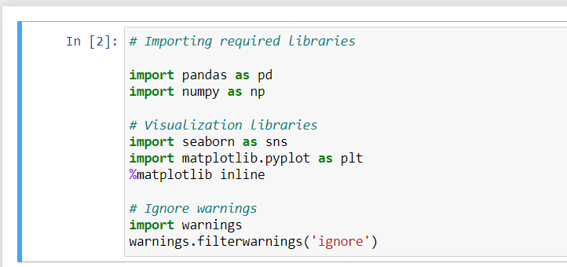
ImpORTING DATA

Slide 9
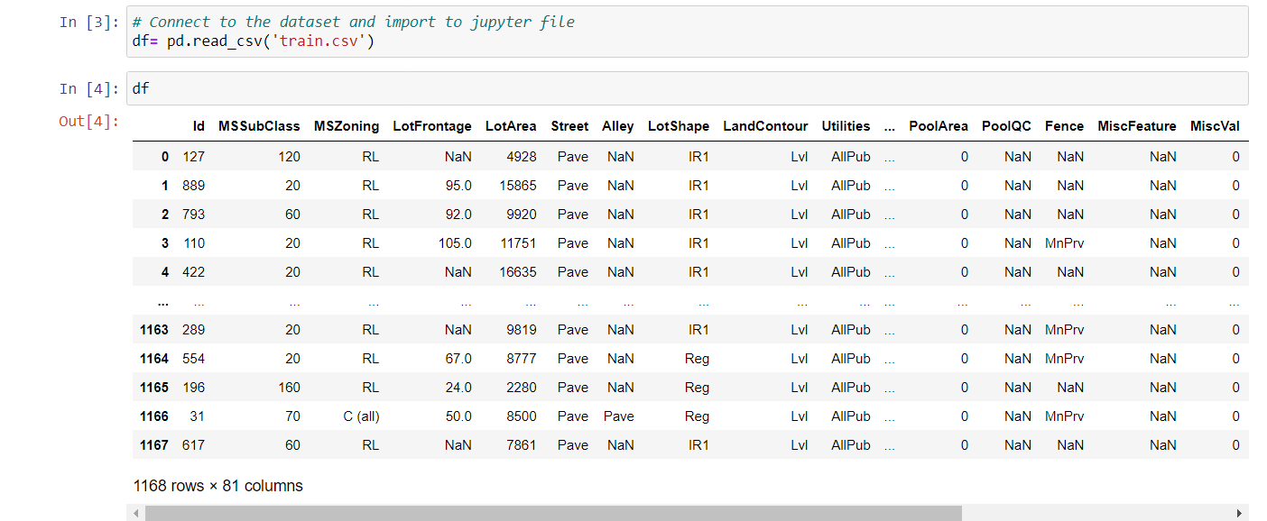
Connecting to dataset and viewing data

Slide 10
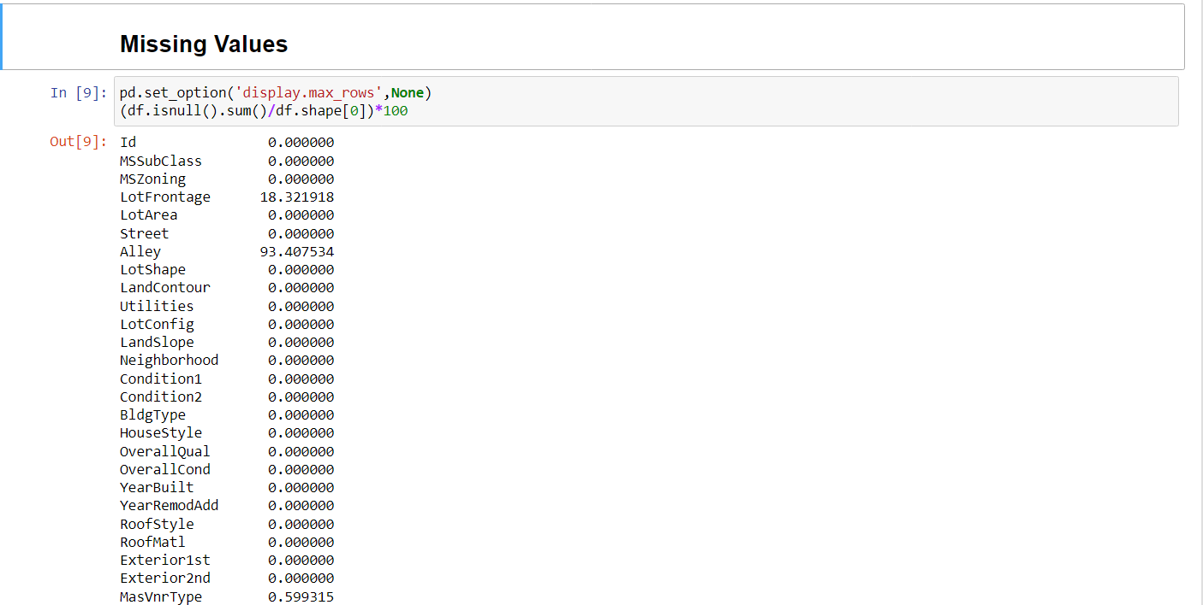
Viewing missing values

Slide 11
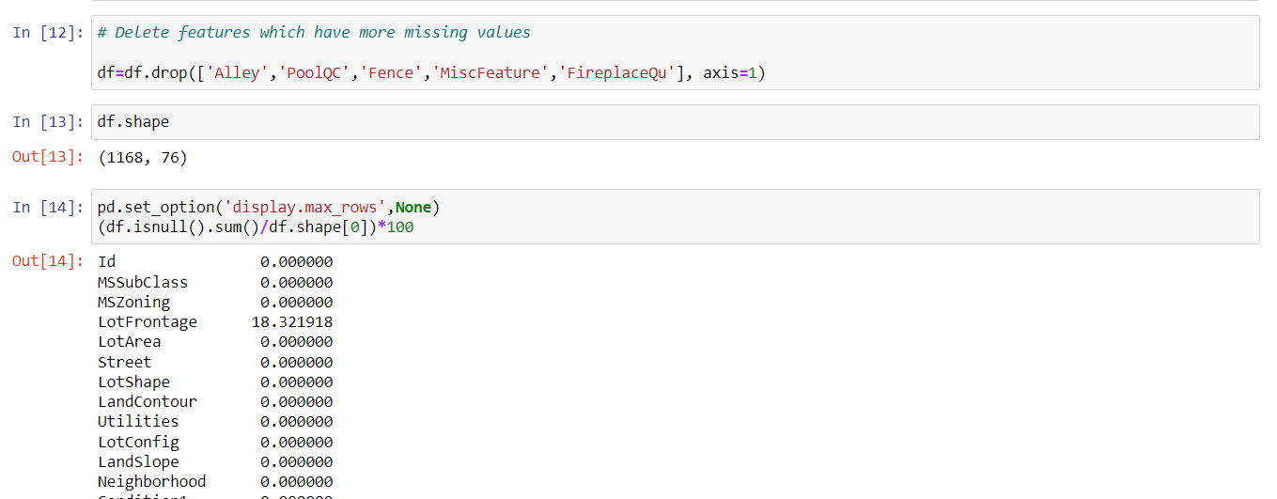
Dropping columns which have higher null values

Slide 12
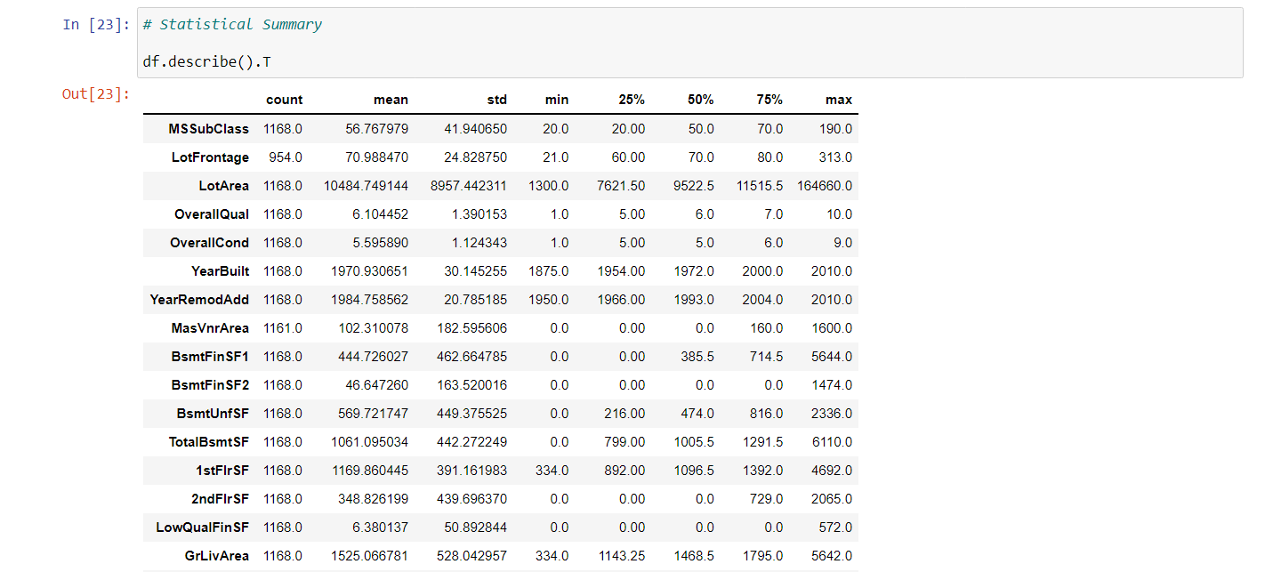
Show statistical summary

Slide 13
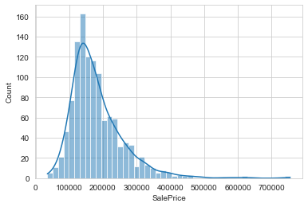
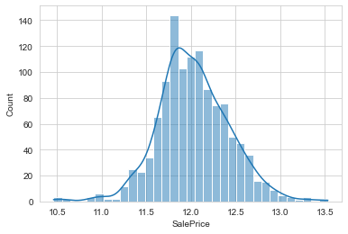
Visualization of data

Slide 14
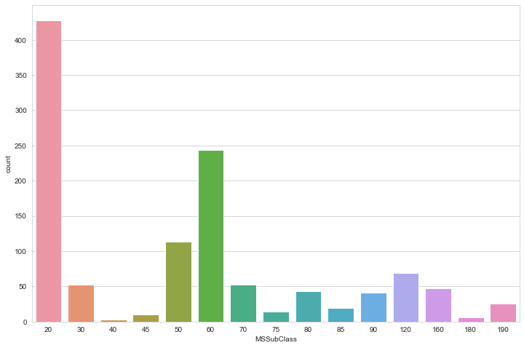
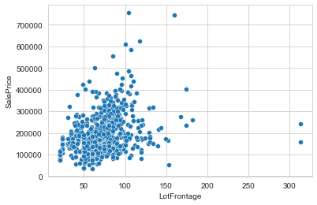
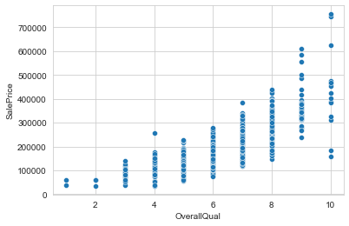
Similarly to the previous slide, we can visualize data for each and every single column using matplotllib and seaborn library.
There are many visualizations done in my project so I am showing you only few of them here.

Slide 15
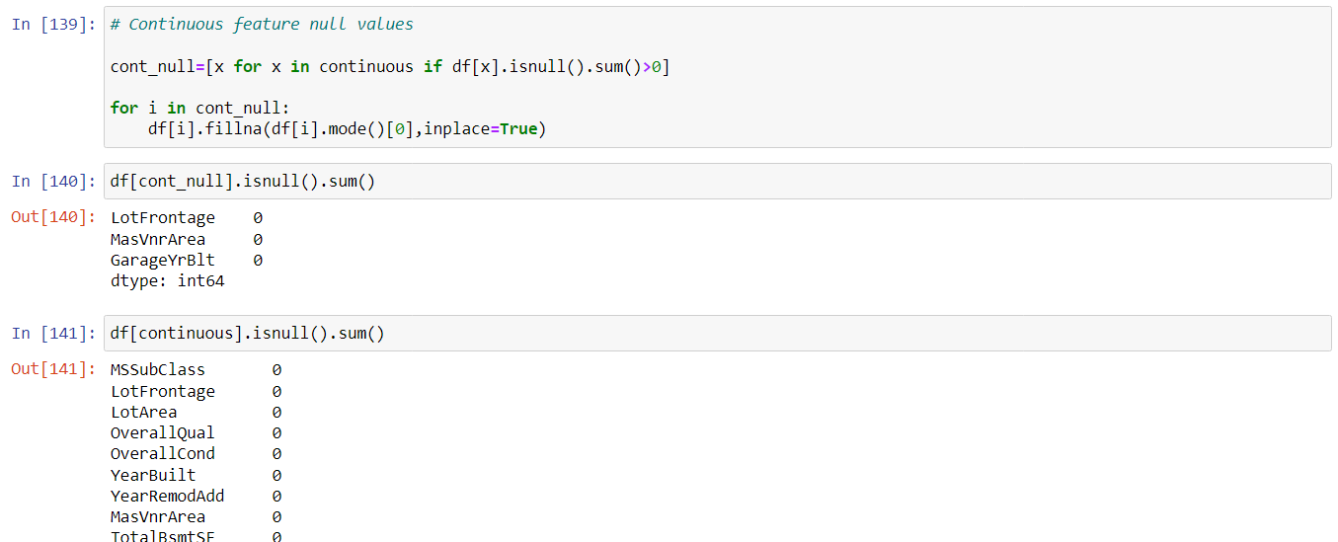
Filling null values
Here I have filled null values using mode() method.

Slide 16
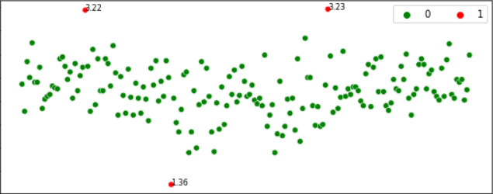
Outliers and its removal
Outliers are the values that look different from the other values in the data. Below is a plot highlighting the outliers in ‘red’ and outliers can be seen in both the extremes of data.
Problems caused by outliers
Outliers in the data may causes problems during model fitting (esp. linear models).
Outliers may inflate the error metrics which give higher weights to large errors (example, mean squared error, RMSE).

Slide 17
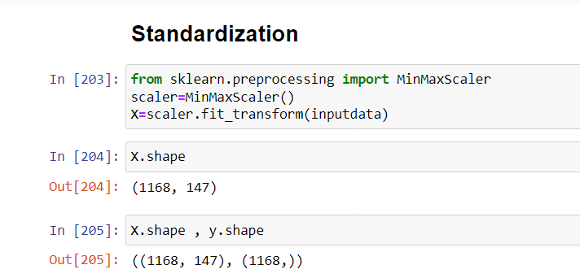
Standarization of data
Standardization is used on the data values that are normally distributed. Further, by applying standardization, we tend to make the mean of the dataset as 0 and the standard deviation equivalent to 1.

Slide 18

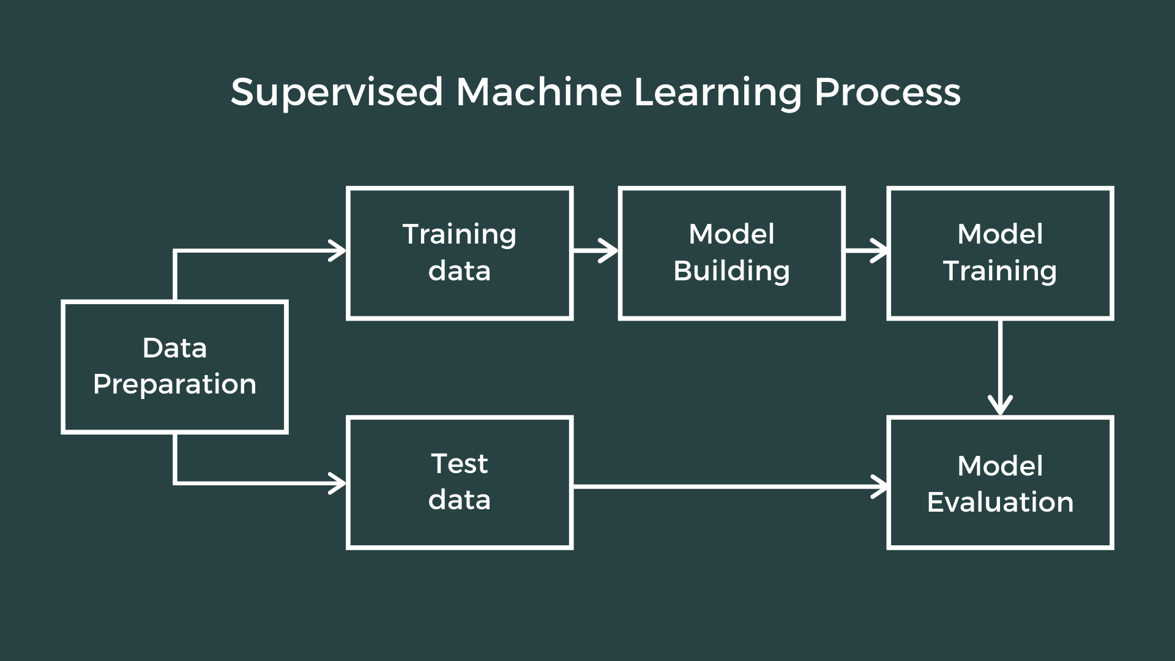
Machine learning

Slide 19
Models used in this project
Regression Model is used in this project. The different types of regression models used are –
Linear Regression
Lasso Regression
Ridge Regression
SVR Regressor
Kneighbor Regressor
AdaBoost Regressor

Slide 20
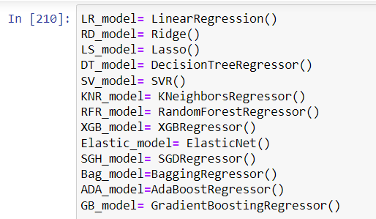
How I choose the best model?
Here are the list of all models I used for prediction. I calculated the –
Mean absolute error of each model
Mean squared error of each model
R2 score of each model
Cross validation score of each model
using a function and then interpreted the results.

Slide 21
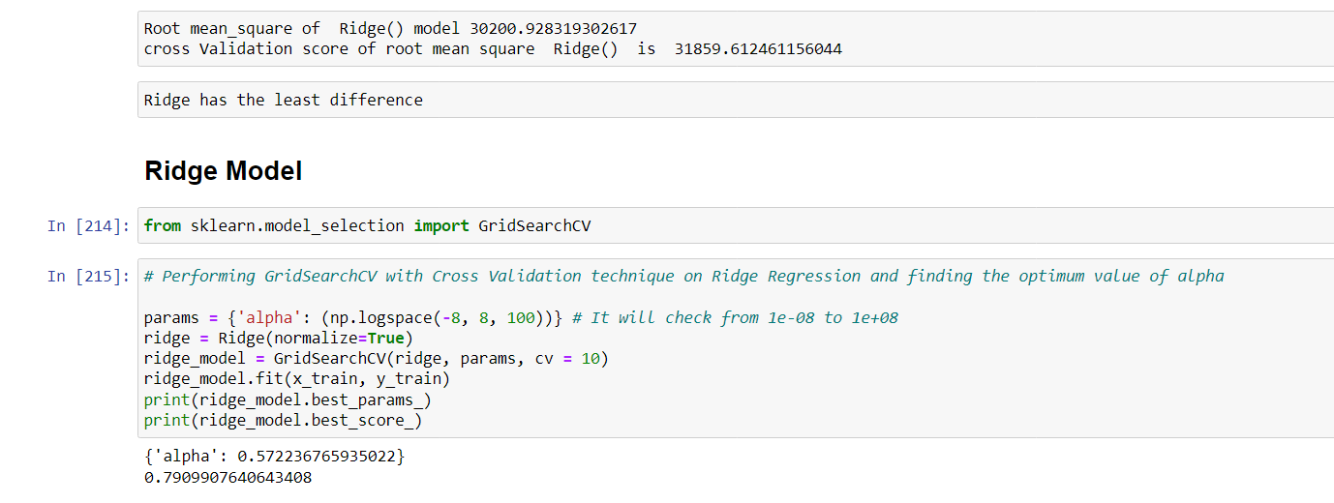
I have calculated the Root Mean Square Value (R2) value and Cross Validation Score of each model individually and found that the
Ridge Regression model has the least difference between the two so it will be better to use this model

Slide 22
Hyperparameter tuning of my model
Sometimes, it is very necessary to hyperparameter tuning our regression model so that its accuracy increases. There are two ways of hyperparameter tuning-
GridSearchCV
RandomizedSearchCV
I have used GridSearchCV algorithm In this project.
In GridSearchCV approach, machine learning model is evaluated for a range of hyperparameter values. This approach is called GridSearchCV, because it searches for best set of hyperparameters from a grid of hyperparameters values.

Slide 23
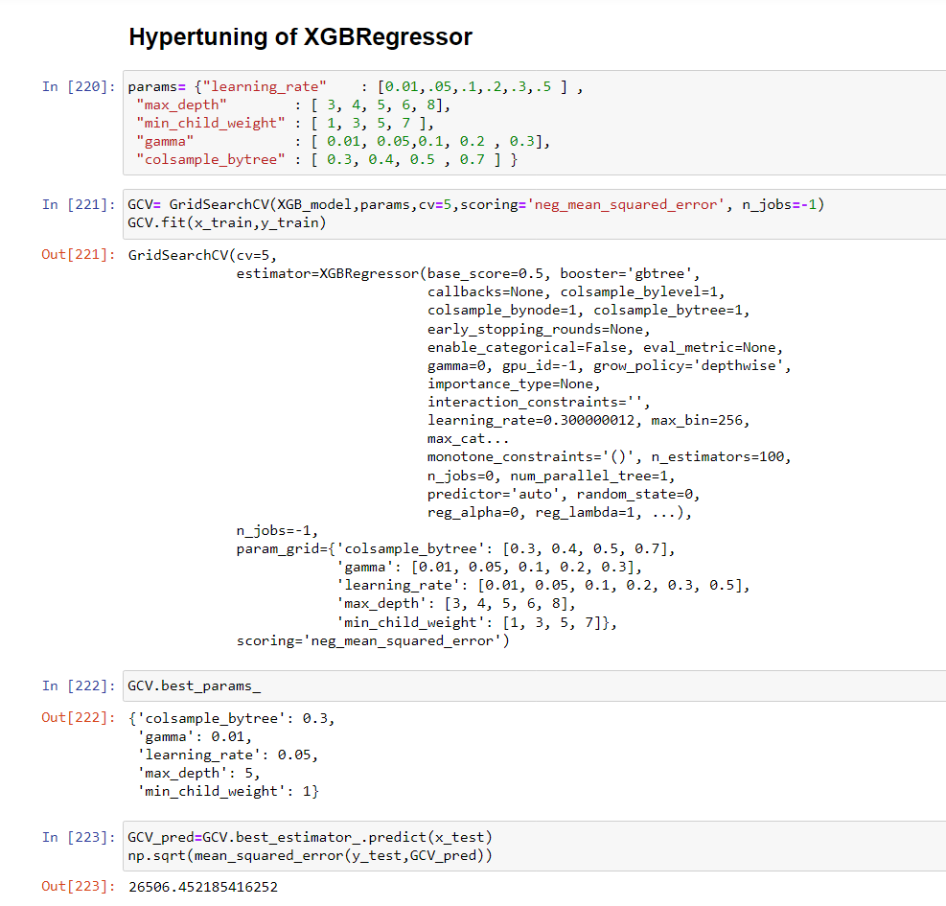
In this way ,I have predicted the best model for my project and then saved it to my system for further use in next step.

Slide 24
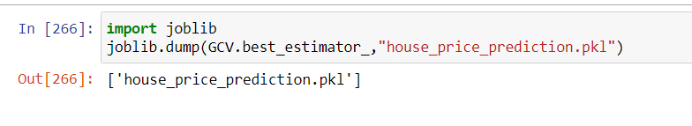
Saving of my model
I have saved the model as ”house_price_prediction.pkl” under my current directory folder using joblib function.
If I want to retrieve it, I can use other functions available in python such as pickle etc.

Slide 25
Conclusion
What I learned from this project is that whatever the regression models I have used for prediction of data, the error values coming was very huge which indicates that data obtained for machine training was not very much refined despite of performing so many EDA steps.
This may occur if our data was taken from a sample or random source or some irrevalent source. So in future I will try to figure out this mistakes and prepare a better predictive model.

