Slide 1

Seasonal Agriculture Performance Analysis
Abhishek Tiwari College Name: [ENTER YOUR COLLEGE]
AICTE STU ID: [ENTER FROM OFFER LETTER]

Slide 2

PROBLEM STATEMENT
PROBLEM STATEMENT

Slide 3
PROJECT DESCRIPTION
This project performs an end-to-end analysis of 4,000 farm records covering Kharif, Rabi and Zaid seasons. The workflow includes data-quality checks, contextual missing-value treatment, seasonal comparisons, crop and irrigation analysis, correlation analysis, visual exploration and a non-parametric statistical test. The objective is to turn raw agricultural observations into evidence-based insights that can support better seasonal planning and resource decisions.

Slide 4

WHO ARE THE END USERS?
Farmers and farm managers — seasonal crop and irrigation planning.
Agricultural planners and field teams — compare performance and resource usage.
Analysts and decision-makers — identify seasonal risk, profitability and areas for deeper investigation.
Training / academic stakeholders — use evidence-based agricultural analytics as a real-world case study.

Slide 5

TECHNOLOGY USED
Python for data analysis and automation
Pandas & NumPy for cleaning, transformation and aggregation
Matplotlib for data visualization
SciPy for statistical testing (Kruskal–Wallis H test)
Jupyter Notebook for reproducible analysis and documentation

Slide 6
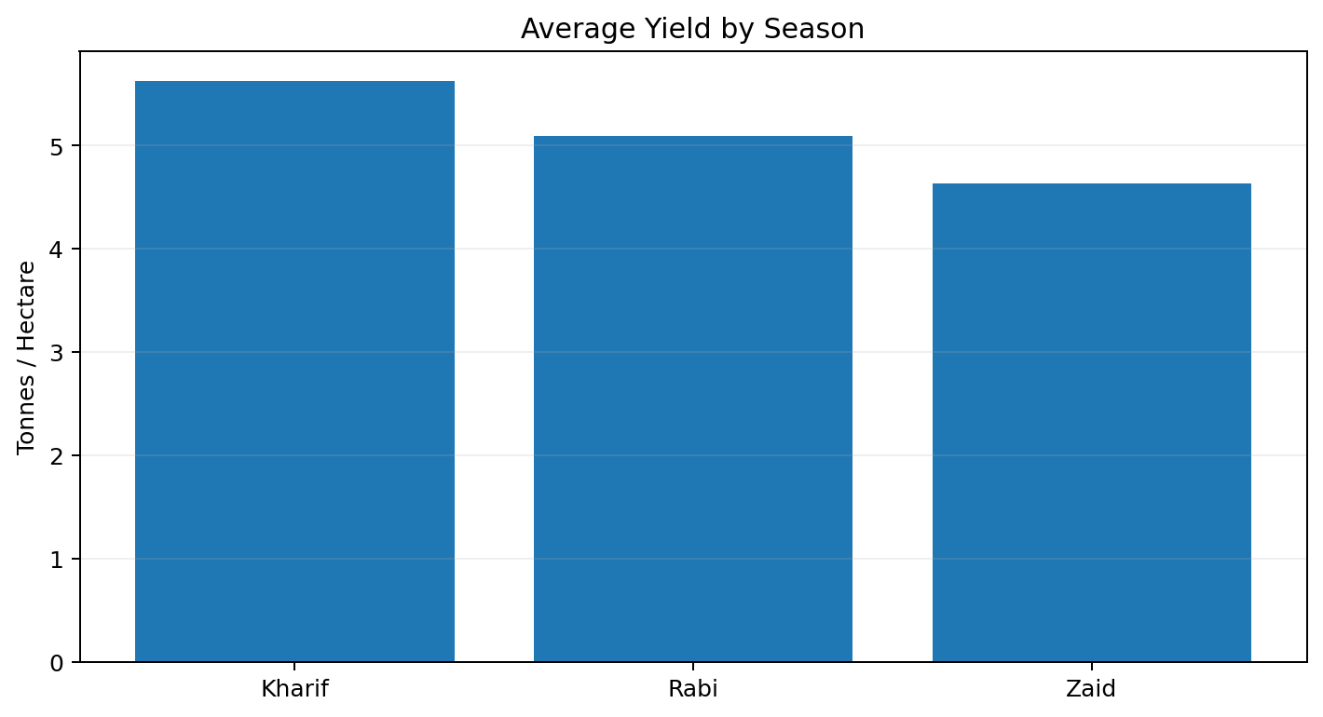
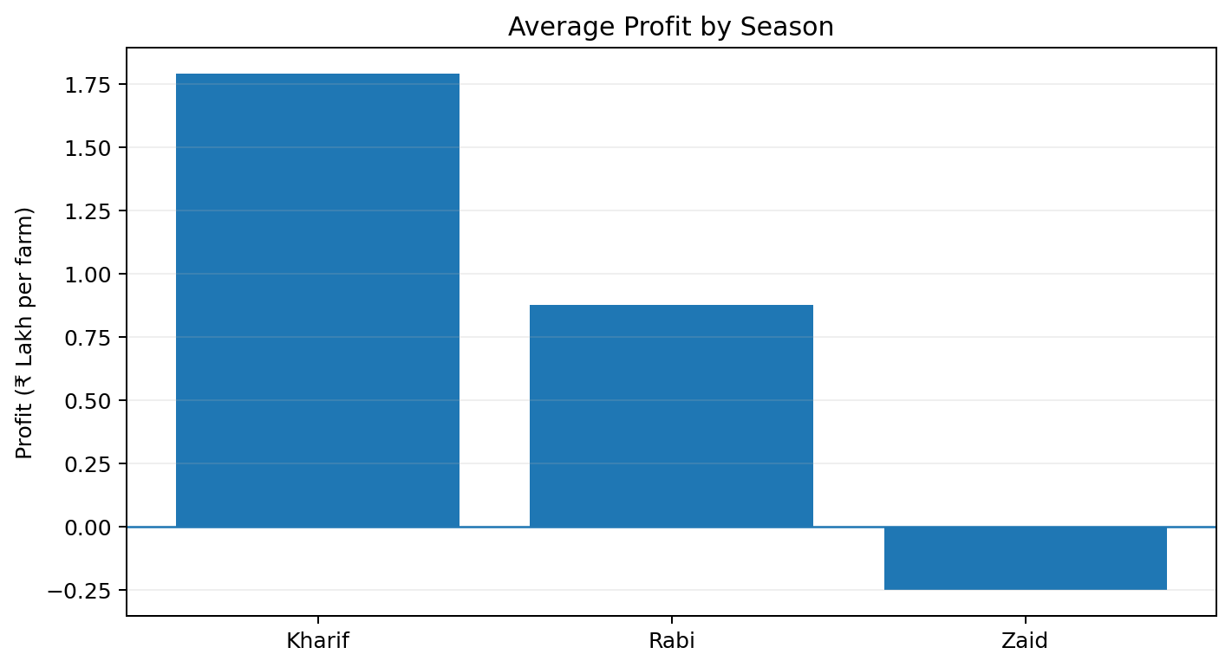
RESULTS — EXECUTIVE SUMMARY
Kharif Avg Profit
Zaid Avg Profit
Drip Avg Yield
Zaid Profitable Farms
₹1.79 L
-₹24,805
6.67 t/ha
35.5%
best seasonal average
loss-making on average
highest irrigation yield
lowest season
Overall pattern: Kharif leads in average profit and profitability; Zaid is financially weakest. Statistical tests confirm seasonal differences in profit, yield, water efficiency and disease/pest risk.

Slide 7
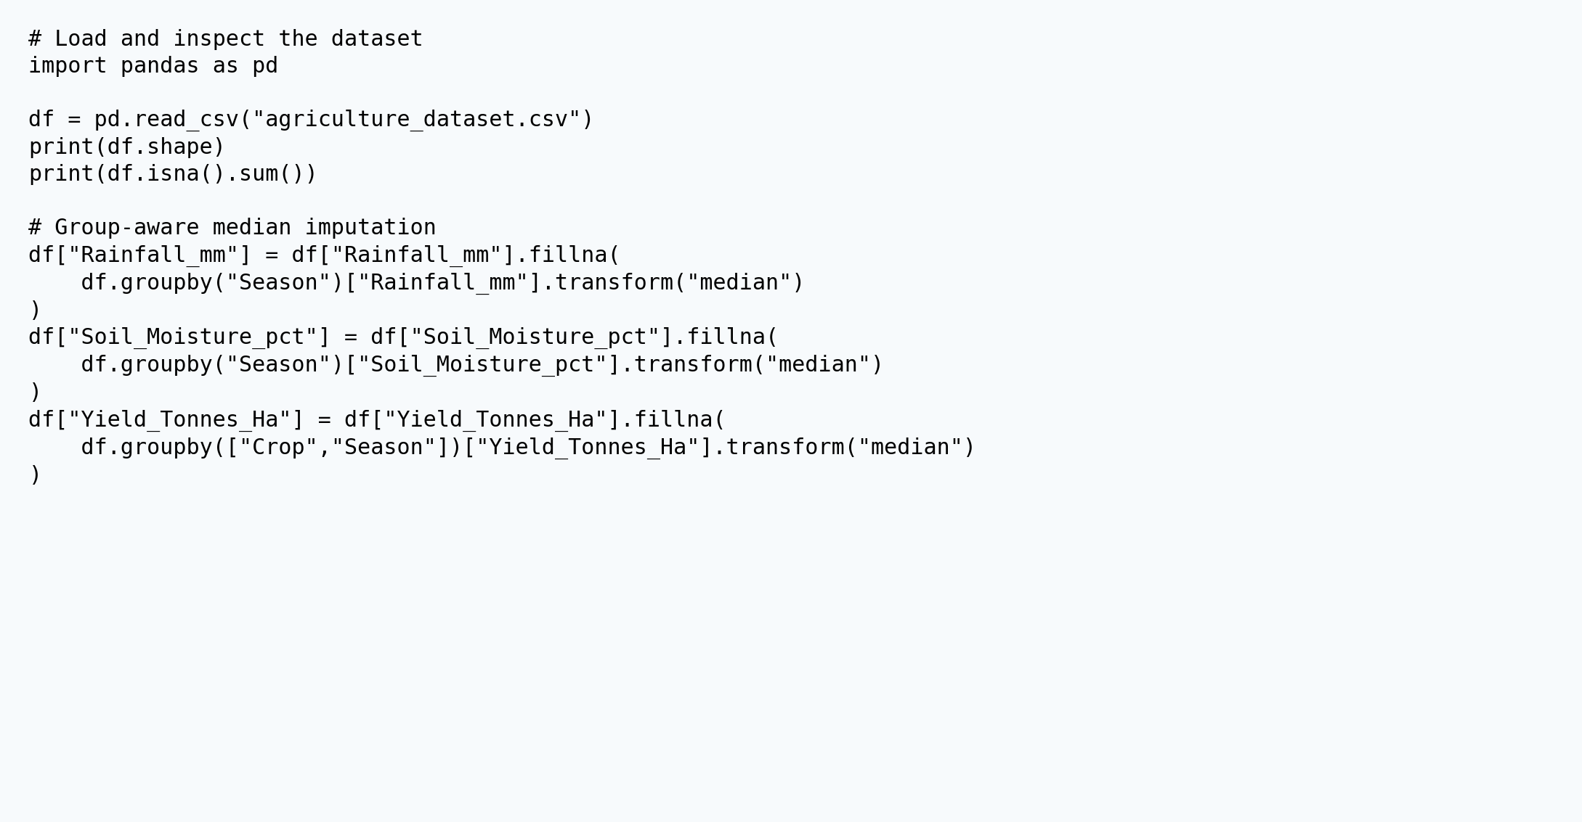
DATA CLEANING & PREPARATION

Slide 8
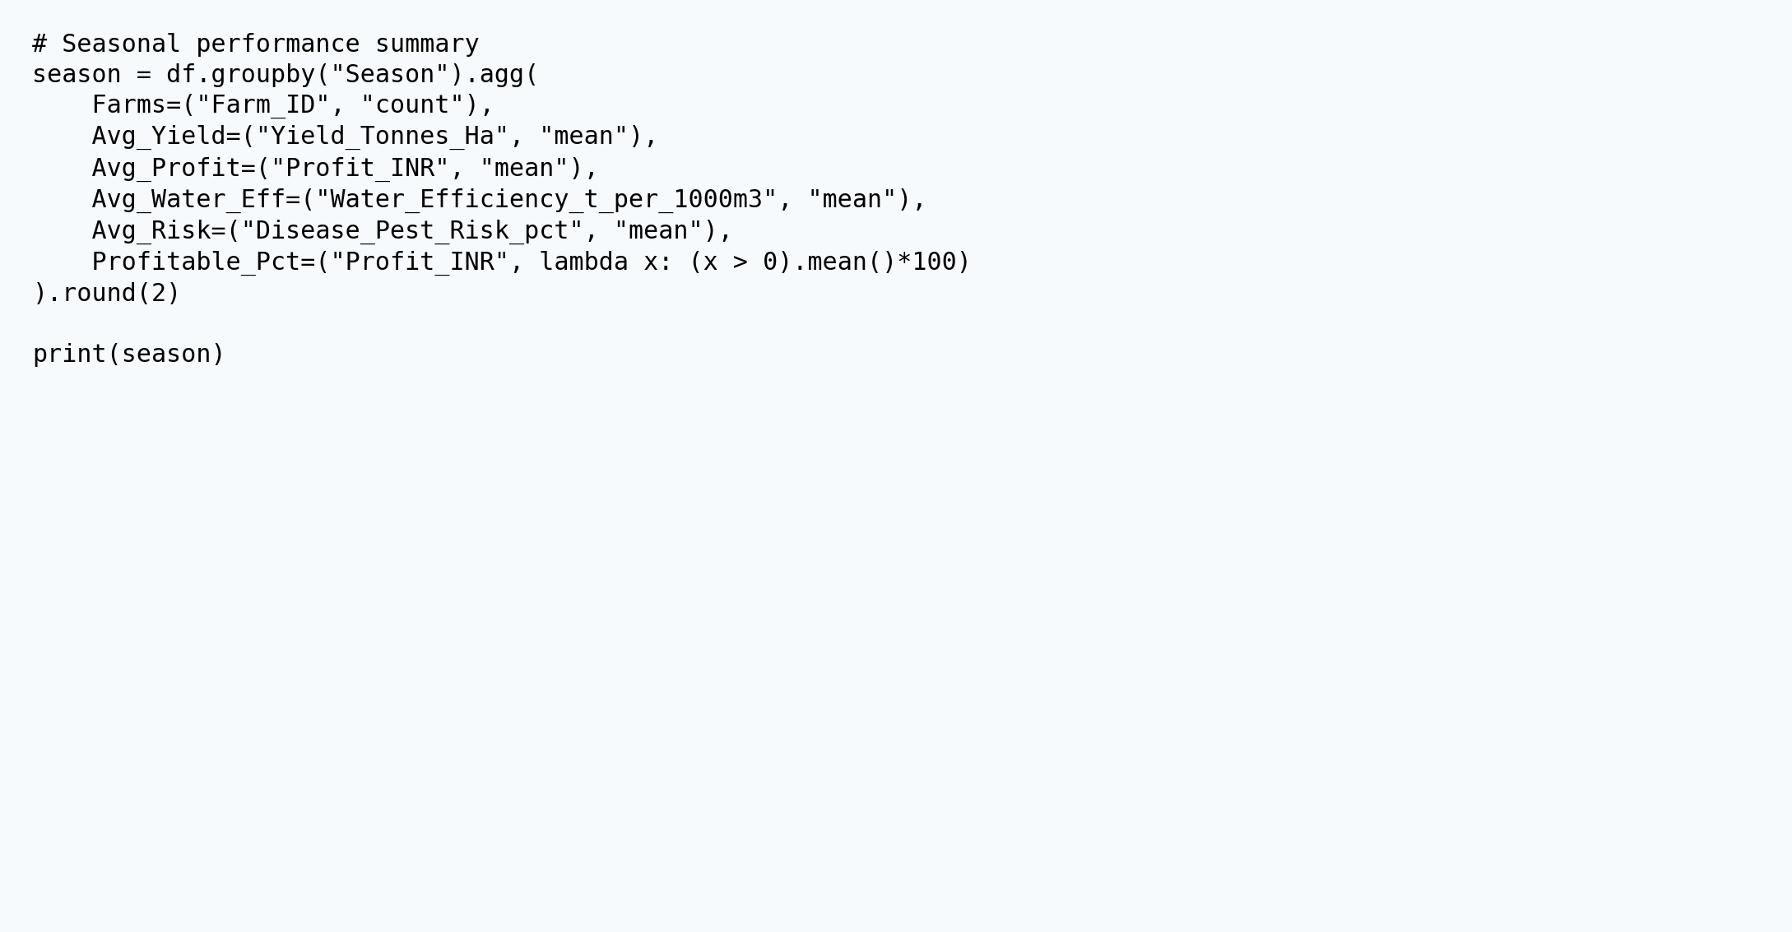
SEASONAL AGGREGATION

Slide 9
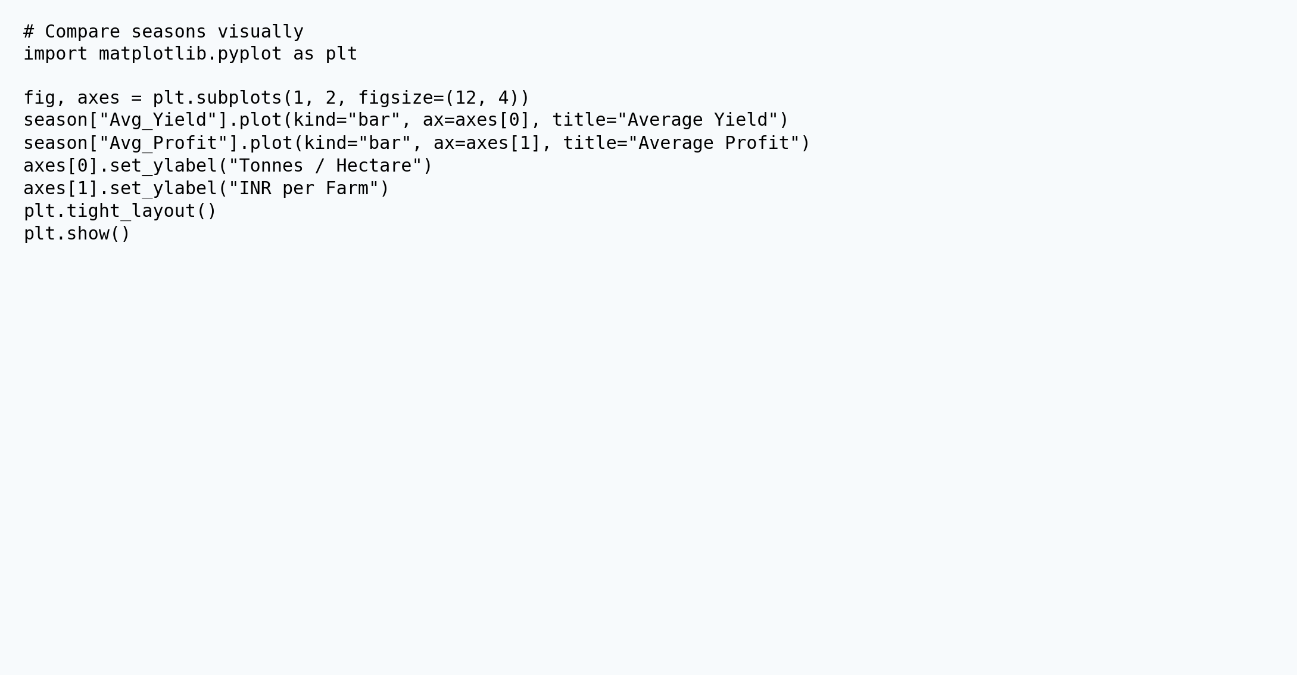
VISUAL ANALYSIS

Slide 10
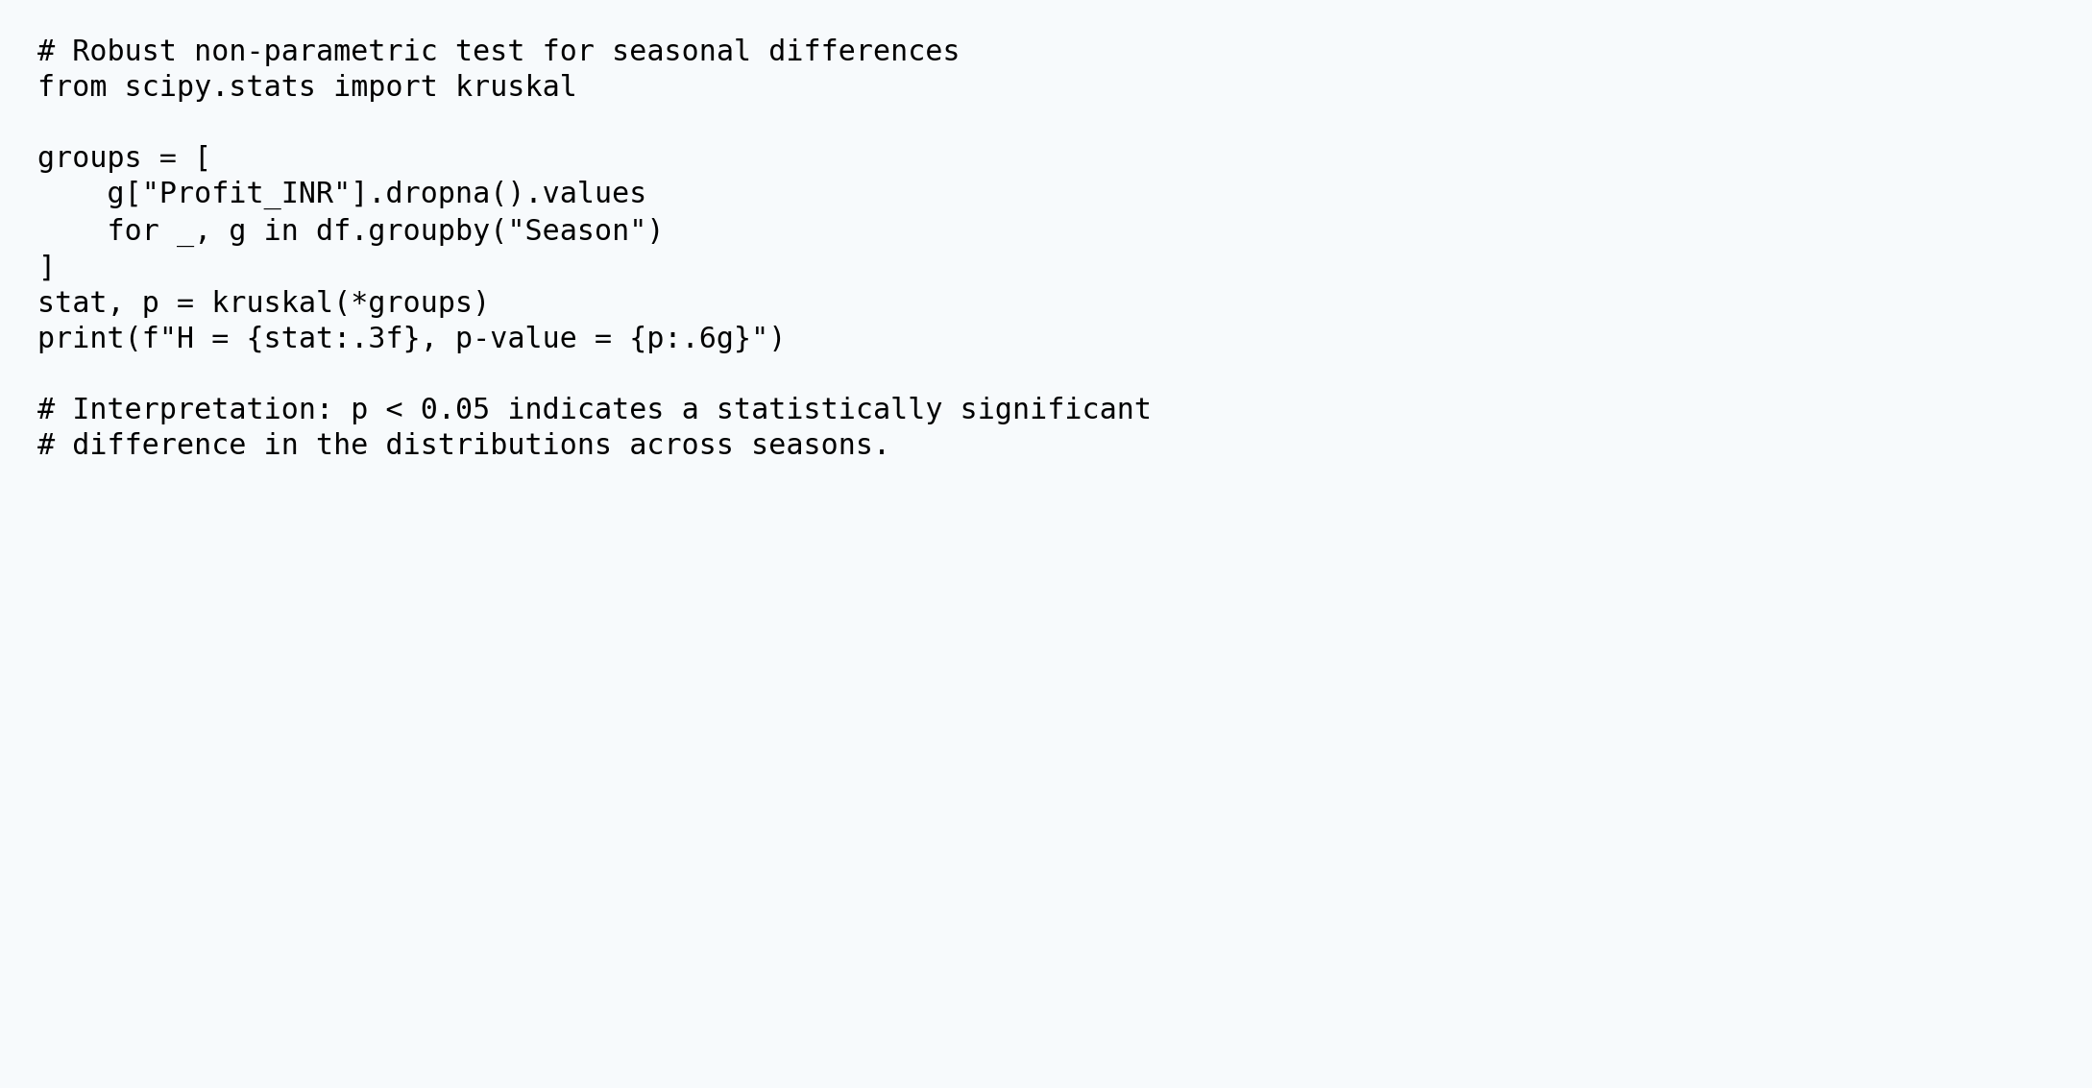
STATISTICAL VALIDATION

Slide 11
FUTURE SCOPE
Add multi-year historical data to separate seasonal effects from year-to-year effects.
Build crop-specific predictive models for yield, profit and disease/pest risk.
Add geospatial analysis and district-level maps for localized planning.
Incorporate market-price forecasting and scenario analysis for input-cost changes.
Create an interactive Power BI / Streamlit dashboard for ongoing monitoring.

Slide 12
GITHUB REPOSITORY
https://github.com/[YOUR_USERNAME]/Seasonal-Agriculture-Performance-Analysis-Abhishek-Tiwari
Create the repository, upload the notebook + cleaned dataset, then replace the placeholder above with the final public repository URL before submission.

Slide 13
VOIS COURSE COMPLETION CERTIFICATE
Course: Data Visualization Status: Attach your completed VOIS certificate here after finishing the course.

Slide 14
Thank you
.
.
Abhishek Tiwari • Seasonal Agriculture Performance Analysis

