Slide 1

Seasonal Agriculture Performance Analysis
Abhishek Tiwari
College Name: Amity University Gwalior
AICTE STU ID: STU6596ba9396c591704376979

Slide 2

PROBLEM STATEMENT
Agricultural performance changes across Kharif, Rabi and Zaid due to seasonal environmental conditions, farming practices, resource availability and market conditions.
Raw agricultural data does not clearly explain how yield, profit, water efficiency and disease/pest risk vary between seasons.
The project analyzes farm records to identify meaningful seasonal patterns, relationships, differences and unusual observations.
The findings support evidence-based seasonal planning and better resource decisions.

Slide 3
PROJECT DESCRIPTION
This project performs an end-to-end analysis of 4,000 farm records covering Kharif, Rabi and Zaid seasons. The workflow includes data-quality checks, contextual missing-value treatment, seasonal comparisons, crop and irrigation analysis, correlation analysis, visual exploration and a non-parametric statistical test. The objective is to turn raw agricultural observations into evidence-based insights that can support better seasonal planning and resource decisions.

Slide 4

WHO ARE THE END USERS?
Farmers and farm managers — seasonal crop and irrigation planning.
Agricultural planners and field teams — compare performance and resource usage.
Analysts and decision-makers — identify seasonal risk, profitability and areas for deeper investigation.
Training / academic stakeholders — use evidence-based agricultural analytics as a real-world case study.

Slide 5

TECHNOLOGY USED
Python for data analysis and automation
Pandas & NumPy for cleaning, transformation and aggregation
Matplotlib for data visualization
SciPy for statistical testing (Kruskal–Wallis H test)
Jupyter Notebook for reproducible analysis and documentation

Slide 6
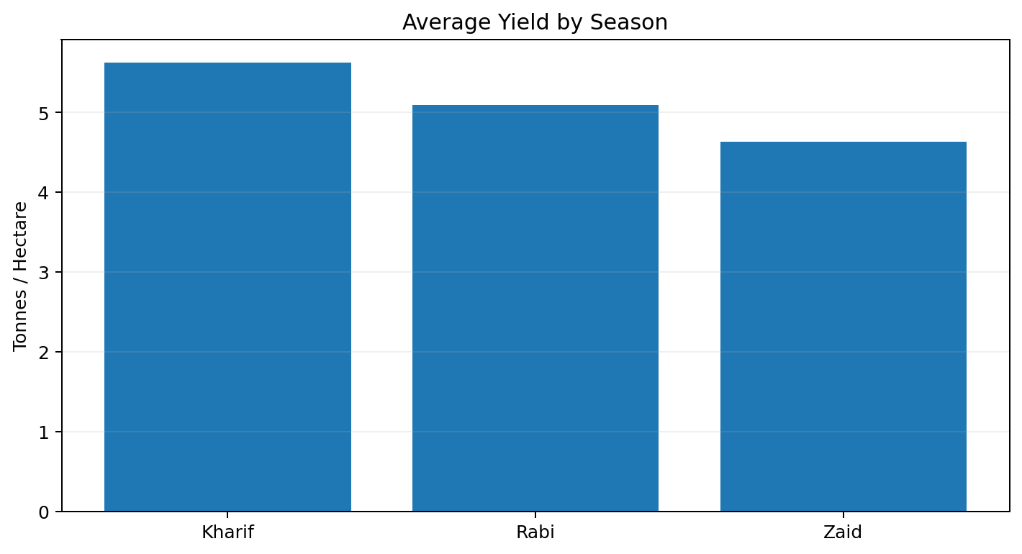
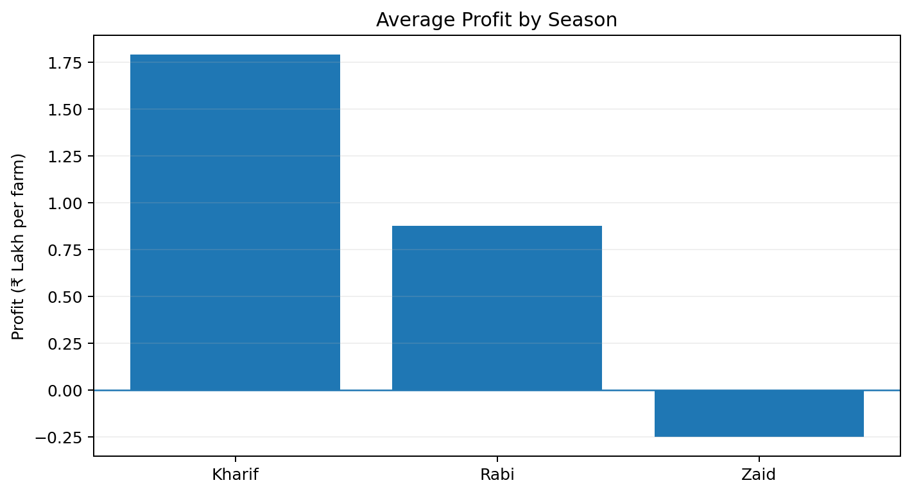
RESULTS — EXECUTIVE SUMMARY
Kharif Avg Profit
Zaid Avg Profit
Drip Avg Yield
Zaid Profitable Farms
₹1.79 L
-₹24,805
6.67 t/ha
35.5%
best seasonal average
loss-making on average
highest irrigation yield
lowest season
Overall pattern: Kharif leads in average profit and profitability; Zaid is financially weakest. Statistical tests confirm seasonal differences in profit, yield, water efficiency and disease/pest risk.

Slide 7
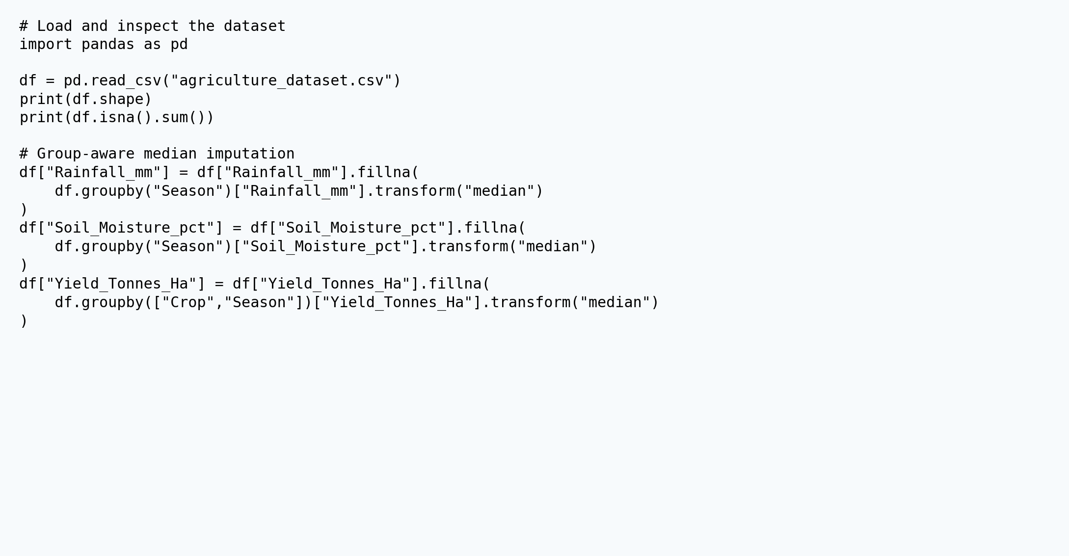
DATA CLEANING & PREPARATION

Slide 8
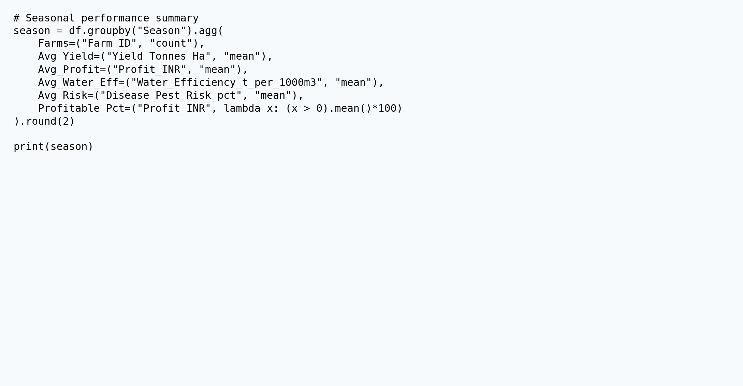
SEASONAL AGGREGATION

Slide 9
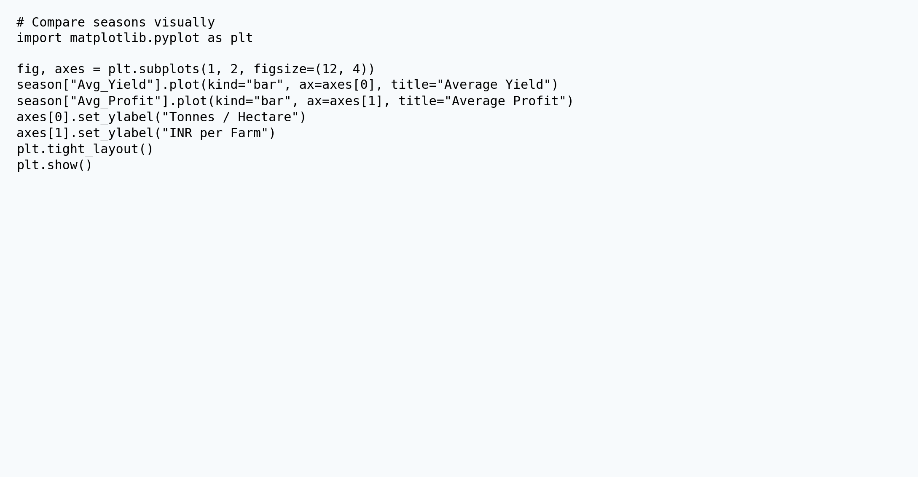
VISUAL ANALYSIS

Slide 10
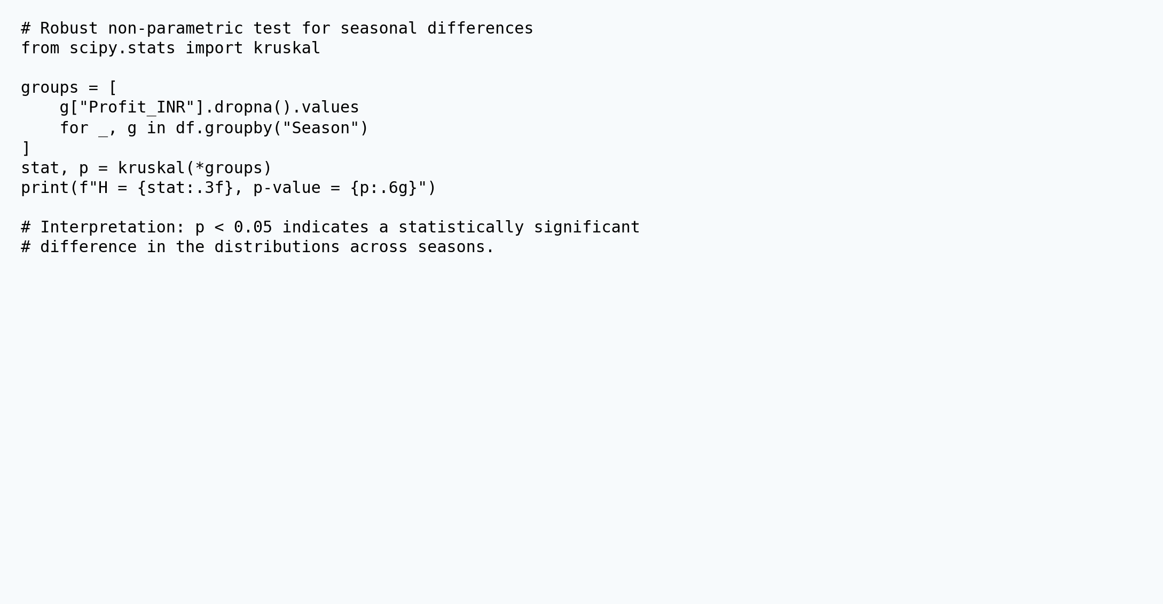
STATISTICAL VALIDATION

Slide 11
FUTURE SCOPE
Add multi-year historical data to separate seasonal effects from year-to-year effects.
Build crop-specific predictive models for yield, profit and disease/pest risk.
Add geospatial analysis and district-level maps for localized planning.
Incorporate market-price forecasting and scenario analysis for input-cost changes.
Create an interactive Power BI / Streamlit dashboard for ongoing monitoring.

Slide 12
GITHUB REPOSITORY
https://github.com/Abhishek09821/Seasonal-Agriculture-Performance-Analysis-Abhishek-Tiwari.git
Project repository containing the Jupyter Notebook and analysis files for the Seasonal Agriculture Performance Analysis.

Slide 13

VOIS COURSE COMPLETION CERTIFICATE

Slide 14
Thank you
.
.
Abhishek Tiwari • Seasonal Agriculture Performance Analysis

