Slide 1

Network Intrusion Detection System Using reinforcement Learning and Automated Audit Reporting
Abhishek Kumar 21BCE0846
Guide Name: Prof. Anisha M. Lal

Slide 2
Presentation Outline
Introduction to Intrusion Detection
Literature Review
Problem Formulation
Relevance to SDG
Proposed System
Analytical & Theoretical Description
Tools & Design Parameters
Results & Analysis
Conclusion
Team Contribution
Societal & Environmental Impact
References

Slide 3
Introduction to Adaptive Intrusion Detection
Limitations of Traditional IDS
Hybrid Learning Approach
Existing signature-based IDS like SNORT and BRO are effective mainly against known threats, lacking adaptability to emerging attacks.
Supervised Learning (Random Forest, Logistic Regression):
Detects known attacks using labeled data (e.g., SQLi, DDoS).
Unsupervised Learning (K-Means Clustering):
Identifies unknown threats through anomaly detection on unlabeled data.
Reinforcement Learning (DQN):
Adapts in real-time, learns from feedback, and improves detection of evolving attacks like Advance Persistent Threats (apts)
Static ML models offer anomaly detection but cannot adapt in real-time to novel attack patterns or evolving threats.

Slide 4
Literature Review: Techniques and Limitations
Technique
Authors
Limitations
CNN (Deep Learning)
Smith et al. (2020)
High computational cost
SVM
Johnson & Lee (2018)
Poor handling of high-dimensional, noisy data
Decision Trees + K-Means
Wang & Chen (2019)
Ineffective on unseen attack types
Ensemble Learning
Kumar et al. (2021)
Vulnerable to adversarial attacks, concept drift
Random Forest
Garcia & Lopez (2017)
Lack of interpretability
LSTM
Brown & Martinez (2019)
Complex, limited interpretability
Genetic Algorithms
Kim & Park (2018)
High cost for large feature sets
DPI
Wang & Liu (2016)
Processing overhead
Fuzzy Logic
Lee & Kim (2017)
Hard to define thresholds

Slide 5


Problem Formulation: Dynamic and Adaptive IDS
Challenges in Traditional IDS
Adaptive Learning Goal
Formulated Problem Statement:
Implement Deep Q-Learning and Actor-Critic models to create a self-updating IDS that learns from live traffic and adjusts detection policies dynamically.
Current IDS rely on static rules and signatures, limiting responsiveness to complex evolving attack techniques like SQL Injection and DDoS.
Develop a robust, adaptive Intrusion Detection System (IDS) using Deep Q-Learning (DQN) and Actor-Critic RL models combined with traditional supervised and unsupervised techniques ,to detect and classify SQL Injection, and outperform static IDS models in adaptability, scalability, and detection precision.

Slide 6
Relevance to Sustainable Development Goals (SDGs)
SDG 9: Industry, Innovation, Infrastructure
SDG 16: Peace, Justice, and Strong Institutions
AI-driven IDS enhances cybersecurity frameworks
Strengthens digital institutional security via proactive intrusion monitoring
Reinforces innovation through RL algorithms increasing adaptive threat detection
Builds trust in essential digital services by reducing cybercrime risks
Supports resilient, real-time digital infrastructures globally
Fosters resilience and institutional integrity with continuous threat response

Slide 7
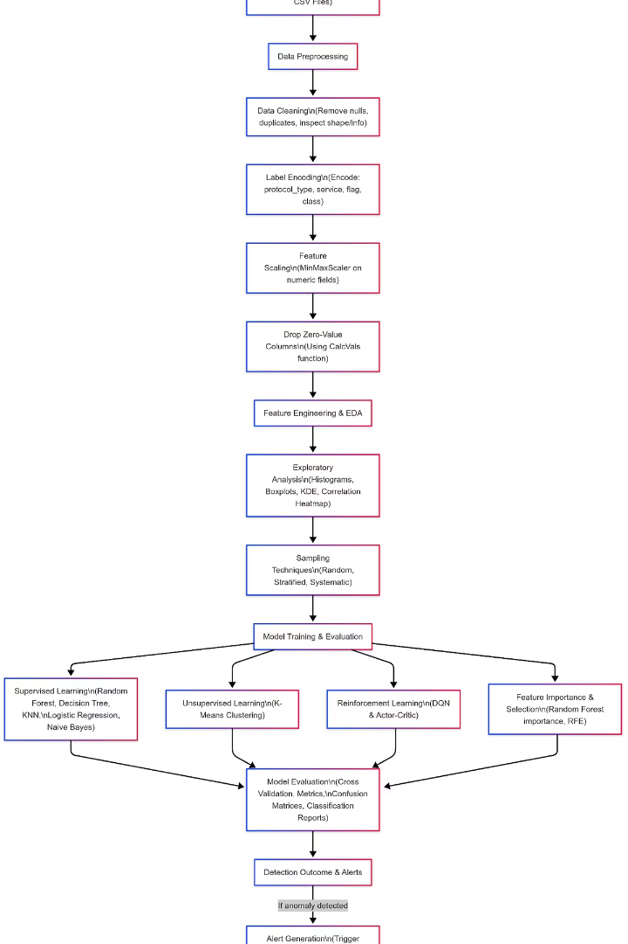
Proposed System Architecture
The architecture integrates modular components including data preprocessing, multi-model learning engines, and an automated audit reporting system. The modular design facilitates real-time decision making by combining supervised, unsupervised, and reinforcement learning models. Real-time network traffic feeds are analyzed continuously with adaptive policies updated via RL techniques.
Automated audit reports generated post-analysis provide clear insights into detected intrusions and system performance, aiding comprehensive cybersecurity oversight.

Slide 8




Analytical & Theoretical Description
Supervised Learning
Uses labeled datasets to classify known attack patterns via Random Forest, Decision Trees, and Logistic Regression, evaluated through standard metrics.
Unsupervised Learning
Utilizes K-Means Clustering and PCA for dimensionality reduction to detect unknown anomalies validated by cluster quality metrics.
Reinforcement Learning
Employs Deep Q-Learning and Actor-Critic models to iteratively adapt detection policies with reward signals based on classification accuracy and false positive penalties.
Statistical Validation
Applies Chi-Square, T-Test, and ANOVA to verify feature importance and model reliability ensuring robustness of detection mechanisms.

Slide 9
Tools, Software, and Hardware Setup
Software Environment
Hardware & Design Parameters
Python with Scikit-learn, PyTorch for ML/DL model implementation
Intel Core i5+, 8-16GB RAM, NVIDIA GPU with CUDA recommended for RL training
Visualization tools: Seaborn, Matplotlib
Simulation parameters: Batch size 64, 20 training episodes, learning rate 0.001, gamma 0.99, epsilon decay 0.995
Development on Jupyter Notebook, Google Colab, and VS Code
Statistical analysis: Pingouin, SciPy libraries
Report Generation: Automated PDF reports using ReportLab

Slide 10
Results and Performance Analysis
Supervised Models
Unsupervised Learning (K-Means)
Random Forest ,knn and Logistic Regression achieved over 90% accuracy; Decision Tree showed interpretability but risked overfitting; Naive Bayes suffered from high false negatives.
Detected unlabeled anomalies effectively with a Silhouette Score above 0.5, demonstrating robust clustering for unknown threats.
Reinforcement Learning Models
Cost-Efficiency Tradeoffs
DQN attained an AUC near 0.93 with stable rewards after about 15 episodes;
But Actor-Critic model faced coverage issue.
Random Forest provides a low-cost, high-accuracy option; K-Means offers very low cost anomaly detection; RL models entail higher GPU costs but excel in adaptive detection capabilities.

Slide 11
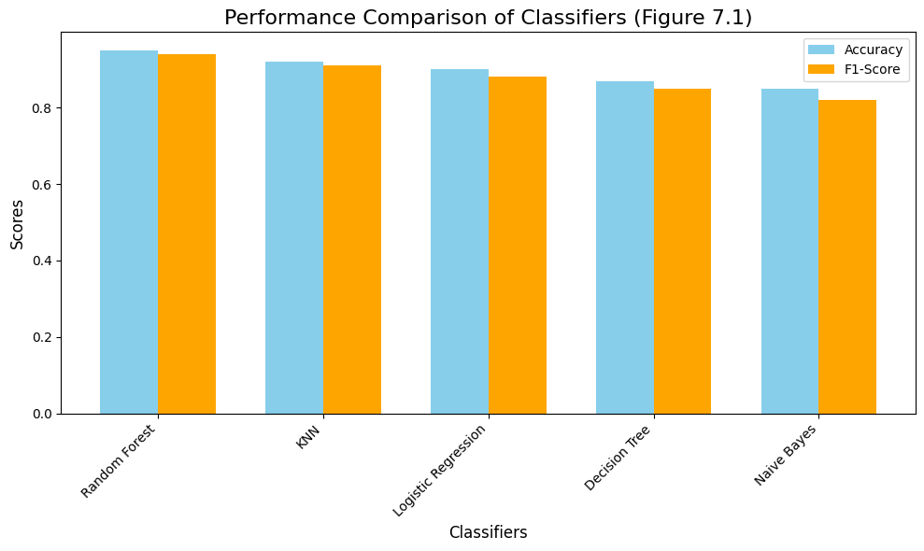
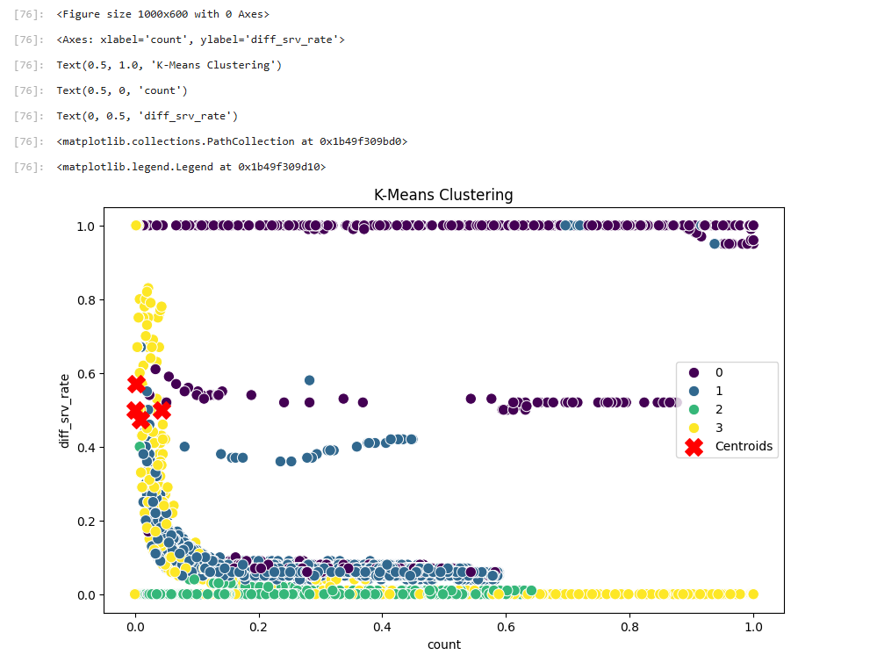
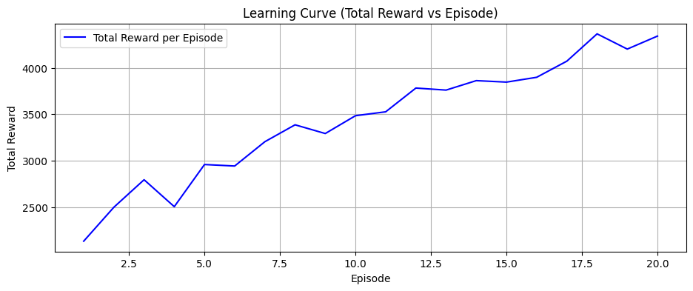

Slide 12

Conclusion
Developed a hybrid IDS using Supervised, Unsupervised & Reinforcement Learning
Reinforcement Learning (DQN, Actor-Critic) improved adaptability to new threats
Modular system design supports real-time detection, evaluation & automated reporting
Achieved high accuracy, flexibility, and scalability across different attack types
Demonstrated strong potential for real-world deployment in evolving cyber environments

Slide 13

Contribution of Team Member
This was an individual project carried out by Abhishek Kumar (21BCE0846)
Solely responsible for:
Literature Review & Problem Formulation
System Architecture & Model Design
Implementation of ML, RL, and Evaluation Modules
Performance Testing & Statistical Validation
Automated Reporting & Final Documentation
Future Enhancements
Use Docker/Kubernetes for deployment. Replace Excel sheet with real DB (e.g., MySQL). Add Explainable AI (SHAP/LIME). Support more attacks in UI (currently only SQLi, per Review 1). Add Federated Learning (can train on multiple devices without leakage od data so privacy-safe )

Slide 14
Impact on Society and Environment
Societal Impact
Environmental Impact
Strengthens cybersecurity infrastructure for institutions, industries, and individuals
Uses software-based solutions with minimal physical resource consumption
Reduces risk of data breaches, identity theft, and financial loss
Open-source libraries and cloud tools reduce hardware dependency and e-waste
Enables real-time threat detection, enhancing public trust in digital systems
Efficient use of computational resources (e.g., optimized training, GPU usage only when needed)
Promotes AI-driven security innovation, encouraging safer digital transformation
Supports a secure digital ecosystem while maintaining environmental sustainability.

Slide 15

Major References
1. Mnih, V. et al. (2015). Human-level control through deep reinforcement learning. Nature.
https://doi.org/10.1038/nature14236
2. Silver, D. et al. (2014). Deterministic Policy Gradient Algorithms. ICML.
3. Chandola, V. et al. (2009). Anomaly Detection: A Survey. ACM Computing Surveys.
https://doi.org/10.1145/1541880.1541882
4. Smith, A. et al. (2020). Deep Learning for NIDS. IEEE Transactions on Information Forensics & Security.
5. Hussain, S. S. (n.d.). SQL Injection Dataset. Kaggle.
https://www.kaggle.com/datasets/syedsaqlainhussain/sql-injection-dataset
6. Canadian Institute for Cybersecurity. CIC-DDoS 2019 Dataset. UNB.
https://www.unb.ca/cic/datasets/ddos-2019.html
7. Scikit-learn (n.d.). Scikit-learn Documentation.
https://scikit-learn.org/stable/
8. ReportLab (n.d.). User Guide for PDF Generation.
https://www.reportlab.com/docs/reportlab-userguide.pdf
Database used
SQL Injection Dataset – Kaggle
CIC-DDoS 2019 – UNB
→ Cleaned, scaled, encoded, split using sklearn & pandas.

