Slide 1

Department of Computer Science and Engineering
PERSUADER
Bangladesh University of Engineering and Technology
PERSUADEE
CSE 450 CAPSTONE · FINAL PRESENTATION
Antiphony
Dual-perspective modeling of persuasion and commitment in asymmetric dialogue
SUPERVISED BY
Dr. Md. Shariful Islam Bhuyan
· Associate Professor, CSE, BUET
Arnob Biswas
Nawriz Ahmed Turjo
Abhishek Roy
Monjur Hossain Khan
Shams Hossain Simanto
2105015
2105032
2105033
2105043
2105048
Notes:
Say it in 15 seconds, then go straight to the hook. The strand on the right is a dialogue: turns alternate between persuader (rose) and persuadee (lavender) and end in the outcome y.

Slide 2
PART 1 OF 5
Problem
1.1
The label disagrees with the transcript
1.2
Problem statement
1.3
Why it’s hard
1.4
What we built
Notes:
Section divider: part 1 of 5.

Slide 3
The Label Disagrees with the Transcript
WHY IT MATTERS
P4G DIALOGUE #124
PERSUASION FOR GOOD
In Bangladeshi social commerce, sales happen inside chats (Messenger, WhatsApp). Pathao needed two things:
Persuader
“We have you down for a $10 donation. Is that correct?”
01
Triage of high-intent leads in real time
Persuadee
02
A small model that runs on their own servers
“Yes that is.”
NOT A ONE-OFF
$0
Dialogue #842: “I will absolutely look to donating something later.” Both donation fields show $0.
Recorded donation field
“You cannot learn commitment from a label that’s wrong, or from a model that never reads the end of the chat.”
Antiphony · Group 10
Notes:
Source: report 1.1, 4.3.1, 2.3.3. A second example, dialogue #842: I will absolutely look to donating something later, with both donation fields at $0.

Slide 4
Problem Statement: Three Sub-Problems
Persuader
turns
Persuadee
ends in
Outcome
argues, makes offers
→
weighs, decides
→
commit: yes / no
SP1 · INTENTION
SP2 · STRATEGY
SP3 · TRANSFER
Intention
Strategy
Transfer
Given dialogue D = (u₁ … u_{N} ), predict commitment y ∈ {yes, no}.
For each persuader turn, predict its strategy set.
In buyer–merchant negotiation, does the model follow the trajectory or just read the last line?
One label per dialogue, from the decider’s final position
11 categories, 41 strategies, multi-label
Δ_{suff} = Macro-F1(full dialogue) − Macro-F1(last turn)
Antiphony · Group 10
Notes:
Rose = persuader, blue-violet = decider on every slide. Source: report 1.2.

Slide 5
Why It’s Hard
01 · TRUNCATION
02 · SPEAKER BLUR
03 · LONG TAIL
04 · SHORTCUTS
0.70
2 → 1
2
“sounds good”
Macro-F1 cap for flat models
speakers flattened into one text
turns of door_in_the_face
a single closing line
256-token models see only about the first half of a dialogue (median 344 words).
conditional has 13 examples; 48.9% of turns are multi-label.
can give the answer away without reading the dialogue.
The model has to rediscover who the decider is.
COMPLEX ENGINEERING PROBLEM · TABLE 1.1
P1 · Depth of knowledge
P2 · Conflicting requirements
P3 · Depth of analysis
P4 · Infrequent issues
Loss design, hierarchical attention, recurrent state, calibrated ensembles
2,048-token dialogues against a 16 GB T4 memory ceiling
Monolithic transformers failed; a new dual-stream network was needed
2 to 5 instance tail classes; silent truncation of 30.4% of endings
P5 · No standard codes
P6 · Stakeholders
P7 · Interdependence
Custom decision tests and three-phase human verification
Merchant conversion against consumer protection and privacy
Pass 3 labels forced retraining of the whole 14-model lineage
Antiphony · Group 10
Notes:
Source: report 1.3, Table 1.1, 2.1.7. Full Table 1.1 is backup.

Slide 6
What We Built
Intention
Strategy
Transfer
P4G, 1,017 dialogues, re-annotated in 3 passes
10,600 turns, 11 categories / 41 strategies
700 synthetic negotiations (500 + 200 reversals)
0.862
0.706
+0.0384
0.862
0.706
+0.0384
0.862
0.706
+0.0384
0.862
0.706
+0.0384
Antiphony Macro-F1 · strict labels 0.845
micro-F1 = 89% of the 0.79 human ceiling
Δ_{suff}, up from +0.0001
Antiphony retrained on buyer–merchant chats
Strongest of the fourteen model versions we built
19-member ensemble with a calibrated blend
Next: how the three pieces fit together
Notes:
Transition out: here is how the three pieces fit together.

Slide 7
PART 2 OF 5
System and Data
2.1
System overview
2.2
Intention ground truth
2.3
Strategy taxonomy and annotation
2.4
Corpus statistics
2.5
Negotiation benchmark
Notes:
Section divider: part 2 of 5.

Slide 8
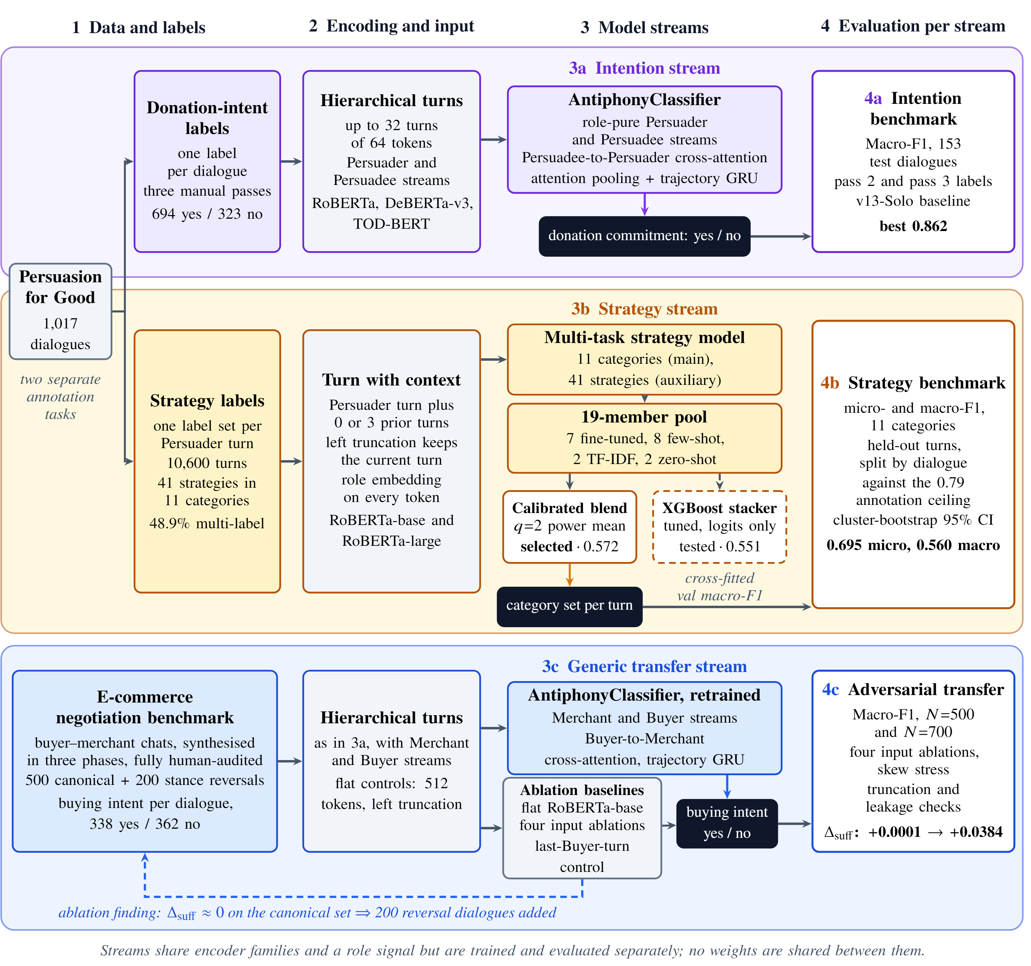
System Overview
ROWS · THREE STREAMS
3a
Intention · P4G donation commitment
3b
Strategy · P4G persuader turns
3c
Transfer · e-commerce negotiation
COLUMNS · FOUR STAGES
1 Data and labels → 2 Encoding and input → 3 Model streams → 4 Evaluation per stream
Streams share encoder families and a role signal. No weights are shared between streams.
Antiphony · Group 10
Notes:
Fig 4.1, report p. 15. Walk the rows 3a, 3b, 3c, then the columns. A small copy of this map returns with the current row marked.

Slide 9
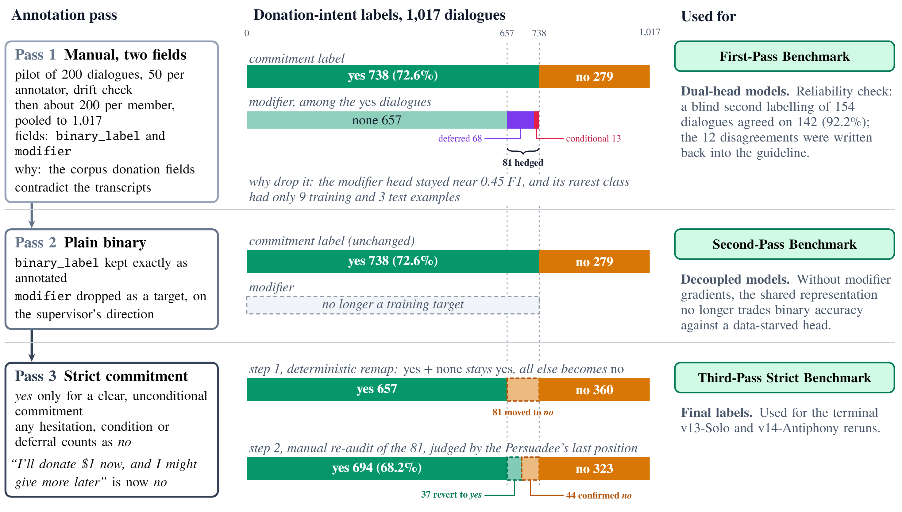
Rebuilding the Intention Ground Truth
PASS 1 · MANUAL, TWO FIELDS
738 yes / 279 no
Modifier: none 657, deferred 68, conditional 13
PASS 2 · MODIFIER DROPPED
Labels unchanged
On the supervisor’s direction; the modifier never broke 0.45 F1
PASS 3 · STRICT
694 yes / 323 no
Any hedge or deferral counts as no
Antiphony · Group 10
Notes:
Fig 4.3. Pass 1 pilot: 200 dialogues split five ways (50 per annotator) for calibration, then about 200 per member. Source: 4.3.

Slide 10
Rebuilding the Intention Ground Truth: Pass 3
STEP 2 · MANUAL RE-READ
PASS 2 LABELS
PASS 3 LABELS
81 dialogues
738 yes
Step 1 · deterministic remap
final
694 yes
81 moved to no
strict labels
279 no
323 no
37 back to yes 44 stayed no
92.21%
THE 12 DISAGREEMENTS · FOUR BOUNDARY CASES
i
Ambiguous temporal deferrals: “I’ll donate through their website tonight”
agreement with an independent second pass, 142 of 154 dialogues
ii
Polite deflection read as consent: “Sure, that sounds like a great cause”
iii
Conditional matches: “I’ll give $1 if you give $1”
iv
Unconfirmed donation queries
Antiphony · Group 10
Notes:
Step 2 rule: if an early hesitation was cleanly resolved into an unconditional yes by the end, the dialogue reverted to yes. Source: 4.3.2-4.3.3.

Slide 11
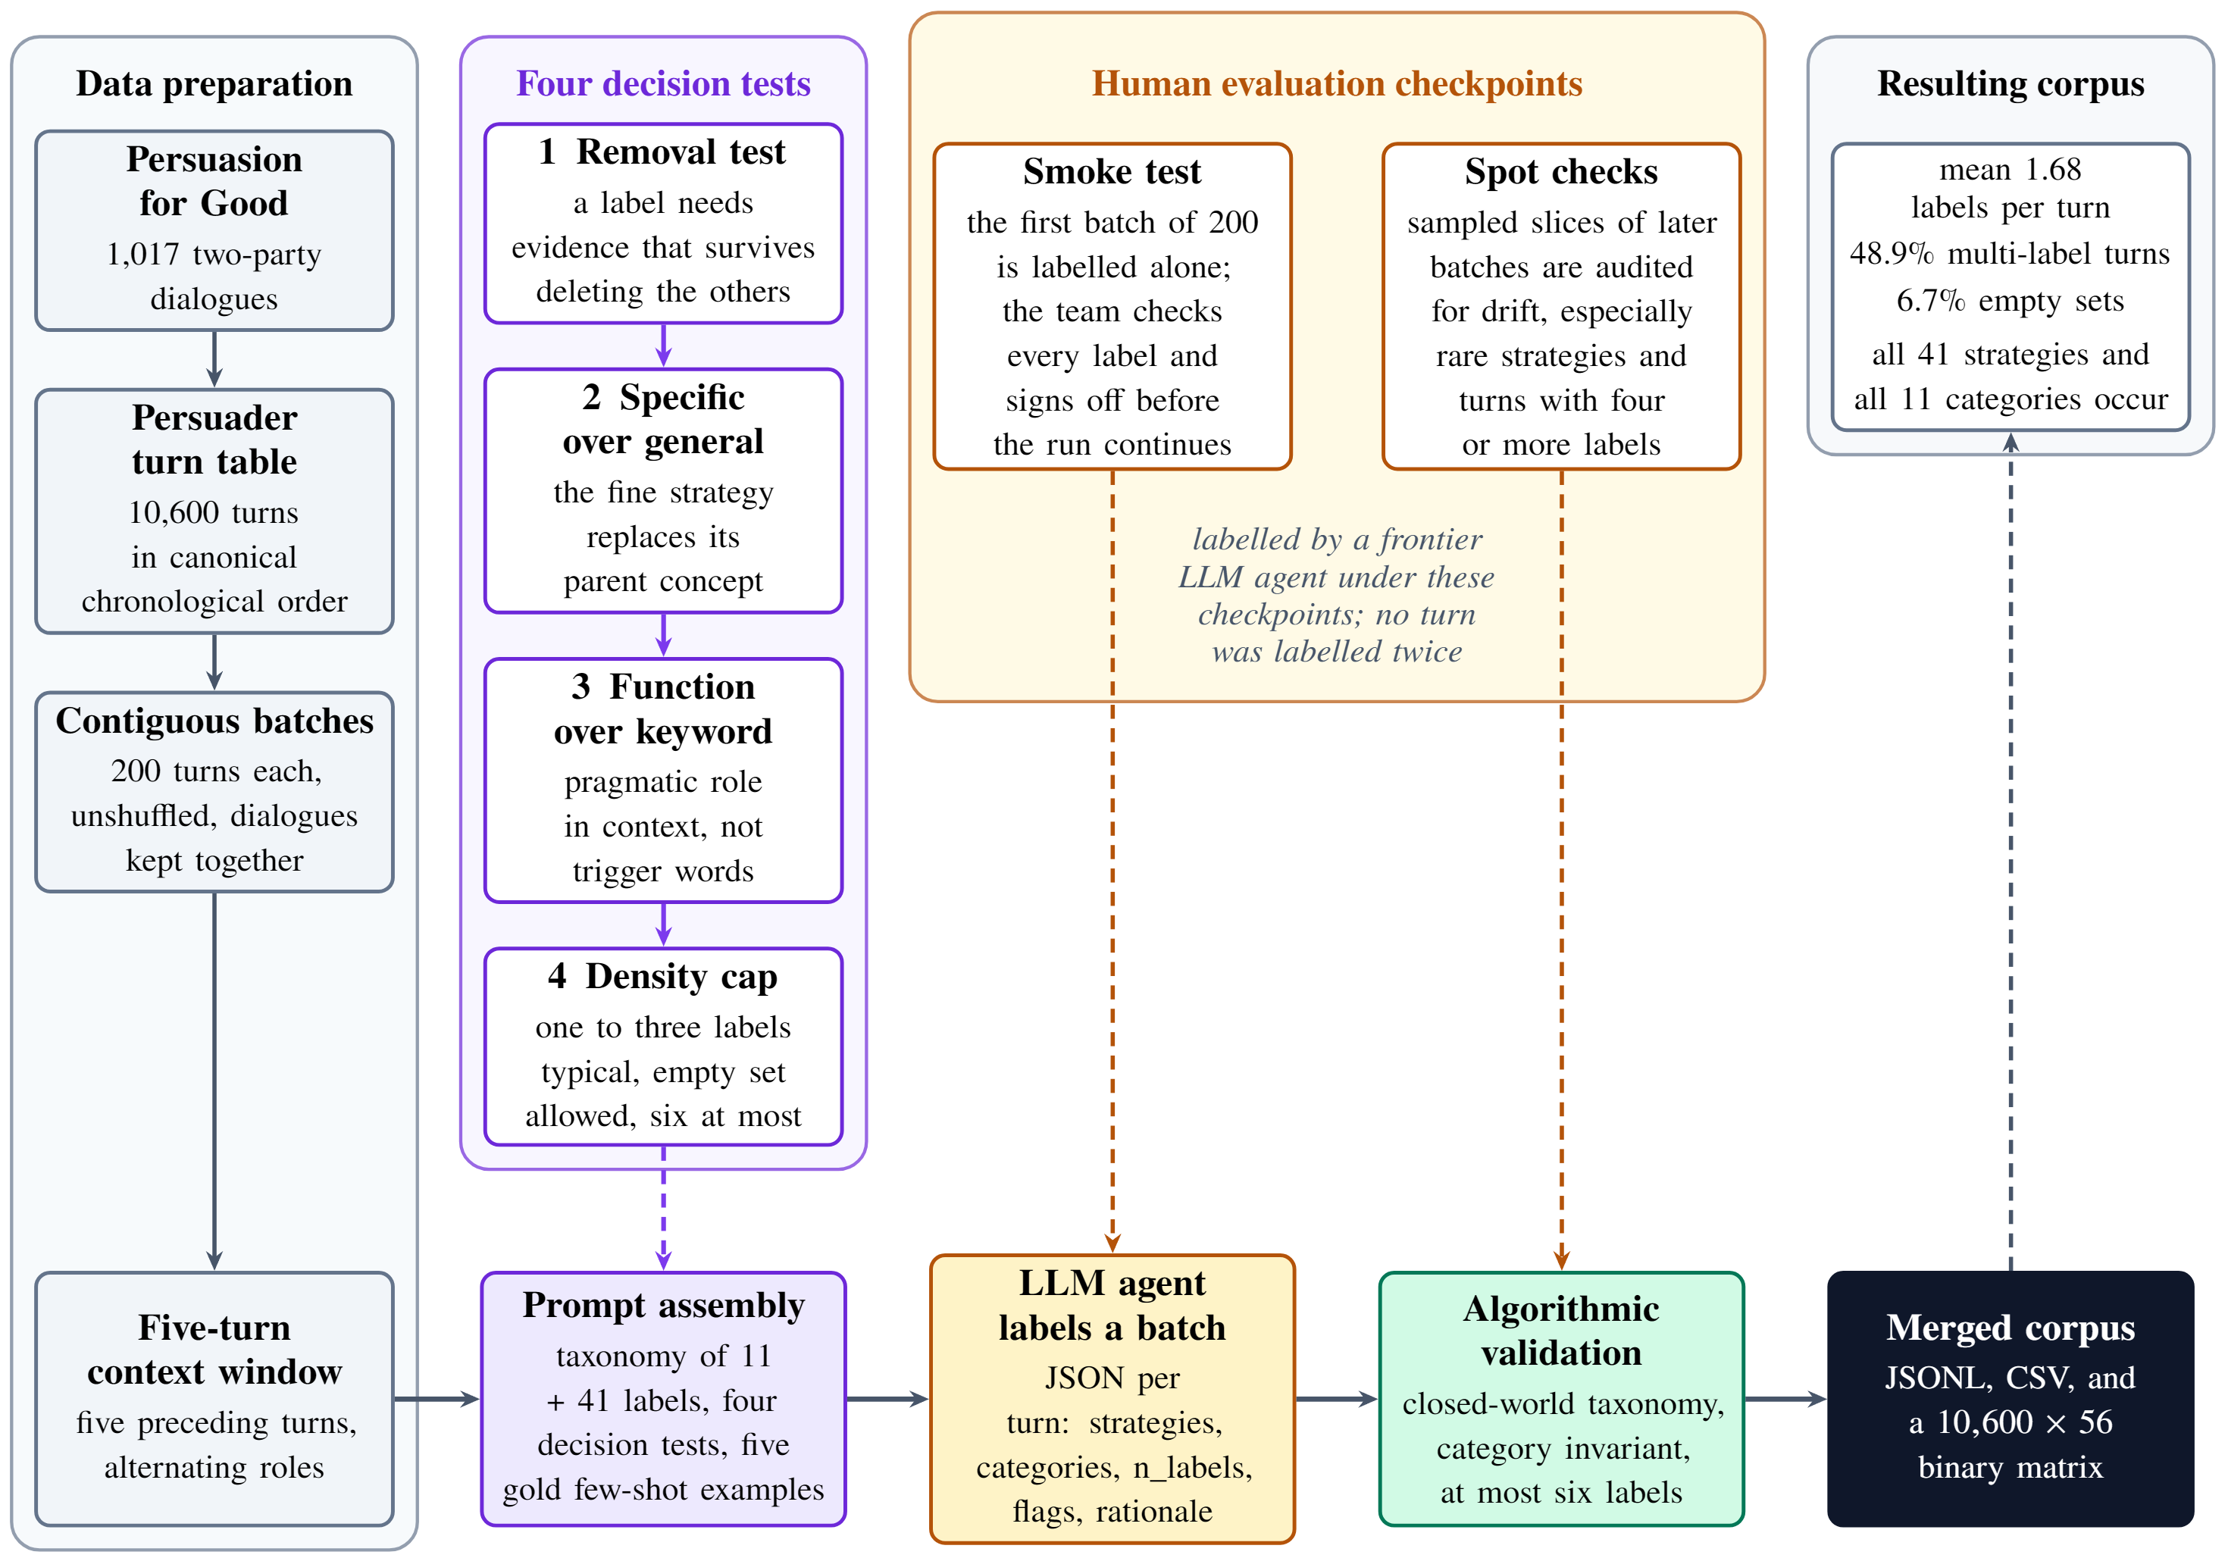
Strategy Taxonomy and Annotation Pipeline
11
41
categories
strategies
IN CONTEXT
5 preceding turns, 200-turn batches
LLM AGENT
Claude 5 Sonnet labels each turn
HUMAN CHECKPOINTS
Smoke test and spot checks; pipeline.py validates every batch
Antiphony · Group 10
Notes:
Fig 4.2. Annotation ran in four segments under human checkpoints; no turn was labelled twice. Source: 4.2.

Slide 12
Strategy Annotation: Four Decision Tests
01
02
03
04
Removal test
Specific over general
Function over keyword
Density cap
Keep a label only if its evidence survives deleting the others
One to three labels typical, empty set allowed, six at most
The fine strategy replaces its parent concept
Label the pragmatic role in context, not trigger words
10,600 × 56
output matrix, zero schema violations
Antiphony · Group 10
Notes:
Source: 4.2.2.

Slide 13
Strategy Corpus Statistics
48.9%
46.2%
of turns are multi-label · mean 1.68, 6.7% empty
Relational and 36.1% Information dominate
Share of turns by category · Threat, Commitment, Urgency each under 3%
Turns by number of strategy labels (2 or more in dark)
Relational and Interactive
46.2%
4,707
Information Provision
36.1%
Emotional Appeal
15.5%
3,443
Social Influence
11.9%
Reciprocity and Exchange
10.2%
Framing and Presentation
9.5%
Credibility Appeal
8.5%
Rational Appeal
7.1%
1,098
Threat and Pressure
2.3%
707
Commitment and Consistency
1.6%
392
175
78
Urgency and Scarcity
1.5%
0
1
2
3
4
5
6
Antiphony · Group 10
Notes:
Fig 5.1a and 5.1b redrawn from Table 4.2 and 4.2.3 values. Mean 1.679 labels per turn (sd 1.061). Source: 4.2.3, 5.2.

Slide 14
Strategy Corpus Statistics: The 41-Strategy Long Tail
Most frequent strategies · turns out of 10,600
Rarest strategies · turns
rapport_building
2,860
reciprocity
14
organization_information
1,735
scarcity_appeal
8
donation_procedure_information
1,417
negative_consequence_warning
7
personal_related_inquiry
1,328
authority_endorsement
5
deadline_pressure
5
personal_story
1,150
door_in_the_face
2
emotion_appeal
1,023
gratitude_and_appreciation
966
rapport_building alone labels 27.0% of turns. Six strategies appear in 14 turns or fewer.
minimization_framing
849
Antiphony · Group 10
Notes:
Appendix E, Table E.1. The top strategy covers 27% of turns; six strategies have 14 turns or fewer. This is why the model pivots to categories. Source: Appendix E.

Slide 15
Strategy Corpus Statistics: Timing and Ceiling
Strategies follow the dialogue’s shape: rapport comes early, procedure and gratitude come late.
HUMAN AGREEMENT CEILING
Same annotator
0.871
Cross-annotator
0.657
Consensus ceiling
≈ 0.79
Micro-F1 above ≈ 0.79 would mean fitting one annotator’s habits.
Rater effect: one segment averaged 2.38 labels per turn, another 1.24.
Antiphony · Group 10
Notes:
Fig 5.2 redrawn; series values read from the report plot. Rater effect: Track A averaged 2.38 labels per turn, Track C 1.24. Source: 4.2.3-4.2.4, 5.2.

Slide 16
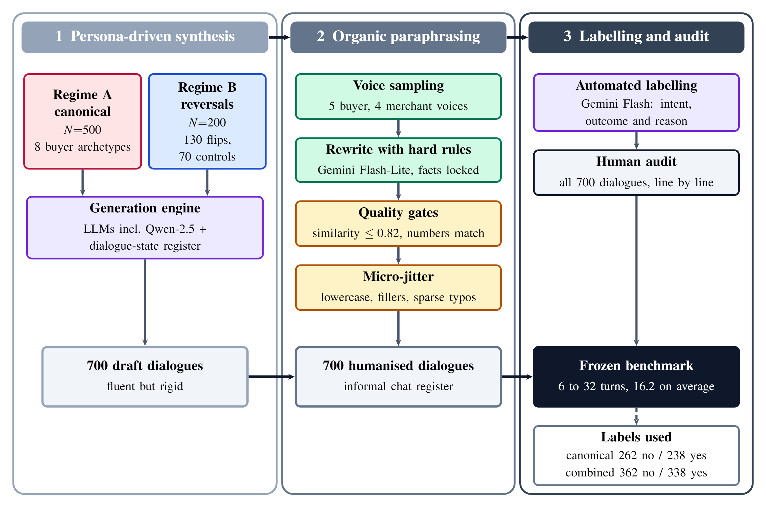
Synthetic E-commerce Negotiation Benchmark
PHASE 1 · PERSONA SYNTHESIS
Regime A canonical, N = 500, 8 buyer archetypes. Regime B, N = 200: 65 + 65 reversals, 70 controls.
PHASE 2 · PARAPHRASING
Gemini, facts locked, similarity gate 0.82, micro-jitter
PHASE 3 · LABELS AND AUDIT
Automated labelling plus a 100% human audit
Antiphony · Group 10
Notes:
Fig 4.4 poster version. Source: 4.4.

Slide 17
Negotiation Benchmark: Counts and Rationale
Canonical, N = 500
Combined, N = 700
CANONICAL
COMBINED
Purchase committed
262 / 238
362 / 338
238
no / yes
no / yes
338
Deferred consideration
REVERSALS
TURNS
100 / 100
16.2
139
157
no / yes
mean, range 6 to 32
Inquiry dropout
112
WHY SYNTHETIC
125
Real merchant chats are private. Canonical data was “solvable from the last line”, so 200 reversals were added.
Explicit rejection
11
80
Antiphony · Group 10
Notes:
The early 250/250 split with six classes is outdated; frozen files have 262/238 and 4 classes. Source: 4.4.3.

Slide 18
PART 3 OF 5
Models
3.1
Architectural evolution
3.2
Antiphony: the idea
3.3
Antiphony: inside
3.4
Strategy classifier ensemble
Notes:
Section divider: part 3 of 5.

Slide 19
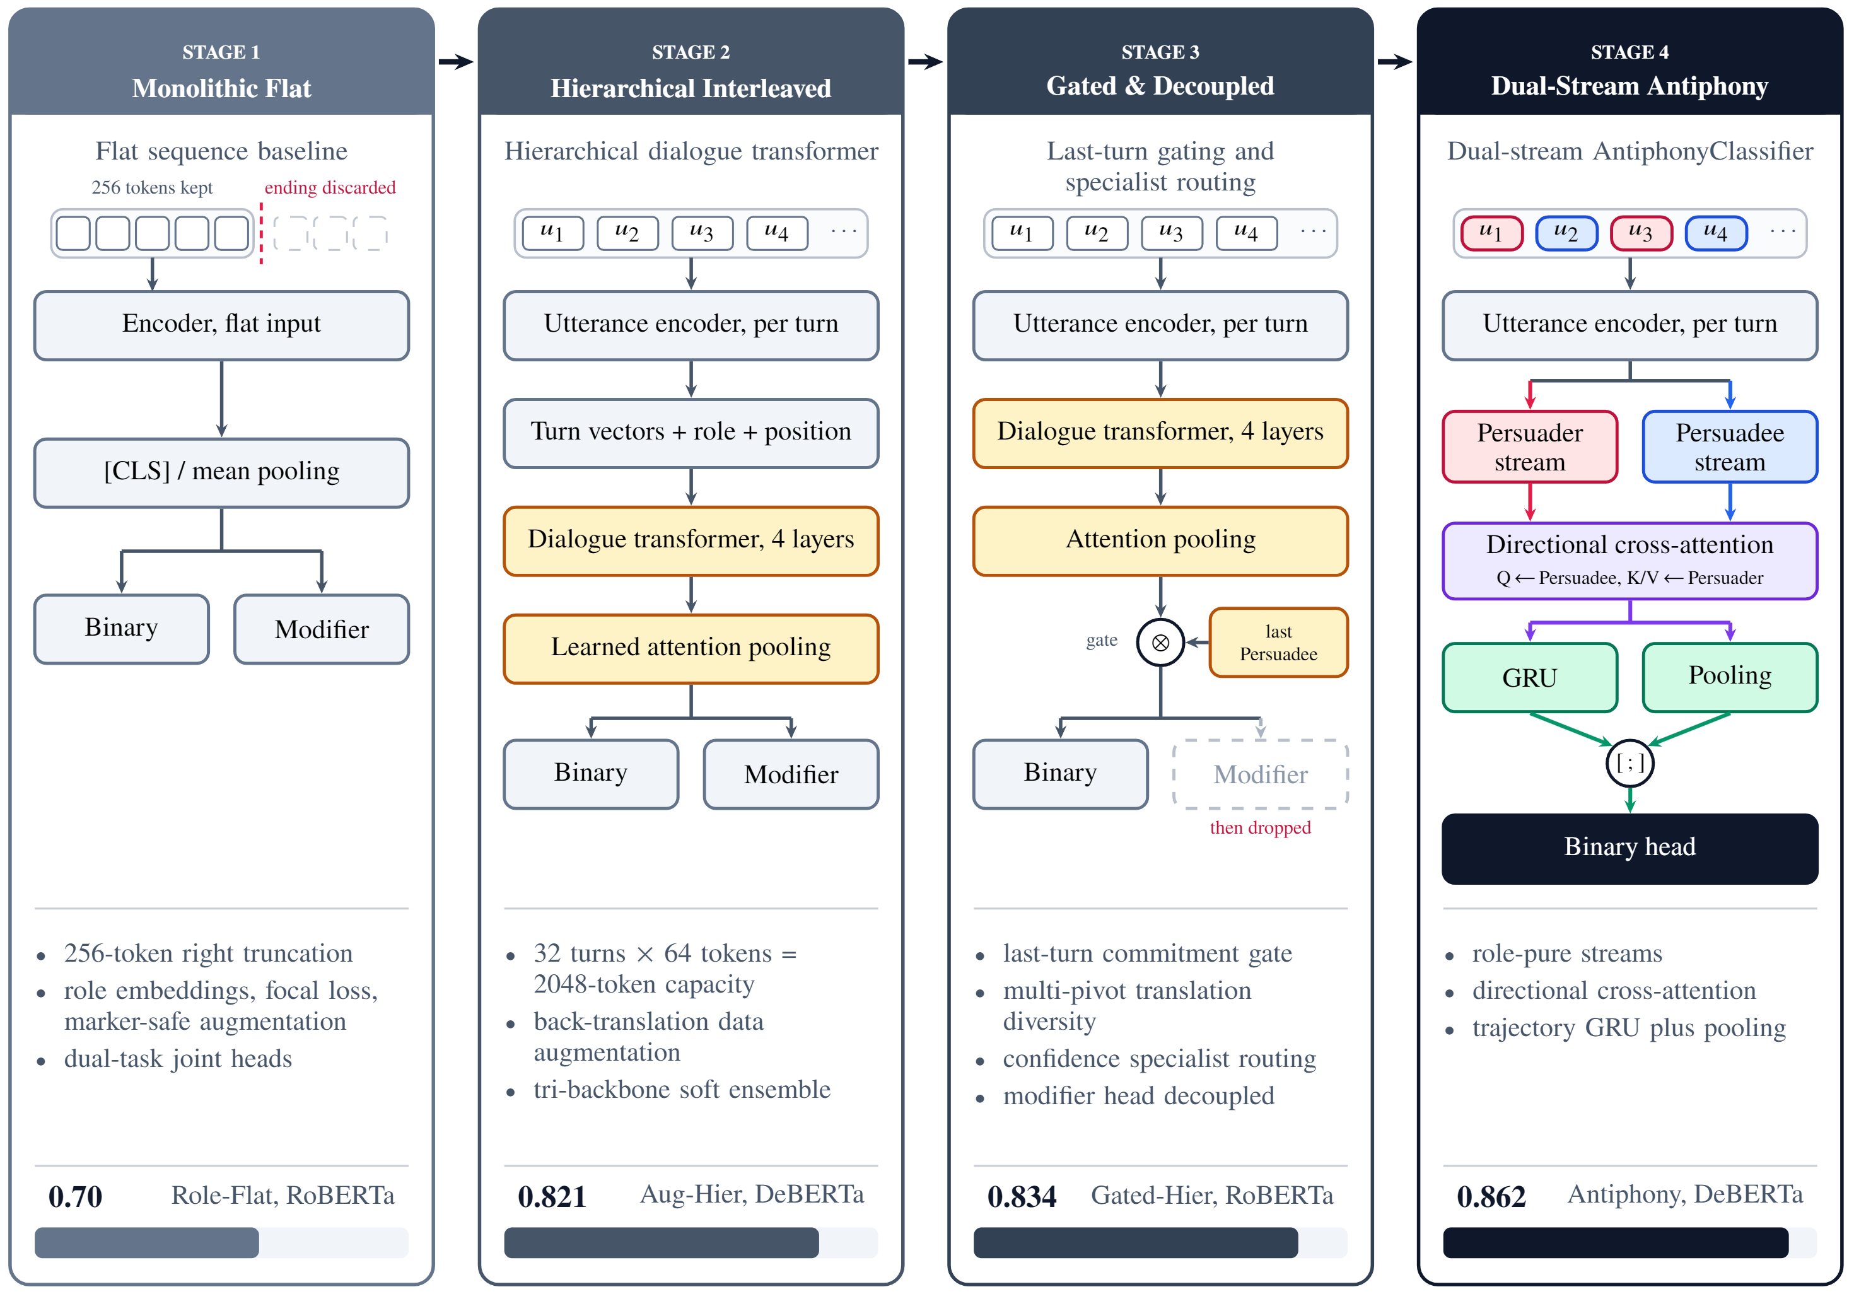
How We Got to Antiphony
PEAK TEST MACRO-F1 PER STAGE
1 · Flat
0.70
2 · Hierarchical
0.821
3 · Gated and decoupled
0.834
4 · Antiphony
0.862
“Each stage fixed the previous stage’s failure. The remaining failure was that the two speakers were mixed together.”
Antiphony · Group 10
Notes:
Fig 4.8, the key design slide. Source: 4.7.

Slide 20
How We Got to Antiphony: Stage by Stage
0.834
0.862
0.821
0.70
STAGE 3 · GATED
STAGE 1 · FLAT
STAGE 2 · HIERARCHICAL
Last-Persuadee-turn gate, RoBERTa; modifier head dropped
STAGE 4 · ANTIPHONY
256 tokens; ending truncated
32 × 64 tokens; DeBERTa + back-translation
Role-pure dual streams
STAGE 1 · THREE BUGS FOUND AND FIXED
Checkpoint metric
Gradient spikes
Glued speaker tags
Chosen on pos_label="yes" F1, so an all-yes model scored 1.0
Raw inverse-frequency weights on 13 conditional examples
57.5% glued to newlines, corrupting 15.9% of augmented rows
Antiphony · Group 10
Notes:
Bars start at 0.60. Source: 4.7.1-4.7.4.

Slide 21
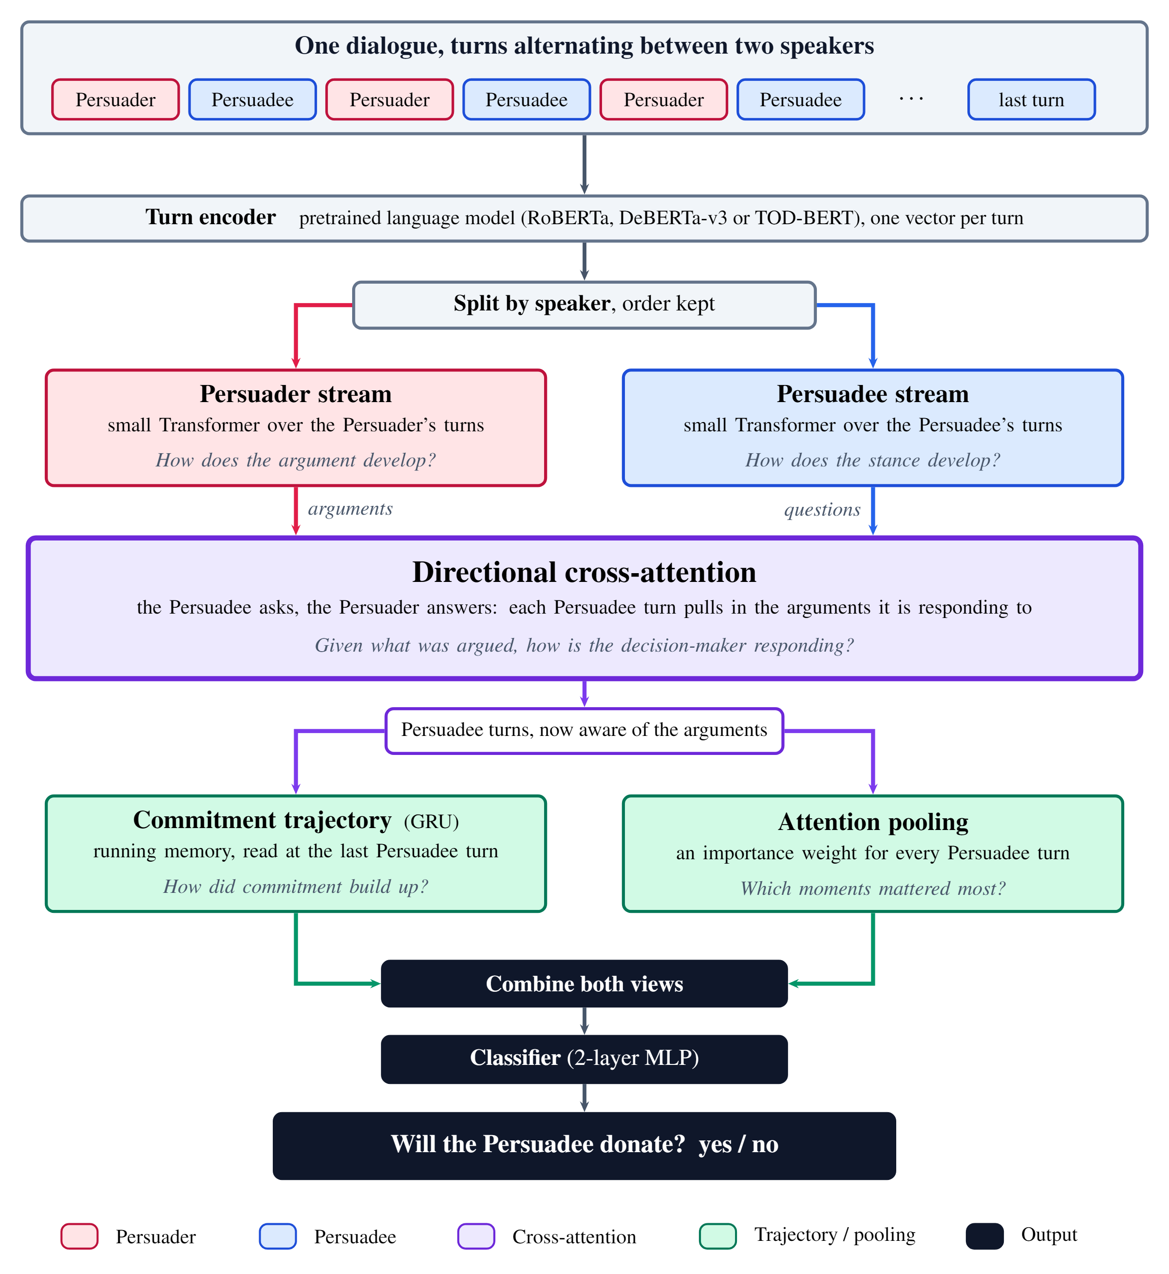
Antiphony: The Idea
1
Encode each turn
2
Split the turns by speaker, order kept
3
Each speaker gets its own small Transformer
4
Directional cross-attention: the Persuadee asks, the Persuader answers
5
A GRU tracks commitment in turn order; attention pooling picks the salient turns
6
Both views are combined; a classifier predicts yes / no
Antiphony · Group 10
Notes:
Fig 4.6 poster version.

Slide 22
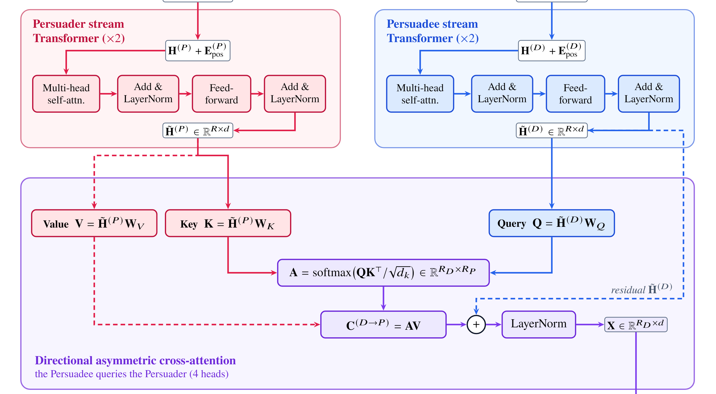
Antiphony: Directional Cross-Attention
“Given what was argued, how is the decider responding?”
Persuadee → queries
Q = H̃^{(D)}W_{Q}. The decider asks.
Persuader → keys, values
K, V from H̃^{(P)} . The arguments answer.
Output
C = AV, plus a residual from the Persuadee stream, 4 heads
Antiphony · Group 10
Notes:
Detail crop from Fig 4.7. Each Persuadee turn pulls in the arguments it is responding to. A residual connection keeps the Persuadee stream, then LayerNorm. 4 heads.

Slide 23
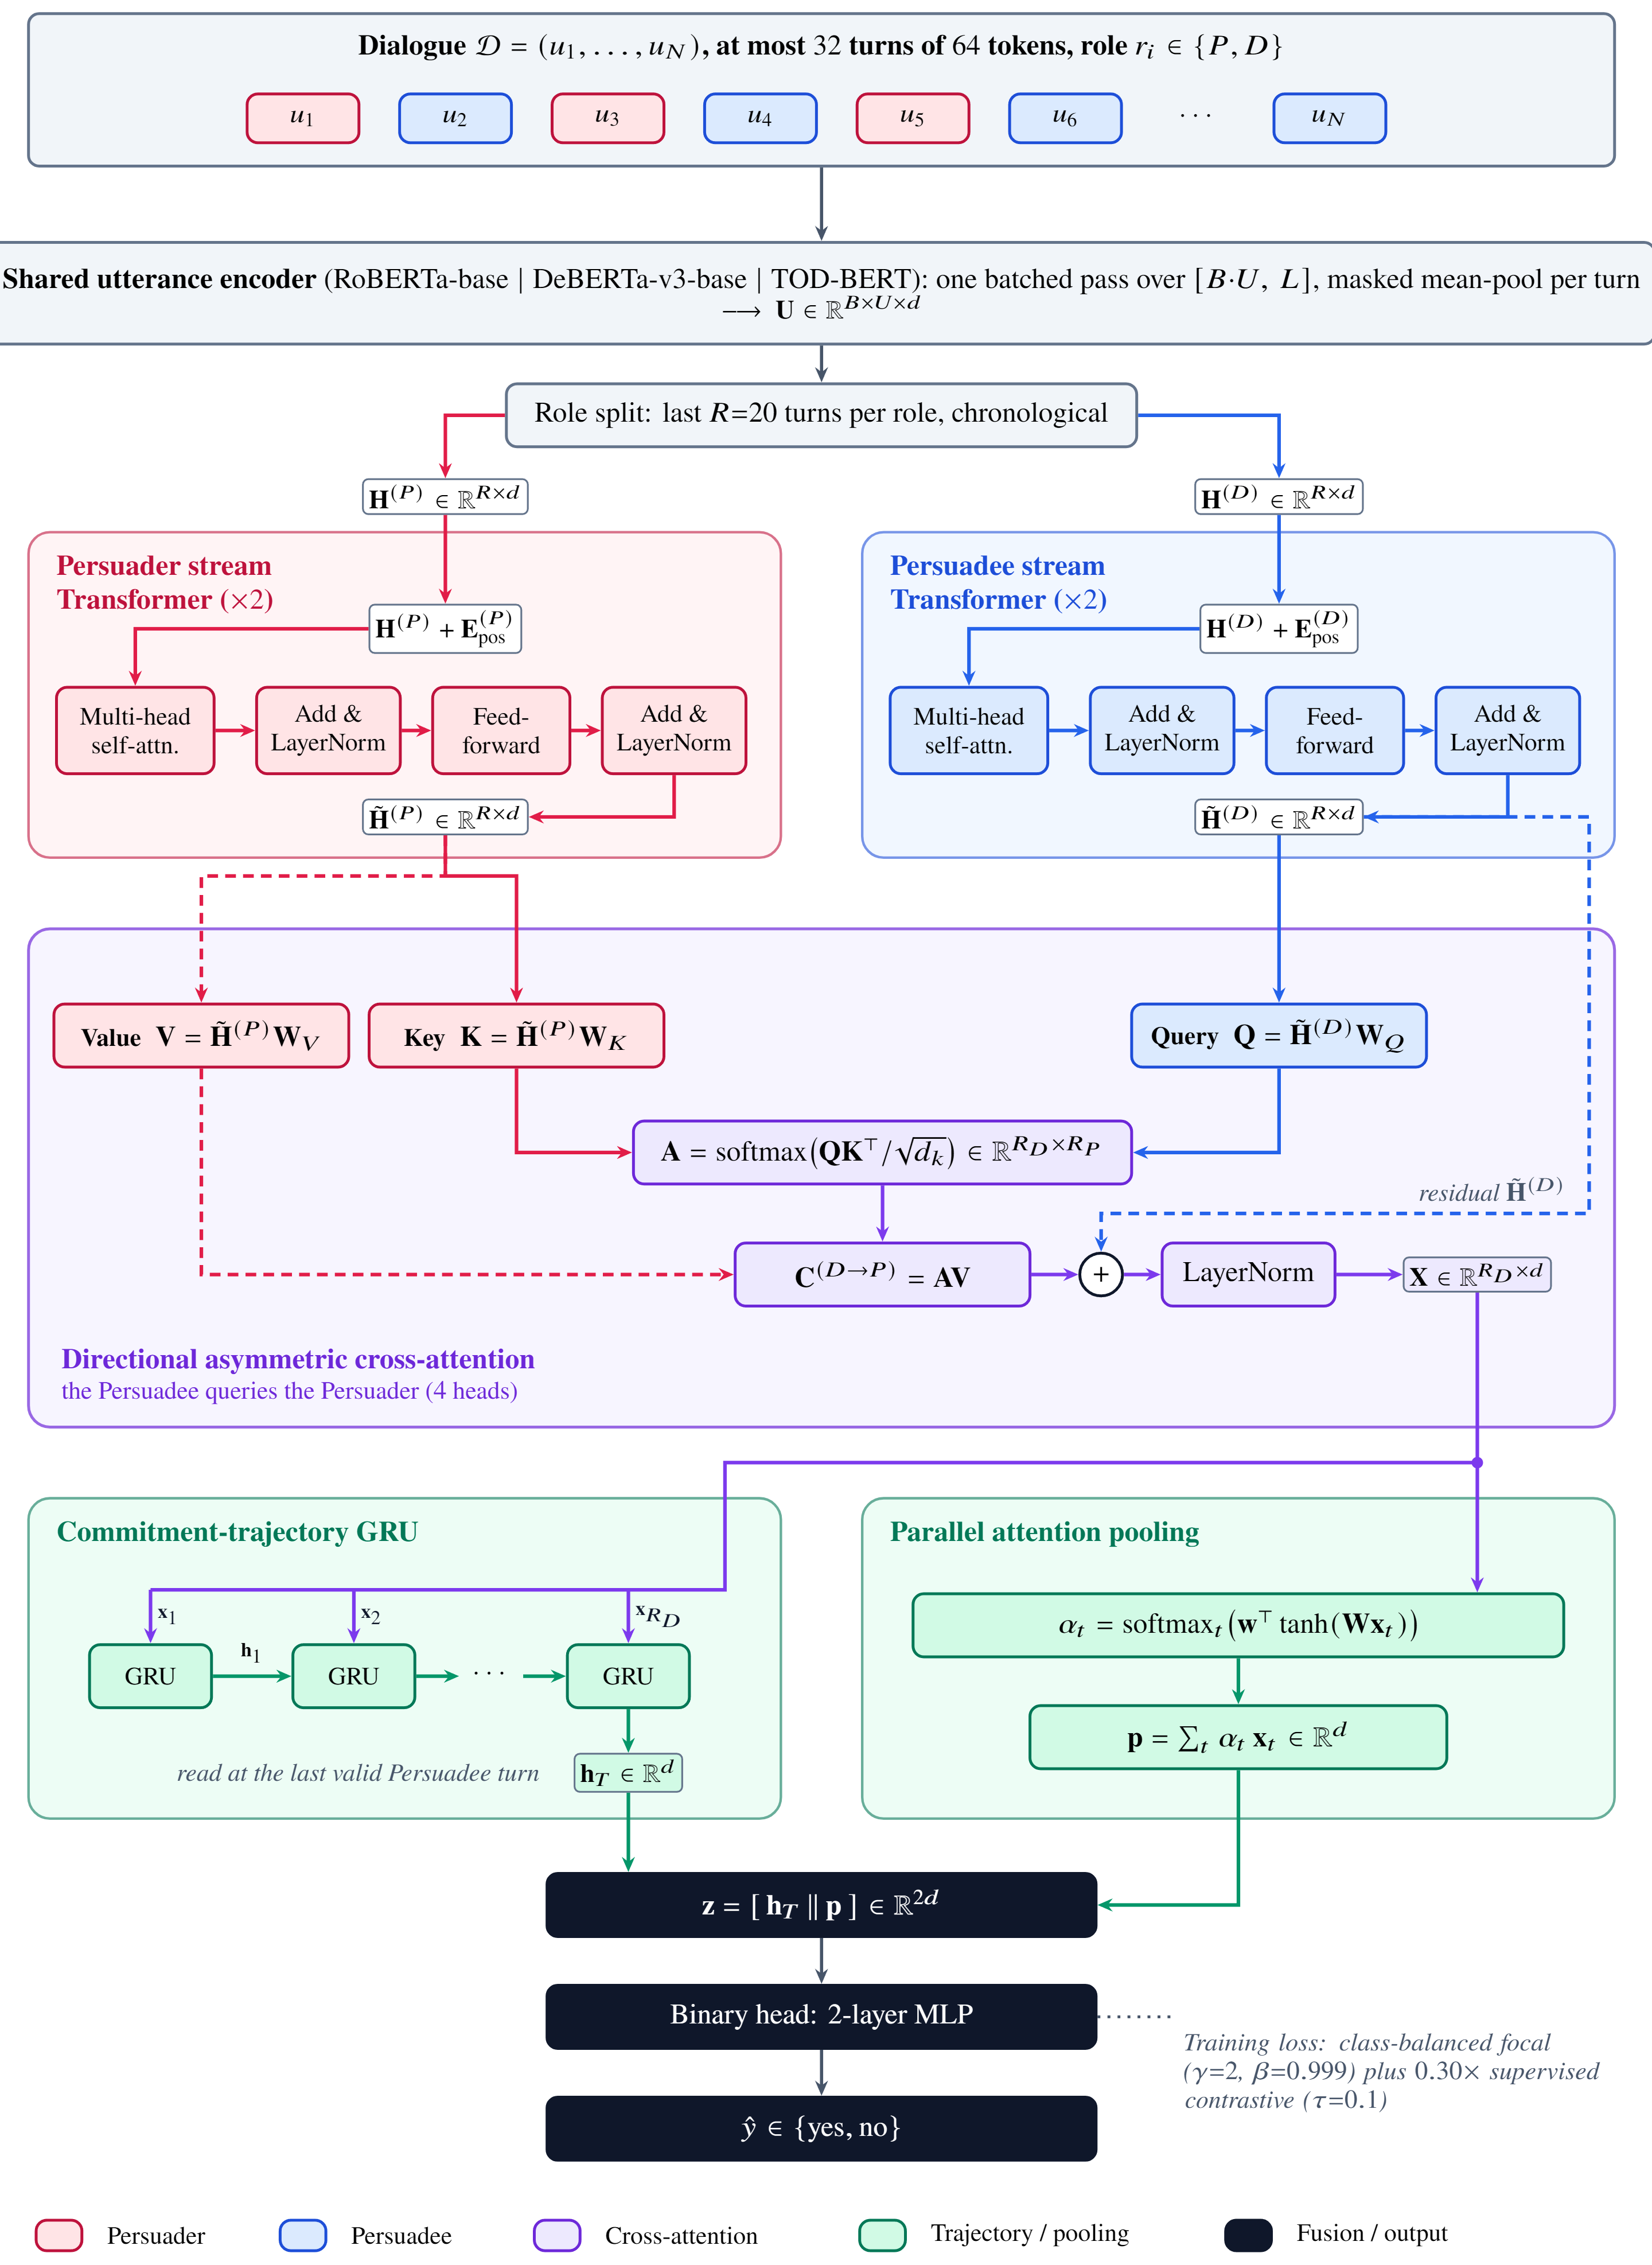
Antiphony: Inside
A
Q = H̃^{(D)}W_{Q}, with K, V from H̃^{(P)}
A
A = softmax(QKᵀ / √d_{k})
B
z = [h_{T} ; p] → 2-layer MLP
A
LOSS
CB-Focal (γ = 2, β = 0.999) + 0.3 × SupCon (τ = 0.1)
STREAMS
Two Transformer layers per role, last R = 20 turns per role, chronological
B
Notes:
Fig 4.7. A marks cross-attention, B marks GRU plus pooling. Source: 4.6.1.

Slide 24
Antiphony: Design Refinement
SEQUENCE BUDGET
ROLE WINDOW
2,048
R = 20
tokens · U = 32 turns × L = 64
turns per role
covers 99.7% of tokens
covers 98.8% of dialogues
MEMORY · T4 16 GB
INFERENCE
B = 2
45 ms
plus gradient checkpointing
per dialogue on GPU
about 60% less memory
380 ms on CPU
Antiphony · Group 10
Notes:
Source: 4.8, 4.11.2.

Slide 25
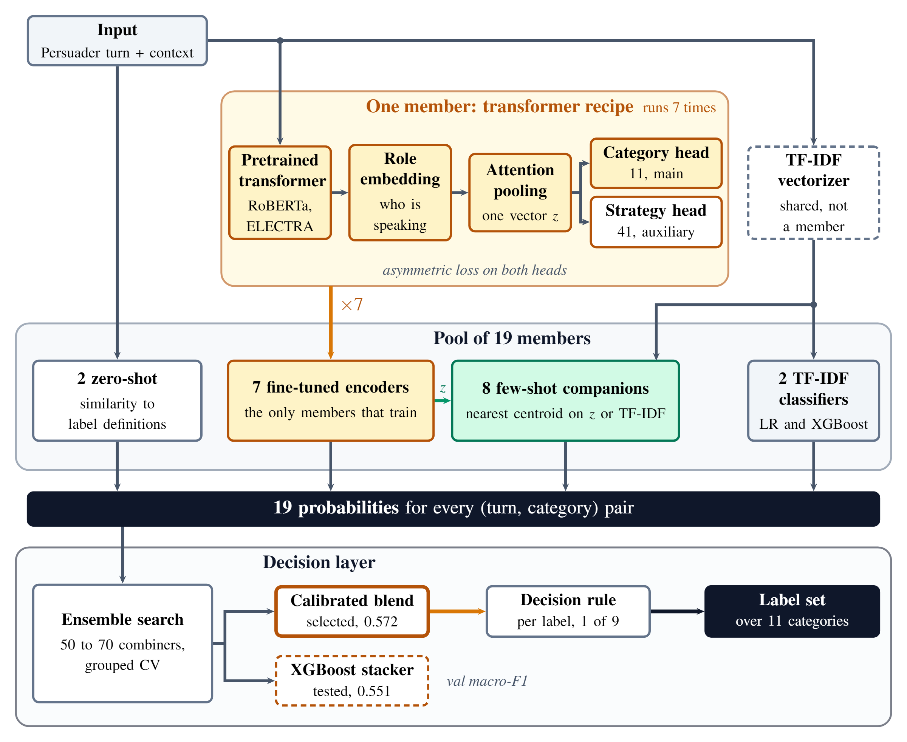
Strategy Classifier: The 19-Member Ensemble
PIVOT
0.368
macro-F1 on all 41 strategies
So: 11 categories as the main target, 41 strategies as a helper
POOL OF 19
7 fine-tuned encoders · 8 few-shot companions · 2 TF-IDF · 2 zero-shot
TRAINING
Asymmetric Loss on both heads
Antiphony · Group 10
Notes:
Fig 4.5 poster version. Source: 4.5.

Slide 26
Strategy Classifier: Decision Layer
Validation macro-F1 · Table 5.9 · bars start at 0.50
Simple probability average
50–70
0.5420
Baseline
Arithmetic mean of 19 members
XGBoost stacker, untuned
0.5329
candidate combiners searched with grouped cross-validation
Deficient
500 trees, depth 6
XGBoost stacker, tuned logits
0.5508
Documented
20 features, 300 trees, depth 4
XGBoost stacker, tuned rich
0.5473
Documented
41 features, 500 trees, depth 4
Hybrid stacker-blend
0.5618
Runner-up
Logits stacker + power-mean blend
Calibrated power-mean blend
0.5716
Selected
Platt-calibrated, q = +2.0
Antiphony · Group 10
Notes:
Table 5.9, cross-validated. Bars start at 0.50. These are validation macro-F1, not test. Source: 4.5.3, 5.4.3.

Slide 27
PART 4 OF 5
Results
4.1
Intention
4.2
Strategy
4.3
Transfer
4.4
Sufficiency gap
4.5
Robustness and forensics
4.6
Havn demo
Notes:
Section divider: part 4 of 5.

Slide 28
Intention Results
Single-stream baseline (v13)
Antiphony (v14)
0.862
0.845
0.836
0.825
PASS 3, FINAL MODEL (ROBERTA)
0.78
0.91
86.9%
no F1
yes F1
accuracy
Test n = 153 dialogues · 70 / 15 / 15 split at dialogue level · Pass 2 Antiphony 0.860 with tuned threshold · baseline 0.829 tuned on Pass 3
“Antiphony wins on both label sets, even against the baseline’s best threshold.”
Pass 2
Pass 3 strict
Test Macro-F1 · axis starts at 0.70
Antiphony · Group 10
Notes:
Table 5.6. 0.8623 is DeBERTa at default threshold; tuned 0.8600. Final model RoBERTa 0.8446 on Pass 3. No significance test was run for v13 vs v14. Source: Tables 5.2-5.6.

Slide 29
Strategy Results Against the Human Ceiling
THE ARC · TABLE 5.7
MICRO-F1 AGAINST THE HUMAN CEILING
0.368
89%
41 strategies
0.706 micro-F1 = 89% of what humans agree on
11 categories
0.556
0.706 best (v17)
v18 blend
0.695 / 0.560
macro-F1; last row micro / macro
0
0.79 human ceiling
Blend 0.572 vs XGBoost 0.551 are validation macro-F1, not test. v17 (0.706 / 0.564) and v18 (0.695 / 0.560) are statistically tied: bootstrap 95% intervals overlap almost completely.
Antiphony · Group 10
Notes:
0.706 / 0.564 is the best measured point (v17, bagged pool). 0.695 / 0.560 is the shipped v18 blend on the system diagram. Bootstrap 95% CIs overlap: [0.533, 0.589] and [0.534, 0.581]. Source: 5.4, Tables 5.7-5.9.

Slide 30
Transfer: Do Models Need the Whole Dialogue?
FLAT ROBERTA · MACRO-F1
LTR
LTR+M
FHO
PRO
Canonical · N = 500 · test n = 75
0.933
0.933
0.771
n/a
Augmented · N = 700 · test n = 105
0.952
0.914
0.848
0.950
Reversal subset · test n = 30
1.000
0.967
0.866
0.958
LTR last turn removed
LTR+M plus trailing merchant confirmations
FHO first half only
PRO pre-reversal only
Removing the last turn barely hurts. Even the pre-reversal input scores 0.950: merchant concessions give the outcome away early.
0 / 20
stance-flip errors
Next: is Antiphony actually using the trajectory? · Table 5.10
Antiphony · Group 10
Notes:
Table 5.10: flat RoBERTa with four input ablations. Reversal subset: the 200 reversal dialogues alone, test n = 30. Stance flip error rate exactly 0% (0/20). Source: 5.5.1.

Slide 31
The Sufficiency Gap
“When the ending stops giving the answer away, the last-turn model loses 0.05 and Antiphony holds. The gap is the trajectory.”
Antiphony · Group 10
Notes:
Table 5.12 with Fig 5.4a/b. On N=700 (test n=105) Antiphony DeBERTa and TOD-BERT both reach 0.9619; RoBERTa 0.9524. The last-turn control degrades by 0.0497. Source: 5.5.2-5.5.3, Table 5.11.

Slide 32
Robustness and Forensics: Skew Stress
0.933–0.973
47.7% → 9.8%
Macro-F1 range across the stress arms
positive training examples
350
261
215
203
TRAINING ARMS
training set, 47.7% yes
training set
training set
training set, 9.8% yes
Protected (tuned threshold) and unprotected (0.50) arms both hold
Antiphony · Group 10
Notes:
Fig 5.7 redrawn with the reported range. Protected arm calibrates thresholds between 0.10 and 0.30; unprotected uses a fixed 0.50. Both stayed between 0.9333 and 0.9733. Source: 5.6.

Slide 33
Robustness and Forensics: Tokenizer Truncation
30.4%
Test Macro-F1, canonical benchmark
Full model (DeBERTa-v3, dual-stream)
of dialogues (152 of 500) lost their endings to default right-truncation
0.9733
0.813 → 0.933
Last turn removed · left-truncation
0.9331
after switching to left-truncation (+0.12)
Last turn removed · right-truncation (default)
0.8133
“Our biggest ‘gap’ at one point was a tokenizer default, not the model.”
First half only
0.7707
Apparent necessity gap: 0.1600 → 0.0402
Antiphony · Group 10
Notes:
Fig 5.8 redrawn with report values. 152 of 500 dialogues exceeded 512 tokens; right-truncation cut their decision turn. Necessity gap 0.1600 shrank to 0.0402. Source: 5.7.1.

Slide 34
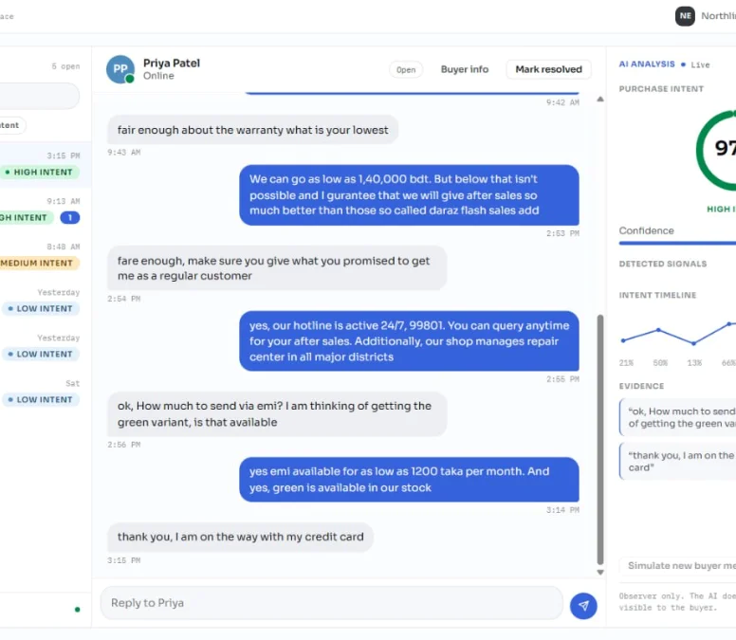
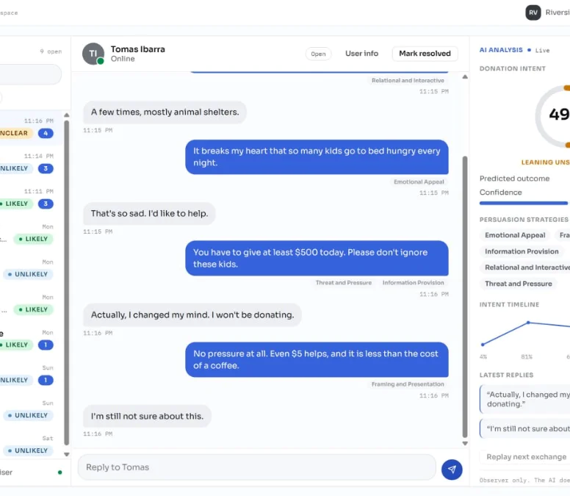
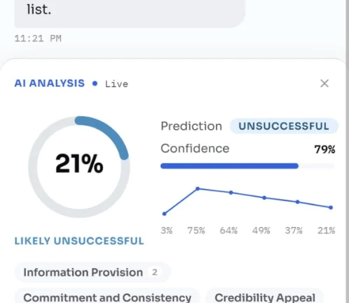
Havn Demo
“Observer only. It reads the chat, scores intent turn by turn, and tags strategies. It never replies.”
97%
49%
Mobile view
Buyer–seller intent, rising per turn
Donation intent falls after a stance reversal
Notes:
Live demo. Havn is an observer only; it never replies.

Slide 35
PART 5 OF 5
Close
5.1
What we learned
5.2
Conclusion and future work
5.3
Questions
Notes:
Section divider: part 5 of 5.

Slide 36
What We Learned
01
Modifier head dropped
because of data sparsity
9 training examples for conditional; it never broke 0.45 F1
02
Categories over strategies
because of the long tail
0.368 macro-F1 on 41 strategies; categories reached 0.556
03
XGBoost stacker rejected
in favour of the calibrated blend
0.5508 against 0.5716 validation macro-F1
04
Right-truncation replaced
by left-truncation
30.4% of endings lost; necessity gap 0.1600 → 0.0402
“Each negative result is documented, not hidden.”
Notes:
Technical deviations only. Source: 5.9.

Slide 37
Conclusion and Future Work
RECAP
LIMITATIONS
FUTURE WORK
0.862 / 0.845
Only 153 test dialogues
Bengali / Banglish with BanglaBERT
intention Macro-F1
A single seed and split
Early-warning signal from the GRU state
English only
0.706
Multi-seed significance tests
The negotiation benchmark is synthetic
strategy micro-F1, 89% of ceiling
Back-translation on the persuader side only
+0.0384
sufficiency gap on reversals
Notes:
Source: 7.1.

Slide 38


ANTIPHONY · CSE 450 · GROUP 10
SCAN FOR THE LIVE DEMOS
Thank you
Persuasion
Donation intent & strategy
Questions and discussion
Buyer–Seller
Negotiation intent
0.862
0.706
+0.0384
intention Macro-F1
strategy micro-F1
sufficiency gap
Notes:
Q&A. Scan to open the live demos: Persuasion (donation intent and strategy) and Buyer-Seller (negotiation intent).

