Slide 1

Library Database Analysis

Slide 2
About me
Hi, myself Abhishek Goud, a B.Tech Computer Science Engineering student from Dr. Babasaheb Ambedkar Technological University, Lonere.
I'm passionate about data-driven decision-making and fascinated by how data science, machine learning, and AI can solve complex, real-world problems. My goal is to build a strong foundation in data analytics, statistical modeling, and machine learning to contribute to innovative and impactful solutions.
📌 LinkedIn: linkedin.com/in/abhishek-goud-860720251.
📌 GitHub: github.com/Abhishek1232333.

Slide 3
Problem Statement
This project analyzes a library’s SQL database to answer key operational questions related to book availability, borrower activity, and branch performance. Using seven tables, it focuses on tracking specific books across branches, identifying active/inactive borrowers, analyzing due loans, and evaluating author-based inventory. The goal is to support better decision-making and improve library services.
Objective:
The goal of this project is to analyze data stored within a library's database to extract meaningful insights. This involves examining various aspects such as book circulation, user activity, borrowing patterns, and catalog usage to derive actionable conclusions that can help improve library operations and services.
The database contains 7 tables namely:
Publisher.
Book.
Author.
Book_copies.
Branch.
Book_loan.
Borrower.

Slide 4
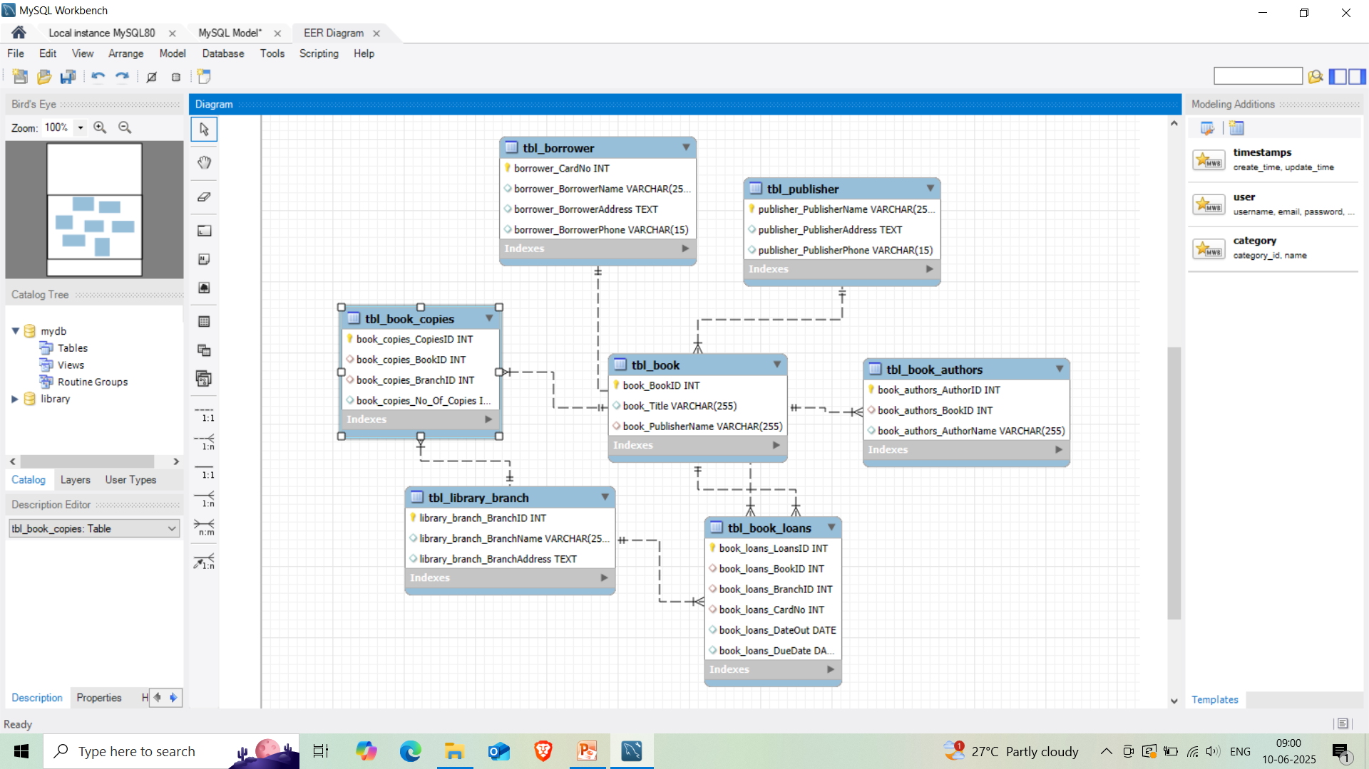
ER Diagram

Slide 5
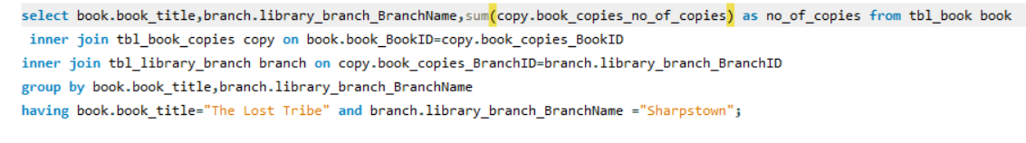
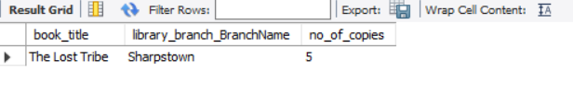
Analysis Questions
How many copies of the book titled "The Lost Tribe" are owned by the library branch whose name is "Sharpstown"?
Result of query

Slide 6
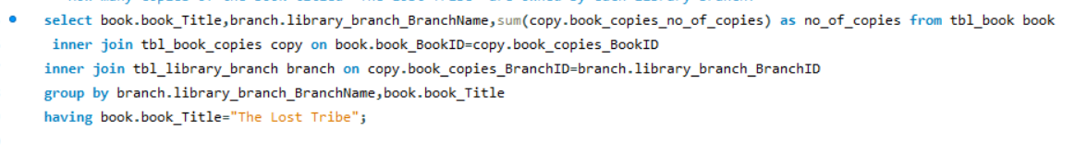
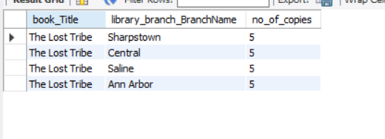
How many copies of the book titled "The Lost Tribe" are owned by each library branch?
Result of query

Slide 7
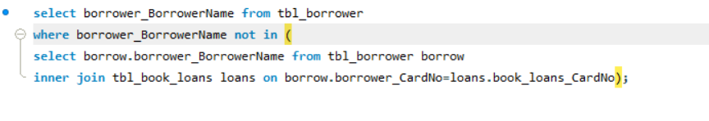

Retrieve the names of all borrowers who do not have any books checked out.
Result of query

Slide 8
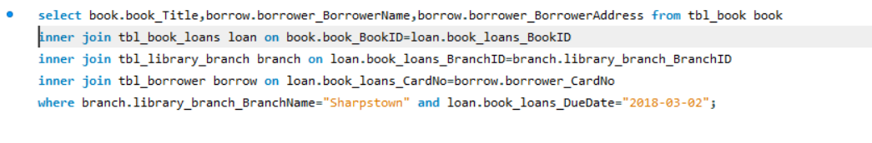
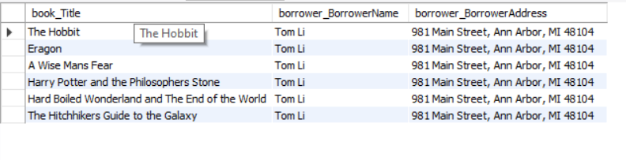
For each book that is loaned out from the "Sharpstown" branch and whose DueDate is 2/3/18, retrieve the book title, the borrower's name, and the borrower's address.
Result of query

Slide 9
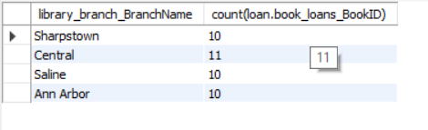
For each library branch, retrieve the branch name and the total number of books loaned out from that branch.
Result of query

Slide 10
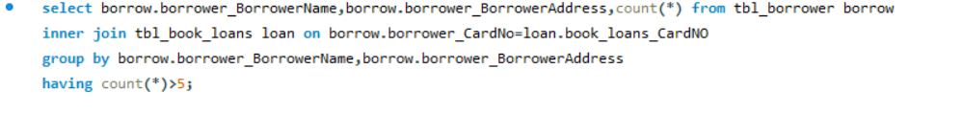
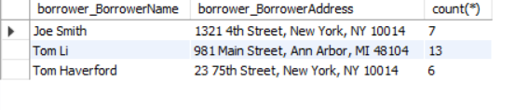
Retrieve the names, addresses, and number of books checked out for all borrowers who have more than five books checked out.
Result of query

Slide 11
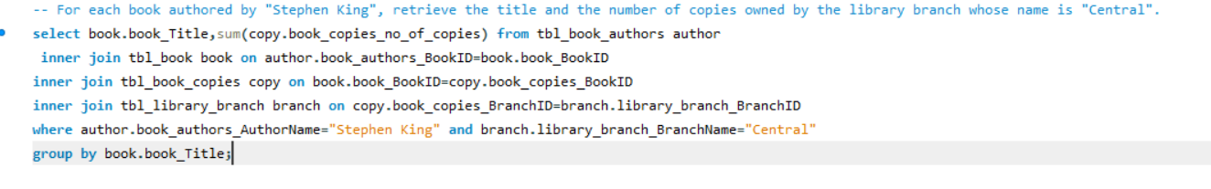
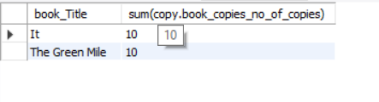
For each book authored by "Stephen King", retrieve the title and the number of copies owned by the library branch whose name is "Central".
Result of query

Slide 12
Conclusion
The analysis provided valuable insights into the operations of the library system.
Identified book availability by title and branch, helping to track inventory distribution.
Tracked borrower activity, highlighting users with zero or high loan activity.
Analyzed popular books by specific authors (e.g., Stephen King) across branches.
Future scope
Integrate real-time data updates for live reporting.
Implement analytics dashboards for staff to monitor trends.

Slide 13

THANK YOU

