Slide 1

Prodigy InfoTech
SUMMER INTERNSHIP PRESENTATION REPORT
Web Development Internship
HTML, CSS, JavaScript & API Integration Fundamentals
STUDENT CREDENTIALS
Student Name
Abhishek Anand
Certificate ID
PIT/AUG26/01100
Internship Domain
Web Development
Host Organization
Prodigy InfoTech
Internship Duration
1 Aug 2026 – 31 Aug 2026 (1 Month)

Slide 2
Candidate & Program Overview
Key details of the student and the internship program
CANDIDATE DETAILS
INTERNSHIP PROFILE
Student Name
Abhishek Anand
Role Offered
Intern – Web Development
Certificate ID
PIT/AUG26/01100
Host Organization
Prodigy InfoTech
Internship Role
Web Development Intern
Duration
1 Aug – 31 Aug 2026 (1 Month)
Duration
1 Aug – 31 Aug 2026
Certificate ID
PIT/AUG26/01100
Work Mode
Remote
Program Status
Completed Successfully
Internship Report | Abhishek Anand | PIT/AUG26/01100
2

Slide 3
Internship at a Glance
A quick snapshot of the internship engagement
1
2
3
4
ORGANIZATION
DURATION
DOMAIN
MODE
Prodigy InfoTech
1 Aug – 31 Aug 2026
Web Development
Remote
ABOUT THE ROLE
Undertook a structured, task-based Web Development internship at Prodigy InfoTech, building practical front-end engineering skills — from HTML, CSS and JavaScript fundamentals, through interactive UI and DOM-driven applications, to API integration and JSON data handling, culminating in a hands-on capstone project. The one-month program was completed successfully and formally recognized with a certificate of completion.
Internship Report | Abhishek Anand | PIT/AUG26/01100
3

Slide 4
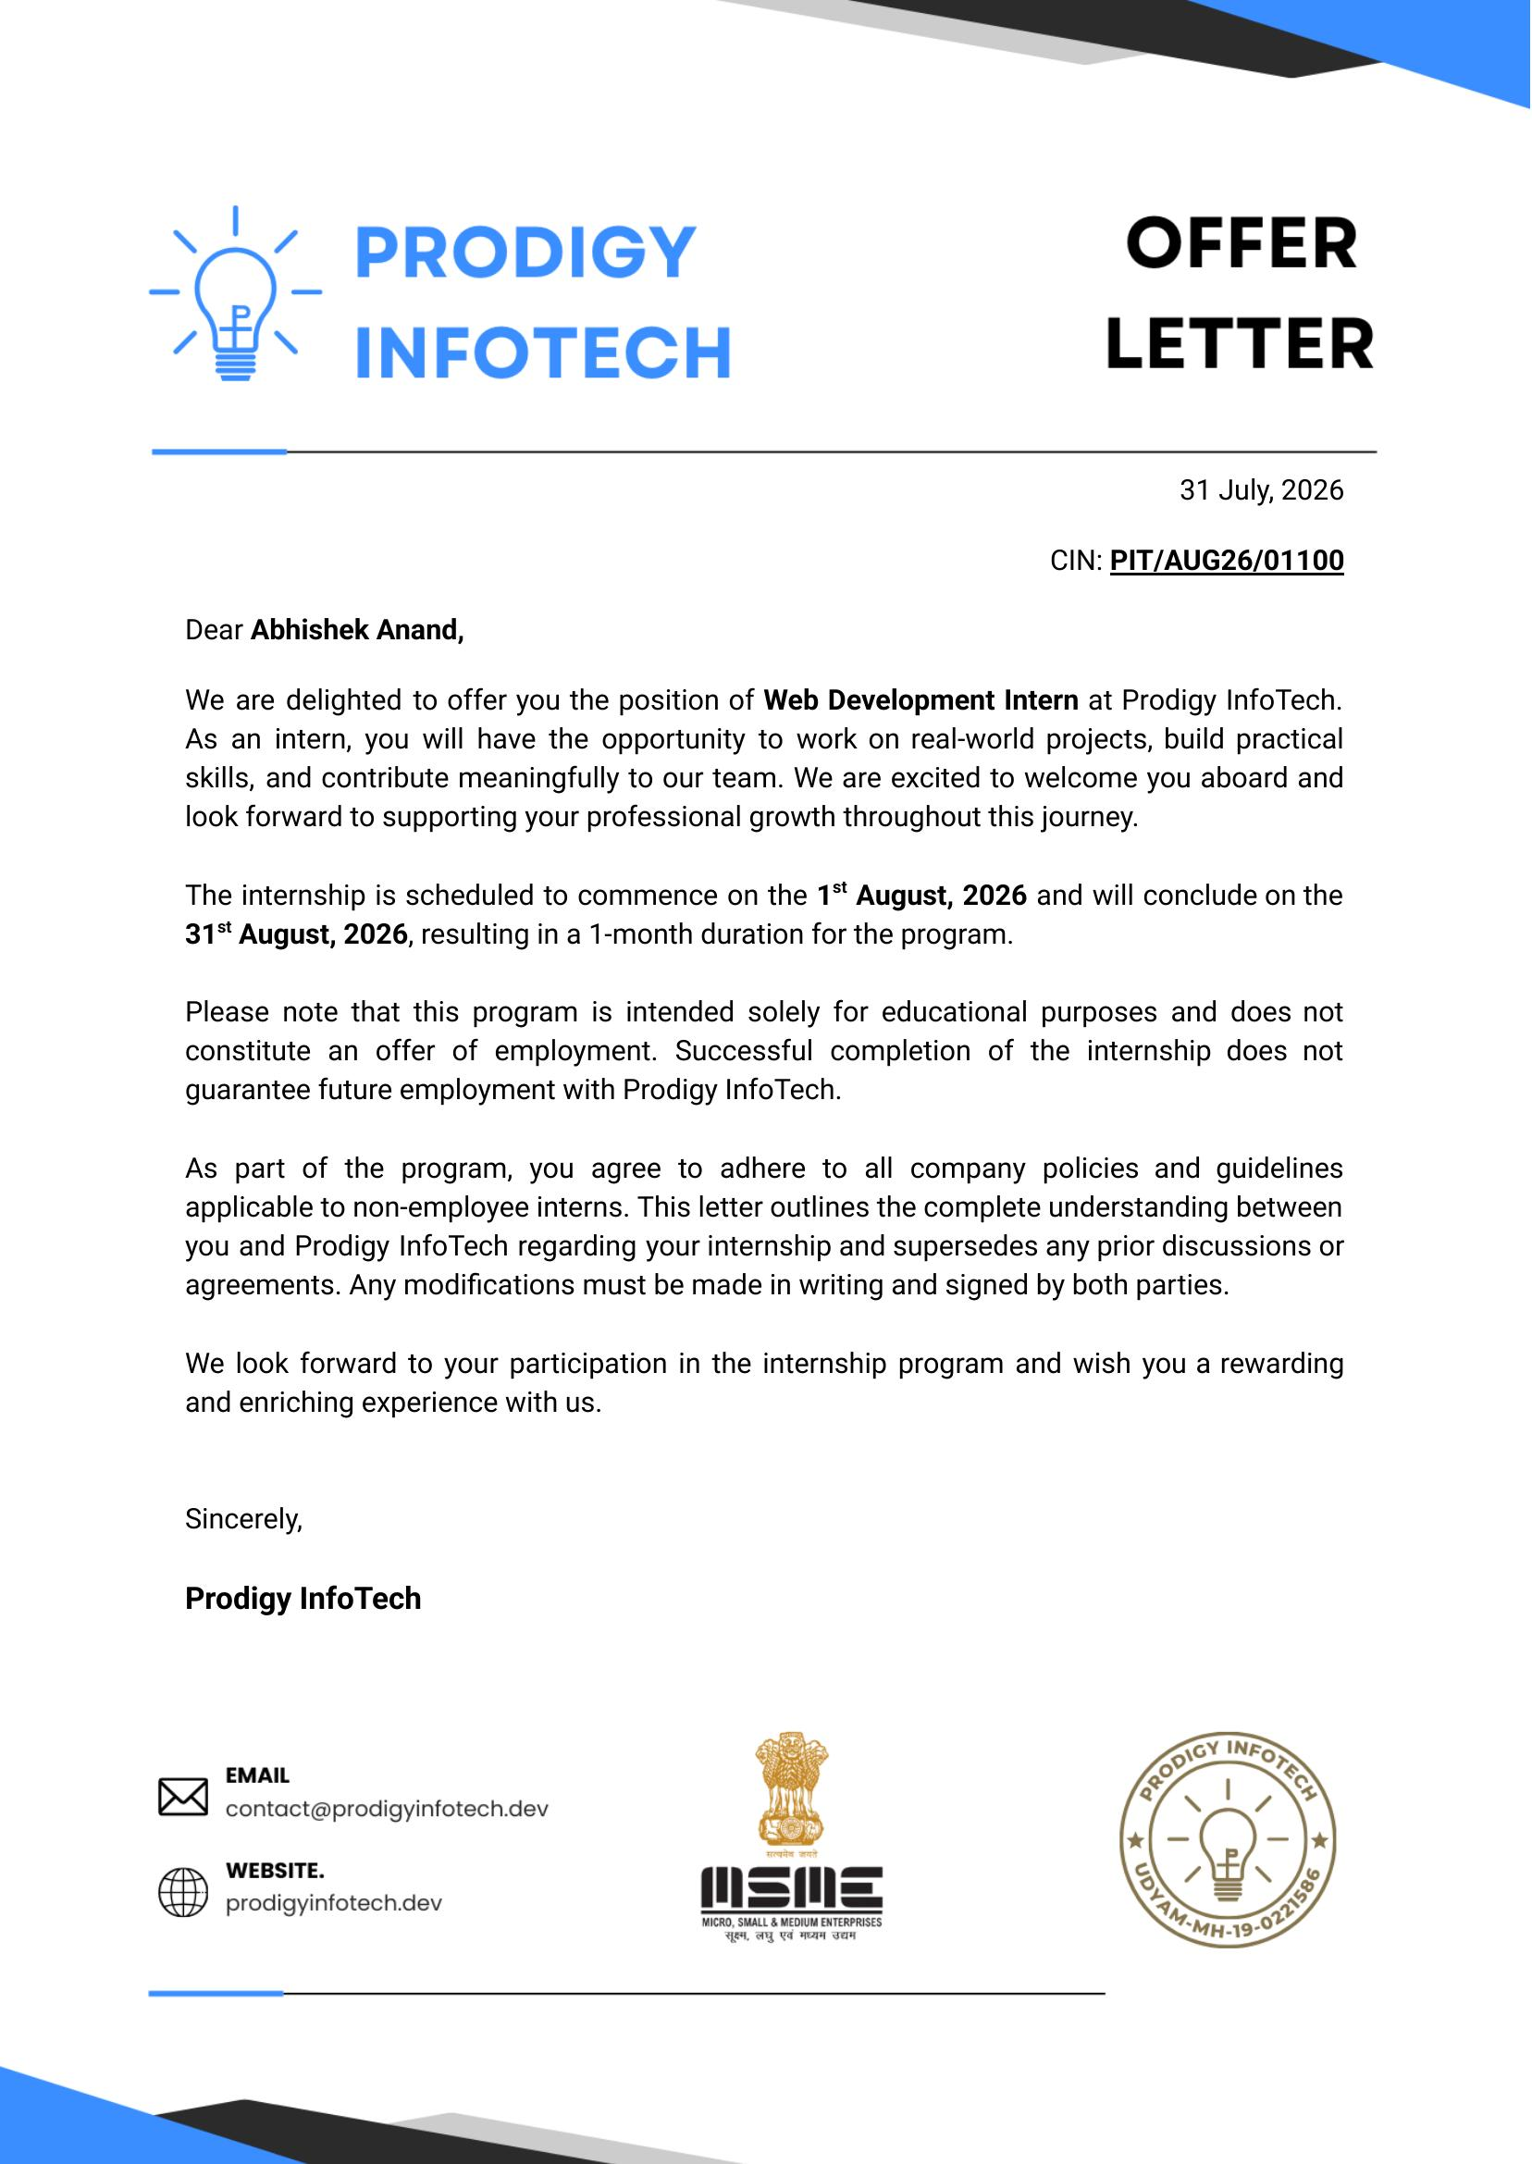
OFFER LETTER
OFFER LETTER
Internship Offer Letter
Internship Offer Letter
Formal offer extended by Prodigy InfoTech confirming the internship terms
Formal offer extended by Prodigy InfoTech confirming the internship terms
OFFER DETAILS
Intern Name
Abhishek Anand
Certificate ID
PIT/AUG26/01100
Internship Role
Web Development Intern
Commencement Date
1 Aug 2026
Completion Date
31 Aug 2026
Issued By
Prodigy InfoTech
Internship Report | Abhishek Anand | PIT/AUG26/01100
4

Slide 5
About the Organization
Prodigy InfoTech
Organization Overview
CREDENTIALS
Prodigy InfoTech offers structured, project-based internship programs designed to build practical, industry-relevant skills through guided, hands-on learning in fields such as Web Development.
Program Type
Skill Development Internship
One-month, task-based internship track
Focus Area
Hands-on experience building real browser applications
Web Development
Guidance aligned with company policies for non-employee interns
Duration
Certificate of completion issued on successful conclusion
1 Month
Certification
Issued on Successful Completion
Internship Report | Abhishek Anand | PIT/AUG26/01100
5

Slide 6
Objectives of the Internship
What the internship set out to achieve
1
Strengthen Web Development Fundamentals
2
Build Interactive UI & Logic
Build a solid foundation in HTML, CSS and JavaScript for real browser apps.
Develop interactive apps using DOM manipulation and event handling.
3
Work with APIs & JSON Data
4
Debug, Test & Deploy via GitHub
Integrate external APIs and process JSON responses dynamically.
Practice debugging, browser testing and version-controlled submission.
Internship Report | Abhishek Anand | PIT/AUG26/01100
6

Slide 7
1
Module 1: Web Fundamentals & Interactive UI
Status: Completed Successfully
TASK DESCRIPTION
Built foundational front-end components to practice page structuring and interactive browser behavior.
KEY SKILLS APPLIED
EXPECTED OUTCOME
Built a fixed navigation menu with hover/scroll interaction
Two working front-end components demonstrating core HTML, CSS and JavaScript fundamentals and event-driven interactivity.
Developed a stopwatch app with start, stop and reset controls
Applied DOM manipulation and browser event handling
Practiced timing logic and state tracking using JavaScript
✓ Completed Successfully
Internship Report | Abhishek Anand | PIT/AUG26/01100
7

Slide 8
2
Module 2: Application Logic & Portfolio Development
Status: Completed Successfully
TASK DESCRIPTION
Built a two-player browser game and a structured personal portfolio to practice UI organization and conditional logic.
KEY SKILLS APPLIED
EXPECTED OUTCOME
Developed a Tic-Tac-Toe game with click handling and win detection
A complete interactive game and a professional portfolio website, showing applied JavaScript logic and UI structuring.
Built a personal portfolio site for profile, skills and projects
Applied conditional logic and state tracking in JavaScript
Structured multi-section pages with clean UI organization
✓ Completed Successfully
Internship Report | Abhishek Anand | PIT/AUG26/01100
8

Slide 9
3
Module 3: API Integration & Data Handling
Status: Completed Successfully
TASK DESCRIPTION
Connected a browser application to an external weather API to practice working with live, dynamic data.
KEY SKILLS APPLIED
EXPECTED OUTCOME
Sent requests to the OpenWeather API from JavaScript
A working weather application demonstrating API integration, asynchronous data handling and dynamic DOM updates.
Processed and parsed JSON responses dynamically
Displayed city, temperature, condition, humidity and wind speed
Handled invalid city input with clear error messaging
✓ Completed Successfully
Internship Report | Abhishek Anand | PIT/AUG26/01100
9

Slide 10
4
Module 4: Mini Project (Capstone) — Weather App
Status: Completed Successfully
TASK DESCRIPTION
Brought together the full front-end workflow — structure, styling, logic and API integration — into a single applied project.
KEY SKILLS APPLIED
EXPECTED OUTCOME
Designed the complete user input to output workflow
A complete, fully functional weather application demonstrating the end-to-end front-end pipeline from user input to live data display.
Integrated live API requests with dynamic DOM updates
Applied error handling for invalid user input
Tested and debugged across multiple browser scenarios
✓ Completed Successfully
Internship Report | Abhishek Anand | PIT/AUG26/01100
10

Slide 11
Tools & Technologies Used
The stack applied across the internship
1
2
3
HTML5
CSS3
JavaScript
Page structure and semantic markup
Styling and responsive layout
Logic and interactivity
4
5
6
OpenWeather API
Visual Studio Code
Git / GitHub
Live weather data for the capstone app
Development environment
Version control for project work
Internship Report | Abhishek Anand | PIT/AUG26/01100
11

Slide 12
Learning Outcomes & Skills Gained
Technical and professional takeaways from the internship
Web Fundamentals
Interactivity & Logic
APIs & Deployment
HTML & CSS page development
JavaScript & DOM manipulation
API integration & JSON handling
Responsive layout & styling
Event handling & game logic
Asynchronous data processing
Semantic structuring basics
Debugging & browser testing
GitHub repository management
Internship Report | Abhishek Anand | PIT/AUG26/01100
12

Slide 13
Challenges & Key Learnings
Reflections from the internship journey
Debugging API & invalid-city responses
!
Learned to systematically trace and resolve errors from live API responses and unexpected user input.
Handling dynamic weather data
!
Refined the ability to process and render live JSON data reliably within the DOM.
Fixing image and icon paths
!
Strengthened attention to asset referencing and browser rendering behavior.
Organizing & submitting work through GitHub
!
Built confidence in structuring, testing and version-controlling a complete front-end project.
Internship Report | Abhishek Anand | PIT/AUG26/01100
13

Slide 14
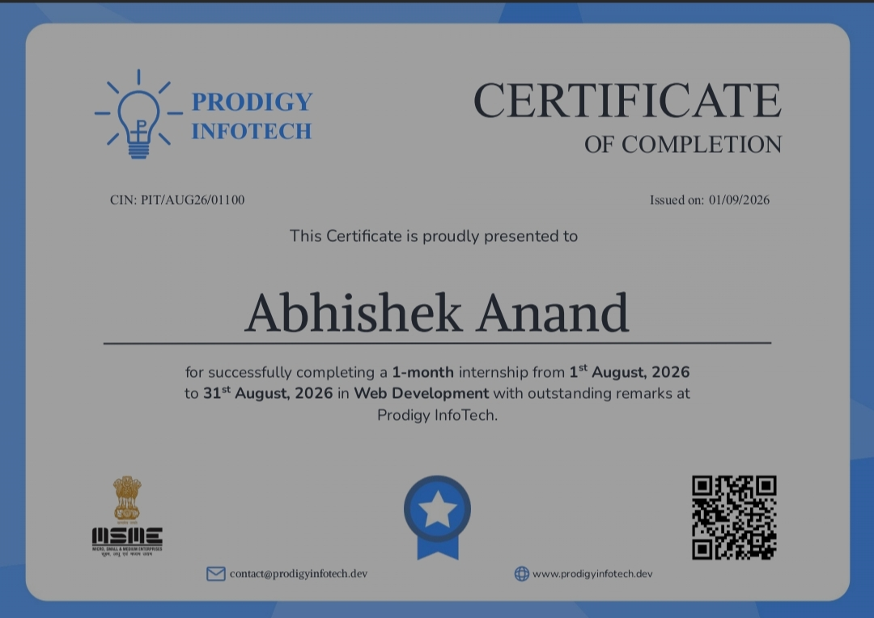
CERTIFICATE
Certificate of Completion
Certificate ID: PIT/AUG26/01100 | Issued by Prodigy InfoTech | Domain: Web Development
Internship Report | Abhishek Anand | PIT/AUG26/01100
14
14

Slide 15
Conclusion
This internship at Prodigy InfoTech provided a practical introduction to front-end web development — from building interactive UI components, through JavaScript logic and game development, to API integration and a complete capstone weather application. The one-month program strengthened core technical skills and built confidence in delivering a complete web application end-to-end.
1
100%
5
Month-Long Internship
Program Completed
Projects Completed
Thank You
Abhishek Anand | Web Development Intern | Prodigy InfoTech

