Slide 1

FASHION TREND ANALYSIS

Slide 2
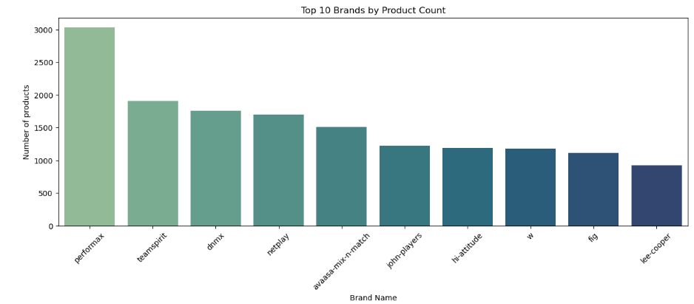
Performax leads the catalog with 3,029 products, reflecting its strong focus on offering a wide range of activewear options.
Teamspirit, DNMX, and Netplay also have a significant presence, indicating healthy competition among major fashion brands.
The top brands collectively account for a large share of the available products, showing that a few established labels dominate the market.
Both western/casual wear and ethnic fashion brands appear in the top rankings, highlighting diverse customer preferences.
A broad product assortment can help brands attract more shoppers, cater to varied tastes, and build stronger brand visibility.
Figure 1 :- Top 10 Brands by Product count

Slide 3
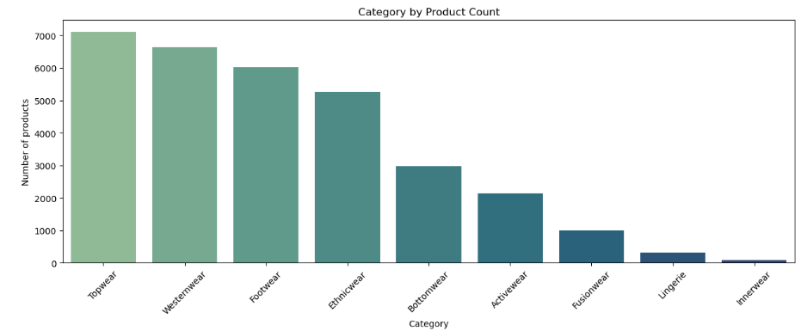
Topwear emerges as the largest category, indicating consistently high consumer demand for items such as shirts, T-shirts, and tops.
Westernwear and Footwear closely follow, highlighting the importance of versatile apparel and accessories in everyday fashion.
The strong presence of Ethnicwear reflects the continued popularity of traditional and festive styles alongside modern trends.
Bottomwear and Activewear maintain a solid share of the catalog, suggesting a balanced interest in both comfort and functionality.
Categories such as Fusionwear, Lingerie, and Innerwear have comparatively smaller offerings, which may represent niche segments or opportunities for future expansion.
Figure 2 :- Top Categories by Product count

Slide 4
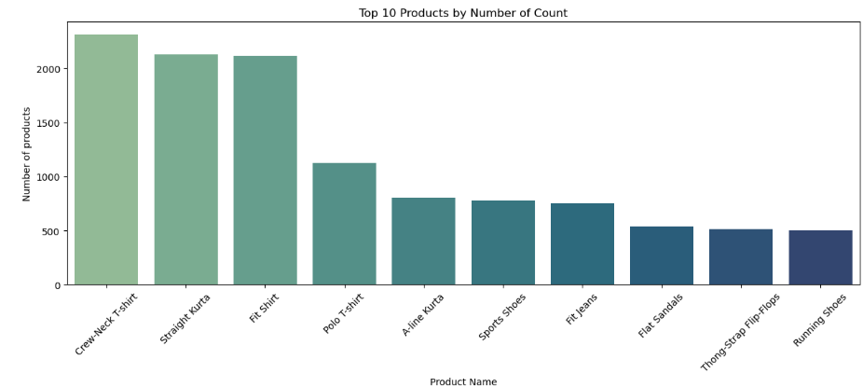
Crew-Neck T-shirts (2,312 items) dominate the product mix, making them the clear everyday staple of the collection.
Straight Kurtas (2,126) and Fit Shirts (2,117) appear in almost equal numbers, revealing a strong balance between ethnic and smart-casual fashion preferences.
With 1,126 listings, Polo T-shirts stand out as a versatile choice that bridges casual and semi-formal dressing.
The footwear segment is led by Sports Shoes (779), followed by Fit Jeans (755), indicating that comfort and practicality remain key purchasing drivers.
Flat Sandals (537), Thong-Strap Flip-Flops (516), and Running Shoes (503) round out the top products, suggesting that consumers increasingly favor styles that combine ease of wear with everyday functionality.
Figure 3 :- Top 10 Products by Number of count

Slide 5
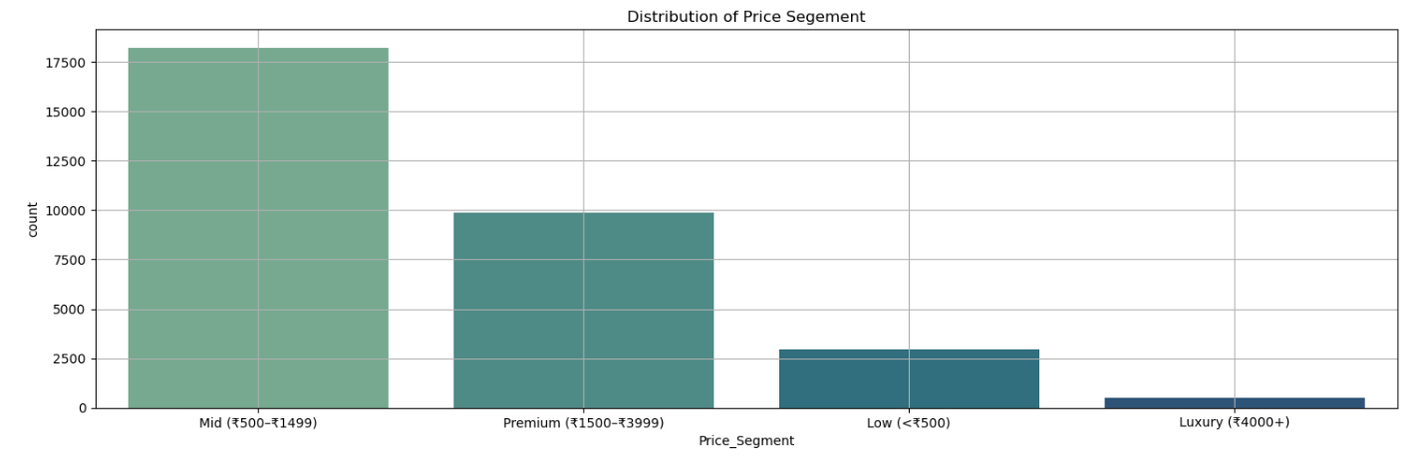
The Mid-price segment (₹500–₹1,499) dominates the catalog with 18,237 products, establishing it as the sweet spot where affordability meets variety.
Premium offerings (₹1,500–₹3,999) account for 9,872 items, indicating a strong consumer appetite for higher-quality and branded fashion. The Low-price category (below ₹500) includes 2,972 products, serving budget-conscious shoppers but representing a smaller share of the market.
With only 501 products, the Luxury segment (₹4,000+) remains highly exclusive and caters to a niche audience.
Overall verdict: The pricing landscape is clearly centered on value-driven fashion, with the mid-range segment emerging as the core engine of both assortment and consumer demand.
Figure 4 :- Distribution of Price Segment

Slide 6
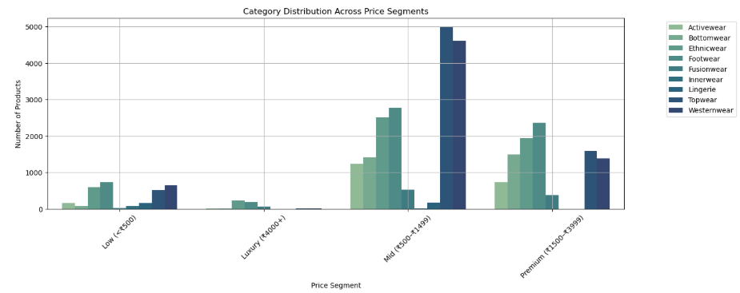
In the Low-price segment, Footwear (725 items) and Westernwear (648) lead the assortment, making budget-friendly style highly accessible to shoppers.
The Mid-price range is driven by Topwear (4,989 products) and Westernwear (4,611), reinforcing this segment’s role as the heart of the fashion market.
Within the Premium category, Footwear (2,357 items) and Ethnicwear (1,944) emerge as key contributors, suggesting that consumers are willing to spend more on quality and occasion wear.
The Luxury segment is relatively small, with Ethnicwear (227 products) and Footwear (182) accounting for the majority of offerings, highlighting the exclusivity of high-end fashion.
Figure 5 :- Category Distribution across Price Segment
Overall insight: As prices rise, the product mix shifts from everyday essentials toward specialized and premium styles, while the mid-price segment remains the strongest across nearly all categories.

Slide 7
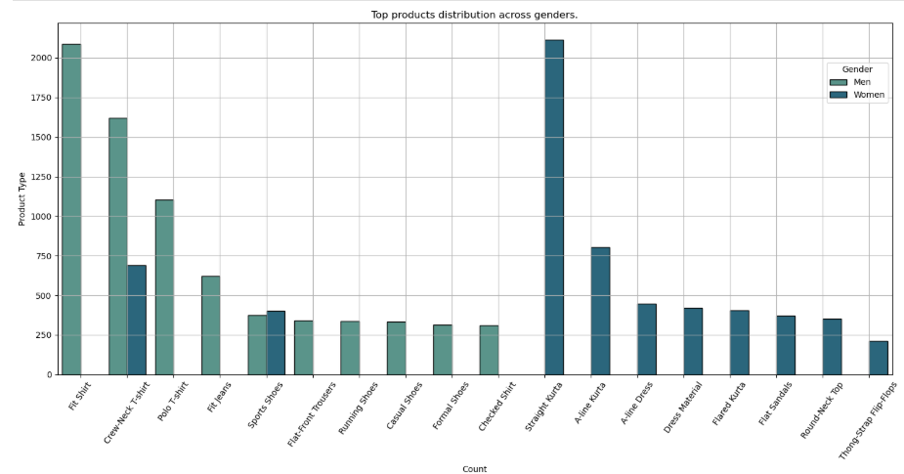
For men, Fit Shirts (2,087 items) lead the catalog, followed by Crew-Neck T-shirts (1,620) and Polo T-shirts (1,105), reflecting a strong preference for smart-casual and versatile wardrobe staples.
Men’s fashion also shows significant demand for practical essentials such as Fit Jeans (622) and a variety of footwear, including Sports Shoes (376) and Running Shoes (338).
In the women’s segment, Straight Kurtas (2,113 products) dominate, underscoring the enduring popularity of ethnic wear.
Women’s offerings are further enriched by styles such as A-line Kurtas (803), Crew-Neck T-shirts (692), and A-line Dresses (447), highlighting a blend of traditional and contemporary fashion choices.
Figure 6 :- Top Products Distribution Across Gender
Key takeaway: Men’s assortments are centered on everyday casual wear, while women’s collections exhibit a broader mix of ethnic, western, and comfort-focused styles, reflecting more diverse fashion preferences.

Slide 8
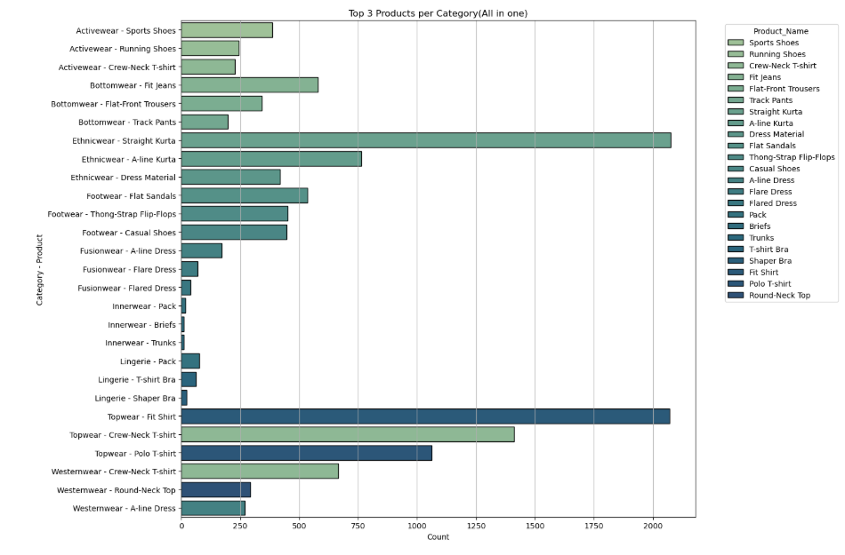
Activewear is led by Sports Shoes (385 items), followed by Running Shoes (243) and Crew-Neck T-shirts (228), highlighting the importance of performance and comfort in this segment.
In Bottomwear, Fit Jeans (580) dominate, while Flat-Front Trousers (342) and Track Pants (198) cater to both formal and casual needs.
Ethnicwear is overwhelmingly driven by Straight Kurtas (2,076 products), with A-line Kurtas (764) and Dress Materials (419) adding depth to the category.
The Footwear category is characterized by versatile everyday styles, with Flat Sandals (535), Thong-Strap Flip-Flops (452), and Casual Shoes (446) leading the way.
In Topwear, Fit Shirts (2,070), Crew-Neck T-shirts (1,411), and Polo T-shirts (1,061) reaffirm the enduring appeal of classic wardrobe essentials.
Westernwear shows a balanced mix of casual and feminine styles, led by Crew-Neck T-shirts (665), Round-Neck Tops (292), and A-line Dresses (270).
Figure 7 :- Top 3 Products per Category
Smaller segments such as Fusionwear, Lingerie, and Innerwear remain niche, with specialized products like A-line Dresses (171), T-shirt Bras (63), and Packs (18) serving focused consumer needs.

Slide 9
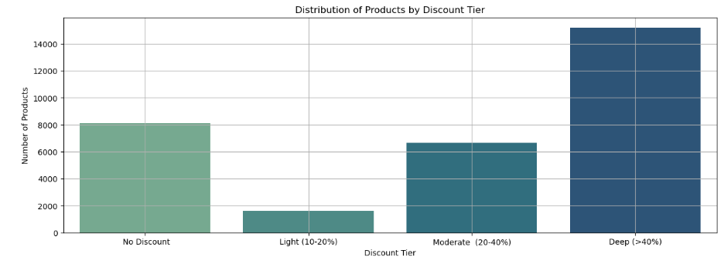
Deep discounts exceeding 40% account for 15,194 products, making aggressive promotions the dominant pricing strategy in the catalog.
No-discount items still represent a substantial share with 8,107 products, indicating that many products retain their full-price appeal.
The Moderate discount tier (20–40%) includes 6,660 items, striking a balance between value for customers and profitability for brands.
Light discounts of 10–20% are relatively uncommon, with only 1,621 products, suggesting that retailers tend to favor either significant markdowns or no discounts at all.
Key insight: The discount landscape is polarized, with brands relying heavily on deep promotions while maintaining a sizeable portfolio of full-priced products.
Figure 8 :-Distribution of Products by Discount Tier

Slide 10
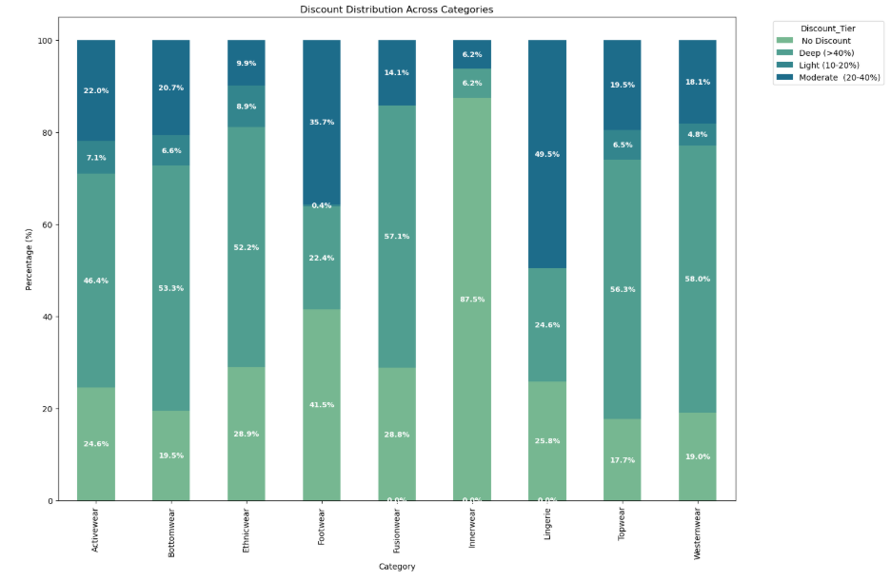
Topwear (56.3%), Westernwear (58.0%), and Fusionwear (57.1%) rely heavily on deep discounts, showing that promotions are a key driver of sales in these fashion segments.
Ethnicwear also favors substantial markdowns, with 52.2% of products offered at discounts above 40%, while nearly 29% remain at full price.
Footwear stands out for its balanced pricing strategy: 41.5% of products are sold without discounts, and 35.7% receive moderate markdowns.
Innerwear is the least promotion-driven category, with an impressive 87.5% of items sold at full price, suggesting strong and stable demand.
Lingerie follows a different pattern, with almost half of its products (49.5%) falling in the moderate discount range.
Overall takeaway: Discounting practices vary significantly by category, reflecting distinct consumer behaviors and pricing strategies across the fashion market.
Figure 9 :- Discount Distribution Across Categories

Slide 11
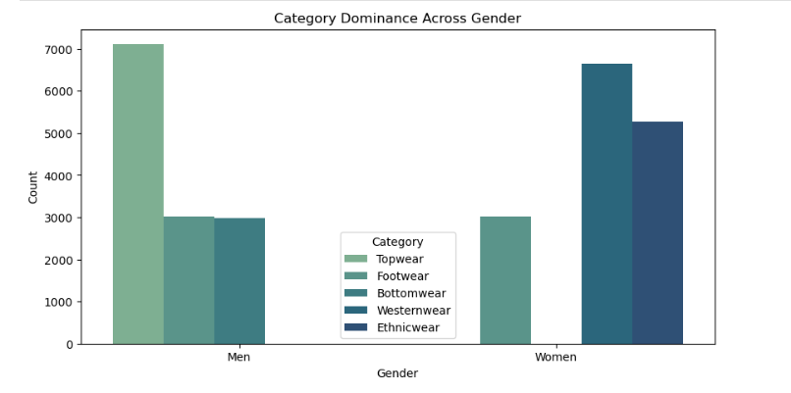
In the men’s segment, Topwear clearly dominates with 7,110 products, far outpacing Footwear (3,015) and Bottomwear (2,984).
This indicates a strong emphasis on shirts, T-shirts, and other everyday essentials.
For women, Westernwear leads the assortment with 6,641 items, followed by Ethnicwear (5,265) and Footwear (3,015), showcasing a rich blend of contemporary and traditional styles.
The equal representation of Footwear (3,015 products) for both genders highlights the universal importance of this category across the fashion market.
Key insight: Men’s collections are concentrated around core apparel staples, whereas women’s fashion exhibits a more diverse mix of style segments, reflecting broader and more varied consumer preferences.
Figure 10 :- Category Dominance Across Gender

Slide 12
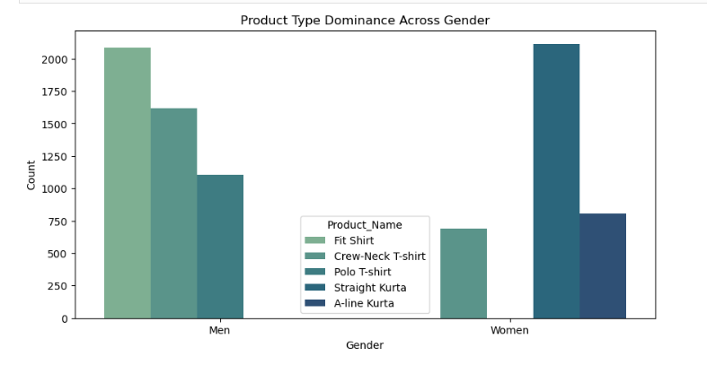
Among men, Fit Shirts lead with 2,087 products, followed by Crew-Neck T-shirts (1,620) and Polo T-shirts (1,105), emphasizing a strong preference for smart-casual essentials.
In the women’s segment, Straight Kurtas dominate with 2,113 items, while A-line Kurtas (803) and Crew-Neck T-shirts (692) further illustrate the blend of ethnic and contemporary styles.
Notably, Crew-Neck T-shirts appear among the top products for both genders, highlighting their universal appeal and versatility.
Final takeaway: Men’s fashion is anchored by classic western staples, whereas women’s collections are led by ethnic silhouettes, reflecting distinct style priorities across genders.
Figure 11 :- Product Type Dominance Across Gender

Slide 13
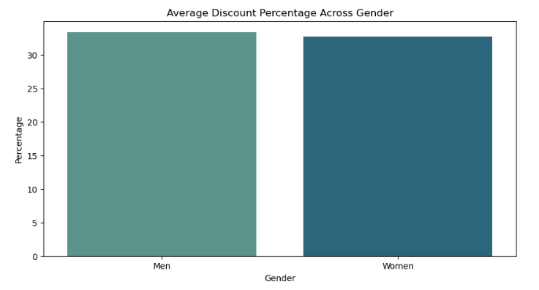
Topwear (56.3%), Westernwear (58.0%), and Fusionwear (57.1%) rely heavily on deep discounts, showing that promotions are a key driver of sales in these fashion segments.
Ethnicwear also favors substantial markdowns, with 52.2% of products offered at discounts above 40%, while nearly 29% remain at full price.
Footwear stands out for its balanced pricing strategy: 41.5% of products are sold without discounts, and 35.7% receive moderate markdowns.
Innerwear is the least promotion-driven category, with an impressive 87.5% of items sold at full price, suggesting strong and stable demand.
Lingerie follows a different pattern, with almost half of its products (49.5%) falling in the moderate discount range.
Overall takeaway: Discounting practices vary significantly by category, reflecting distinct consumer behaviors and pricing strategies across the fashion market.
Figure 12 :- Average Discount Percentage Across Gender

Slide 14
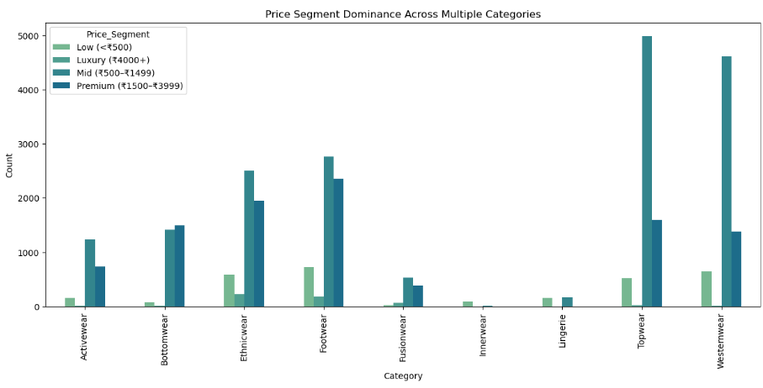
The mid-price segment (₹500–₹1,499) is the clear leader across most categories, with especially strong representation in Topwear (4,989 products) and Westernwear (4,611).
This range emerges as the sweet spot for mainstream fashion.
Footwear maintains a broad presence across all price tiers, peaking at 2,766 items in the mid segment and 2,357 in the premium segment, highlighting consumers’ willingness to invest in quality shoes.
Ethnicwear shows remarkable depth, with 2,506 mid-range and 1,944 premium offerings, while also accounting for a significant share of the luxury market (227 items).
The premium segment is particularly important for Bottomwear, which reaches its highest count of 1,488 products, slightly surpassing the mid-price range.
Key takeaway: Most fashion categories achieve their greatest breadth in the mid-price tier, while premium and luxury segments are driven by specialized categories such as ethnicwear and footwear.
Figure 13 :- Price Segment Dominance Across Multiple Categories

Slide 15
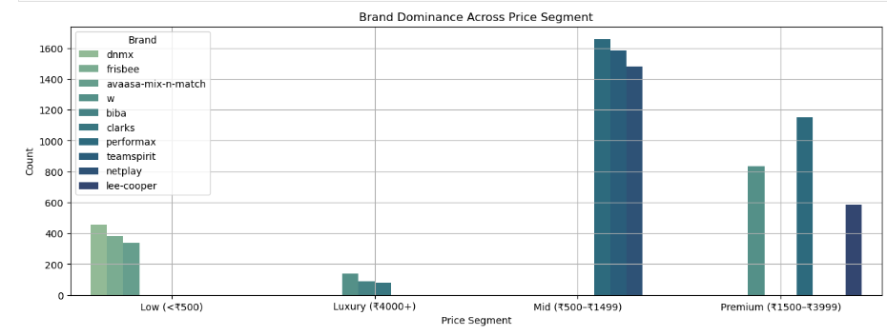
In the low-price segment, DNMX (453 products) leads the market, followed by Frisbee (385) and Avaasa Mix-N-Match (339), indicating strong competition in the value-fashion space. The luxury tier is dominated by W (139 items), with Biba (91) and Clarks (82) also maintaining a notable premium presence.
In the highly competitive mid-price range, Performax (1,657 products) emerges as the frontrunner, closely followed by Teamspirit (1,583) and Netplay (1,479).
Performax also commands the premium segment with 1,153 offerings, ahead of W (833) and Lee Cooper (588).
Overall insight: Brands tend to establish clear strongholds within specific price tiers, allowing them to cater effectively to distinct customer segments and reinforce their market positioning.
Figure 14 :- Brand Dominance Across Price Segment

