Slide 1
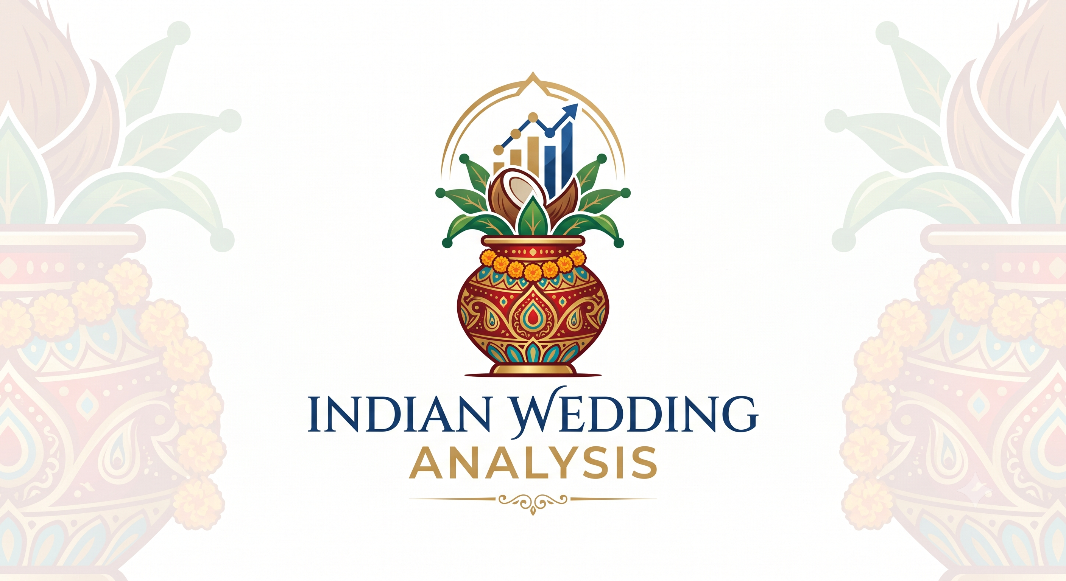
Indian_Wedding_Analysis

Slide 2
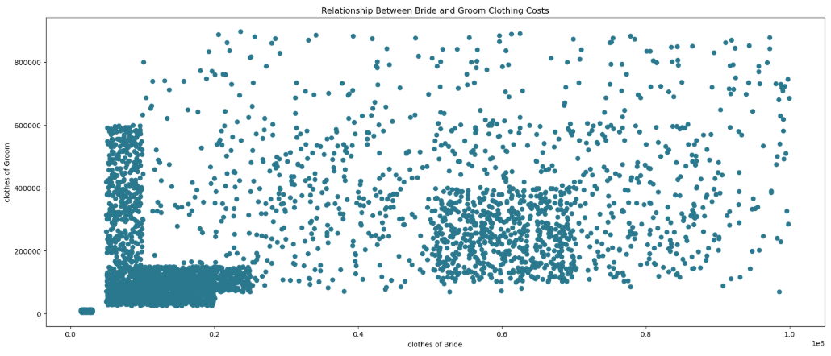
Most purchases are concentrated in the lower-to-mid price range, indicating that the majority of customers prefer moderate wedding clothing budgets.
There is no strong linear relationship between bride and groom clothing costs, as the points are widely scattered across the chart.
High-spending outliers are present for both bride and groom attire, showing that a smaller segment of customers opts for premium or luxury wedding fashion.
Groom clothing expenses vary significantly even when bride clothing costs are similar, suggesting independent purchasing decisions.
Bride clothing costs span a broad range, reflecting diverse preferences in wedding fashion and budgeting.
Overall spending behavior appears highly diverse, with customers following different budget priorities rather than a consistent spending pattern across both outfits.
Figure 1 :- Relationship between Bride and Groom Clothing cost

Slide 3
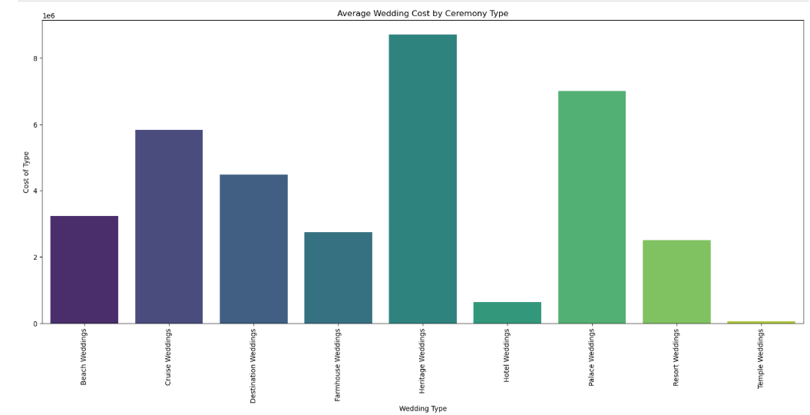
Heritage Weddings have the highest average cost at approximately ₹8.7 million, making them the most expensive ceremony type in the analysis. Palace Weddings rank second with an average cost of around ₹7.0 million, reflecting the premium associated with luxurious venues and grand celebrations.
Cruise Weddings (₹5.9 million) and Destination Weddings (₹4.5 million) also require substantial budgets, highlighting the higher costs of travel-based ceremonies.
Beach Weddings (₹3.2 million), Farmhouse Weddings (₹2.8 million), and Resort Weddings (₹2.5 million) offer comparatively more budget-friendly alternatives.
Hotel Weddings have a relatively low average cost of approximately ₹0.65 million, making them a cost-effective choice for many couples.
Figure 2 :- Average Wedding cost by ceremony Type
Temple Weddings are the most economical option, with an average cost of only ₹0.05 million, reflecting their simple and traditional nature.
Key insight: The choice of wedding venue has a significant impact on the overall ceremony budget, with luxury venues commanding several times the cost of traditional or conventional options.

Slide 4
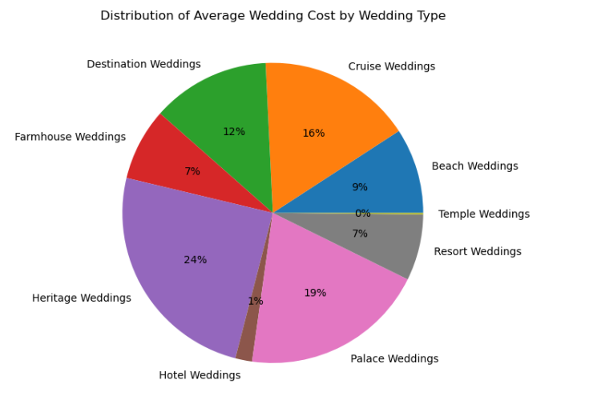
Heritage Weddings account for the largest share of the average wedding cost at 24%, making them the most expensive ceremony type.
Palace Weddings contribute 19% of the total average cost, reflecting the premium associated with luxury venues and grand celebrations. Cruise Weddings (16%) and Destination Weddings (12%) together represent a significant portion of wedding expenses, highlighting the popularity of travel-based ceremonies.
Beach Weddings make up 9% of the overall cost distribution, offering a balance between luxury and affordability. Farmhouse Weddings (7%) and Resort Weddings (7%) have similar cost shares, making them attractive mid-range options for couples.
Hotel Weddings account for only 1% of the total average cost, indicating a relatively economical choice compared to luxury venues.
Temple Weddings contribute less than 1% of the overall cost, making them the most budget-friendly ceremony option.
Figure 3 :- Distribution of average wedding cost by wedding type

Slide 5
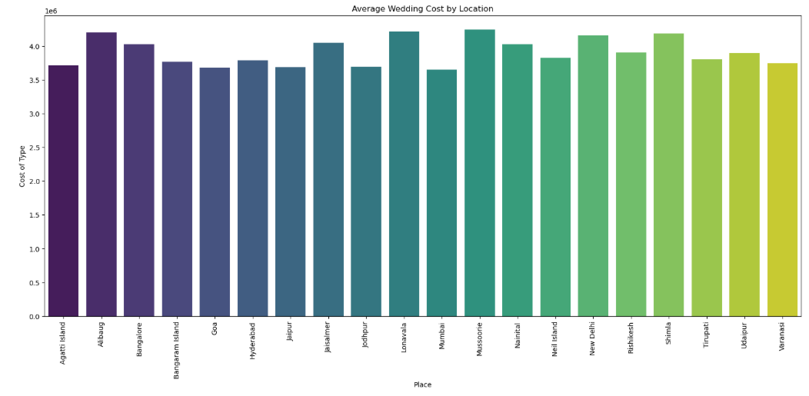
Figure 4 :-Average Wedding cost by Location

Slide 6
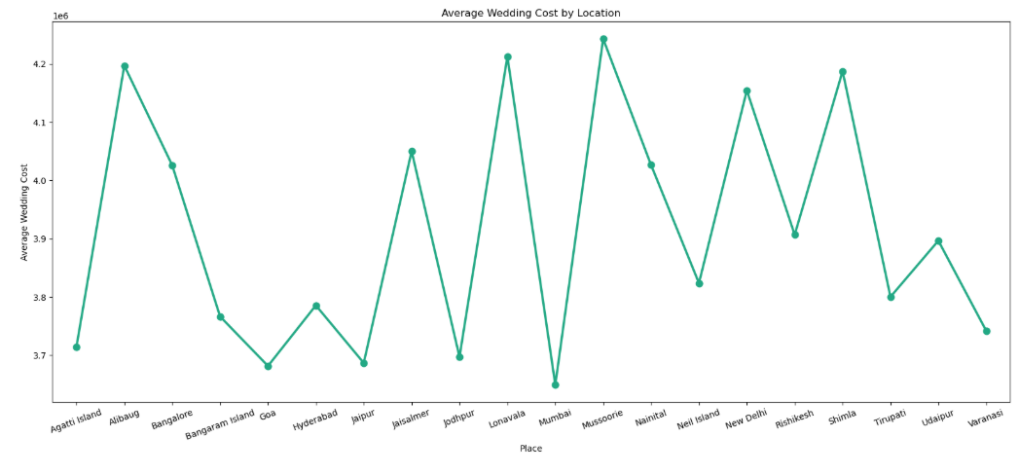
Figure 4 :-Average Wedding cost by Location

Slide 7
Mussoorie records the highest average wedding cost at approximately ₹4.24 million, making it the most expensive destination in the dataset.
Lonavala (₹4.21 million), Alibaug (₹4.20 million), Shimla (₹4.19 million), and New Delhi (₹4.15 million) also rank among the costliest wedding locations.
Popular destinations such as Bangalore (₹4.03 million), Nainital (₹4.03 million), and Jaisalmer (₹4.05 million) maintain relatively high average wedding budgets.
Mid-range destinations include Rishikesh (₹3.91 million), Udaipur (₹3.90 million), Hyderabad (₹3.79 million), and Neil Island (₹3.82 million), offering a balance between luxury and affordability.
Mumbai (₹3.65 million) has the lowest average wedding cost among the listed locations, followed closely by Goa (₹3.68 million), Jaipur (₹3.69 million), and Jodhpur (₹3.70 million).
The variation in average wedding costs across destinations is relatively moderate, ranging from ₹3.65 million to ₹4.24 million, indicating that location influences the budget but not as dramatically as the choice of wedding type.
Key insight: While all destinations require a substantial investment, scenic hill stations and premium tourist destinations generally command higher wedding budgets than metropolitan or traditional wedding locations.

Slide 8
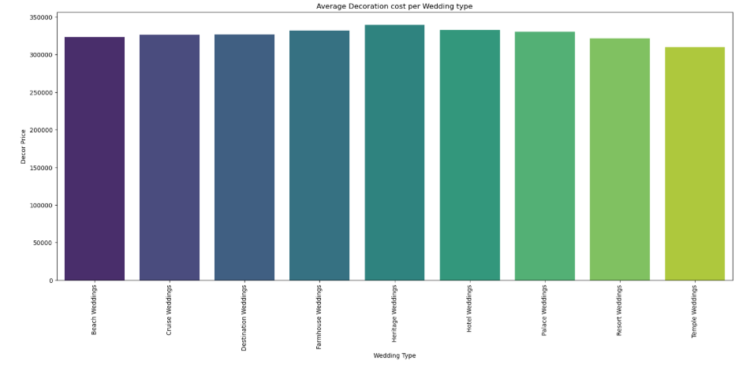
Figure 5 :- Average Decoration Cost per Wedding Type

Slide 9
Heritage Weddings have the highest average decoration cost at approximately ₹339,522, reflecting the premium décor required for grand heritage venues.
Hotel Weddings (₹332,493) and Farmhouse Weddings (₹332,040) also involve significant decoration expenses, emphasizing the importance of venue aesthetics.
Palace Weddings average around ₹330,276, showcasing the high investment needed to complement luxurious and royal settings.
Destination Weddings (₹326,682) and Cruise Weddings (₹326,387) have nearly identical decoration costs, indicating consistent décor budgets for travel-based celebrations.
Beach Weddings require an average decoration cost of ₹323,378, while Resort Weddings are slightly lower at ₹321,578, making them comparatively economical among premium venues.
Temple Weddings record the lowest average decoration cost at approximately ₹310,287, reflecting their simpler and more traditional setup.
Key insight: Decoration expenses remain relatively consistent across wedding types, ranging from ₹310,287 to ₹339,522, suggesting that venue style influences décor costs, but the variation is less significant than the overall wedding budget.

Slide 10
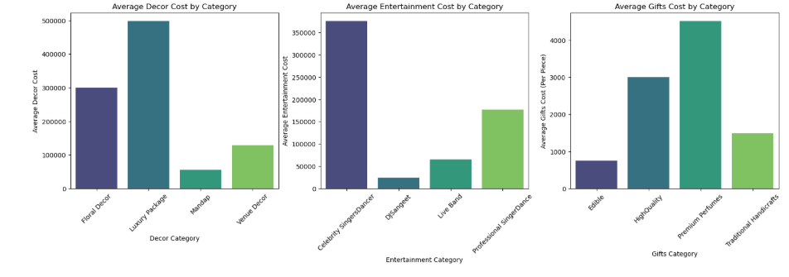
Figure 6 :- Average Decoration Cost per Wedding Type

Slide 11
Average Decor Cost by Category
Luxury Package has the highest average décor cost at approximately ₹500,000, reflecting premium and elaborate event decorations.
Floral Decor follows with an average cost of around ₹300,000, making it a popular mid-range decoration option.
Venue Decor costs approximately ₹130,000, offering a more budget-friendly alternative while enhancing the event ambiance.
Mandap has the lowest average decoration cost at about ₹60,000, making it the most economical décor component.
Key insight: Luxury decoration packages account for the highest spending, while individual décor elements provide more affordable customization options.
Average Entertainment Cost by Category
Celebrity Singers/Dancers command the highest average entertainment cost at approximately ₹375,000, reflecting the premium charged by renowned performers.
Professional Singers/Dancers average around ₹180,000, providing a balance between quality and affordability.
Live Bands cost approximately ₹65,000, making them a cost-effective option for live entertainment.
DJs have the lowest average entertainment cost at around ₹25,000, making them the most budget-friendly choice.
Key insight: Entertainment costs increase significantly with the popularity and exclusivity of the performers.
Average Gifts Cost by Category
Premium Perfumes are the most expensive gift category, with an average cost of approximately ₹4,500 per piece.
High-Quality Gifts rank second at around ₹3,000 per piece, offering premium gifting options at a moderate price.
Traditional Handicrafts cost approximately ₹1,500 per piece, providing a balance between affordability and cultural value.
Edible Gifts are the most economical option, averaging around ₹800 per piece.
Key insight: Premium gifting options require significantly higher investment, while edible and traditional gifts offer cost-effective alternatives for wedding guests.

Slide 12
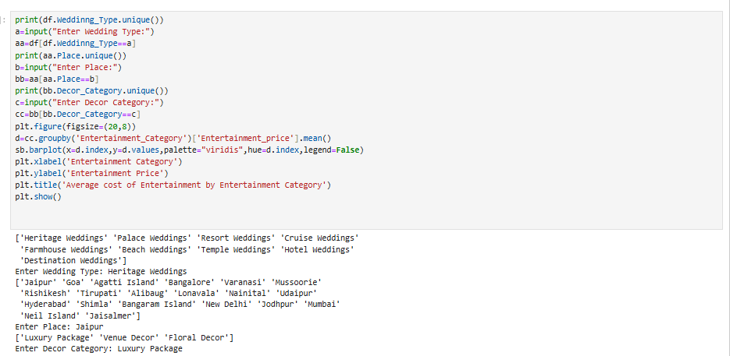
Figure 7 :- Dashboard (Dynamic Filter Selection) Wedding Type → Place → Decor Category

Slide 13
Dynamic Filter Selection (Wedding Type → Place → Decor Category)
The analysis begins by allowing the user to select a Wedding Type, followed by a Place and a Decor Category, creating a personalized filtering process.
For this example, the selected inputs are Temple Weddings, Tirupati, and Floral Decor, representing a traditional wedding setup.
After applying these filters, only the records matching the selected criteria are retained for further analysis.
The filtered dataset is then grouped by Entertainment Category, enabling a comparison of average entertainment costs for the chosen wedding configuration.
This dynamic filtering approach allows users to explore multiple combinations of wedding preferences and understand how costs vary across different scenarios.
Key takeaway: Interactive filtering makes the analysis flexible and user-centric, helping couples estimate expenses and compare entertainment options based on their specific wedding requirements rather than relying on overall averages.

Slide 14
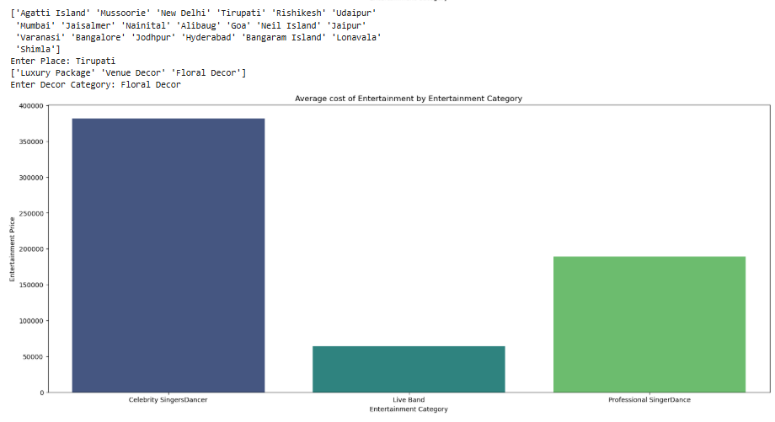
Figure 8 :- Dynamic Analysis: Entertainment Cost by Category (Place: Tirupati | Decor: Floral Decor)

Slide 15
Dynamic Analysis: Entertainment Cost by Category (Place: Tirupati | Decor: Floral Decor)
For the selected filters (Tirupati and Floral Decor), Celebrity Singers/Dancers have the highest average entertainment cost at approximately ₹3.8 lakh.
Professional Singers/Dancers rank second with an average cost of around ₹1.9 lakh, offering a premium yet more affordable entertainment option.
Live Bands are the most economical choice, with an average entertainment cost of approximately ₹65,000.
The cost difference between Celebrity Performers and Live Bands is substantial, highlighting the premium associated with renowned artists.
The selected wedding configuration demonstrates that entertainment expenses vary significantly depending on the type of performers chosen.
Key insight: For weddings in Tirupati with Floral Decor, entertainment budgets are primarily driven by performer selection, with celebrity performances requiring the highest investment while live bands provide a cost-effective alternative.

Slide 16
THANK YOU

