Slide 1
Snowflake Overview
The Datawarehouse build for Cloud

Slide 2
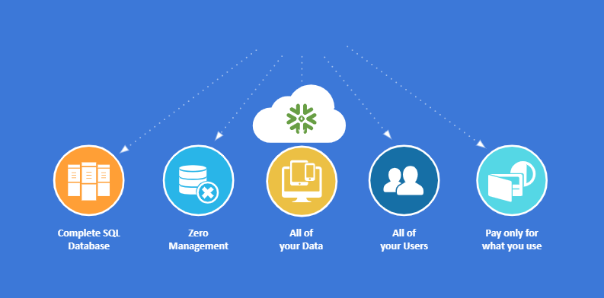
DATA WAREHOUSE BUILT FOR THE CLOUD

Slide 3
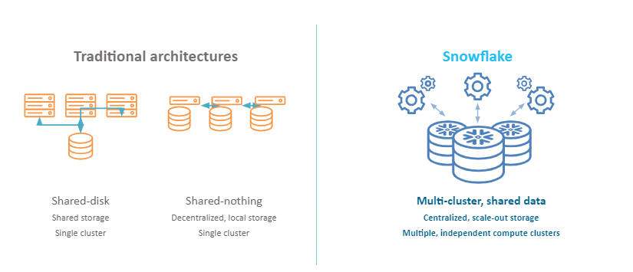
A NEW ARCHITECTURE FOR DATA WAREHOUSING

Slide 4
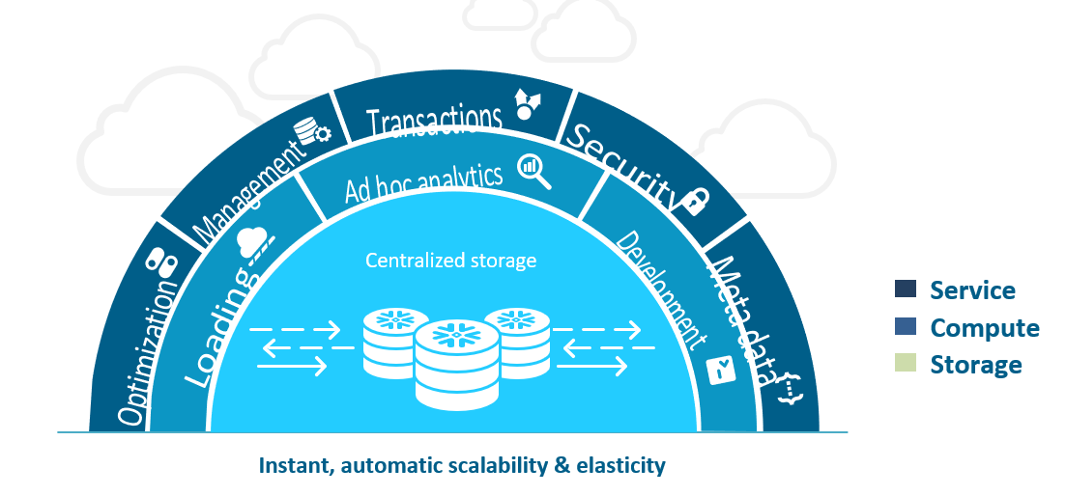
SNOWFLAKE’S MULTI-CLUSTER, SHARED DATA ARCHITECTURE

Slide 5
Why Snowflake
Architecture/Storage: New technology. Multi-cluster shared data architecture. Data stored in S3, allowing multiple EC2 compute clusters to access simultaneously without contention.
Data Types: Ability to ingest and query raw JSON, XML, Avro, Parquet without prior transformation.
Scalability: Data not coupled to compute, allowing the ability to resize instantly and shut down when not in use.
Concurrency: Ability to isolate users on separate compute resources to avoid contention. Auto-scale feature scales compute resources horizontally to support concurrent workloads.
Administration/Design: ZERO; free up your DBA team for other tasks. Load data in real time without need for model. No IT involvement.
Support: 24/7 live technical support.
Ecosystem: Certified Tableau connector, ability to move to Tableau Live Connection

Slide 6
Unique Snowflake features
JSON: Ingest raw JSON without transformation. Query JSON with SQL and correlate against relational data
Cloning: Instant dev/test environments or point in time snapshots. Give Dev team a separate up-to-date copy of production database, without duplicating the data
Time Travel: Useful for instant undrop and ETL troubleshooting. Query data as of any point in time within the past 90 days
Query Caching: instant results for Executive dashboards and commonly run reports. Query result sets are cached for 24 hours
Backups: Automatic cross data center replication, managed by AWS
Data Sharing: publish or consume data sets to external clients without direct system access. Share data across Snowflake accounts without transferring/copying
Auto-Scaling: dynamic horizontal scaling for concurrency to deliver consistent SLAs
Central Data Store: consolidate all data and eliminate separate Dev/QA environments. Get everyone at Logitech under one platform
Upgrades: weekly system updates with zero downtime
Security: encryption by default
Charge Back: monitor business unit/user usage, down to hourly increments, to understand how much each user costs you

Slide 7
Snowflake Model
Snowflake is a DWaaS offering that is very different than traditional DW solutions because it’s:
Purely Elastic – Resources are consumed on an hourly basis (money is spent only when used). Resources can be turned on, off, made bigger or made smaller with the click of a button. Traditional systems require Logitech to pay for resources on a constant basis even when not using the system.
Storage Is Separate From Compute – Traditional systems require Logitech to purchase “nodes” which combine storage and compute. This forces the admin to make compromises and purchase more than what’s needed. Snowflake, on the other hand, handles each completely separately and lets Logitech purchase only the amount of compute needed for the task and only pay for storage when it’s consumed.

Slide 8
Thank You

