Slide 1
Snowflake Virtual Warehouses

Slide 2
A virtual warehouse in Snowflake is a cluster of compute resources. It provides resources — including memory, temporary storage and CPU — to perform tasks such as DML operation and SQL execution.
A virtual warehouse, often referred to simply as a “warehouse”, is a cluster of compute resources in Snowflake. ... Executing SQL SELECT statements that require compute resources (e.g. retrieving rows from tables and views).

Slide 3
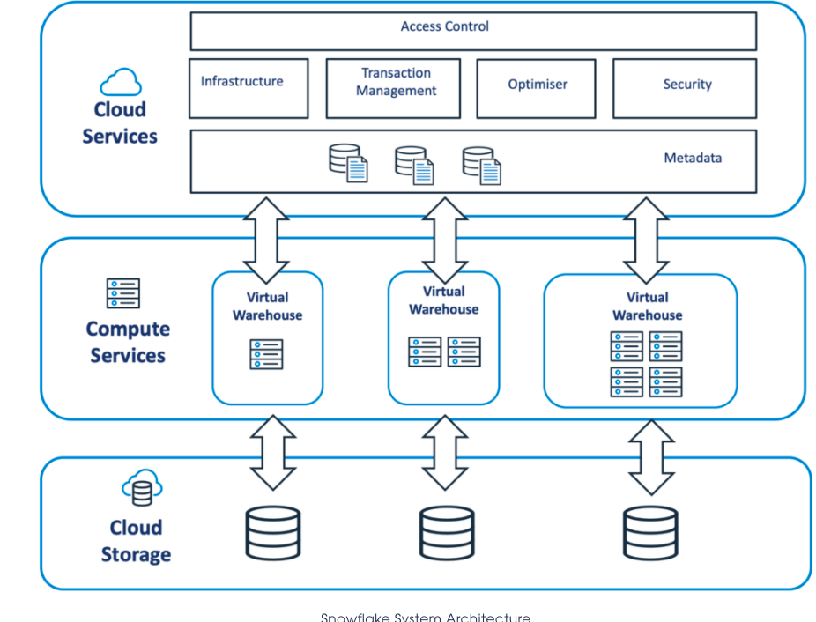

Slide 4
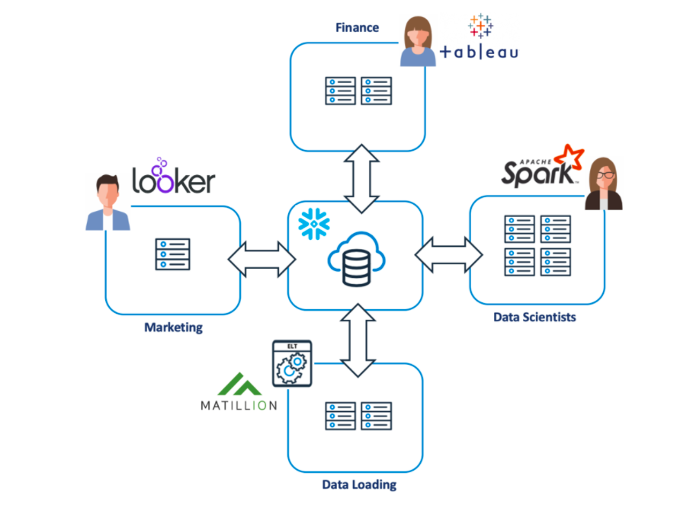

Slide 5
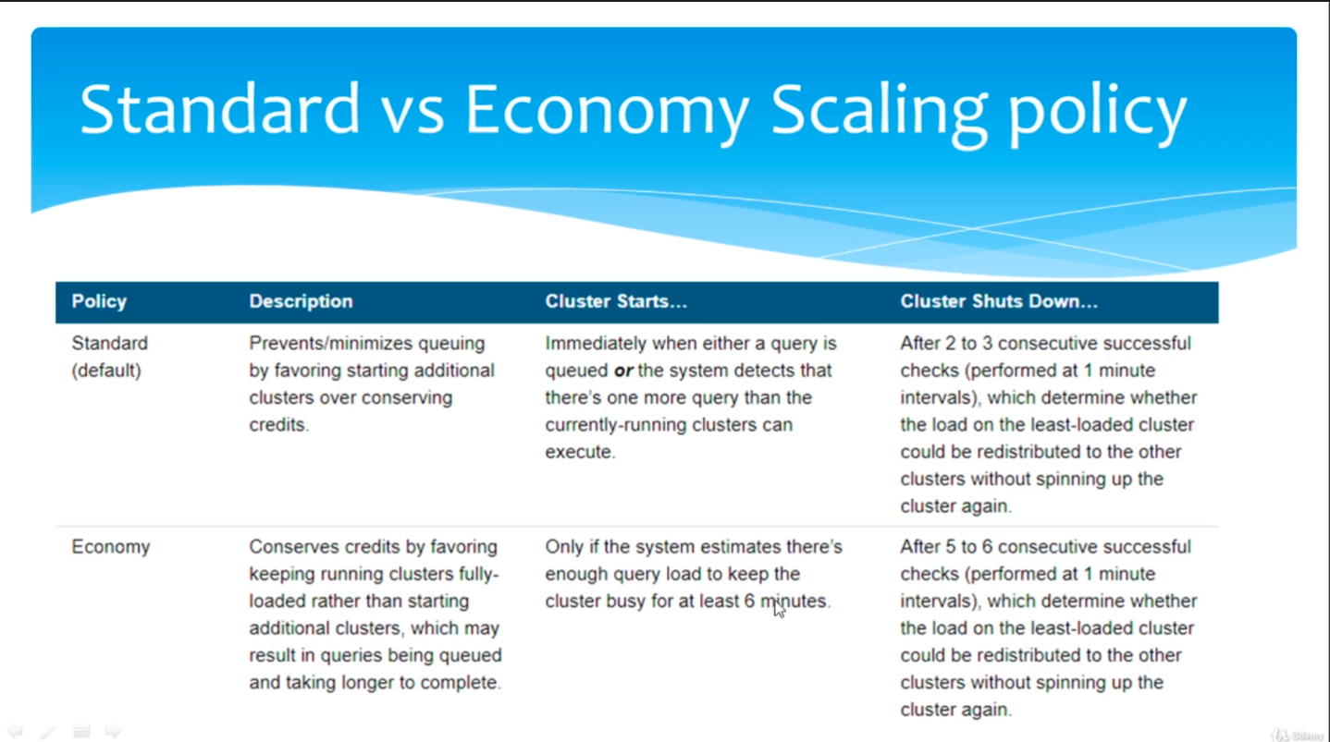

Slide 6
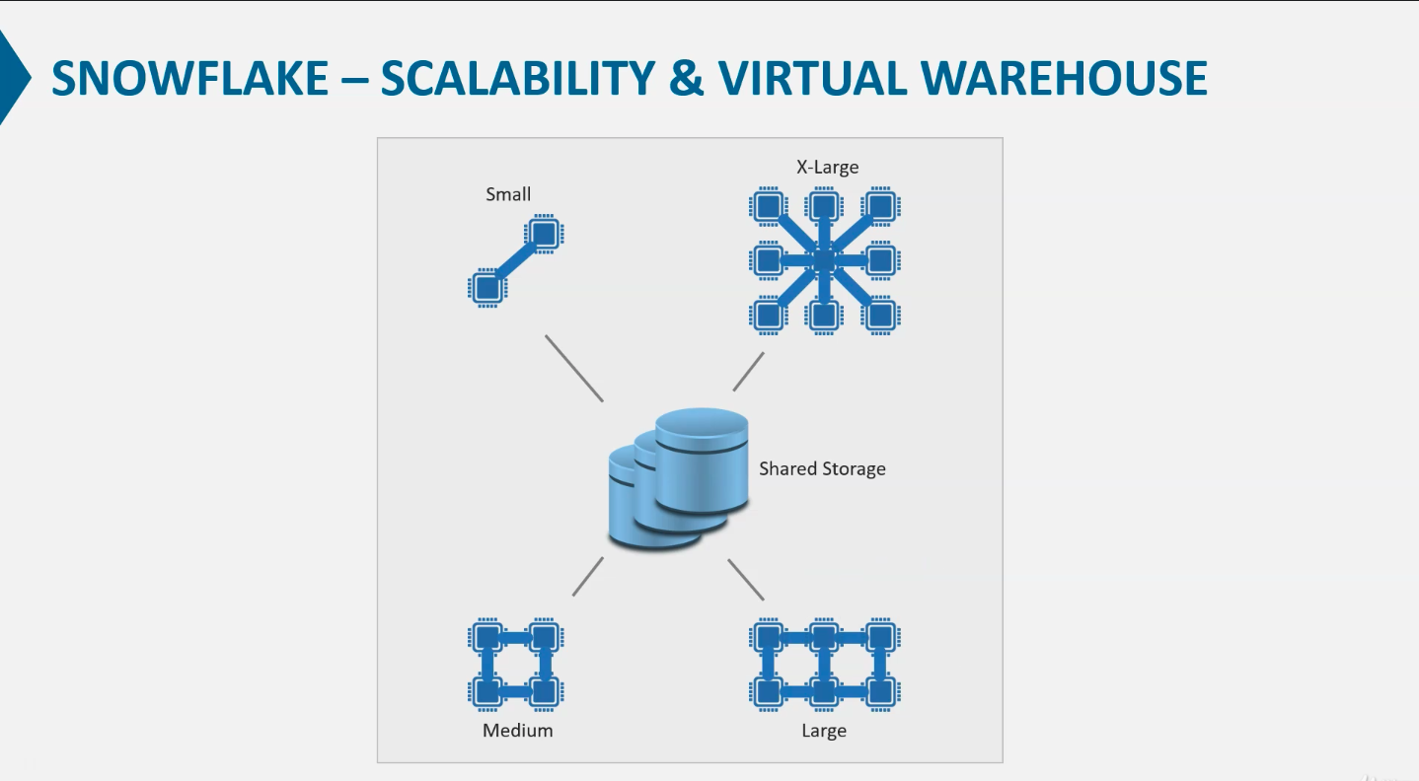

Slide 7
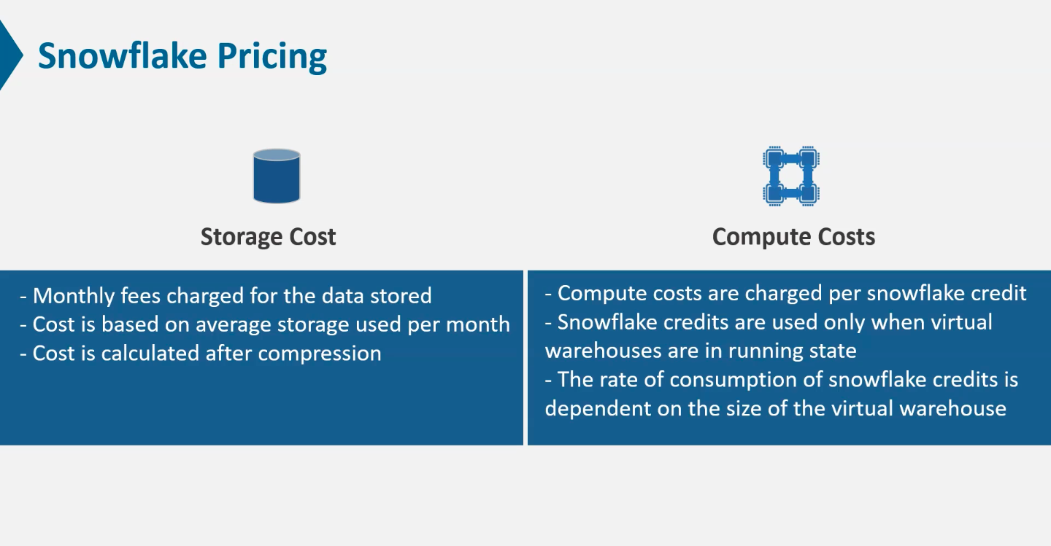

Slide 8
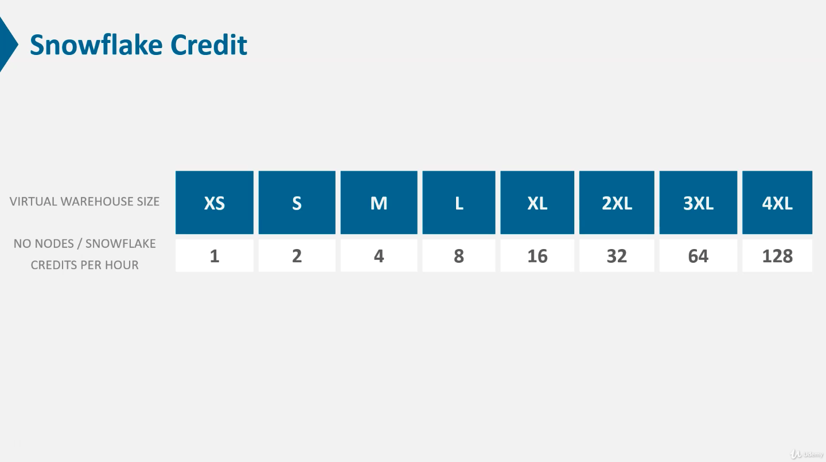

Slide 9
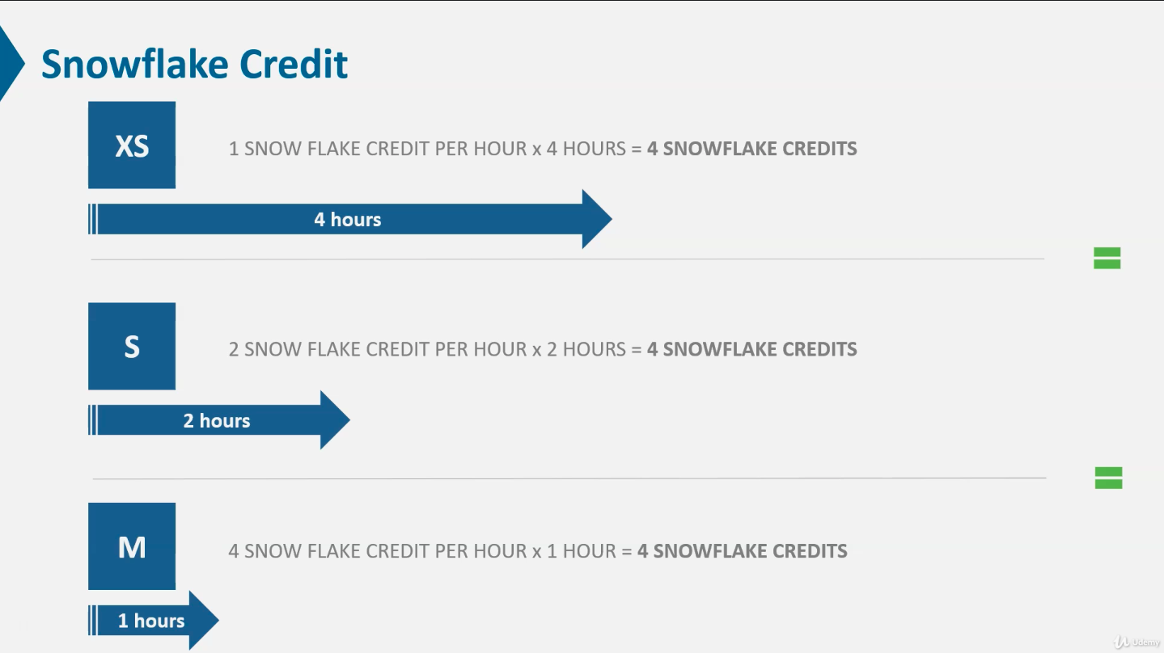

Slide 10
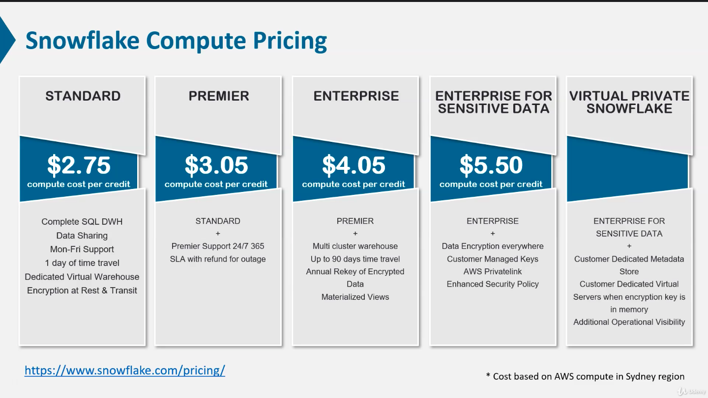

Slide 11
