Slide 1
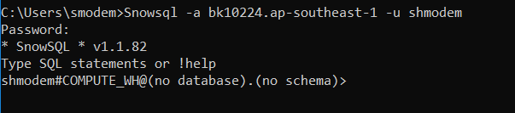
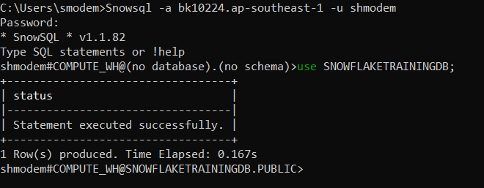
SnowSQL – Lab Exercise
Snowflake Login URL : https://bk10224.ap-southeast-1.snowflakecomputing.com
Copy domain “bk10224.ap-southeast-1” excluding snowflakecomputing.com
Snowsql –a bk10224.ap-southeast-1 –u <username>
<Username> -- Enter your User Name
Eg : Snowsql –a bk10224.ap-southeast-1 –u shmodem
3. Enter Your Password
4. Enter DB Name and Schema Name

Slide 2
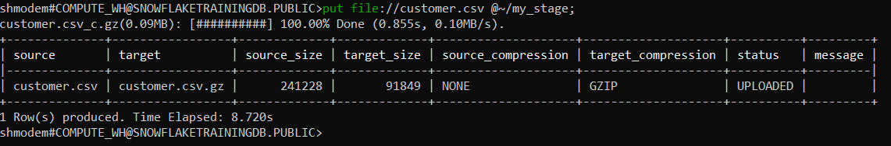
Create File Format
1. Execute the below SQL for Creating CSV file Format
> Create Or Replace file format my_csv_format1 type = csv skip_header=1;
> Create Or Replace file format my_json_format1 type = json ;
> Create or replace file format my_parquet_format type = 'parquet’;
> Show file formats;
2. Create a Stage
1. Temporary Stage ( User Level)
> Create or replace temporary stage my_stage;
> Show Stages;
3. Upload The File For Loading
Quit From Snowsql
>!quit
Go To Your Directory Where your customer.csv file is located
> cd C:\Snowflake\Snowflake Training
> Snowsql –a bk10224.ap-southeast-1 –u shmodem
> put file ://customer.csv @~/my_stage

Slide 3
put file ://customer.csv @~/my_stage
Copy into my_customer from @~/my_stage
Select count(1) from @~/my_stage

