Slide 1
Data Loading Best Practises

Slide 2
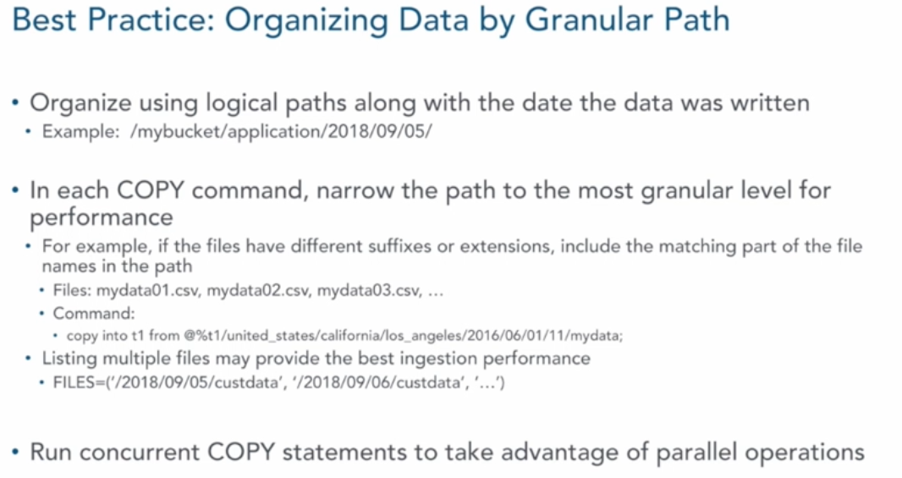
Data Loading – Best Practices

Slide 3
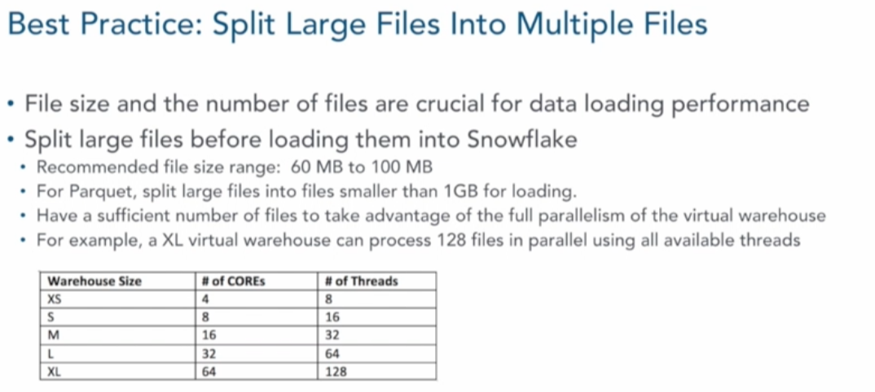
Data Loading – Best Practices

Slide 4
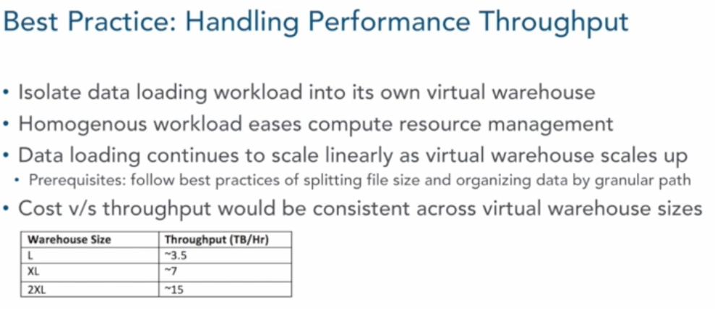
Data Loading – Best Practices

Slide 5
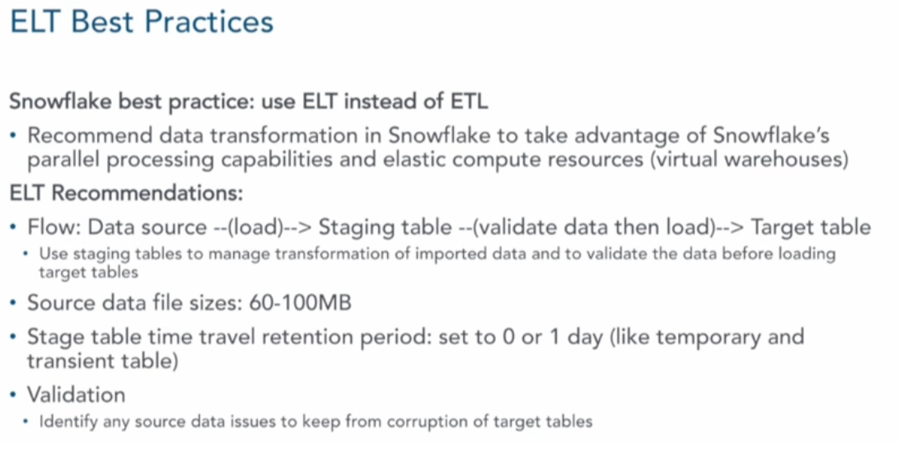
Data Loading – Best Practices

Slide 6
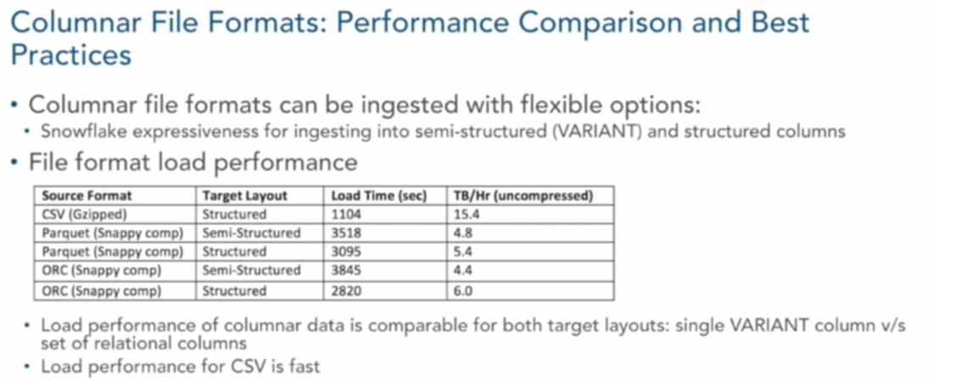
Data Loading – Best Practices

Slide 7
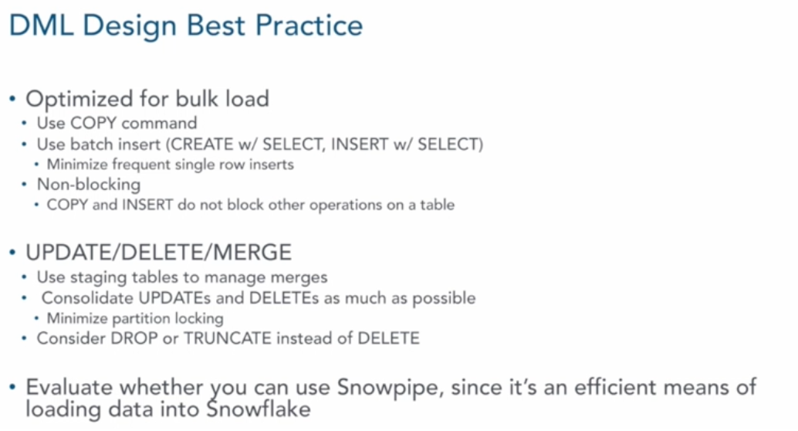
Data Loading – Best Practices

Slide 8
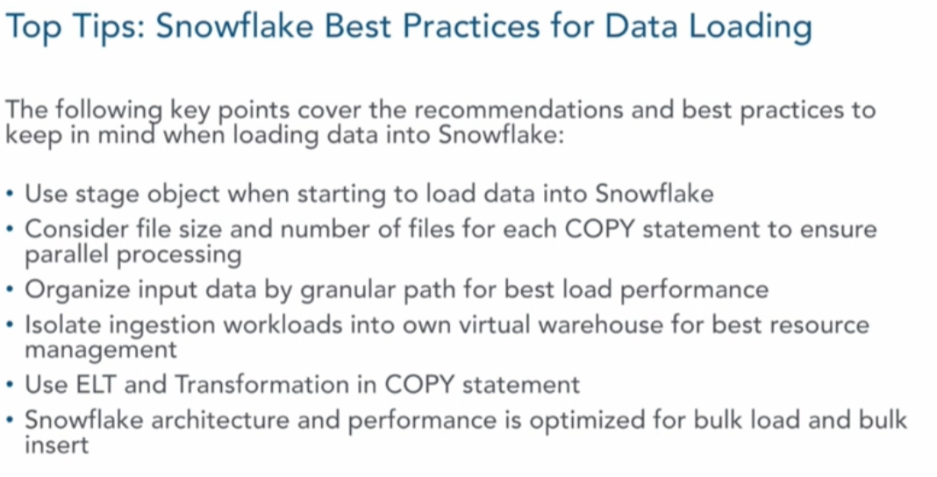
Data Loading – Best Practices

